Slide 1
Team1
Gene Prediction Results
Member: YunZhe Huang, JunKai Yang, Gabriel Leventhal-Douglas
Ramit Bharanikumar

Slide 2
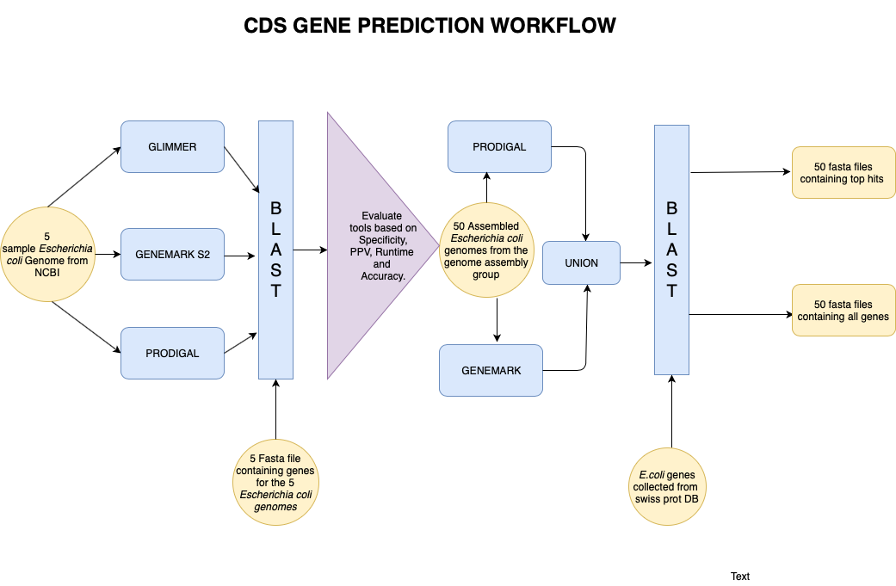
Overview of tools and pipeline
Barnap

Slide 3
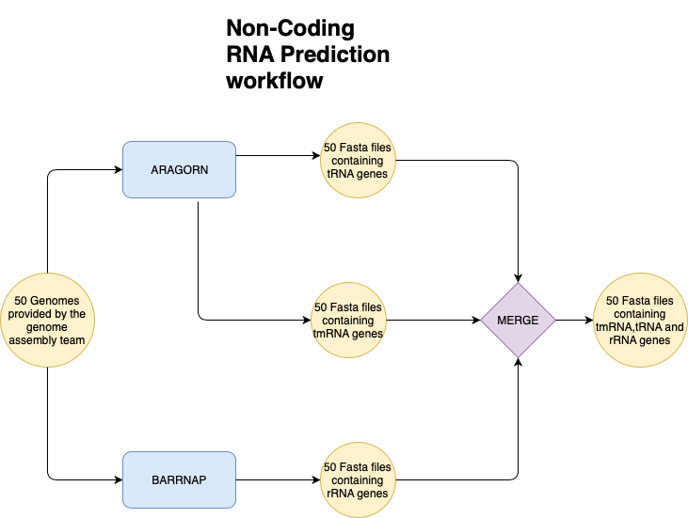

Slide 4
Validation of Tools
Make local databases using genes from known strains downloaded from NCBI. (DB)
Try ab-initio tools to predict genes using corresponding genomes. (query)
Blastn for 5 known strains, query predicted genes against their own database of genes respectively.
Gain the TP/(TP+FP), TP/(TP+FN+FP), TP/(TP+FN) of every tool.
Sensitivity : TP/(TP + FN) Positive Predictive Value: TP/(TP+FP) Accuracy: TP/(TP+FN+FP)
TP: True Positives; FP: False Positives; FN: False Negatives

Slide 5
Evaluation of tools--GeneMarkS2, Prodigal, Glimmer3
For every strain:
TP+FN
TP+FN
build
Database
Genes
query
TP
TP+FP
Genome
Ab-initio
Predicted genes
TP: predicted seqs that have hits in blast results
FP: predicted seqs that do not have hits in blast results
FN: sequences that did not have hits in the blast db.

Slide 6
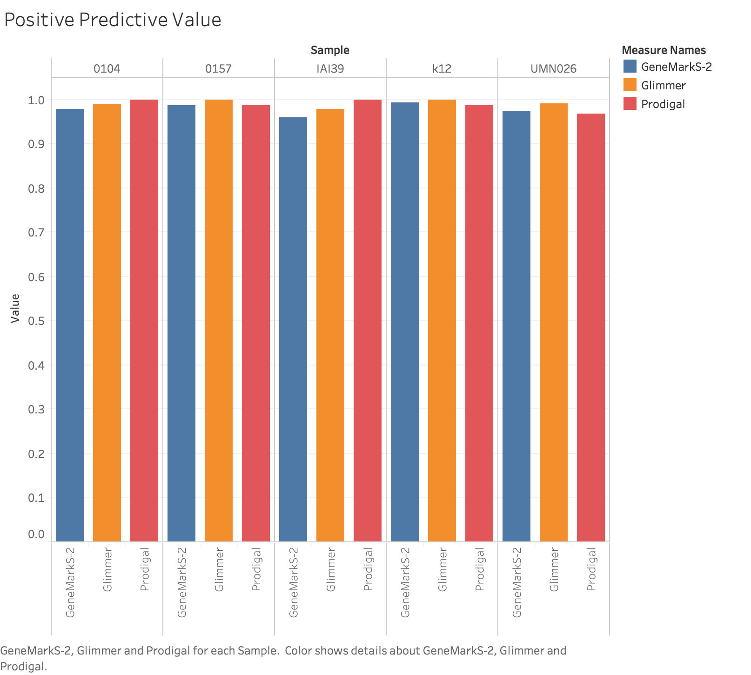

Slide 7
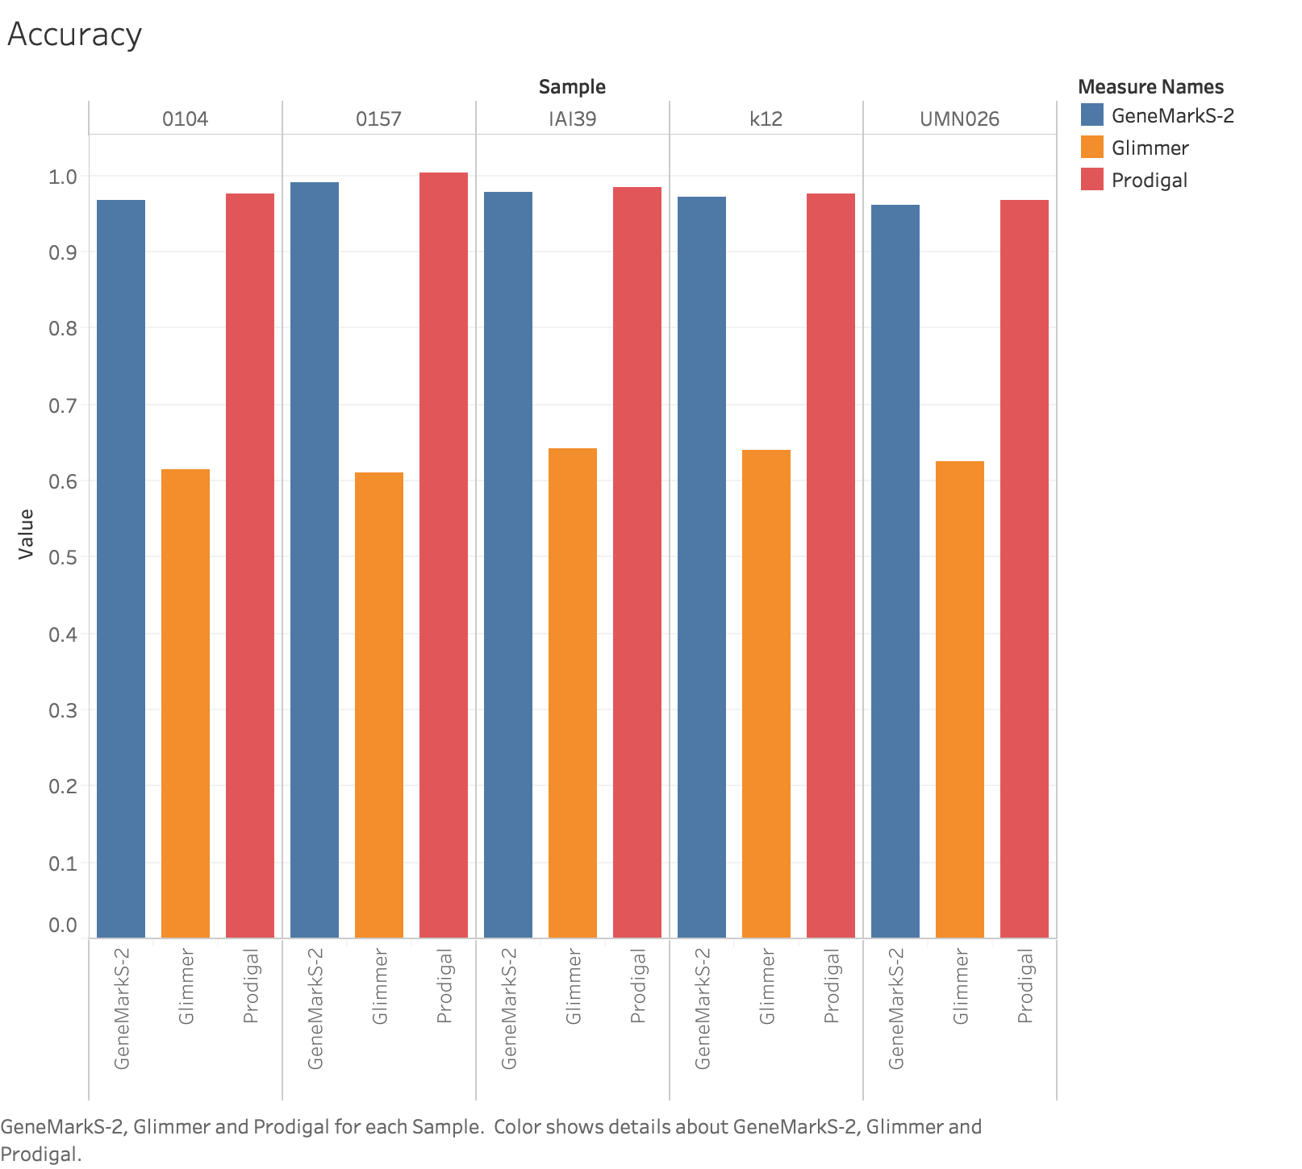
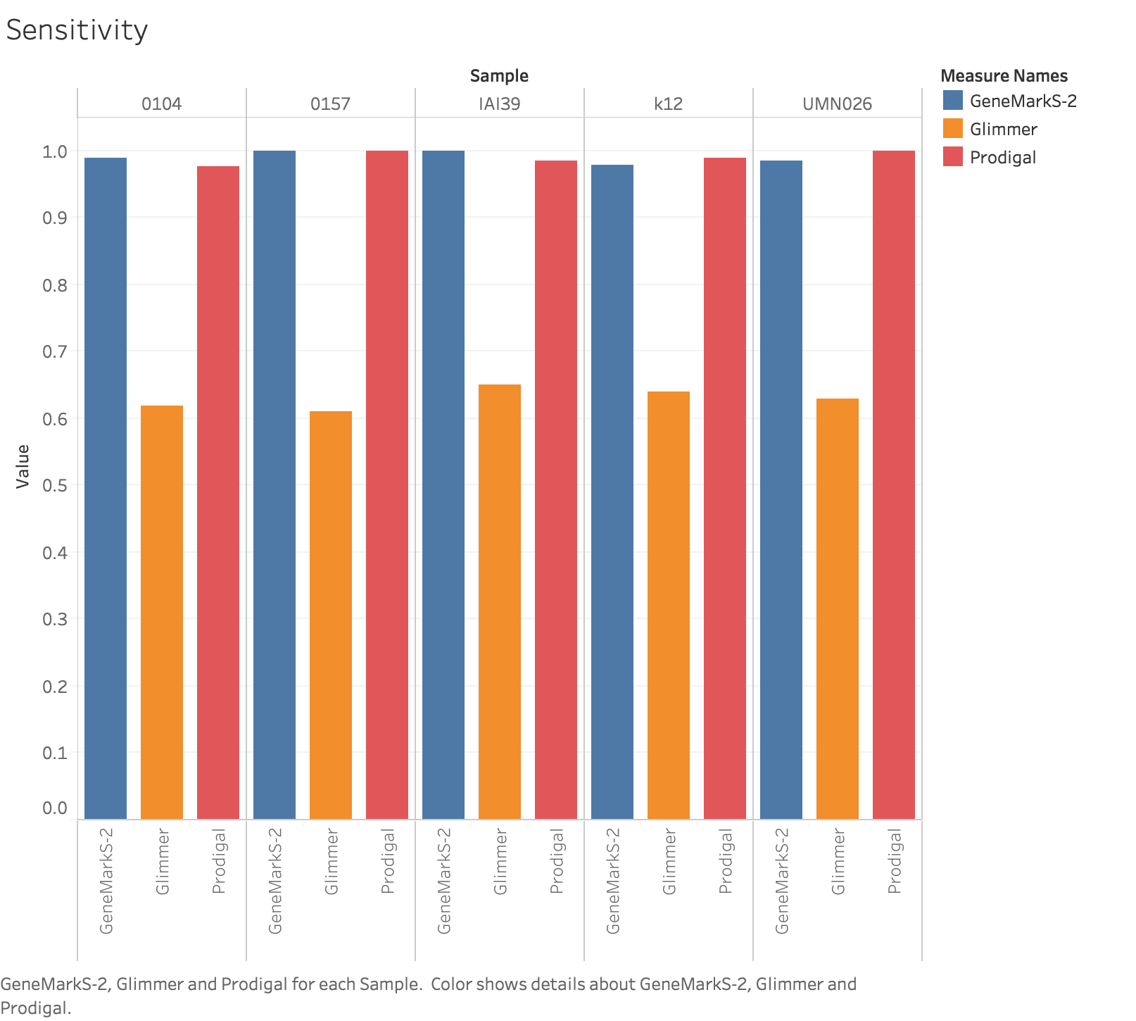

Slide 9
The PRODIGAL gene returns!!
Prodigal (Prokaryotic Dynamic Programming Genefinding Algorithm) is a microbial (bacterial and archaeal) gene finding program developed at Oak Ridge National Laboratory and the University of Tennessee.
Prodigal is an extremely fast gene recognition tool (written in vanilla C). It can analyze an entire microbial genome in 30 seconds or less.
Prodigal is a highly accurate gene finder. It correctly locates the 3' end of every gene in the experimentally verified Ecogene data set (except those containing introns).
It possesses a very sophisticated ribosomal binding site scoring system that enables it to locate the translation initiation site with great accuracy (96% of the 5' ends in the Ecogene data set are located correctly).

Slide 10
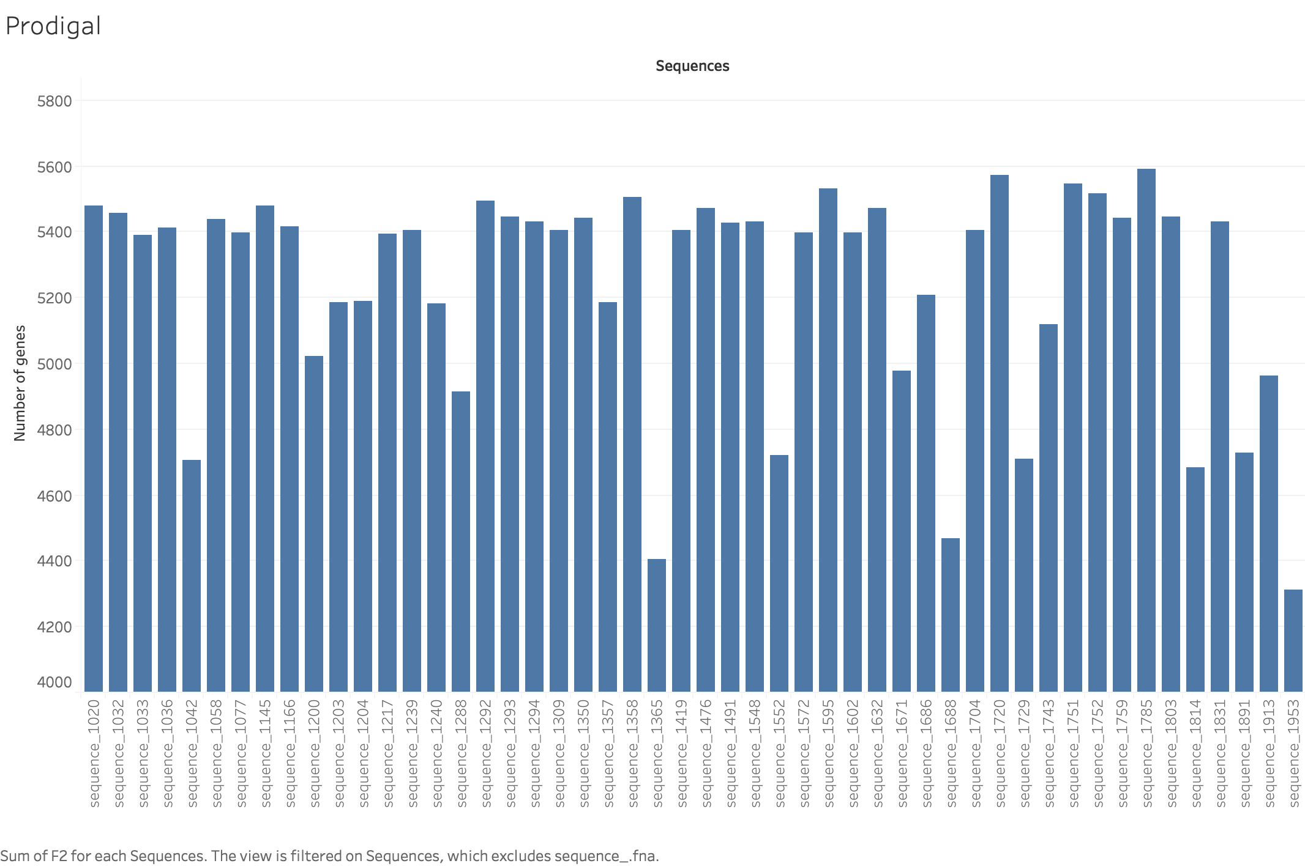
Prodigal--result histogram

Slide 11
GeneMarkS2
GeneMark S-2 is based on a hidden Markov model (HMM) framework that follows the logic of the genetic structure of the bacterial genome.
It can deal simultaneously with direct and reverse DNA strands using the functional units of bacterial genomes.

Slide 12
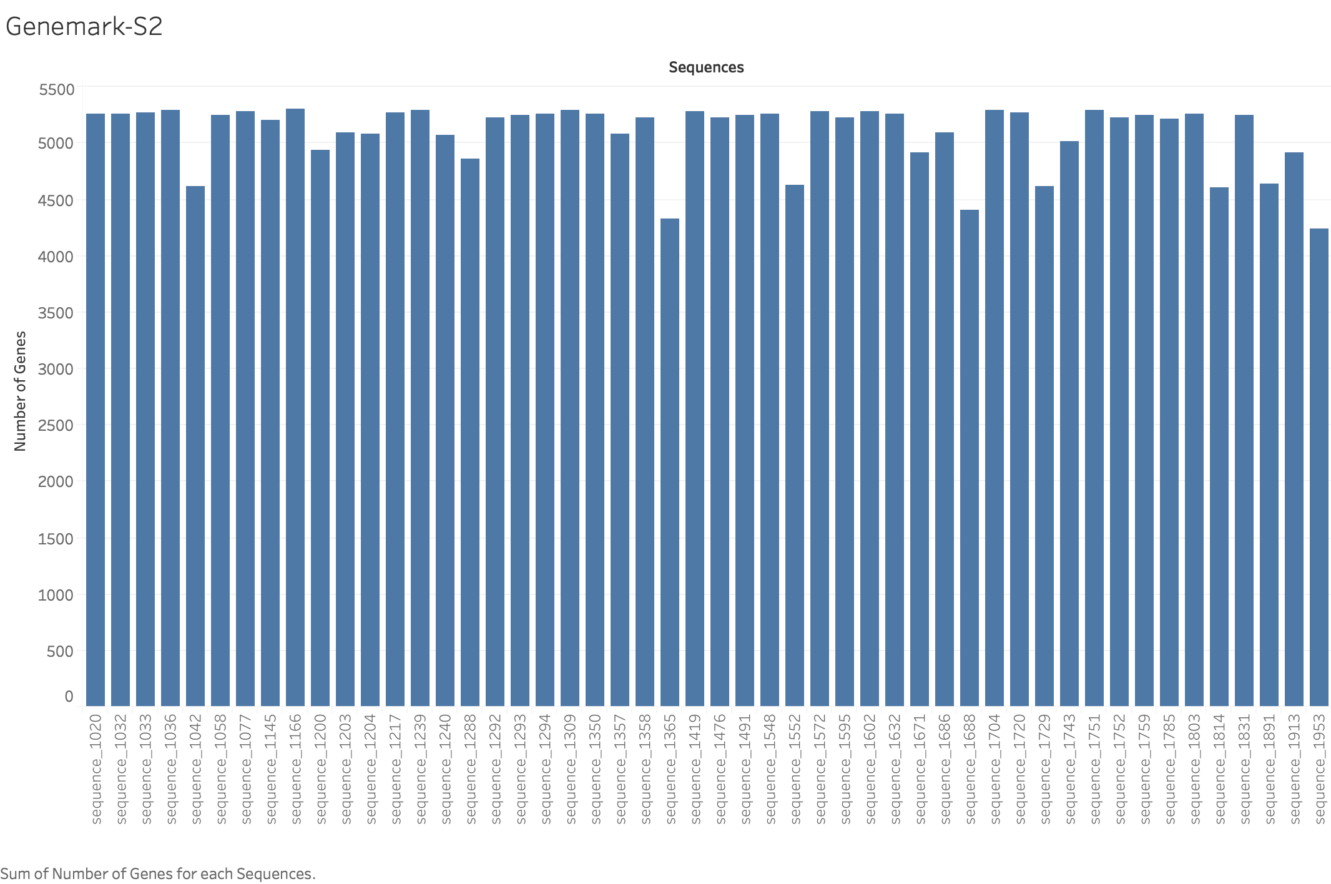
GeneMarkS2--result hisogram

Slide 13
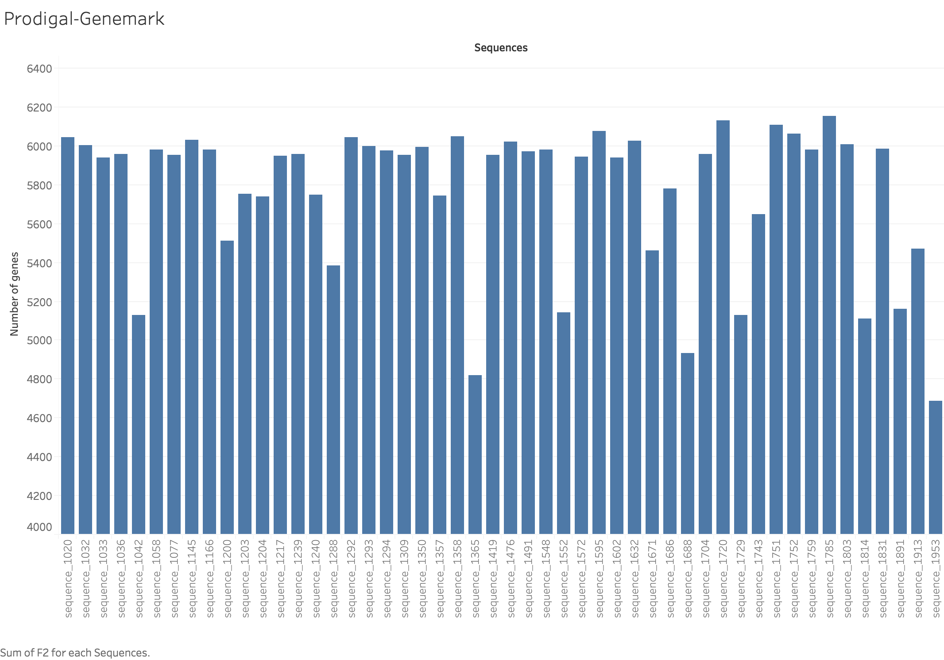
Union of Prodigal-GeneMarkS2

Slide 14
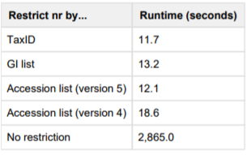
Let’s have a BLAST!!(Validation)
Database: swissprot_v5 Taxonomy: Escherichia coli
Max_target_seqs: 1 E-value: 1e-6
Version_5 database supports a faster searching method depending on taxonomic node.
https://ftp.ncbi.nlm.nih.gov/blast/db/v5/blastdbv5.pdf
AAC51230 (human MEN1 protein) against nr

Slide 15
Validation of the results from the Union
Fasta file
Blast result
Two fasta file
seq1
seq2
seq3
seq4
seq5
seq6
seq7
TP
FP
seq2
seq3
seq4
seq5
seq6
seq2
seq3
seq4
seq5
seq6
seq1
seq7

Slide 16
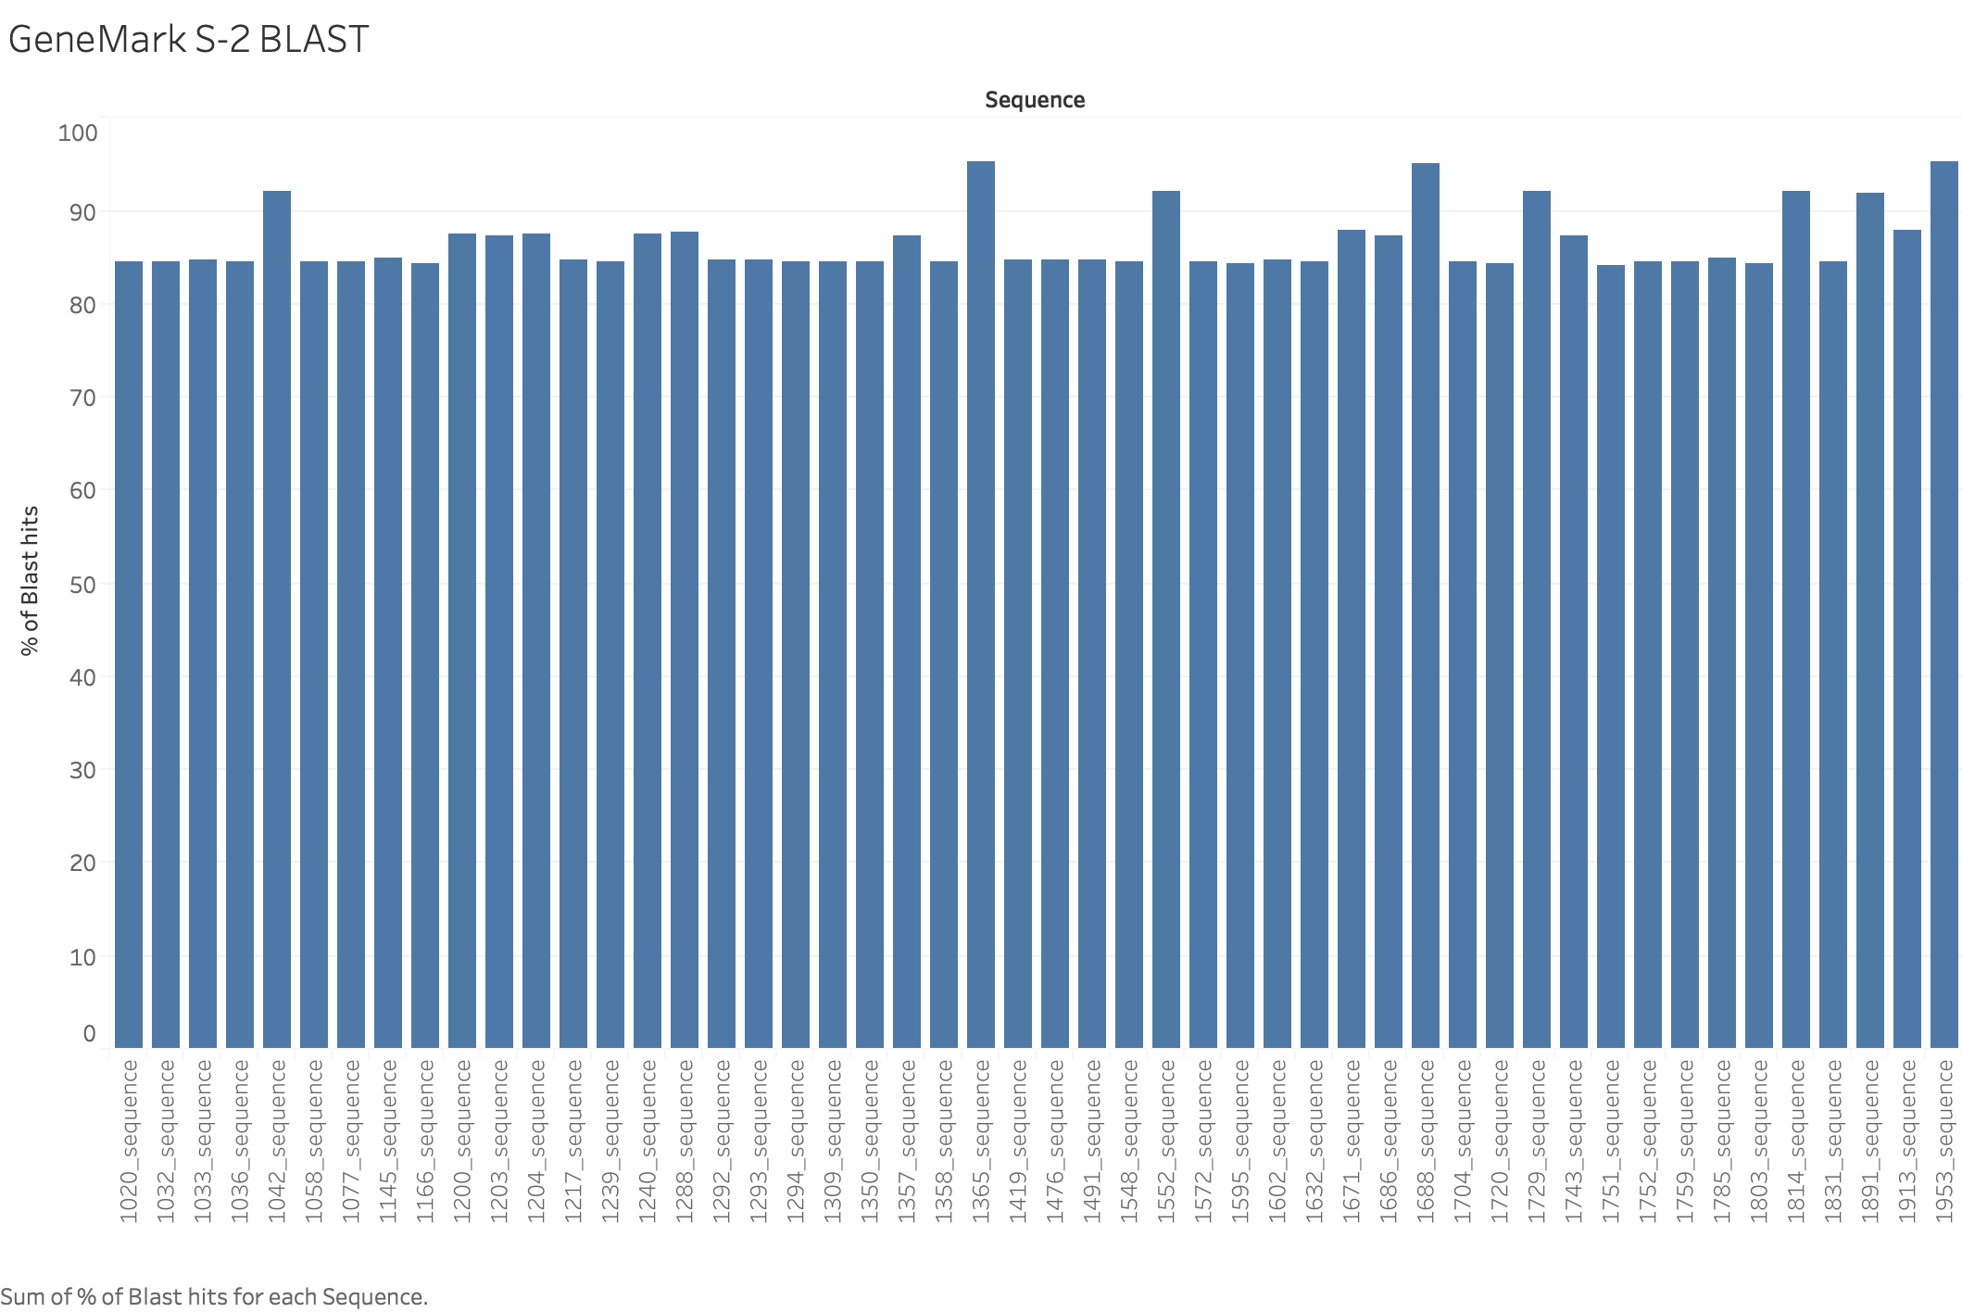

Slide 17
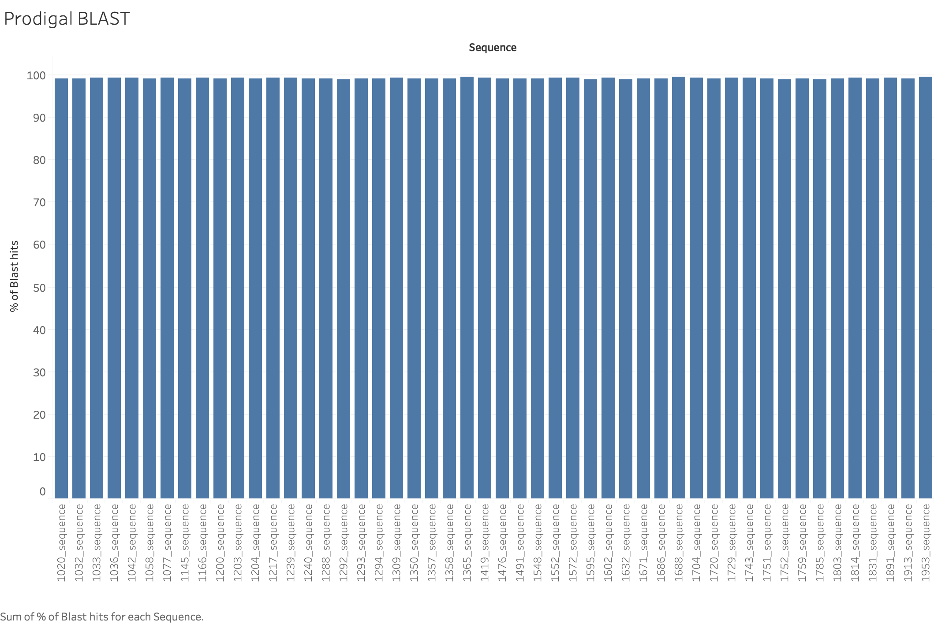

Slide 18
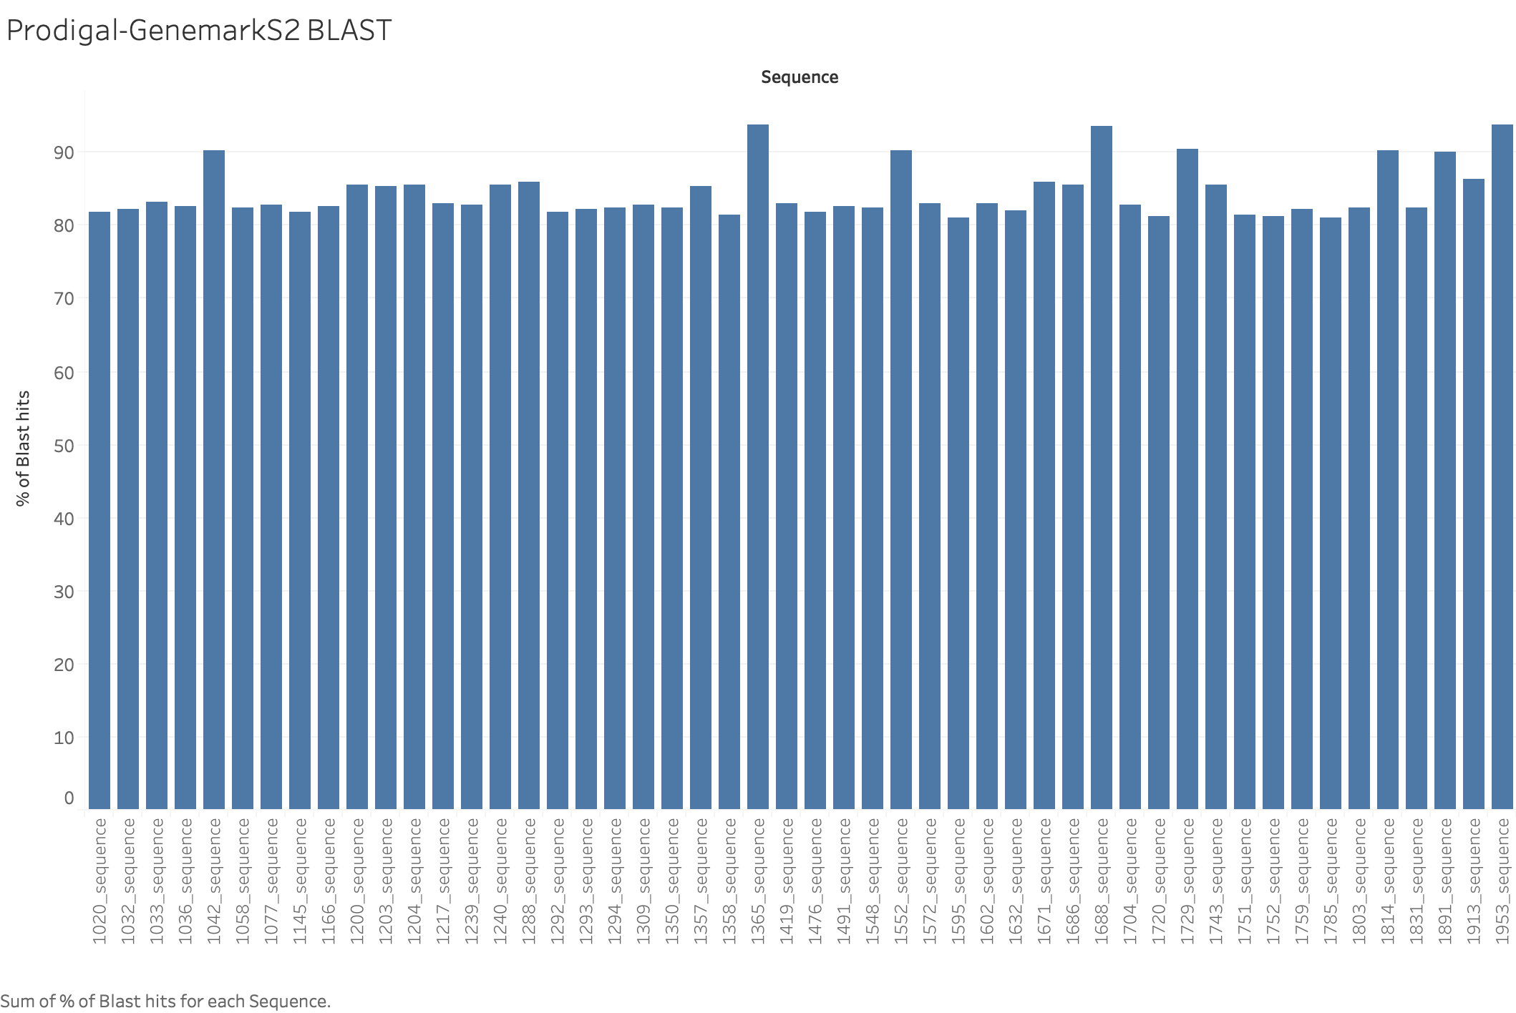

Slide 19
Non-coding region
Aragorn ( For tRNA and tmRNA prediction)
Barrnap ( For rRNA prediction)

Slide 20
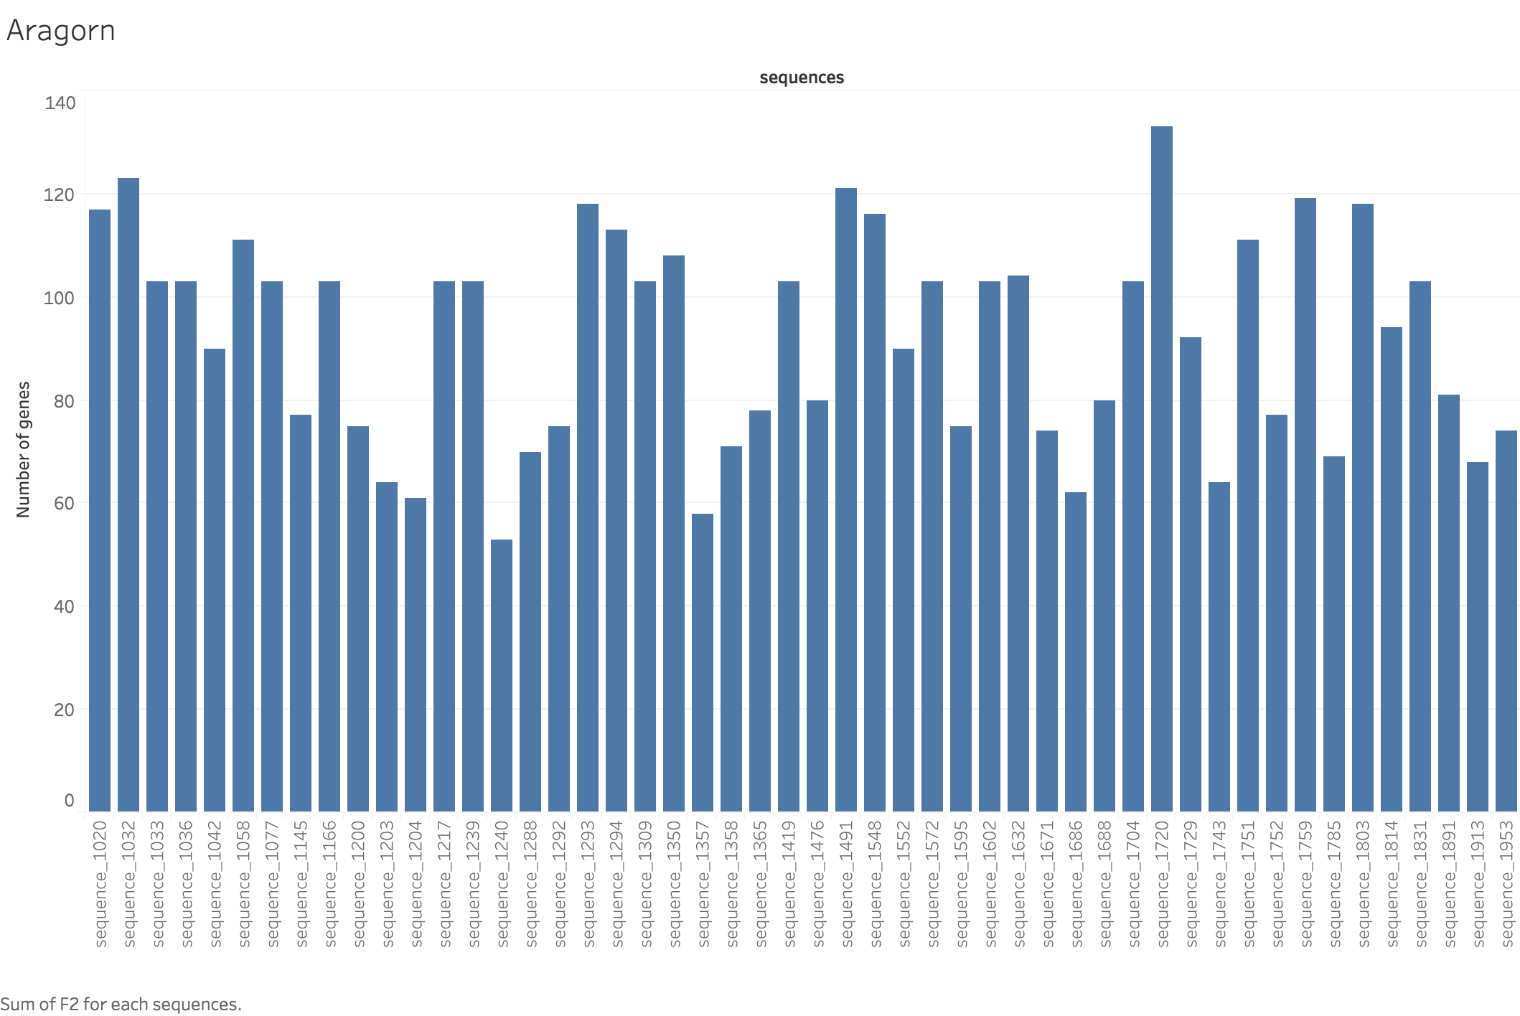

Slide 21
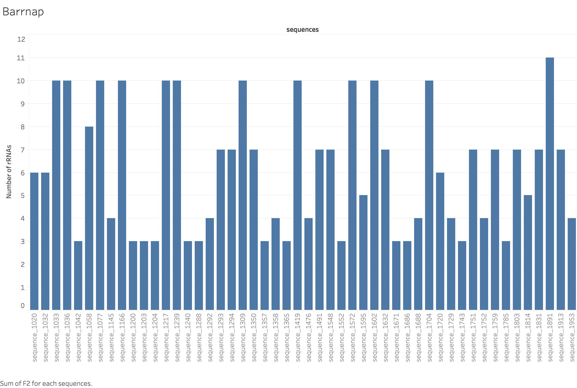

Slide 22
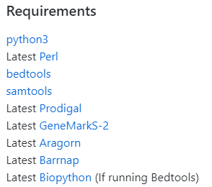
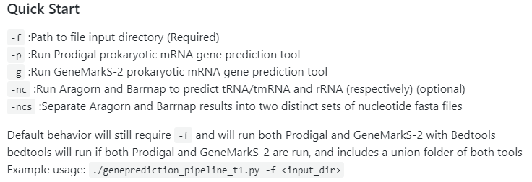
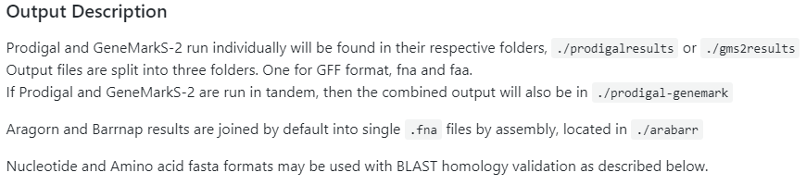
Pipeline

Slide 23
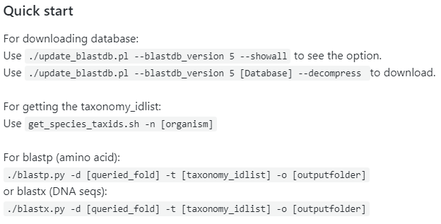
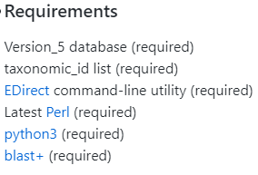
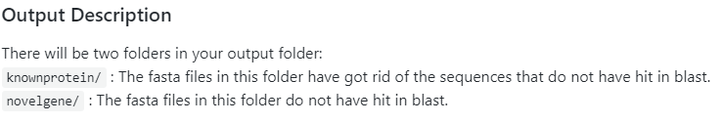
BLAST validation

Slide 24
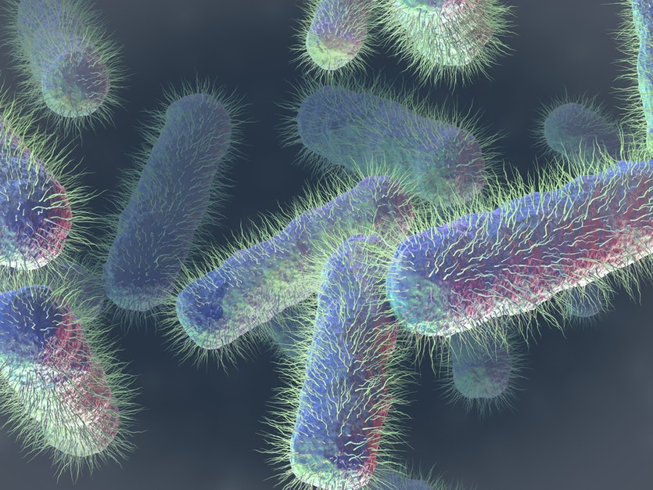
Questions?

Slide 25
References
https://biopython.org/wiki/Download
http://www.vicbioinformatics.com/software.barrnap.shtml
http://mbio-serv2.mbioekol.lu.se/ARAGORN/Downloads/
http://topaz.gatech.edu/GeneMark/license_download.cgi
http://compbio.ornl.gov/prodigal/
https://bedtools.readthedocs.io/en/latest/content/installation.html
http://samtools.sourceforge.net/
https://blast.ncbi.nlm.nih.gov/Blast.cgi?CMD=Web&PAGE_TYPE=BlastDocs&DOC_TYPE=Download
https://www.python.org/
http://www.perl.org/get.html
https://www.ncbi.nlm.nih.gov/books/NBK179288/

