Slide 1
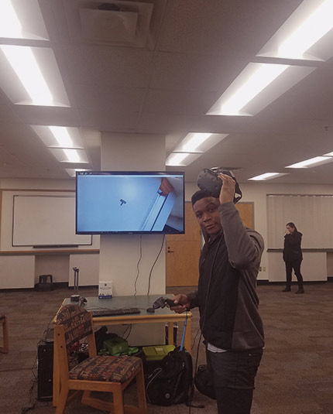
Chicken Galaga - Sprint 3
BY: EVERISTUS AKPABIO

Slide 2
Game Summary
v
Enemies are spawned in waves
Asteroids and birds have their waves
Health and Shield powerups now spawn at intervals

Slide 3
As a gamer, I want to collect the health powerup so that I can increase my health
v
The health powerup should spawn at random intervals
The health powerup should be a cyan color
The health powerup should collide with the player
The health powerup should be add a life to the player
The players life counter should increase after receiving the powerup

Slide 4
As a gamer, I want to collect the shield so that I can protect myself from the enemies
v
The shield powerup should spawn at random intervals
The shield powerup should be yellow in color
The shield powerup should make the player invincible for a few seconds
The player's ship should turn yellow when invincibility is on
The shield's invincibility boost should wear off after a few seconds
The player's ship should turn cyan when invincibility is off

Slide 5
As an asteroid, I want to randomly move to the screen during a wave so that I may kill the player on impact
v
Asteroids should spawn on the second wave
Asteroids should have an entry animation
Asteroids should be susceptible to damage from player's bullets
Asteroids should kill the player on collision

Slide 6
As an asteroid, I want to bounce back into the scene so that I stay within the bounds of the screen
v
At the left edge of the screen the asteroid should not move beyond the bounds of the screen
At the right edge of the screen the asteroid should not move beyond the bounds of the screen
Asteroids should be animated while moving back and forth

