Slide 1
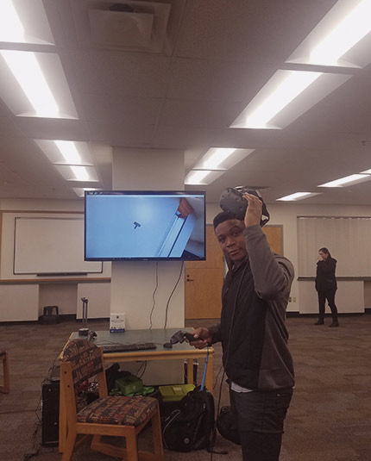
Chicken Galaga - Sprint 1
BY: EVERISTUS AKPABIO

Slide 2
Game Summary
v
Start screen background and user interface has been implemented.
Leaderboard screen can be viewed
Enemies are spawned in waves after the previous wave has been eliminated
Players can shoot enemies with bullets
Animation added for both the player and enemies on collision
Implemented a game over message, state and animation on players death

Slide 3
As a gamer, I want to be able to click on the leaderboard button so that I can see my scores
v
The leaderboard button is present on the main menu
A player can click on the leaderboard button to see how their scores stack up

Slide 4
As a gamer, I want to be able to go back to the start screen so that I can play the game
v
Closing the leaderboard returns to the main menu
Closing the leaderboard does not affect the state of the leaderboard

Slide 5
As a gamer, I want to move the shooter using 4 arrow keys so that the shooter can navigate the game scene
v
The shooter moves to the right by 10 pixels with the right arrow key press
The shooter moves to the left by 10 pixels with the left arrow key press
The shooter moves upwards by 10 pixels with the up arrow key press
The shooter moves downwards by 10 pixels with the down arrow key press
For each of 4 arrow keys, the shooter moves continuously as long as the key is pressed

Slide 6
As a gamer, I want to move the shooter without leaving the game scene so that the shooter does not disappear from the screen
v
At the right edge, the shooter does not move to the right arrow key press
At the left edge, the shooter does not move to the left arrow key press
At the top edge, the shooter does not move to the up arrow key press
At the bottom edge, the shooter does not move to the down arrow key press
At the four corners of the game scene, the shooter stays inside the scene after pressing arrow keys

Slide 7
As a gamer, I want to stop my movement when I hit the SPACE bar so that I can shoot based on my position
v
Pressing the SPACE bar will spawn a bullet from the ship's barrel
Pressing the SPACE bar will stop the players movement and shoot in the positive direction vertically

Slide 8
As a bullet, I want to hit enemies along the travel path so that I can kill enemies
v
The bullet launches always from the shooter's barrel as the shooter changes its location
The bullet stops when it hits an enemy
The bullet kills enemies as it hits them.

Slide 9
As a gamer, I want to be susceptible to damage so that I can lose a life when I collide with an enemy
v
Colliding with a moving enemy should kill the player
Colliding with a falling enemy should kill the player

Slide 10
As a bird, I want to fly to my spot in the formation at the start of a wave so that I can stop the player from getting past me
v
Each bird should have the flying animation
Each bird should fly into a formation
Each bird should keep flying in place
Each bird should die and also kill the player on collision

