Slide 1
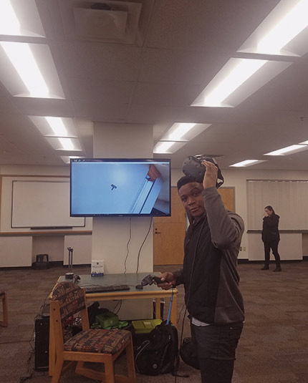
Chicken Galaga - Sprint 2
BY: EVERISTUS AKPABIO

Slide 2
Game Summary
v
Score counter, Life counter and Time counter added.
Birds are hurt after the first hit and killed after the second.
Birds are able to release lethal droppings.
Player earns points for hurting or killing birds.
Player now starts with 3 lives and respawns with each death.
Game ends after player’s lives have been depleted.

Slide 3
As a gamer, I want to be able to shoot at my enemies so that I can hurt them and increase my score
v
Pressing the SPACE bar will spawn a bullet from the ship's barrel
The bullet launches always from the shooter's barrel vertically
The bullet should collide with an enemy
The bullet should hurt the enemy
The score counter should reflect points earned for hurting an enemy

Slide 4
As a gamer, I want to be able kill an enemy so that I can significantly increase my score
v
Pressing the SPACE bar will spawn a bullet from the ship's barrel
The bullet launches always from the shoot's barrel vertically
The bullet should collide with an enemy
The bullet should kill the enemy
The score counter should reflect points earned for killing an enemy

Slide 5
As a gamer, I want to be susceptible to damage so that I can lose a life when I am hit by an enemy
v
Player should be able to collide with the enemy
Player's death animation should play on collision
Player's life should decrease by 1

Slide 6
As a gamer, I want to be susceptible to damage so that I can lose a life when I am hit by an enemy's bullet
v
Player should collide with the enemy dropping
Player's death animation should play on collision
Player's life should decrease by 1
If the Player's lives are depleted, the game should end

Slide 7
As a bird, I want to release dropping at interval below me so that it may hit the player
v
Bird droppings should be spawned at the bird's location
Bird droppings should be spawned at intervals
Bird droppings should fall from the bird vertically

Slide 8
As a bird I want my droppings to be lethal so that it can kill the player on impact
v
Bird droppings should collide with the player
Bird droppings should take a life from a player
The players life counter should reflect a life lost from the collision

