Slide 1
Deduplicating Source Locations
Across Loaded Modules
Cutting loaded SourceLocation pressure in Clang
foo.h
foo.h
foo.h
foo.h
Ayokunle Amodu
The C++ Alliance / Compiler Research Group
Mentor: Vassil Vassilev
3 copies
1 copy
MIDTERM CHECKPOINT
Notes:
Title. Introduce myself and the project. The whole talk is about one specific waste: a header shared across modules gets its source locations duplicated once per module at load time, and that eats a finite address space.

Slide 2
THE PROBLEM
One header, many modules
#include
foo.h
A.pcm
B.pcm
C.pcm
foo.h
foo.h
foo.h
A header included by many modules is serialized into each of their PCM.
Notes:
Setup. foo.h is textually included by three modules, so it is baked into all three PCMs. Nothing is wrong yet, it is just stored three times, and the three copies are identical.

Slide 3
THE PROBLEM
Every copy takes real address space
loaded SourceLocation address space
A.pcm
B.pcm
C.pcm
foo.h
foo.h
foo.h
duplicate
duplicate
Two of three ranges are pure waste.
On a large -fmodules build this duplication is one of the things that pushes you toward source-location exhaustion.
Notes:
The cost. Each copy claims its own slice of a finite, shared address space. Here foo.h is claimed three times. On a big modules build this is a real contributor to running out of source locations.

Slide 4
THE PAYOFF
Before → After
duplicate
duplicate
Today
foo.h
foo.h
foo.h
kept
Deduplicated
foo.h
When a file is already loaded, later modules reuse that copy instead of reserving a fresh range.
Same file, same content — file, line and column are unchanged. A diagnostic pointing into foo.h from B still resolves into A’s copy.
Notes:
The payoff, shown directly. A loads first and its foo.h is the copy we keep. B and C match it, so nothing new is allocated and their references remap into A's range. Correctness is untouched: same file means same line and column.

Slide 5
DESIGN
When are two entries the same file?
✗
✓
First plan
What we do
FileEntryRef
name + size
Resolving the file entry means unnecessary open syscalls at load.
Read straight from the serialized entry metadata.
size 812
size 812
size 812
size 912
foo.h
=
foo.h
a.h
≠
a.h
same name & size → same file
different name → stays distinct
size guards against two modules built against different versions of the same file
Notes:
Design choice. We first thought to key identity on the file-entry reference, but that pulls the file back through the file manager and costs syscalls at load. Instead we identify a file by name plus size, read from metadata already in the PCM, so loading touches nothing on disk. Same name and size means same file; size stops two different versions from merging.

Slide 6
HOW IT WORKS
What happens when a module loads
1
2
3
4
Scan
Classify
Reduce
Remap
read the entry records
flag files already loaded
reserve less space
build the local→global map
Notes:
Overview of the load path. Scan the entries, classify which duplicate an already-loaded file, reserve a smaller range accordingly, then build the map that turns this module's local locations into global ones. The last step is where old and new differ.

Slide 7
STEPS 1–2
Scan the entries, flag the duplicates
B’s SLoc file entries
identity check
new
keep
running tally
b.h
1
foo.h
already loaded (from A)
duplicate
duplicate entry
50 bytes
main.cpp
new
keep
would-be duplicate space
Each entry is given its name + size identity and checked against files already loaded. Matches are flagged, and the space they would have taken is tallied.
Notes:
Steps one and two. Walk B's entries, attach each one's identity, and look it up among files loaded by earlier modules. foo.h is already loaded from A, so it is flagged. We also add up the bytes those duplicates would have used. This is bookkeeping only; no space is committed here.

Slide 8
STEP 3
Reserve a smaller range up front
would reserve
SLocSpaceSize
dup (50 bytes)
subtract duplicate bytes
actually reserve
ReducedSize
returned
ReducedSize = SLocSpaceSize − duplicate bytes
Because the duplicates are already known, the module claims a smaller slice.
Notes:
Step three. Since the scan already told us how many entries and bytes are duplicates, the module reserves the reduced size instead of the full size. That reclaimed space stays available for everything else.

Slide 9
STEP 4 · BEFORE
The old map: one flat shift
B’s local locations
global loaded space
b.h
foo.h
…
b.h
foo.h
…
+ base offset
0
120
200
320
global = local + baseOffset. A module’s entries were one contiguous block, so a single add slid the whole block into loaded space.
Notes:
Step four, the old world. Every entry in a module was contiguous, so turning local into global was one addition of the module's base offset. The whole block shifts together.

Slide 10
STEP 4 · BEFORE
A location, the old way
B’s local locations
global loaded space
b.h
foo.h
…
b.h
foo.h
…
+ 200
local 65
global 265
local 65 → 65 + 200 = 265.
The location lands in B’s own private copy of foo.h.
Notes:
Trace one location the old way. A diagnostic points into foo.h at local offset 65. Add the base offset, 200, and you get 265 - a slot inside B's own duplicated copy of foo.h. Remember the number 265.

Slide 11
STEP 4 · NOW
Now: a reused file leaves a hole
B’s segment table (sorted by local start)
B’s local locations
local range
maps to
b.h
hole
…
[0, 40)
b.h → B’s block +200
[40, 90)
foo.h → A’s copy +60
foo.h reused from A → not stored here
[90, 120)
… → B’s block +150
Each module carries a short sorted table of segments. Kept files shift into their own block; the reused file redirects into A. Translating a location is a binary search for the covering segment.
Notes:
Step four, now. Because foo.h is reused, it is not stored in B's block - it leaves a hole, and one flat shift can no longer describe the mapping. So each module keeps a small sorted table of segments. Kept files shift into their own block, the reused file redirects into A's copy. To translate a location you binary-search for the segment that covers it.

Slide 12
STEP 4 · NOW
The same location, now
B’s local locations
binary search
A’s loaded space
b.h
…
segment [40,90)
delta + 60
…
foo.h
local 65
global 125
Old local 65 → 265 its own copy
New local 65 → 125 A’s shared copy
With nothing deduplicated the table is a single segment = the old flat shift.
Notes:
Same location, now. local 65 falls in segment [40,90), whose delta is +60, so it maps to 125 - straight into A's shared copy of foo.h, same line and column. Old gave 265 in a private copy; new gives 125 in the shared one. And when there are no duplicates the table collapses to one segment identical to the old shift, so the fast path is untouched.

Slide 13
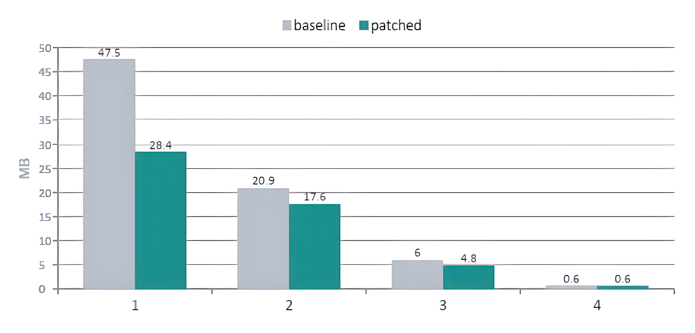
RESULTS
Loaded SLoc space, measured on a custom Boost bench
40%
less loaded SLoc space on the combined main TU
asio + beast + spirit + hana · 47.5 → 28.4 MB
Compile time
flat (−0.9%)
Peak RSS
flat (+1.2%)
stat / open calls
identical
Self-contained libraries with nothing shared show 0% i.e., the dedup does nothing when there is nothing to reuse.
config (nothing shared)
0%
Notes:
Results on Boost with a per-library module map. The combined main TU drops loaded SLoc space by 40 percent, from 47.5 to 28.4 megabytes. Beast and system drop too; config, which shares nothing, is flat at zero, exactly as expected. Compile time and peak memory are essentially unchanged and we add no filesystem calls.

Slide 14
SCALING
40% is not a magic number
a file shared by n modules
50%
90%
→ 100%
n − 1
n
2 modules
10 modules
many
The 40% just reflects how much this particular module set happens to share.
More shared headers → a bigger number on the same code.
Notes:
How far this goes. A file pulled into n modules gives back n-1 over n of its footprint: two modules is half, ten is ninety percent, approaching a hundred as more modules share it. So 40 percent is not special - it is just this module set. A workload that shares more headers shows a bigger number on the same code.

Slide 15
STATUS
Where it stands
1
Posted & under review
It's up on upstream; maintainers testing it against their internal codebases.
2
Reduce peak RSS
Right now RSS ticks up slightly on our custom bench; find out why and bring it down.
3
Reused-entry include chain
Confirm a redirected file inheriting the primary's "included from" info is fine as-is, or add a fix if not.
Notes:
Status, kept short. The patch is posted and under review. The interesting part now is real-world testing: getting it onto codebases that actually lean on modules, which is where the flow really gets exercised. Open modules-heavy codebases are hard to find, so the real validation is people taking the patch and running it. The result I would most like to show is a build that was hitting source-location exhaustion and, with this, no longer does.

