Slide 1
Docker

Slide 2
Contents
Fundamental of Docker
Container at a scale.
Benefits of docker.
Blue-Green deployments.
Docker can not solve.
Virtual machine and container
Docker concepts

Slide 3
Contents
Install docker
Docker hub
Docker images
Docker networking
Container life cycle
Executing command
Container management

Slide 4
Contents
Persistent storage
Start a wordpress environment
Logs and monitoring
Docker compose
Image management
CI/CD Pipelines and docker
Backup and Restore.

Slide 5
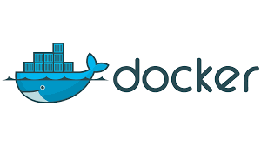
Fundamental of docker Docker logo
https://logos-world.net/docker-logo/

Slide 6
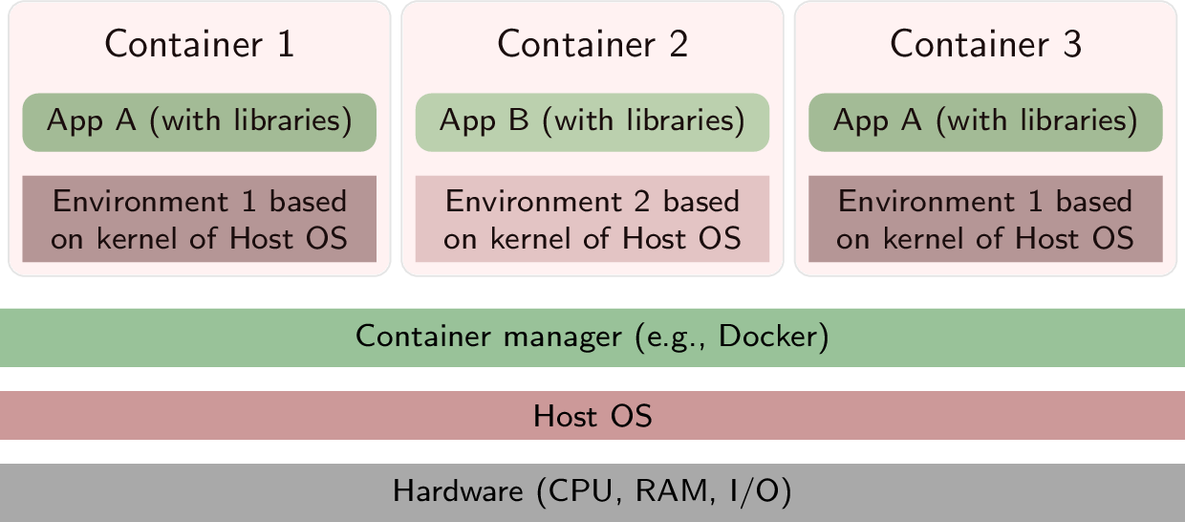
Fundamental of docker O/S Virtualization
levelup.gitconnected.com

Slide 7
Fundamental of docker
What is docker?
Set of services and tools help running and managing containers.
What is container?
Unit of s/w that packages up libraries, code and dependencies to run the application quickly, and reliable from one system to another. The container is a temporary, or ephemeral.

Slide 8
Fundamental of docker
What included in container?
System libraries
Programming language runtimes
Programming language libraries.
Configuration settings.
Static data files.

Slide 9
Container at a scale
The platform must ensure availability of container.
Must respond to application spikes by increasing/decreasing the running containers.
Use a load balancing techniques.
React according to failure of container, or container host.
Automated workflow to deliver new application in transparent and secure way.
Kubernetes is an orchestration layer.

Slide 10
Benefits of docker
Main benefits
More efficient use of system resources | Less memory than VM Saves costs of s/w licenses. Process isolation.
Faster software delivery cycles | Easy scaling to meet demand Easy to put new versions of s/w Quickly roll-back to previous version Easy to implement blue/green deployments.
Application portability | Because of encapsulation, Allow applications to be shuttled easily between environments. Any host running docker runtime can run the container
Shine for microservices architecture | No single point of failure. Perfect suited to the microservices approach .
Scalability | Can scale out based on load using orchestration layer like kubernetes
Speed | Startup, and stop more quickly
Notes:
No Single point of failure — We’ve all been in that situation where an error in a tiny function crashes an entire application with functionalities not even related to it i.e., Single point of failure. Docker helps you in preventing this situation. You can break a huge monolithic app into multiple microservices, helping you with easier deployments.
Scalability — Containers are quickly scalable with the help of orchestration services like Kubernetes or swarm that helps it in creating and destroying multiple copies of containers very fast. Scalability — Containers are quickly scalable with the help of orchestration services like Kubernetes or swarm that helps it in creating and destroying multiple copies of containers very fast.
Isolation on os level
Ease of use: Docker has made it much easier for anyone — developers, systems admins, architects and others — to take advantage of containers in order to quickly build and test portable applications. It allows anyone to package an application on their laptop, which in turn can run unmodified on any public cloud, private cloud, or even bare metal. The mantra is: “build once, run anywhere.”

Slide 11
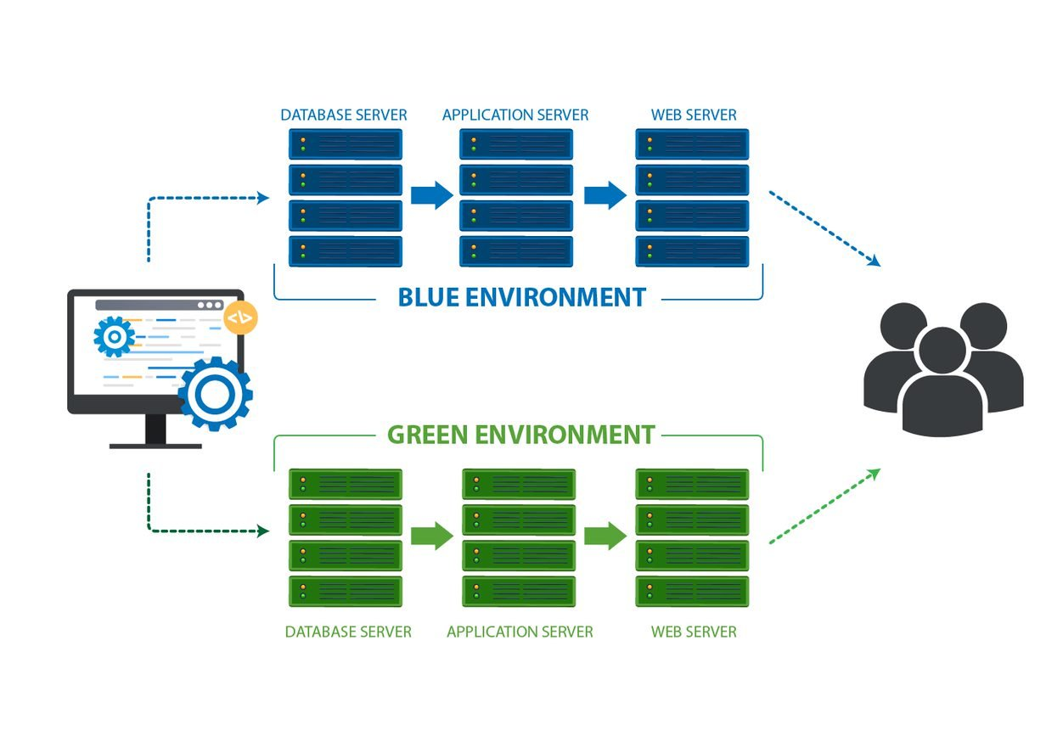
Blue-Green deployments
A software release strategy.
Reduces downtime, and risk.
Uses two identical production environments.
Blue is the current version, Green is the new version.
Use a router/load balancer to switch between them.
What about Cost, Databases, user sessions?
Use of kubernetes, CI/CD, and cloud services.
https://blog.inedo.com/devops/blue-green-deployment-best-practices

Slide 12
Docker don’t solve
Docker don’t solve?
Fix your security issues.
Does not turn your application into microservices.
Is not substitute of VMs.

Slide 13
Virtual machine and container
Virtual machine and container?
Virtual machine | Container
Multiple OS run side by side | Run directly on the OS, sharing hardware and OS across all containers.
Hypervisor to divide hardware into virtual hardware system | Share the same SO, isolate the containerized application processes from the rest of the system.
Require a complete OS | Require less hardware resources.

Slide 14
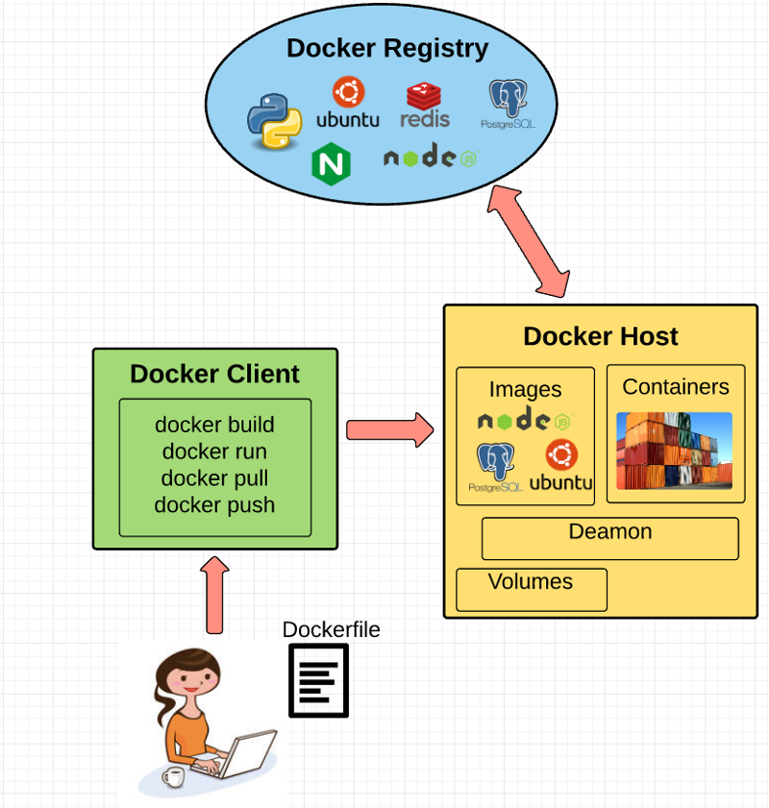
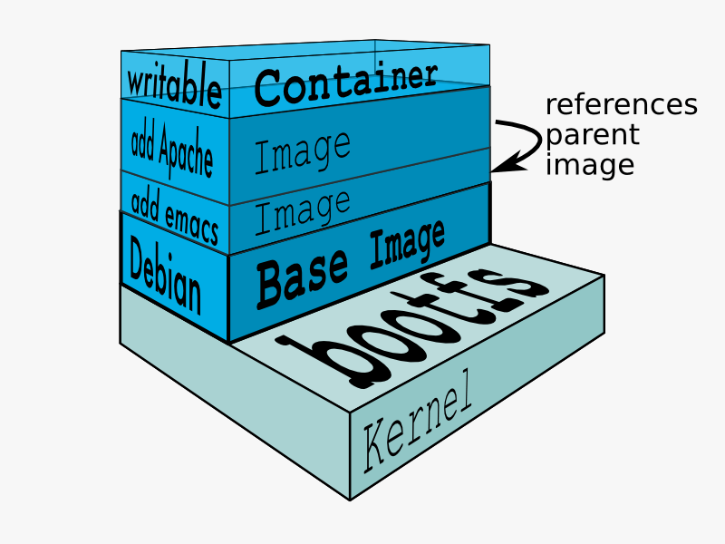
Docker concepts
Docker Engine
Docker client
Docker daemon
Docker file
Docker image
Union file system
Volumes
Docker containers
From docker
www.freecodecamp.org

Slide 15
Install
sudo apt install apt-transport-https ca-certificates curl software-properties-common
curl -fsSL https://download.docker.com/linux/ubuntu/gpg | sudo apt-key add --
sudo add-apt-repository "deb [arch=amd64] https://download.docker.com/linux/ubuntu $(lsb_release -c|awk ' { print $2 } ') stable "
sudo apt update
sudo apt-get install docker-ce docker-ce-cli containerd.io

Slide 16
Docker hub
To login to docker hub
$sudo docker login
To get an image: docker pull <image name>:<tag>
$sudo docker pull ubuntu
To search for an image: docker search <image>
$sudo docker search ubuntu
Logout: docker logout
$sudo docker logout

Slide 17
Docker images
To list all images:
$sudo docker images
To remove an image: docker rmi <image>
$sudo docker rmi ubuntu
To display a container information: docker inspect <image>
$sudo docker inspect ubuntu

Slide 18
Docker networking
Docker networking uses drivers to provide network functionality.
Bridge: The default driver
Host: Removes the network isolation, and the containers have no IP addresses. The connected containers uses the docker host sockets.
Overlay
Also, there are ipvlan, macvlan, none, and a custom network drivers.

Slide 19
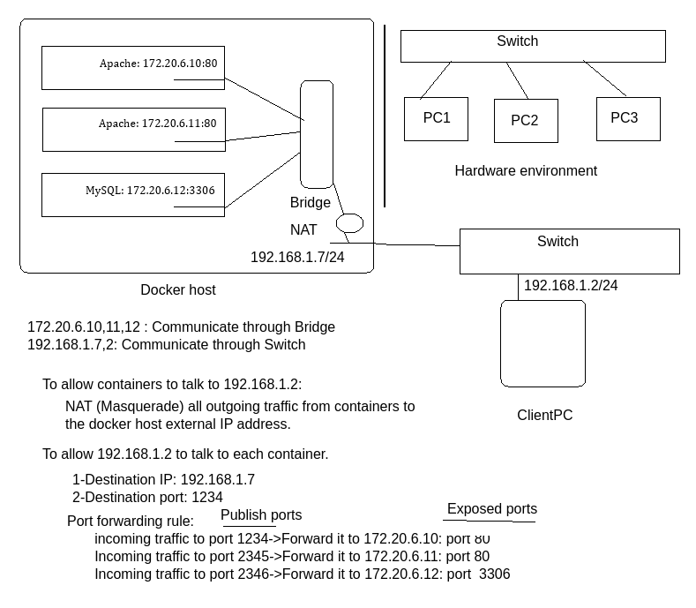
Docker networking Bridge
Bridge: The default driver forwards traffic between all connected containers and isolates them from the other containers are not connected to the bridge in the same Docker host.
What about localhost in each container?

Slide 20
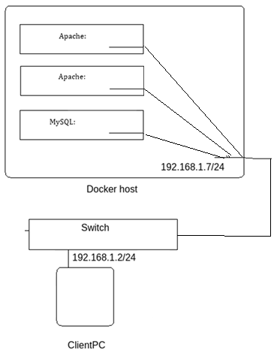
Docker networking Host
Removes the network isolation.
All containers use the Docker host sockets.
No IP for each container.
All containers must have different port assigned.
1st apache socket; 192.168.1.7:80
2nd apache socket: 192.168.1.7:81
MySQL socket: 192.168.1.7:3306
What about localhost in each container?

Slide 21
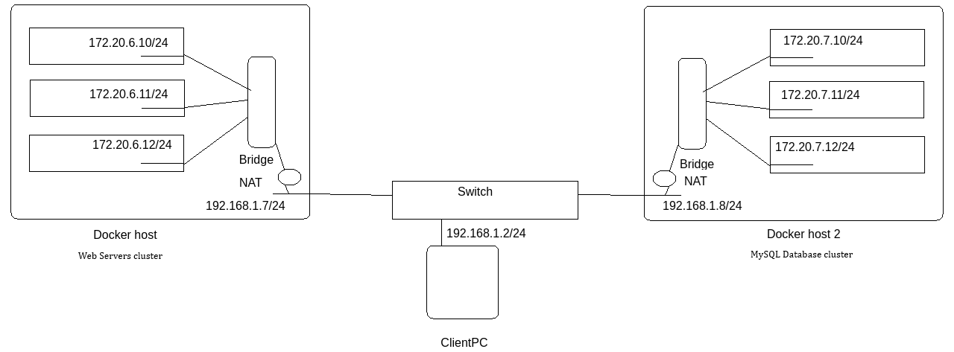
Docker networking Overlay
Connects multiple Docker daemons together without needs from OS routing.

Slide 22
Docker networking(contd)
Working with docker bridge networking:
To create:
sudo docker network create <Network name>
docker network create --gateway <Gateway> --subnet <Subnet> <Network name>
To list
sudo docker network ls
To delete
sudo docker network rm <network name>
To display network information
sudo docker network inspet <network name>
To connect a container to a network
sudo docker network connect <Network nae> <Container name>

Slide 23
Container life cycle
To list all running containers: docker ps-a
$sudo docker ps -a
Create a container from docker image: docker run <options> <image name>
-t:Terminal, -d: Daemon, -p <host port>:<container port>, --name <container name>,--ip <ip>, -e VAR=VALUE, --restart always
$sudo docker run –td –p 81:80 –name myweb ubuntu

Slide 24
Executing command
To execute a command : docker exec <options> <container> <command>
$sudo docker exec –it myweb bash

Slide 25
Container management
To stop a container: docker stop <container>
$sudo docker stop mytest
To start a stopped container: docker start <container>
$sudo docker start mytest
To remove a stopped container: docker rm <container>
$sudo docker rm mytest
To copy files/directory: docker cp <src> <container>:<dest> or docker cp <container>:<src> <dest>
$sudo docker cp /tmp/myfile mytest:/tmp
To display information about container: docker inspect <container>
$sudo docker inspect myweb1

Slide 26
Persistent storage
Containers are temporary and ephemeral
Persistent storage is an external storage that mounted to a directory inside the container
4 types of persistent storage
Volumes: Stored as a part of docker host file system. Should not be modified outside container.. Created under /var/lib/docker/volumes. Volume drivers allowing storing data to remote hosts.
Bind: A directory on docker host. Can be modified outside container.
Tmpfsmounts. Stored in the host memory.
Named pipe: Used for communication between docker host and the container.

Slide 27
Persistent storage (contd)
To create a volume: docker volume create <volme name>
$sudo docker volume create mydb
To list configured volumes
$sudo docker volume ls
To remove a volume: docker volume rm <volume>
$sudo docker volume rm mydb
To display information about a volume: docker volume inspect <volume>
$sudo docker volume inspect mydb

Slide 28
Persistent storage (contd)
To start a container with volume: docker run with mount options
-v <volume>,<container directory>
$sudo docker run –td –name myweb1 –v mydb:/var/lib/mysql mysql
To start a container with bind options: docker run with mount options
-v <docker host dir>,<container directory>
$sudo docker run –td –name myweb1 –v /mydbs:/var/lib/mysql mysql

Slide 29
Start a Wordpress
Wordpress is an open source Content Management System (CMS).
Written in PHP, with MySQL Backend DB.
Check my repo : https://github.com/compilereg/docker/tree/main/wordpress

Slide 30
Logs and monitoring
To check resource usage: docker stats
$sudo docker stats
To debug events:: docker events
$sudo docker events
To display running processes: docker top <container>
$sudo docker top myweb1
To display container logs: docker logs <container>
$sudo docker logs myweb1

Slide 31
Docker compose
Tool to help define and share multi-container application.
With yaml file, and with a single docker-compose command to spin up everything or tear it all down.
Define all application stack in one yaml file which can be stored in SVN root.
The services defined will be created in order they appear in the yaml file.

Slide 32
Docker compose(contd)
To install:
sudo curl -L "https://github.com/docker/compose/releases/download/1.29.2/docker-compose-$(uname -s)-$(uname -m)" -o /usr/local/bin/docker-compose
sudo ln –s /usr/local/bin/docker-compose /usr/sbin
sudo chmod a+x /usr/local/bin/docker-compose

Slide 33
Docker compose(contd)
To use docker compose
Create a docker file called docker-compose.yml
To spin up use: sudo docker-compose up –d
To tear down: sudo docker-compose down
To tear down and created volumes: sudo docker-compose down --volumes

Slide 34
Docker compose(contd)
Odoo example:
Is an open source CRM
Postgres backend database
Check my repo: https://github.com/compilereg/docker/tree/main/odoo
-

Slide 35
Image management
Use a Dockerfile : docker build <Directory>/ -t <image name>
To create an image for apache based on ubuntu:
Create a file called Dockerfile
Check my repo: https://github.com/compilereg/docker/tree/main/webapp_dockerfile
$sudo docker build MynewWeb/ -t mynewimage

Slide 36
Image management Run
Used to execute a command(s) during image creation
Each Run, generates a new layer (increase the image size)
Each Run always starts from the /

Slide 37
Image management Entrypoint Vs. CMD
Both used to specify the executable used to run when the container start.
Feature | ENTRYPOINT | CMD
Purpose | Specifies the main command that always runs | Default command or arguments that can be overridden
Overridable | Partially overridable (via docker run --entrypoint) | Fully overridable by arguments to docker run
Use Case | Used when you want a container to execute a specific command consistently | Used for default behavior that can be changed during runtime
Syntax | ENTRYPOINT ["executable", "arg1", "arg2"] (shell form: ENTRYPOINT command arg1 arg2) | CMD ["executable", "arg1", "arg2"] (shell form: CMD command arg1 arg2)
Combining with Args | Works well with CMD to define default arguments | Typically overridden when ENTRYPOINT is used
Typical Examples | ENTRYPOINT ["python"] to always run Python | CMD ["app.py"] as a default script to execute with Python

Slide 38
Image management Entrypoint Vs. CMD (contd)
In Dockerfile
1-Used CMD ["apache2ctl", "-DFOREGROUND"]:
means, if no cmd passed in the docker command, the default command apache2ctl will be used and passes DFOREGROUND parameter to it
docker run -it <image> /bin/bash : will run the bash instead of start the apahce2
2-Used ENTRYPOINT[“myscript", “par1"]:
means, if no entrypoint passed in the docker command, the script myscript will be started without parameter par1
docker run -it –entrypoint[“par2”] <image>, the script myscript will start with the par1 parameter passed appended to it also par2
3-Used both (What does it mean):
ENTRYPOINT[“python”,”/myprog.py”]
CMD[“—port 8080”]

Slide 39
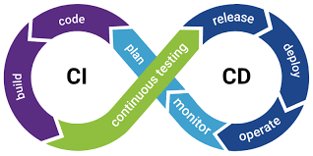
CI/CD Pipelines and Docker
Continuous Integration/ Continuous Delivery/Deployment

Slide 40
CI/CD Pipelines and Docker
1- A GitHub repo for the application
2-A Push or Merge to the repo (CI)
3-Build the Docker image, and push it to the registry (CD)
4-Use github actions to implement the pipeline
1-The github needs a username, and password to push to hub.docker.com
2-Do not store your sensitive data as plain text
3-Use of github secrets to store the Docker registry credentials.
5-Check my repo: https://github.com/compilereg/docker/tree/main/githubactions

Slide 41
Backup and Restore
Images:
Backup:
Dump the image to std/out with all parent layers+all tags
sudo docker save –o <tar file> <image name>
Restore:
Restore an image from std/in
sudo docker load –i <tar file>

Slide 42
Backup and Restore
Containers:
Backup:
Dump a snapshot of container file system to std/out
sudo docker export –o <tar file> <container name>
Restore:
Extract the tar file into an image, which can be used to run a container
sudo docker import –i <tar file>

Slide 43
Backup and Restore
Volumes:
Backup:
Create a temporarily container, and remove it after finish backup
sudo docker run --rm --volumes-from <container name> -v $(pwd):/backup ubuntu tar cvf /backup/backup.tar <Volume mount point>
--rm : Remove container after exit
--volumes-from : mount all volumes from the <container name>

Slide 44
Backup and Restore
Volumes:
Restore:
Create a temporarily container, and remove it after finish restore
sudo docker run --rm --volumes-from <container name> -v $(pwd):/backup ubuntu bash -c "cd /dbdata && tar xvf /backup/backup.tar --strip 1"
--rm : Remove container after exit
--volumes-from : mount all volumes from the <container name>

