Slide 1

Testing the Hard Stuff and Staying Sane
John Hughes
Notes:
Who really loves testing?

Slide 2
Why is testing hard?
n features
O(n²) test cases
O(n³) test cases
O(n) test cases
3—4 tests per feature
pairs of features
triples of features
race conditions
Notes:
You can’t test everything. Where are you going to stop!

Slide 3
Don’t write tests!
Generate them

Slide 4

QuickCheck
1999—invented by Koen Claessen and myself, for Haskell
2006—Quviq founded marketing Erlang version
Many extensions
Finding deep bugs for Ericsson, Volvo Cars, Basho, etc…

Slide 5
Typical usage
API under test
A minimal failing example

Slide 6
Example: a circular buffer
new
3
put
get
size
put
3
2
2
4
1

Slide 7
Example: a circular buffer

Slide 8
Size is a little tricky…
int size(Queue *q)
{ return (q->inp - q->outp) % q->size;
}

Slide 9
State Machine Models
Erlang
API Calls
API Calls
API Calls
API Calls
postconditions
Erlang
Model state
Model state
Model state
Model state
Erlang

Slide 10
Example
put 1
put 2
get
put 3
get
[]
[1]
[1,2]
[2]
[2,3]
1
2

Slide 11
Code Fragments: specifying get
get_pre(S) ->
S#state.ptr /= undefined andalso
S#state.contents /= [].
get_next(S,_Value,_Args) ->
S#state{contents=tl(S#state.contents)}.
get_post(S,_Args,Res) ->
eq(Res,hd(S#state.contents)).
Precondition
State transition
Postcondition

Slide 12
Time for some tests!

Slide 13
Lessons
The same property can find many different bugs
Minimal failing tests make diagnosis easy

Slide 14
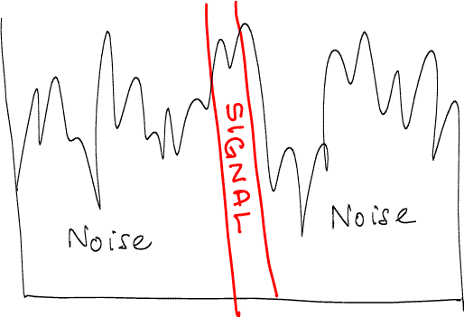

Slide 15

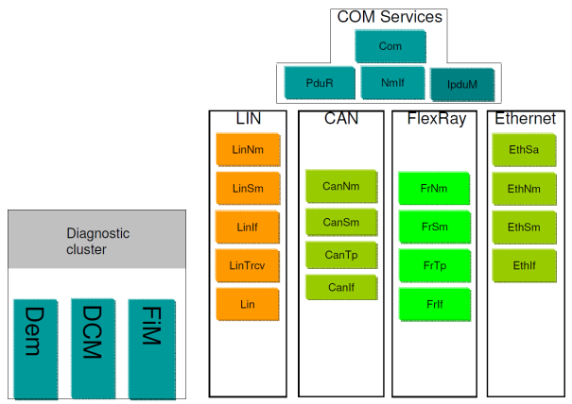
Doing it for real…

Slide 16
Theory
Car manufacturers should be able to buy code from different providers and have them work seamlessly together

Slide 17
Practice
VOLVO's experience has been that this is often not the case

Slide 18
A Bug in a vendor’s CAN stack
sending 1
send priority 1
CAN bus
send priority 2
queued
send priority 3
1 sent
sending 3
tx_confirm
Notes:
Feature interaction: you cannot test all combincations

Slide 19
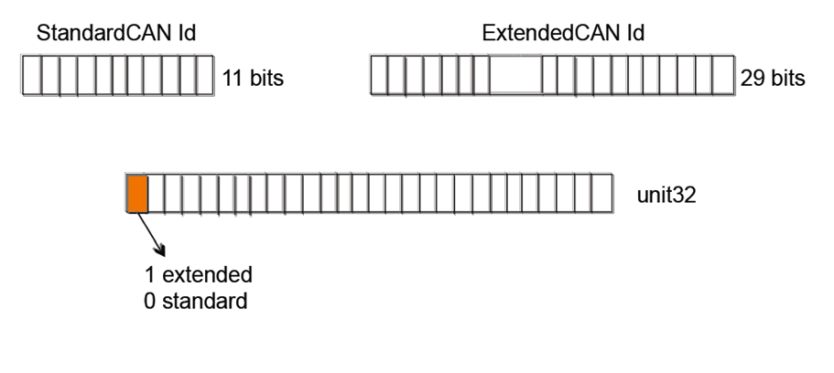
The Problem
CAN bus identifiers determine bus priority

Slide 20
A Bug in a vendor’s CAN stack
sending 1
send priority 1
CAN bus
send priority 2
queued
send priority 3
1 sent
sending 3
tx_confirm
Failed to mask off the top bit before comparing priorities
Notes:
Feature interaction: you cannot test all combincations

Slide 21
3,000 pages of specifications
20,000 lines of QuickCheck
1,000,000 LOC, 6 suppliers
200 problems
100 problems in the standard
10x smaller test code

Slide 22
"We know there is a lurking bug somewhere in the dets code. We have got 'bad object' and 'premature eof' every other month the last year. We have not been able to track the bug down since the dets files is repaired automatically next time it is opened.“
Tobbe Törnqvist, Klarna, 2007

Slide 23

What is it?
Application
Invoicing services for web shops
Mnesia
Distributed database: transactions, distribution, replication
Dets
Tuple storage
Race conditions?
File system

Slide 24
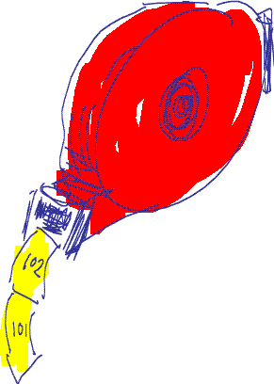
Imagine Testing This…
dispenser:take_ticket()
dispenser:reset()

Slide 25
A Unit Test in Erlang
test_dispenser() ->
ok =
1 =
2 =
3 =
ok =
1 =
reset(),
take_ticket(),
take_ticket(),
take_ticket(),
reset(),
take_ticket().
Expected results
Easy to model in QuickCheck

Slide 26
Modelling the dispenser
reset
take
take
take
0
0
1
2
ok 1 2 3

Slide 27
A Parallel Unit Test
reset
ok
take_ticket
1
2
1
3
1
2
take_ticket
3
2
1
take_ticket
Three possible correct outcomes!

Slide 28
Another Parallel Test
reset
take_ticket
take_ticket
reset
take_ticket
take_ticket
30 possible correct outcomes!

Slide 29
Deciding a Parallel Test
take➔1
take➔3
reset➔ok
take➔2

Slide 30
Let’s run some tests

Slide 31
take_ticket() ->
N = read(),
write(N+1),
N+1.
Prefix:
Parallel:
1. dispenser:take_ticket() --> 1
2. dispenser:take_ticket() --> 1
Result: no_possible_interleaving

Slide 32
dets
Tuple store:
{Key, Value1, Value2…}
Operations:
insert(Table,ListOfTuples)
delete(Table,Key)
insert_new(Table,ListOfTuples)
…
Model:
List of tuples (almost)

Slide 33
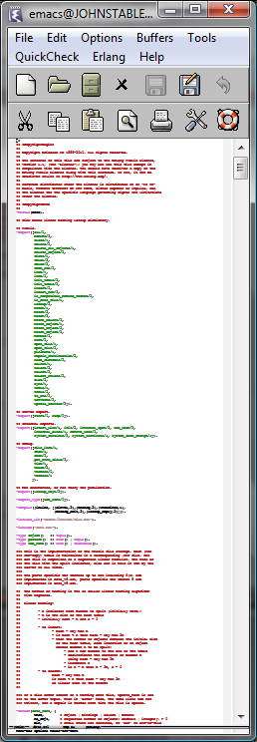
QuickCheck Specification
... …
... …
<100 LOC
> 6,000 LOC

Slide 34
Remember…
…dets had been in production for >15 years
…is heavily used in Erlang applications

Slide 35
Bug #1
insert_new(Name, Objects) -> Bool
Types:
Name = name()
Objects = object() | [object()]
Bool = bool()
Prefix:
open_file(dets_table,[{type,bag}]) --> dets_table
Parallel:
1. insert(dets_table,[]) --> ok
2. insert_new(dets_table,[]) --> ok
Result: no_possible_interleaving

Slide 36
Bug #2
Prefix:
open_file(dets_table,[{type,set}]) --> dets_table
Parallel:
1. insert(dets_table,{0,0}) --> ok
2. insert_new(dets_table,{0,0}) --> …time out…
=ERROR REPORT==== 4-Oct-2010::17:08:21 ===
** dets: Bug was found when accessing table dets_table

Slide 37
Bug #3
Prefix:
open_file(dets_table,[{type,set}]) --> dets_table
Parallel:
1. open_file(dets_table,[{type,set}]) --> dets_table
2. insert(dets_table,{0,0}) --> ok
get_contents(dets_table) --> []
Result: no_possible_interleaving
!

Slide 38
Is the file corrupt?

Slide 39
Bug #4
Prefix:
open_file(dets_table,[{type,bag}]) --> dets_table
close(dets_table) --> ok
open_file(dets_table,[{type,bag}]) --> dets_table
Parallel:
1. lookup(dets_table,0) --> []
2. insert(dets_table,{0,0}) --> ok
3. insert(dets_table,{0,0}) --> ok
Result: ok
premature eof

Slide 40
Bug #5
Prefix:
open_file(dets_table,[{type,set}]) --> dets_table
insert(dets_table,[{1,0}]) --> ok
Parallel:
1. lookup(dets_table,0) --> []
delete(dets_table,1) --> ok
2. open_file(dets_table,[{type,set}]) --> dets_table
Result: ok
false
bad object

Slide 41
"We know there is a lurking bug somewhere in the dets code. We have got 'bad object' and 'premature eof' every other month the last year.”
Tobbe Törnqvist, Klarna, 2007
Each bug fixed the day after reporting the failing case

Slide 42
Before
After
Files over 1GB?
Rehashing?
> 6 weeks of effort!
Database with one record!
5—6 calls to reproduce
< 1 day to fix

Slide 43
Property Based Testing
…finds more bugs with less effort!

Slide 44
Don’t write tests… Generate them!

Slide 45
Where to find out more…
Haskell QuickCheck
The original… ICFP 2000
Quviq QuickCheck
Commercial tool & services www.quviq.com
Many, many tools inspired by QuickCheck
test.check, ScalaCheck, FsCheck (F#)…

Slide 46
What does it feel like?
Docs
QC Spec
Code

Slide 47
Properties vs test cases
Code sizes for the Flexray interface:
9x smaller code! …and it tests more!

Slide 48
Properties vs implementations
The test code is 3—6x smaller than the implementation

