Slide 1

Building Industrial grade Modelica compiler
Tech talk in The Computer Scientist in Society course
Contact: Iakov.Nakhimovski@modelon.com

Slide 2
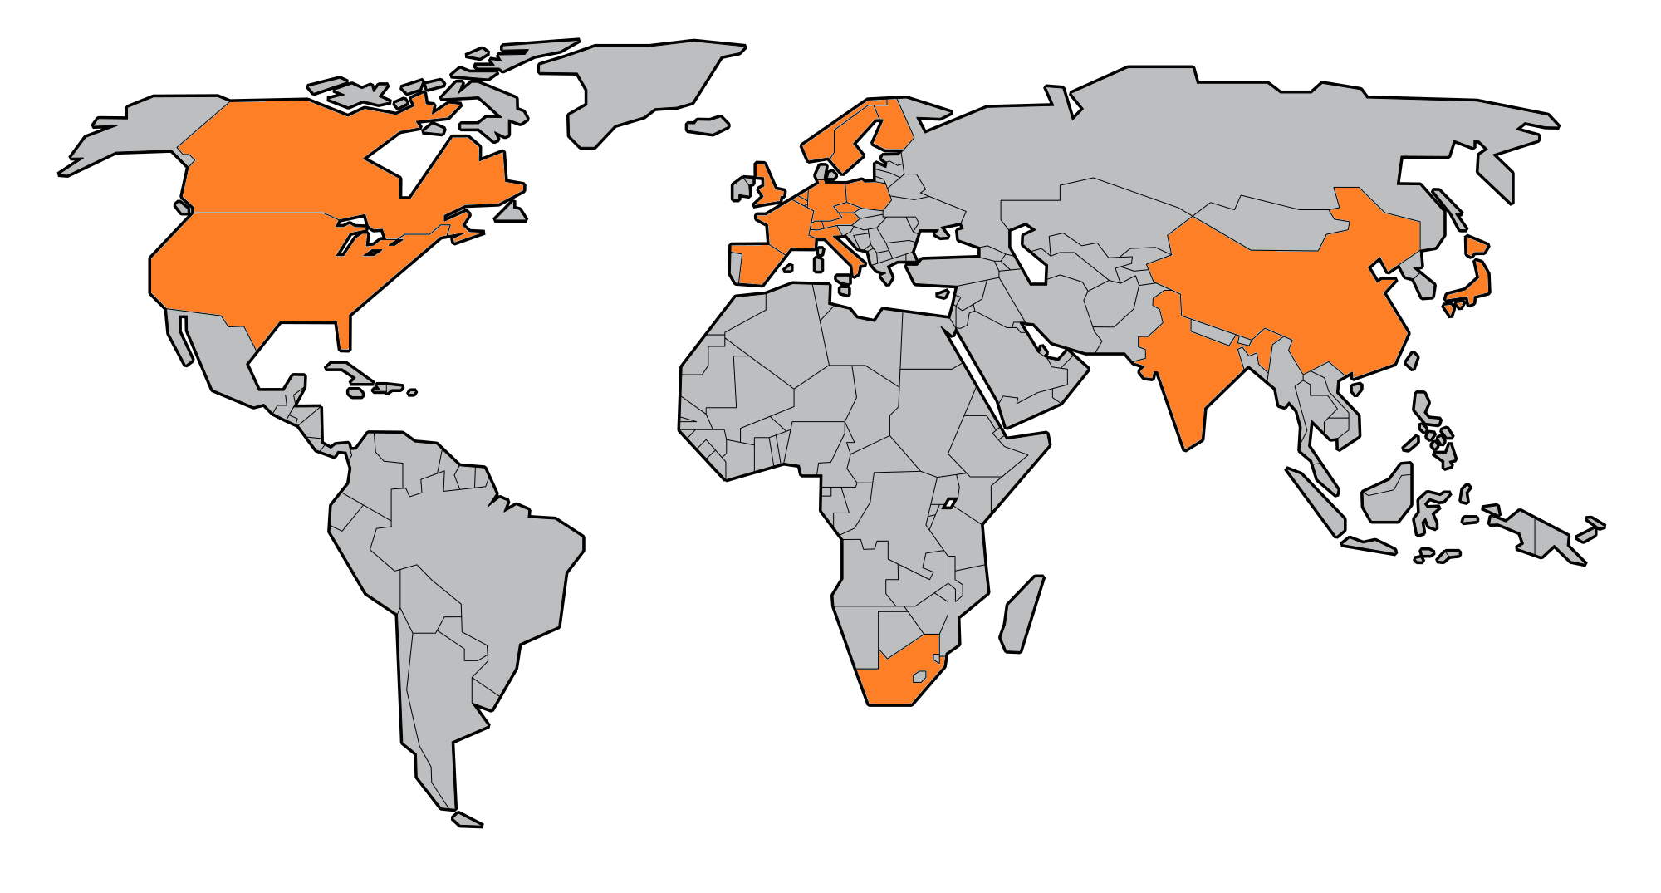

modelon CUSTOMER AND OFFICE LOCATIONS
Ann Arbor, MI
Hartford, CT
Gothenburg, SE
Lund, SE
Hamburg, DE
Munic, DE
Tokyo, JP
Global customers mostly among Fortune 500 technology companies in Automotive, Aerospace, Energy and Industrial Equipment
>30% annual growth

Slide 3
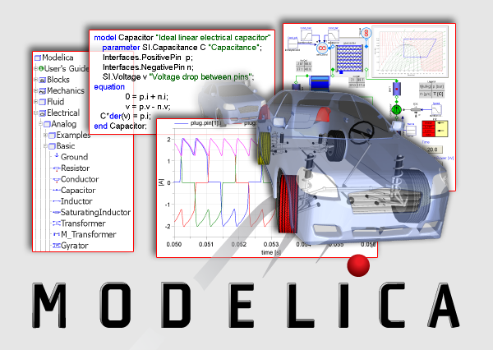
https://www.modelica.org/education/educational-material/lecture-material/english/ModelicaOverview.ppt/view

Slide 4
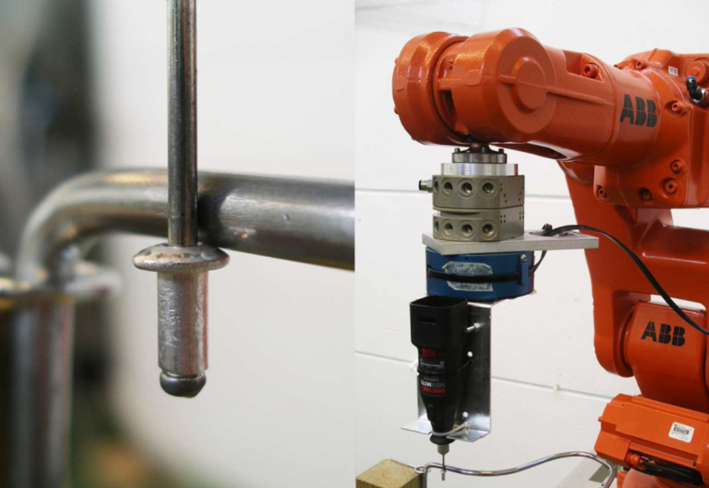
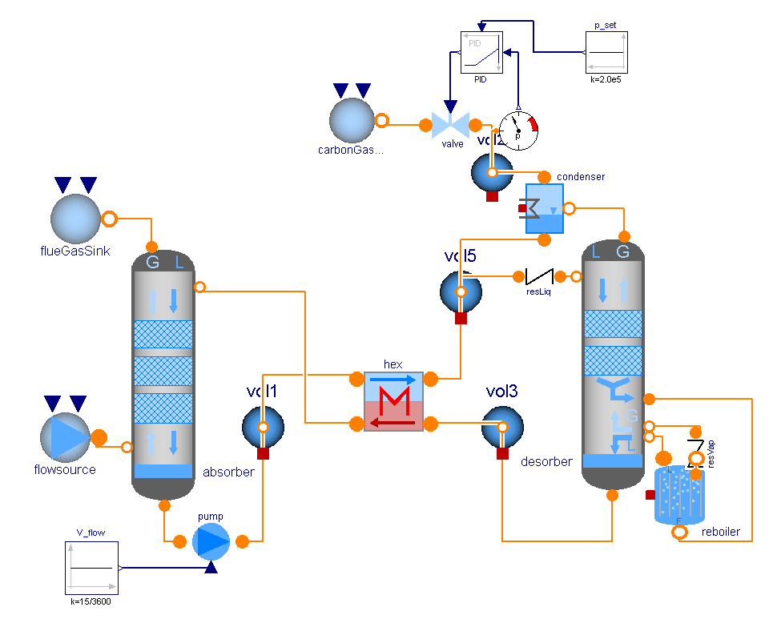
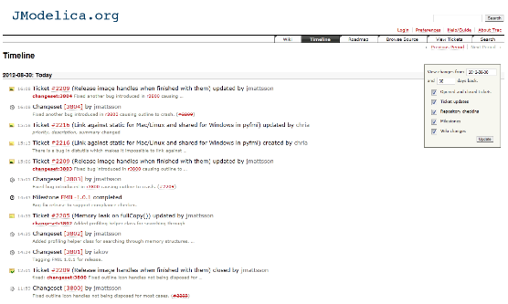
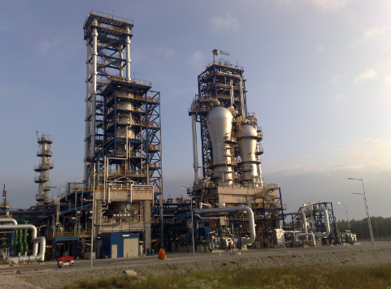

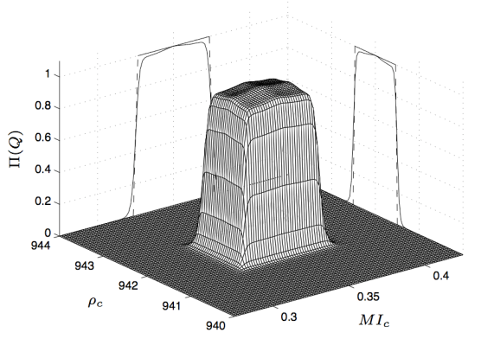


Jmodelica.org
Open source license (GPL)
Modeling with Modelica
Simulation with FMI
Optimization with Optimica
C/C++
Java/JastAdd
Compilation target
Python package
Simulation and optimization runtime
Modelica compiler
FMI 1.0 runtime
FMI 2.0RC1 runtime
Optim. runtime
Front-end
Symbolic kernel
Code generation
FMU 1.0 (ME/CS)
FMU 2.0RC1 (ME/CS)
FMUX
(XML eqns.)
FMI Library
CasADi Modelica
JModelica.org is developed
in collaboration with
academic institutions at
Lund university
Assimulo
PyFMI
Collocation Optim.
CasADi Interface
PyModelica
Python user scripts

Slide 5
What is FMI?
FMI – Functional Mock-up Interface
Open interface standard for model exchange between different modeling and simulation environments.
Consists of
Model Description XML Schema:
Define model variables and meta data.
Model Binary Interface:
C API to expose model equations evalutation.
Packaging into an FMU – Functional Mock-up Unit
Zip-file with specified content
Development started as a part of the MODELISAR project
ITEA2 European project to improve the design of systems and embedded software in vehicles.
http://www.fmi-standard.org/

Slide 6

From Research project to industrial Modelica Compiler
JModelica.org
Open source licens (GPL)
Base-line Modelica and FMI support
Modular components and openendedness
Community support
Python scripting
OPTIMICA Compiler Toolkit
Based on JModelica.org components
End-user and OEM licenses
Python and MATLAB scripting
Encrypted library support
Steady-state simulation support
Third party numerical solvers
Support contract
”
[We are] applying the platform to Mitsubishi Electric Problems
Scott Bortoff, Mitsubishi Electric Research Laboraties
”
It was so much easier when we did not have any real users
Jon Sten, Modelon

Slide 7
Modelica compiler stages
Symbolic simplifications
Index reduction
Equation sorting and Block Lower Triangular form
Tearing of systems of equations
Code generation (XML and C)
Linking in run-time library (numerical solvers) and packaging

Slide 8
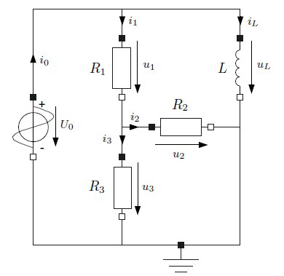
Equation sorting Example
model Circuit
Real u0,u1,u2,u3,uL;
Real i0,i1,i2,i3,iL;
parameter Real R1 = 1;
parameter Real R2 = 1;
parameter Real R3 = 1;
parameter Real L = 1;
equation
u0 = sin(time);
u1 = R1*i1;
u2 = R2*i2;
u3 = R3*i3;
uL = L*der(iL);
u0 = u1 + u3;
uL = u1 + u2;
u2 = u3;
i0 = i1 + iL;
i1 = i2 + i3;
end Circuit;

Slide 9
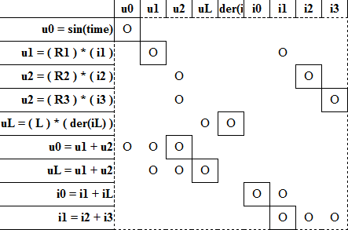
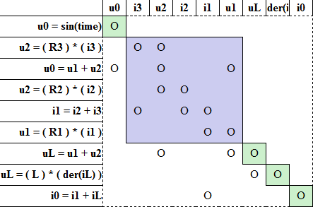
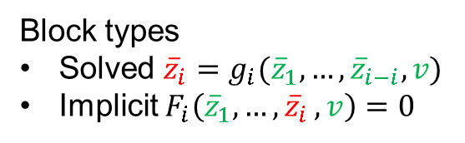
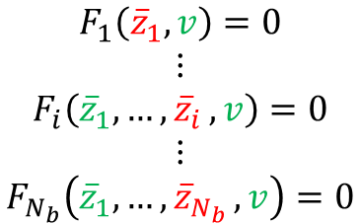
Equation sorting
Equations
Variables
U0 = sin(time)
u0
Block Lower Triangular Form
Tarjan’s algorithm
Minimally sized blocks
u1 = R1 * i1
u1
Incidence matrix
Matched entries
u2 = R2 * i2
u2
u2 = R3 * i3
uL
uL = L*der(iL)
der(iL)
u0 = u1 + u2
i0
uL = u1 + u2
i1
i0 = i1 + iL
i2
i1 = i2 + i3
i3
Bipartitite graph
Maximum matching
Linear time algorithms
$$\begin{matrix}\begin{matrix}F_{1}\left({\overline{z}}_{1},v\right)=0 \\ ⋮ \\ F_{i}\left({\overline{z}}_{1},{…,\overline{z}}_{i},v\right)=0\end{matrix} \\ \begin{matrix}⋮ \\ F_{N_{b}}\left({\overline{z}}_{1},{…,\overline{z}}_{N_{b}},v\right)=0\end{matrix}\end{matrix}$$
Block types
Solved ${\overline{z}}_{i}=g_{i}({\overline{z}}_{1},…,{\overline{z}}_{i−i},v)$
Implicit $F_{i}\left({\overline{z}}_{1},{…,\overline{z}}_{i},v\right)=0$

Slide 10
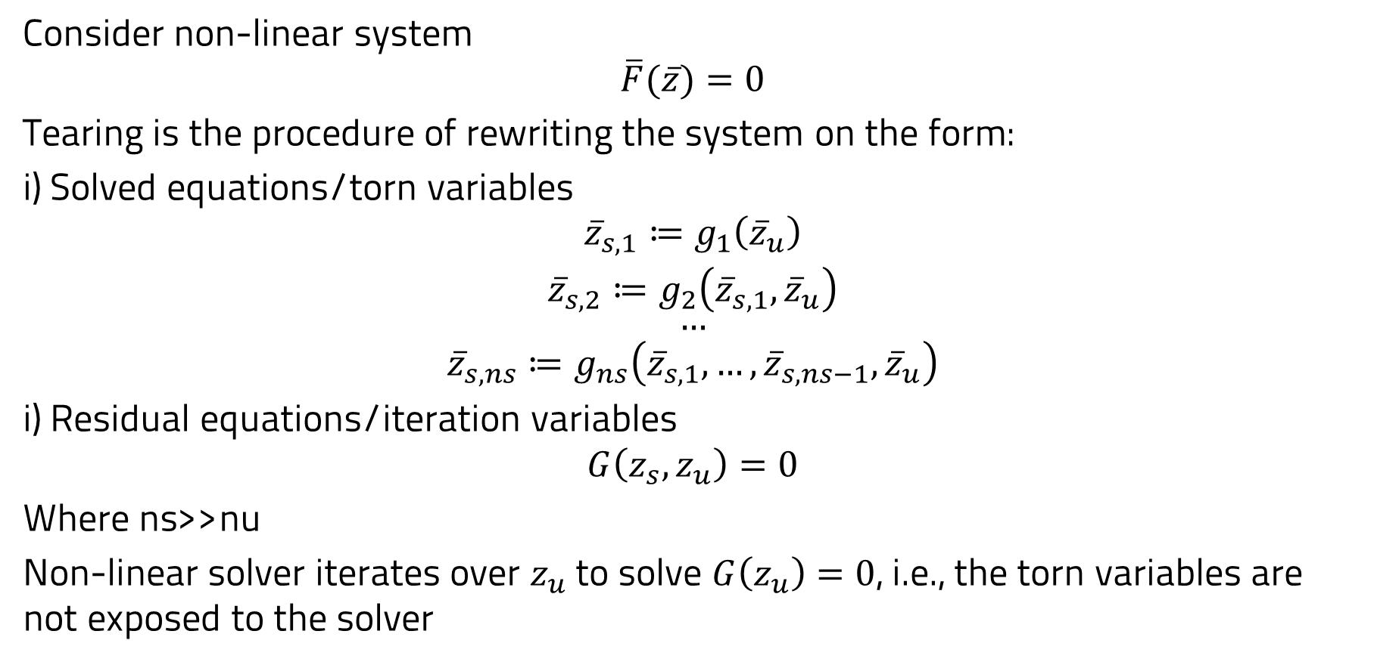
tearing
Consider non-linear system
$$\overline{F}(\overline{z})=0$$
Tearing is the procedure of rewriting the system on the form:
i) Solved equations/torn variables
$$\begin{matrix}\begin{matrix}{\overline{z}}_{s,1}≔g_{1}\left({\overline{z}}_{u}\right) \\ {\overline{z}}_{s,2}≔g_{2}\left({\overline{z}}_{s,1},{\overline{z}}_{u}\right)\end{matrix} \\ \begin{matrix}… \\ {\overline{z}}_{s,ns}≔g_{ns}\left({\overline{z}}_{s,1},…,{\overline{z}}_{s,ns−1},{\overline{z}}_{u}\right)\end{matrix}\end{matrix}$$
i) Residual equations/iteration variables
$$G\left(z_{s},z_{u}\right)=0$$
Where ns>>nu
Non-linear solver iterates over $z_{u}$ to solve $G\left(z_{u}\right)=0$, i.e., the torn variables are not exposed to the solver

Slide 11
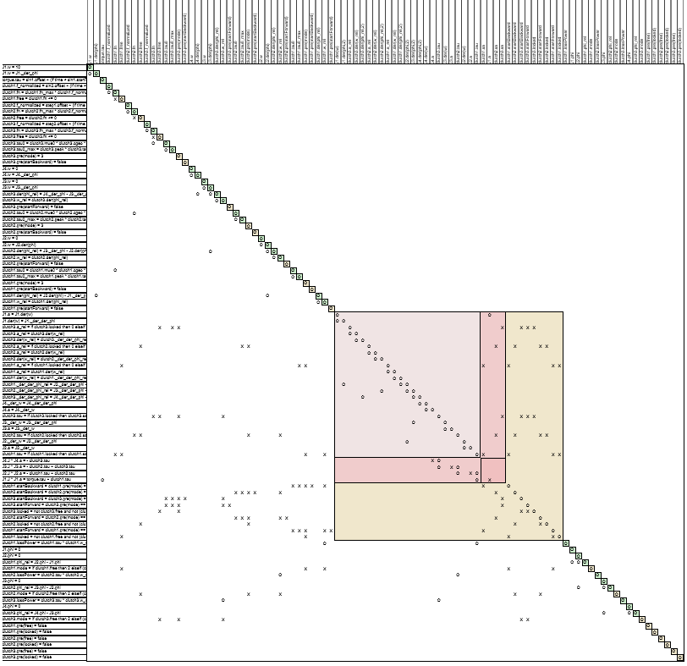
Goal of Tearing
Transform BLT-blocks (algebraic loops) into bordered triangular matrices
Exploit that many equations can be solved analytically – diagonal incidence (L)
Only a small number of residual equation remains (J)
Finding smallest k is NP-complete
Intuition: if tearing variables are known, L-part can be computed analytically in sequence
Tearing
Variables
L_{m ∙ m}
A_{k ∙ m}
Residual
Equations
B_{k ∙ m}
J_{k ∙ k}

Slide 12
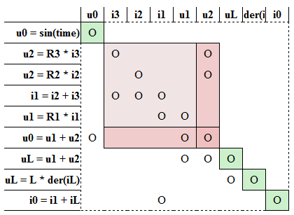
Tearing algorithm
Tearing algorithm computes a small set of residuals and iteration variables
No gurantee for minimal number of iteration variables
Structural analysis
Heuristics exploit information about e.g., start values to make selections
BLT form
Torn BLT form

Slide 13

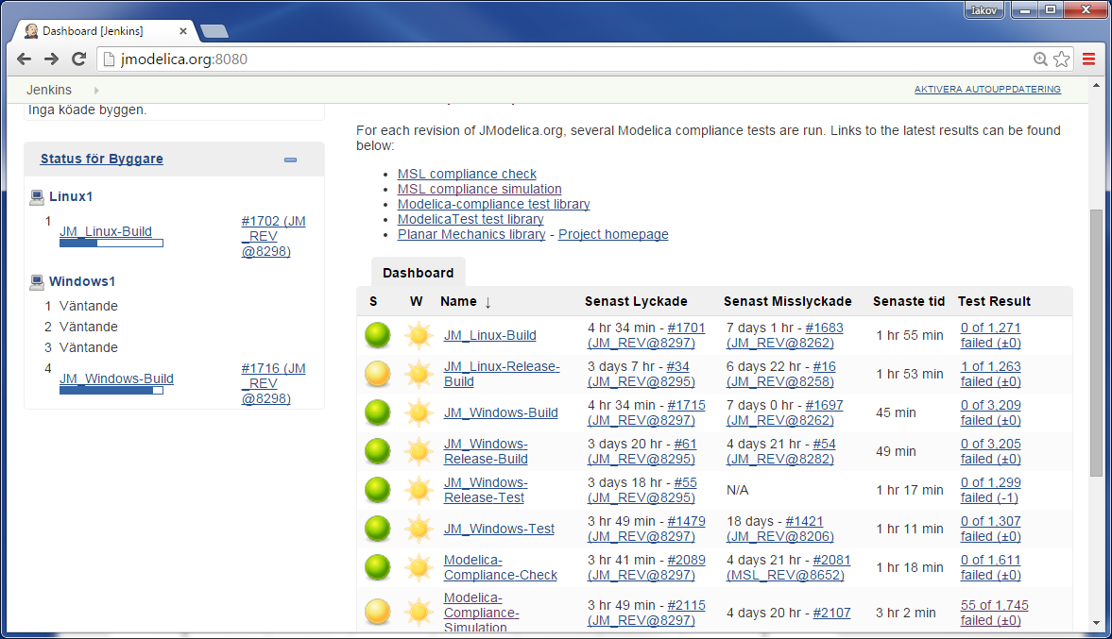

Slide 14
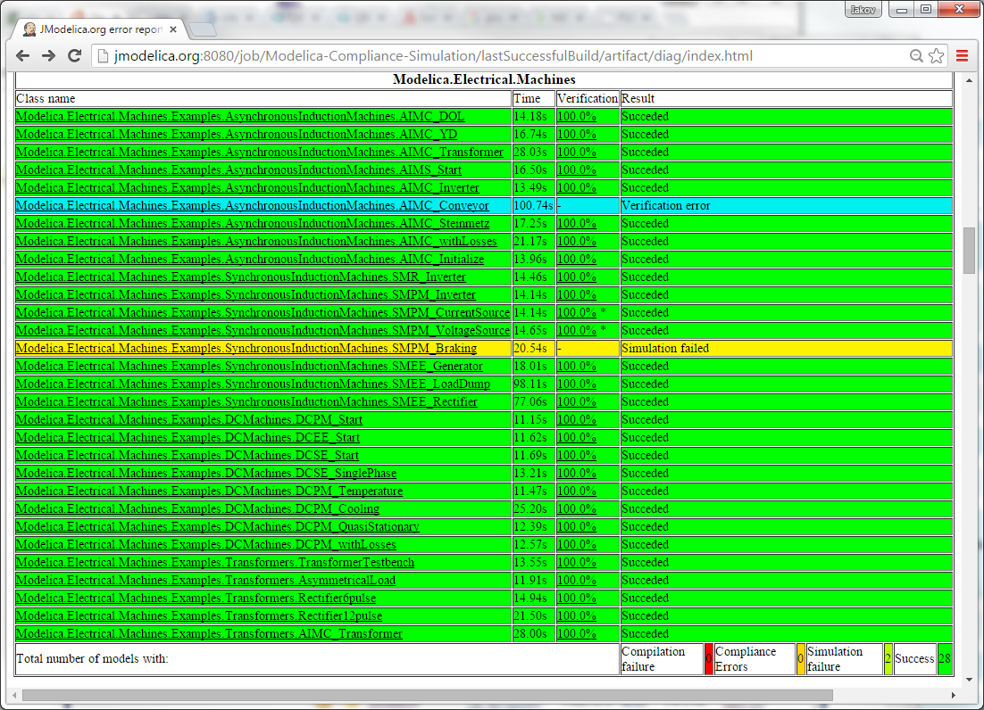

Slide 15
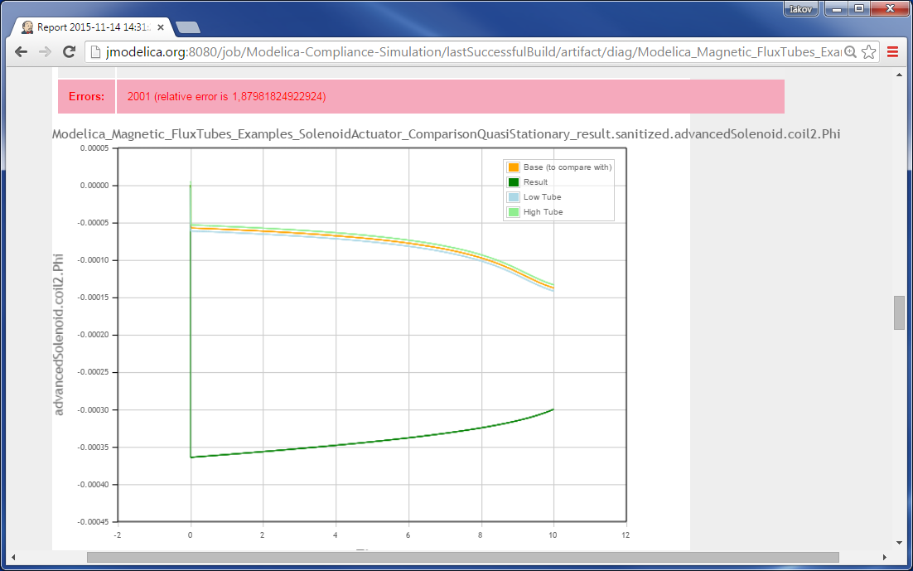
Error?

Slide 16

OPTIMICA Compiler TooLkit
The OPTIMICA Compiler Toolkit unifies simulation and optimization for transient and steady-state computations throughout the design process.
Flexibility and interoperability with user-friendly scripting APIs in MATLAB and Python
Integrates with user toolchain and development processes for application development and deployment
Transient simulation with Modelica and FMI
Industrial grade optimization with third party algorithms
Based on JModelica.org technology
”
[We] are integrating Modelon’s Optimica Compiler into the Simplorer environment, providing our customer base with support for creating and simulating a rich collection of Modelica models that span numerous engineering disciplines and applications
Lee Johnson, ANSYS

