Slide 1

Extracting insights from FOMC Statements
Alexander Ng
Arun Reddy
Henry Otuadinma
Jagdish Chhabria
Date: 05/13/2019

Slide 2
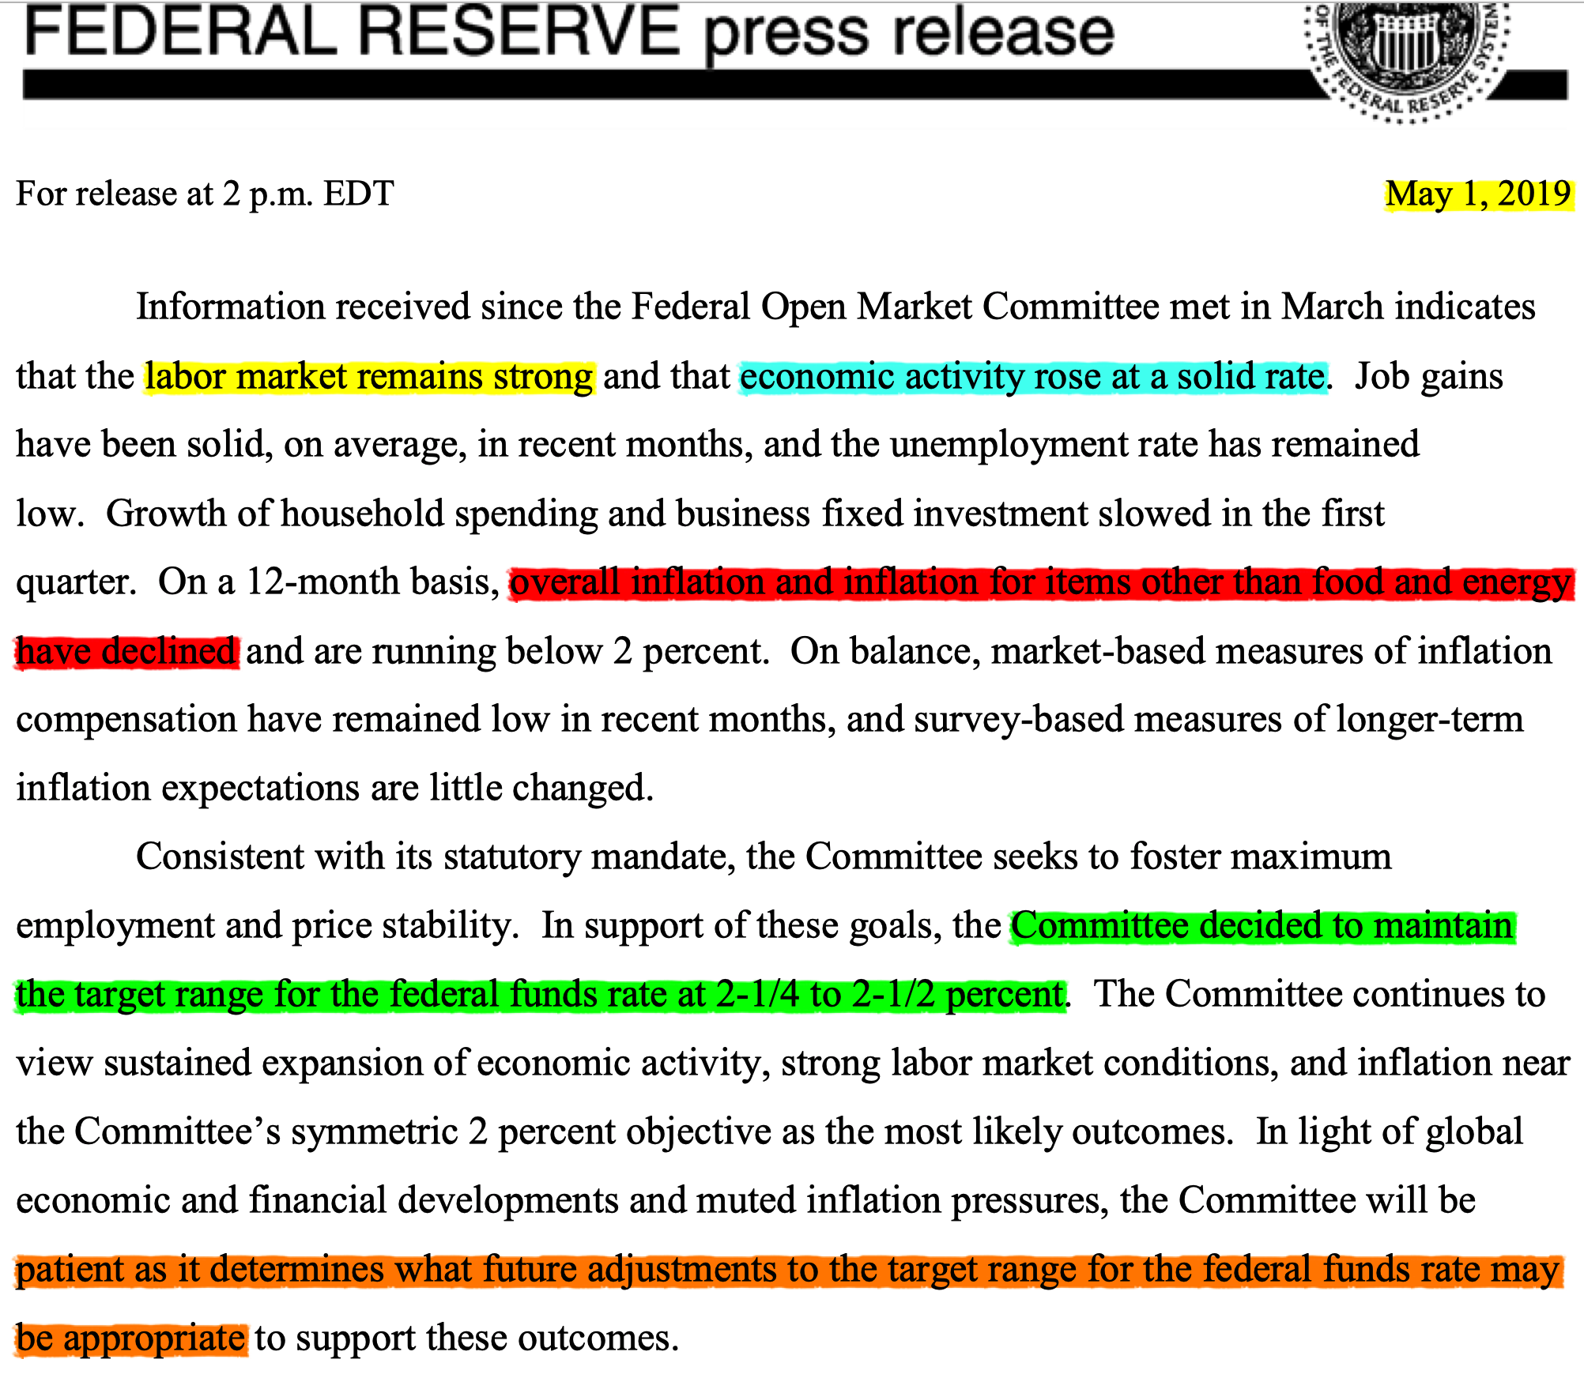
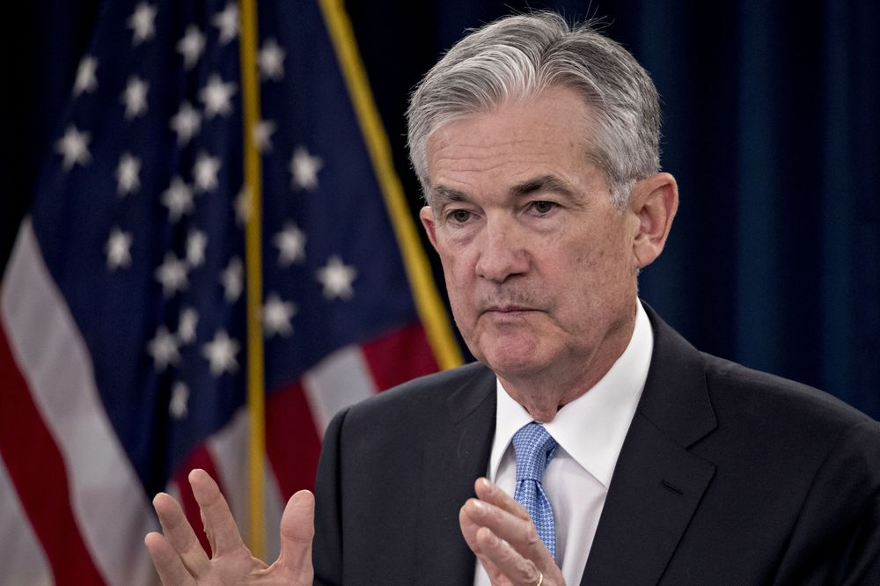
Intro to Fed Speak 101: FOMC Statements
Key Attributes
Economic Growth
Employment
Inflation
Future Rate Outlook
Policy Rate Target
Analyzed
102 Statements 2007-2019

Slide 3
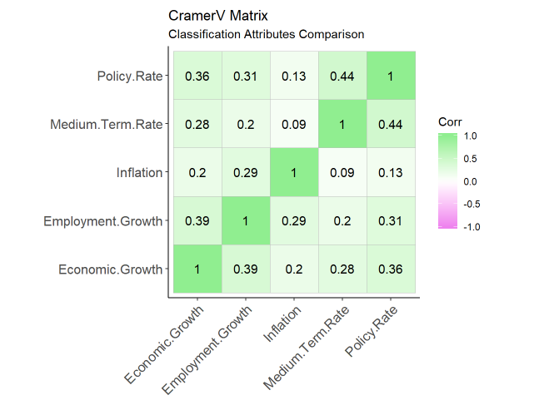
How are the Attributes Related?
Correlation only works for numerical variables.
For categorical variables:
Cramer's V
Range: 0-1
0 means no association
1 mean perfect association

Slide 4
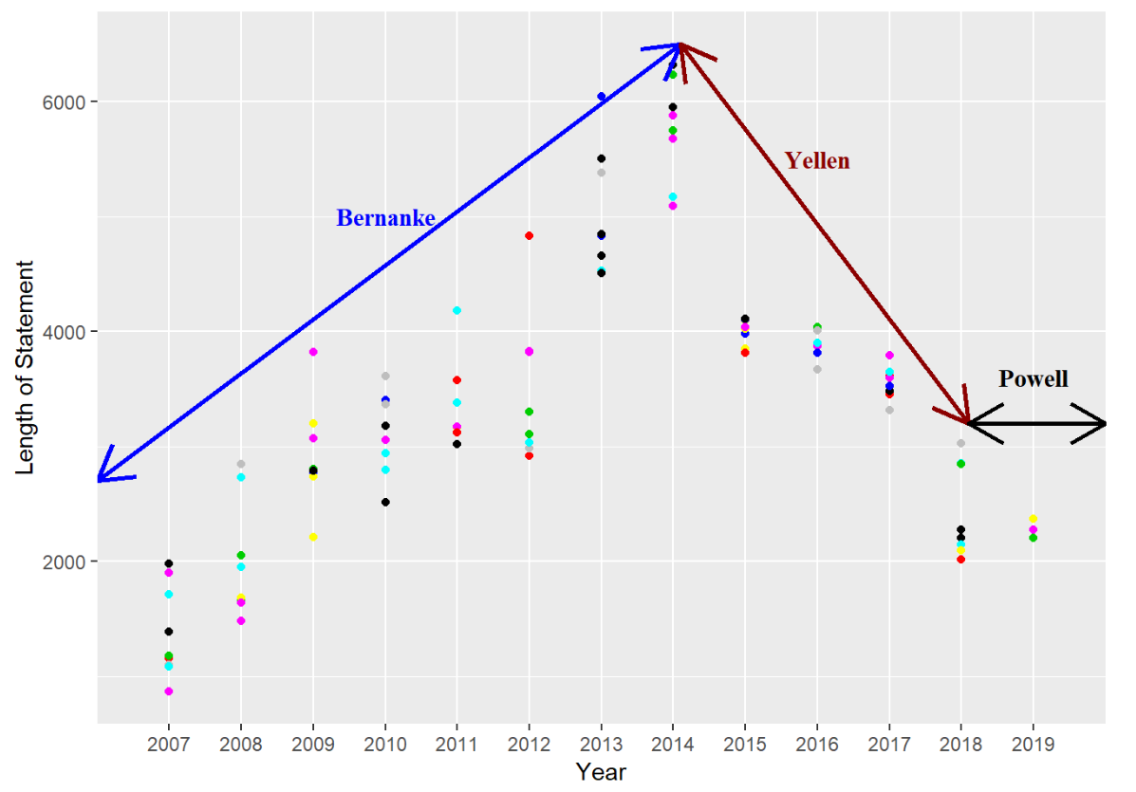
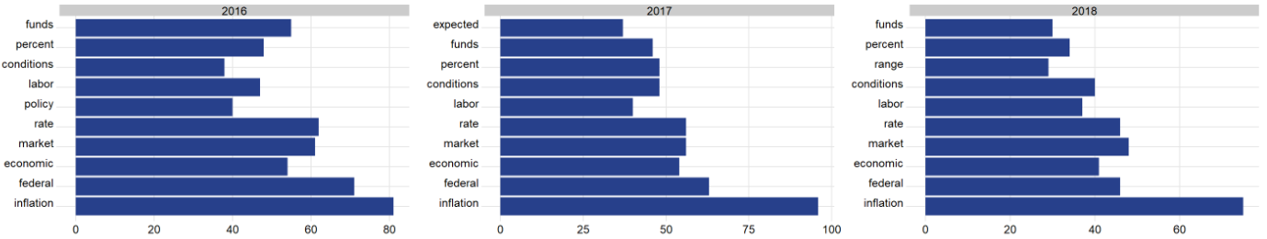
FOMC Statement Length and Most Frequent Words

Slide 5
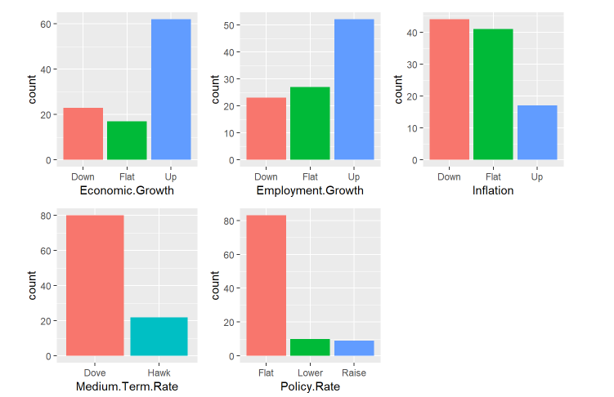
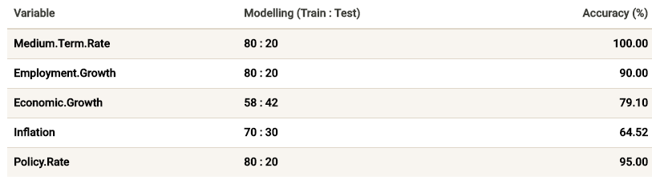
Textual Classifications

Slide 6

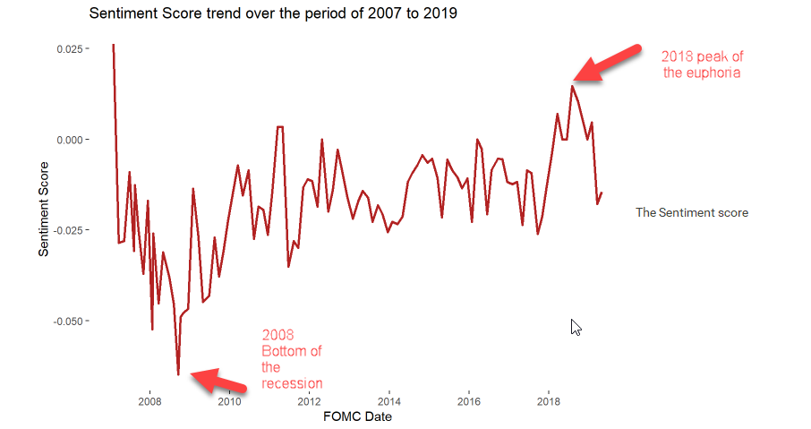
Sentiment Score
Loughran-McDonald Dictionary

Slide 7
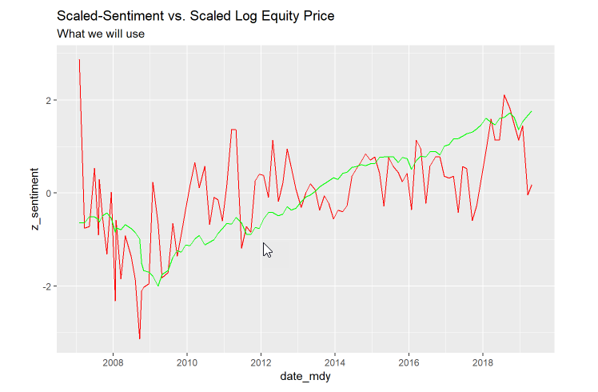
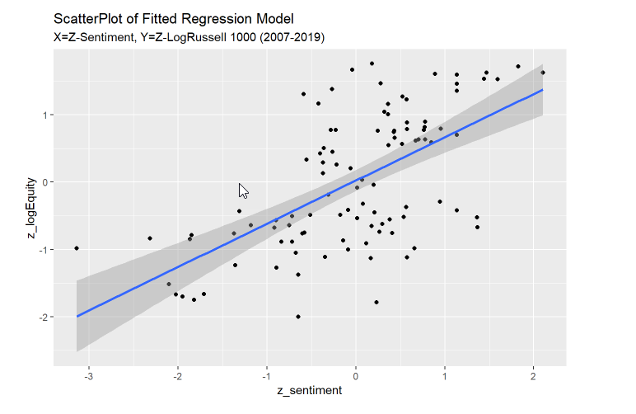
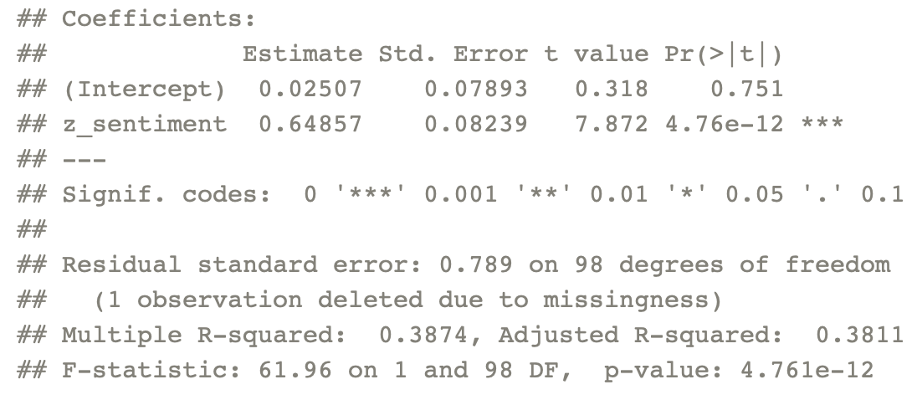
Sentiment and Equity Markets
Level of sentiment is positively related to level of equities during the observation period. Results are very statistical significant.
But sentiment is more volatile than equity market – possibly due to robustness issues.
Regression on returns or lagged variables is next logical step.

Slide 8
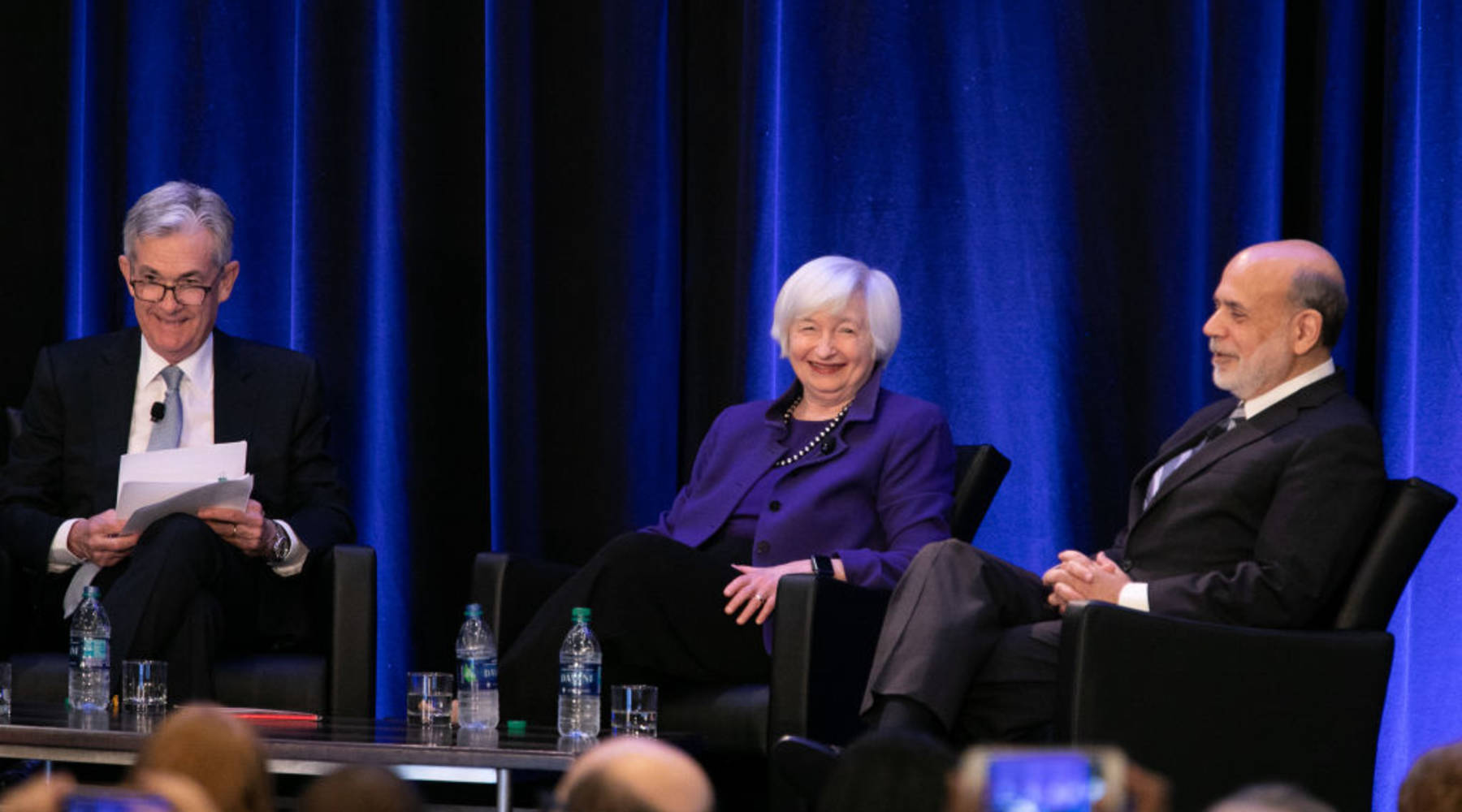
THANKS
Our Paper, Data and Code
http://rpubs.com/jackv13/extracting-insights-from-fomc-statements
https://github.com/completegraph/DATA607FINAL/tree/master/DATA
https://github.com/completegraph/DATA607FINAL/blob/master/Code/Project-Final.Rmd

