Slide 1
X Sushi Bar Location plan

Slide 2
Summary
X Sushi Restaurant, LLC is a standard sushi bar business that will be located in Toronto Ontario Canada. The restaurant will be involved in full-service dining sushi sales, beverage sales and take-out sushi sales et al. There are many large and small sushi restaurants all around Toronto, which is why we spent time and resources to conduct our ‘location searching plan’.

Slide 3
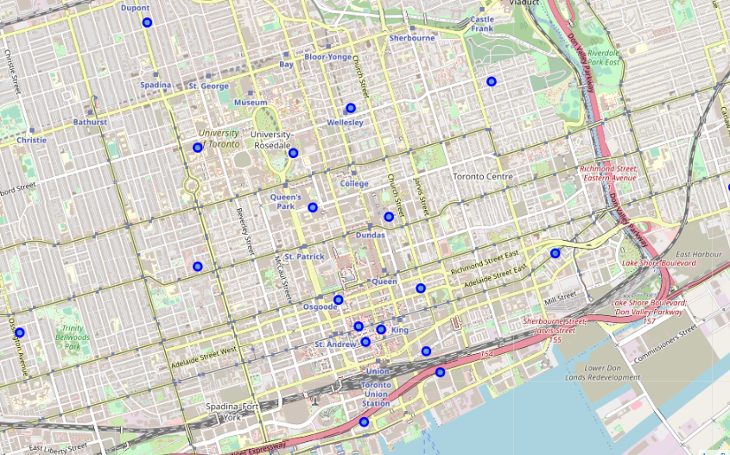
Choice of Neighborhood
A neighborhood with college students
Walking distance from major office buildings
Limited number of competitors nearby
Downtown, near University of Toronto

Slide 4
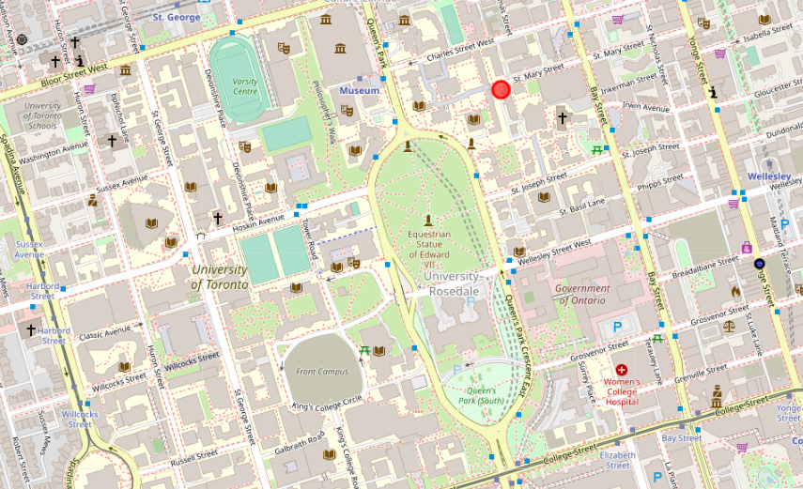
Narrow down the searching area
University residences
Central business district

Slide 5
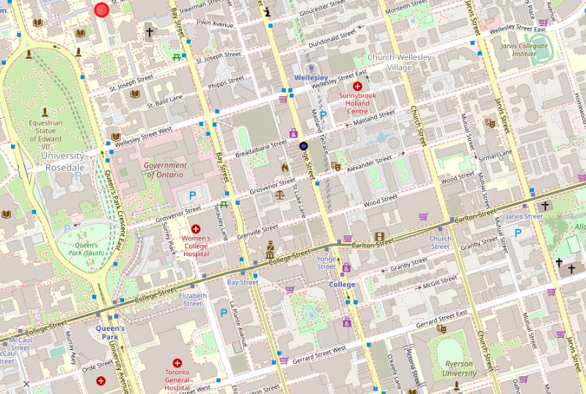
Narrow down the searching area
Another University

Slide 6
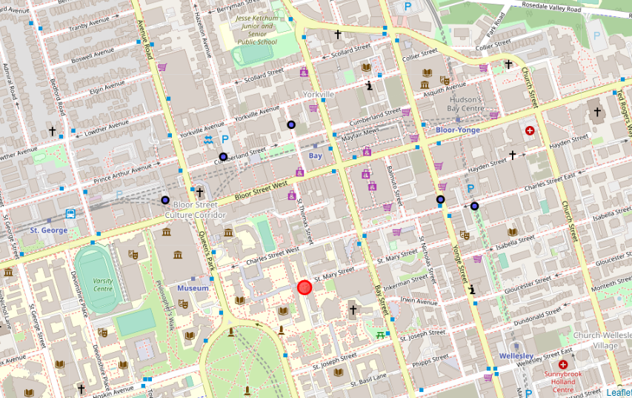
Competitors and final location
5 Japanese restaurants but given the students and offices population, there should be enough demand.
Final location area

