Slide 1
Mixing Limits of the Strange B⁰ Meson
Jamie E. Hegarty
Advised by Phil Gutierrez
Capstone 2005

Slide 2
Mixing Limits: Outline
Background & Motivation
  Standard Model Quarks
  B_{s} Production & Detection
  B_{s} Decay & Mixing
  The B_{s} Mixing Process
Simulating Mixing Events
  Raw Decays and Detector Resolution
  Neutrino Smearing
  Tagging
  Mistagging
Analysis & Calculations
  Fitting to Simulated Data
  Dilution Comparison
  Sensitivity Calculation
Results & Conclusions
  Sensitivity Results
  Conclusions
Ref’s & Ack’s.

Slide 3
Background & Motivation

Slide 4
Standard Model Quarks
Quarks come in 6 flavors, and 3 “flavor doublets”, as do the antiquarks:
Hadrons are composites of 2 or 3 quarks
Mesons are hadrons which contain quark-antiquark (q,qbar) pairs.
The B⁰ meson contains (bbar,d).
The strange B⁰ (B_{s}) contains (bbar,s).
Chg: | Quarks
+2/3 | u | c | t
-1/3 | d | s | b
Chg: | Antiquarks
-2/3 | ubar | cbar | tbar
+1/3 | dbar | sbar | bbar
CHARGE
CONJUGATION

Slide 5
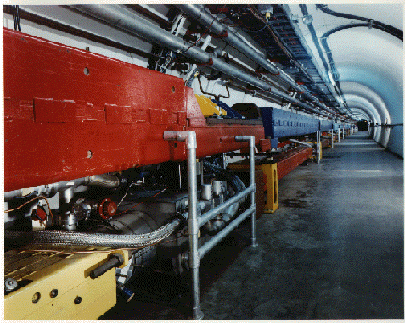
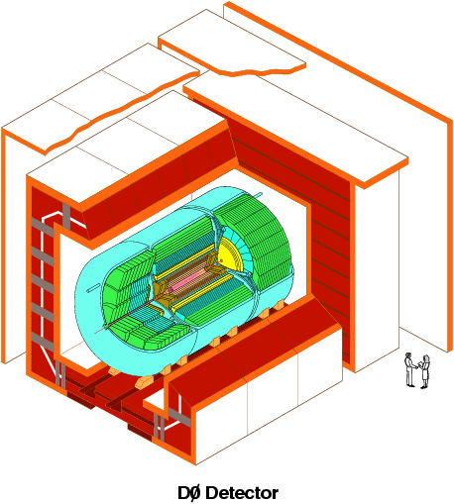
B_{s} Production & Detection
B_{s} currently produced at the Tevatron (Fermilab), detected at DØ.
DØ only detects stable long-lived, charged particles
(e, μ, p, etc.)
B_{s} not detected directly - must be reconstructed from tracks of other particles
TeV is a hadron collider (not designed for B physics), so reconstruction is messy
Images: http://www.fnal.gov

Slide 6
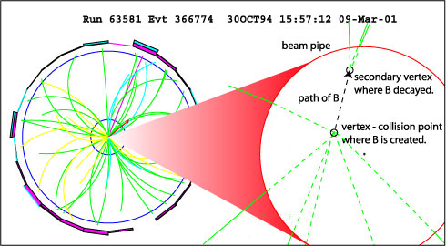
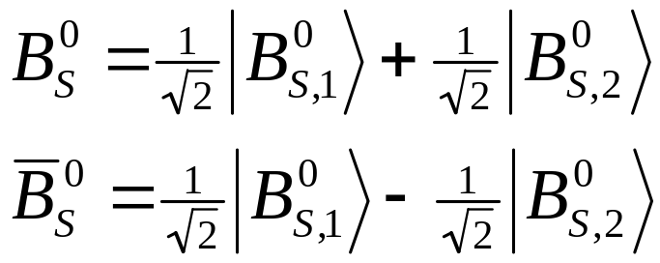
B_{s} Decay & Mixing
B_{s} Decay at DØ
Lifetime of B_{s} must be Reconstructed
inherent error in lifetime measurement
(vertex not always well-defined)
http://www.fnal.gov
B_{s} and B_{s}bar are Neutral
Exist in superposition of 2 mass/CP eigenstates (differ by Δm_{s})
Δm_{s} small (~10 meV … m_{B}~5.3 GeV)
B_{s} may transition to B_{s}bar or v.v. [mixing]
“mixing” may occur before decay
B_{s} Mass Eigenstates

Slide 7
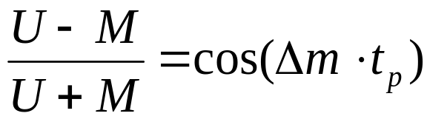
The B_{s} Mixing Process
time
B_{s} transforms into B_{s}bar via exchange of virtual W’s between quarks
Weak, flavor-changing interaction
Dominated by top quark
b
s
(u,c,t)
B_{s}bar
W⁺
W⁻
B_{s}
sbar
(ubar,cbar,tbar)
bbar
Statistical Frequency of Mixing determined by difference in mass.
Measurement of mixing frequency allows measurement of Δm
Goals: 1. Set a Limit on Measurement of Δm
( 2. Measure Δm )

Slide 8
Simulating Mixing Events
“Toy” Monte Carlo Production

Slide 9
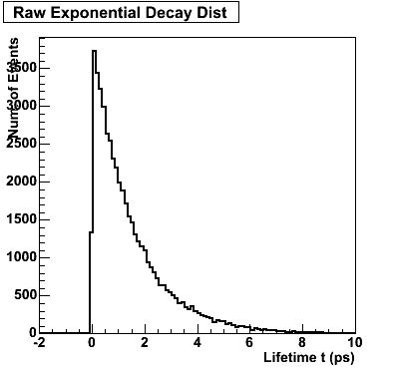
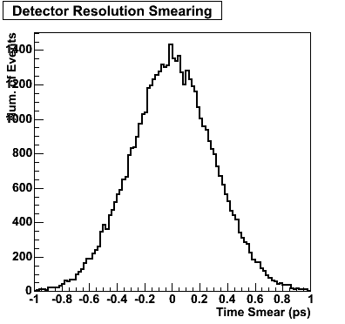
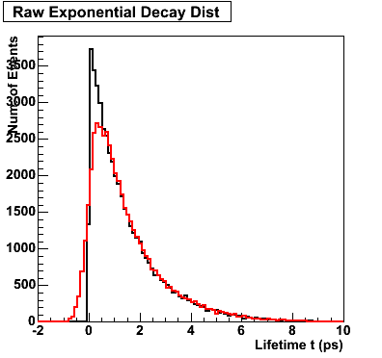
Simulating Mixing Events
Lifetime t_{p} Randomly Selected from Raw Exp. Decay Dist. e^{-t/τ}
  τ is the mean B_{s} lifetime:
  τ =1.5 * 10⁻¹² s
t_{p} is “smeared” to Account for Time-Resolution of the Detector
⇒ Random “smearing” Value Selected from Gaussian (centered at 0, width σ_{t} )… added to t_{p}
Smeared
Lifetime

Slide 10
Simulating Mixing Events
Lifetime t_{p} smeared again to account for (unmeasured) neutrinos in primary decay
  B_{s} → D_{s}⁻ + μ⁺ + ν_{μ}
  Higher momentum (longer t_{p}) B_{s} decay to higher momentum ν_{μ}
  This smearing is lifetime-dependent (σ = t_{p}σ_{n})
Random Value Selected from Gaussian
(cent. at 0, width t_{p}σ_{n}) … added to t_{p}

Slide 11
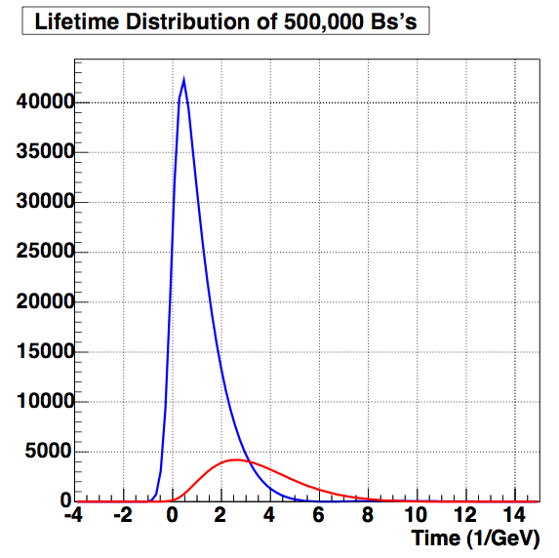
Simulating Mixing Events
Tagging: Separating B_{s} from B_{s}bar
  U(t_{p}) = “Unmixed” (B_{s} or B_{s}bar remained intact)
  M(t_{p}) = “Mixed” (B_{s} became B_{s}bar, or v.v.)
U, M related by:
Random Number Selected from a flat dist. -1 ≤ n ≤ 1
  n < cos (Δm t_{p}) → Unmixed
  n > cos (Δm t_{p}) → Mixed
Time (ps)

Slide 12
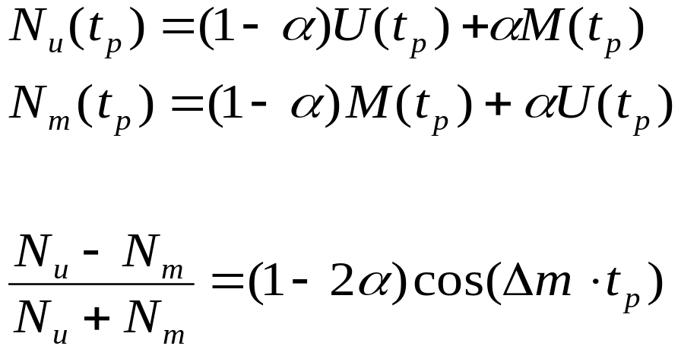
Simulating Mixing Events
Mistagging: Tagging B_{s} as B_{s}bar or v.v.
With mistag rate α :
Mistagging affects only the amplitude of the cosine.
(1-2α) is called “Dilution”

Slide 13
Analysis & Calculations
Determining Sensitivity of a Dilution Measurement to Changes in Other Parameters

Slide 14
Fitting to the Simulated Data
A long, complicated function f(t) was used
  5 parameters (!): tag, σ_{t-fit}, Δm_{fit}, τ_{fit}, α_{fit}
Unbinned Likelihood Amplitude Fitting:
  [unbinned] MC lifetime data compared event-by-event (rather than being histogrammed first)
  [likelihood] Each value of t_{p} in the MC compared to distribution f(t_{p}) to determine likelihood that t_{p} was selected from f(t)
  [amplitude] All parameters except α_{fit} held fixed during the fit
    ⇒ only fit for Dilution (D=1-2α)

Slide 15
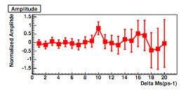
Analysis: Dilution Comparison
Each fit done ~20 times, varying Δm_{fit} each time.
Resulting Values of
D_{fit}=(1-2α_{fit}) divided by D_{MC} (dilution in the MC), then plotted against Δm_{fit}
D_{fit}/D_{MC} peaks to 1 when Δm_{fit} = Δm_{MC}
Errors in D_{fit} greater for larger Δm_{fit}
W A R N I N G !
⬇
If error in D_{fit} ≥ 1, true Δm cannot be determined!
!

Slide 16
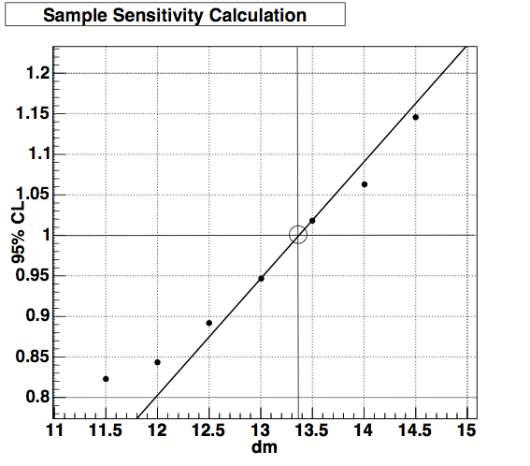
Sensitivity Calculation
Goal: Find Δm_{fit} for which error in D_{fit} is ≥ 1 … regardless of true Δm
Δm_{MC} set very high (>1eV, or 1000 ps⁻¹) so no peak occurs
Error in D_{fit}/D_{MC} plot vs. Δm_{fit}
Δm_{fit} where error = 1: Sensitivity of D to these MC/fit conditions
Correct D (and Δm) would only be measurable below the Sensitivity value.
Dmfit
Error in D_{fit}/D_{MC}
Δm_{fit} (ps ⁻¹)

Slide 17
Results & Conclusions

Slide 18
Sensitivity Results
Sensitivity Calculated for:
  ± 20% variation in σ_{t} (detector time resolution)
  ± 20% variation in D (dilution)
  No neutrino smearing used here (σ_{n} = 0)
  Fit values for D are “initial” values
Sens of D to ±20% var. in σ_{t} (ps⁻¹)
Fit/MC | 0.08 | 0.10 | 0.12
0.08 | 22.07 | 23.56 | -
0.10 | 17.66 | 17.74 | 17.88
0.12 | - | 15.74 | 15.00
Sens of D to ±20% var. in D (ps⁻¹)
Fit/MC | 0.128 | 0.160 | 0.192
0.128 | 16.35 | 16.35 | -
0.160 | 17.75 | 17.74 | 17.75
0.192 | - | 18.90 | 18.91
(4000 events)

Slide 19
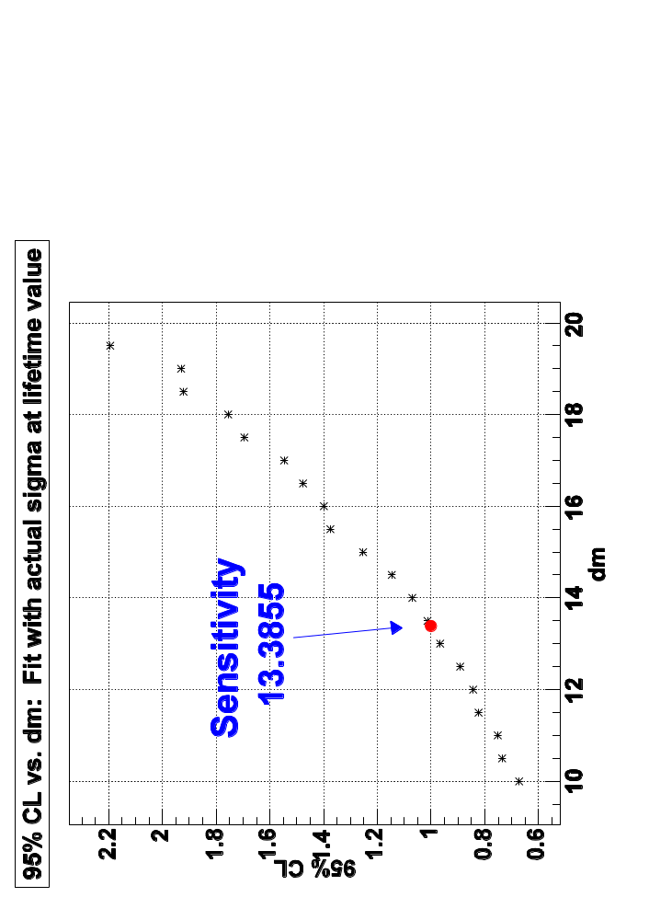
Sensitivity Results
Sensitivity Calculated for:
  ± 20% variation in σ_{n}
  (time-dependent resolution)
  σ_{n} couldn’t be explicity included in fitting
  σ_{n} ignored:
  included in MC but not in fit
  Avg:
  MC values binned, bin-weighted average σ used
  in fit
  Eff σ at t:
  actual smearing value calc’d at each t during fit
Sens of D to ±20% var. in σ_{n} (ps⁻¹)
Fit/MC | 0.130 | 0.163 | 0.196
σ_{n} ignored | 17.799 | 17.783 | 17.808
Avg (σ_{n,} σ_{t}) | 6.473 | 5.840 | 5.162
Eff σ at t | - | 13.386 | -

Slide 20
Conclusions
Goals: 1. Set a Limit on Measurement of Δm
( 2. Measure Δm )
So Far:
  Most realistic sensitivity value: 13.386
    … We can measure Δm if it’s below this …
Up Next:
  Add background noise
  Repeat all this with Full DØ-MC
  Check sensitivity values with another method
  Find a way to include σ_{n} in the fit function?
  Measure Δm!!!
b
(u,c,t)
s
B_{s}bar
W⁺
W⁻
B_{s}
sbar
(ubar,cbar,tbar)
bbar

Slide 21
References & Acknowledgements
References
  Anikeev et. Al, “B Physics at the Tevatron: Run II and Beyond”, FERMILAB-Pub-01/197, December 2001
  Perkins, Donald H., Introduction to High Energy Physics, 4th ed., Cambridge UP, 2000
  “CP Violation in B Meson Decay: FAQ”, http://www.physics.uc.edu/~kayk/cpviol/CP_A0.html, 09/30/04
  Griffiths, David, Introduction to Elementary Particles
Acknowledgements
  Phil Gutierrez (advisor)
  Peter Williams (theory guru)
Images:
  B-event: http://quarknet.fnal.gov/run2/b_lifetime2.shtml
  DØ cutaway: http://www-d0.fnal.gov/public/detector/picures.html

