Slide 1
Mixing Limits of the Strange B⁰ Meson
Jamie E. Hegarty
  Advised by Dr. Phil Gutierrez
    Capstone Oct.01.’04

Slide 2
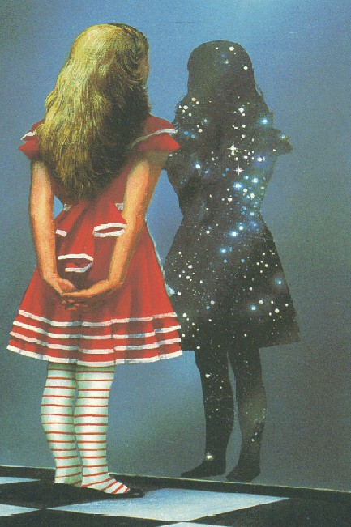
Outline
Background & Motivation
  The Standard Model
  Why study the B_{s}?
B_{s} Mixing
  B_{s} Mixing Process & W± coupling
  Cabibbo-Kobayashi-Makasa Matrix
  Mass & Flavor Eigenstates
  Mixing and the Lifetime Distribution
  B_{s} Mixing Limits
Conclusion
References & Acknowledgements

Slide 3
Standard Model Quarks
Quarks come in 6 flavors, and 3 “flavor doublets”, as do their antiquarks:
Hadrons are composites of 2 or 3 quarks - and no more (according to QCD)!
Mesons are hadrons which contain quark-antiquark (q,qbar) pairs.
The B⁰ meson contains (b,dbar).
The strange B⁰ (B_{s}) contains (b,sbar).
Chg: | Quarks
+2/3 | u | c | t
-1/3 | d | s | b
Chg: | Antiquarks
-2/3 | ubar | cbar | tbar
+1/3 | dbar | sbar | bbar
CHARGE
CONJUGATION

Slide 4
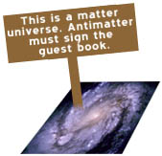
Why Study the B_{s}?
B and K mesons decay via W±, and sometimes in a way that violates CP.
Understanding CP-violation may give insight to Matter-Antimatter Asymmetry in the Universe
C = Charge Conjugation
P = Parity
T = Time Reversal
http://www.particleadventure.org/

Slide 5
The B_{s} Mixing Process
b
s
(u,c,t)
B_{s}
B_{s}bar
W⁺
W⁻
sbar
(ubar,cbar,tbar)
bbar
B_{s} transforms into B_{s}bar via an exchange of virtual W’s between its consituent quarks
Weak, flavor-changing interaction
Dominated by top quark

Slide 6
B_{s} Mixing: W± coupling
t
s
The weak interaction (W±) mediates between flavor doublets.
The coupling strength at each node depends on the coupling “constant” α_{W} and the quarks involved
The stronger the coupling, the more likely the process is to occur
α_{W}V_{ts}
W⁻
Chg: | Quarks
+2/3 | u | c | t
-1/3 | d | s | b

Slide 7
The CKM Matrix
The V_{qq}’s make up the Cabibbo-Kobayashi-Maskawa (CKM) Matrix
The CKM Matrix …
  Tells everything about weak interactions
  Is Unitary (V*V = 1)
  Contains a CP-Violation term
  All terms must be known to test the Standard Model
Frequency of B_{s}-mixing proportional to V_{ts}

Slide 8
B_{s} Mass and Flavor Eigenstates
The B_{s} and B_{s}bar each exist in a superposition of 2 mass eigenstates
Since the signs are different, there is a difference in the mass between B_{s} and B_{s}bar (∆m)
Mass difference is small enough for “mixing”

Slide 9
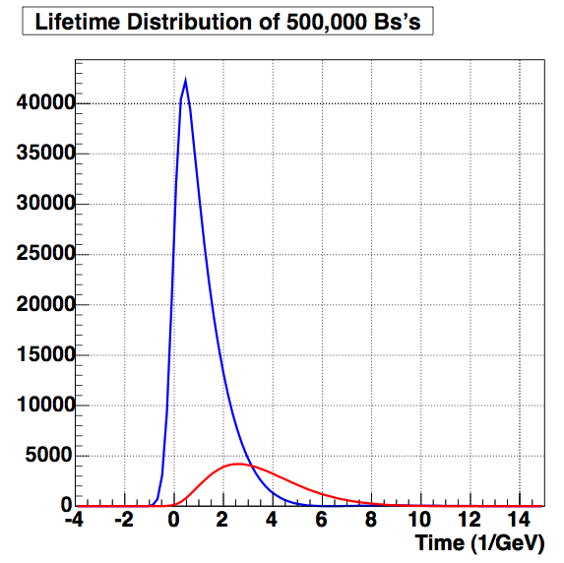
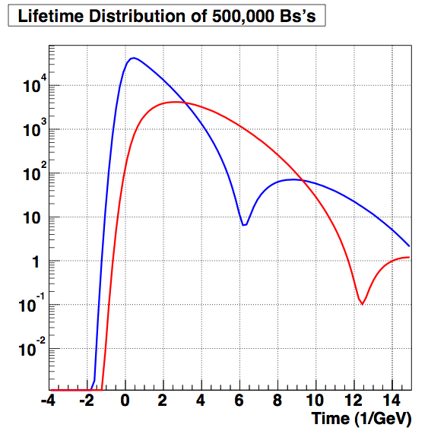
B_{s} Mixing and Lifetime
B_{s} and B_{s}bar have very similar lifetimes
If mixing occurs, some B_{s}’s will become B_{s}bars before they decay
Mixing exposes itself as an oscillation in the B_{s} lifetime curve.
Oscillation frequency ƒ proportional to 2∆m and to V_{ts}
Total lifetime remains essentially unaffected.

Slide 10
B_{s} Mixing Limits
In reality, there are limits to measurement:
  Gaussian Smearing due to time/dist resolution limit
  “Mistagging” also a problem (confusing a B_{s} with a B_{s}bar)
  Time-Dependent smearing due to neutrinos
  Background noise (decay from other processes -- very significant in hadron colliders!)
Capstone Goal: Determine the effect of each of these on measurement of V_{ts} and ∆m.
  (and maybe, measure them!)

Slide 11
Finding B_{s} Mixing Limits
Run “Toy” Monte Carlo Simulations
Vary the detector parameters, as well as expected measurements
Fit lifetime distribution to a mixing function
Determine whether/how detector parameters affect perceived ∆m
Determine whether/how ∆m affects perceived detector parameters
Repeat with background noise in the simulation
Repeat with full (actual, latest) detector physics in the simulation
Repeat with data?

Slide 12
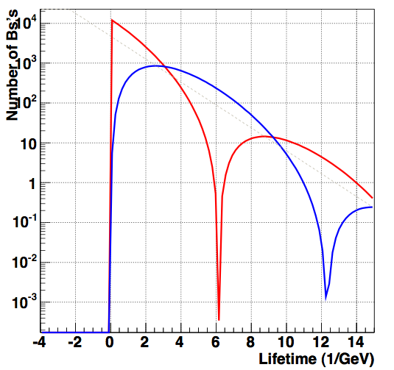
Conclusion
b
(u,c,t)
s
B_{s}-mixing measurement:
  Studies CP-Violation in the quark sector
  Gives V_{ts} …
    (test Standard Model)
  Gives ∆m …
    (Matter, Anti-matter asymmetry)
  Sensitive to new physics
Goal: Determine mixing limits
B_{s}
W⁺
W⁻
B_{s}bar
(ubar,cbar,tbar)
sbar
bbar
t
s
α_{W}V_{ts}
W⁻

Slide 13
References & Acknowledgements
References
  Anikeev et. Al, “B Physics at the Tevatron: Run II and Beyond”, FERMILAB-Pub-01/197, December 2001
  Perkins, Donald H., Introduction to High Energy Physics, 4th ed., Cambridge UP, 2000
  “CP Violation in B Meson Decay: FAQ”, http://www.physics.uc.edu/~kayk/cpviol/CP_A0.html, 09/30/04
Acknowledgements
  Phil Gutierrez (advisor)
  Peter Williams (theory guru)
  Horst Severini (moral support)

