Slide 1
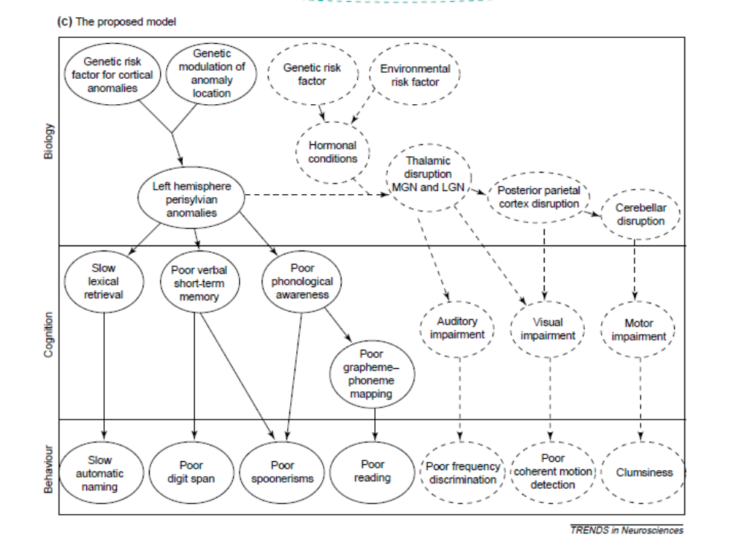

Slide 2
Genetic risk factors
Environmental risk factors
Endocrine anomalies
Biology
Cortical anomalies
Thalamic anomalies
Cerebellar anomalies
Poor phonological awareness
Auditory impairment
Visual impairment
Cognition
Poor phoneme representations
Motor impairment
Attention impairment
Poor phoneme to grapheme mappings
Slow lexical retrieval
Memory impairment
Poor reading
Impaired speech perception
Poor performance on psychophysical tasks
Behaviour
Poor performance on phonological tasks
Slow automatic naming
Poor motor skills

Slide 3
Interaction dominant dynamics
Component dominant dynamics
τ_{a}
τ_{b}
τ_{c}
τ_{d}
A
B
C
Behaviour emerges from interaction between many processes on different timescales in body and environment
Behaviour is the result of a linear arrangement of cognitive components and processes
Place of measurement
Environment
Environmental risk factors, poor reading, poor digit span, poor phonological skills, slow automatic naming, poor performance in psychophysical and motor tasks, poor attention
Body
Genetic anomalies, endocrine anomalies
CNS
Cortical anomalies, thalamic anomalies, cerebellar anomalies, functional brain anomalies
Cognitive components and processes

Slide 4
Interaction dominant dynamics
Component dominant dynamics
τ_{a}
τ_{b}
τ_{c}
τ_{d}
A
B
C
Behaviour emerges from interaction between many processes on different timescales in body and environment
Behaviour is the result of a linear arrangement of cognitive components and processes
Place of measurement
Environment
Overt behavior, Performance measures, Interaction, Joint action
Body
Electromagnetic and biochemical signals (muscle tension, hormone levels, etc.), Immune system, Endocrine system
CNS
Central Nervous system, Brain structure & function, Cerebellum, Glial cells
Cognitive components and processes

