Slide 1
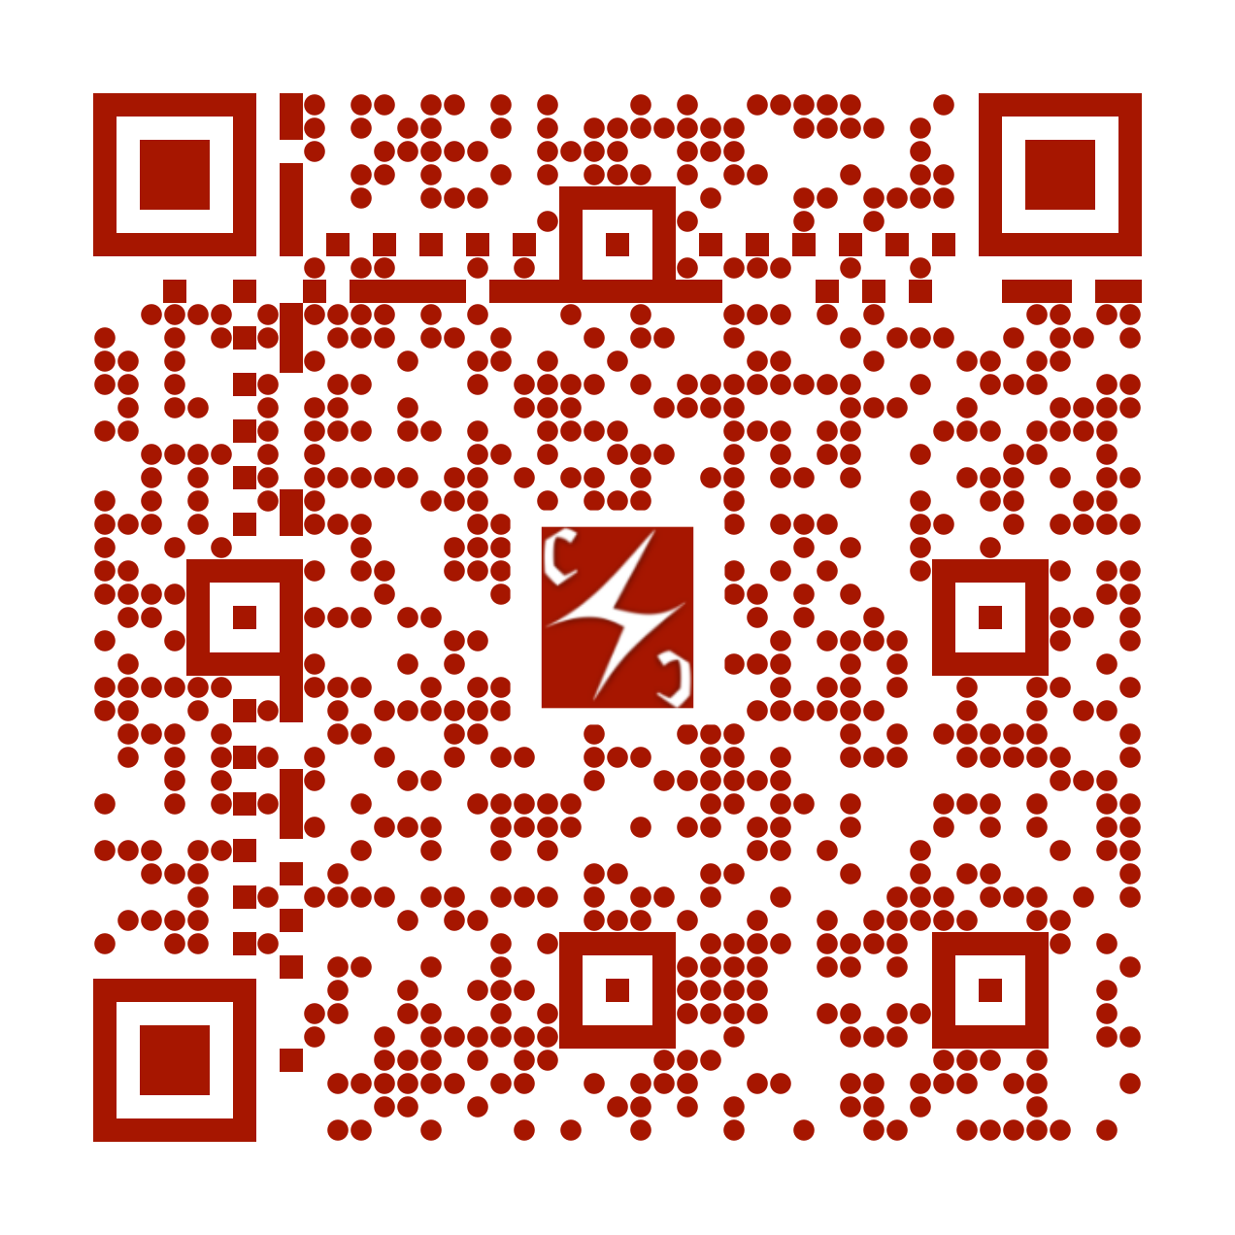





01 / 16
SIGGRAPH ASIA 2026 / TECHNICAL COMMUNICATIONS
Gaussian Image Steganography
via Parameter-Domain Keyed Embeddings
“Hide information in Gaussian parameters — not pixels”
Tong Wu¹ · Runze Cheng²,³ · Xiaoyue Fan³ · Kaan Akşit³
¹ East China University of Science and Technology
² University of Cambridge ³ University College London
1–4 December 2026
PROJECT PAGE

Slide 2

INTRODUCTION
02 / 16
What is steganography?
Steganography hides a message in a carrier while aiming to conceal its presence.
Cover image
Stego image
Similar appearance
Embed
1011 0010
Message
Extract
Recovered message
Uses: covert communication, watermarking, and hidden identifiers.
1011 0010

Slide 3
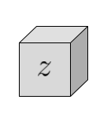
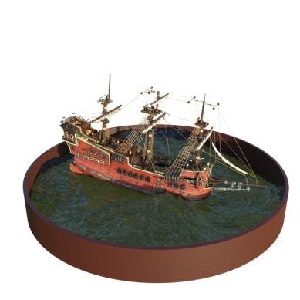
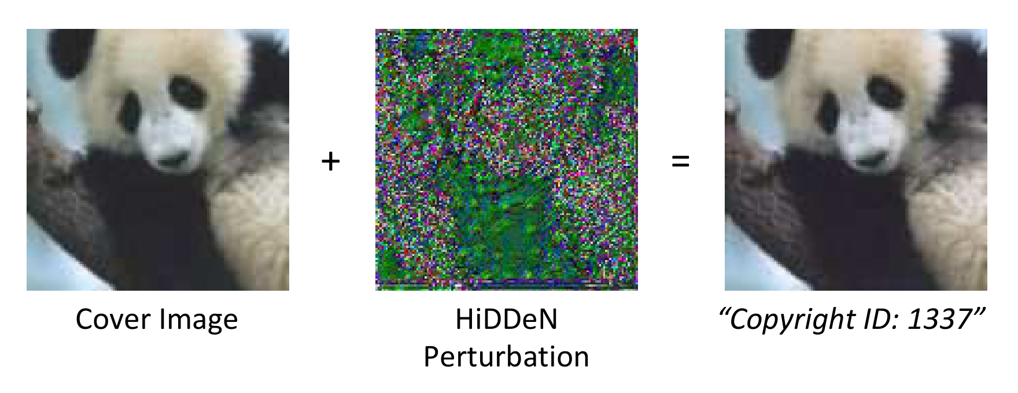
RELATED WORK
03 / 16
Where can hidden information live?
Image pixels
Learned latent
representations
3D Gaussian
representations
HiDDeN
RoSteALS
GaussianMarker / 3D-GSW
Small changes to image pixels carry the message.
The message is added to an autoencoder’s latent code.
GaussianMarker reads parameters and renders.
3D-GSW reads rendered views.
HiDDeN, ECCV 2018 · RoSteALS, CVPRW 2023 · GaussianMarker, NeurIPS 2024 · 3D-GSW, CVPR 2025.

Slide 4
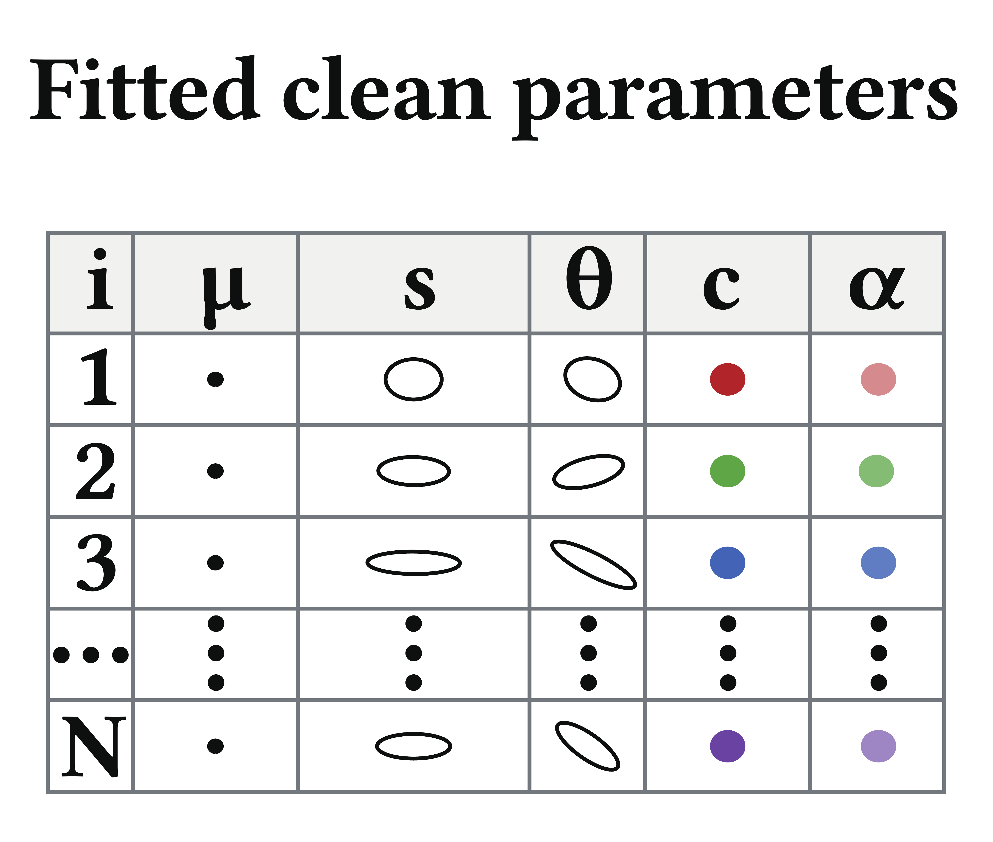
OUR SETTING
04 / 16
One image represented by 2D Gaussian parameters
One image, represented by
a set of 2D Gaussians
Position (μ) · Shape (s)
Orientation (θ) · Color (c)
Opacity (α)
Can selected parameter changes
carry a hidden message?
Keep the rendered image close to the clean fit.
Each row describes one Gaussian.

Slide 5
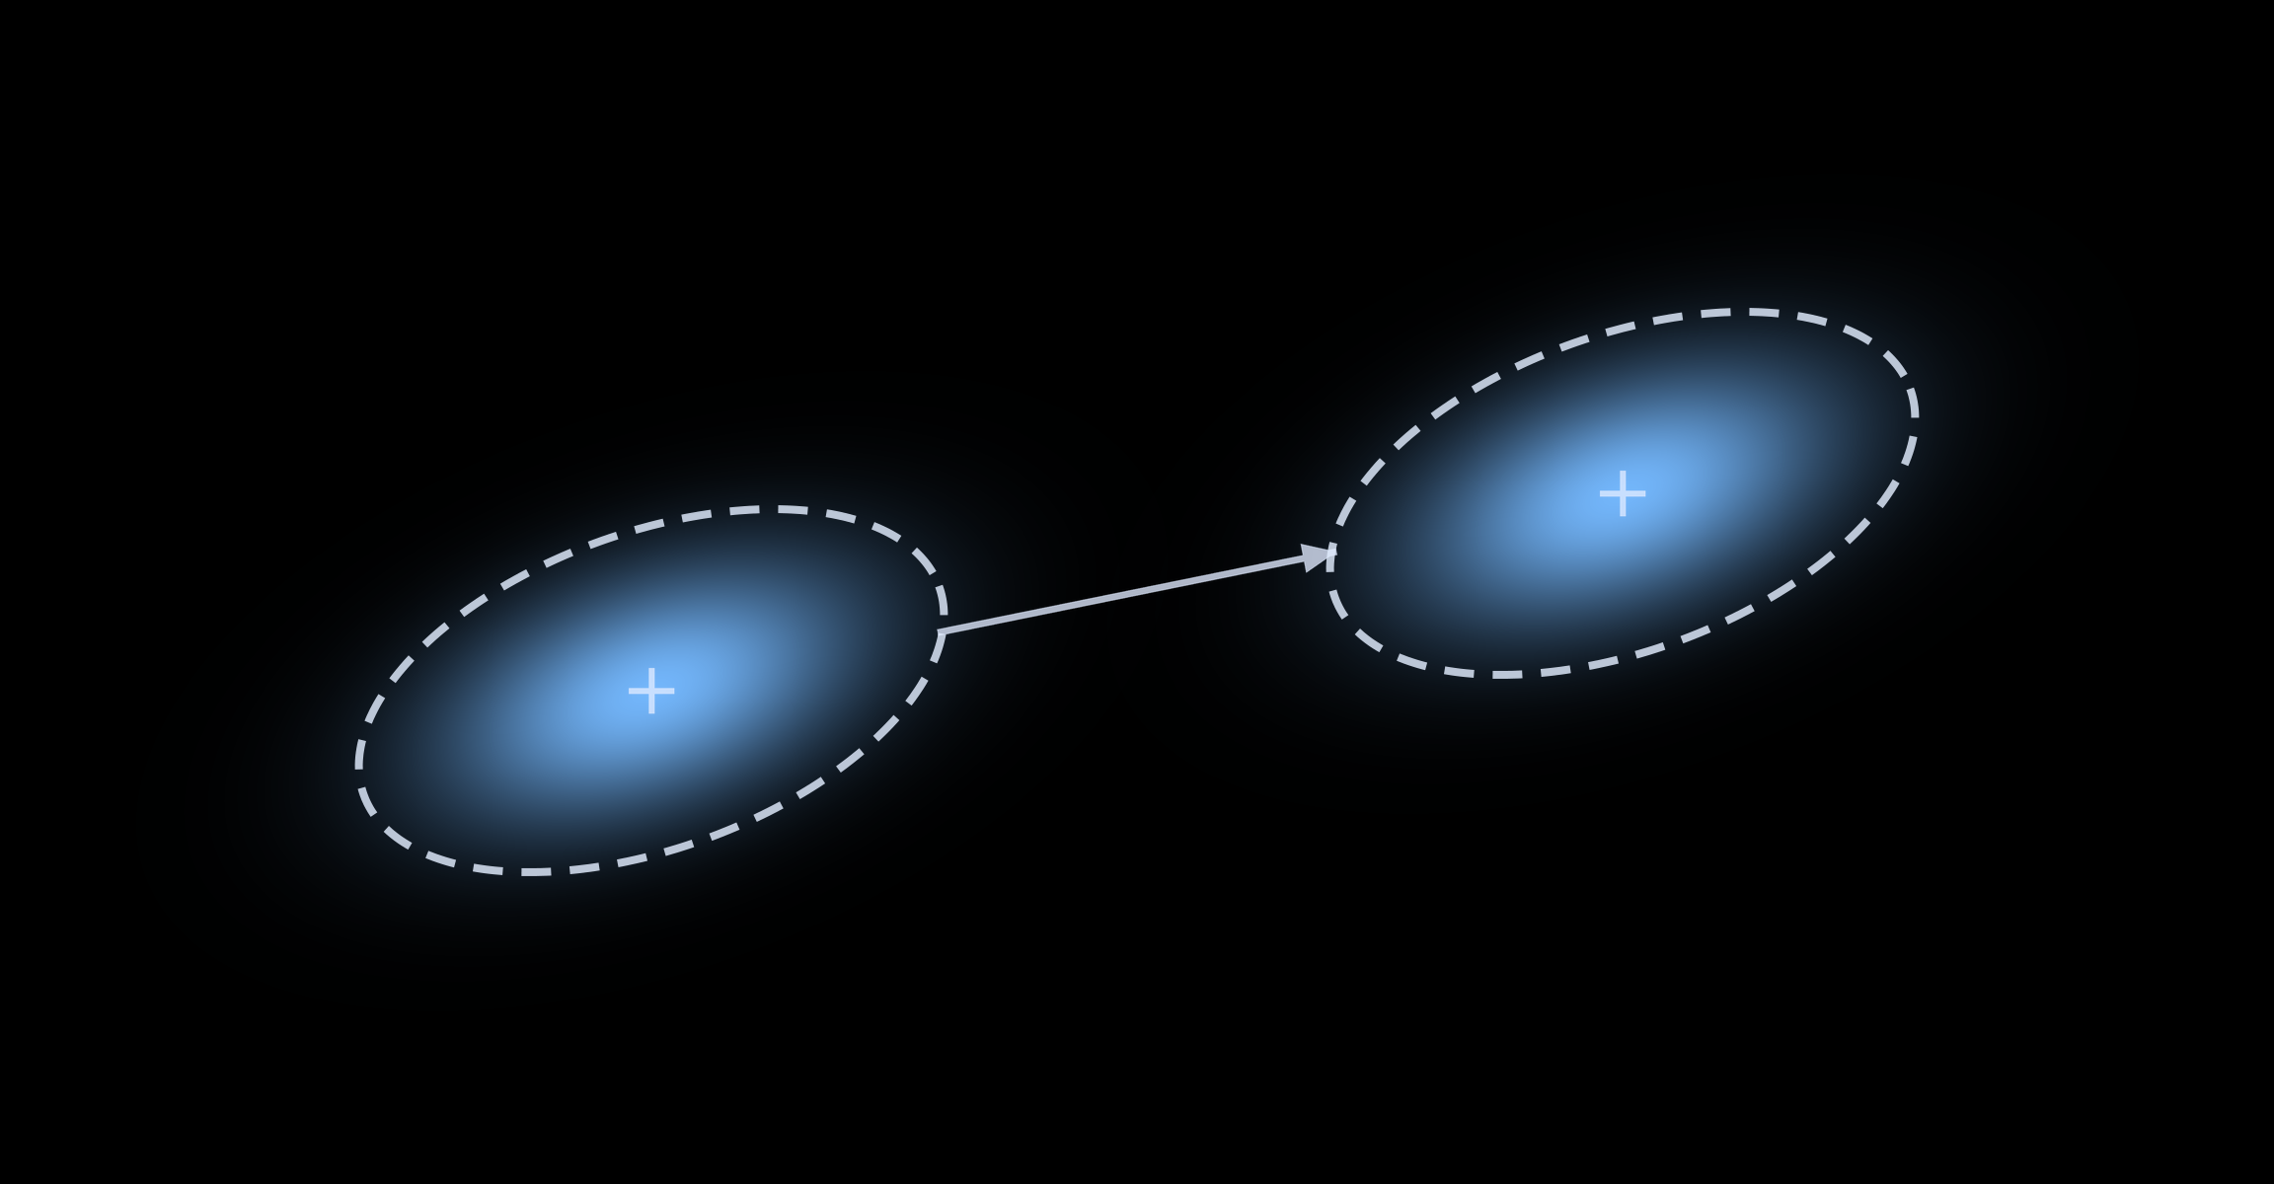
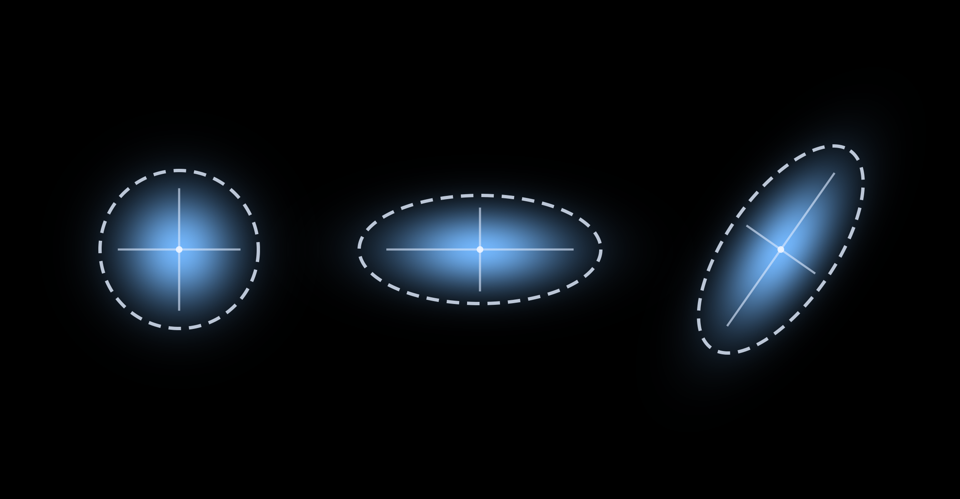
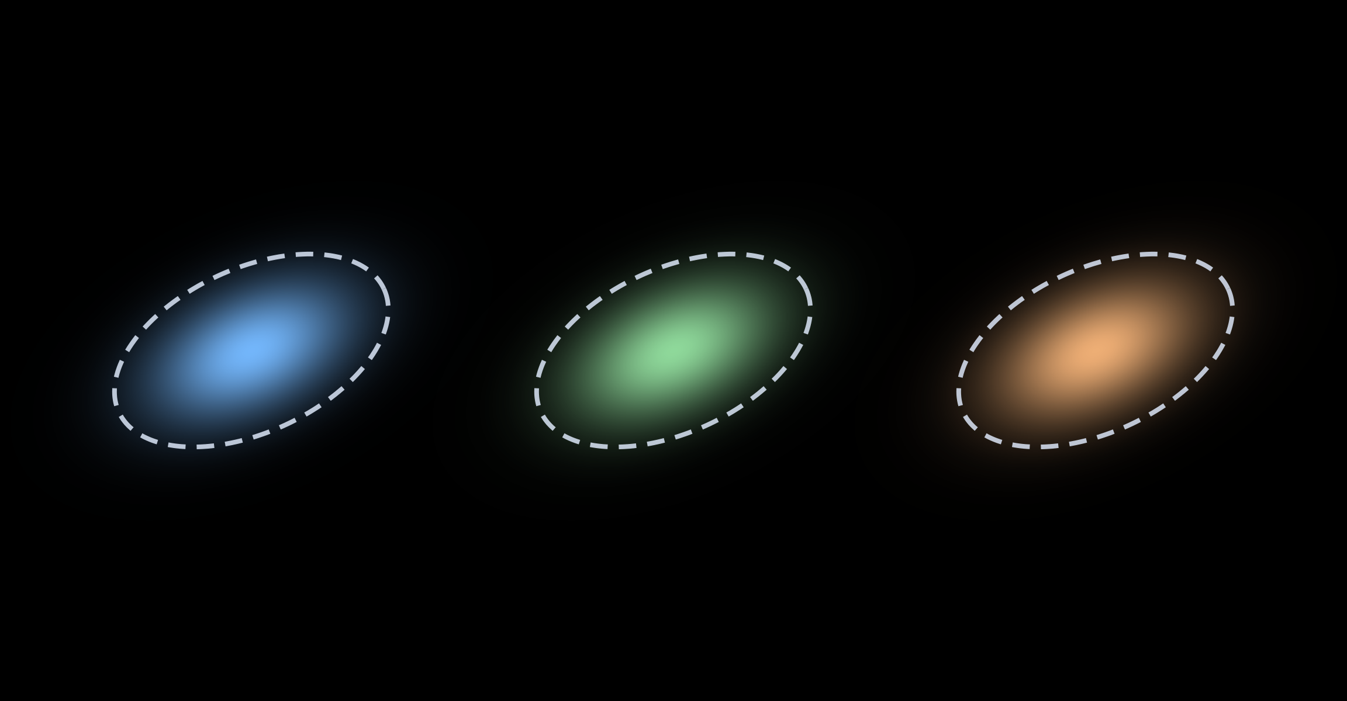

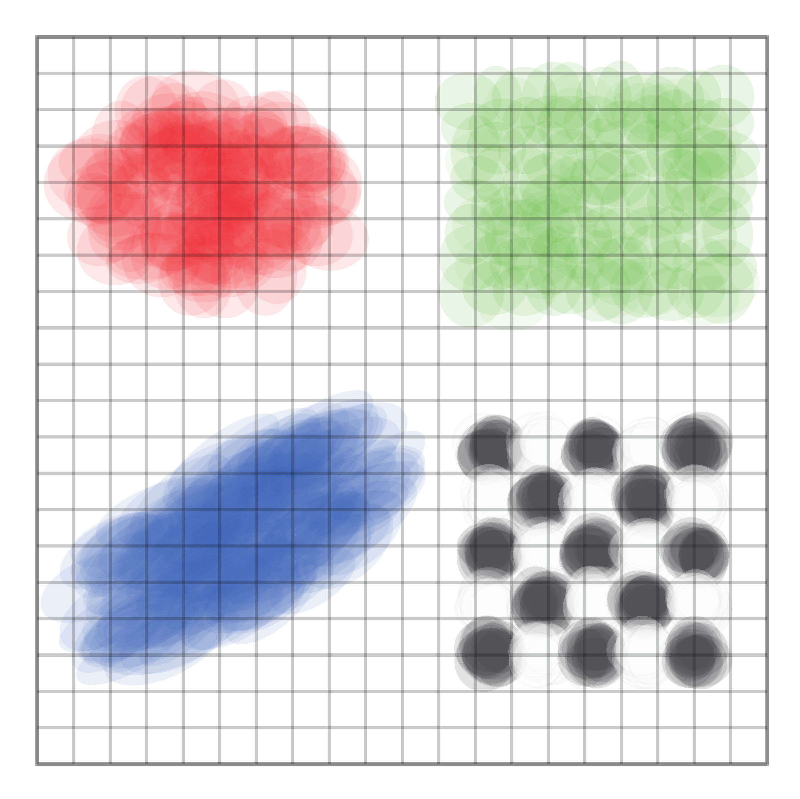
GAUSSIAN REPRESENTATION
05 / 16
An image can be represented by 2D Gaussians
Position
Shape and orientation
Color
Opacity
Overlapping soft, colored primitives form an image.
We send the Gaussian parameters to the receiver, who can use them to render the image.

Slide 6


GAUSSIAN REPRESENTATION
06 / 16
Fitting Gaussians to the target image
Fitting adjusts the Gaussian parameters to approximate the target.
Target Image
Gaussian Parameter Updates
This is the clean fit, before message embedding.
Can we add a message while keeping the rendering nearly unchanged?

Slide 7
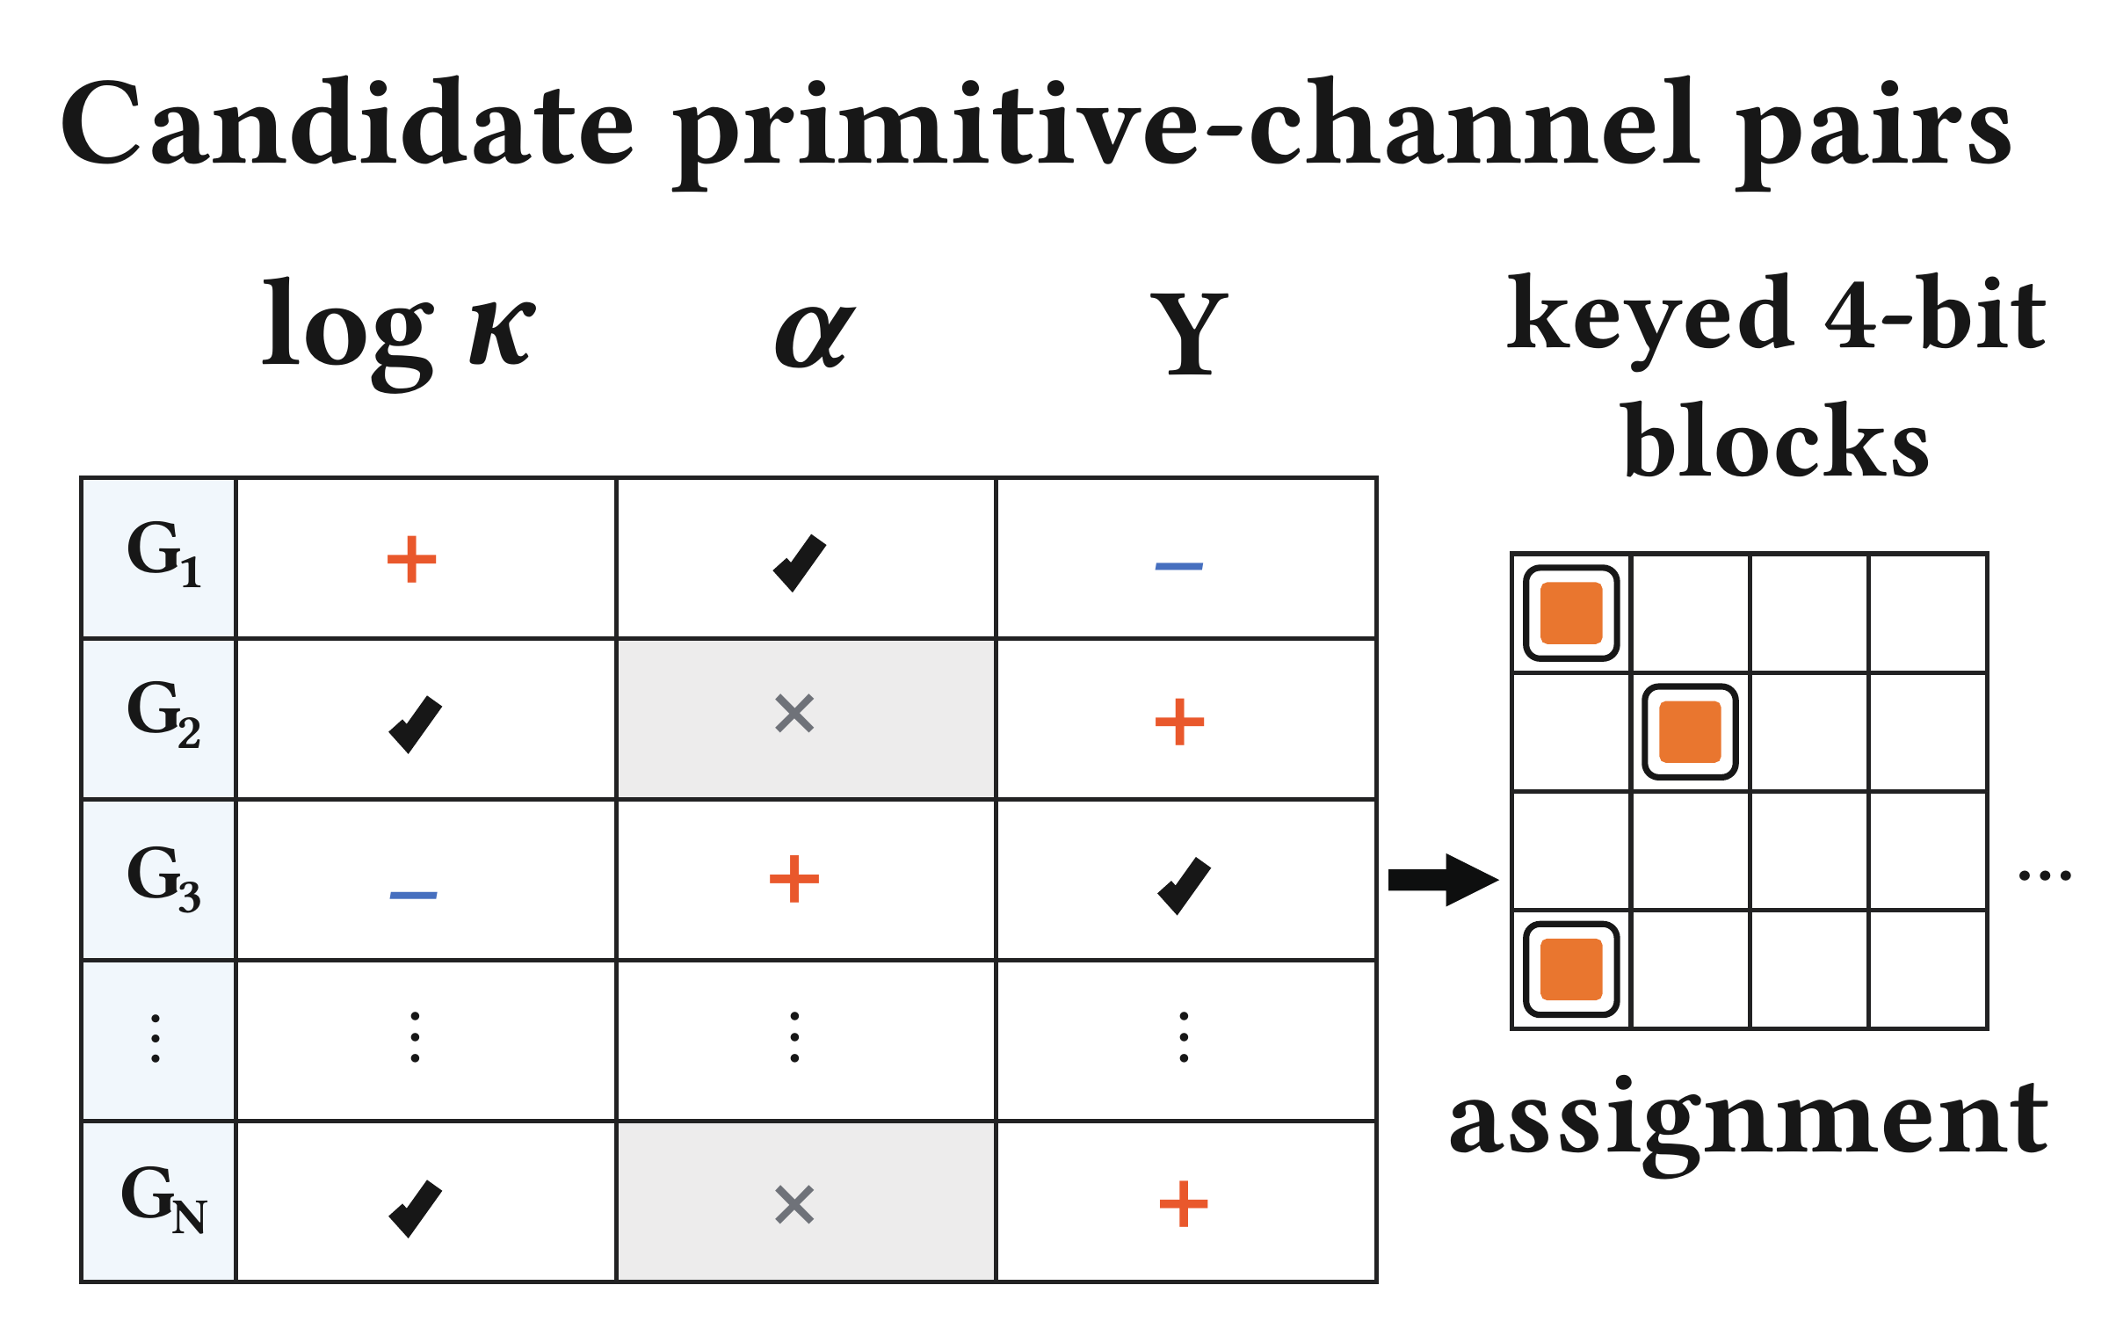
THE CHALLENGE
07 / 16
Which parameter changes should carry the message?
01
Low visual impact
02
Reliable detection
03
Correct message
We need edits that satisfy all three requirements.

Slide 8
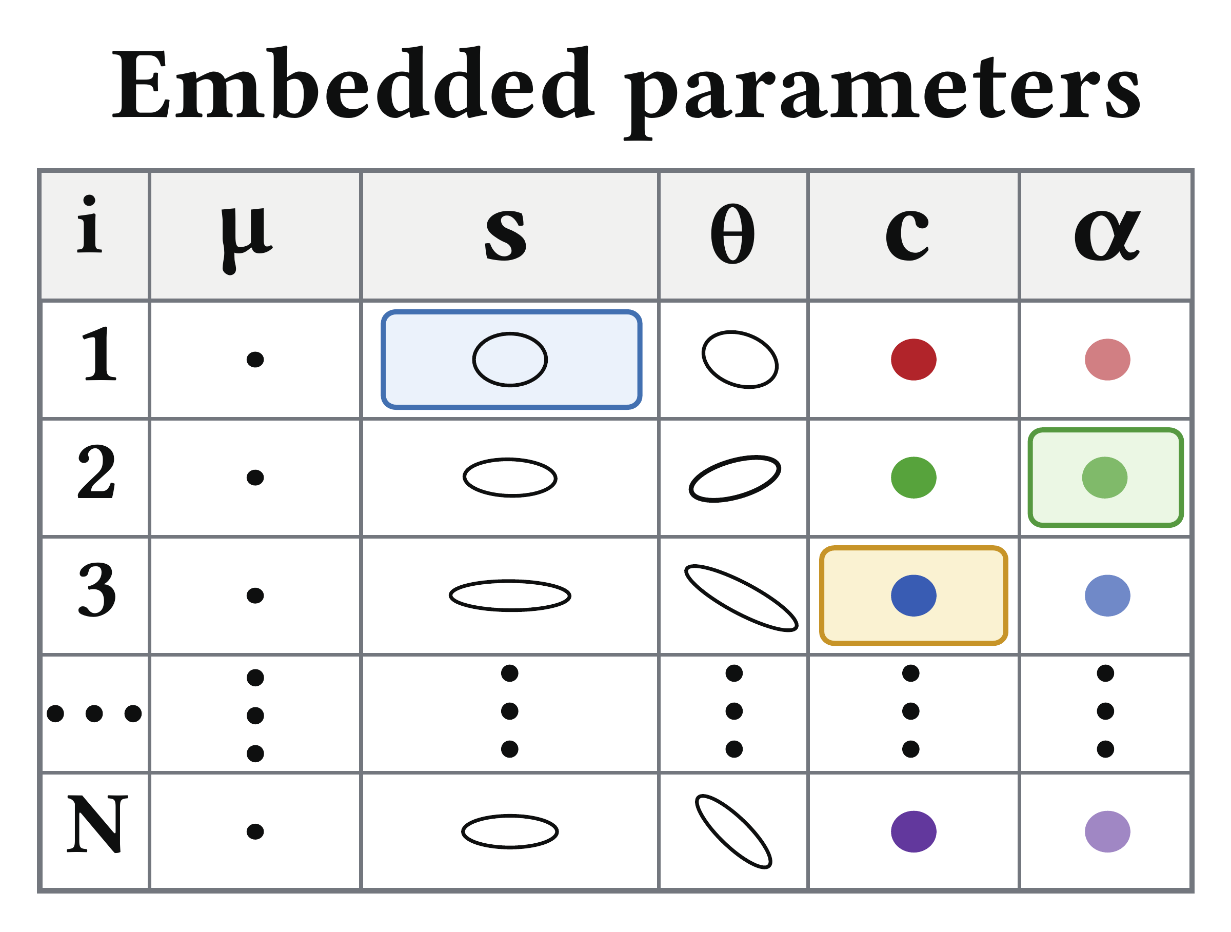
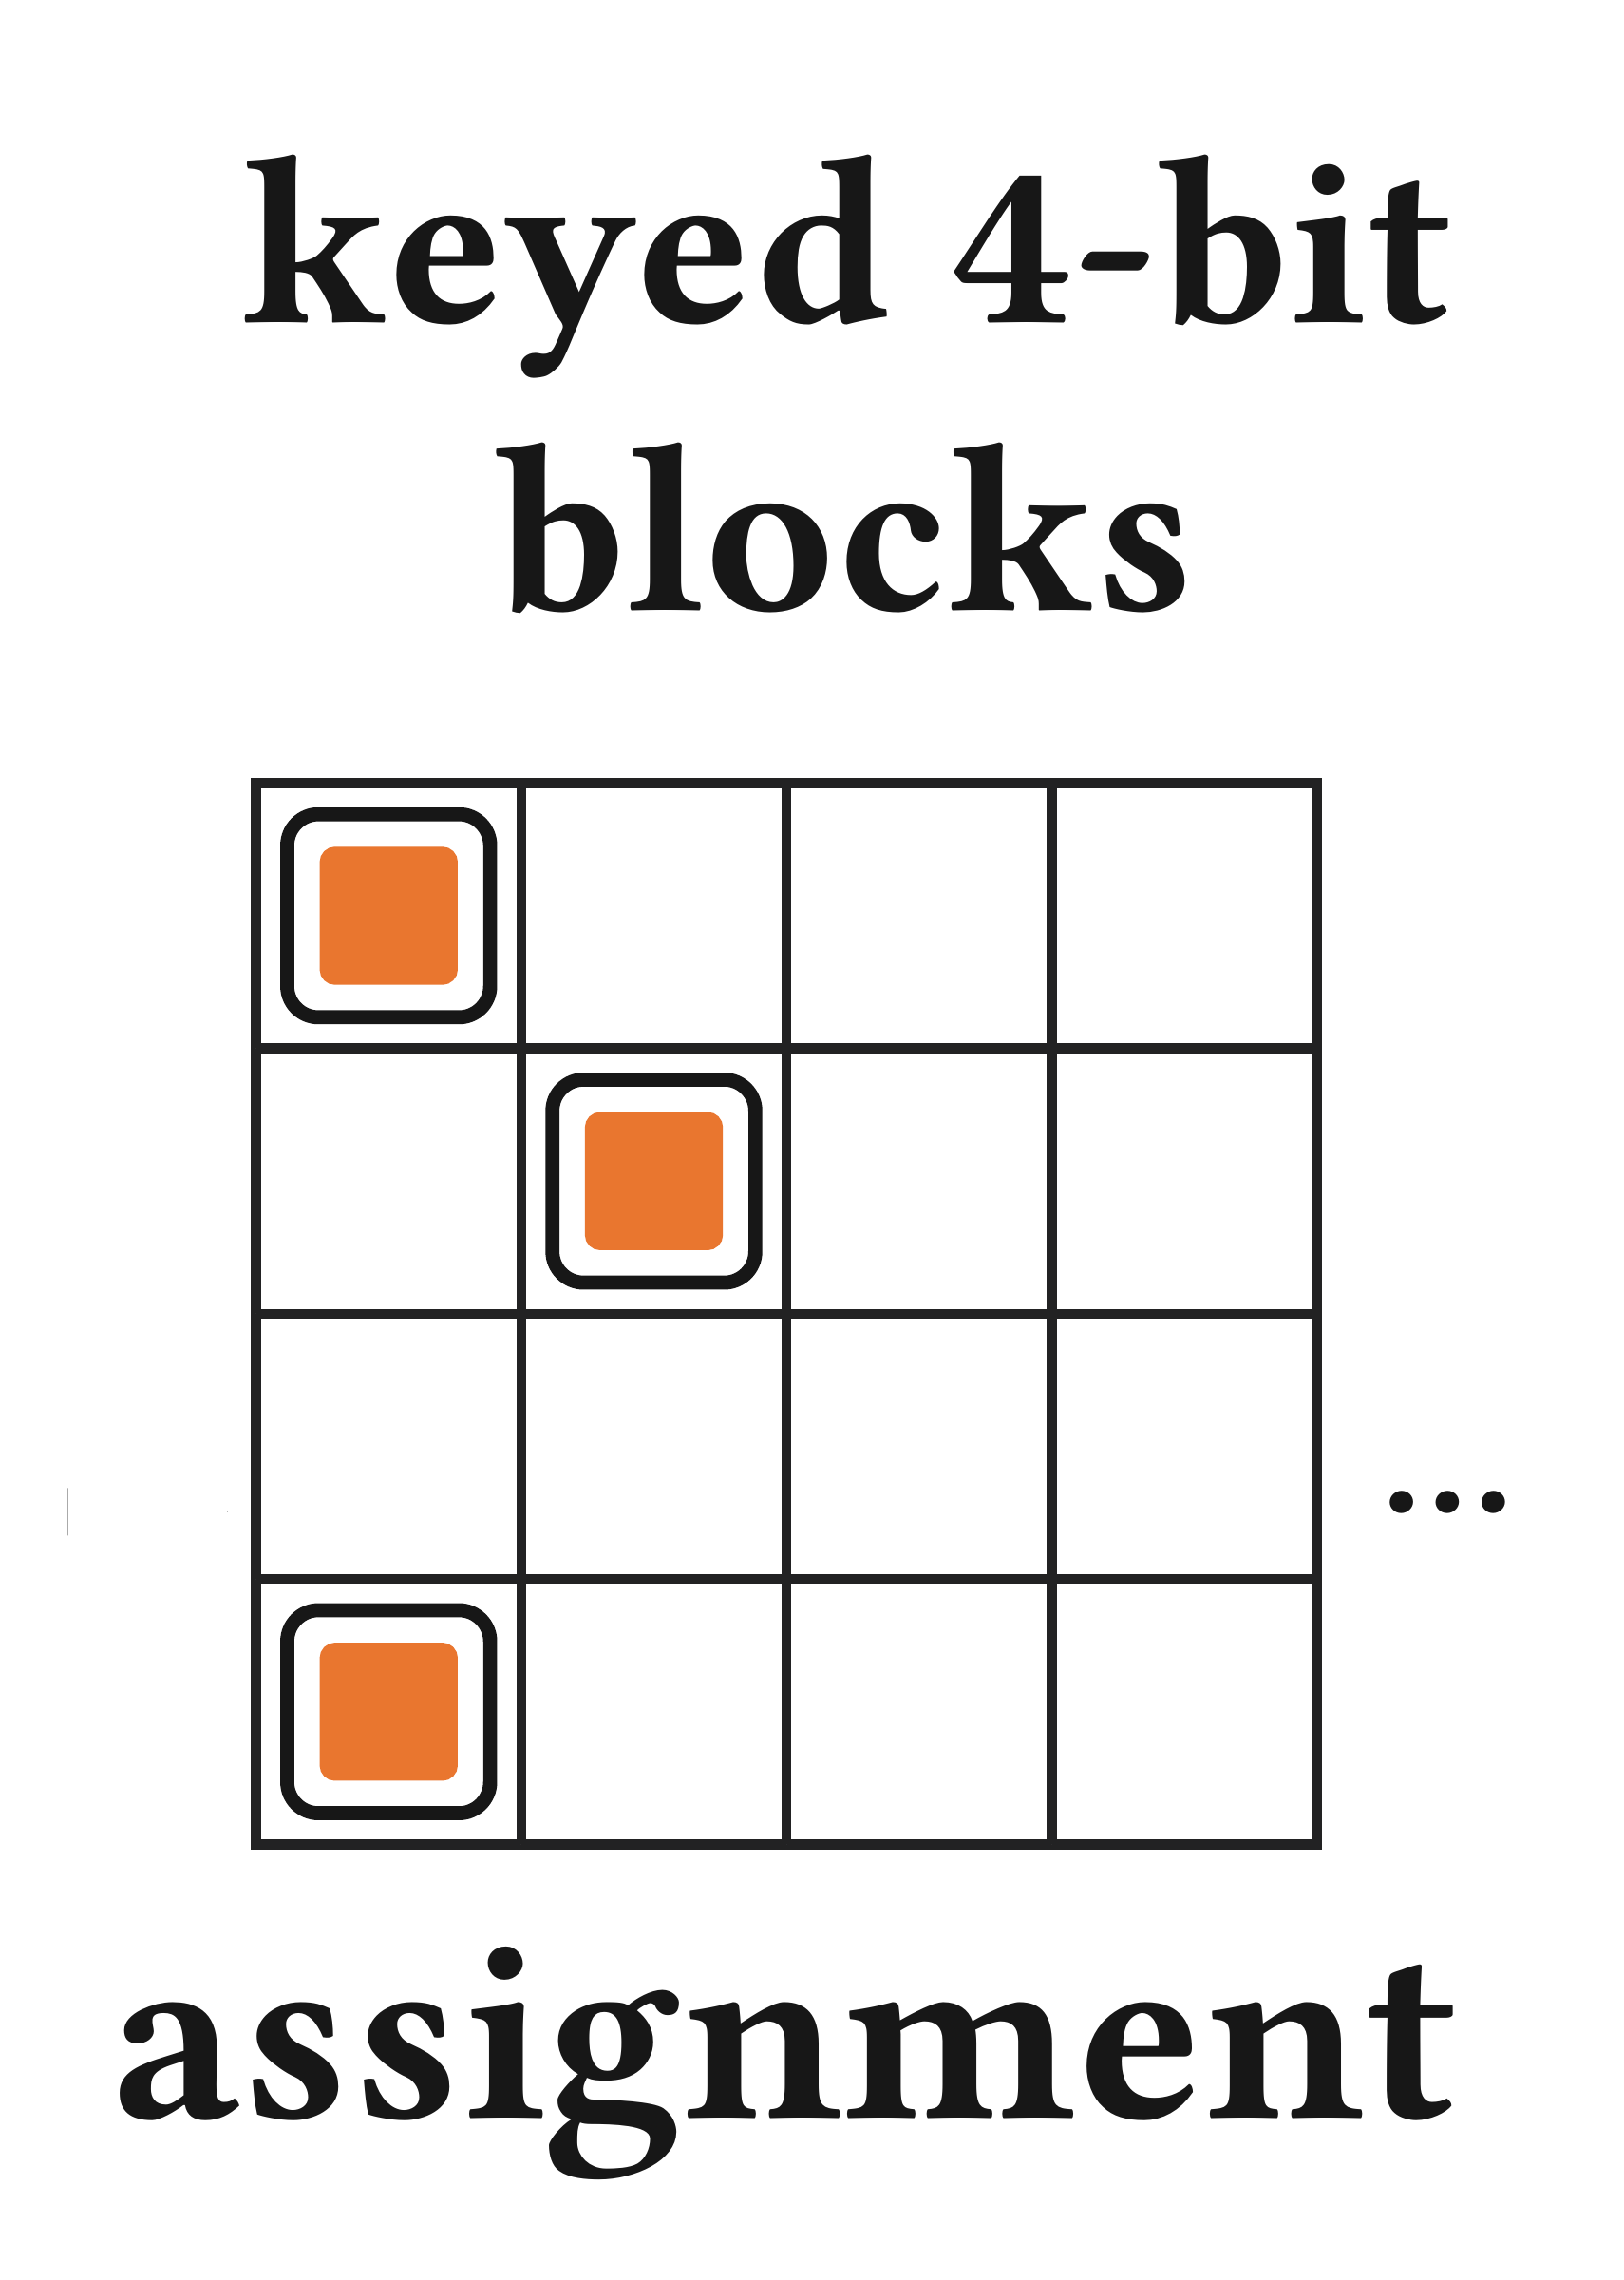
METHOD OVERVIEW
08 / 16
Choose the edits, then optimize the parameters
Clean parameters
Embedded
parameters
Keyed
assignment
Selected edits
Fine-tuning
Assignment map
Message + Secret key
Start with clean parameters, the message, and a secret key.
Choose allowed edits that encode the message at lower cost.
Record the reading locations and bit mapping in an assignment map.
Fine-tune the selected parameters to make the edits readable.
Export embedded parameters for rendering and decoding.
Assignment chooses the edits. Fine-tuning embeds the message.

Slide 9

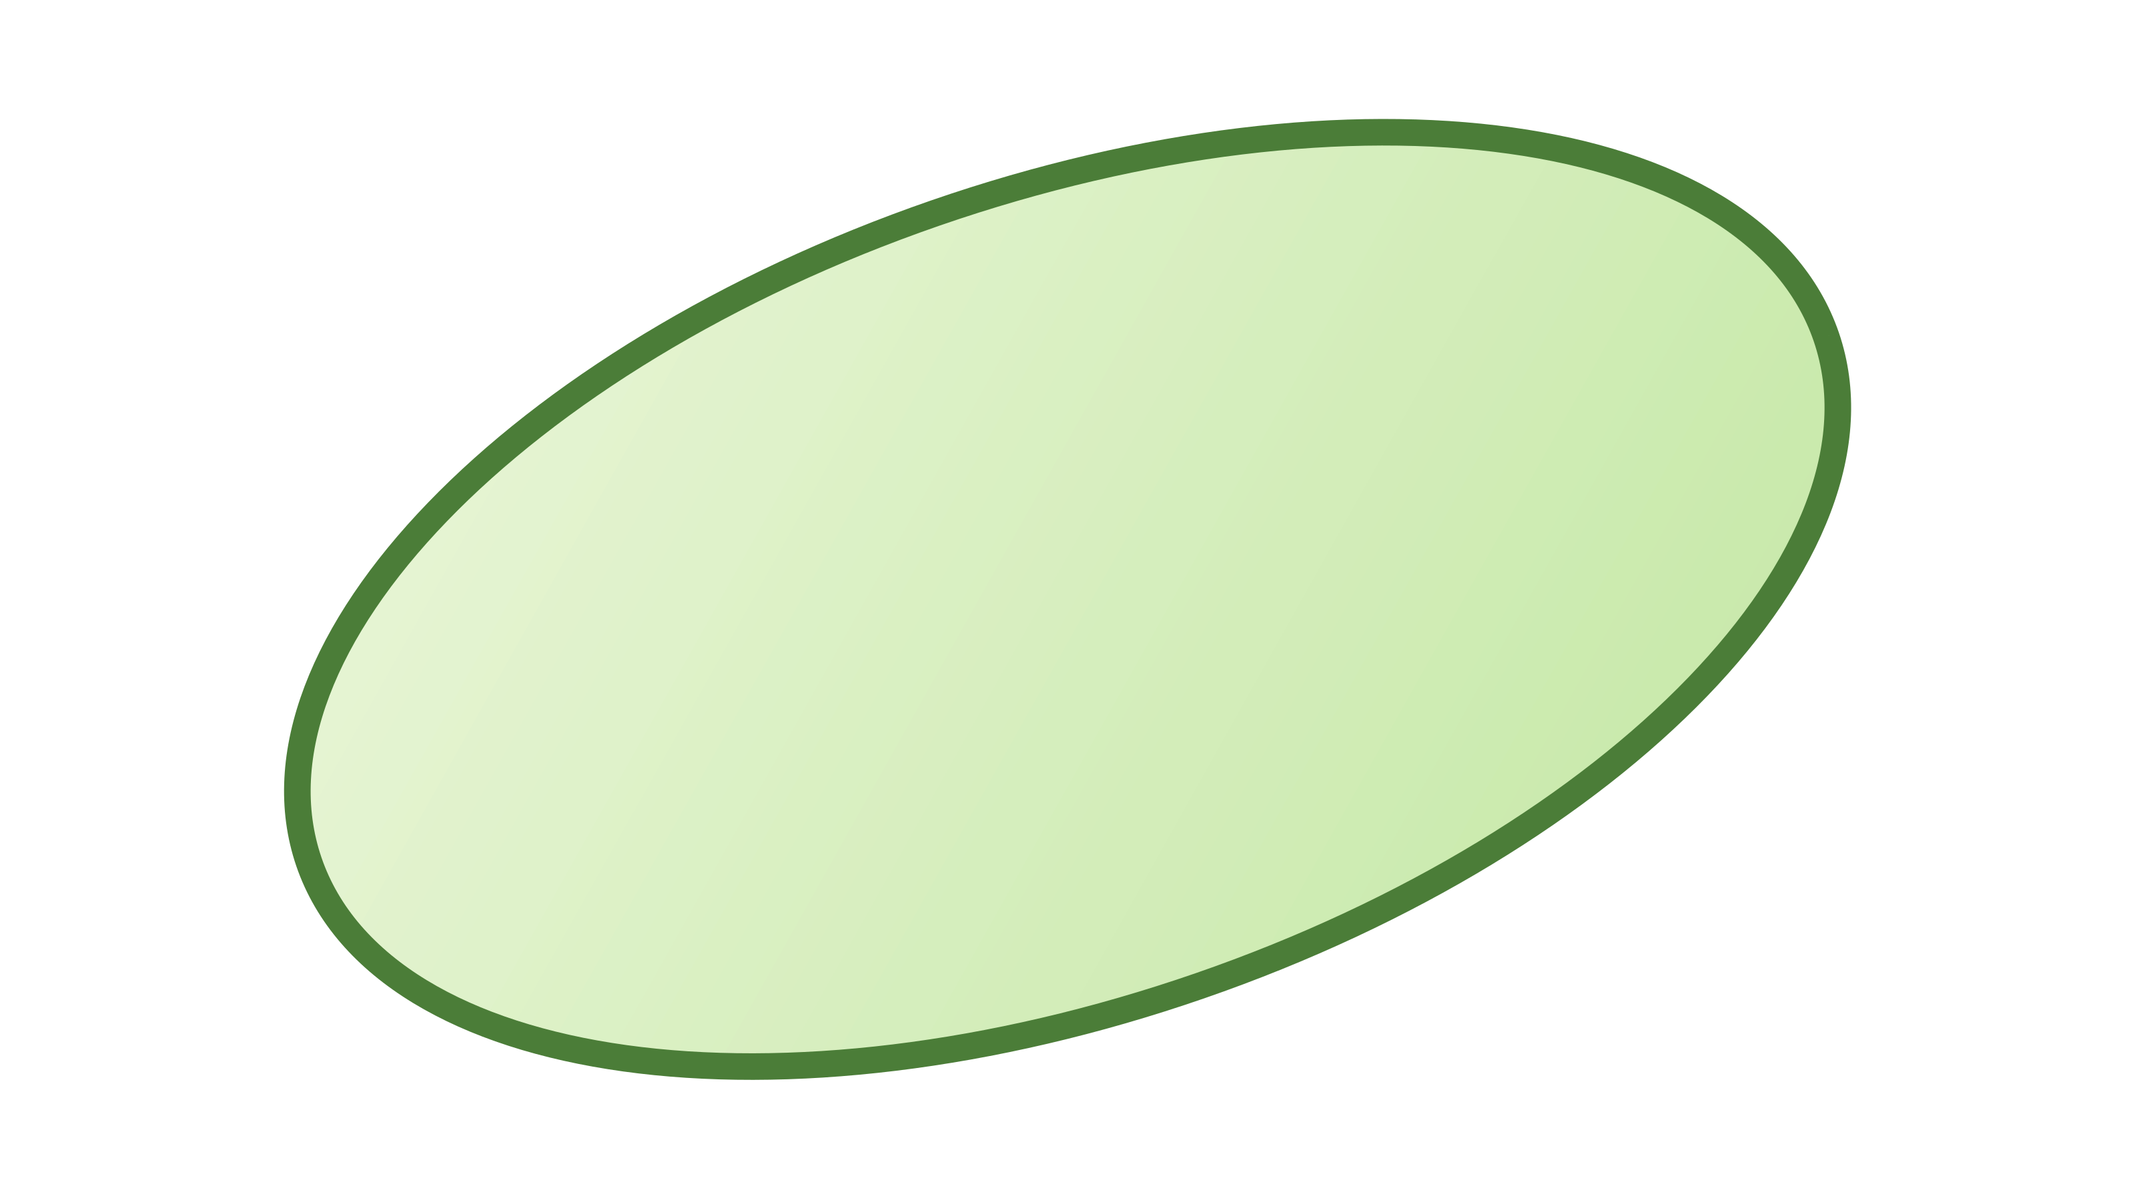
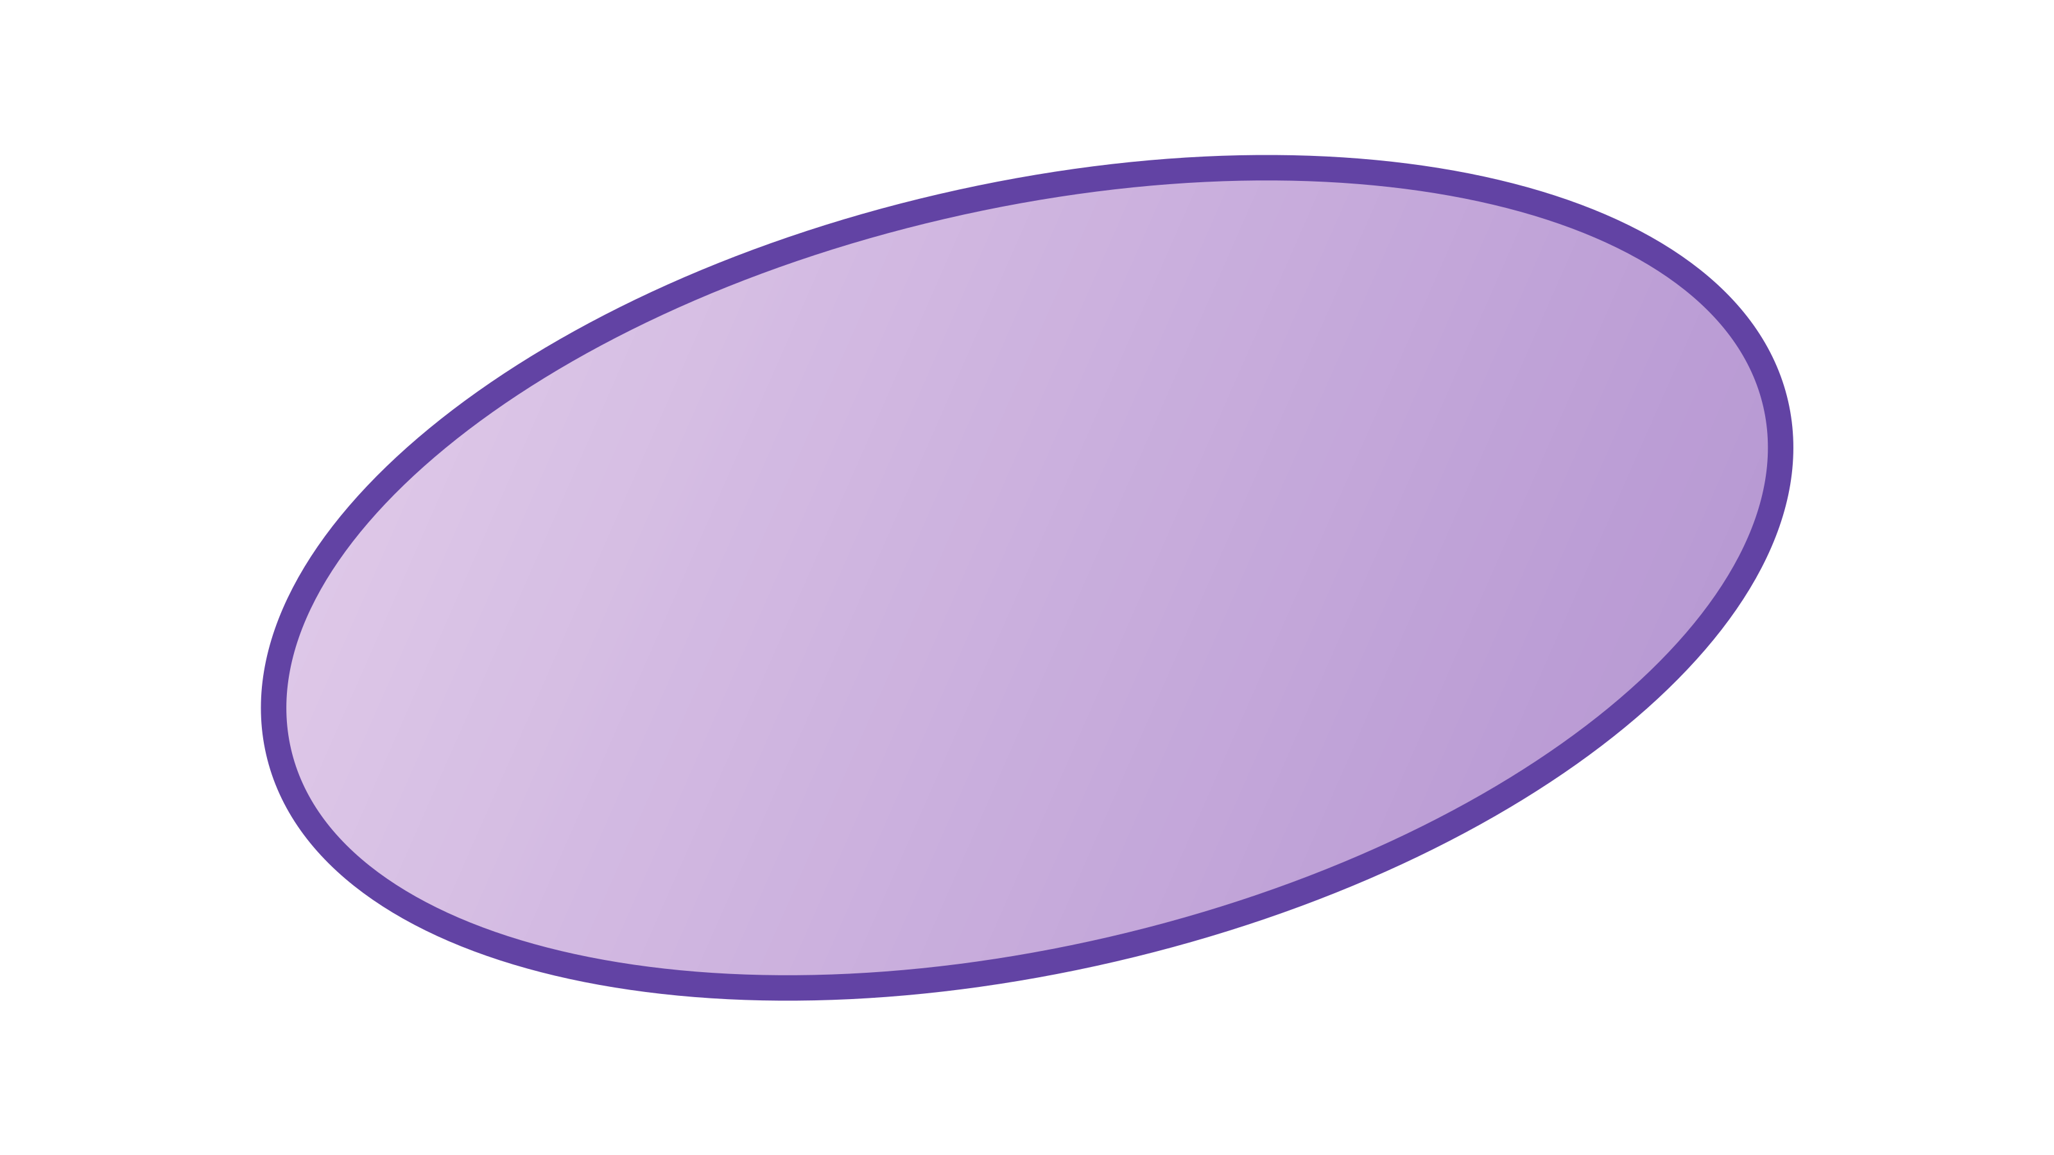
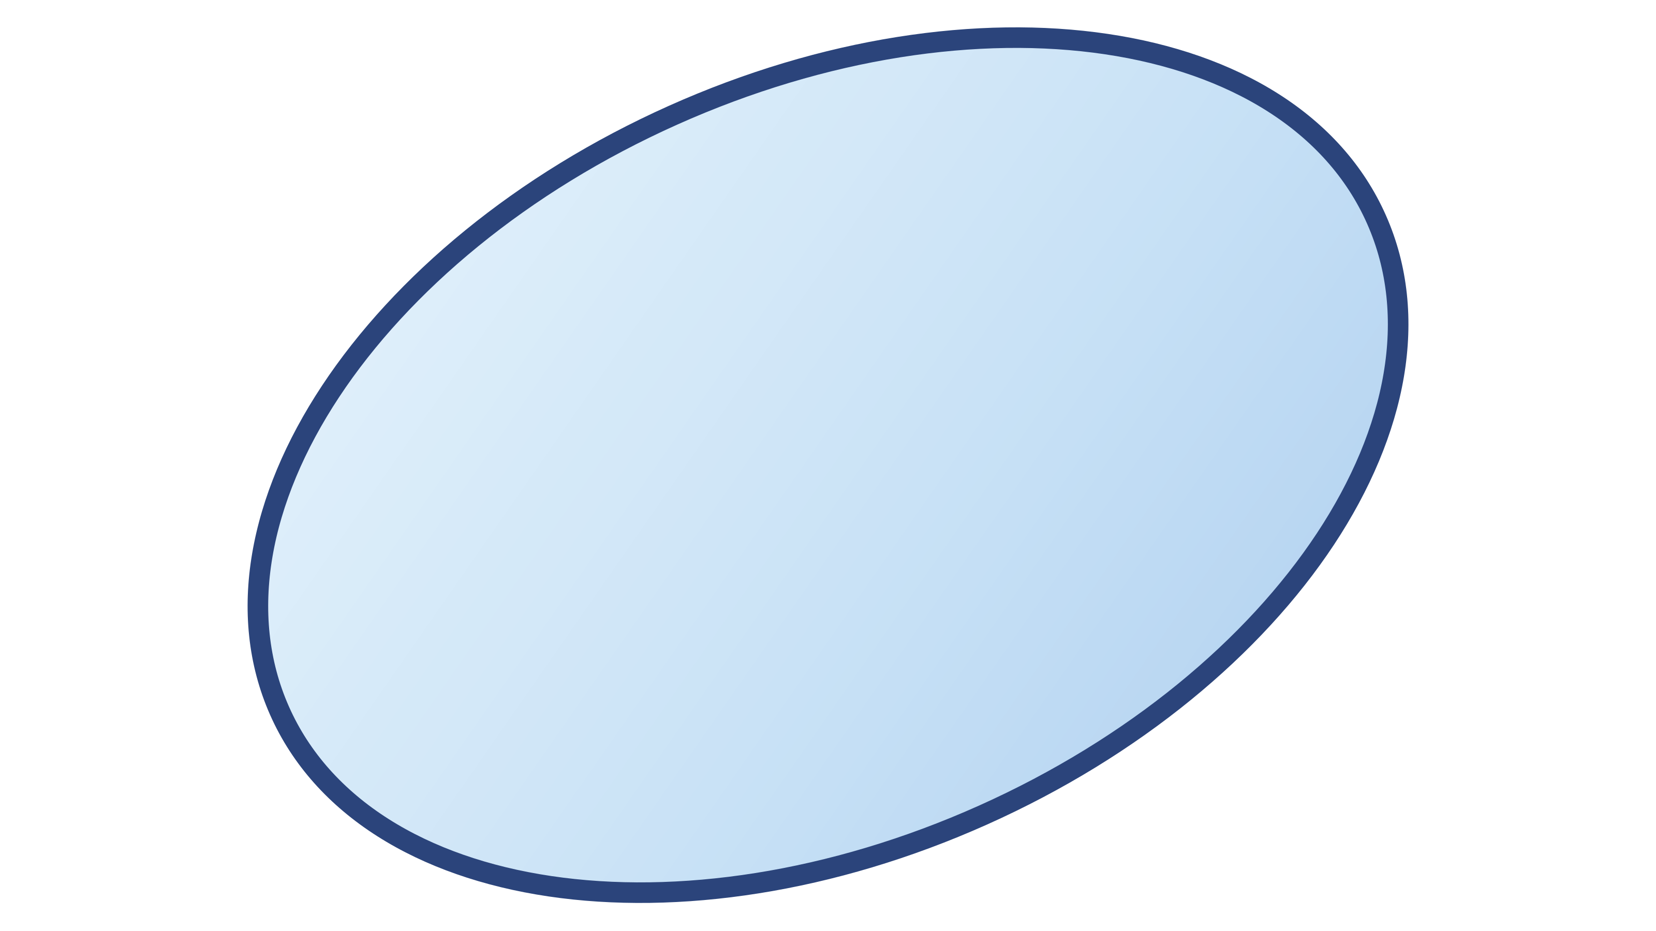
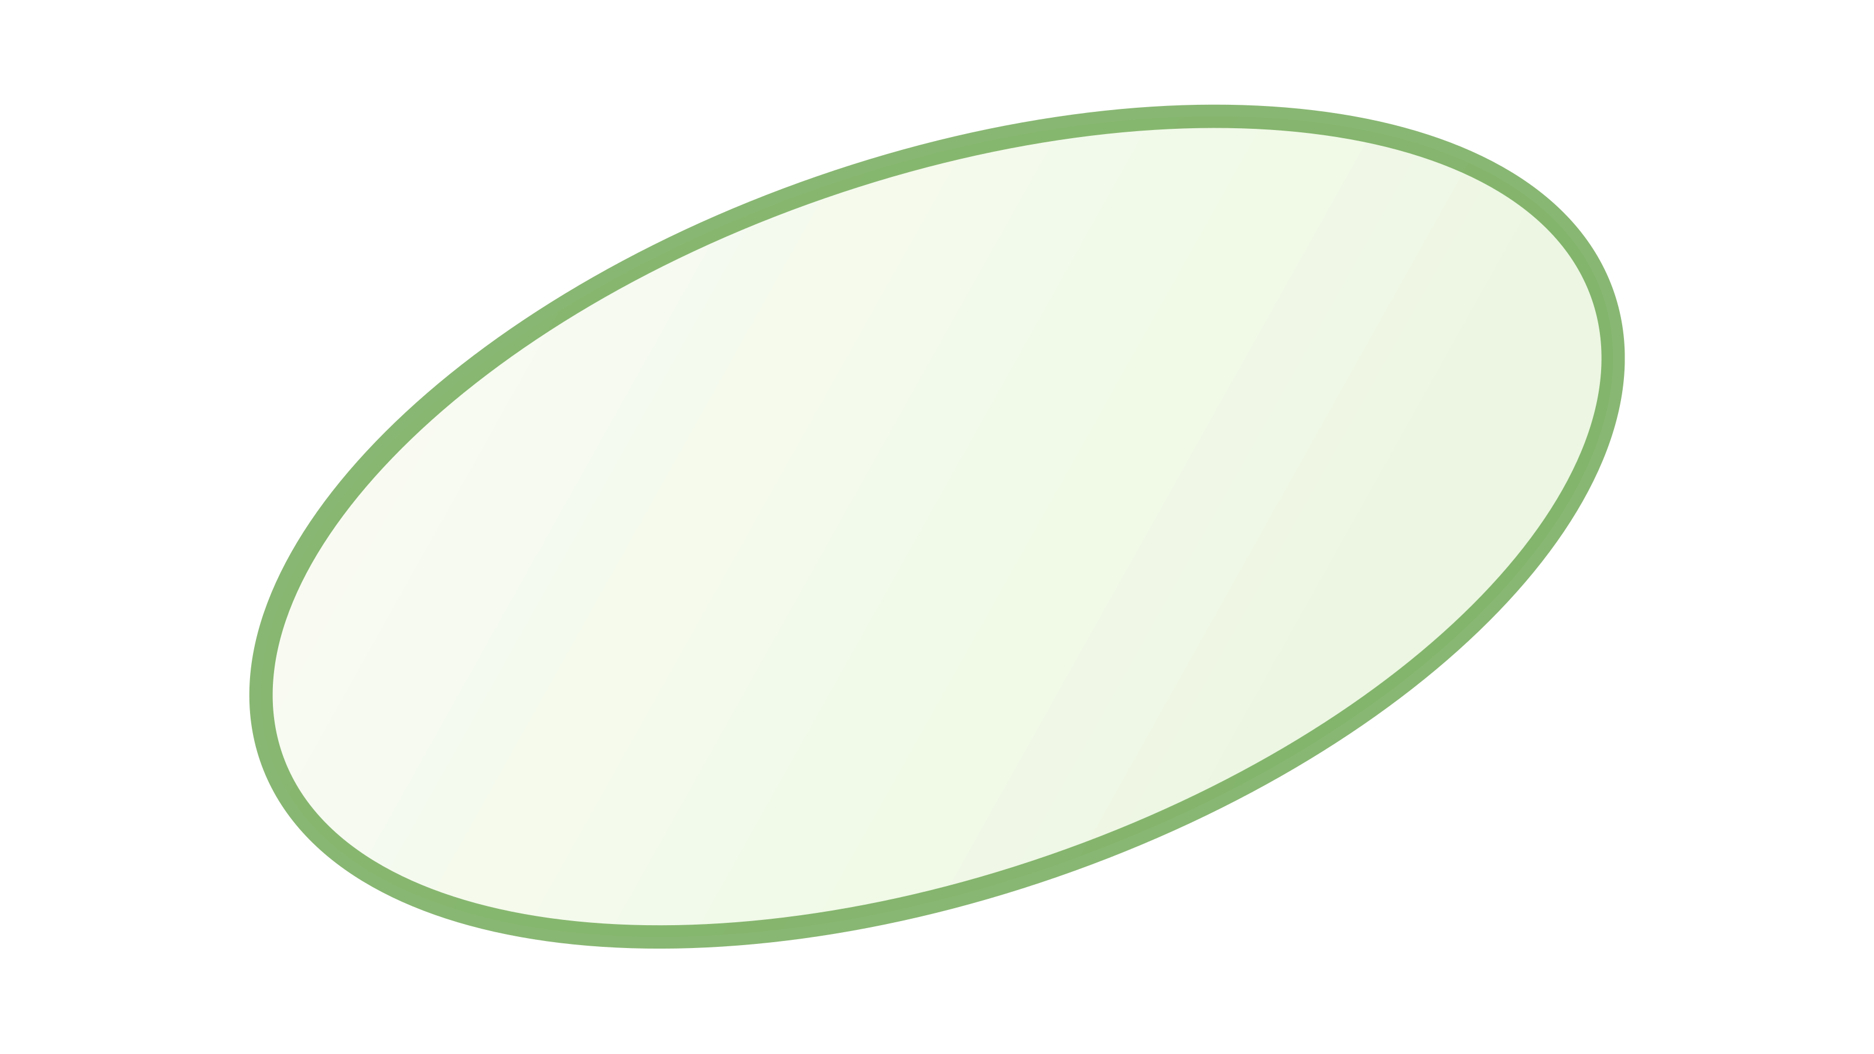
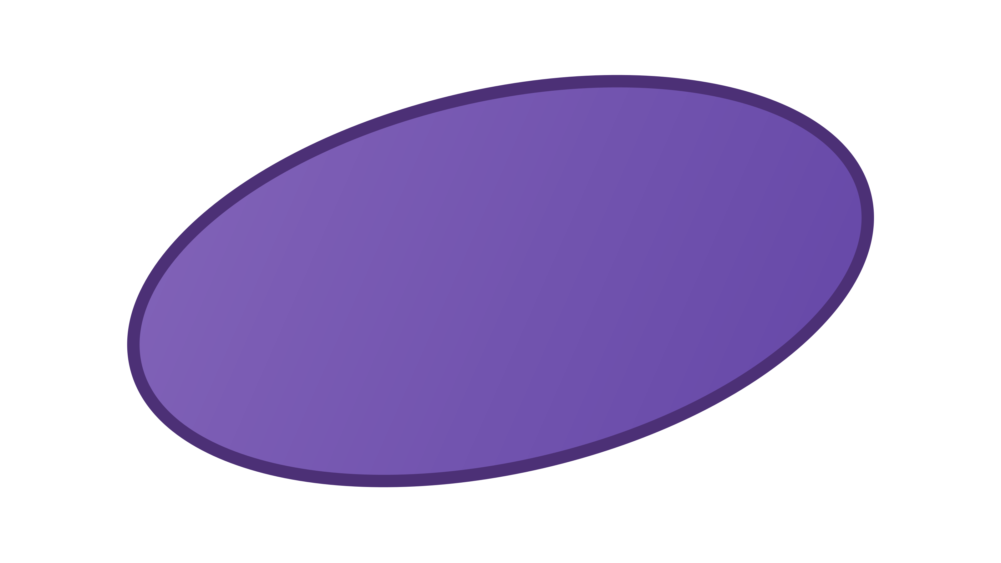
CANDIDATE EDITS
09 / 16
Three parameters we can change
Elongation — log κ
Opacity — α
Brightness — Y
How stretched
the Gaussian is
How strongly it contributes
to the image
How bright
its color is
+Δ
+Δ
+Δ
More stretched
Stronger contribution
Brighter
−Δ
−Δ
−Δ
More rounded
Weaker contribution
Darker
One edit specifies a Gaussian, a parameter,
and an increase or decrease.

Slide 10
KEYED ASSIGNMENT
10 / 16
Choose valid edits with lower cost
Candidate edits
Select an edit set
E₁
Increase elongation of
Gaussian 1
1. Keep sets that encode
the target message.
E₂
Increase opacity of
Gaussian 3
The key defines the candidate edits
and their mapping to message bits.
E₃
Decrease brightness of
Gaussian 1
2. Among valid sets, prefer
lower total cost.
An edit set uses several
candidate edits together.
Cost estimates visual and
parameter changes.
Example edit set: E₁ and E₂
Region and coverage constraints also apply.

Slide 11
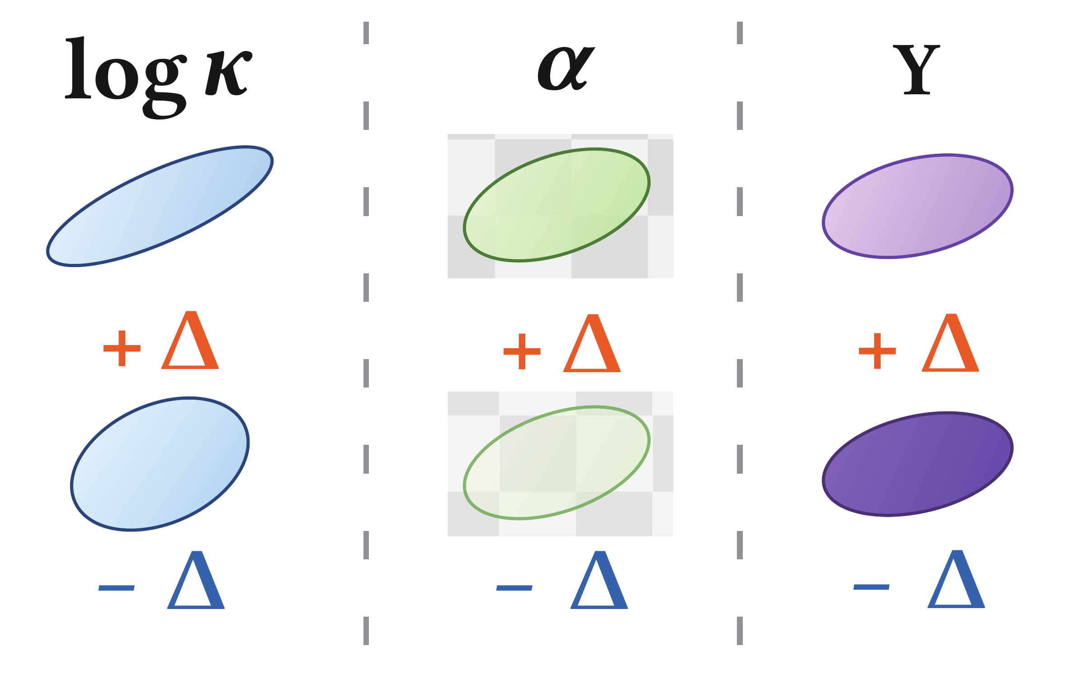
FINE-TUNING
11 / 16
Fine-tuning refines the selected parameter edits
01
Make the intended
changes readable.
02
Preserve the
rendered appearance.
03
Limit changes to the
parameter distribution.

Slide 12
DECODING
12 / 16
Read the message from parameter changes
Clean parameters
before embedding
Embedded parameters
Assignment map
compare
Which edits to check
How to read their changes
How to combine the decisions
Measure parameter
changes
Convert changes into
0/1 decisions
Recover four-bit
message blocks
Fixed 8-bit message: 256 Gaussians per synthetic fit / 4,096 per natural image.

Slide 13
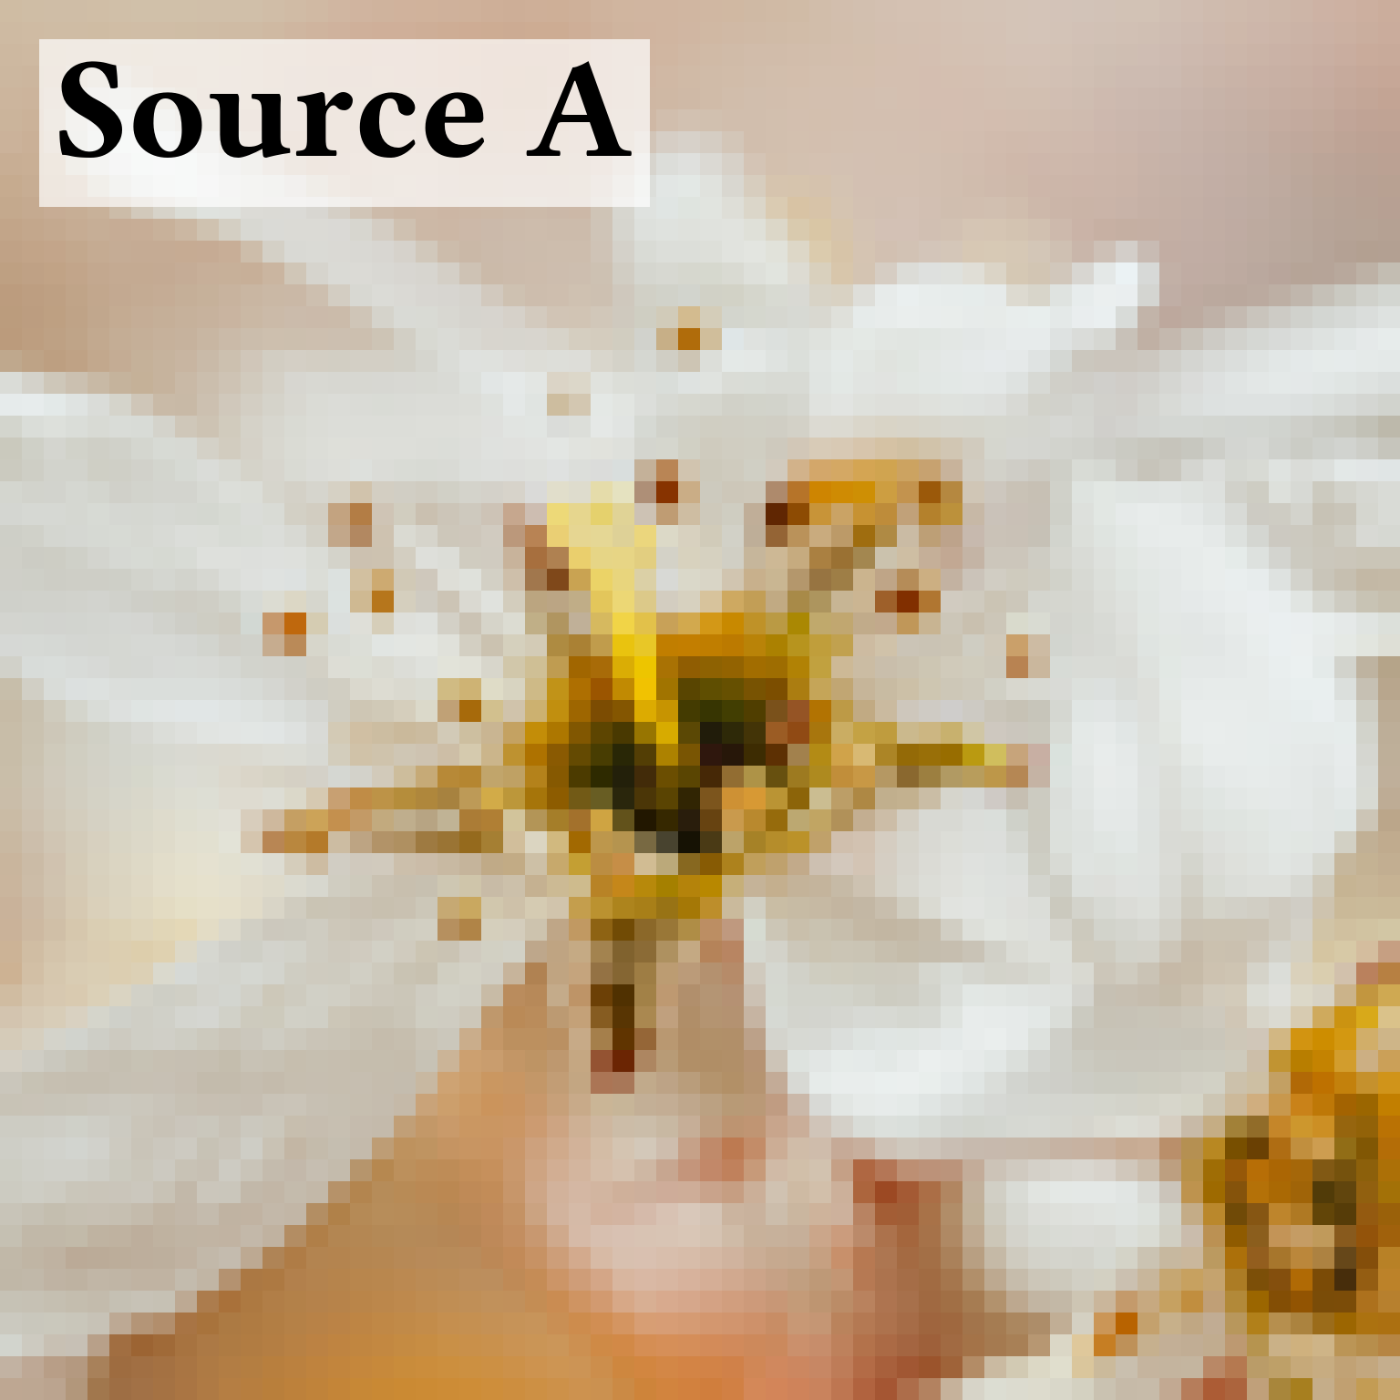
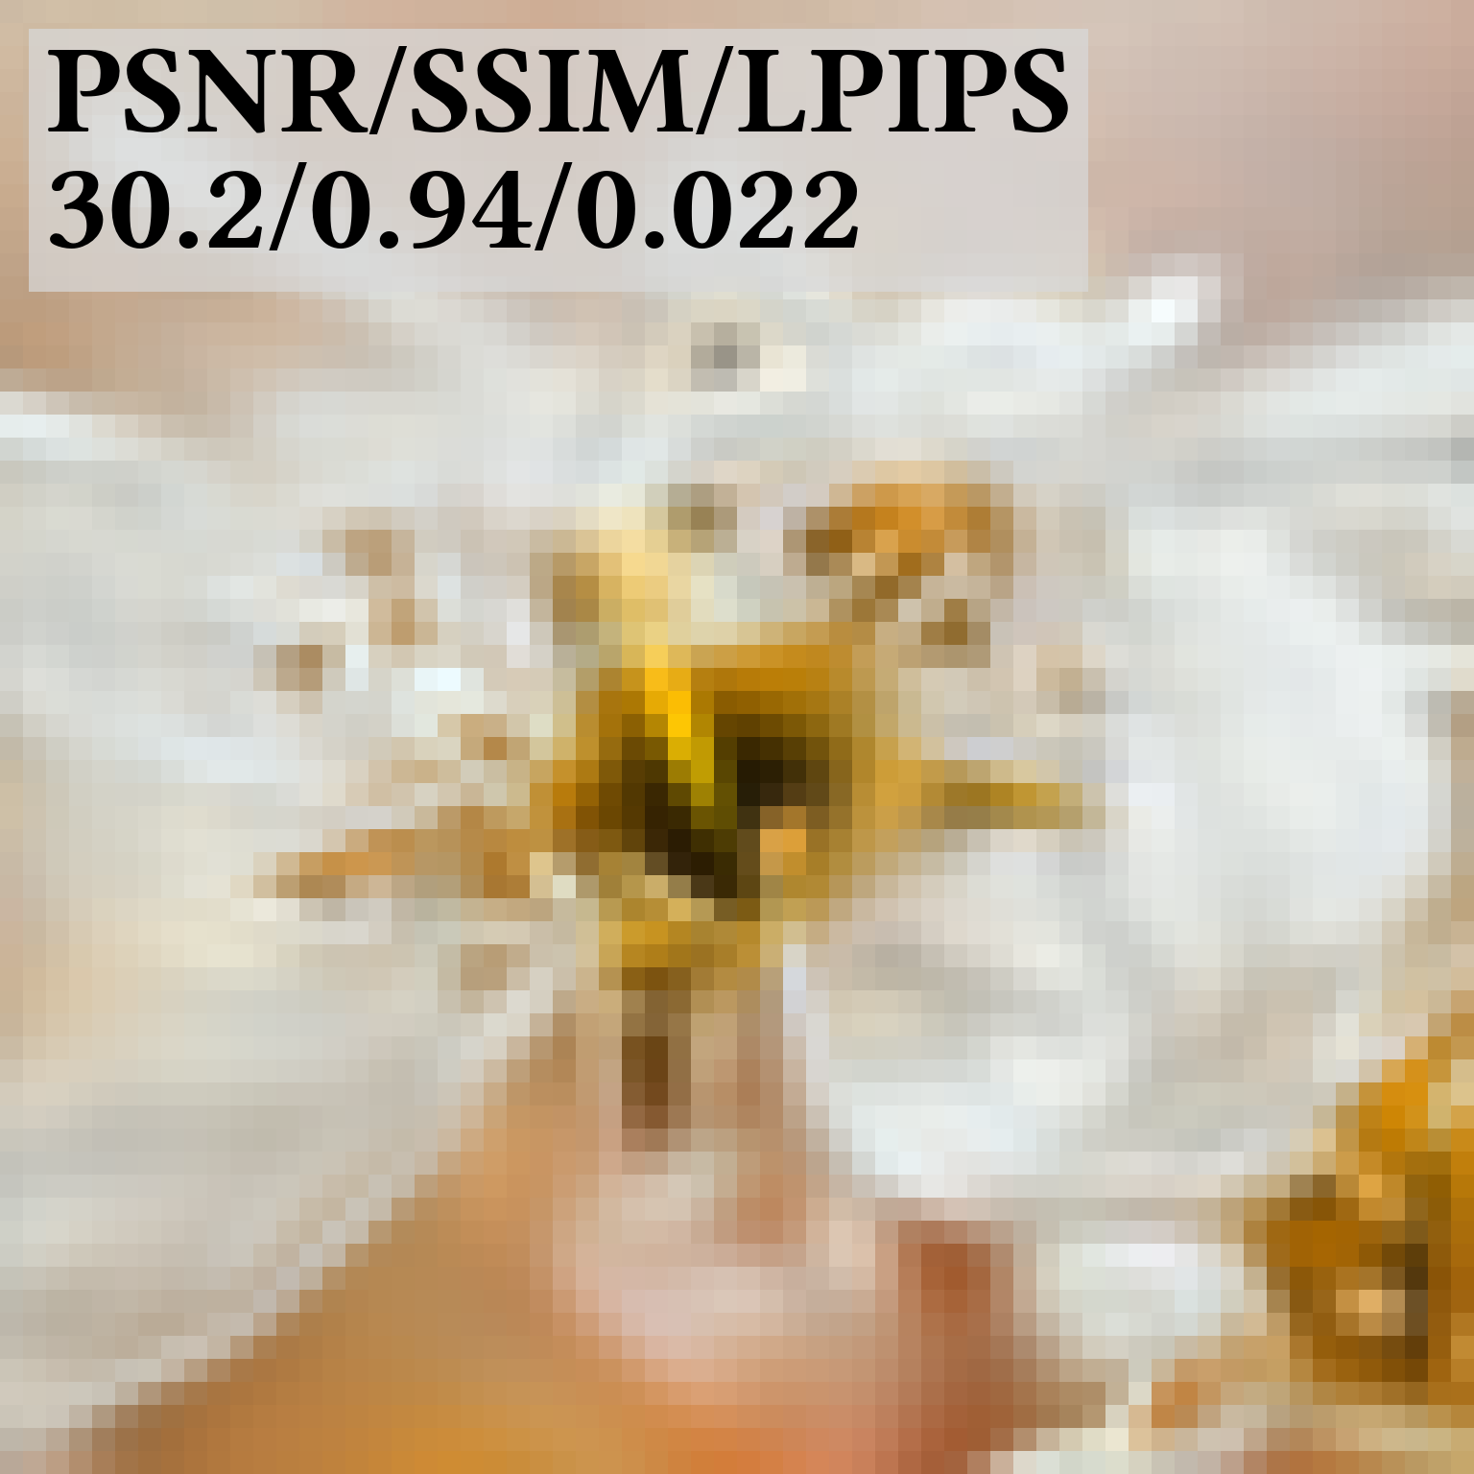
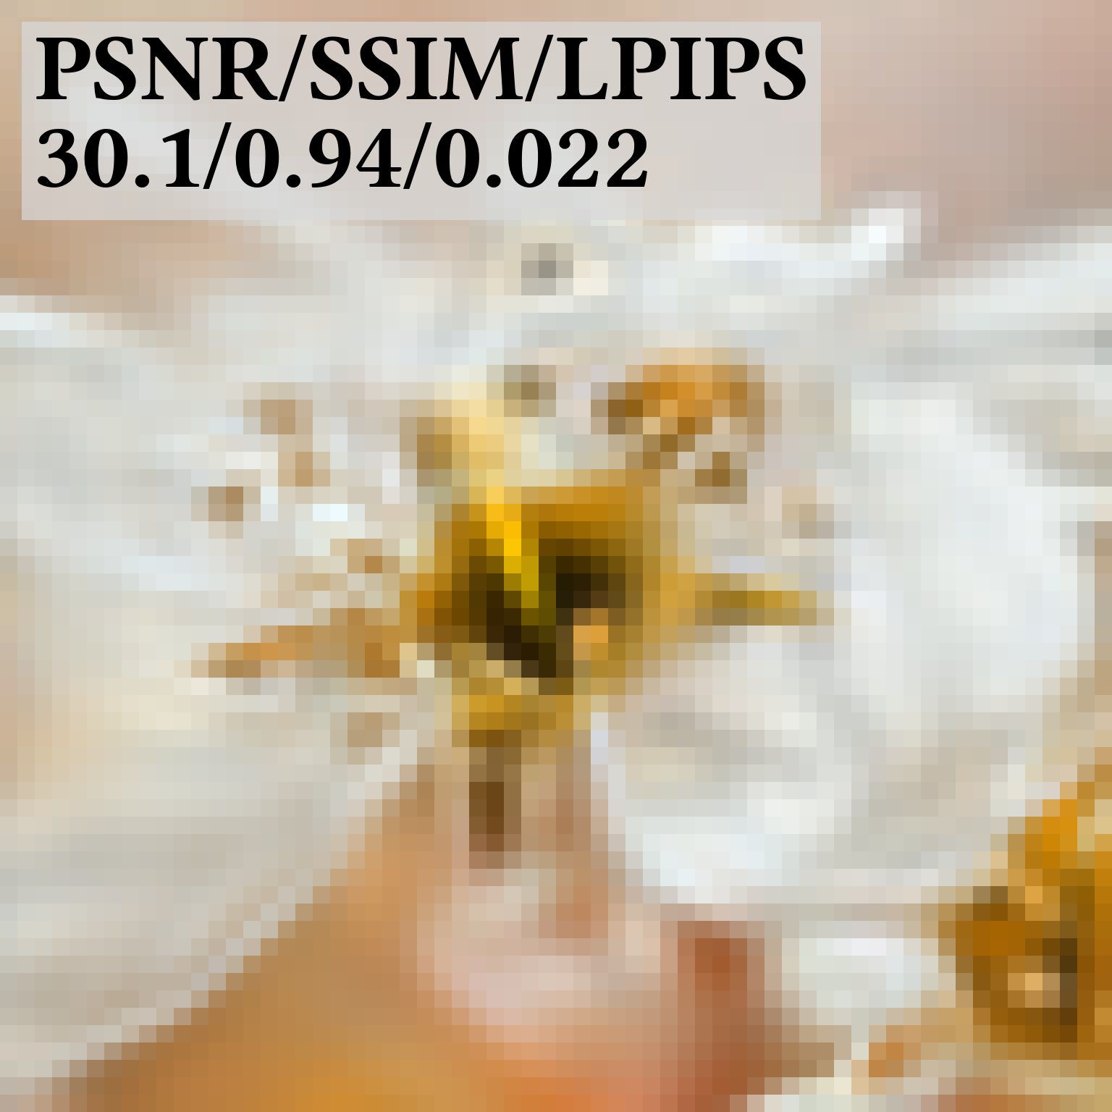
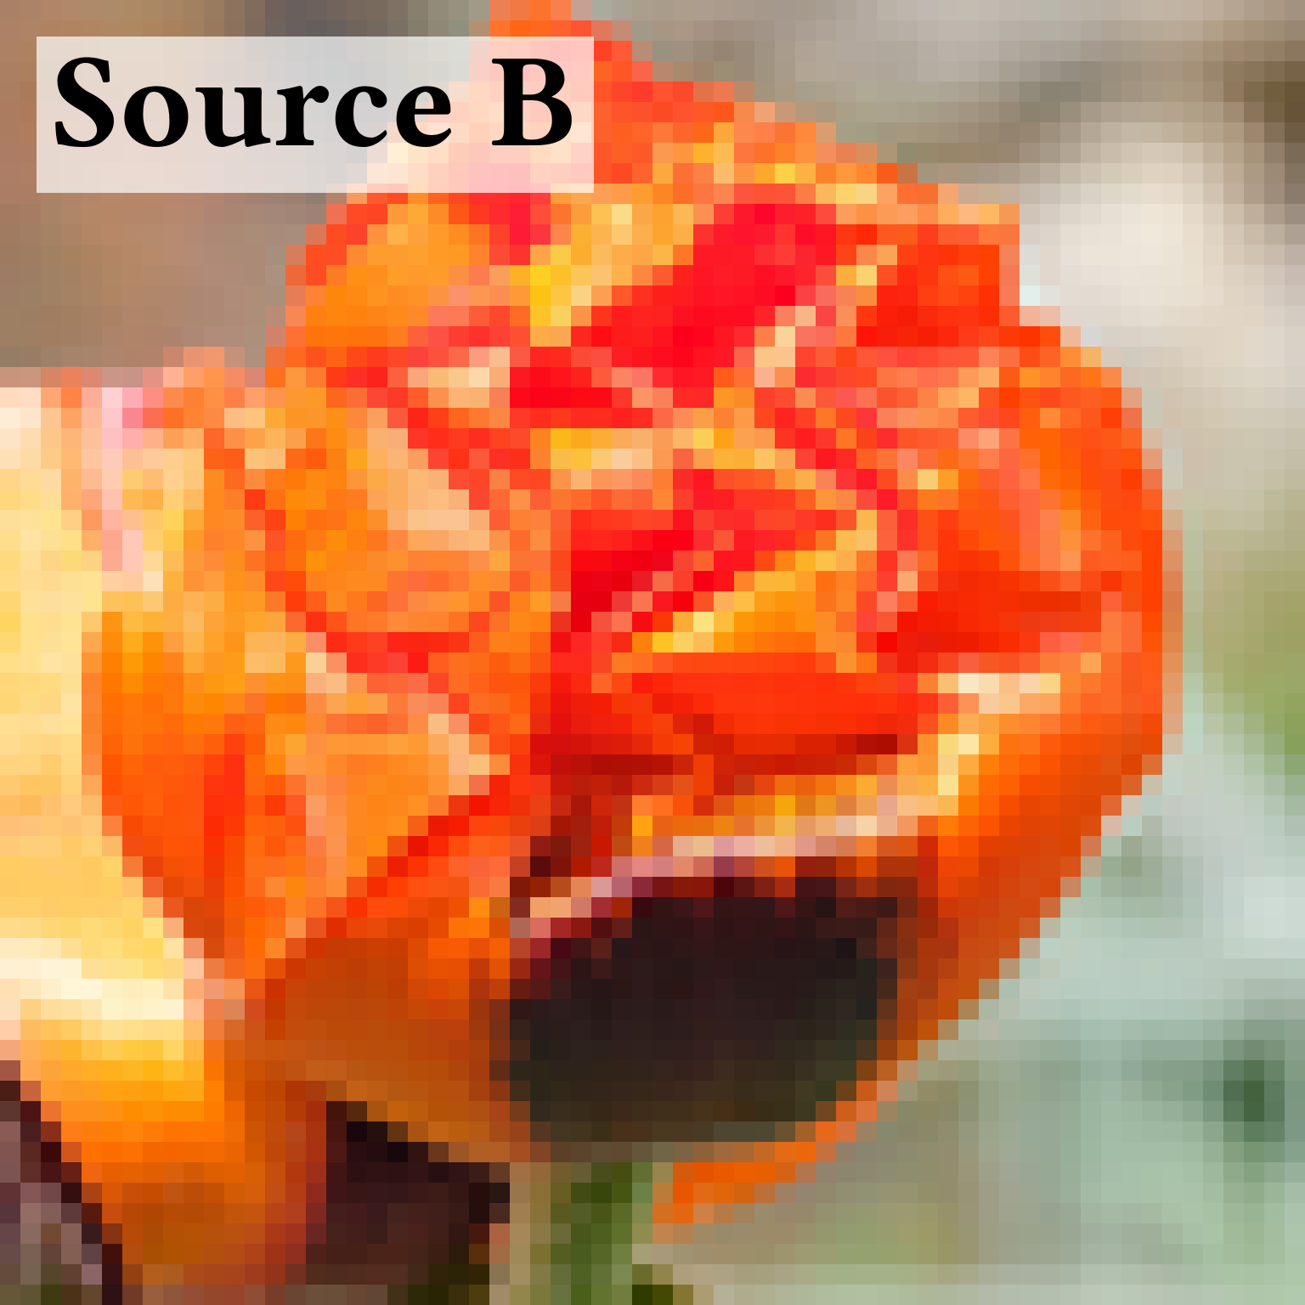
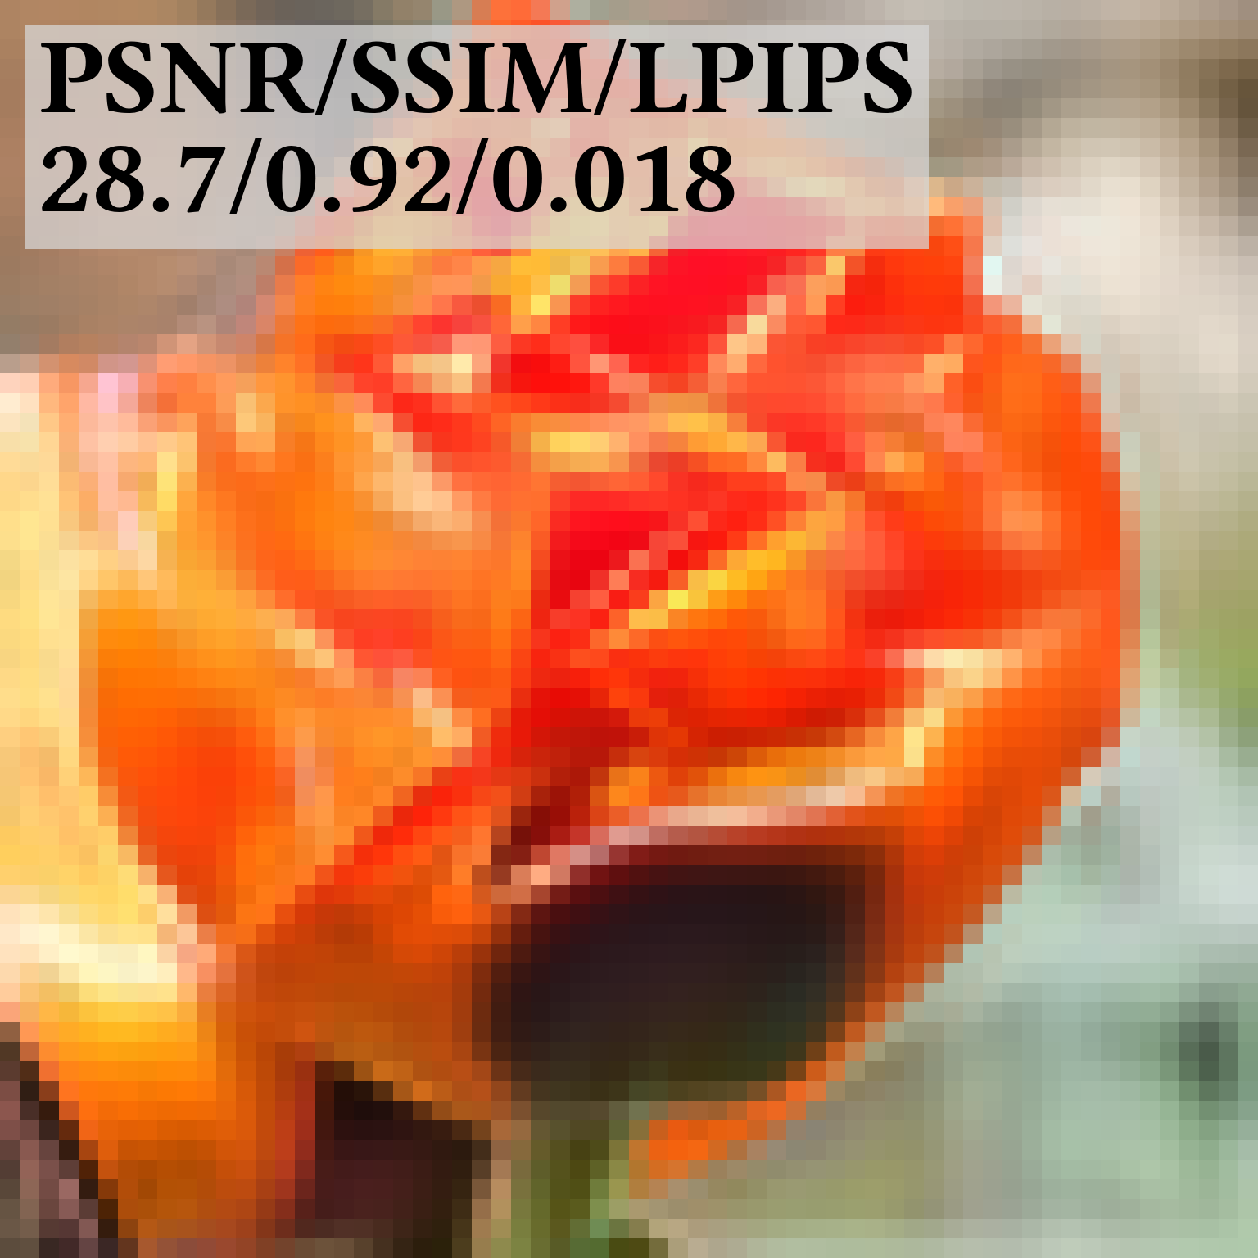

VISUAL QUALITY
13 / 16
The clean and embedded images look similar
Source image
Clean Gaussian fit
Embedded Gaussian fit
Perceptually similar results
ΔPSNR = max(0, PSNR_{clean} − PSNR_{embedded})

Slide 14
CONTROLLED EVALUATION
14 / 16
Cost-aware selection improves recovery over random selection
30 synthetic fits / 256 Gaussians / fixed 8-bit message
Exact recovery
Mean ΔPSNR ↓
Matched random
25 / 30
0.066 dB
Random edits with a key
Greedy no-key
30 / 30
0.075 dB
Lowest-cost edits, no key
Ours
30 / 30
0.091 dB
Cost-aware keyed assignment
0
10
20
30
fits
Both methods recover every message in this test.
Greedy no-key selects low-cost edits without a key. It does not address key-specific decoding.
Our method uses a key to define candidate edits and their mapping to message bits.
Correct-key BER: 0.000. Mean wrong-key BER: 0.543 (chance level: 0.5).

Slide 15
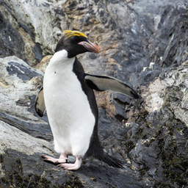
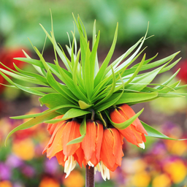
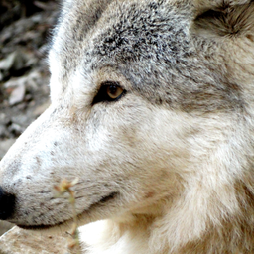


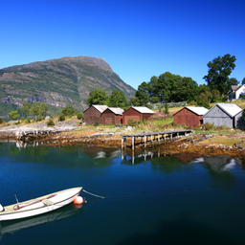
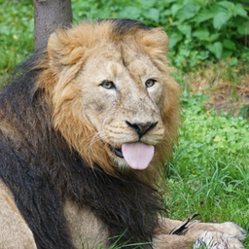
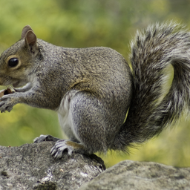
HELD-OUT EVALUATION
15 / 16
The fixed message is recovered from all 112 test images
112 held-out images / 256 × 256 / 4,096 Gaussians / fixed 8-bit message
Examples from the held-out input set
112 / 112
Exact message recovery
Correct-key BER: 0.000
0801
0803
0805
0806
0.009 dB
Mean ΔPSNR
0.520
Mean wrong-key BER
0807
0808
0809
0810
Chance BER = 0.5

Slide 16
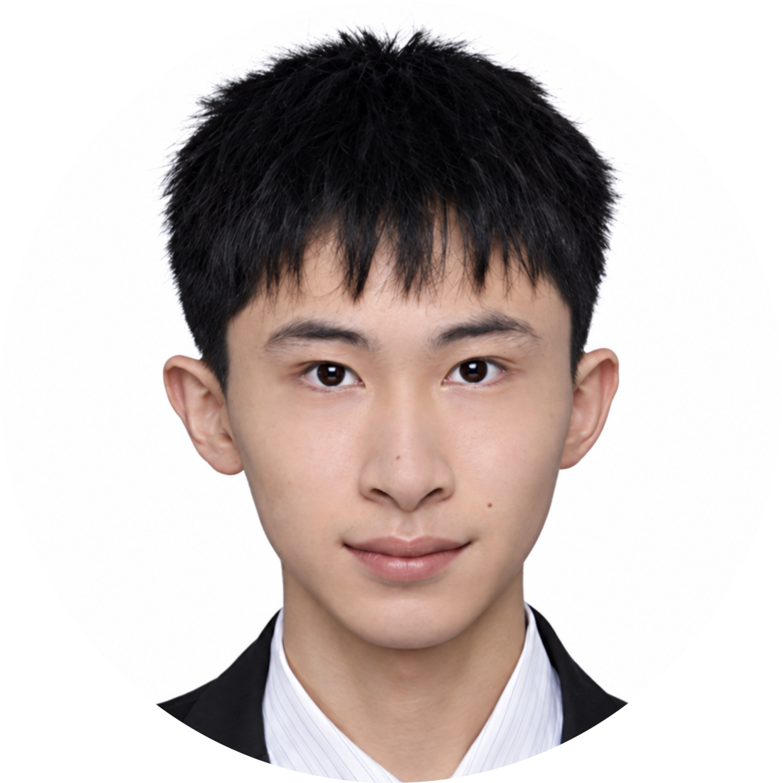
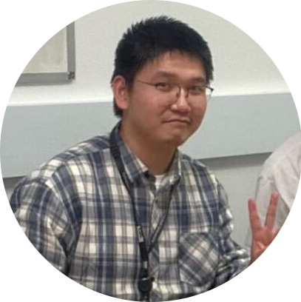
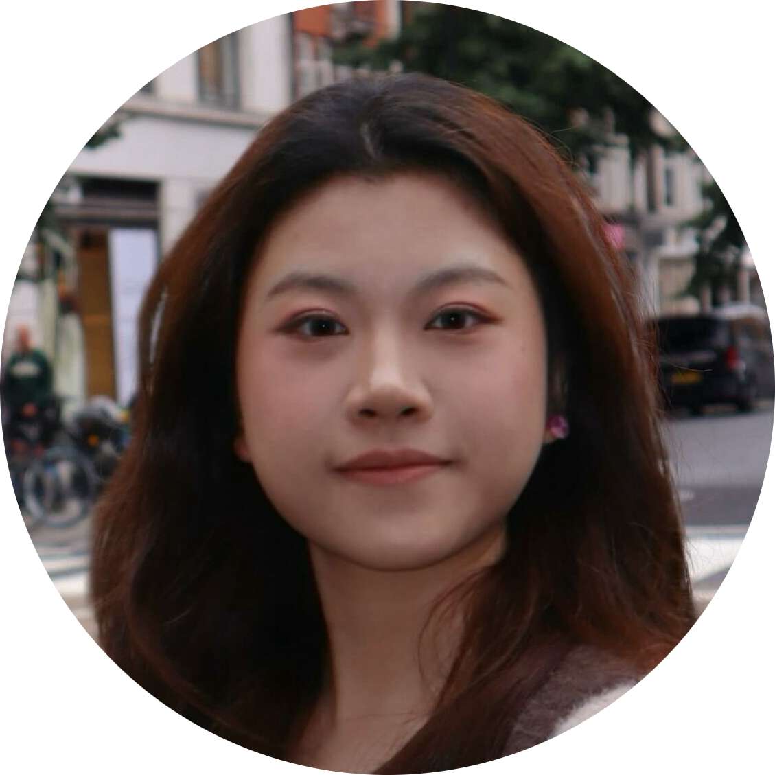

16 / 16
GAUSSIAN IMAGE STEGANOGRAPHY
Thank you
Paper / Supplementary material / Code / Slides
Tong Wu
Runze Cheng
Xiaoyue Fan
Kaan Akşit
Citation
Tong Wu, Runze Cheng, Xiaoyue Fan, and Kaan Akşit.
Gaussian Image Steganography via Parameter-Domain Keyed Embeddings.
SIGGRAPH Asia 2026 Technical Communications (2026).
Association for Computing Machinery.
https://doi.org/10.1145/3829339.3847833
PROJECT PAGE
Tong Wu
24012920@mail.ecust.edu.cn

