Slide 1

Bio-Meeting, 24 October 2011
Meta-Proteome-Analyzer
A brief introduction to applied bioinformatics
presented by Alexander Behne
in cooperation with Robert Heyer, Thilo Muth
under supervision of Dr. Dirk Benndorf, Dr. Erdmann Rapp
MAX-PLANCK-INSTITUT
DYNAMIK KOMPLEXER
TECHNISCHER SYSTEME
MAGDEBURG
Max Planck Institute Magdeburg
Oct 2011
Meta-Proteome-Analyzer

Slide 2
Contents
Introduction
    Current situation and challenges
Approach
    Short-term requirements and long-term goals
Summary & Outlook
Meta-Proteome-Analyzer
Oct 2011

Slide 3


Introduction – Metaproteomics
Proteomics: large-scale study of proteins
Genome | vs. | Proteome
relatively constant |  | highly variable w.r.t. time, loca-tion, etc.
Metaproteomics: study of proteins in environmental samples
method of choice
  mass spectrometry of protein samples
  database searching
„Shotgun Proteomics“
Meta-Proteome-Analyzer
Oct 2011

Slide 4
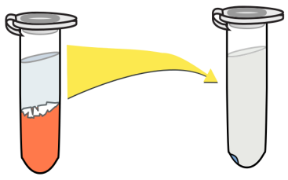
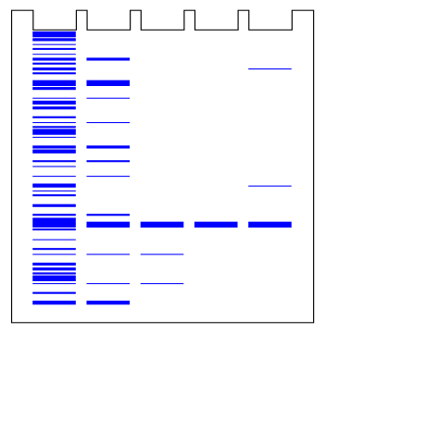
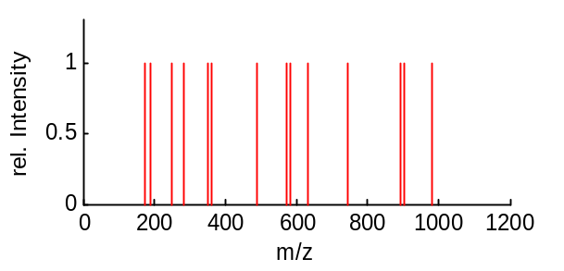
Introduction – Sample treatment
Cells
cell disruption
Lysate
protein extraction
Pellet
electrophoretic separation
Bands/Spots
tryptic digestion
Peptides
fragmentation
Spectra
database search
Meta-Proteome-Analyzer
Oct 2011

Slide 5
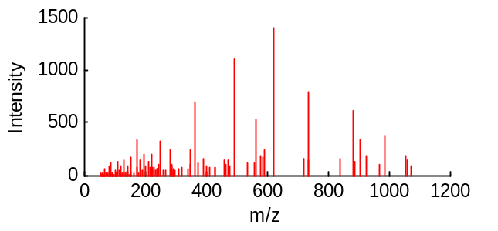
Introduction – Mass spectrometry
pep-tides
ioni-zation
detec-tion
+
–
+
+
+
+
+
m/z sepa-ration
m/z sepa-ration
+
+
fragment
+
+
+
+
Meta-Proteome-Analyzer
Oct 2011

Slide 6
Introduction – Mass spectrometry
pep-tides
Challenges
    lots of data to process
varying quality of data
weak correlation between theor. spectra and observed spectra
environmental samples often contain unsequenced species
~70-80% of peptide spectra not identifiable via conventional sequence database searching
ioni-zation
detec-tion
+
–
+
+
+
m/z sepa-ration
m/z sepa-ration
fragment
+
+
+
+
Meta-Proteome-Analyzer
Oct 2011

Slide 7
Approach
Meta-Proteome-Analyzer
main idea: identifying peptides by comparing spectra directly to each other
Meta-Proteome-Analyzer
Oct 2011

Slide 8
Approach – Project goals
General requirements and objectives
  building a spectral library of identified peptides to search against
  developing a robust search algorithm backed by statistical data
  offloading bulk workload onto external, remote server architecture
  local pre-processing of experimental data to reduce workload and save bandwidth
  optional remote post-processing of submitted data to enhance future search performance
Meta-Proteome-Analyzer
Oct 2011

Slide 9
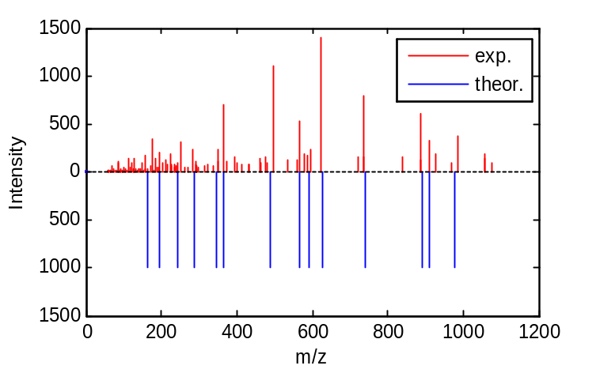
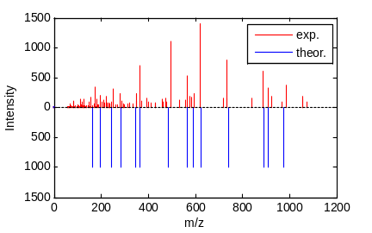
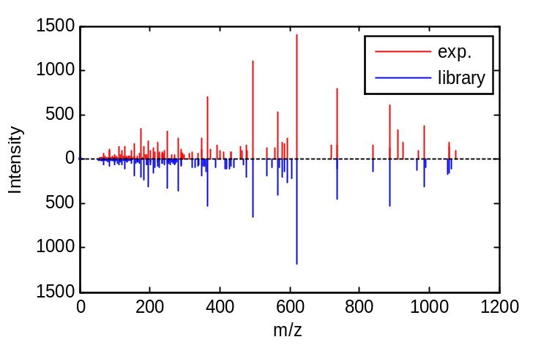
Approach – Spectral library
spectral library matching
possibly weak correlation
better matching expected
spectral library contents
  database built from conventionally identified spectra
  extensibility via optional user uploads
Meta-Proteome-Analyzer
Oct 2011

Slide 10
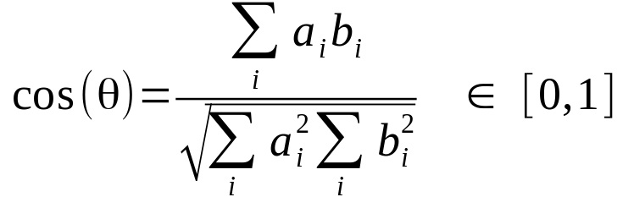
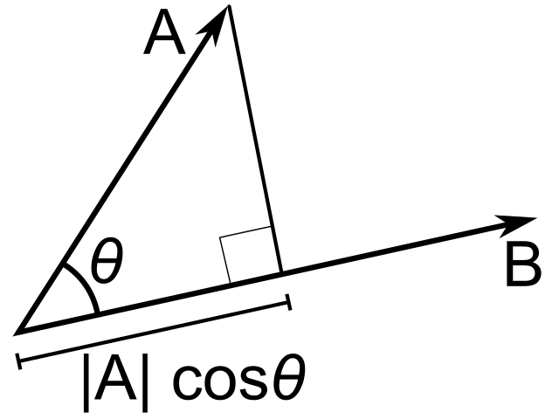
Approach – Search algorithm
Measuring quality of match of exp. spectra to library spectra
    spectral similarity
  tried-and-true formula: spectral contrast angle
  (a.k.a. normalized dot product
  or cosine correlation)
  alternatives:
    Euclidean distance
    Hertz et al. similarity index
    probability-based matching
    …
➔ less discriminating power
Meta-Proteome-Analyzer
Oct 2011

Slide 11
Approach – Dot product
advantages:
  simple (computationally lightweight)
  easy to grasp (e.g. as percent range)
  widely used concept (SEQUEST, X!Hunter, Bibliospec, SpectraST, …)
disadvantage: does not scale well with library size
variations based on pre-treatment of input data:
  method of data vectorization (k highest peaks, binning)
  intensity normalization, weighting, transformation
    sub-objective:
    determining optimal pre-treatment methods and parameters for maximal discriminating power and minimal false discovery rates
Meta-Proteome-Analyzer
Oct 2011

Slide 12
Summary and Outlook
Main goals:
  develop superior workflow to reliably identify large amounts of peptide mass spectra
  speed up time-consuming workflow steps via remote processing
Further possible applications:
  approach not limited to peptides
  infer process behaviour from composition of samples (e.g. taken at specific time intervals)
  feed quantitative data into pathway analysis tools
  … ?
Meta-Proteome-Analyzer
Oct 2011

Slide 13
The End
Thank you for listening!
Meta-Proteome-Analyzer
Oct 2011

Slide 14
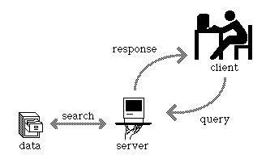
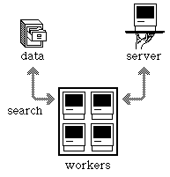
Approach – Client/Server architecture
database searching and sophisticated data processing is time-consuming
entirely local processing not viable when dealing with vast quantities of data and large databases, therefore:
  offloading main workload onto remote server
  simple client-side pre-processing to
  save bandwidth and storage space
  (e.g. filtering out low-quality spectra)
long-term goal:
  expand communication system into distributed computing network to further increase performance
Meta-Proteome-Analyzer
Oct 2011

Slide 15
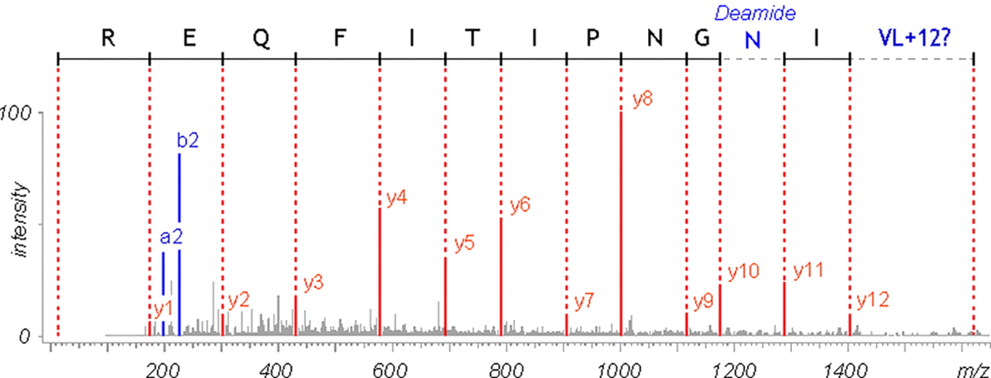
Approach – Remote processing
clustering of input data
  create consensus spectra by averaging similar spectra
    decreases total amunt of spectra to match against library
    increases signal-to-noise ratio (SNR)
analogous: clustering of database spectra
statistical evaluation of found matches
  target-decoy approach to determine false discovery rate
optional: attempt de novo sequencing of unidentifiable spectra
optional: incorporate results into database
Meta-Proteome-Analyzer
Oct 2011

