Slide 1


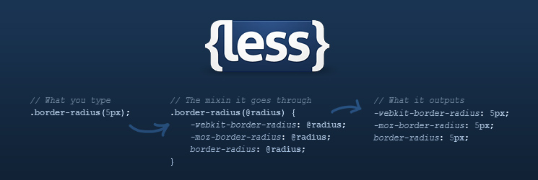
LESS
The Dynamic Stylesheet Language
CSS
Telerik Software Academy
http://academy.telerik.com

Slide 2

Table of Contents
LESS Overview
Working with LESS
Using LESS
On the Client
On the Server
LESS Features
Selector nesting
Mixins and Functions
Variables and Interpolation
Many More

Slide 3

LESS Overview
What is LESS?

Slide 4

LESS Overview
Extension to CSS - http://lesscss.org/
Write "less" code – compile to normal CSS
Can be parsed both Client and Server side
Using a LESS parser written in JavaScript
LESS Features include
Variables,
Mixins
Color editing functions
Selector nesting and more

Slide 5
Working with LESS
Client and Server Side

Slide 6
Using LESS on the Client
LESS can be parsed on the client (browser)
Include a JavaScript file, that does the parsing
Steps:
Write your LESS
Using Visual Studio, you should add a mime type for the LESS in web.config
You are ready to go
<link rel="stylesheet/less" type="text/css" href="styles.less"/>
<script src="less.js"></script> //after the less link
<configuration> <system.webServer> <staticContent>
<mimeMap fileExtension=".less" mimeType="text/css" />
</staticContent> </system.webServer> </configuration>

Slide 7
Using LESS on the Client (2)
How client-side LESS works?
The JavaScript performs a AJAX GET request to LESS file
Then it parses all the LESS code into pure CSS
The CSS is appended to the HEAD of the page
Using client-side LESS is slow
All the parsing is done by the client
i.e. spend some of the browser resources for kinda pointless parsing
Imagine a 2000-lines-long LESS file…

Slide 8
Using LESS on the Client
Live Demo

Slide 9
Parsing LESS on the Server
LESS can be parsed on the server in many ways
Using the client approach and copy the parsed CSS
Not good enough, lots of copy-pastying
Using node.js to do the parsing
Better solution - the parsing is automated
Using VS plugin - Web Essentials
Live parses the LESS to pure CSS

Slide 10
How To Use Node.js
Install Node from https://nodejs.org/
Open Command Prompt and write
Navigate to the folder with the .less file
Write down the following
You can also minify the result
npm install less -g
$ lessc {less file} {output CSS file}
$ lessc –x {less file} {output CSS file}

Slide 11
Parsing LESS on the Server
Live Demo

Slide 12

LESS Features
Selector Nesting, Mixins, Variables, etc…

Slide 13
Selector Nesting
LESS introduces selector nesting
body {
font: normal 16px arial;
color: #fff;
background-color: #011b63;
h1 {
font-size: 2.3em;
font-weight: bold;
}
}
body {
font: normal 16px arial;
color: #fff;
background-color: #011b63;
}
body h1 {
font-size: 2.3em;
font-weight: bold;
}
Parses to

Slide 14
Selector Nesting (2)
All selectors inside a selector are translated to nested selectors
Selectors can also reference themselves inside their selector using the symbol & (AND)
body {…
h1 {…}
}
body {…}
body h1{…}
…
a{
&:hover{…}
}
…
…
a{…}
a:hover{…}
…

Slide 15
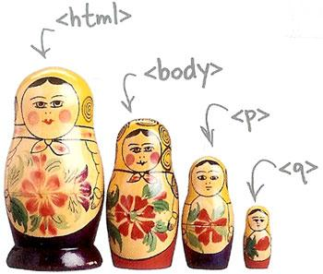
Selector Nesting
Live Demo

Slide 16
LESS Variables
LESS also has variables
Using the @ (at) symbol
Can be used to store colors, size, etc…
Usable to set default background-color, font-color, font-size, etc…
@link-color: #ffffff;
@v-link-color: #646363;
a {
color: @link-color;
&:visited {
color: @v-link-color;
}
body a {
color: white; }
body a:visited {
color: #646363; }

Slide 17

Variables
Live Demo

Slide 18
Interpolation
LESS variables can be inserted as CSS properties
Using @{…}
@border-side:top;
@border-color:blue;
@border-style:ridge;
@border-width:15px;
…
border-@{border-side} :
$border-width $border-style $border-color;
border-top : 15px ridge blue

Slide 19
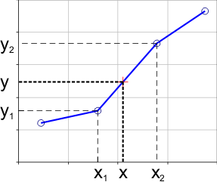
Interpolation
Live Demo

Slide 20
Extend
The :extend pseudo selector can be used to extend a selector
More here: http://lesscss.org/features/#extend-feature
nav ul {
&:extend(.inline);
background: blue;
}
.inline {
color: red;
}
nav ul {
background: blue;
}
.inline,
nav ul {
color: red;
}

Slide 21
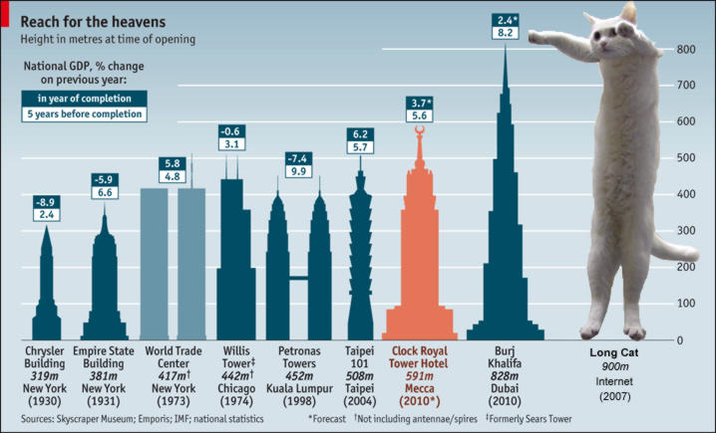
Extend
Live Demo

Slide 22
Functions
LESS support predefined functions
For stuff with colors
For sizes (percentages)
Find all the functions at http://lesscss.org/functions/
@color: #ffffff;
background-color:lighten(@color, 10%);
color:darken(@color, 15%);
percentage(0.5); //returns 50%

Slide 23

Functions
Live Demo

Slide 24
Mixins
Mixins are kind of developer defined functions
The developer can make them for clear LESS
Two kind of mixins
Parameterless
Get a default styles every time
With parameters
Get style based on some parameters
Gradient, borders, etc…

Slide 25
Mixins (2)
How to define mixins?
Use .mixin-name
Then the styles are normal LESS
How to use the mixin?
Place use .mixin-name
.clearfix{
zoom:1;
&:after{
display:block; content:"";
height:0; clear:both; } }
ul#main-nav{
.clearfix;
}

Slide 26

Basic Mixins
Live Demo

Slide 27
Mixins with Arguments
Mixins can also be defined with parameters
i.e. for gradient-background
Use the arguments like a C# method
.opacity(@value){
…
}
//arguments can take default values
.box(@border:none,@bg:rgba(0,0,0,0.7),@size:200px) {
…
}
…
div.box-div{
.box; //using the mixin with default parameter values
.opacity(0.5); //using the mixin with 0.5 value
}
…

Slide 28

Mixins with Arguments
Live Demo

Slide 29
Pattern-matching Mixins
Mixins can define different behavior, depending on its parameters
.color(dark,@color){
color:@darken(@color);
}
.color(light,@color){
color:@lighten(@color);
}
//called no matter which of the above is called
@color(@_,@color){
border: 1px solid @color; }

Slide 30

Pattern-matching Mixins
Live Demo

Slide 31
Mixin "Return" Values
Mixins can have "return" values because of the variable scope
.average(@x, @y) {
@average: ((@x + @y) / 2);
}
div {
.average(16px, 50px); // "call" the mixin
padding: @average; // use its "return" value
}
/* Compiles to */
div {
padding: 33px;
}

Slide 32

Mixin "Return" Values
Live Demo

Slide 33
Importing Other Files
You can import other files wherever you want
In our main file
In our "other-styles.less" file
Results in
.foo { background: #900; }
@import "other-styles.less";
.foobar { background: #900; }
.foo { background: #900; }
.foobar { background: #900; }

Slide 34

Importing Other Files
Live Demo

Slide 35
Conditional Mixins
Also called "Mixin Guards"
Using "when" keyword can specify conditions on which the mixin will be called
Operators are >, >=, =, =<, <
.mixin (@a) when (lightness(@a) >= 50%) {
background-color: black;
}
.mixin (@a) when (lightness(@a) < 50%) {
background-color: white;
}

Slide 36
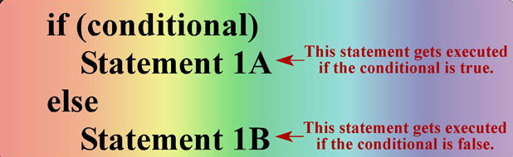
Conditional Mixins
Live Demo

Slide 37
Loops
Because of "Mixin Guards" you can create loop/iterations structure
.loop(@counter) when (@counter > 0) {
.loop((@counter - 1)); // next iteration
width: (10px * @counter); // code for each iteration
}
div {
.loop(5); // launch the loop
}

Slide 38

Loops
Live Demo

Slide 39
LESS
http://academy.Telerik.com

Slide 40




Free Trainings @ Telerik Academy
"Web Design with HTML 5, CSS 3 and JavaScript" course @ Telerik Academy
html5course.telerik.com
Telerik Software Academy
academy.telerik.com
Telerik Academy @ Facebook
facebook.com/TelerikAcademy
Telerik Software Academy Forums
forums.academy.telerik.com

