Slide 1
Team-Ang
Ang, Pagador, Rodriguez, Vertulfo

Slide 2

What would you do if this boy shared his HappyMeal with you?
Notes:
Boys like him starve every day. I commute almost everyday and I remember that almost everytime I pass by this certain mother and her child she would offer me food. Ironically we find it so difficult to give them the little help they ask for.

Slide 3
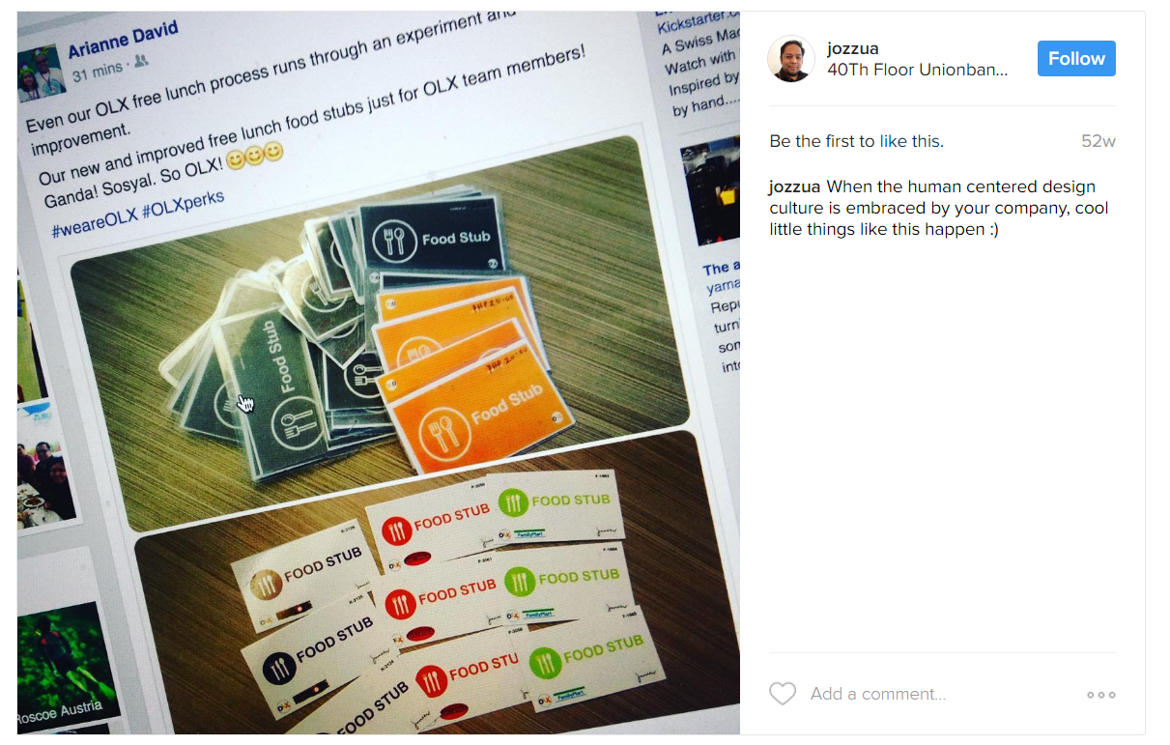
Food is being wasted

Slide 4
What can we do?

Slide 5
Over 1.3 billion tons of food is lost each year, [according] the latest findings of the Food and Agriculture Organization (FAO).
According to Fritzie Rodriguez from Rappler.com

Slide 6
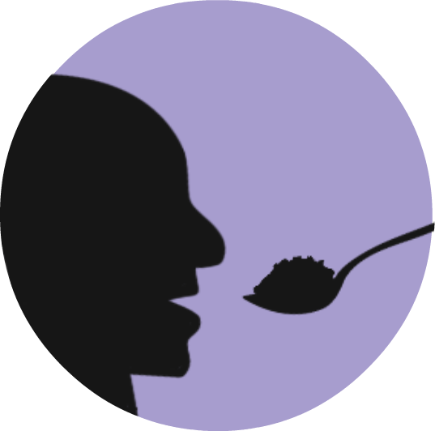
FoodBridge
“Connecting people through food”

Slide 7
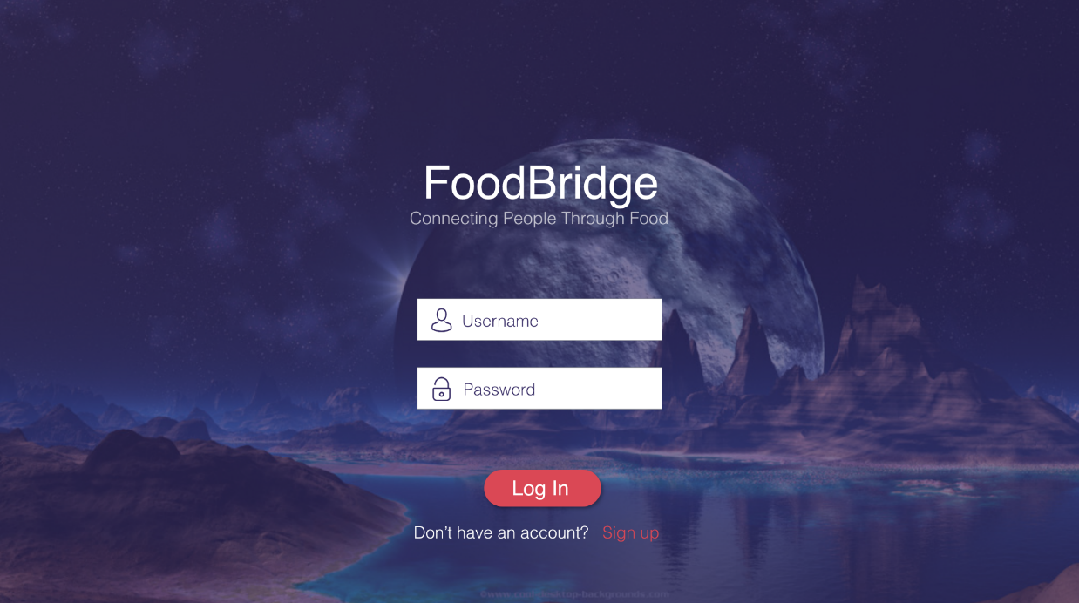
FoodBridge
A website application that connects food suppliers and food retailers to charitable institutions to be able to

Slide 8
Prototype

Slide 9
Business Plan
Membership
We would charge a premium fee of 30% from each transaction made.
Why would you subscribe then?
Revenue of P3000 can be generated from a P10,000 disposal loss.
We take the hassle off your hands as we provide logistics

Slide 10
Business Plan
Membership
We would charge a premium fee of 30% from each transaction made.
World food wastage
₱8.28T
PH food waste
₱7.3B
Income
Notes:
Worldwatch.org and Rappler.com

Slide 11
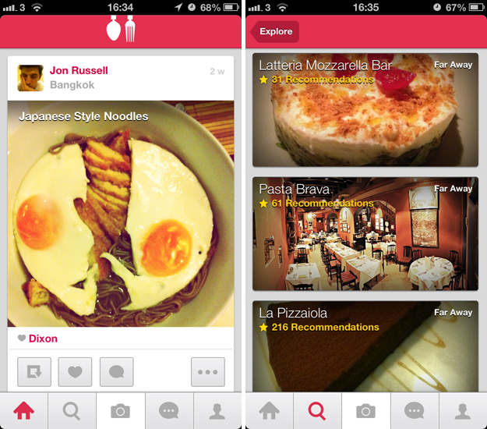
Competitors
Feedie
This app allows users to share photos of their meals and with each meal shared, the restaurant then gives food donations to townships and rural areas of South Africa

Slide 12
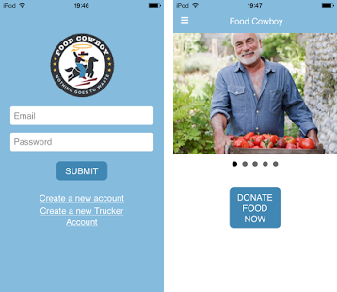
Competitors
Food Cowboy*
This app matches food companies with charities and compositors to keep wholesome surplus food from going to waste.

Slide 13
FoodBridge
Pros
Cons
No one has made it here in the Philippines before
Increases revenue while reducing waste in terms of Overstocked goods
Charity Orgs can initiate transactions quickly
Internet-based and needs to be maintained
Has a small niche market

Slide 14
Alternatives or Modifications to the Solution
- Mobile Platforms
- Responsiveness to Calamities
- Expand to others markets

Slide 15
If we were to eliminate hunger, everybody has to be involved.

