Slide 2
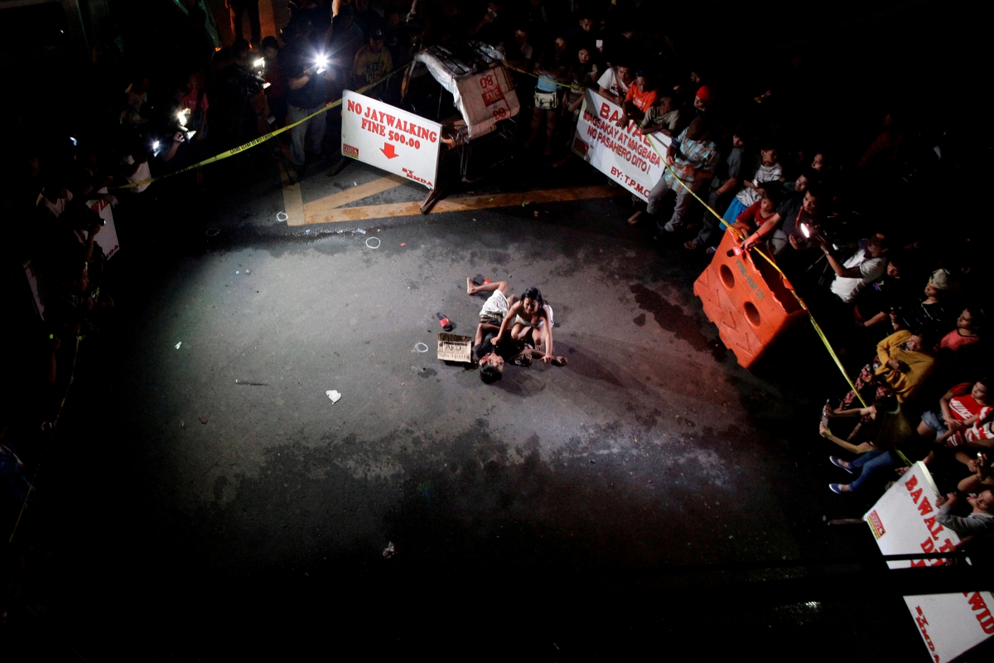

Slide 3

a-bot-gado
abot*abogado

Slide 4
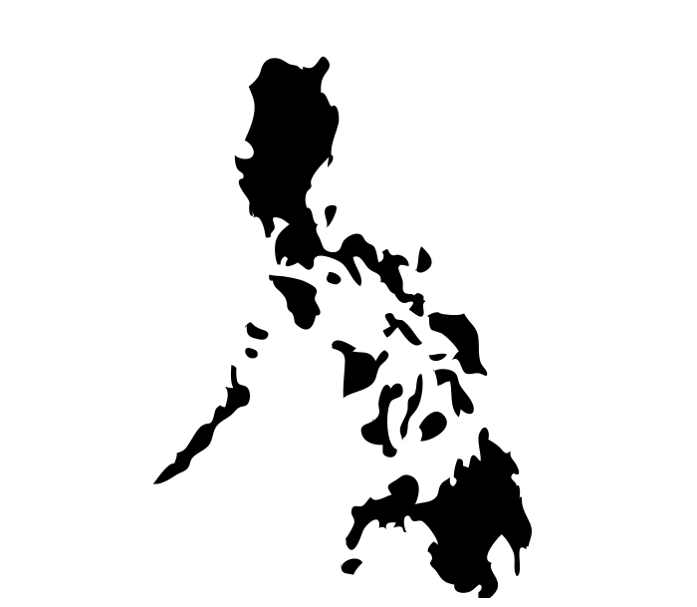

Social Media Capital
of the World

Slide 5

ELEMENTS
Client
Abotgado
Legal Adviser

Slide 6

Legal Procedures and Forms Aid

Slide 7

Location Services

Slide 8

Legal Consultation

Slide 9

Emergency Legal Support

