Slide 1
Pi-C-ni-c
Pamilya Community Nutrition. checker
Submitted by
TEAM RARR

Slide 2
State of our Nation
The Philippine chronic malnutrition rate among children aged 0-2 was at 26.2%, (highest in 10 years) From 2013 to 2015, 10% of the stunting children increased to an average of 40%, and is expected to increase in 2016.
The Philippines is losing at least P328 billion a year due to the impact of childhood stunting on education and workforce productivity with 33% childhood stunting nationwide, Olney said the Philippines is now ranked 9th in the world in terms of total number of stunted children

Slide 3

Project Overview
This project aims to inform families/communities of the nutritional state of their members, and what steps they should take to get back on the road to wellness. A user, upon registering through their family account, can check their BMI, review prescribed wellness tips, and contact a licensed nutritionist for further information.

Slide 4

Which SDGs it tackles

Slide 5
Software Requirements
System Functionalities
Users and User Roles

Slide 6
System Functionalities
The app possesses several functionalities that help serve this purpose:
Family Account Registration through Google
BMI Calculator
Basic Health Information from BMI Result
Direct SMS between Families and Doctors

Slide 7
Users and user roles
Family/Community
One account for all members
Per new user, will have to add another member to the account
Nutritionist
Provide necessary information to the family and community members.

Slide 8
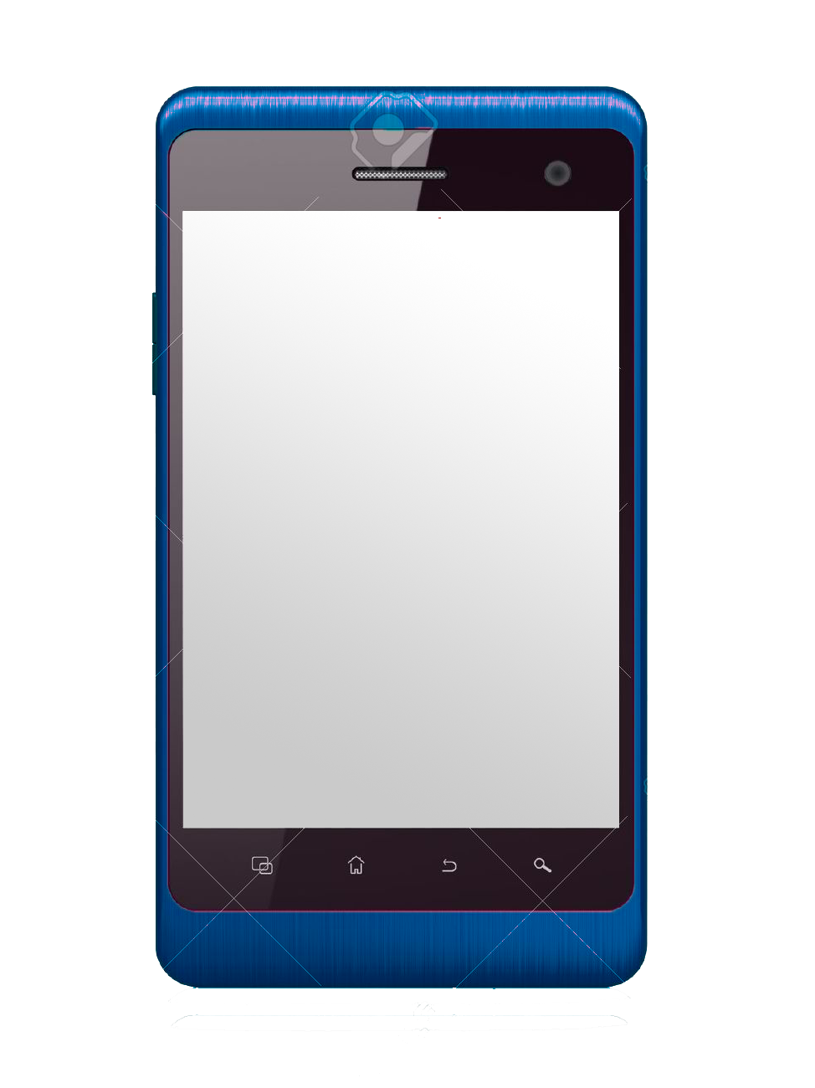


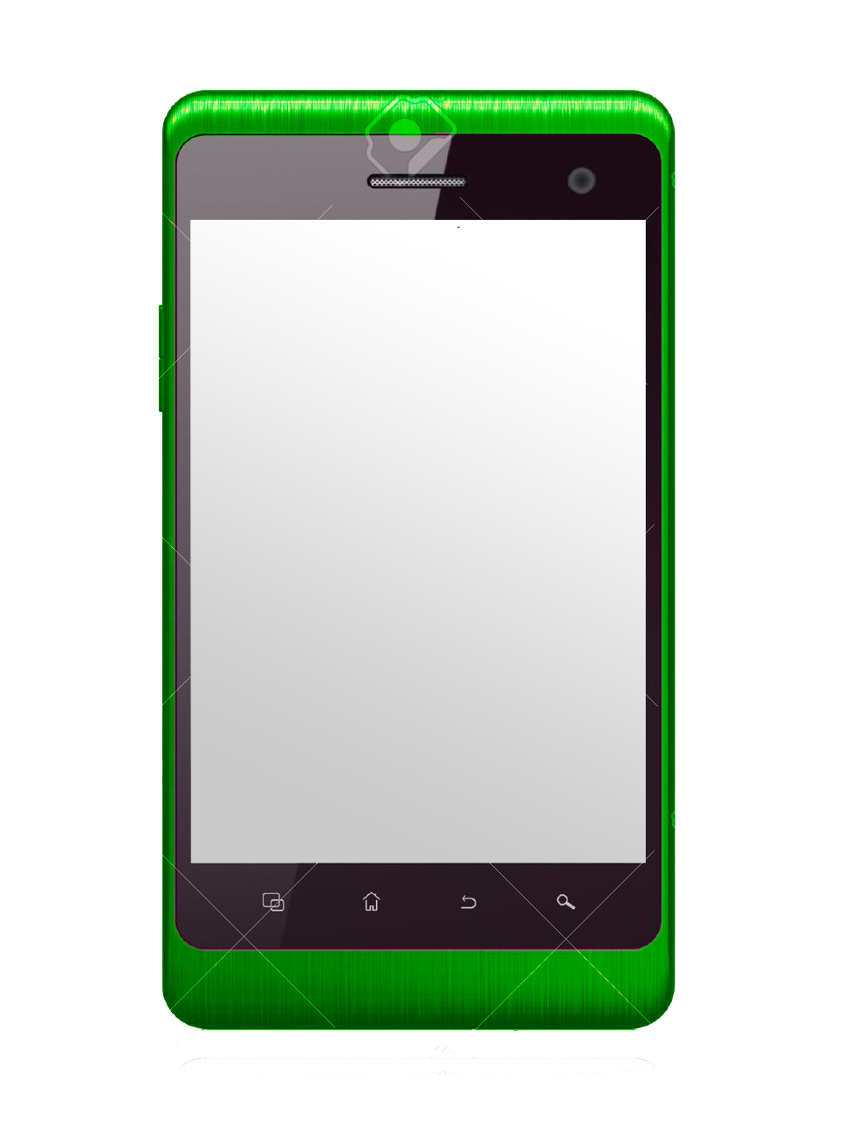

Mockup of system Version 1
Nutritionalists
Patient
Monitor

Slide 9
Mockup of system Version 2
Nutritionalists
Patient
Monitor

