Slide 1
Wireless Mesh Networks:
Fair Scheduling & Load Balancing
Jason Ernst
University of Guelph © 2008
Advisor: Dr. Mieso Denko

Slide 2
Presentation Outline
Introduction & Background
  Wireless Mesh Networks
Motivation
  Fair Scheduling
  Classification of Scheduling Techniques
  Load Balancing
Related Work
Current Problems
Future Work & Conclusions
Questions
Jason Ernst – © University of Guelph

Slide 3
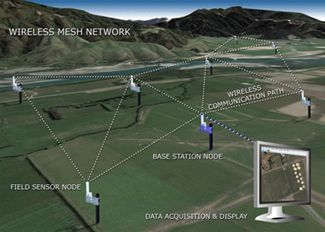
Wireless Mesh Networks
WMN - Wireless Mesh Network:
  Ad-hoc network with a core which has limited mobility
Mesh Router:
  A wireless base station with limited or no mobility
  Infrastructure of the network
Mesh Clients:
  A wireless node which is fully mobile, may also act as a router in some WMNs
Image: Indigo Systems – WMN for Environmental Monitoring
Jason Ernst – © University of Guelph

Slide 4
Motivation: Fair Scheduling
Starvation & Unequal Quality of Service (QoS)
  “Greedy” flows cause other traffic to be ignored resulting in starving or unequal QoS
  Nodes closer to the gateways cause farther nodes starvation or unequal QoS
In commercial applications people who pay the same amount expect the same quality of service
Jason Ernst – © University of Guelph

Slide 5
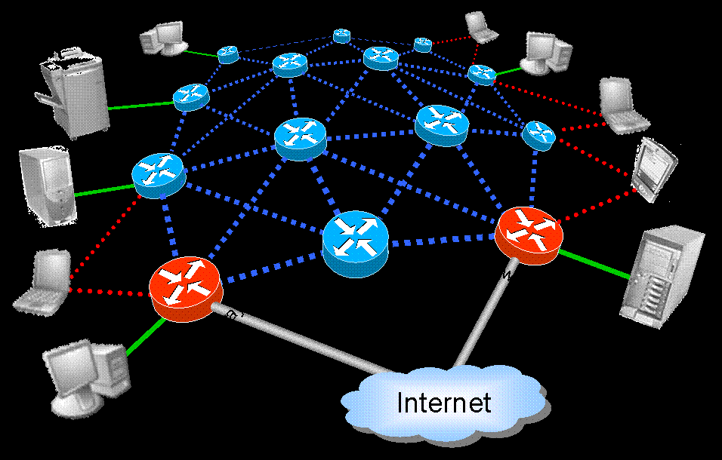
Motivation: Fair Scheduling
Image: NC State University Elec. Eng. Dept.
Jason Ernst – © University of Guelph

Slide 6
Classifications of Scheduling
Throughput
Fairness
Jason Ernst – © University of Guelph

Slide 7
Classifications of Scheduling
Throughput
Fairness
Maximum Throughput Scheduling
Optimizes Resource Utilization but starvation occurs if there are many simultaneous flows with different costs because of high priority for least “expensive flows” ie) close proximity, small flows
Jason Ernst – © University of Guelph

Slide 8
Classifications of Scheduling
Maximum Throughput Scheduling
Throughput
Fairness
Equal Fairness / Best Effort / Round Robin
“Greedy” users with large flows are favoured over smaller flows because of equal time slices for each flow
Jason Ernst – © University of Guelph

Slide 9
Classifications of Scheduling
Maximum Throughput Scheduling
Throughput
Fairness
Equal Fairness
Max-Min Fairness (Fair Queuing)
The minimum data rates are maximized for each flow resulting in higher throughput than equal fairness but still much less than max throughput
Jason Ernst – © University of Guelph

Slide 10
Classifications of Scheduling
Maximum Throughput Scheduling
Throughput
Fairness
Equal Fairness
Min-Max
Proportional Fairness
Compromise between throughput and fairness using priorities and weighting functions to maximize throughput while providing minimum QoS
Jason Ernst – © University of Guelph

Slide 11
Related Work: Fair Scheduling
Operating Systems
  User / process scheduling in interactive OS’s started in the 1960s and 70’s (multics, unix)
Wired Networks & Wireless LAN (single hop)
Ad-hoc Networks
Distributed Computing – SHARCNET
Jason Ernst – © University of Guelph

Slide 12
Motivation: Load Balancing
One important benefit of WMNs is multiple path redundancy
However sometimes many nodes make use of common links causing congestions while others remain unused
Load Balancing can also be used as a method to achieve fairness in a WMN
Current Research suggests that
Jason Ernst – © University of Guelph

Slide 13
Load Balancing
Load Balancing in WMNs may be applied:
  On the links
  On the Mesh Routers
  On the Gateways to the Internet
  By partitioning the network
Another Technique:
  “Curveball Routing” which avoids the central portion of the network by using curved routing paths
Jason Ernst – © University of Guelph

Slide 14
Load Balancing
Image: NC State University Elec. Eng. Dept.
Jason Ernst – © University of Guelph

Slide 15
Related Work: Load Balancing
Resource Sharing
  CPUs (multiple core, clusters etc), HDDs (RAID 0,5)
  Internet Services - HTTP, FTP, DNS servers
  Use many servers to distribute the workload
Redundancy - RAID 1
WLAN, Ad-hoc Networks
Jason Ernst – © University of Guelph

Slide 16
Current Problems
Fair Scheduling
  Some papers make assumptions such as single hop networks, limited mobility, fixed topology (APs cannot be added or removed)
  Assumption which treats uplink and downlink together when it may be beneficial to treat them independently
  Localized VS Centralized scheduling & load balancing
Load Balancing
  Existing algorithms use metrics such as RTT and gateway queue length but work can still be done using other metrics
  Investigate load balancing at the gateways, links or mesh routers
Jason Ernst – © University of Guelph

Slide 17
Future Work
Future Work:
  Identifying an area of current research to expand upon
  Make use of experimentation to determine optimal parameter values, metrics for load balancing etc.
  Cross Layered Optimizations on solution
  Write a thesis based on the research
Jason Ernst – © University of Guelph

Slide 18
References
Agrawal et Al. Achieving Load Balancing in Wireless Mesh Networks Through Mulitple Gateways. IEEE. 2006. 807-812.
Bejerano, Yigal., Han, S-J., Kumar, Amit. Efficient Load-Balancing Routing for Wireless Mesh Networks. 2007. Computer Networks. 51. 2450-2466.
Chandranmenon et. Al. On the Design and Implementation of Infrastructure Mesh Networks. IEEE Workshop on Wireless Mesh Networks (WiMesh) 2005.
Cheng, S-M., Lin, Phone., Huang, Di-Wei., Yang, Shun-Ren. A Study on Distributed / Centralized Scheduling for Wireless Mesh Network. 2006. IWCMC ’06. ACM. 599-604.
Gupta, Piyush., Sankarasubramaniam, Yogesh., Stolyar, Alexander. Random-Access Scheduling with Service Differentiation in Wireless Networks. 2005. IEEE. 1815-1825.
Erwu, Liu., Shan, Jin., Gang, Shen., Luoning, Gui. Fair Scheduling in Wireless Multi-Hop Self-Backhaul Networks. IEEE AICT/ICIW 2006.
Hubaux, J-P., Salem, Ben Naouel. A Fair Scheduling for Wireless Mesh Networks. WIMESH. 2005
Koutsonikolas, Dimitrios., M. Das., Saumitra., Hu, Charlie, Y. An Interference-aware Fair Scheduling for Multi-cast in Wireless Mesh Networks. 2008. Journal of Parallel and Distributed Computing. 68. 372-286.
Popa, Lucian., Rostamizadeh, Afshin., Karp, Richard, M., Papadimitriou, Christos., Stoica, Ion. Balancing Traffic Load in Wireless Networks with Curveball Routing. 2007. Mobihoc ‘07. ACM. 170 – 179.
Jason Ernst – © University of Guelph

Slide 19
Questions?
Jason Ernst
jernst@uoguelph.ca
University of Guelph
Advisor: Dr. Mieso Denko
Jason Ernst – © University of Guelph

