Slide 1


Neural network models:
Inferring network models from (task) data
Joao Barbosa
Institute for Neuromodulation & NeuroSpin
joao.barbosa@inserm.fr
jbarbosa.org

Slide 2
"The person who asks a question is a fool for a minute; the person who does not remains a fool forever."
— Chinese Proverb
Neural network models:
Inferring network models from (task) data
Joao Barbosa
Institute for Neuromodulation & NeuroSpin
joao.barbosa@inserm.fr
jbarbosa.org

Slide 3

What we want to know

Slide 4
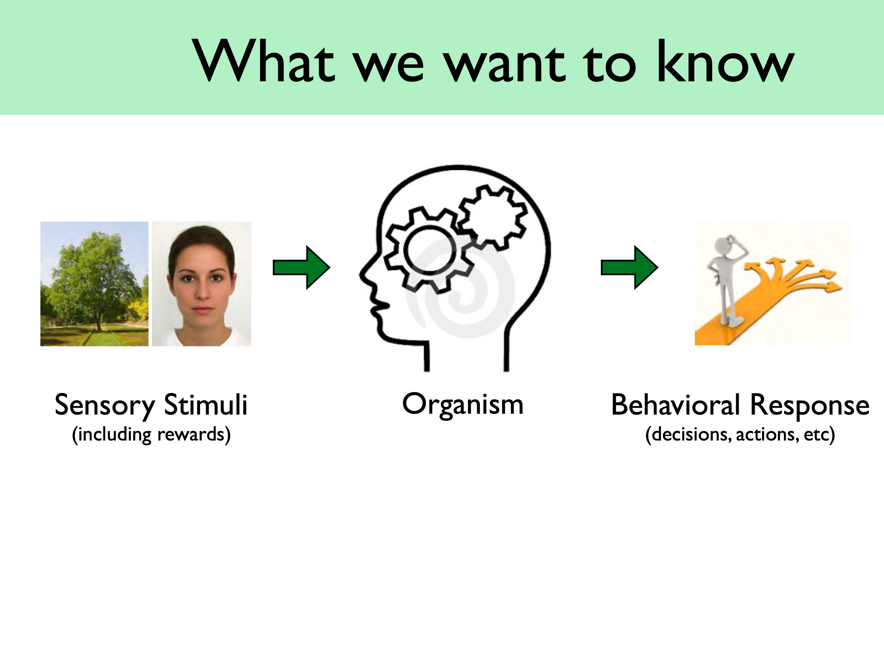
What we want to know

Slide 5
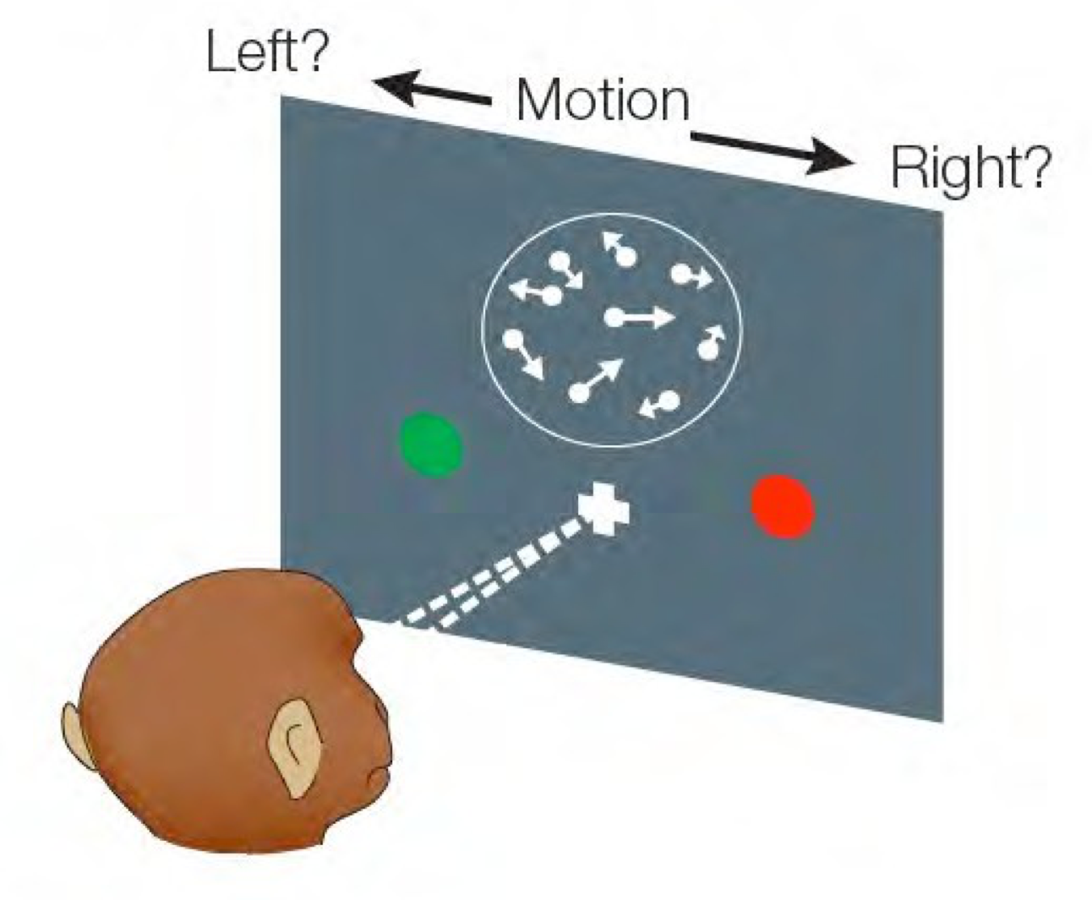
What we try to know!

Slide 6
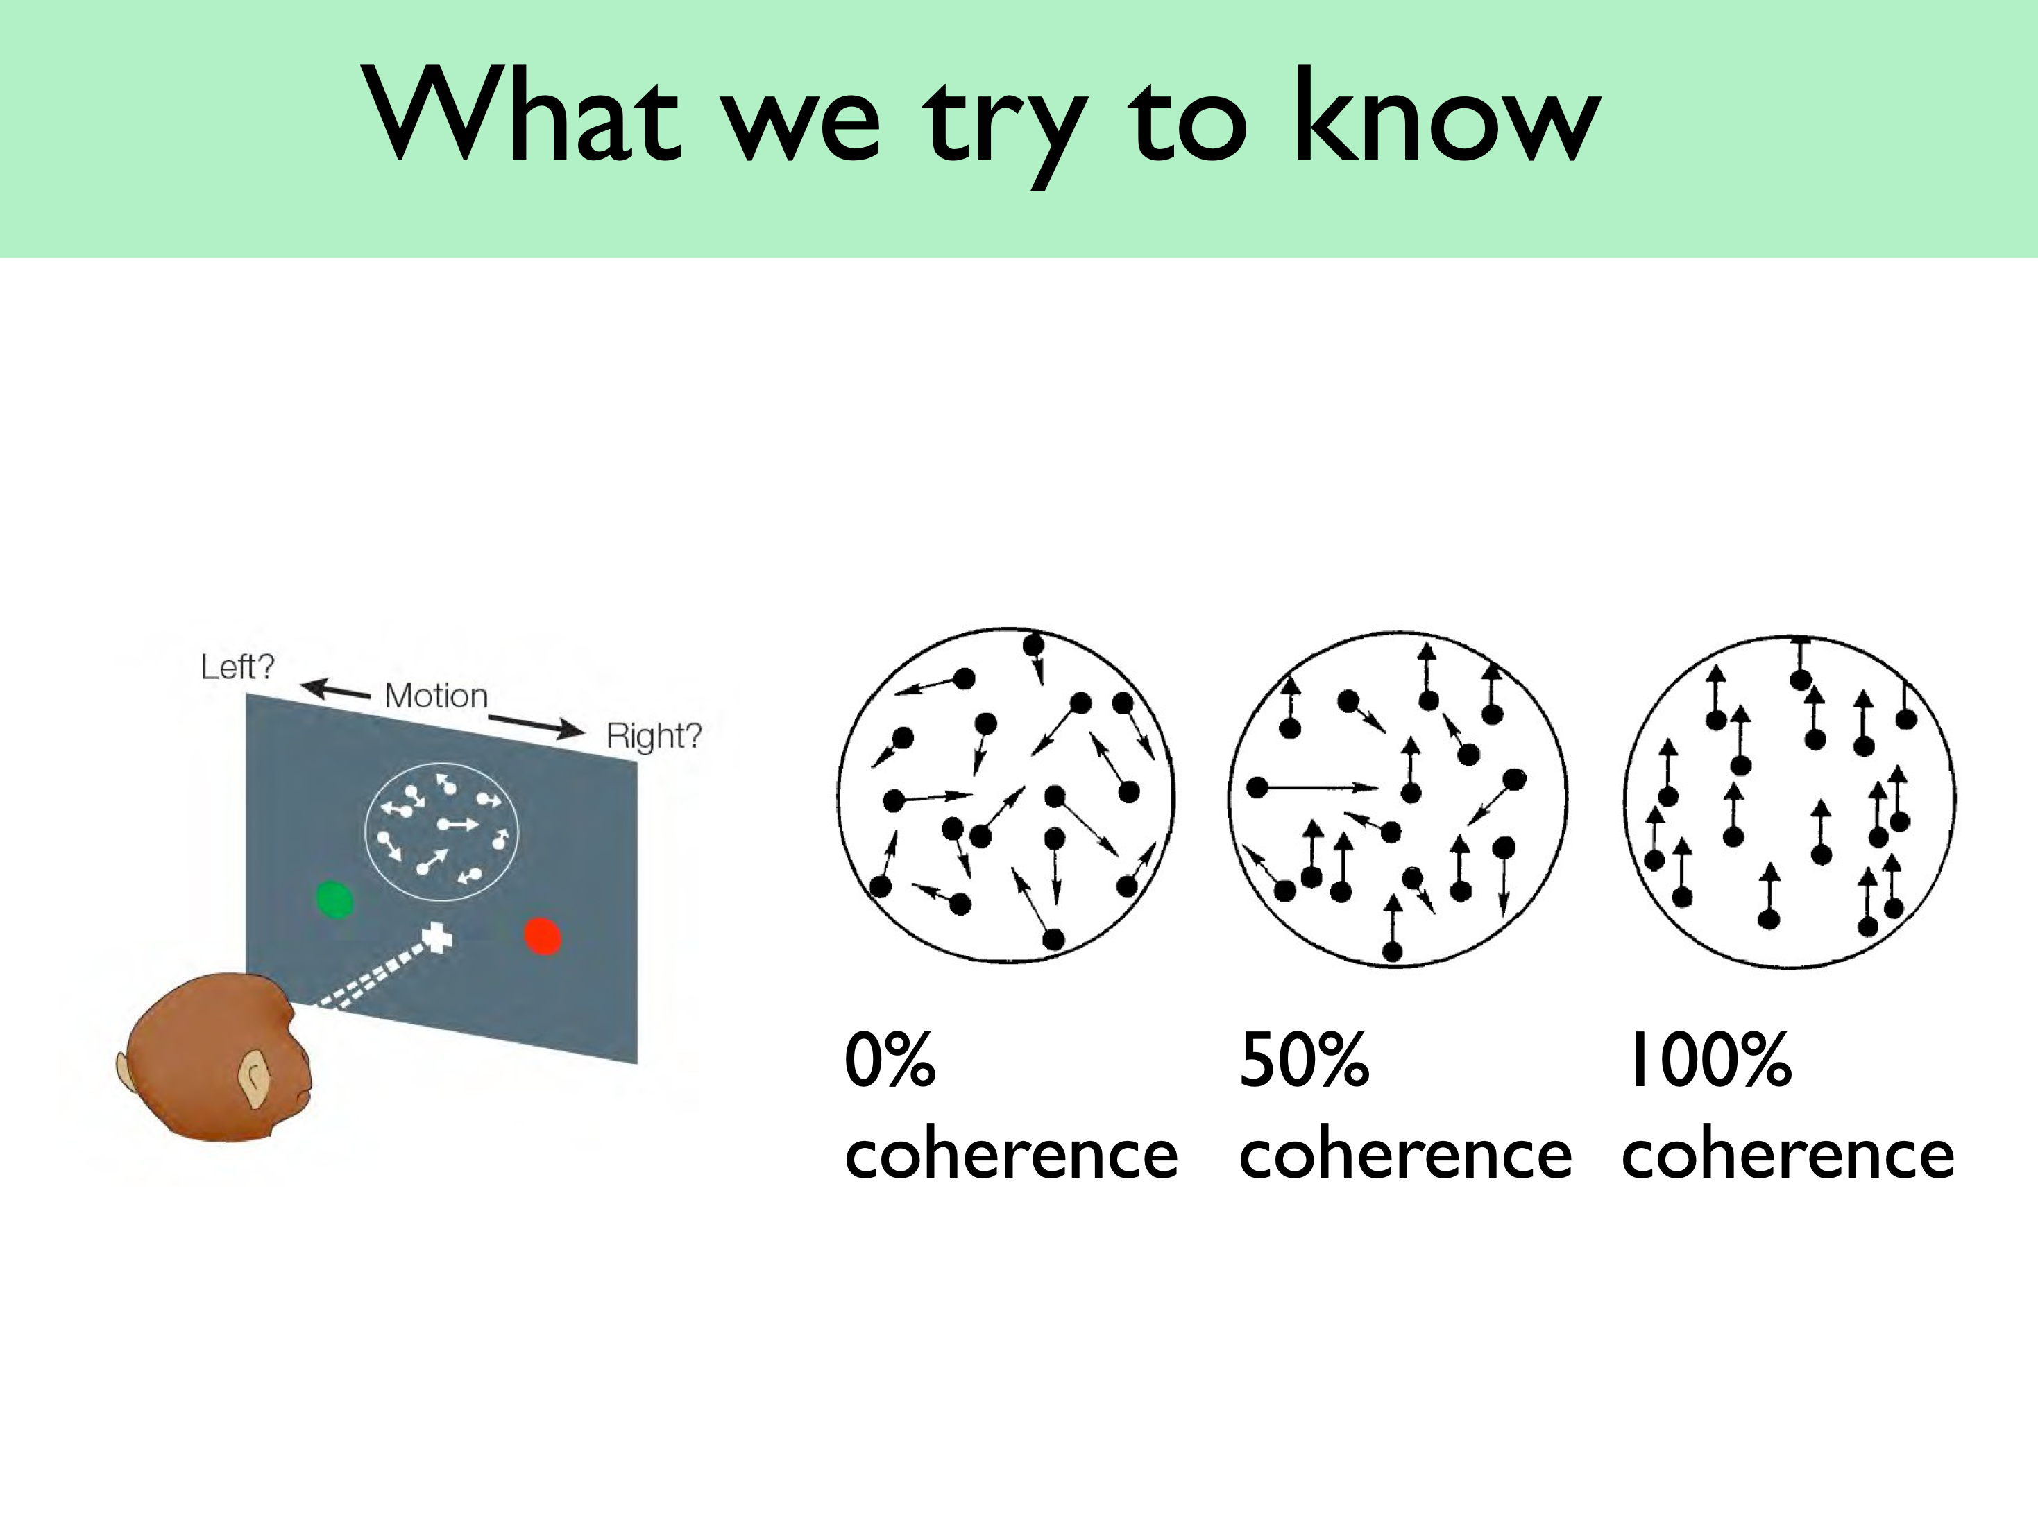
What we try to know!

Slide 7
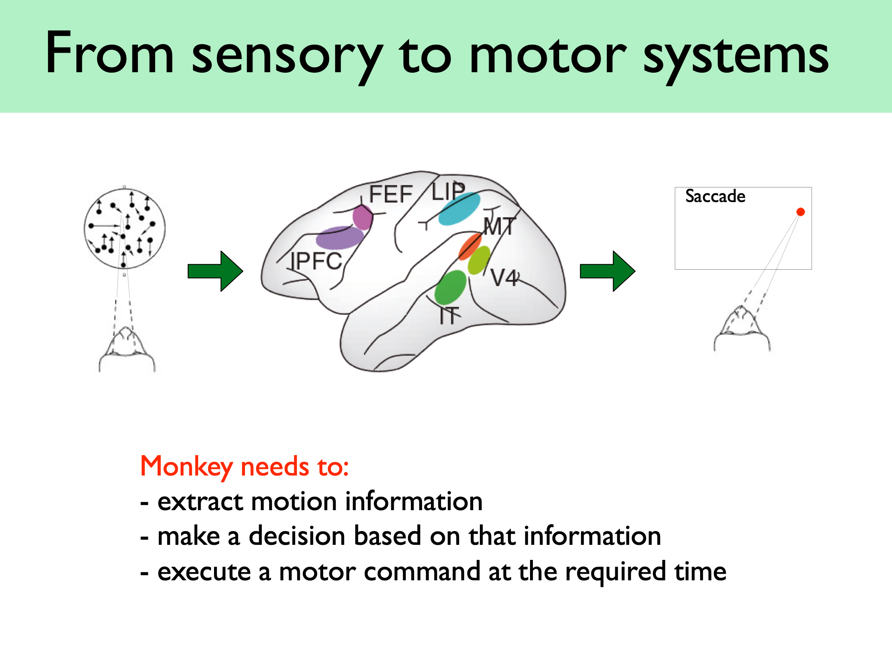
What we try to know!

Slide 8
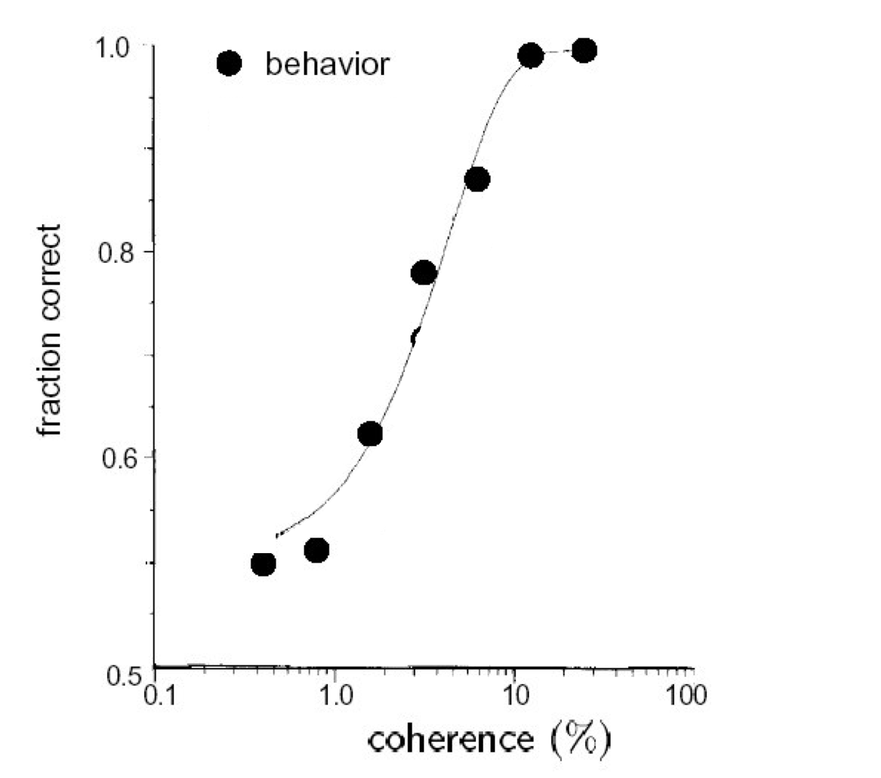
What we try to know!

Slide 9
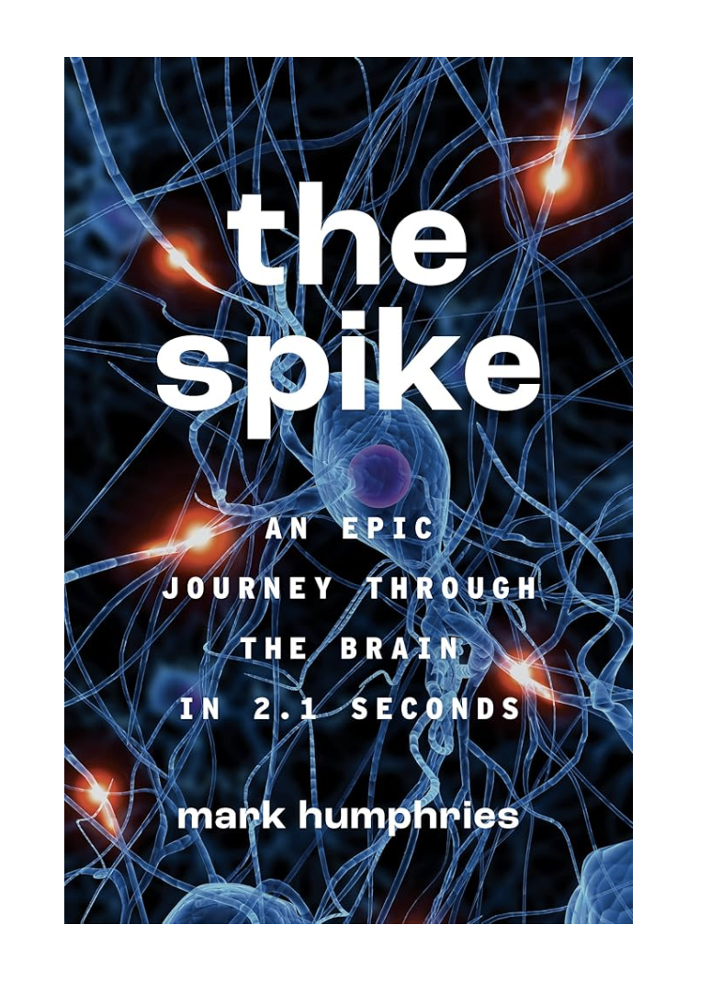

What we try to know!
Two great books!

Slide 10
What we try to know!

Slide 11
What we try to know!
Recording with electro-physiology

Slide 12
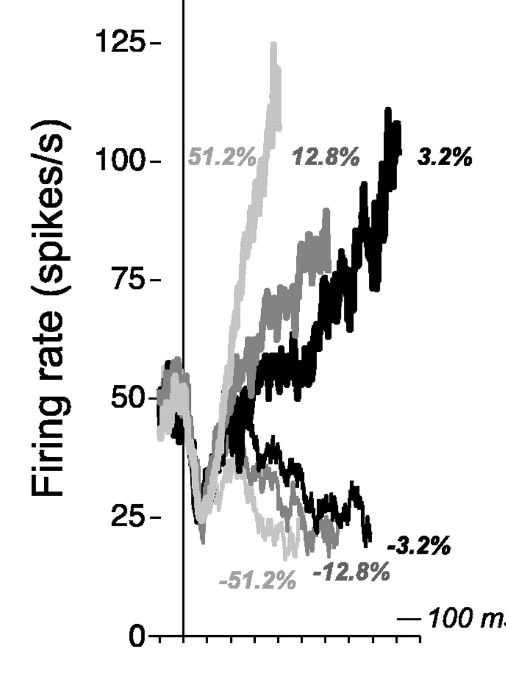
LIP makes decisions:
ramping activity!
Recording with electro-physiology

Slide 13
How to model decision making?
Recording with electro-physiology

Slide 14


How to model decision making?
Model
Recording with electro-physiology

Slide 15
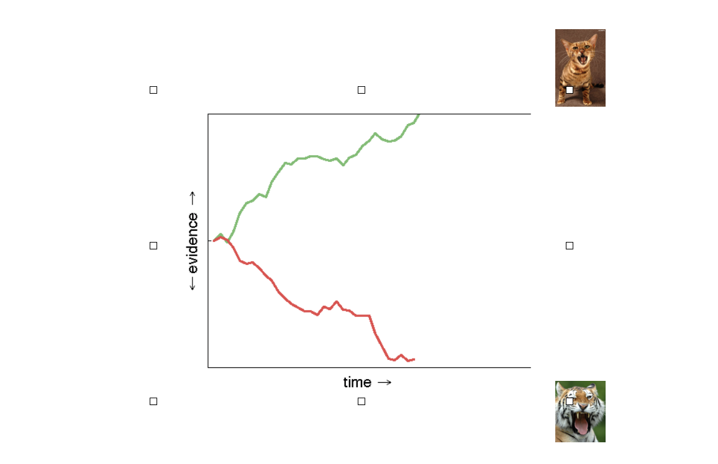
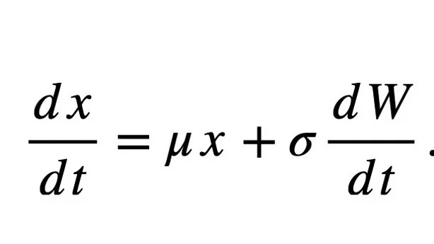
How to model decision making?
Model
Recording with electro-physiology

Slide 16
How to model decision making?
Another model?
Recording with electro-physiology

Slide 17
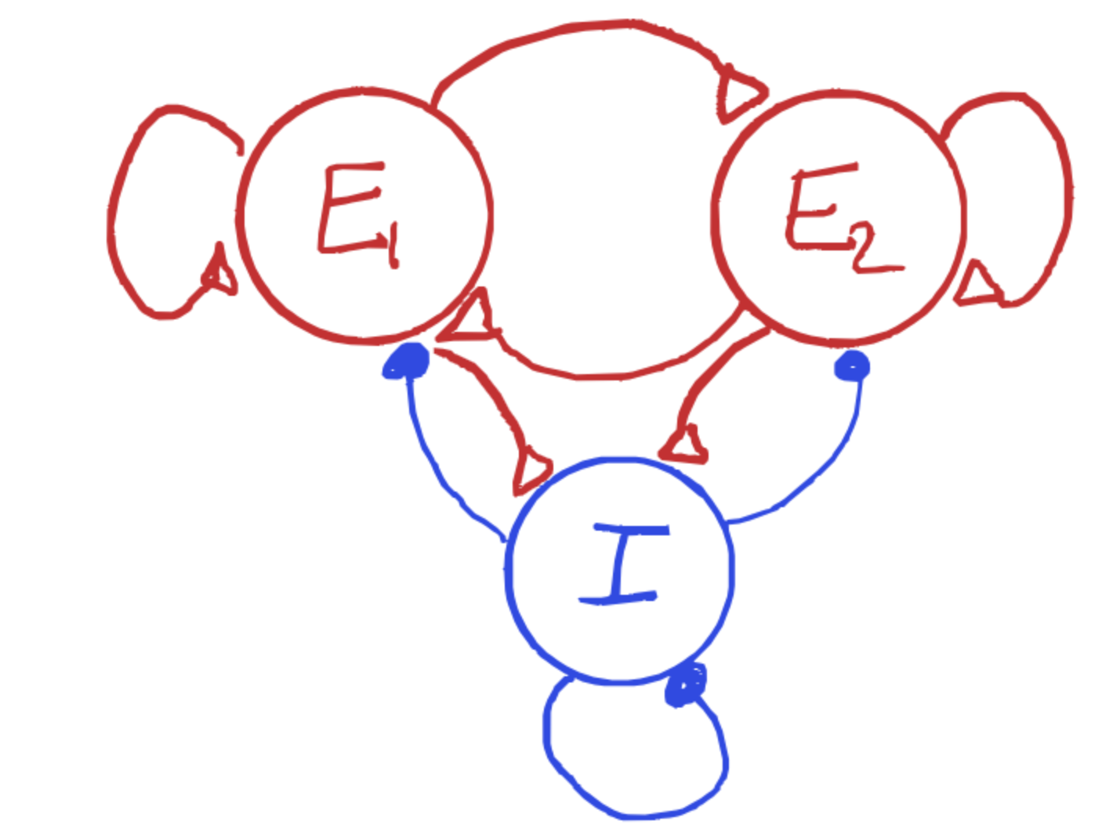
How to model decision making?
Model with neuron dynamics!
Recording with electro-physiology

Slide 18
How to model decision making?
double-well
Recording with electro-physiology

Slide 19
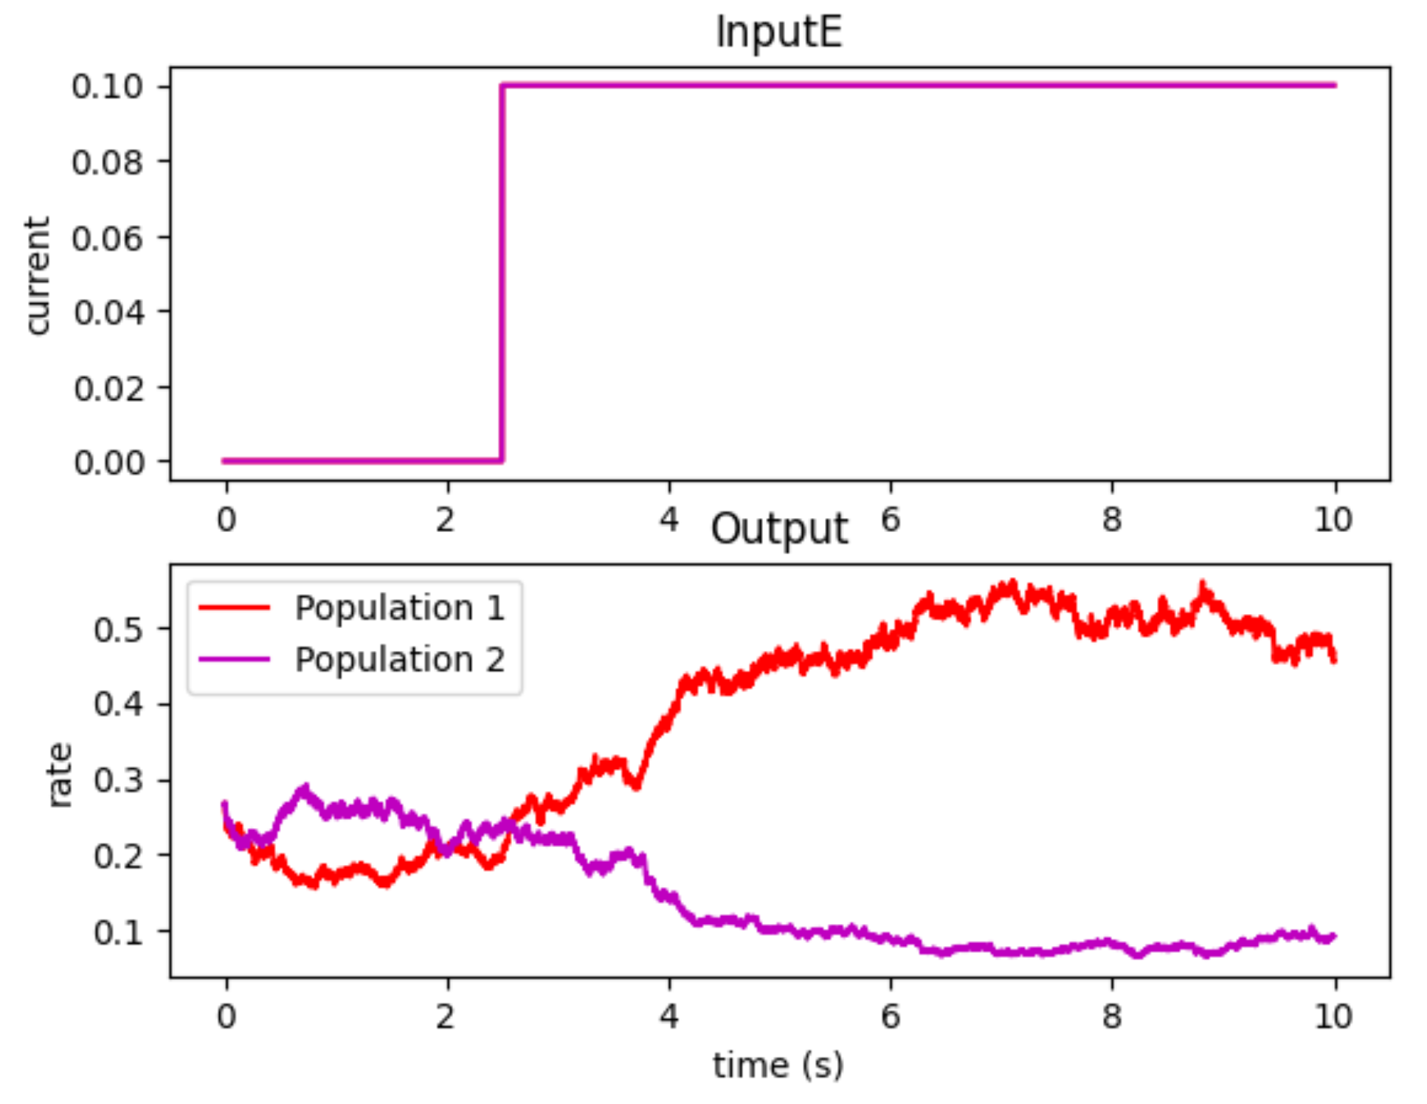
How to model decision making?
Recording with electro-physiology

Slide 20
How about another function, like working memory?

Slide 21
What is working memory?

Slide 22
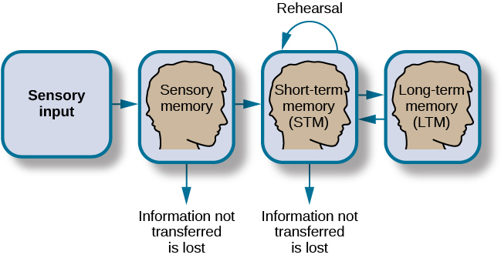
What is working memory?

Slide 23
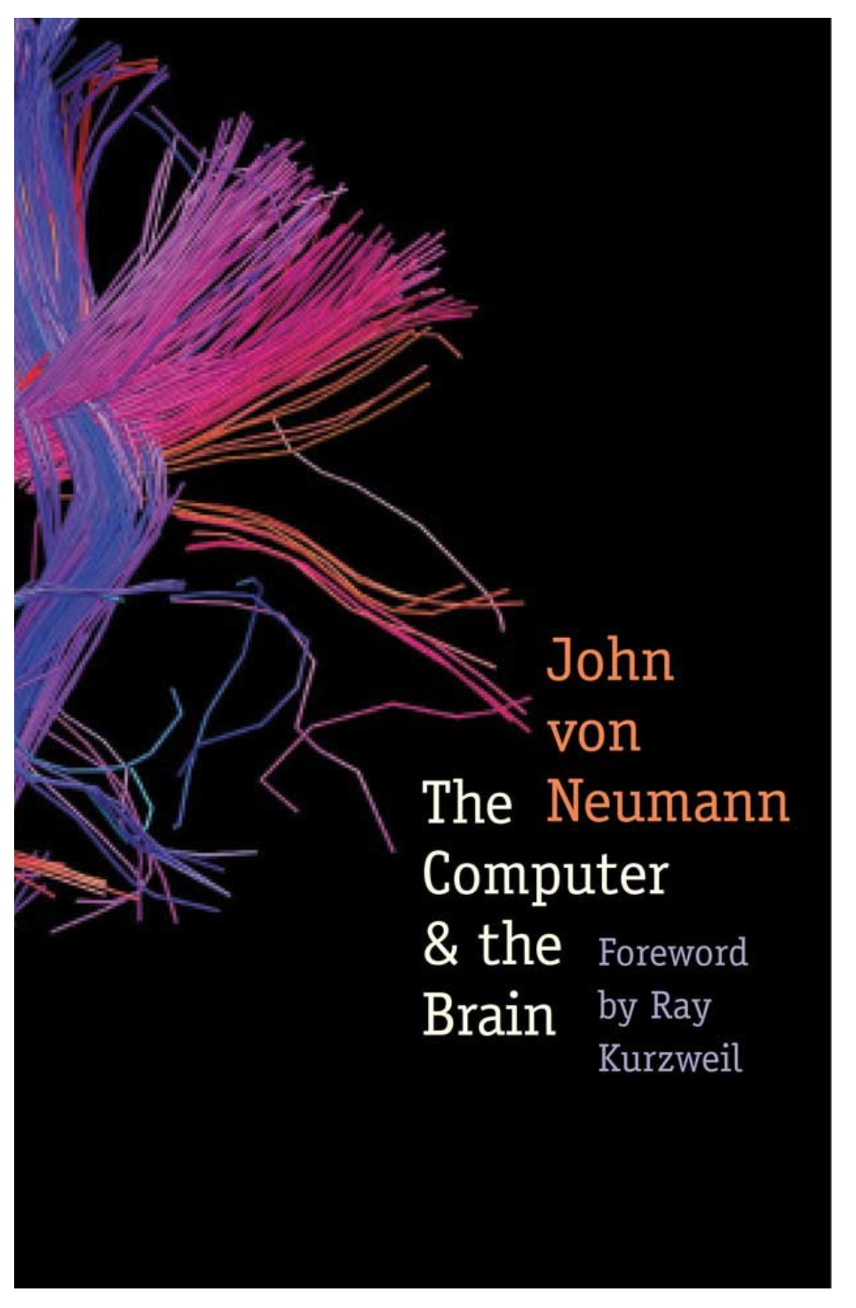
What is working memory?
1958

Slide 24
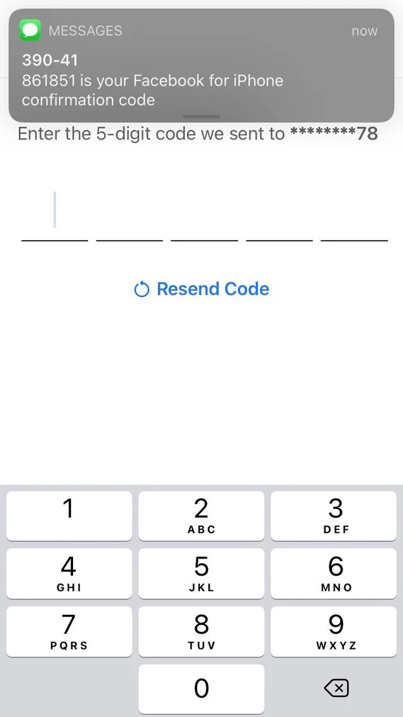
What is working memory?

Slide 25
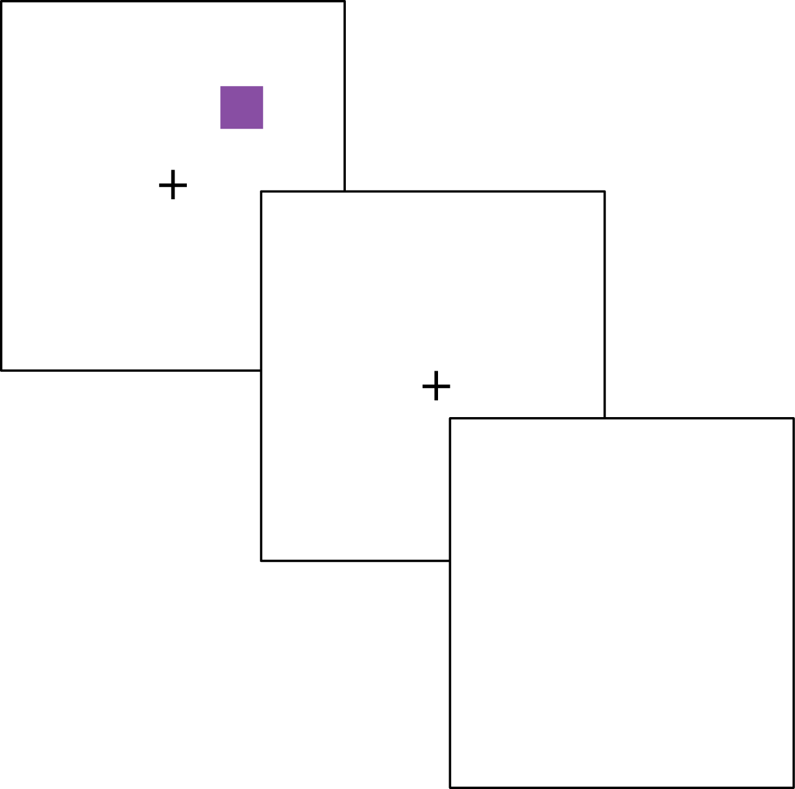
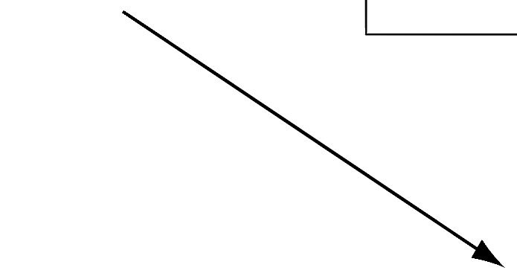

What we try to know
What we want to know
saccade

Slide 26

Lets look into the brain!
Recording from another region
saccade

Slide 27
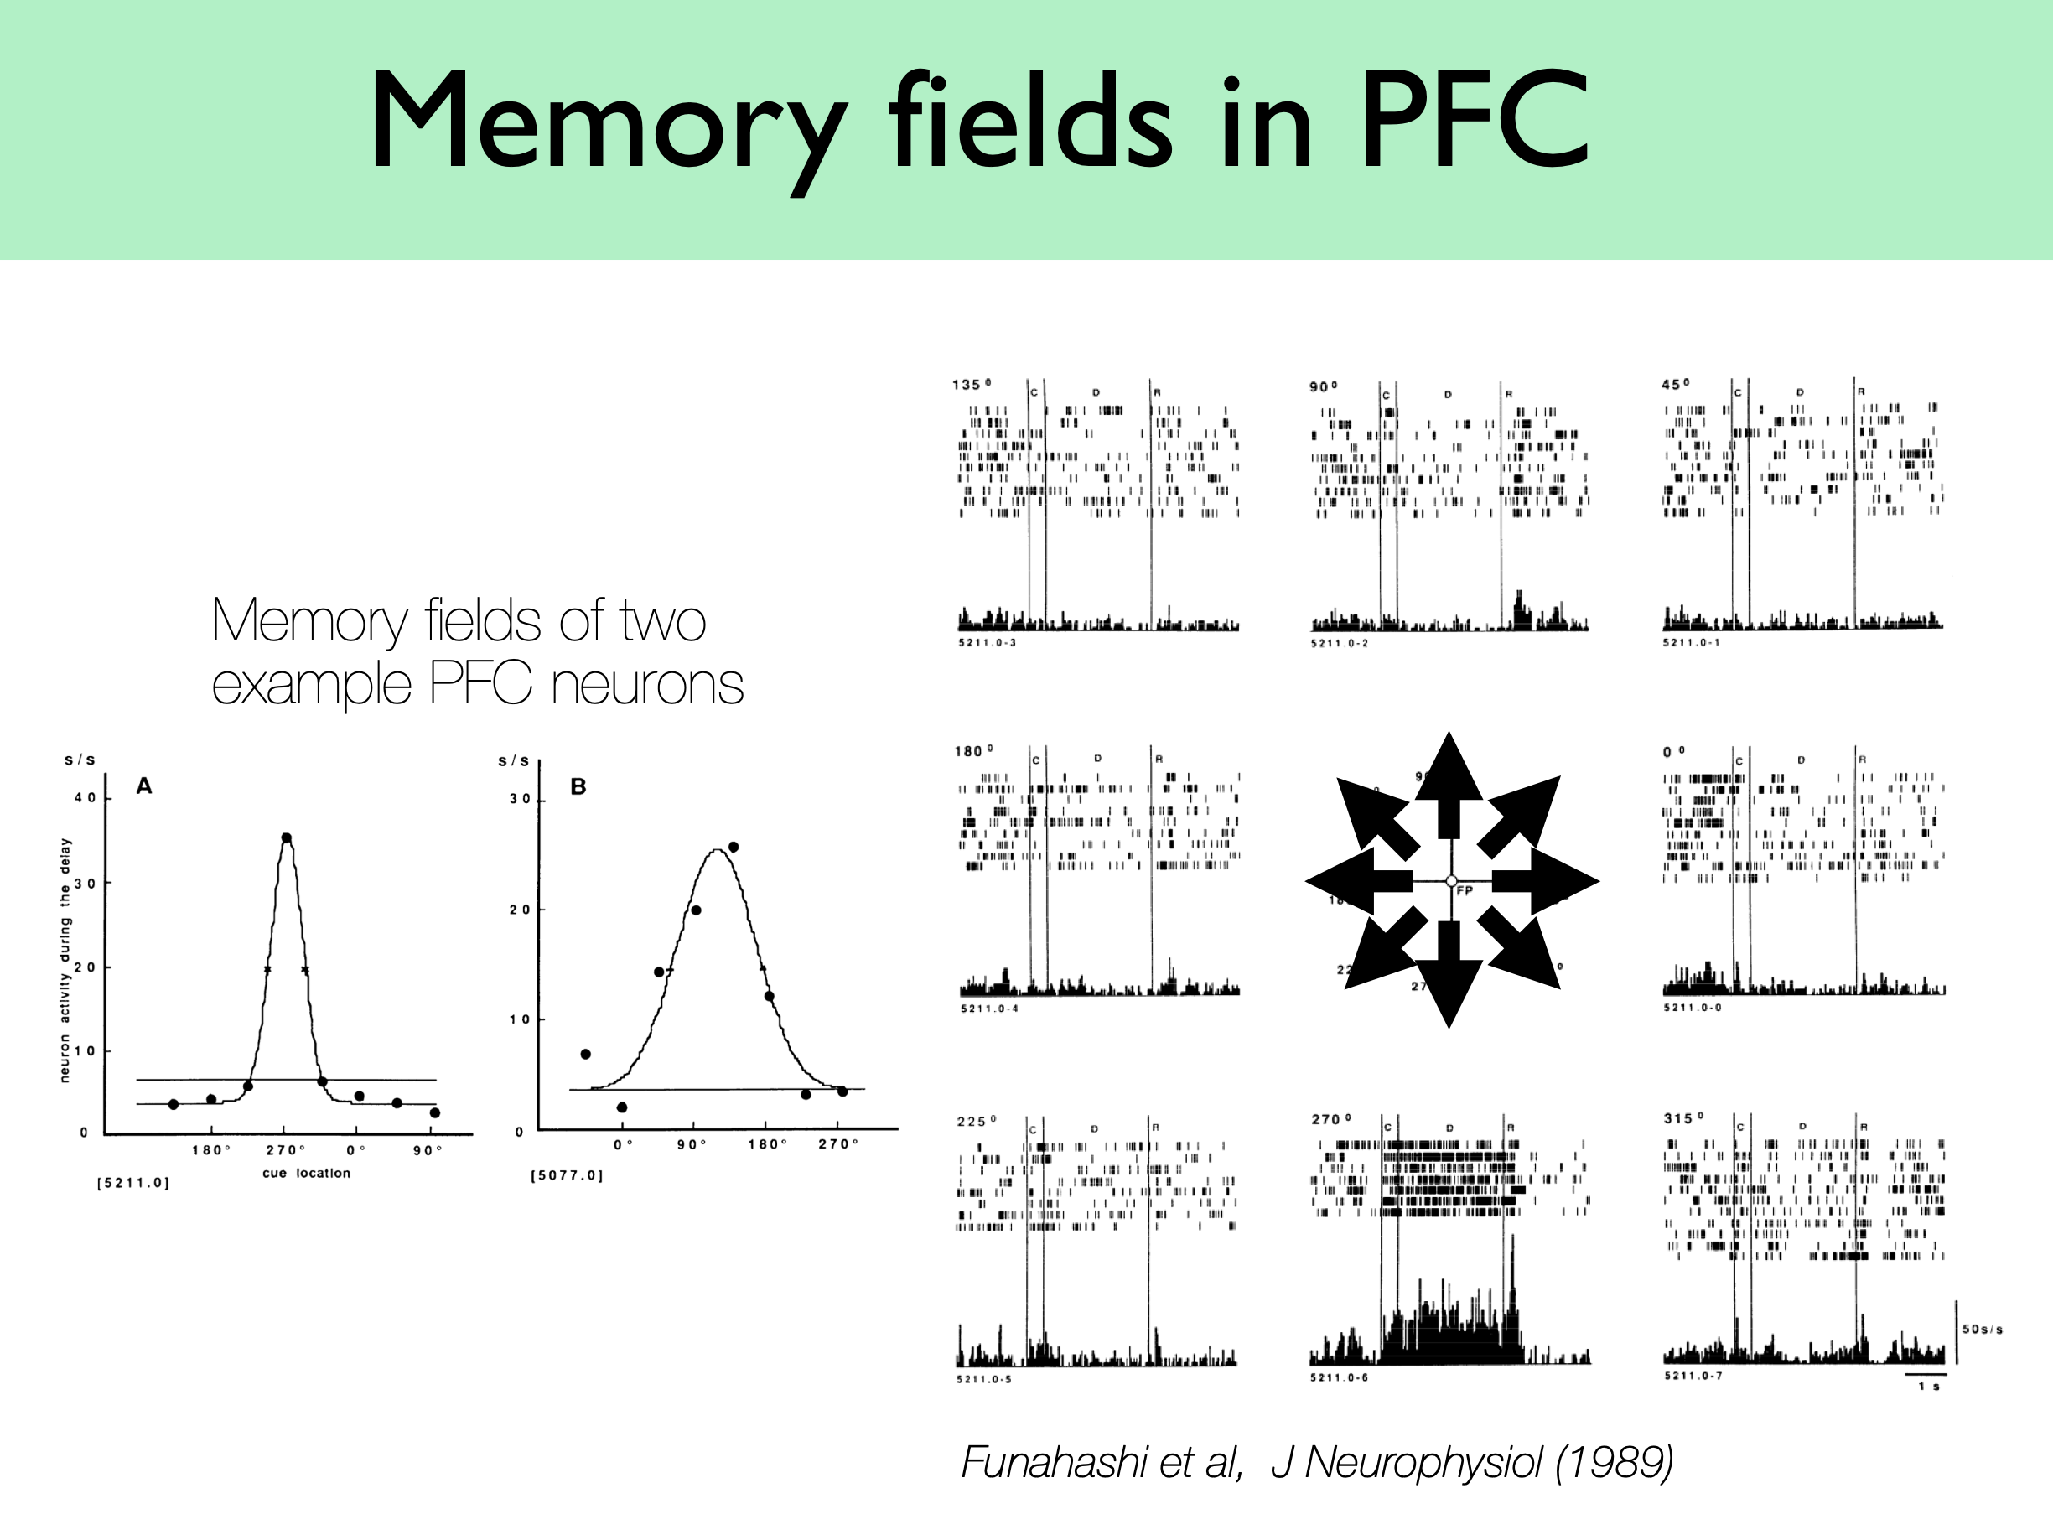
Persistent activity in PFC
saccade

Slide 28
Persistent activity in PFC

Slide 29
How to model it?

Slide 30
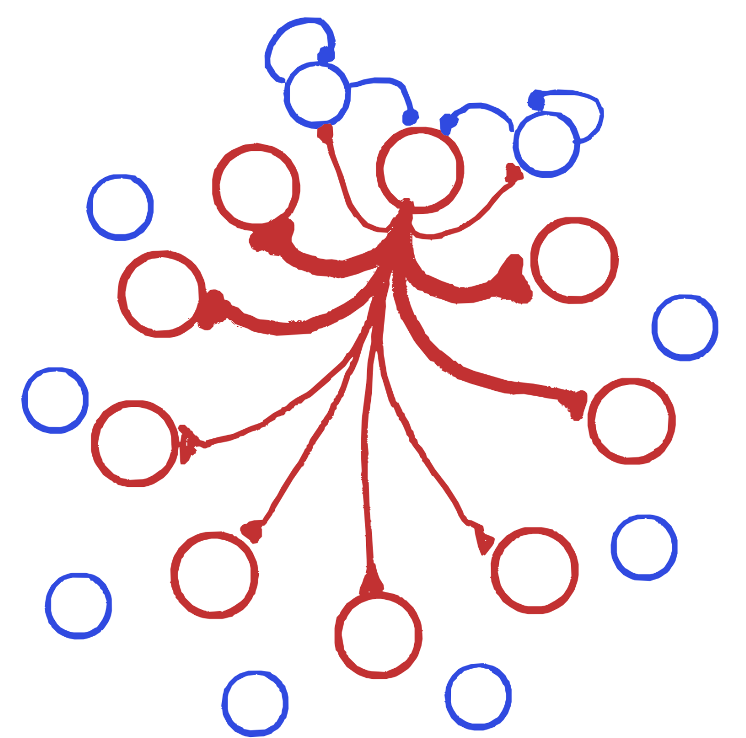
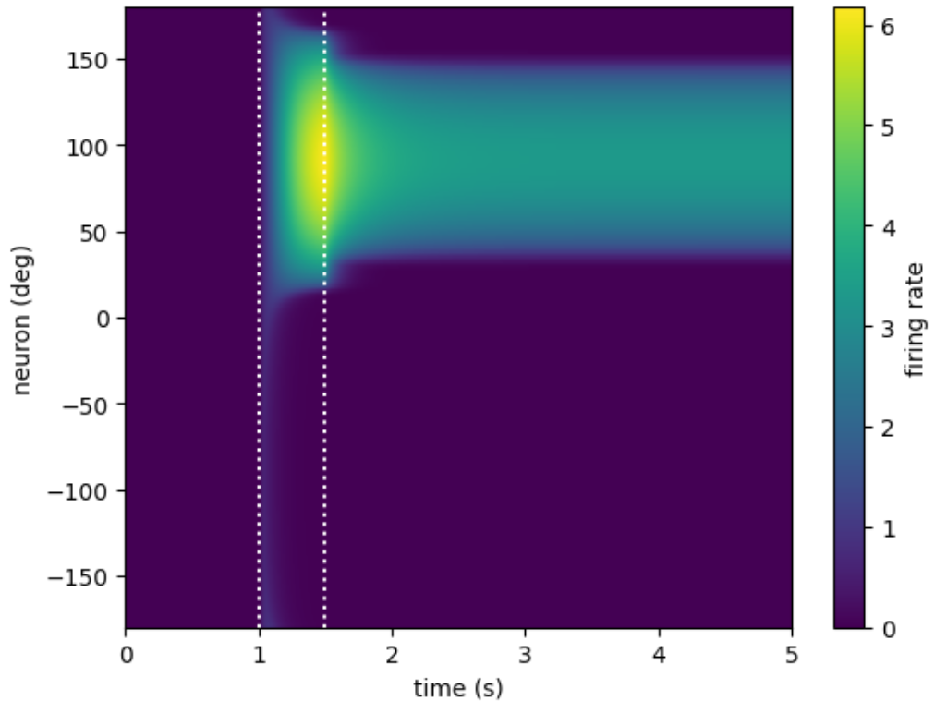
How to model it?
PFC
Model
Network simulation: one trial

Slide 31
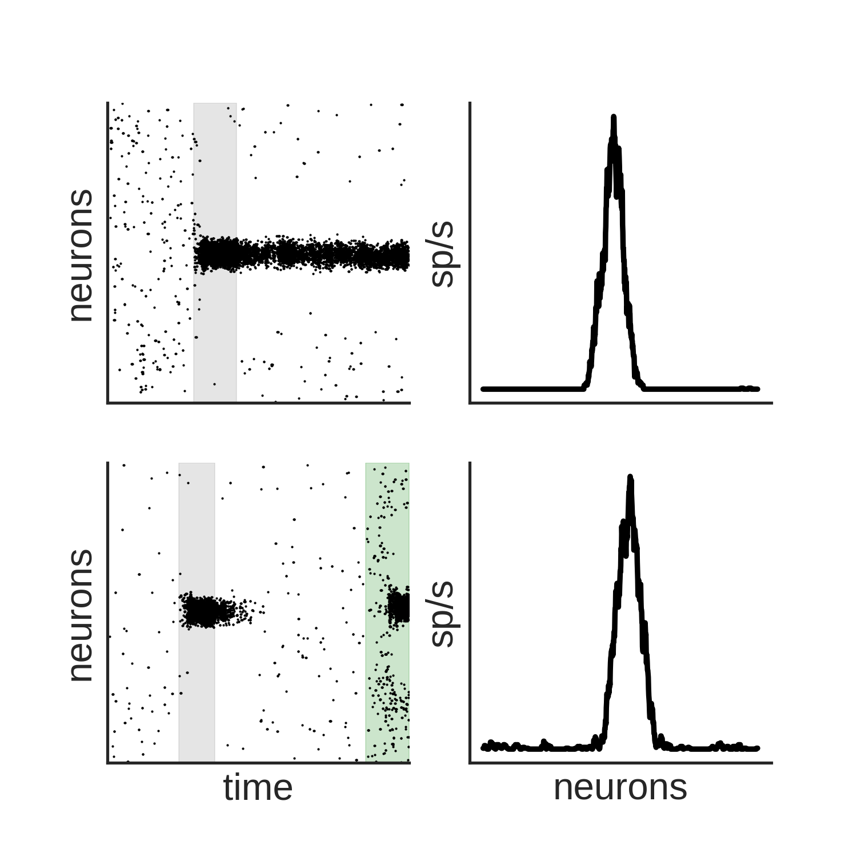
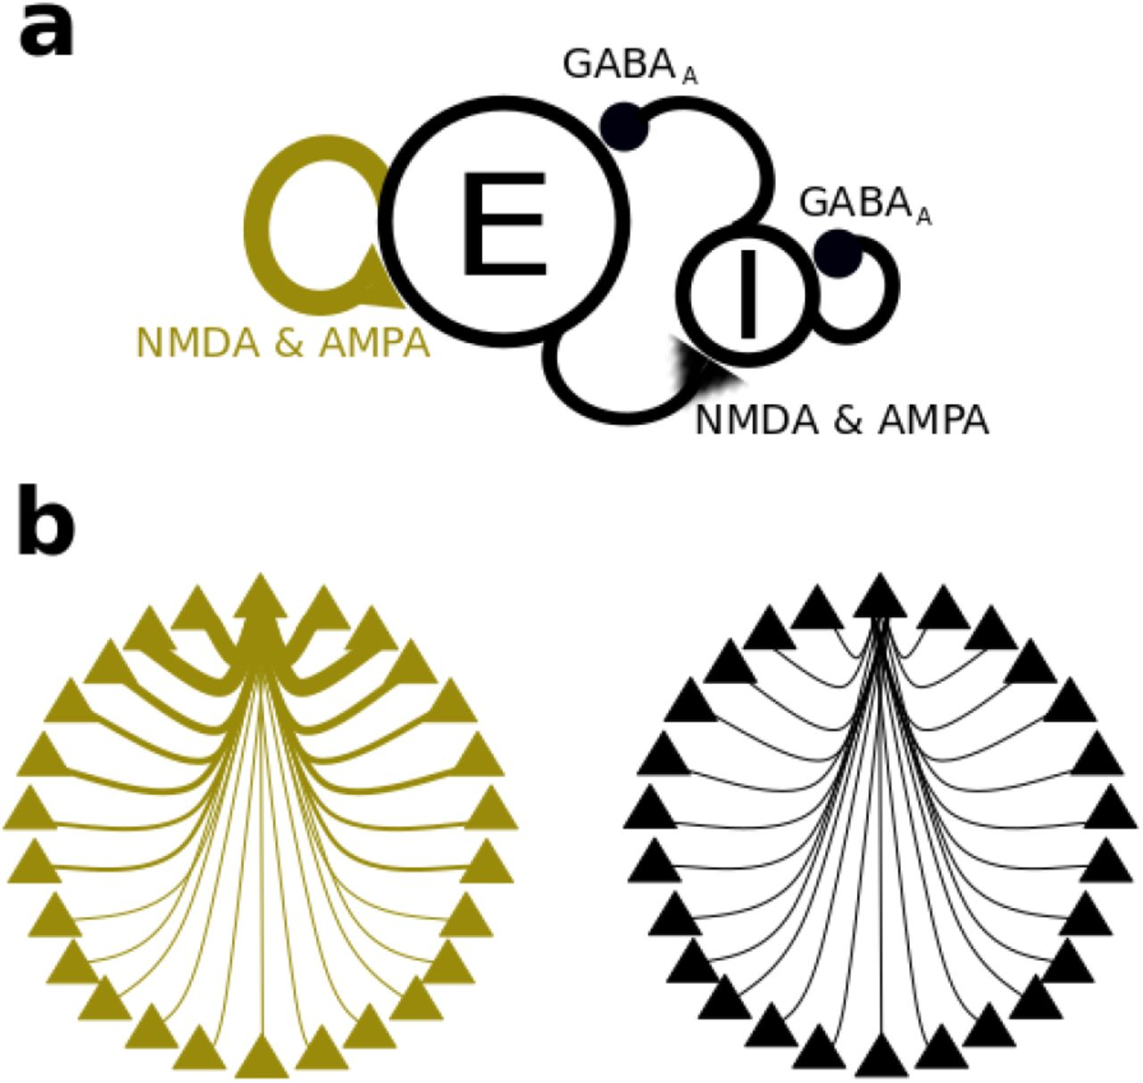
How to model it?
PFC
Model
stimulus
time
Compte et al, Cerebral Cortex (2000)

Slide 32
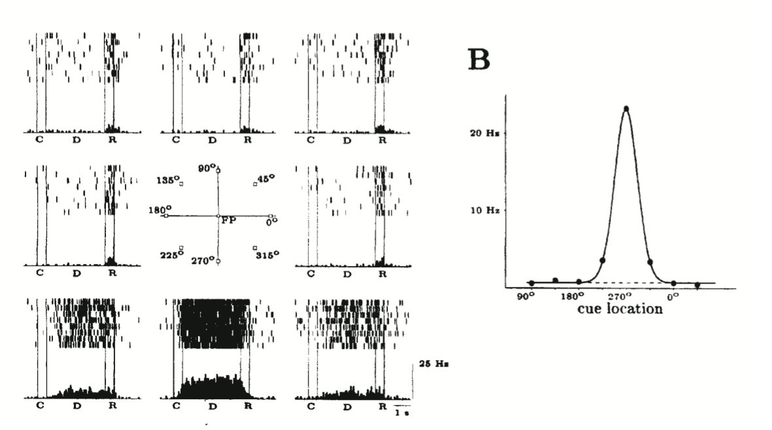
How to model it?
PFC
Model
time
Compte et al, Cerebral Cortex (2000)

Slide 33
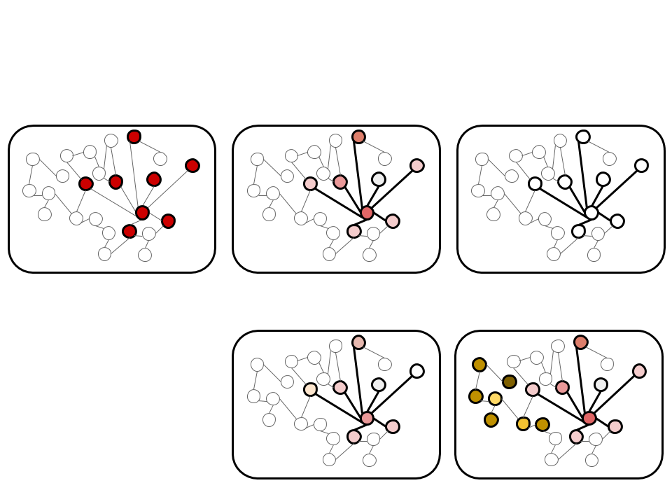
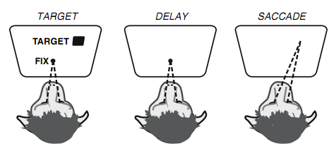
Two alternative hypothesis
memory
in activity
persistent
activity

Slide 34
Two alternative hypothesis
memory
in synapses
activity-silent
persistent
activity

Slide 35
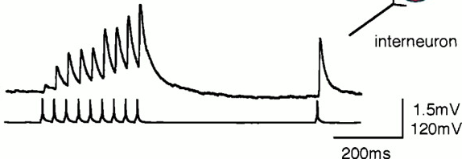
How to model working memory?
Activity-based
Activity-silent
stimulus
stimulus
time
time
Compte et al, Cerebral Cortex (2000)

Slide 36
How about more complicated tasks?

Slide 37
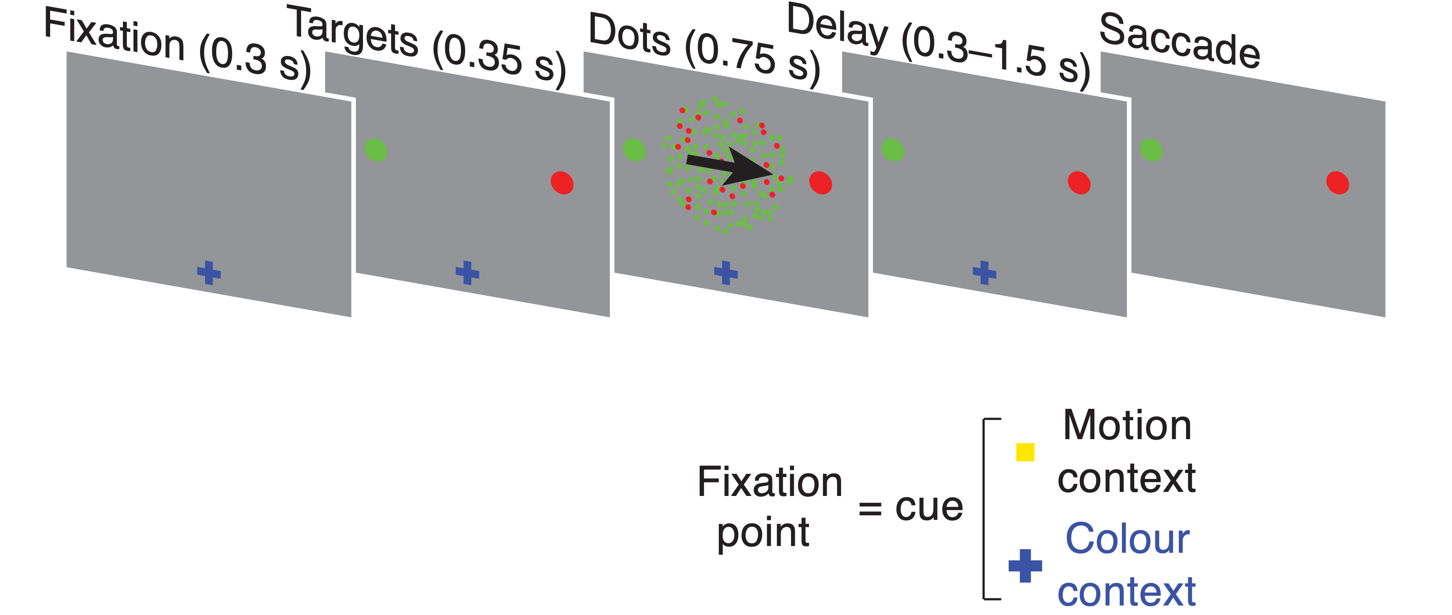
How about more complicated tasks?
Mante and Susillo et al. Context-dependent computation by recurrent dynamics in prefrontal cortex (2013)

Slide 38
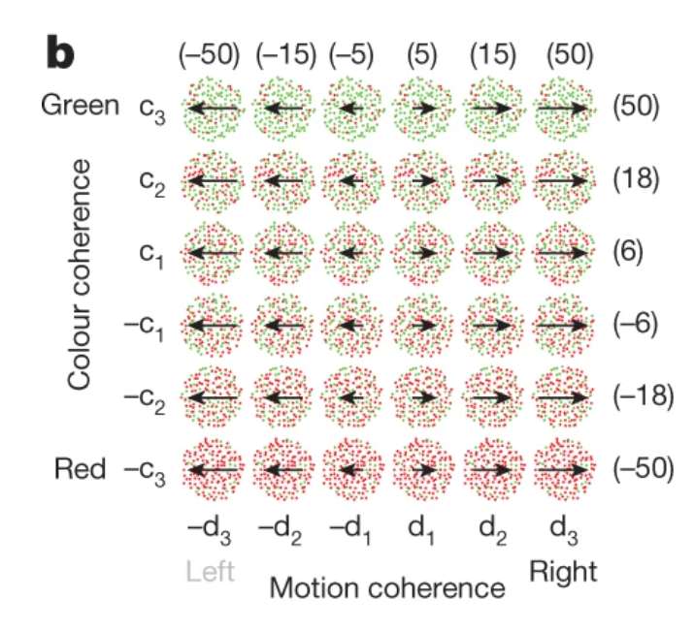
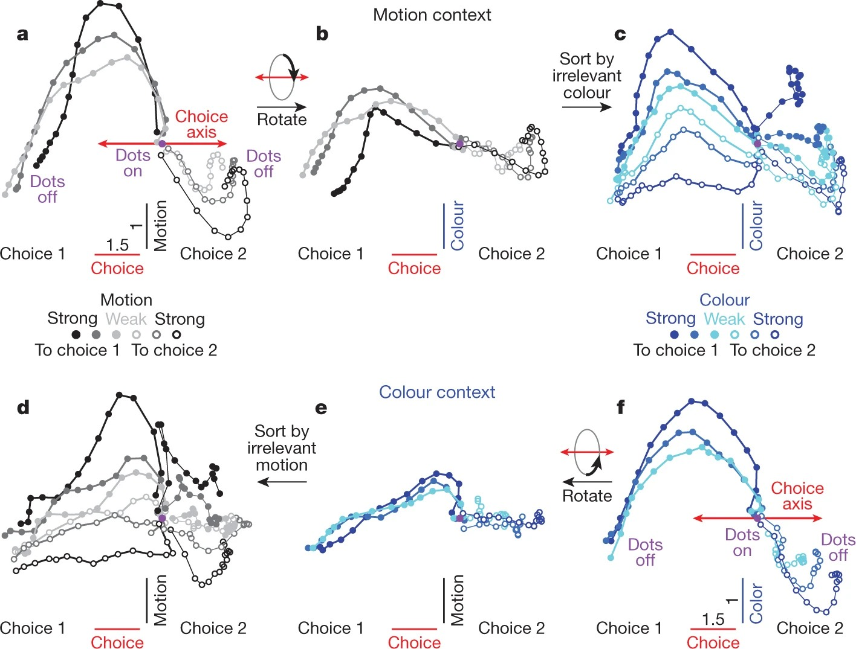
One possible model for context-dependent decision making
before
Ardid and Wang. A Tweaking Principle Model for Executive Control J. Neurosci (2013)
Mante and Susillo et al. Context-dependent computation by recurrent dynamics in prefrontal cortex (2013)

Slide 39
One possible model for context-dependent decision making
now?
Ardid and Wang. A Tweaking Principle Model for Executive Control J. Neurosci (2013)
Mante and Susillo et al. Context-dependent computation by recurrent dynamics in prefrontal cortex (2013)

Slide 40
One possible model for context-dependent decision making
Ardid and Wang. A Tweaking Principle Model for Executive Control J. Neurosci (2013)
Mante and Susillo et al. Context-dependent computation by recurrent dynamics in prefrontal cortex (2013)

Slide 41
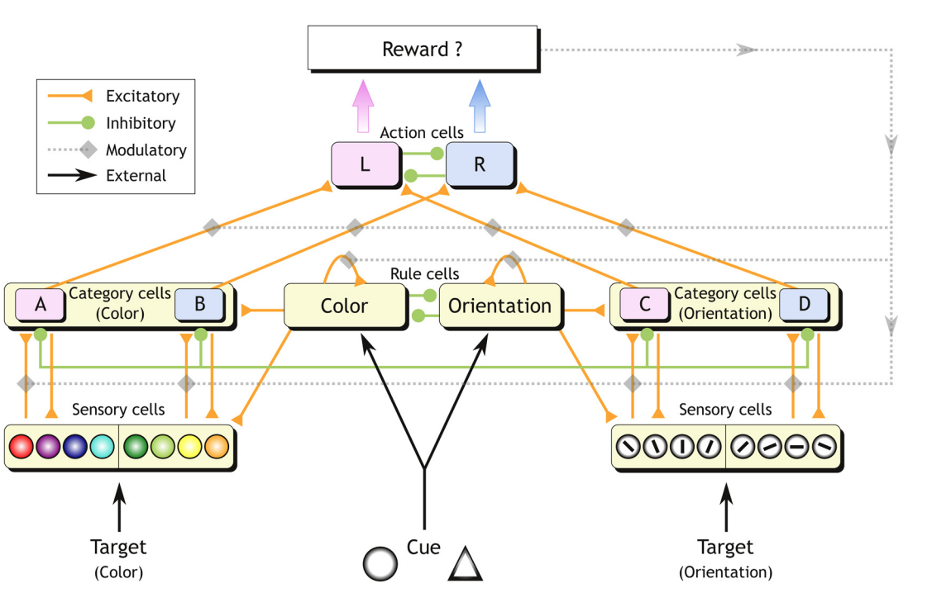
One possible model for context-dependent decision making
Ardid and Wang. A Tweaking Principle Model for Executive Control J. Neurosci (2013)
Mante and Susillo et al. Context-dependent computation by recurrent dynamics in prefrontal cortex (2013)

Slide 42
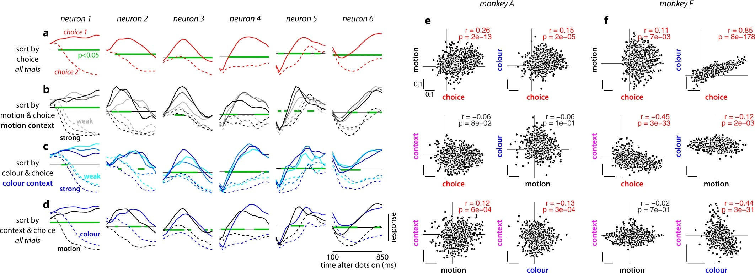
Single cells selectivity in PFC
Mante and Susillo et al. Context-dependent computation by recurrent dynamics in prefrontal cortex (2013)

Slide 43
Single cells selectivity in PFC
Mante and Susillo et al. Context-dependent computation by recurrent dynamics in prefrontal cortex (2013)

Slide 44
Single cells selectivity in PFC
Mante and Susillo et al. Context-dependent computation by recurrent dynamics in prefrontal cortex (2013)

Slide 45
Mixed selectivity in PFC
Mante and Susillo et al. Context-dependent computation by recurrent dynamics in prefrontal cortex (2013)

Slide 46
Mixed selectivity in PFC
Dimensionality
reduction
Mante and Susillo et al. Context-dependent computation by recurrent dynamics in prefrontal cortex (2013)

Slide 47
Mixed selectivity in PFC
Color
context
Dimensionality
reduction
Mante and Susillo et al. Context-dependent computation by recurrent dynamics in prefrontal cortex (2013)

Slide 48
Mixed selectivity in PFC
Motion
context
Color
context
Mante and Susillo et al. Context-dependent computation by recurrent dynamics in prefrontal cortex (2013)

Slide 49
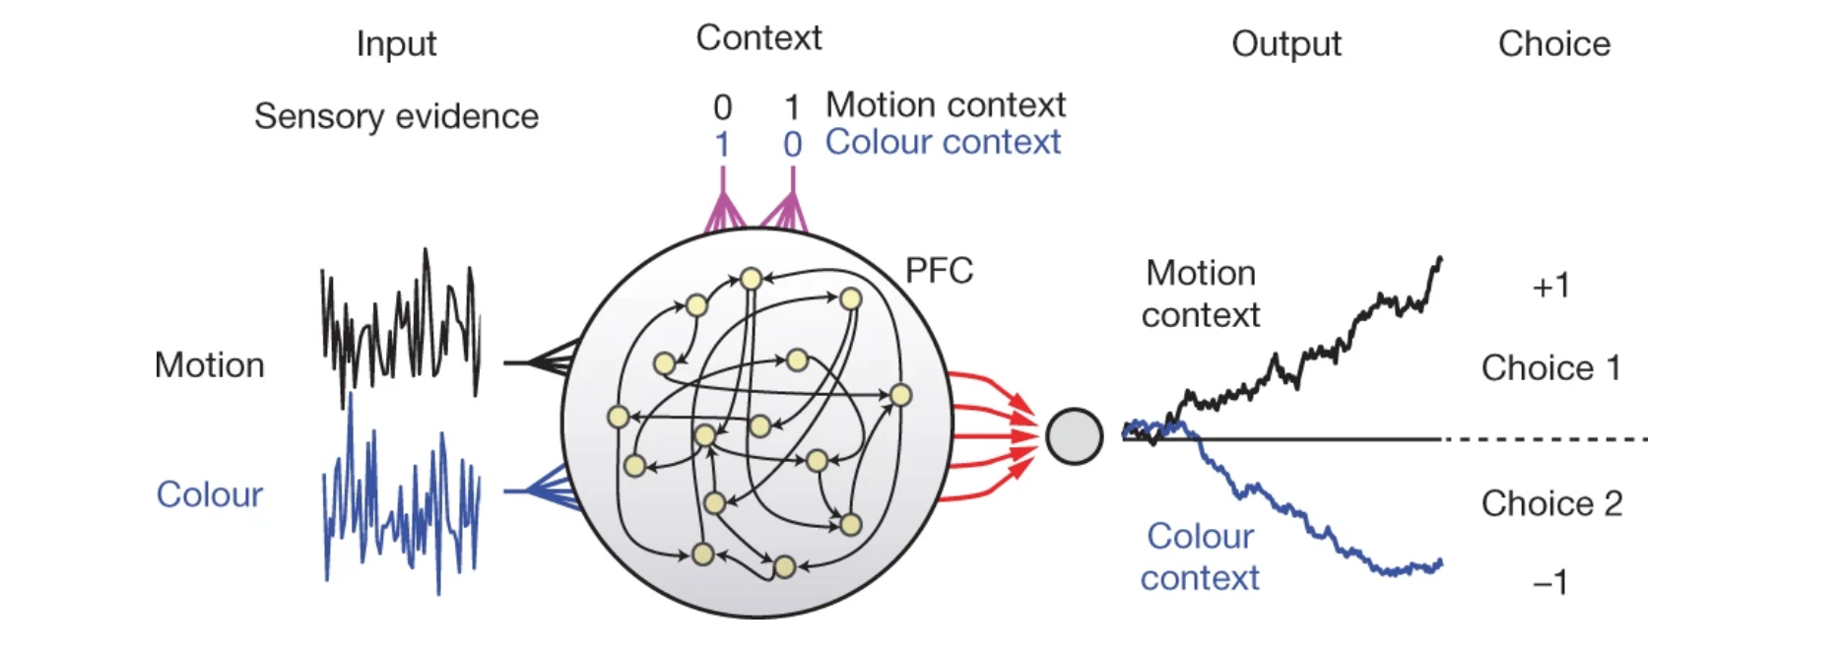
How to model complicated tasks?
$$w$$
$$x$$
$$output$$
Mante and Susillo et al. Context-dependent computation by recurrent dynamics in prefrontal cortex (2013)

Slide 50
How to model complicated tasks?
$$error=?$$
$$w$$
$$x$$
$$output$$
Mante and Susillo et al. Context-dependent computation by recurrent dynamics in prefrontal cortex (2013)

Slide 51
How to model complicated tasks?
$$error=correct-output$$
$$w$$
$$x$$
$$output$$
Mante and Susillo et al. Context-dependent computation by recurrent dynamics in prefrontal cortex (2013)

Slide 52
How to model complicated tasks?
$$error=(correct-output)^{2}$$
$$w$$
$$x$$
Mante and Susillo et al. Context-dependent computation by recurrent dynamics in prefrontal cortex (2013)

Slide 53
minimize with backprop!
How to model complicated tasks?
$$error=(correct-output)^{2}$$
$$w$$
$$x$$
$$output$$
Mante and Susillo et al. Context-dependent computation by recurrent dynamics in prefrontal cortex (2013)

Slide 54
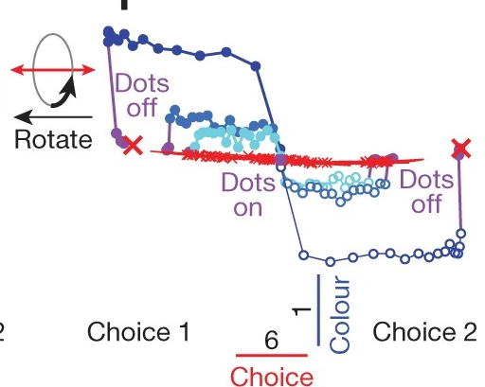
RNN
PFC
Color
context
Mante and Susillo et al. Context-dependent computation by recurrent dynamics in prefrontal cortex (2013)

Slide 56
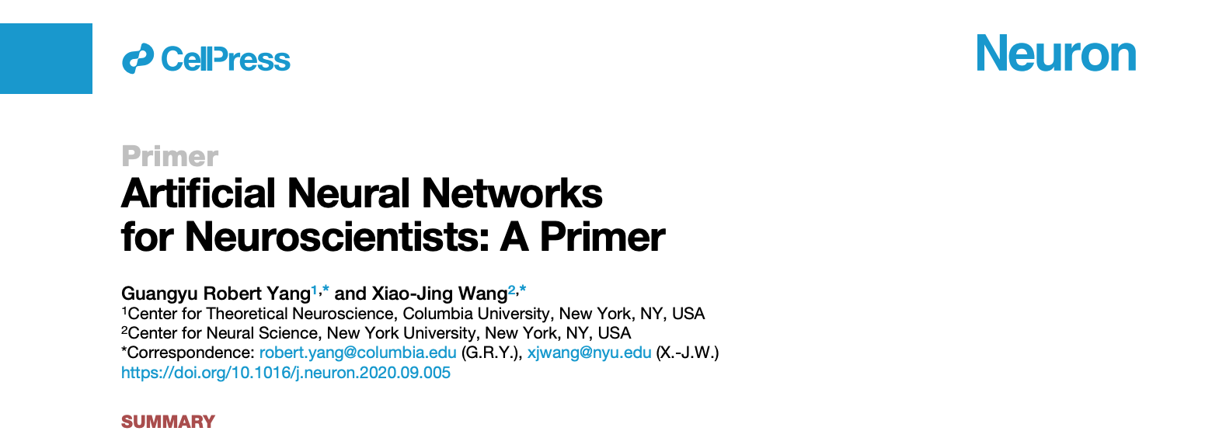
Future reading

