Slide 1
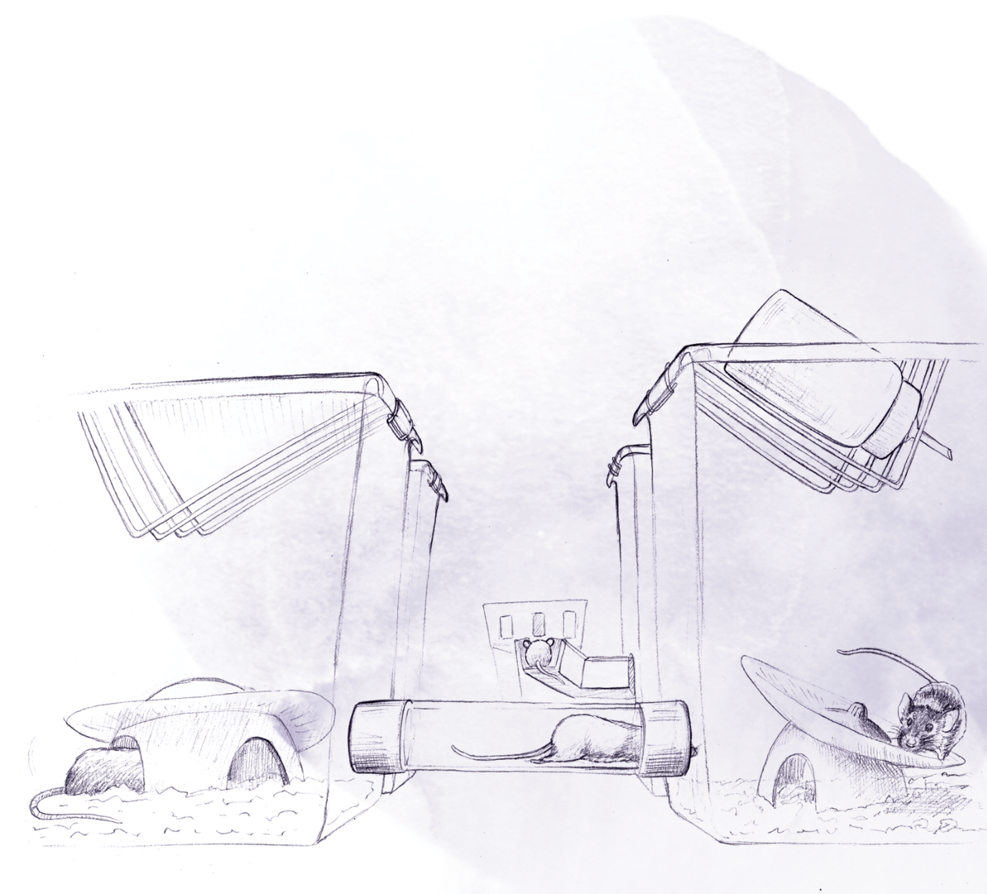
The Training Village
An open platform for continuous testing of rodents in cognitive tasks
Balma Serrano Porcar
Brain Circuits and Behavior Lab | IDIBAPS
Notes:
Intro 4 minutes
Setup description 7 min
Results 14
Future aplications conclusions, acknow 5

Slide 2
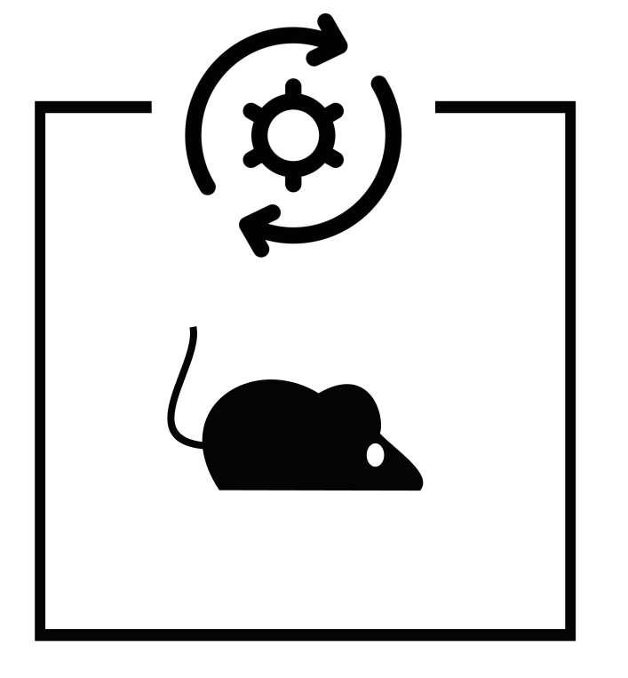

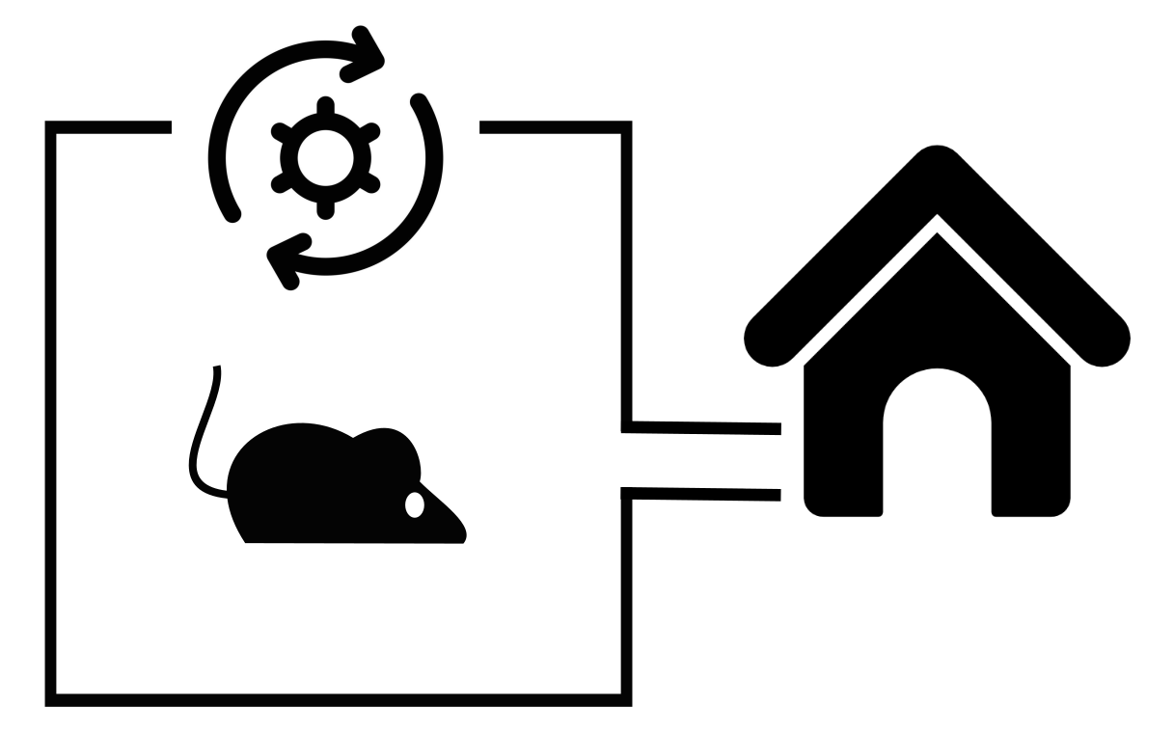
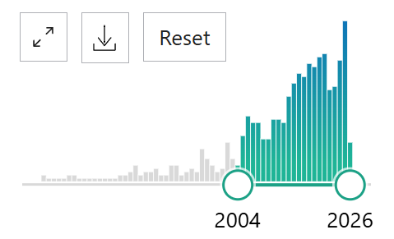
Towards fully automated behavioral training
Manual training
Automatic training
Parallelized training
24/7 continuous training
Reproducibility
Time reduced
No human intervention
Increased animal welfare
Cost-effective
PubMed search: “automated behavioral training rodents”
Notes:
Initially, behavioral training was carried out manually by researchers placing them into an arena and interacting with them. This process was highly time-consuming and animals’ learning was very dependent on researcher skills and subjective decisions.
To improve reproducibility, behavioral tasks were automatized and controlled by a computer. However, human involvement was still required to place animals in and out of operant chambers.
To optimize this, laboratories scaled up data collection by training multiple animals in paralel which optimized experimenters time. Nevertherless, animal manipulation stress was still present. Additionally, running many operant systems in parallel demands considerable equipment, space and maintenance costs.
The novel fully-automated training systems overcome these problems. As they that allow animals to train by themselves continuously. This approach eliminates completely human intervention, removing potential stress, improves animal welfare and optimizes the space and costs of the setup as its used very efficiently.

Slide 3






Goals
Automated system
Translational validity
Modularity and versatility
Group housing
Notes:
- Following this trend, In the Brain Circuits and Behavior lab we wanted to develop an automatic training system,
Specially designed for behavioral task with a potential translational validity.
Additionally, we also wanted a versatile system that could be warped around almost any behavioral paradigm,
And finally, we wanted to keep our animals group housed

Slide 4
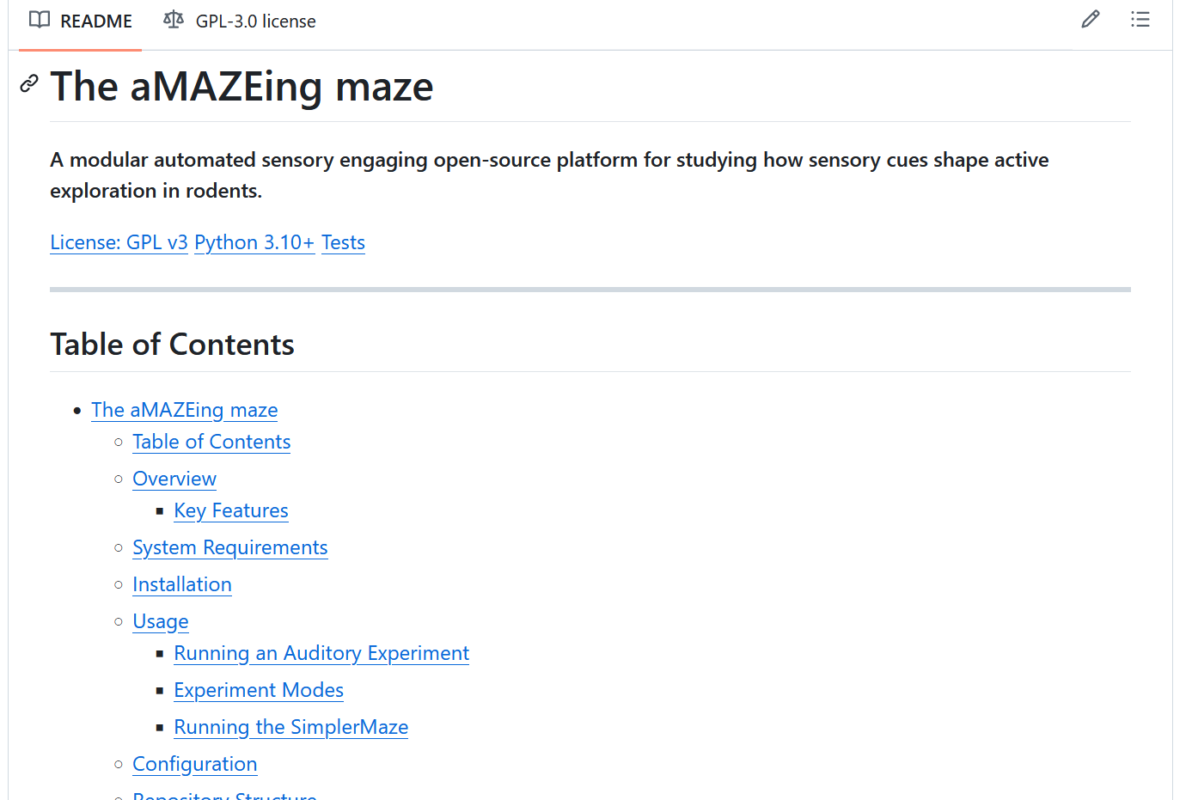

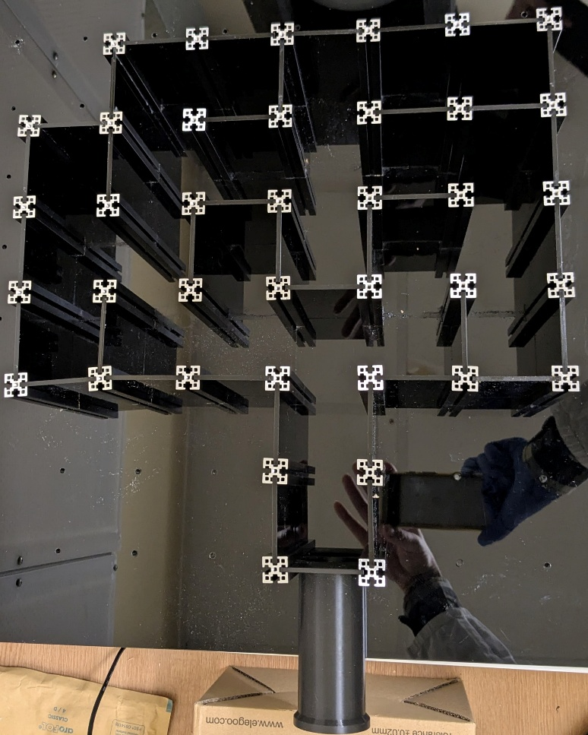


Alejandra’s aMAZEing maze
https://github.com/MaravallLab/aMAZEing-maze
Pros:
Cons:
It’s easy to use
It’s scalable
It’s completely automated
It has a great documentation
It includes well detailed data analysis pipelines
Can be easily adapted to different sensory modalities

Slide 5

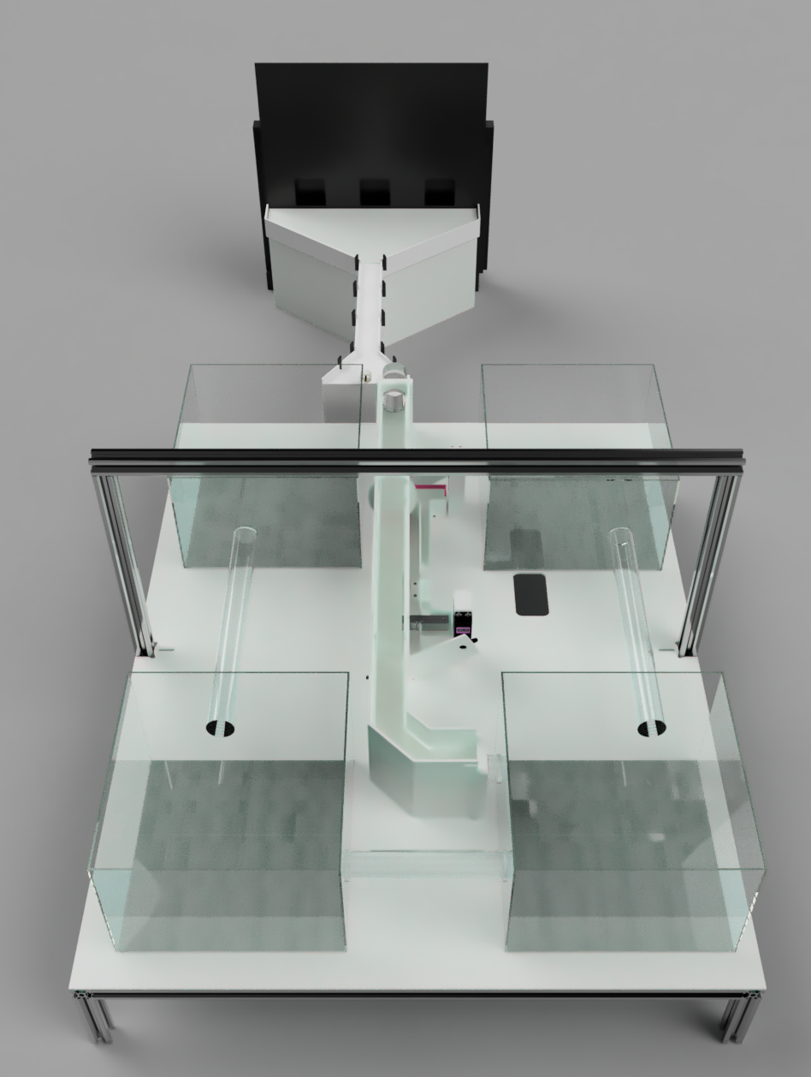


OPERANT BOX
touch screen
RFID
Doors
scale
CORRIDOR
RFID
Serrano-Porcar 2026, Biorxiv
HOME CAGES
Notes:
With these goals in mind, we developed the Training VIllage
In this system, RFID-tagged animals live group-housed and self-initiate training sessions by crossing a sorting corridor.
This corridor contains two motorized doors, an RFID sensor and a videotracking system, which together guarantee that only one animal enters the chamber at a time.
The operant chamber is versatile allowing for the performance of multiple behavioral paradigms.
To motivate training without the need for water restriction, animals have continuous access to bitter-tasting water in the home cage and receive sucrose water as a reward during training in the operant chamber.

Slide 6
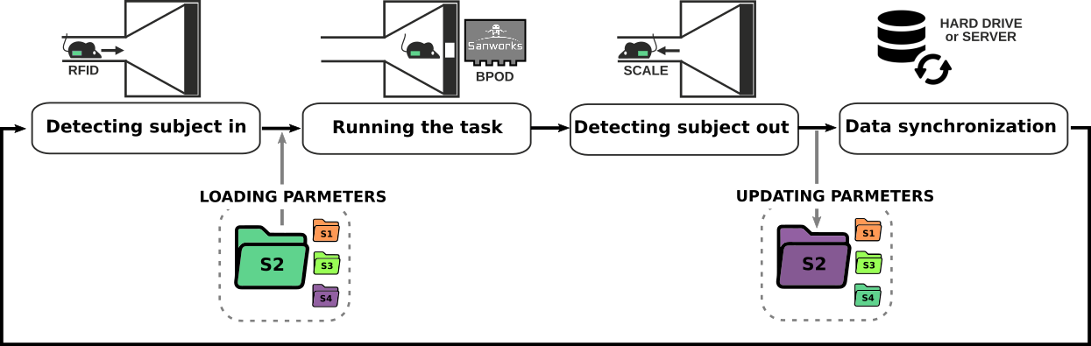
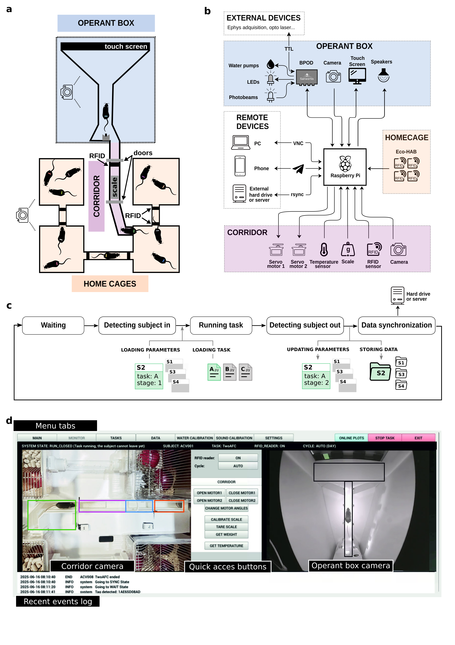
Automated Individualized Training
Hard drive
or server
Waiting
Detecting subject in
Running task
Detecting subject out
Data synchronization
Raspberry Pi
Notes:
Lets move now to the software, the Training Village runs on a Raspberry Pi and allows the automatic individual training of the animals. It operates as follows:
First, the system waits until an animal is detected in the corridor. Once detected, if there are no other animals trying to enter, it loads the corresponding training parameters for that specific subject and initiates the behavioral task.
The task itself is controlled by a behavioral acquisition system the Bpod, the system is modular and can be adapted to other platforms for behavioral control, such as pyControl or Arduino.
Once the task ends, the door opens allowing the animal to exit. A scale detects the animal's exit and records its weight. After this, subject parameters are updated based on its performance during the session. As the system works continuously 24/7, we are forced to define objective training protocols that improve the reproducibility of animal learning, as typically these decisions have been very biased by the researcher's criteria. Which is very advantageous to study study learning.
Finally, all collected data is automatically synchronized to an external hard drive or server.

Slide 7

Video here: https://braincircuitsbehaviorlab.github.io/village/_static/video.m4v

Slide 8






Remote control
Modular
Open source
Notes:
The system is designed to be controlled remotely
WE have remote access to the system at any time.The graphical user interface allows for observing the animals in real-time via cameras placed in the corridor and the operant chamber.
We’ve also implemented an alarm system that immediately notifies researchers of any issues via Telegram messages sent directly to their phones.
This platform is modular, it can be adapted to different behavioral paradigms.
The entire system is open-source and developed in Python.

Slide 10
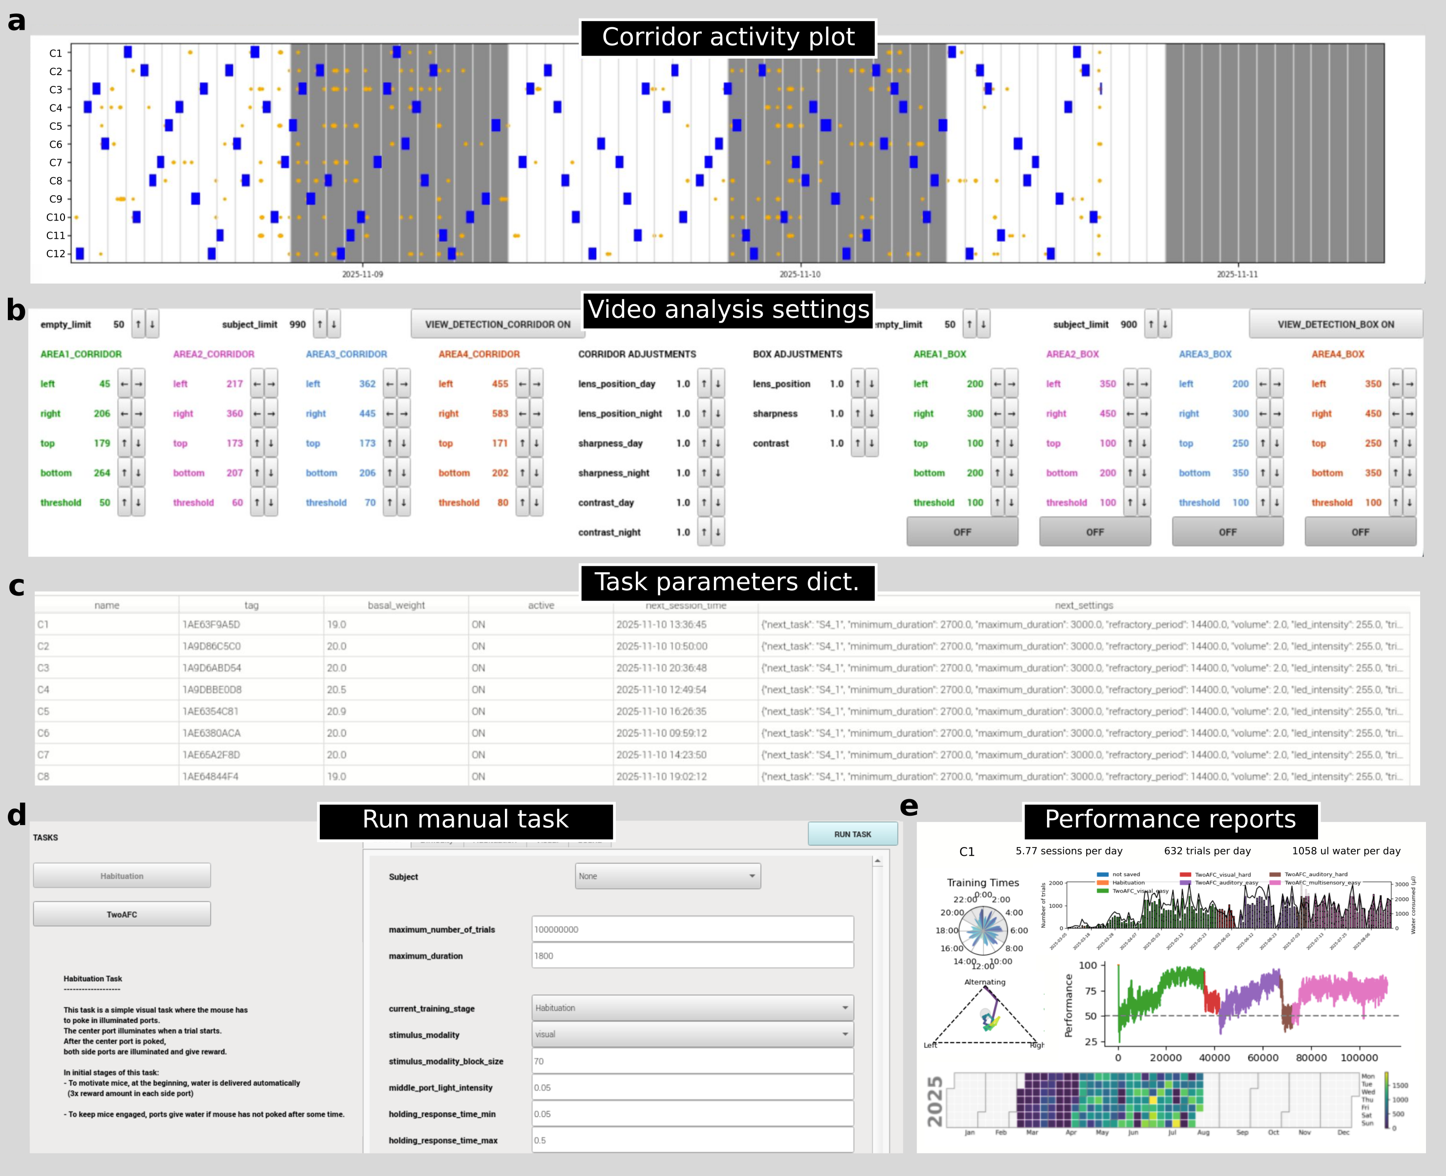

Slide 12
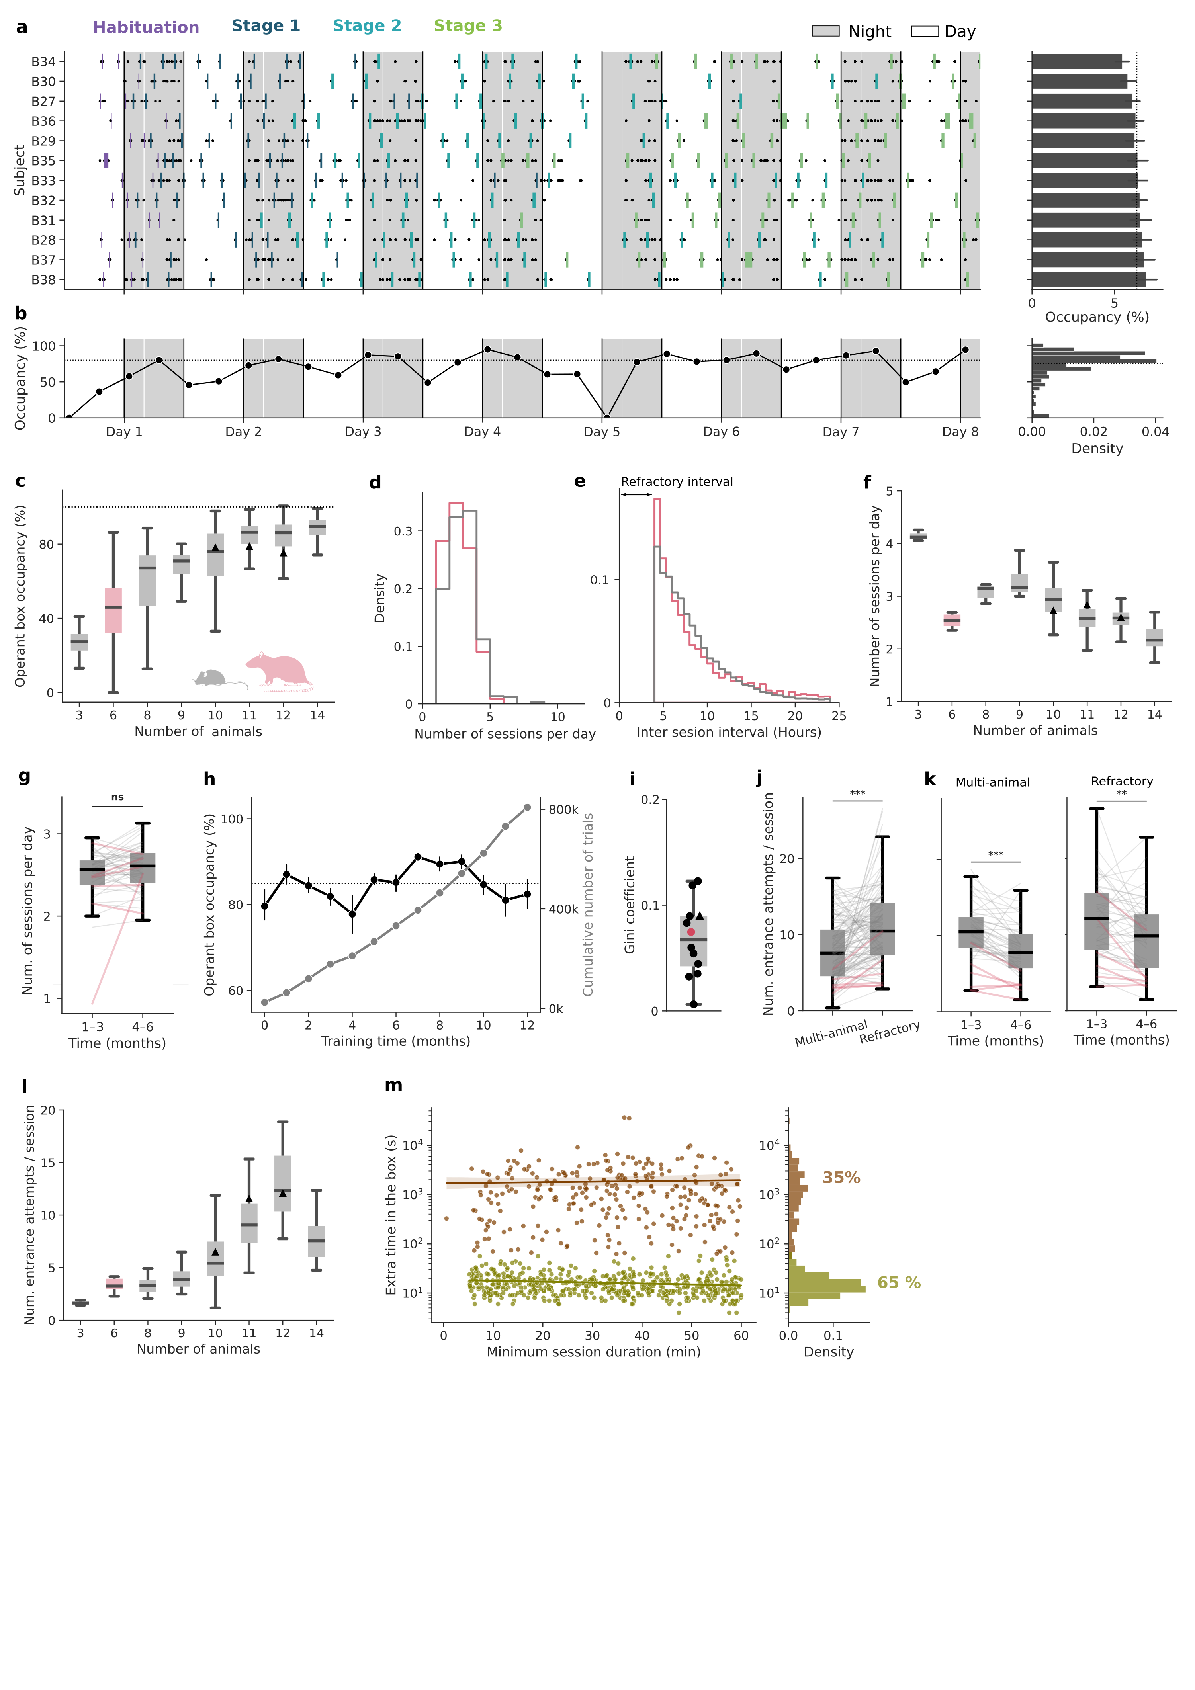
Efficient and balanced access to the operant box
Notes:
Having described the setup specifications, let me show how animals use the training village. You can see here a raster plot of animal activity in the system during the first days of training. This was a group of 12 animals, each line represents a subject and the dots indicate detections of the subject in the corridor and the vertical rectangles represent behavioral sessions inside the operant chamber. You can see how animals distribute their access to the chamber during the day (in white) and night (in gray), and also among them. Here is a summary of the occupancy of the operant chamber for each subject across all the entire time that this experiment was running.
The colors show how animals progress through the different training stages, each animal progress though training stages at their own speed.
We also observe that with a group of 12 animals the system is used efficiently, as on average, the operant chamber is occupied 80% of the time.

Slide 13
The TV can host large group sizes

Slide 14
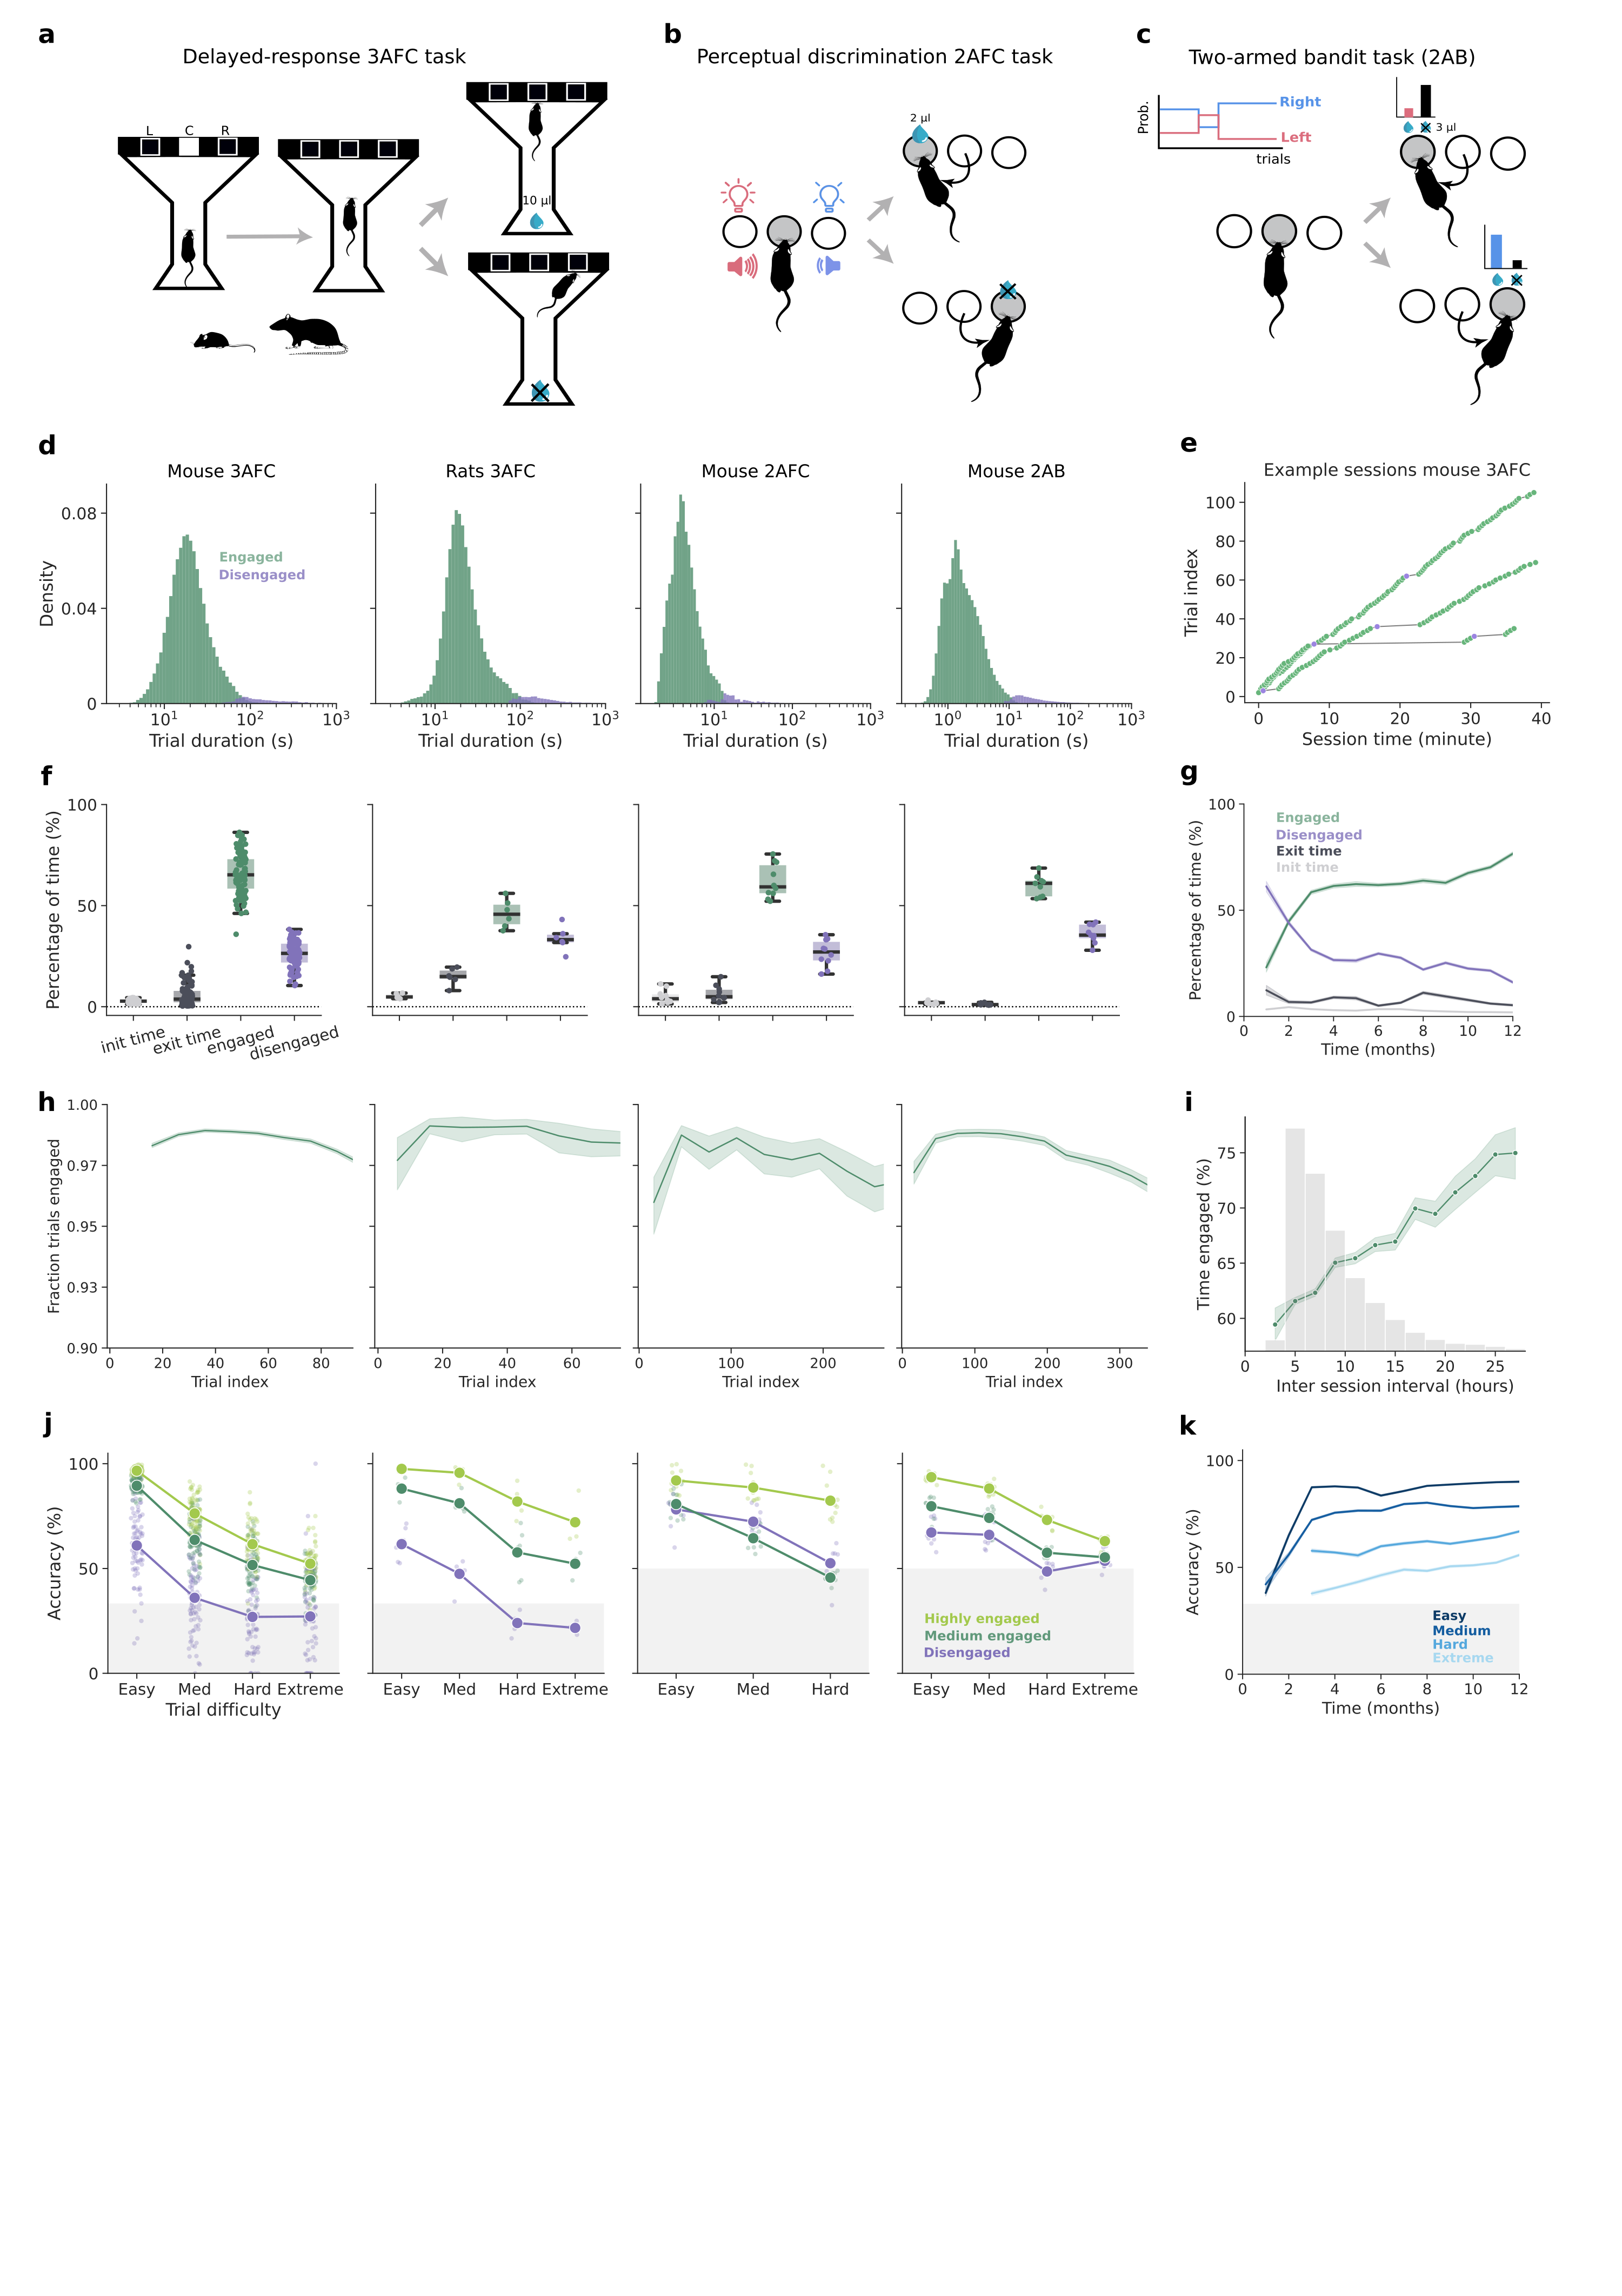
Compatible with multiple behavioral paradigms

Slide 15
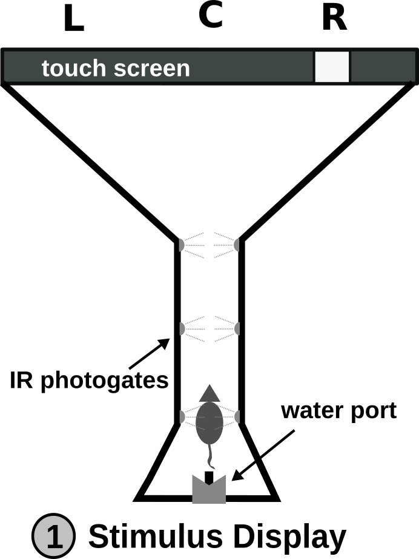
Multiple-choice delayed-response task

Slide 16
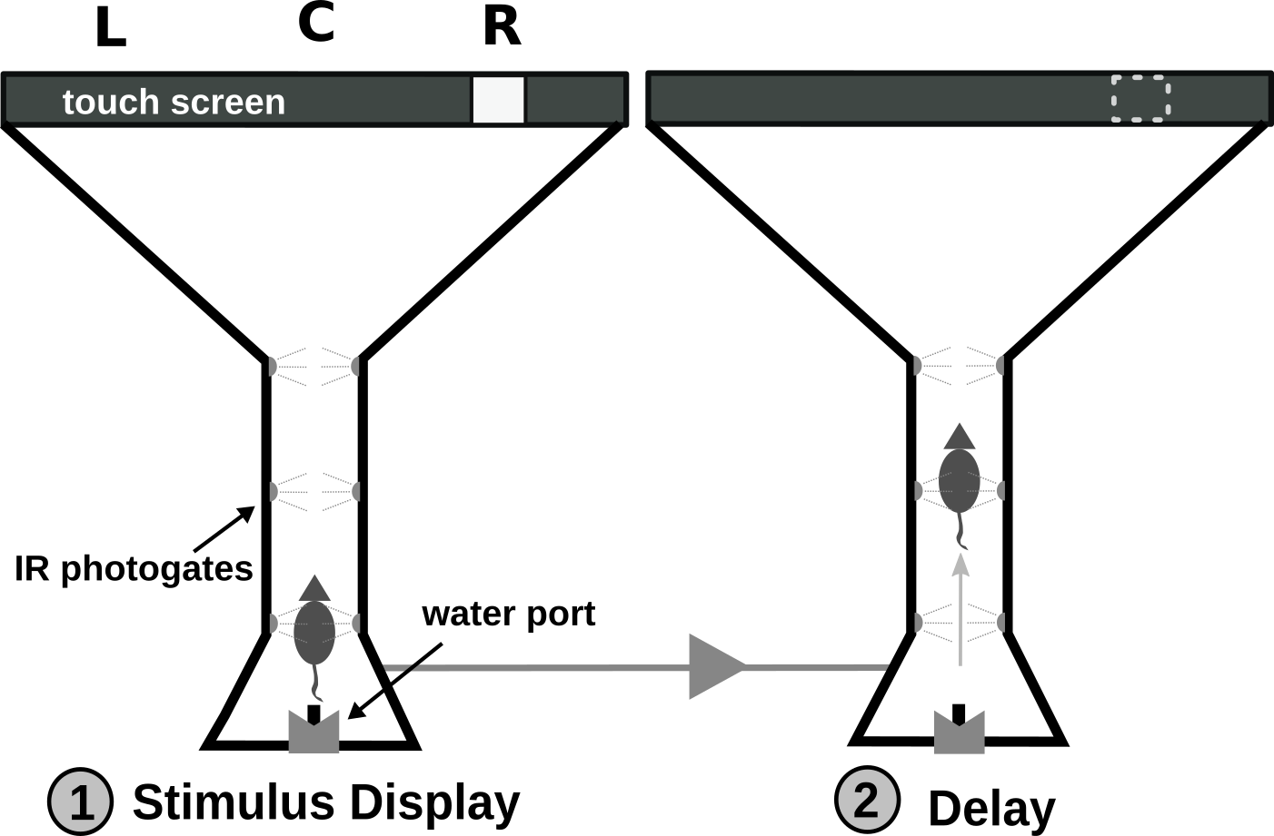
Multiple-choice delayed-response task

Slide 17
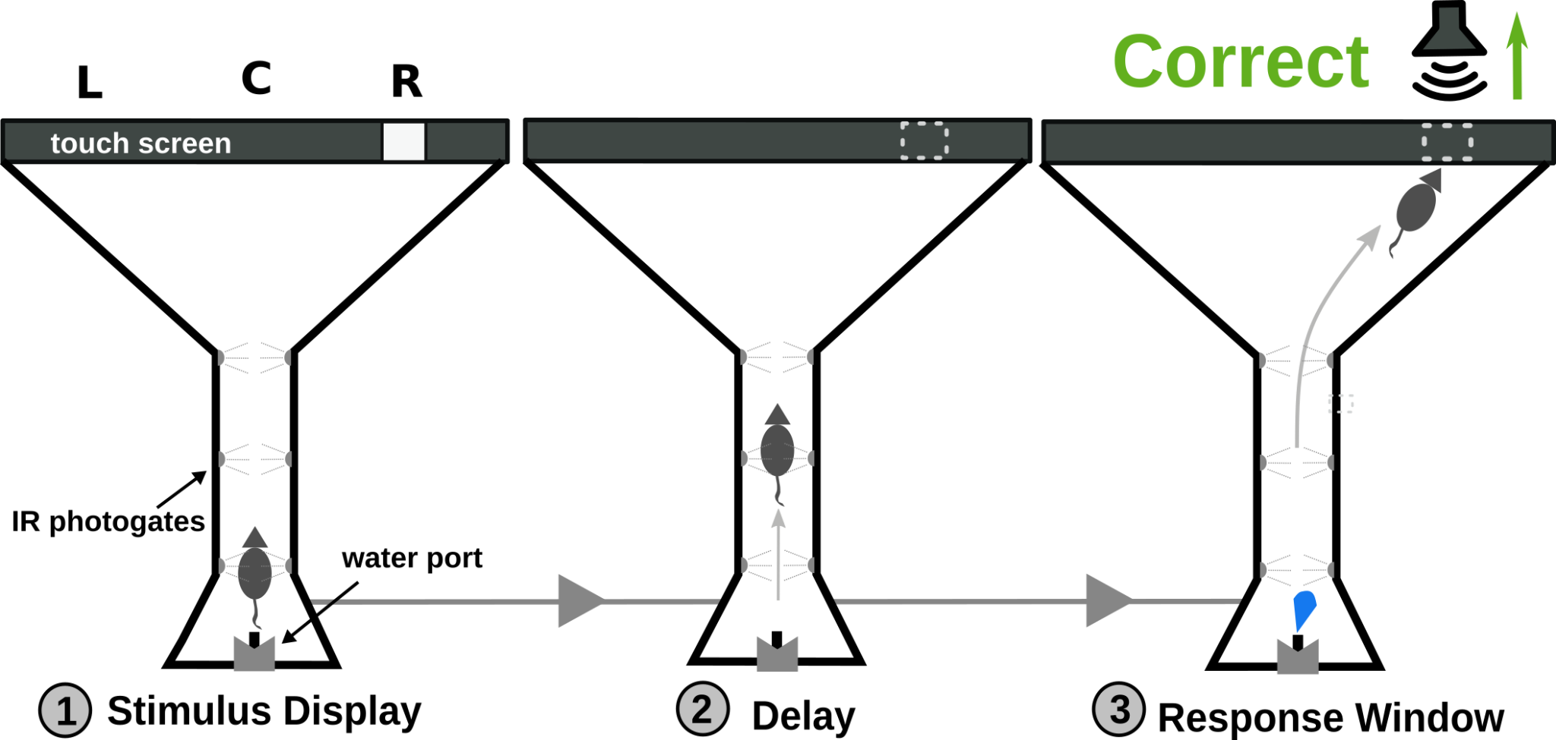
Multiple-choice delayed-response task

Slide 18
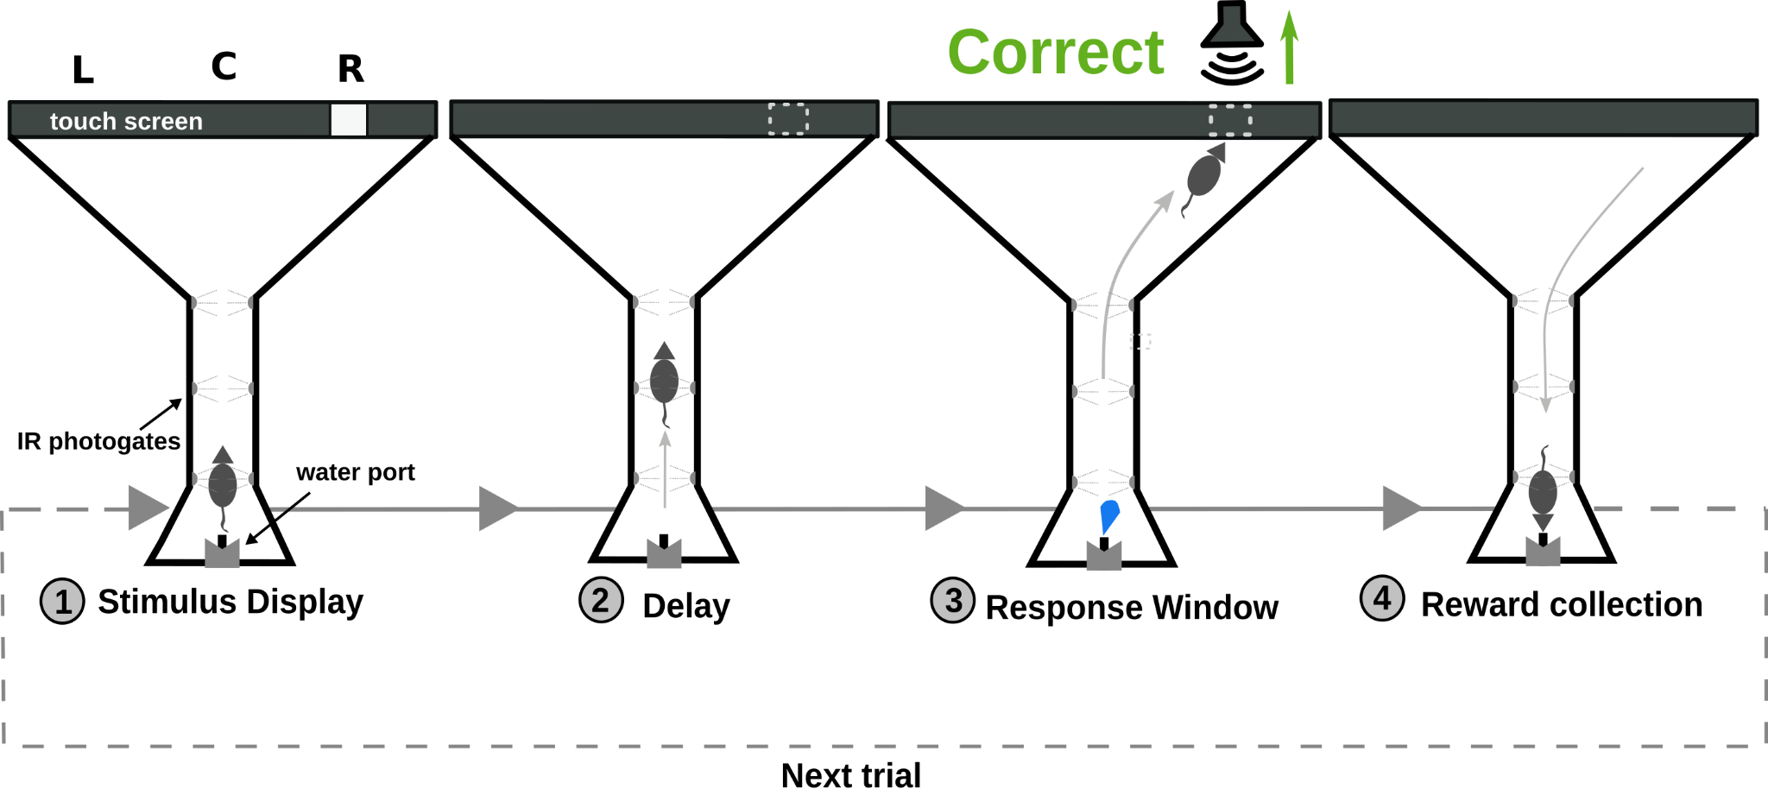
Multiple-choice delayed-response task

Slide 19
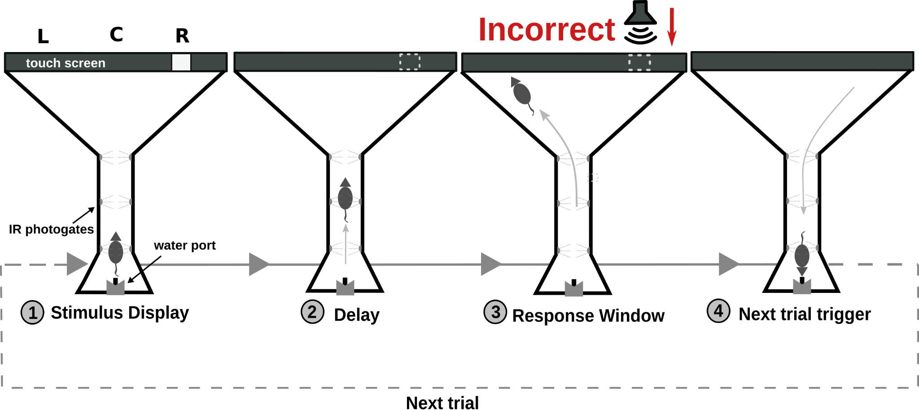
Multiple-choice delayed-response task

Slide 20
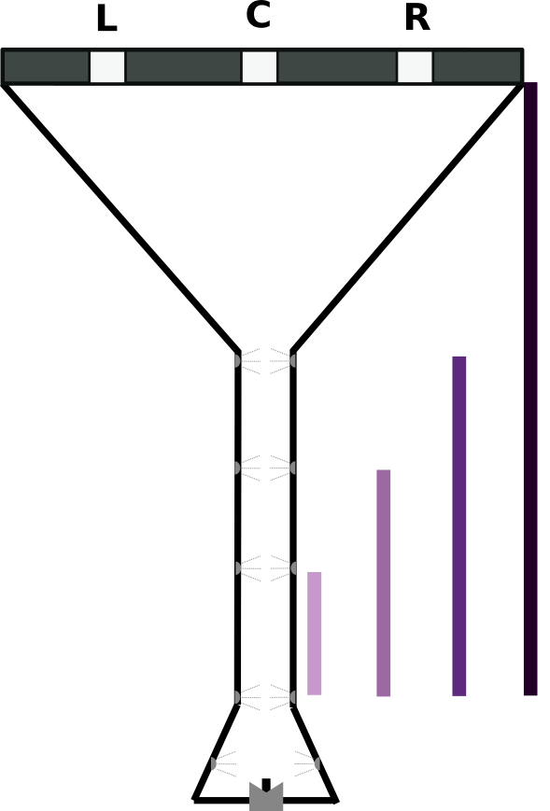
Multiple-choice delayed-response task

Slide 21
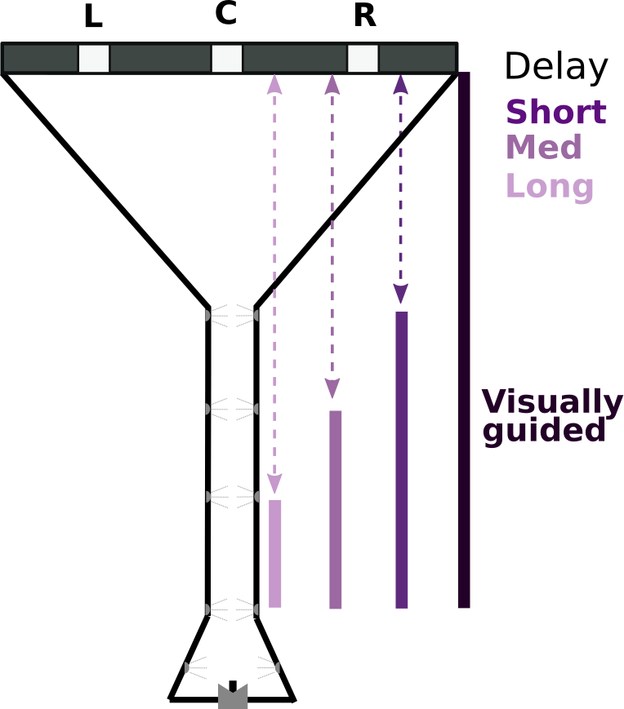
Multiple-choice delayed-response task

Slide 22
Engagement in complex cognitive tasks
Disengaged
Engaged

Slide 23
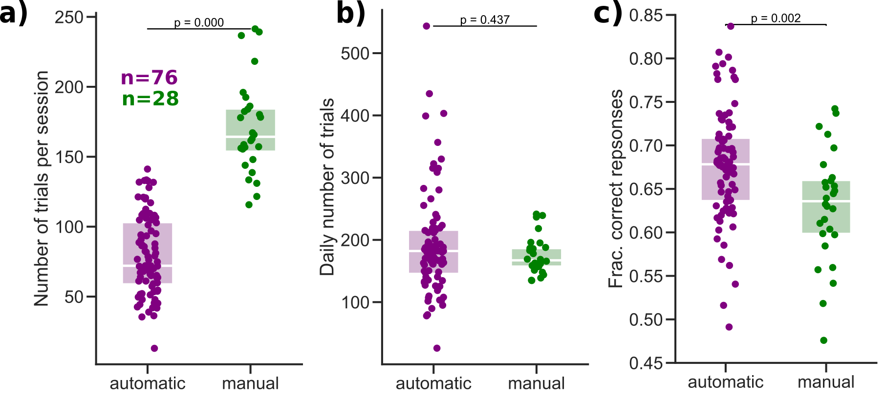
Comparable performance to manual training

Slide 24
Suitable for longitudinal behavioral assesment
n=12

Slide 25
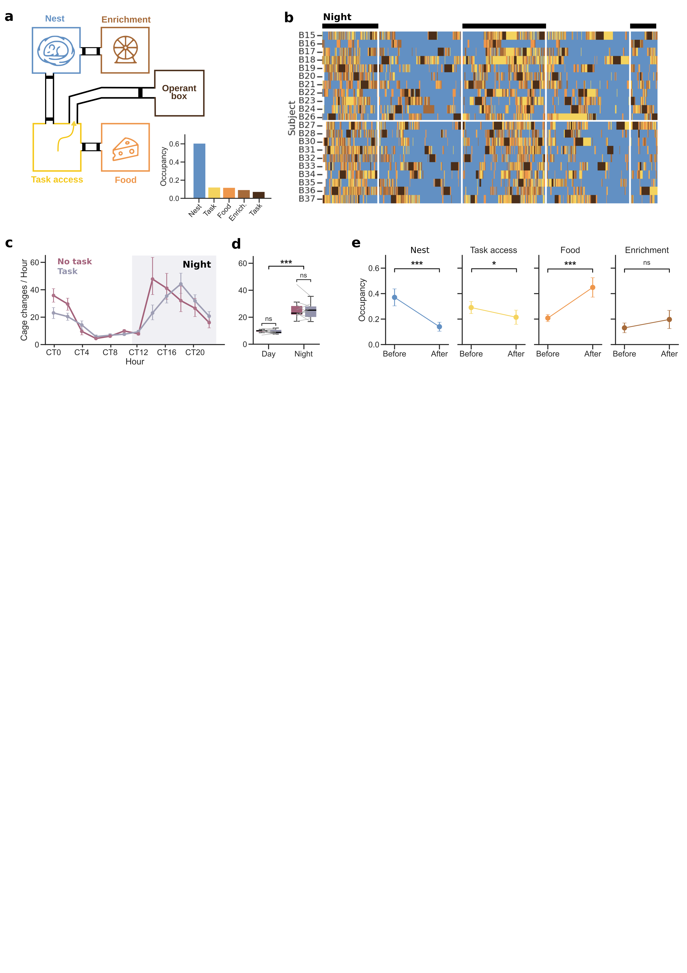
Homecage behaviors are modulated by the task
Box
Nest
Enrich.
Task a.
Food
Eco-HAB
Puścian et al., 2016
Notes:
Anther powerful advantage of this system is that allows to address behavior outside the task, and answer novel questions, such as for example what are animals doing before and after training?
In this experiment en each homecage we placed different items. One had bedding and and igloos, for animals to sleep, and the other had the food, another had some running wheels and tubes ot play, and one was completely empty. We had the recordings of where was each mouse, the different colors represent the cage, and you can see that the majority of the time they are in the sleeping cages, especially during the day.

Slide 26
Homecage behaviors are modulated by the task
Eco-HAB
Puścian et al., 2016
Notes:
And we observed thet immediately before the training sessions they were in the sleeping cages, and afterwards they preferred to eat. This is just one example of the multiple questions we can ask about how task behavior is influenced by contextual variables just as sleep, water and food deprivation, social interactions

Slide 27
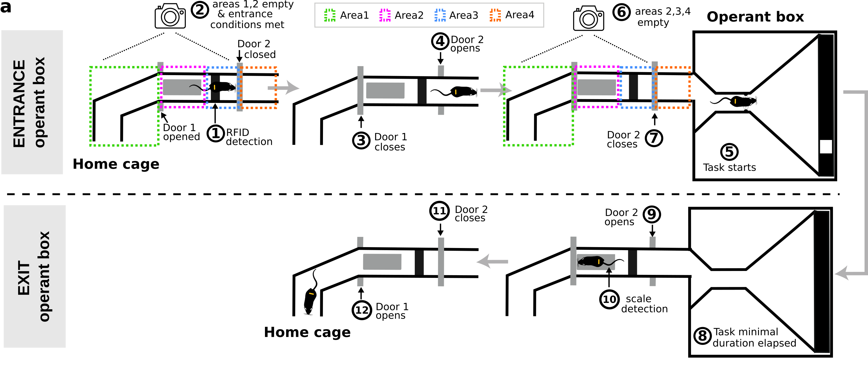

Slide 28
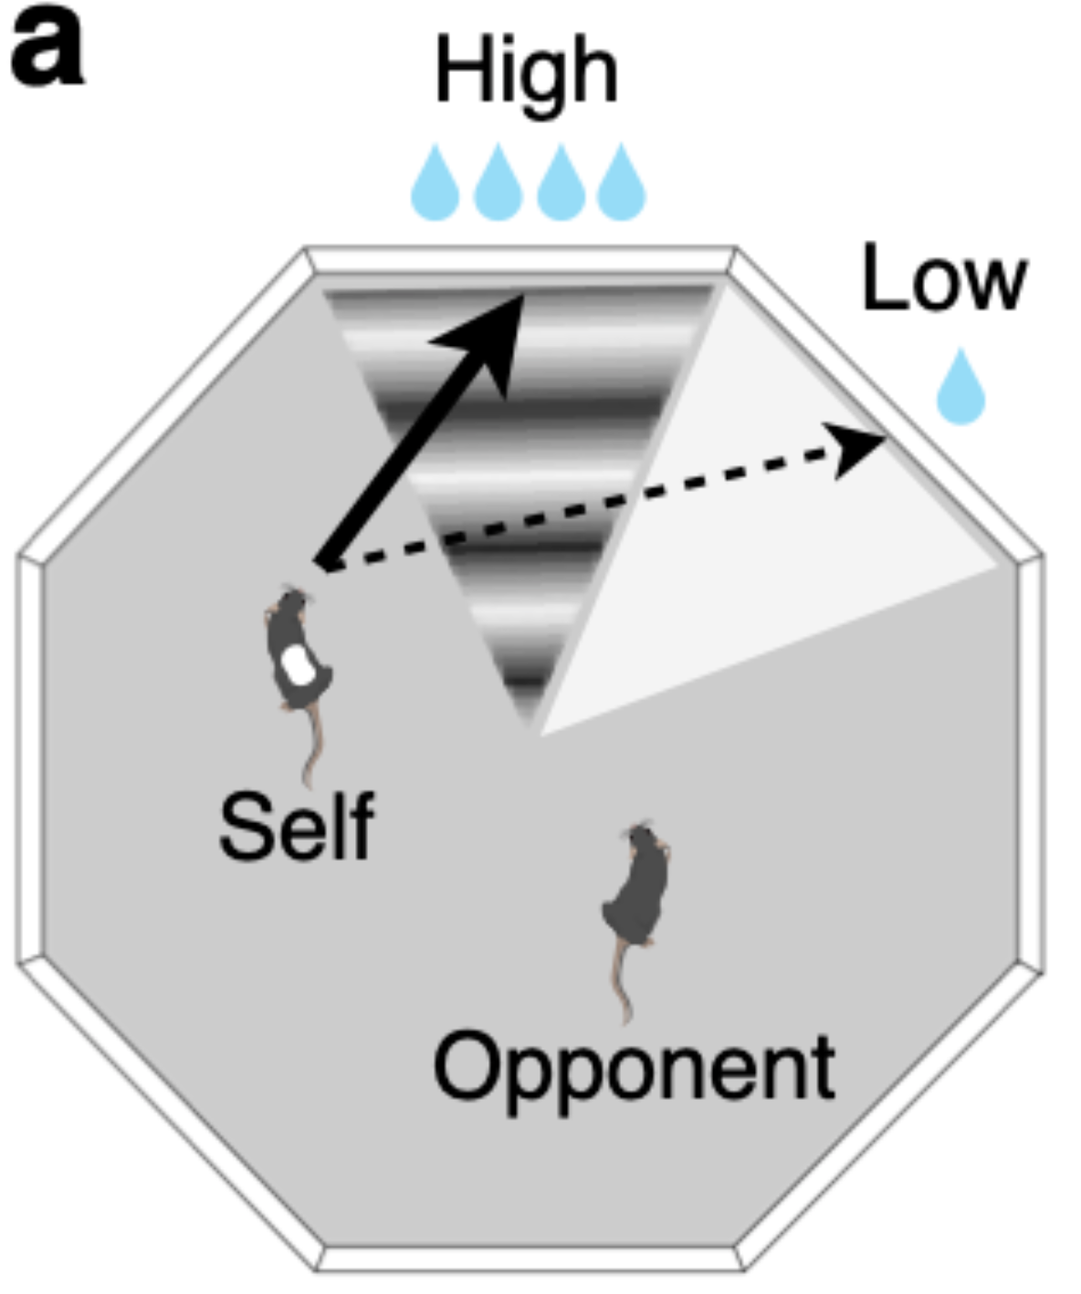
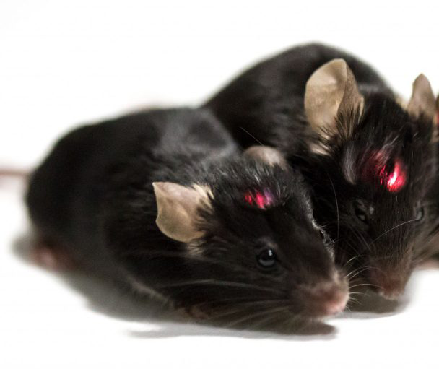
Training Village allows continuous and high-quality data collection in complex cognitive tasks
Multi-animal tasks (competition, cooperation, …)
Relationship of cognitive abilities with social interactions
Longitudinal pharmacological and agining experiments
Erlich et al 2025
Wireless optogenetics/fiber photometry

Slide 29
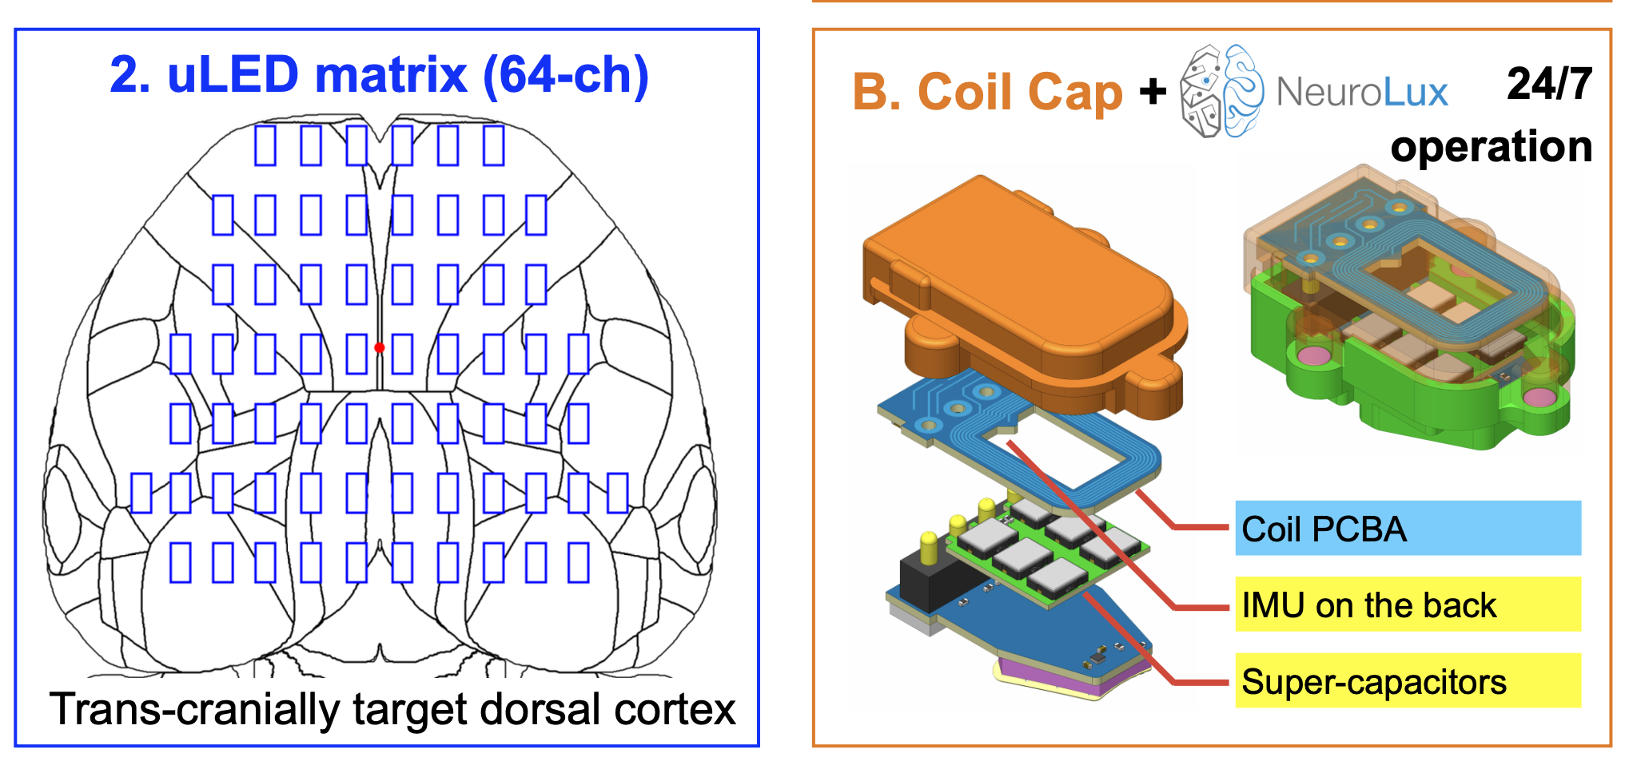
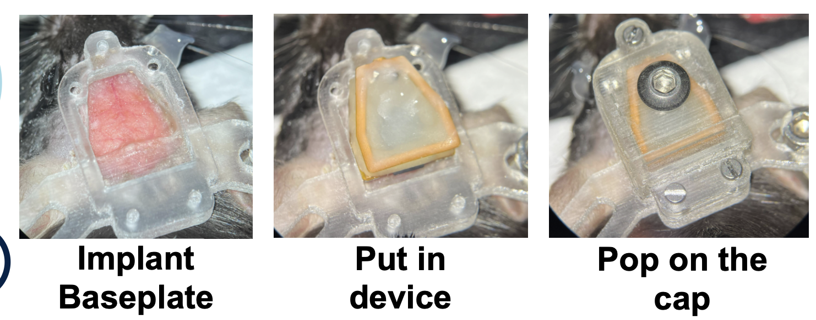
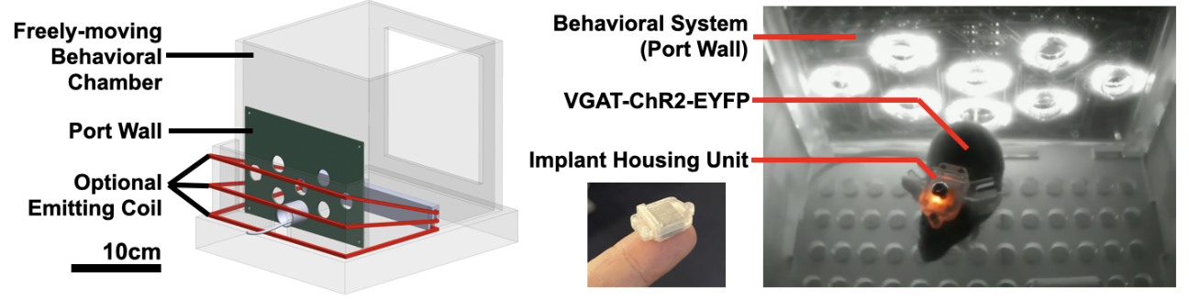

Slide 30

A Task example: Delayed Side-Cue Discrimination Task
Start
First Cue
Delayed Cue
Choose first side
Reward
Start poke
First Cue
Delayed Cue
Choice poke
Async Delay
[0, 100, 250, 500, 1000, +∞]

Slide 31

S1
Start trial
S5
ITI (1s)
Center poke
S2
S4
First cue
Lateral poke
Correct poke
Reward
No response
in 40s
[0, 1000ms]
S3
S6
S7
Second cue
Incorrect poke
Time-out (3s)
Lateral poke
1.5

Slide 32
We are looking for beta testers!
contact: balmaserrano@gmail.com

Slide 33







Thank you!
Webpage link
Rafa Marin
Jaime de la Rocha
Javi Rodríguez
Hernando Vergara
Brain Circuits and Behavior Lab
Animal Minds Lab (Rat Village)
Eco-HAB team

Slide 38
Homecage activity is not altered by the TV

Slide 39
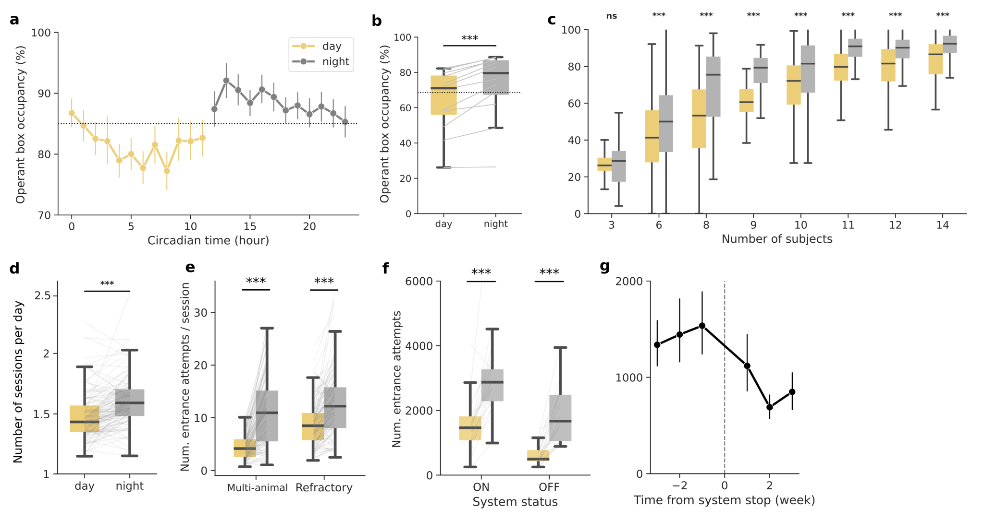
Circadian modulations with the TV

