Slide 1
Face Recognition And Description System
By Aditya Kulkarni,Sushant Belsare and Sarang Kulkarni

Slide 2
Index
Introduction
Problem Statement
Objective
Literature Survey
Architecture
Methodology
Outcome

Slide 3

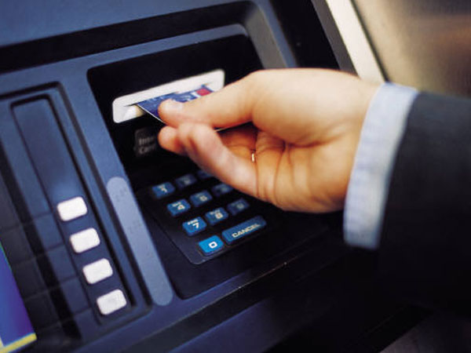
Introduction
The information age revolutionizing the ways transactions are completed. This growth in electronic transactions has resulted in a greater demand for fast and accurate user identification and authentication.
In today's networked world, the need to maintain the security of information or physical property is becoming both increasingly important and increasingly difficult.

Slide 4

Introduction
From time to time we hear about the crimes of credit card fraud, computer breaking by hackers, or security breaches in a company or government building.
If someone steals, duplicates, or acquires identity means, he or she will be able to access our data or our personal property any time they want.
Recently, technology became available to allow verification of "true" individual identity. This technology is based in a field called "biometrics".

Slide 5
Biometrics
Biometrics is unique, measurable characteristic of a human being that can be used automatically recognize an individual.
Biometrics can measure both physiological and behavioral characteristics.
Physiological biometrics include:
Finger scan
Facial Recognition
Hand scan

Slide 6
Facial Recognition???
There are several reasons to choose face recognition. This include the following:
It requires no physical interaction on behalf of the user.
It is accurate and allows for high enrolment and verification rates.
It can use your existing hardware infrastructure , existing cameras and image capture devices will work with no problems.

Slide 7
Facial Recognition
In face recognition ,there are two types of comparisons:
VERIFICATION-
The system compare given individual with who they say they are and give decision yes or no.
IDENTIFICATION-
The system compares the given individual to all other individuals in the database and gives a ranked list of matches.

Slide 8
Problem Statement:
Currently existing systems is not completely flawless , the system somehow tends to inaccuracy even though its minute.
Till date there is not single face recognition for fulfilling maximum factors in real time application.
Every method have its pros and cons.
The presenter motivated by the unsatisfactory scenario of face recognition system to enhance the performance of it.

Slide 9
Objective:
To develop a system which can recognize human faces and gives equivalent description about it.
To distinguish between different facial patterns with a designed system.

Slide 10
Literature Survey
Sr No | IEEE Paper Name | Advantages | Disadvantages
1 | A Complementary Study for the Evaluation of Face Recognition Technology By Taketo Horiuchi,Takuro Hada(2013) | Complementary experiments by confirming whether the recognition accuracy is influenced by four factors, A change over the years (15 year aging) An angle of photo taking A change of expressions (smiling and laughing) Wearing accessories (cap, sunglasses, beard and mustache). | The results of the experiments were no more than the evaluation with good condition while neglecting other conditions such as low resolution camera
2 | The Development Trend of Evaluating Face-Recognition Technology By Caixia Liu(2014) | Whether FERET, FRVT, FRGC of American, or CAS- PEAL (2004), Gallery (2008) of China, all made an indelible contribution to the rapid development of visible light face- recognition technology. | FERET, FRVT, FRGC of American, or CAS- PEAL (2004), Gallery (2008) of China, all preferred to testing face-recognition algorithm relatively, and their test environments were mostly in natural light.
3 | Automatic Face Recognition System by Combining Four Individual Algorithms By Manzoor Ahmad Lone,S. M. Zakariya and Rashid Ali(2011) | In the multi-algorithmic approach, we combine PCA, DCT, Correlation and PIFS techniques in a pair of two, three and all to obtain combinations face recognition system namely PCA-DCT, PCA-DCT-Corr and PCA-DCT-Corr-PIFS. These combinations based systems provide better results than the corresponding individual algorithms. | This approach is implemented against ORL (Olivetti Research Laboratory) database consisting 400 face images taken from 40 people, 10 images per person against dark homogeneous background.

Slide 11
Literature Survey
Sr No | IEEE Paper Name | Advantages | Disadvantages
4 | Feature Extraction and Classification by Machine Learning Methods for Biometric Recognition of Face and Iris By Miloš Oravec(2014) | Introduction of machine learning by MLP wherein m<p and m is number of hidden neurons, p is number of input-output neurons. Using this machine learning for feature extraction and classification of data for face recognition. | Dimensionality of the feature space is the same as that of data space but when the transform is not chosen appropriately, the dimensionality of the feature space will remain unchanged.
5 | Face Recognition using Subspaces Techniques By G. Prabhu Teja,S.Ravi(2012) | The approach is primarily to reduce the error rates by using preprocessing techniques and recognizing using subspace methods in which False Acceptance Rate (FAR) and False Rejection Rate (FRR) will compute to find error rates (ERR). | Difference of Gaussian filter does not support the complete removal of darkness instead removing local shading
6 | Markovian Mixture Face Recognition with Discriminative Face Alignment By Ming Zhao,Tat Seng-Chua(2008) | Mixture of top-down as well as bottom up approach to incorporate class-speciﬁc knowledge. | Discriminative face alignment model for each person increases space complexity.
7 | Face Recognition Using Principal Component Analysis and Self Organizing Maps By Dian Retno Anggraini(2014) | Self-Organizing Maps, is an unsupervised learning neural network. It is used to classify patterns of image feature extraction by Principal Component Analysis method. Accuracy obtained after implementation is better. | Results are not satisfactory when computed against CNNL database.

Slide 12
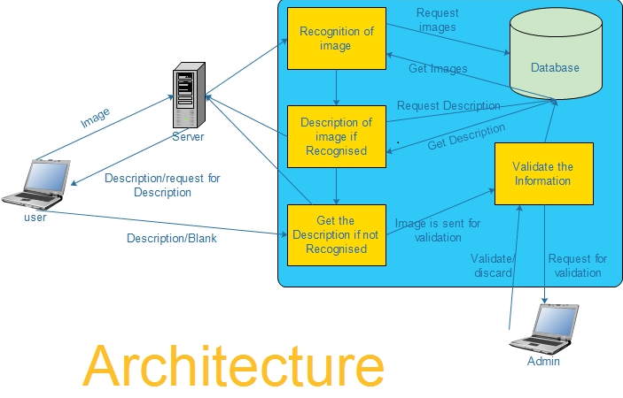

Slide 13
• Recognition of Image: In this phase the image is compared with the existing images in the database.
•Description of image if recognize : This phase will return the related information of the Image which is there in the Database.
• Get the description if not recognized: This phase will ask the user for the description if the image is not recognized.
• Validate the information: In this phase the information provided by the user for a particular image is cross veriﬁed and is validated by the administrator.
• Database: It stores the image and image related information.

Slide 14
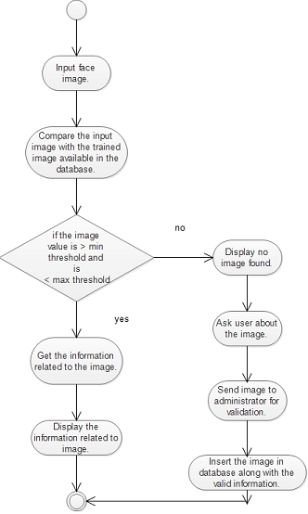
Activity Diagram

Slide 15
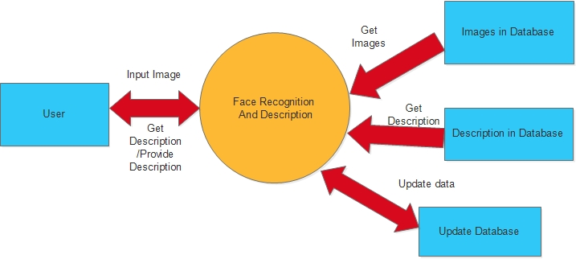
Dataflow diagram

Slide 16
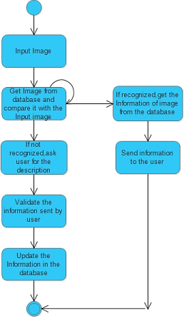
State diagram

Slide 17
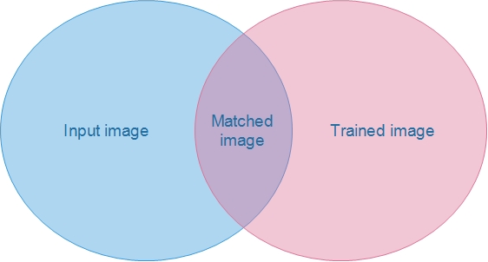
Venn diagram

Slide 18
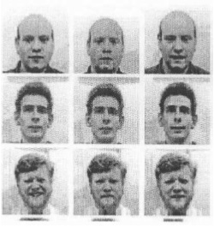
Eigenface,the algorithm
First we will obtain images I_1,I_2,…..,I_M which are training faces
Now we will represent every Image I_i in the form of vector Γ¡

Slide 19
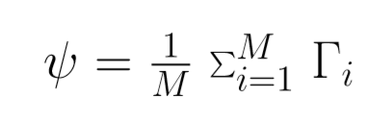
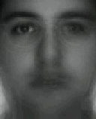
Eigenface,the algorithm
Now we will compute the average vector ψ,

Slide 20

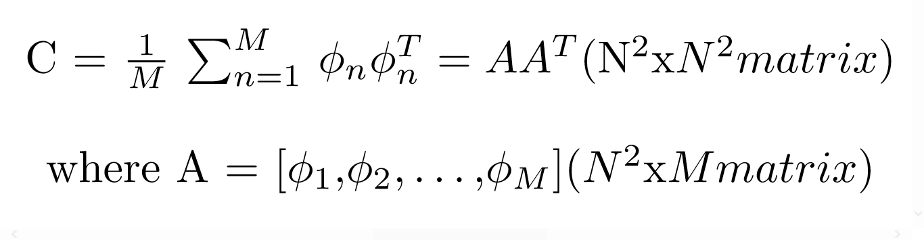
Eigenface,the algorithm
Now we will subtract the mean face,
Now we will compute the covariance matrix,

Slide 21

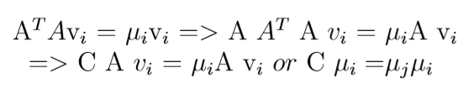

Eigenface,the algorithm
Now we will compute eigenvector μ¡ of C.
But the matrix is very large and hence not practical.
Consider a matrix of which we will compute eigenvector V¡.
where

Slide 22
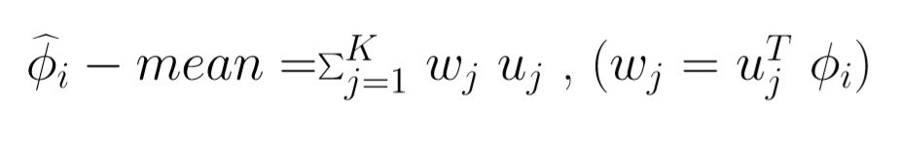
Eigenface,the algorithm
Each face Φ¡ in the training set can be represented as linear combination of best K eigenvectors,

Slide 23
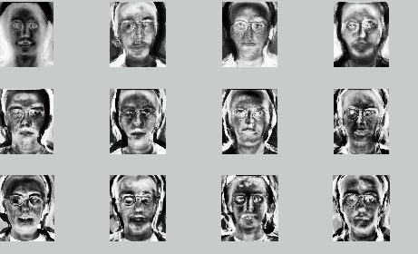
Eigenface,the algorithm
Eigenfaces of original faces

Slide 24
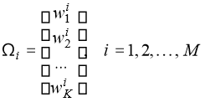
Eigenface,the algorithm
Each normalized training face Φ¡ is represented in this basis by a vector,

Slide 25
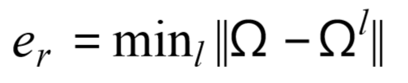

Eigenface,the algorithm
For the recognition of face we are calculating,
If the value of is less than threshold then eigenvector is recognized as face l from training set.

Slide 26
Outcome
Given the input as human face image,the image is recognized by the system.
Then the description equivalent to image must be retrieved.
If the image is not recognized,then the description is asked to the user.

