Slide 1
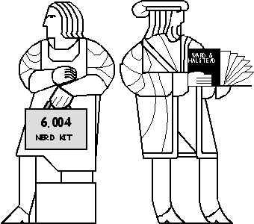
Designing an Instruction Set
move flour,bowl
add milk,bowl
add egg,bowl
move bowl,mixer
rotate mixer
...
Nerd Chef at work.
Von Neumann Model
Intro to Beta Instruction Set

Slide 2
Example: Factorial
factorial(N) = N! = N*(N-1)*…*1
C:
int a = 1;
int b = N;
do {
a = a * b;
b = b – 1;
} while (b != 0)
initially: a = 1, b = 5
after iter 1: a = 5, b = 4
after iter 2: a = 20, b = 3
after iter 3: a = 60, b = 2
after iter 4: a = 120, b = 1
after iter 5: a = 120, b = 0
Done!

Slide 3
Example: Factorial
factorial(N) = N! = N*(N-1)*…*1
C:
High-level FSM:
int a = 1;
int b = N;
do {
a = a * b;
b = b – 1;
} while (b != 0)
b’!=0
start
loop
b’==0
done
a ← 1
b ← N
a ← a * b
b ← b - 1
a ← a
b ← b
start: a ← 1, b ← 5
loop: a ← 5, b ← 4
loop: a ← 20, b ← 3
loop: a ← 60, b ← 2
loop: a ← 120, b ← 1
loop: a ← 120, b ← 0
done:
Helpful to translate into hardware
D-registers (a, b)
2-bits of state (start, loop, done)
Boolean transitions (b’==0, b’!=0)
Register assignments in states (e.g., a ← a * b)

Slide 4
Datapath for Factorial
b != 0
Draw registers
Draw combinational circuit for each assignment
Connect to input muxes
start
loop
b == 0
done
a ← 1
b ← N
a ← a * b
b ← b - 1
a ← a
b ← b
1
N
32
32
wa_{SEL}
2
wb_{SEL}
2
0 1 2
0 1 2
32
32
a
b
32
32
-1
*
+
32
32

Slide 5
Control FSM for Factorial
b’!=0
Draw combinational logic for transition conditions
Implement control FSM:
States: High-level FSM states
Inputs: Transition logic outputs
Outputs: Mux select signals
start
0
loop
1
b’==0
done
2
a ← 1
b ← N
a ← a * b
b ← b - 1
a ← a
b ← b
1
N
Control FSM
wa_{SEL}
(2 bits)
wb_{SEL}
(2 bits)
wa_{SEL}
0 1 2
wb_{SEL}
0 1 2
z
S | Z | wa_{SEL} | wb_{SEL} | S’
00 | 0 | 10 | 00 | 01
00 | 1 | 10 | 00 | 01
01 | 0 | 01 | 01 | 01
01 | 1 | 01 | 01 | 10
10 | 0 | 00 | 10 | 10
10 | 1 | 00 | 10 | 10
a
b
0
-1
*
==
+
z

Slide 6
Control FSM Hardware
ROM
8 locs x 6 bits
ROM contents
D[5:4]
wa_{SEL}
A[2:0] | D[5:0]
000 | 10 00 01
001 | 10 00 01
010 | 01 01 01
011 | 01 01 10
100 | 00 10 10
101 | 00 10 10
IN
A[0]
D[3:2]
wb_{SEL}
A[2:1]
D[1:0]
Current state
Next state
2
2

Slide 7
So Far: Single-Purpose Hardware
Problem→ Procedure (High-level FSM)→ Implementation
Systematic way to implement high-level FSM as a datapath + control FSM
Is this implementation an FSM itself?
If so, can you draw the truth table?
How should we generalize our approach so we can solve many problems with one set of hardware?
More storage for operands and results
A larger repertoire of operations
General-purpose datapath

Slide 8
A Simple Programmable Datapath
a_{SEL}
Each cycle, this datapath:
Reads two operands (a, b) from 4 registers (R0-R3)
Performs one operation of +, -, *, NAND on operands
Optionally writes result to a register
Control FSM:
LE
R0
LE
R1
w_{SEL}
w_{EN}
LE
R2
LE
R3
Control FSM
a_{SEL}
b_{SEL}
b_{SEL}
op_{SEL}
w_{SEL}
+
-
*
NAND
==?
w_{EN}
z
op_{SEL}
0 1 2 3
z

Slide 9
A Control FSM for Factorial
R0 value = 1
R1 value = N
R2 value = -1
R3 value = 0
Assume initial register contents:
Control FSM:
z == 0
loopmul
loop
sub
loopbeq
z == 1
done
asel = 0
bsel = 1
opsel = 2 (*)
wen = 1
wsel = 0
asel = 1
bsel = 2
opsel = 0 (+)
wen = 1
wsel = 1
asel = 1
bsel = 3
opsel = X
wen = 0
wsel = X
asel = 1
bsel = 3
opsel = X
wen = 0
wsel = X
R0 ← R0 * R1
R1 ← R1 + R2
N! in R0

Slide 10
New Problem → New Control FSM
You can solve many more problems with this datapath!
Exponentiation, division, square root, …
But nothing that requires more than four registers
By designing a control FSM, we are programming the datapath
Early digital computers were programmed this way!
ENIAC (1943):
First general-purpose digital computer
Programmed by setting huge array of dials and switches
Reprogramming it took about 3 weeks

Slide 11
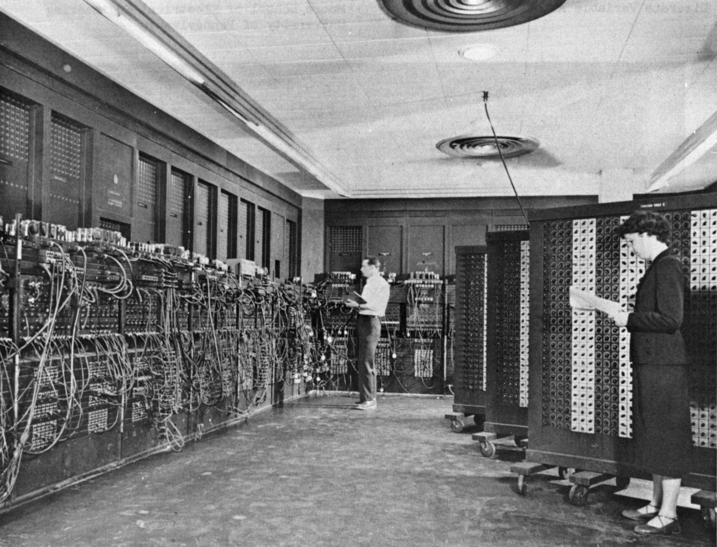
"Eniac" by Unknown - U.S. Army Photo.
Notes:
"Eniac" by Unknown - U.S. Army Photo. Licensed under Public Domain via Commons - https://commons.wikimedia.org/wiki/File:Eniac.jpg#/media/File:Eniac.jpg

Slide 12
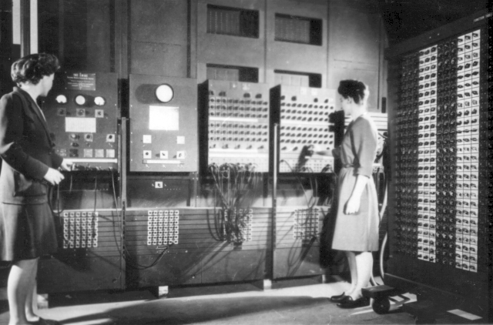
U.S. Army Photo.
Notes:
https://commons.wikimedia.org/wiki/File:Two_women_operating_ENIAC.gif

Slide 13
The von Neumann Model
Many approaches to build a general-purpose computer. Almost all modern computers are based on the von Neumann model (John von Neumann, 1945)
Components:
Central Processing Unit
Main Memory
address
Datapath
status
Control FSM
Input/ Output
data
control
Central processing unit: Performs operations on values in registers
Main memory: Array of W words of N bits each
Input/output devices to communicate with the outside world
& memory

Slide 14
Key Idea: Stored-Program Computer
Express program as a sequence of coded instructions
Memory holds both data and instructions
CPU fetches, interprets, and executes successive instructions of the program
op
ra rb
rc
Main Memory
rc ← op(ra,rb)
instruction
instruction
But, how do we know which words hold instructions and which words hold data?
Central
Processing
Unit
instruction
data
data
data
0xba5eba11

Slide 15
Anatomy of a von Neumann Computer
Datapath
Control Unit
control
Internal storage
status
address
data
address
instructions
Main Memory
PC
1101000111011
dest
R1 ←R2+R3
…
registers
• Instructions coded as binary data
• Program Counter or PC: Address of the instruction to be executed
• Logic to translate instructions into control signals for datapath
asel
bsel
fn
ALU
status
operations

Slide 16
Instructions
Instructions are the fundamental unit of work
Each instruction specifies:
An operation or opcode to be performed
Source operands and destination for the result
In a von Neumann machine, instructions are executed sequentially
CPU logically implements this loop:
By default, the next PC is current PC + size of current instruction unless the instruction says otherwise
Fetch instruction
Decode instruction
Read src operands
Execute
Write dst operand
Compute next PC

Slide 17
Instruction Set Architecture (ISA)
ISA: The contract between software and hardware
Functional definition of operations and storage locations
Precise description of how software can invoke and access them
The ISA is a new layer of abstraction:
ISA specifies what the hardware provides, not how it’s implemented
Hides the complexity of CPU implementation
Enables fast innovation in hardware (no need to change software!)
8086 (1978): 29 thousand transistors, 5 MHz, 0.33 MIPS
Pentium 4 (2003): 44 million transistors, 4 GHz, ~5000 MIPS
Both implement x86 ISA
Dark side: Commercially successful ISAs last for decades
Today’s x86 CPUs carry baggage of design decisions from the 70’s

Slide 18
Instruction Set Architecture Design
Designing an ISA is hard:
How many operations?
What types of storage, how much?
How to encode instructions?
How to future-proof?
How to decide? Take a quantitative approach
Take a set of representative benchmark programs
Evaluate versions of your ISA and implementation with and without feature
Pick what works best overall (performance, energy, area…)
Corollary: Optimize the common case
Let’s design our own instruction set: the Beta!

Slide 19
Beta ISA: Storage
CPU State
Main Memory
PC
Up to 2³² bytes (4GB of memory) organized as 2³⁰ 4-byte words
Address
31
0
0x00
3
2
1
0
0x04
r0
0x08
Each memory word is 32-bits wide, but for historical reasons the β uses byte memory addresses. Since each word contains four 8-bit bytes, addresses of consecutive words differ by 4.
r1
0x0C
r2
0x10
0x12
...
32-bit “words”
32-bit “words”
(4 bytes)
r31
000000....0
General Registers
Why separate registers and main memory?
Tradeoff: Size vs speed and energy
r31 hardwired to 0

Slide 20
Storage Conventions
Variables live in memory
Registers hold temporary values
To operate with memory variables
Load them
Compute on them
Store the results
int x, y;
y = x * 37;
0x1000:
n
0x1004:
r
0x1008:
x
R0 ← Mem[0x1008]
R0 ← R0 * 37
Mem[0x100C] ← R0
0x100C:
y
0x1010:

Slide 21
Beta ISA: Instructions
Three types of instructions:
Arithmetic and logical: Perform operations on general registers
Loads and stores: Move data between general registers and main memory
Branches: Conditionally change the program counter
All instructions have a fixed length: 32 bits (4 bytes)
Tradeoff (vs variable-length instructions):
Simpler decoding logic, next PC is easy to compute
Larger code size

Slide 22
Beta ALU Instructions
Format:
OPCODE
r_{c}
r_{a}
r_{b}
unused
Example coded instruction: ADD
0
0
0
0
0
0
0
0
0
0
0
1
0
0
0
0
0
0
0
0
1
1
0
0
0
0
1
0
0
0
1
0
unused
OPCODE = 100000, encodes ADD
r_{a}=1, r_{b}=2
encodes R1 and R2 as
source locations
r_{c}=3,
encodes R3 as destination
32-bit hex: 0x80611000
We prefer to write a symbolic representation: ADD(r1,r2,r3)
ADD(ra,rb,rc):
Similar instructions for other ALU operations:
Reg[rc] ← Reg[ra] + Reg[rb]
arithmetic: ADD, SUB, MUL, DIV
compare: CMPEQ, CMPLT, CMPLE
boolean: AND, OR, XOR, XNOR
shift: SHL, SHR, SRA
“Add the contents of ra to the contents of rb; store the result in rc”

Slide 23
Implementation Sketch #1
Now that we have our first set of instructions, we can create a more concrete implementation sketch:
OPCODE
r_{c}
r_{a}
r_{b}
unused
r_{c}
…
0
32 registers
PC
r_{a}
r_{b}
4
+
fn
ALU
operations

Slide 24
Should We Support Constant Operands?
Many programs use small constants frequently
e.g., our factorial example: 0, 1, -1
Tradeoff:
When used, they save registers and instructions
More opcodes → more complex control logic and datapath
Analyzing operands when running SPEC CPU benchmarks, we find that constant operands appear in
>50% of executed arithmetic instructions
Loop increments, scaling indicies
>80% of executed compare instructions
Loop termination condition
>25% of executed load instructions
Offsets into data structures

Slide 25
Beta ALU Instructions with Constant
Format:
OPCODE
r_{c}
r_{a}
16-bit signed constant
Example instruction: ADDC adds register contents and constant:
1
1
0
0
0
0
0
0
0
1
1
0
0
0
0
1
1
1
1
1
1
1
1
1
1
1
1
1
1
1
0
1
OPCODE = 110000, encoding ADDC
r_{a}=1,
encoding R1 as first operand
r_{c}=3,
encoding R3 as destination
16-bit two’s complement constant, encoding -3 as second operand (will be sign-extended to become 32-bit two’s complement operand)
Symbolic version: ADDC(r1,-3,r3)
ADDC(ra,const,rc):
Similar instructions for other ALU operations:
Reg[rc] ← Reg[ra] + sext(const)
arithmetic: ADDC, SUBC, MULC, DIVC
compare: CMPEQC, CMPLTC, CMPLEC
boolean: ANDC, ORC, XORC, XNORC
shift: SHLC, SHRC, SRAC
“Add the contents of ra to const; store the result in rc”

Slide 26
Implementation Sketch #2
Next we add the datapath hardware to support small constants as the second ALU operand:
OPCODE
r_{c}
r_{a}
16-bit signed constant
r_{c}
…
0
32 registers
PC
r_{a}
r_{b}
4
+
sxt(const)
bsel
fn
ALU
operations

Slide 27
Beta Load and Store Instructions
Loads and stores move data between the internal registers and main memory
Address calculation is just like ADDC instruction!
OPCODE
r_{c}
r_{a}
16-bit signed constant
address
LD(ra,const,rc) Reg[rc] ← Mem[Reg[ra] + sext(const)]
Load rc with the contents of the memory location
ST(rc,const,ra) Mem[Reg[ra] + sext(const)] ← Reg[rc]
Store the contents of rc into the memory location
To access memory the CPU has to generate an address. LD and ST compute the address by adding the sign-extended constant to the contents of register ra.
To access a constant address, specify R31 as ra.
To use only a register value as the address, specify a constant of 0.

Slide 28
Using LD and ST
Variables live in memory
Registers hold temporary values
To operate with memory variables
Load them
Compute on them
Store the results
int x, y;
y = x * 37;
R0 ← Mem[0x1008]
R0 ← R0 * 37
Mem[0x100C] ← R0
0x1000:
n
0x1004:
r
0x1008:
x
0x100C:
y
0x1010:
LD(R31,0x1008,R0)
MULC(R0,37,R0)
ST(R0,0x100C,R31)

Slide 29
Can We Solve Factorial With ALU Instructions?
No! Recall high-level FSM:
Factorial needs to loop
So far we can only encode sequences of operations on registers
Need a way to change the PC based on data values!
Called “branching”. If the branch is taken, the PC is changed. If the branch is not taken, keep executing sequentially.
Branch taken
Branch target
b != 0
mul
sub
loop
b == 0
done
a ← a * b
b ← b - 1
Conditional
branch
Branch not taken

Slide 30
Beta Branch Instructions
The Beta’s branch instructions provide a way to conditionally change the PC to point to a nearby location...
... and, optionally, remembering (in Rc) where we came from (useful for procedure calls).
“offset” is a SIGNED CONSTANT encoded as part of the instruction!
BEQ or BNE
r_{c}
r_{a}
16-bit signed constant
BEQ(ra,offset,rc): Branch if equal
BNE(ra,offset,rc): Branch if not equal
NPC ← PC + 4 Reg[rc] ← NPC
if (Reg[ra] == 0)
PC ← NPC + 4*offset
else
PC ← NPC
NPC ← PC + 4 Reg[rc] ← NPC
if (Reg[ra] != 0)
PC ← NPC + 4*offset
else
PC ← NPC
offset = distance in words to branch target, counting from the instruction following the BEQ/BNE. Range: -32768 to +32767.

Slide 31
Can We Solve Factorial Now?
int a = 1;
int b = N;
do {
a = a * b;
b = b – 1;
} while (b != 0)
// Assume r1 = N
ADDC(r31, 1, r0) // r0 = 1
L:MUL(r0, r1, r0) // r0 = r0 * r1
SUBC(r1, 1, r1) // r1 = r1 – 1
BNE(r1, L, r31) // if r1 != 0, run MUL next
// at this point, r0 = N!
Remember control FSM for our simple programmable datapath?
Control FSM states → instructions!
Not the case in general
Happens here because datapath is similar to basic von Neumann datapath
z == 0
loopmul
loop
sub
loopbne
z == 1
done

Slide 32
Beta JMP Instruction
Branches transfer control to some predetermined destination specified by a constant in the instruction. It will be useful to be able to transfer control to a computed address.
011011
r_{c}
r_{a}
unused
JMP(Ra,Rc): Reg[Rc] ← PC + 4
PC ← Reg[Ra]
Useful for procedure call return…
…
[0x100] BEQ(R31,sqrt,R28)
…
[0x678] BEQ(R31,sqrt,R28)
…
R28 = 0x104
sqrt:
…
JMP(R28,R31)
R28 = 0x67C
1st time: PC←0x104
2nd time: PC←0x67C

Slide 33
Beta ISA Summary
Storage:
Processor: 32 registers (r31 hardwired to 0) and PC
Main memory: 32-bit byte addresses; each memory access involves a 32-bit word. Since there are 4 bytes/word, all addresses will be a multiple of 4.
Instruction formats:
Instruction types:
ALU: Two input registers, or register and constant
Loads and stores
Branches, Jumps
OPCODE
r_{c}
r_{a}
r_{b}
unused
OPCODE
r_{c}
r_{a}
16-bit signed constant
32 bits

