Slide 1
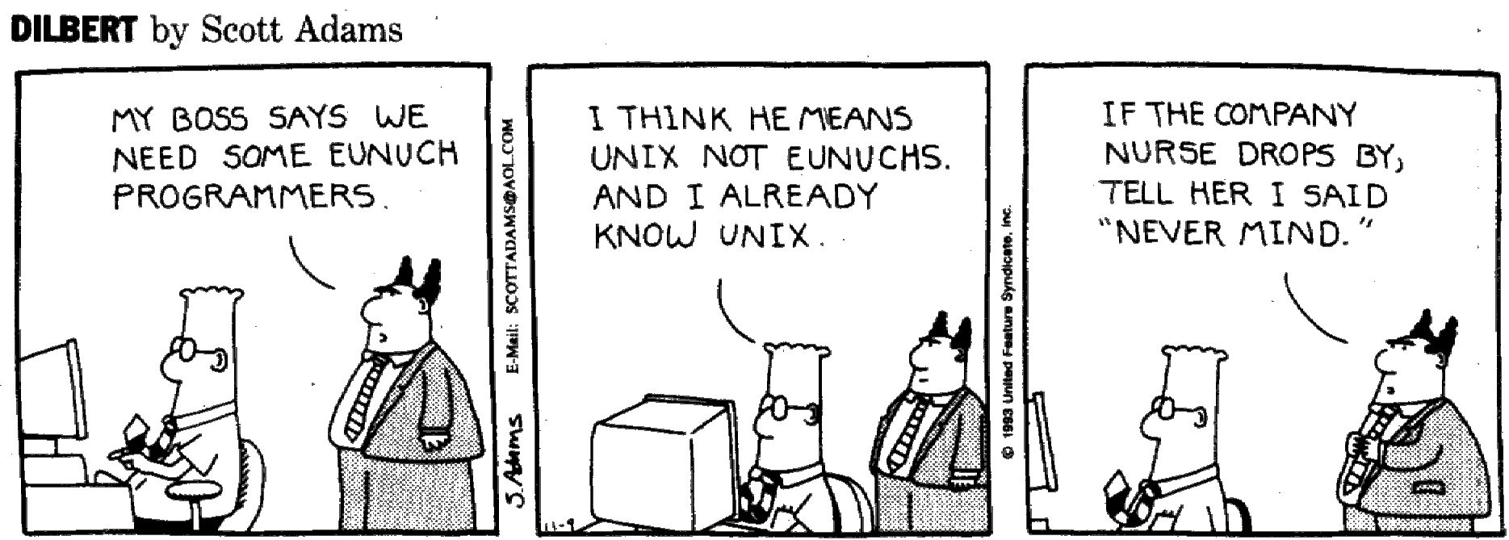
Virtualizing the Processor
Page map example
Virtual machines
Processes
Timesharing
Communicating with OS

Slide 2
Review: Virtual Memory
CPU
VA
MMU
PA
RAM
Virtual
Memory
Physical
Memory
D
R
PPN
X
X
X
PAGEMAP
Goal: create illusion of large virtual address space
divide address into (VPN,offset), map to (PPN,offset) or page fault
use high address bits to select page: keep related data on same page
use cache (TLB) to speed up mapping mechanism—works well
long disk latencies: keep working set in physical memory, use write-back

Slide 3
MMU Address Translation
32-bit virtual address
32
1
2
3
Page fault
(handled by SW)
Context #
20
12
10
10
12
PDIR
D R PPN
D R PPN
VPN +
context
Page Directory
(1 page)
Partial Page Table
(1 page)
Data
Translation
Look-aside
Buffer
Access to the state for a particular MMU context is controlled by two registers:
Context #, used by TLB
PDIR, used by multi-level page map

Slide 4
Contexts
A context is an entire set of mappings from VIRTUAL to PHYSICAL page numbers as specified by the contents of the page map:
Virtual Memory
Physical Memory
We would like to support multiple VIRTUAL to PHYSICAL Mappings and, thus, multiple Contexts.
D
R
X
X
X
PAGEMAP
THE BIG IDEA: Several programs, each with their own context, may be simultaneously loaded into main memory!
Virtual
Physical
Virtual
“Context switch”:
reload the page map!
Memory 1
Memory
Memory 2
We only have change Context# and PDIR
map
map

Slide 5
Building a Virtual Machine (VM)
PROCESS #0
physical
memory
PROCESS #1
virtual
memory
virtual
memory
P0
P1
P0
P1
shared
?
P0
P1
Context #0
?
Context #1
?
Goal: give each program its own “VIRTUAL MACHINE”; programs don’t “know” about each other…
New abstraction: a process which has its own
• machine state: R0, …, R30 • program (w/ shared code) • context (virtual address space) • virtual I/O devices
• PC, stack
“OS Kernel” is a special, privileged process running in its own context. It manages the execution of other processes and handles real I/O devices, emulating virtual I/O devices for each process.

Slide 6
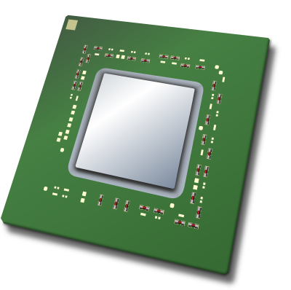



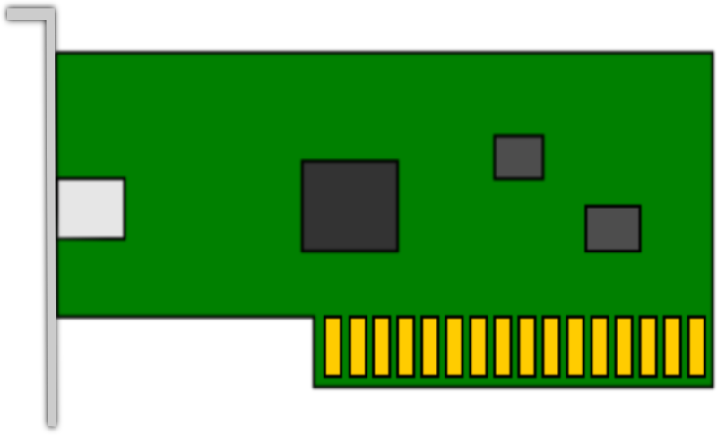
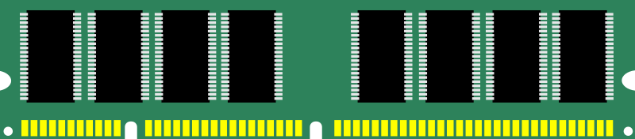
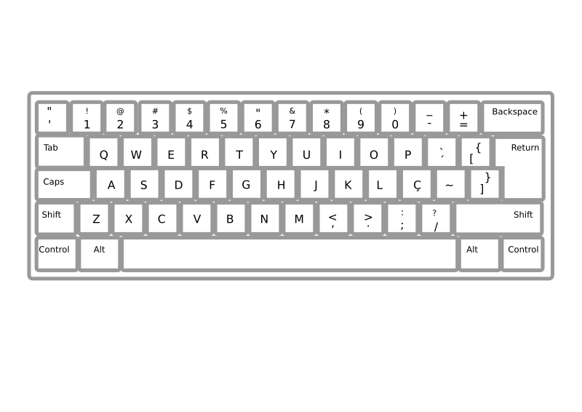

One VM For Each Process
P2
Application
CPU
Virtual
Memory
Windows
I/O
events
files
sockets
SVCs
Application
P3
Application
CPU
Virtual
Memory
Windows
I/O
events
files
sockets
SVCs
Virtual
Memory
I/O
events
P4
Application
P1
CPU
Windows
files
sockets
SVCs
CPU
Virtual
Memory
Windows
I/O
events
files
sockets
SVCs
P5
Application
CPU
Virtual
Memory
Windows
I/O
events
files
sockets
SVCs
OS Kernel (Specially privileged process)
CPU
MEM
TIMER
DISK
I/O
KVM
Notes:
https://openclipart.org/detail/24868/time-icon
https://openclipart.org/detail/152407/open-disk-drive
https://openclipart.org/detail/25792/ram-computer-memory
https://openclipart.org/detail/100267/cpu-central-processing-unit
https://openclipart.org/detail/32443/network-card
https://openclipart.org/detail/189864/monitor
https://openclipart.org/detail/26499/keyboard-abnt2-pt-br
https://openclipart.org/detail/24771/mouse-icon

Slide 7
Processes: Multiplexing the CPU
Running in process #0
Stop execution of process #0 either because of explicit yield or some sort of timer interrupt; trap to handler code, saving current PC+4 in XP
First: save process #0 state (regs, context) Then: load process #1 state (regs, context)
“Return” to process #1: just like return from other trap handlers (ie., use address in XP) but we’re returning from a different trap than happened in step 2!
Running in process #1
When this process is interrupted.
We RETURN to this process!
PROCESS
Operating
System
PROCESS
0
1
Virtual time
1
2
3
4
5

Slide 8
Key Technology: Timer Interrupts
XAdr
ILL
If (IRQ == 1 && PC[31] == 0) {
// Reg[XP] ← PC+4; PC ←“Xadr”
PCSEL = 4,
WASEL = 1, WDSEL = 0, WERF = 1,
MWR = 0
}
OP
JT
PCSEL
4
3
2
1
0
PC
00
A
Instruction
Memory
+4
D
Ra: <20:16>
Rb: <15:11>
Rc: <25:21>
+
WASEL
0
1
RA2SEL
XP
RA1
Register
RA2
Rc: <25:21>
1
WA
WA
File
WD
WERF
0
RD1
RD2
WE
Z
JT
PC+4+4*SXT(C)
C: SXT(<15:0>)
IRQ
Z
Control Logic
ASEL
1
0
1
0
BSEL
PCSEL
RA2SEL
A
B
ASEL
ALUFN
ALU
WD
WE
MWR
BSEL
Data Memory
OE
MOE
WDSEL
ALUFN
Adr
RD
MWR, MOE
WERF
WASEL
PC+4
0
1
2
WDSEL

Slide 9
Beta Interrupt Handling
Minimal Hardware Implementation:
Check for Interrupt Requests (IRQs) before each instruction fetch.
On IRQ j:
copy PC+4 into Reg[XP];
INSTALL j*4 as new PC.
Handler Coding:
Save state in “UserMState” structure
Call C procedure to handle the exception
re-install saved state from UserMState
Return to Reg[XP]-4
WHERE to find handlers?
BETA Scheme: WIRE IN a low-memory address for each exception handler entry point
Common alternative: WIRE IN the address of a TABLE of handler addresses (“interrupt vectors”)
RESET → 0x8000000
0:
BR(...)
ILLOP → 0x8000000
4:
BR(...)
X_ADR → 0x8000000
8:
BR(...)
12:
BR(...)
UserMState:
SAVED
STATE
TRANSPARENT to interrupted program!
SP

Slide 10
Example: Timer Interrupt Handler
Example:
Operating System maintains current time of day (TOD) count. But...this value must be updated periodically in response to clock EVENTs, i.e. signal triggered by 60 Hz timer hardware.
Program A (Application)
Executes instructions of the user program.
Doesn't want to know about clock hardware, interrupts, etc!!
Can incorporate TOD into results by “asking” OS.
Clock Handler
GUTS: Sequence of instructions that increments TOD. Written in C.
Entry/Exit sequences save & restore interrupted state, call the C handler. Written as assembler “stubs”.

Slide 11
Interrupt Handler Coding
long TimeOfDay;
struct MState { int Regs[31];} UserMState;
/* Executed 60 times/sec */
Clock_Handler(){
TimeOfDay = TimeOfDay+1;
}
Handler
(written in C)
if (TimeOfDay % QUANTUM == 0) Scheduler();
Clock_h:
ST(r0, UserMState) // Save state of
ST(r1, UserMState+4) // interrupted
... // app pgm...
ST(r30, UserMState+30*4)
LD(KStack, SP) // Use KERNEL SP
BR(Clock_Handler,lp) // call handler
LD(UserMState, r0) // Restore saved
LD(UserMState+4, r1) // state.
...
LD(UserMState+30*4, r30)
SUBC(XP, 4, XP) // execute interrupted inst
JMP(XP) // Return to app.
“Interrupt stub”
(written in assy.)

Slide 12
Simple Timesharing Scheduler
struct MState { int Regs[31]; } UserMState;
struct PCB { // Process Control Block struct MState State; // Processor state struct Context PageMap; // MMU state for proc int DPYNum; // Console number (and other I/O state)
} ProcTbl[N]; // one per process
int Cur; // index of “Active” process
Scheduler() {
ProcTbl[Cur].State = UserMState; // Save Cur state Cur = (Cur+1)%N; // Incr mod N UserMState = ProcTbl[Cur].State; // Install state for next User
LoadUserContext(ProcTbl[Cur].PageMap); // Install context
}

Slide 13
OS Organization: Processes
loop:SVC(0)
...
SVC(1)
...
BR(loop)
loop:SVC(2)
...
SVC(3)
...
BR(loop)
loop:SVC(3)
...
SVC(1)
...
BR(loop)
…
User
Mode
PC[31]=0
USER PROCESSES
P1
P2
PN
P1:
MState
DPYNUM=0
P2:
MState
DPYNUM=1
…
PN:
MState
DPYNUM=27
Kernel
Mode
PC[31]=1
KERNEL
Saved
Regs
(MState)
Scheduler
Clock Handler

Slide 14
One Interrupt at a Time!
Interrupts allowed!
loop:SVC(0)
...
SVC(1)
...
BR(loop)
loop:SVC(2)
...
SVC(3)
...
BR(loop)
loop:SVC(3)
...
SVC(1)
...
BR(loop)
…
User
Mode
PC[31]=0
USER PROCESSES
P1
P2
PN
P1:
MState
DPYNUM=0
P2:
MState
DPYNUM=1
…
PN:
MState
DPYNUM=27
Kernel
Mode
PC[31]=1
KERNEL
Saved
Regs
(MState)
Scheduler
Clock Handler
Kernel code is not re-entrant!
No interrupts!

Slide 15
Exception Hardware
0x80000004
ILL
if (bad opcode) {
// Reg[XP] ← PC+4; PC ←“Illop”
PCSEL = 3,
WASEL = 1, WDSEL = 0, WERF = 1,
WR = 0
}
XAdr
OP
JT
PCSEL
4
3
2
1
0
Look! The supervisor bit is on!
So the processor enters kernel mode before first instruction of handler is fetched.
PC
00
A
Instruction
Memory
+4
D
Ra: <20:16>
Rb: <15:11>
Rc: <25:21>
+
WASEL
0
1
RA2SEL
XP
RA1
Register
RA2
Rc: <25:21>
1
WA
WA
File
WD
0
RD1
RD2
WE
W
E
R
F
Z
JT
PC+4+4*SXT(C)
C: SXT(<15:0>)
IRQ
Z
Control Logic
ASEL
1
0
1
0
BSEL
PCSEL
RA2SEL
A
B
ASEL
ALUFN
ALU
WD
WE
MWR
BSEL
Data Memory
OE
MOE
WDSEL
ALUFN
Adr
RD
MWR, MOE
WERF
WASEL
PC+4
0
1
2
W
D
S
E
L

Slide 16
Exception Handling
// hardware interrupt vectors are in low memory
. = 0
BR(I_Reset) // when Beta first starts
BR(I_IllOp) // on Illegal Instruction (eg SVC)
BR(I_Clk) // on timer interrupt
BR(I_Kbd) // on keyboard interrupt, use RDCHAR() to get character
BR(I_Mouse) // on mouse interrupt, use CLICK() to get coords
// start of kernel-mode storage
KStack:
LONG(.+4) // Pointer to ...
STORAGE(256) // ... the kernel stack.
// Here's the SAVED STATE of the interrupted user-mode process
// filled by interrupt handlers
UserMState:
STORAGE(32) // R0-R30... (PC is in XP/R30!)
N = 16 // max number of processes
Cur:
LONG(0) // index (0 to N-1) into ProcTbl for current process
ProcTbl:
STORAGE(N*PCB_Size) // PCB_Size = # bytes to hold complete state
This is where the HW sets the PC during an illegal opcode exception

Slide 17
Useful Macros
Code is from beta.uasm
// Macro to extract and right-adjust a bit field from RA, and leave it
// in RB. The bit field M:N, where M >= N.
.macro extract_field (RA, M, N, RB) {
SHLC(RA, 31-M, RB) // Shift left, to mask out high bits
SHRC(RB, 31-(M-N), RB) // Shift right, to mask out low bits.
}
.macro save_all_regs(WHERE) save_all_regs(WHERE, r31)
.macro save_all_regs(WHERE, base_reg) {
ST(r0,WHERE,base_reg)
...
ST(r30,WHERE+120,base_reg)
}
.macro restore_all_regs(WHERE) restore_all_regs(WHERE, r31)
.macro restore_all_regs(WHERE, base_reg) {
LD(base_reg,WHERE,r0)
...
LD(base_reg,WHERE+120,r30)
}
Macros can be used like an in-lined procedure call

Slide 18
Illop Handler
/// Handler for Illegal Instructions
I_IllOp:
save_all_regs(UserMState) // Save the machine state.
LD(KStack, SP) // Install kernel stack pointer.
ADDC(XP, -4, r0) // Fetch the illegal instruction
BR(ReadUserMem,LP) // interpret addr in user context
SHRC(r0, 26, r1) // Extract the 6-bit OPCODE
MULC(r1, 4, r1) // Make it a WORD (4-byte) index
LD(r1, UUOTbl, r1) // Fetch UUOTbl[OPCODE]
JMP(r1) // and dispatch to the UUO handler.
.macro UUO(ADR) LONG(ADR+0x80000000) // Auxiliary Macros
.macro BAD() UUO(UUOError)
UUOTbl: BAD() UUO(SVC_UUO) UUO(swapreg) BAD()
BAD() BAD() BAD() BAD()
BAD() BAD() BAD() BAD()
… more table follows …
So kernel code can make subroutine calls!
supervisor bit…
This is a 64-entry dispatch table. Each entry is an address of a “handler”

Slide 19
Accessing User Locations
We’ll need to use the VtoP routine from the previous lecture to translate a user-mode virtual address into the appropriate physical address. VtoP will have to be modified slightly to find the correct context now that we have multiple processes.
// expects user-mode virtual address in R0,
// returns contents of that location in user’s virtual memory
ReadUserMem:
PUSH(LP) // save registers we use below
PUSH(r0)
BR(VtoP,LP) // returns physical address in R0
DEALLOCATE(1)
LD(r0,0,r0) // load the contents
POP(LP) // restore regs, return to caller
JMP(LP)

Slide 20
Handler for Actual Illops
// Here's the handler for truly unused opcodes (not SVCs or swapreg):
// Illegal instruction is in R0, it’s address is Reg[XP]-4
UUOError:
CALL(KWrMsg) // Type out an error msg,
.text "Illegal instruction ”
ADDC(XP, -4, r0) // Fetch the illegal instruction
BR(ReadUserMem,LP) // interpret addr in user context
CALL(KHexPrt)
CALL(KWrMsg)
.text " at location 0x”
MOVE(xp,r0)
CALL(KHexPrt)
CALL(KWrMsg)
.text "! .....”
HALT() // Then crash system.
These kernel utility routines (Kxxx) don’t follow our usual calling convention – they take their args in registers or from words immediately following the procedure call! They adjust LP to skip past any args before returning.

Slide 21
Emulated Instruction: swapreg(Ra,Rc)
// swapreg(RA,RC) swaps the contents of the two named registers.
.macro swapreg(RA,RC) betaopc(0x02,RA,0,RC)
// swapreg instruction is in R0, it’s address is Reg[XP]-4
swapreg:
extract_field(r0, 25, 21, r1) // extract rc field
MULC(r1, 4, r1) // convert to byte offset into regs array
extract_field(r0, 20, 16, r2) // extract ra field
MULC(r2, 4, r2) // convert to byte offset into regs array
LD(r1, UserMState, r3) // r3 <- regs[rc]
LD(r2, UserMState, r4) // r4 <- regs[ra]
ST(r4, UserMState, r1) // regs[rc] <- old regs[ra]
ST(r3, UserMState, r2) // regs[ra] <- old regs[rc]
// all done! Resume execution of user-mode program
BR(I_Rtn) // defined in the next section!

Slide 22
Communicating with the OS
User-mode programs need to communicate with OS code:
Access virtual I/O devices
Communicate with other processes
…
But if OS Kernel is in another context (ie, not in user-mode address space) how do we get to it?
Solution:
Abstraction: a supervisor call (SVC) with args in registers –
result in R0 or maybe user-mode memory
Implementation:
use illegal instructions to cause an exception --
OS code will recognize these particular illegal instructions as a user-mode SVCs
Okay… show me how it works!

Slide 23
OS Organization: Supervisor Calls
loop:SVC(0)
...
SVC(1)
...
BR(loop)
loop:SVC(2)
...
SVC(3)
...
BR(loop)
loop:SVC(3)
...
SVC(1)
...
BR(loop)
…
User
Mode
PC[31]=0
USER PROCESSES
P1
P2
PN
P1:
MState
DPYNUM=0
P2:
MState
DPYNUM=1
…
PN:
MState
DPYNUM=27
Kernel
Mode
PC[31]=1
KERNEL
Saved
Regs
(Mstate)
Scheduler
Yield
WrCh
GetKey
…
Timer Handler
Illegal Op Handler

Slide 24
Handler for SVCs
SVC Instruction format
000001---------------------
xxx
SVC opcode
SVC index
// Sub-handler for SVCs, called from I_IllOp on SVC opcode:
// SVC instruction is in R0, it’s address is Reg[XP]-4
SVC_UUO:
ANDC(r0,0x7,r1) // Pick out low bits,
SHLC(r1,2,r1) // make a word index,
LD(r1,SVCTbl,r1) // and fetch the table entry.
JMP(r1)
SVCTbl: UUO(HaltH) // SVC(0): User-mode HALT instruction
UUO(WrMsgH) // SVC(1): Write message
UUO(WrChH) // SVC(2): Write Character
UUO(GetKeyH) // SVC(3): Get Key
UUO(HexPrtH) // SVC(4): Hex Print
UUO(WaitH) // SVC(5): Wait(S), S in R3
UUO(SignalH) // SVC(6): Signal(S), S in R3
UUO(YieldH) // SVC(7): Yield()
Another dispatch table!

Slide 25
Returning to User-mode
// Alternate return from interrupt handler which BACKS UP PC,
// and calls the scheduler prior to returning. This causes
// the trapped SVC to be re-executed when the process is
// eventually rescheduled...
HaltH:
I_Wait:
LD(UserMState+(4*XP), r0) // Grab XP from saved MState,
SUBC(r0, 4, r0) // back it up to point to
ST(r0, UserMState+(4*XP)) // SVC instruction
YieldH:
CALL(Scheduler) // Switch current process,
BR(I_Rtn)
// Here's the common exit sequence from Kernel interrupt handlers:
// Restore registers, and jump back to the interrupted user-mode
// program.
I_Rtn:
restore_all_regs(UserMState)
JMP(XP) // Good place for debugging breakpoint!

Slide 26
Adding New SVCs
.macro GetTOD() SVC(8) // return time of today in R0
.macro SetTOD() SVC(9) // set time of day to value in R0
// Sub-handler for SVCs, called from I_IllOp on SVC opcode:
// SVC instruction is in R0, it’s address is Reg[XP]-4
SVC_UUO:
ANDC(r0,0xF,r1) // Pick out low bits,
SHLC(r1,2,r1) // make a word index,
LD(r1,SVCTbl,r1) // and fetch the table entry.
JMP(r1)
SVCTbl: UUO(HaltH) // SVC(0): User-mode HALT instruction
UUO(WrMsgH) // SVC(1): Write message
UUO(WrChH) // SVC(2): Write Character
UUO(GetKeyH) // SVC(3): Get Key
UUO(HexPrtH) // SVC(4): Hex Print
UUO(WaitH) // SVC(5): Wait(S), S in R3
UUO(SignalH) // SVC(6): Signal(S), S in R3
UUO(YieldH) // SVC(7): Yield()
UUO(GetTOD) // SVC(8): return time of day
UUO(SetTOD) // SVC(9): set time of day

Slide 27
New SVC Handlers
// return the current time of day in R0
GetTOD:
LD(TimeOfDay,r0) // load OS time of day value
ST(r0,UserMState+4*0) // store into user’s R0
BR(I_Rtn) // resume execution with updated R0 value
// set the current time of day from the value in user’s R0
SetTOD:
LD(UserMState+4*0,r0) // load value in (saved) user’s R0
ST(r0,TimeOfCay) // store to OS time of day value
BR(I_Rtn) // resume execution
SVCs provide controlled access to OS services and data values and offer “atomic” (uninterrupted) execution of instruction sequences.

