Slide 1
3. CMOS Technology
6.004x Computation Structures
Part 1 – Digital Circuits
Copyright © 2015 MIT EECS

Slide 2
Combinational Device Wish List
Design our system to tolerate some amount of error ⇒ Add positive noise margins ⇒ VTC: gain>1 & nonlinearity
Lots of gain ⇒ big noise margin
Cheap, small
Changing voltages will require us to dissipate power, but if no voltages are changing, we’d like zero power dissipation
Want to build devices with useful functionality (what sort of operations do we want to perform?)
V_{in}
V_{out}
V_{out}
V_{OH}
V_{OL}
V_{in}
V_{IL}
V_{IH}

Slide 3
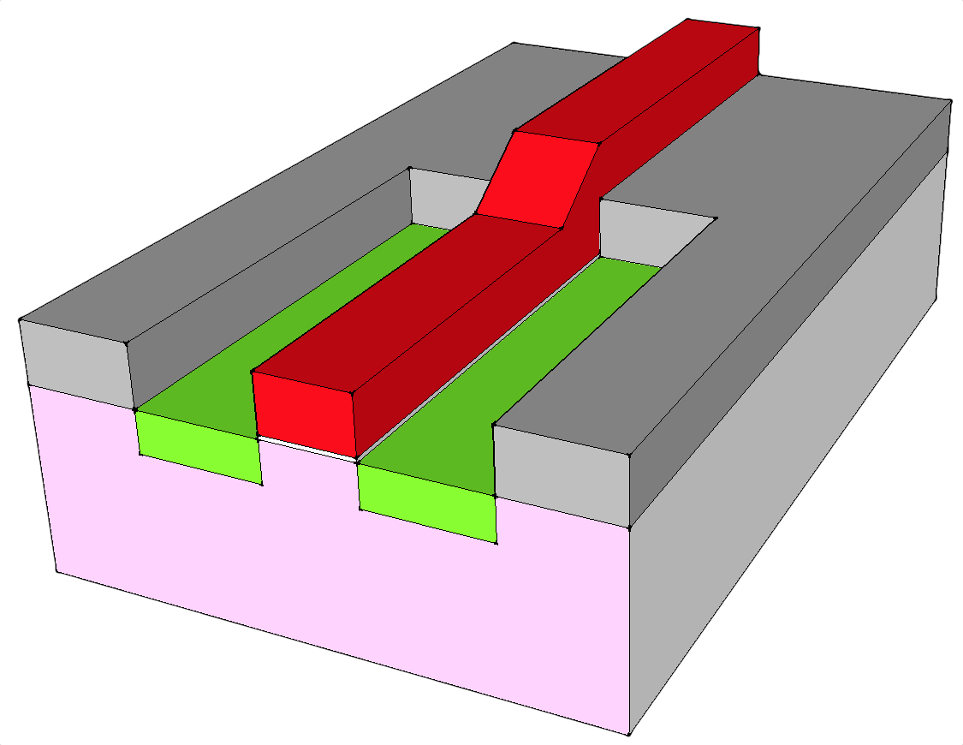
N-Channel MOSFET: Physical View
gate
source
Polysilicon wire
Heavily doped n-type diffusions
I_{DS}
Inter-layer SiO₂ insulation
Very thin (<20Å) high-quality SiO₂ insulating layer isolates gate from channel region.
drain
W
I_{DS} ∝ W/L
Channel region: electric field from charges on gate locally “inverts” type of substrate to create a conducting channel between source and drain.
L
Doped p-type silicon substrate
bulk
MOSFETs (metal-oxide-semiconductor field-effect transistors) are four-terminal voltage-controlled switches. Current flows between the diffusion terminals if the voltage on the gate terminal is large enough to create a conducting “channel”, otherwise the mosfet is off and the diffusion terminals are not connected.

Slide 4
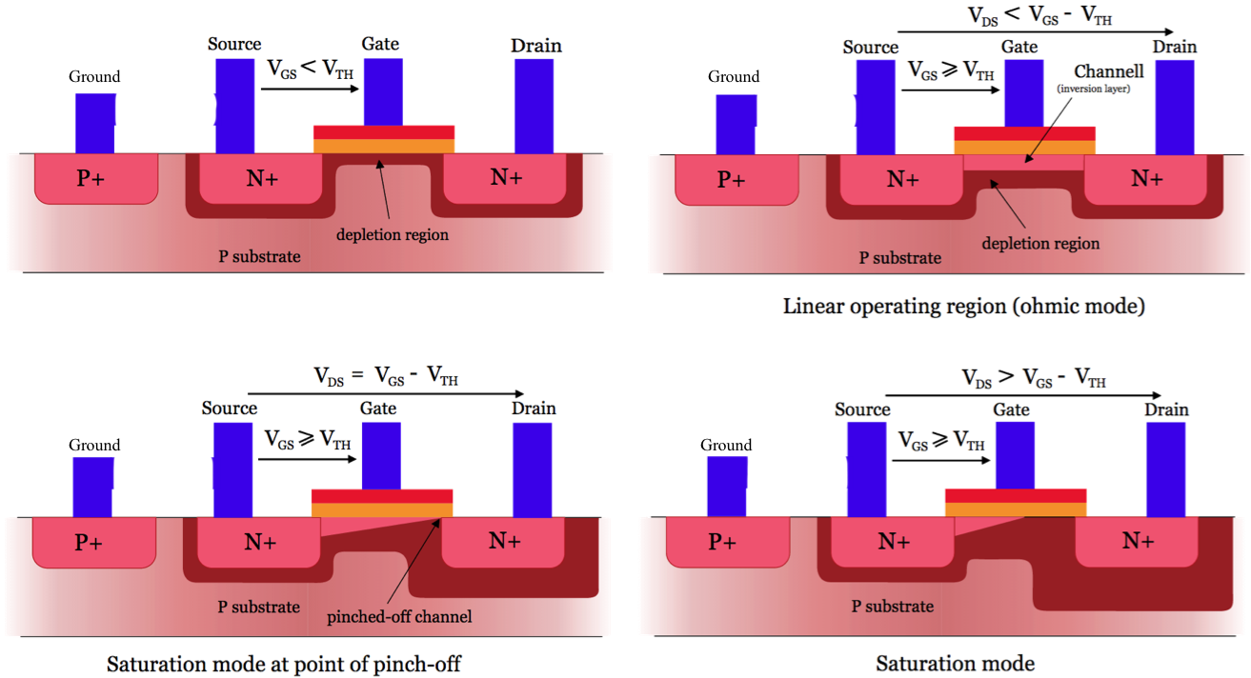
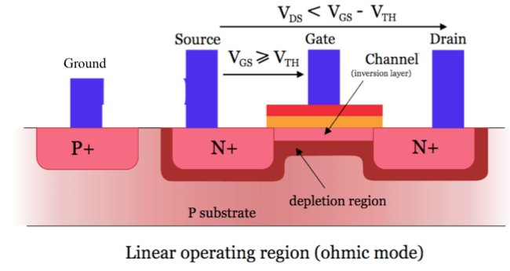
N-Channel MOSFET: Electrical View
The four terminals of a Field Effect Transistor (gate, source, drain and bulk) connect to conductors that generate a set of electric fields in the channel region which depend on the relative voltages of each terminal.
Want V_{P} ≤ V_{N}
Olivier Deleage and Peter Scott (CC BY-SA 3.0)
Notes:
http://commons.wikimedia.org/wiki/File:MOSFET_functioning.svg

Slide 5
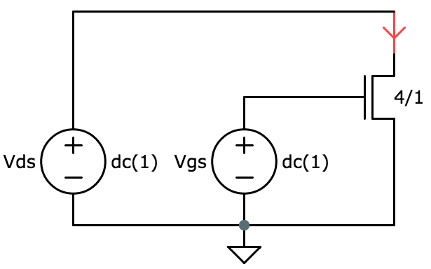
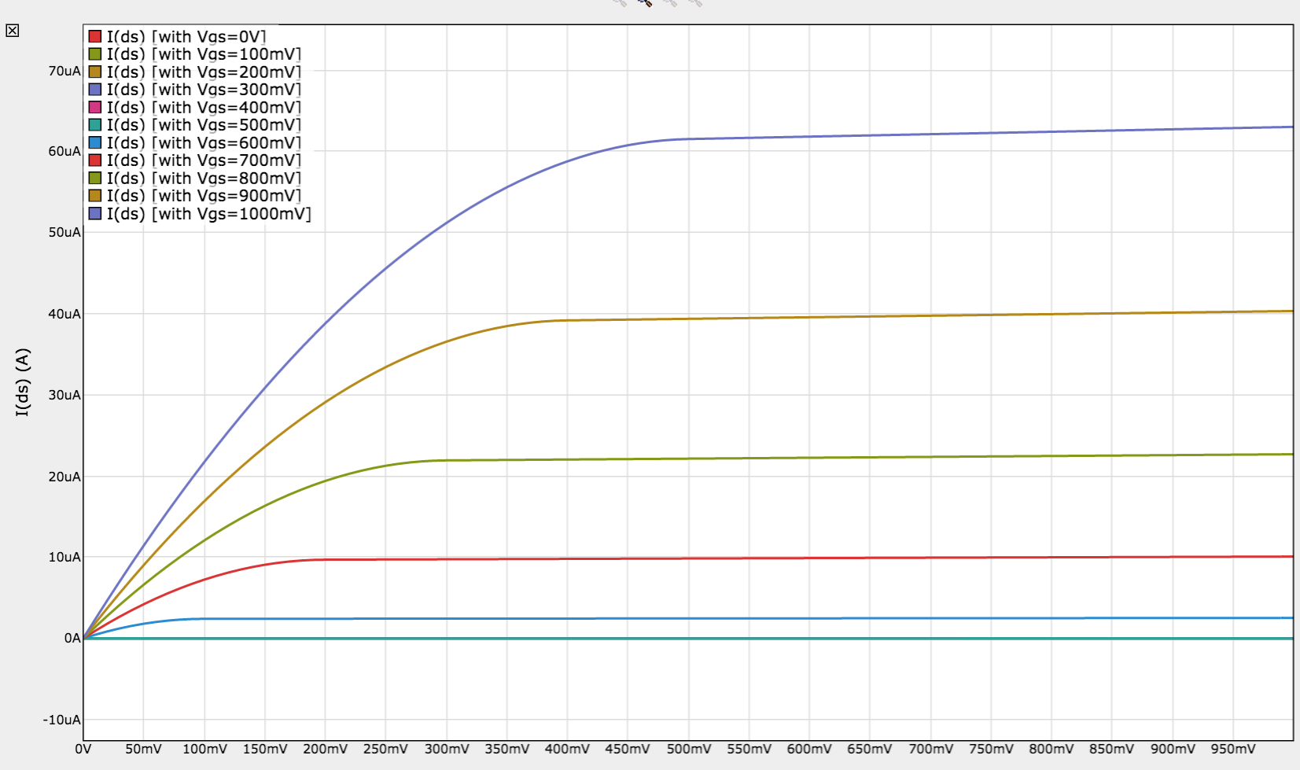
N-channel MOSFET I_{DS} vs. V_{DS}
Ohmic: I_{DS} = V_{DS}/R
saturated
I_{DS}
Increasing V_{GS}
V_{TH} = 0.5V
V_{DS}

Slide 6
FETs Come in Two Flavors
NFET: n-type source/drain diffusions in a p-type substrate. Positive threshold voltage; inversion forms n-type channel
PFET: p-type source/drain diffusions in a n-type substrate. Negative threshold voltage; inversion forms p-type channel.
G
G
B
S
D
B
S
D
n
n
p
p
p
n
Connect B to GND to keep PN reverse-biased
(Vp ≤ Vn); keeps D and S insulated from B
Connect B to VDD to keep PN reverse-biased
D
S
B
G
B
G
S
D
The use of both NFETs and PFETs – complimentary transistor types – is a key to CMOS (complementary MOS) logic families.

Slide 7
CMOS Recipe
If we follow two rules when constructing CMOS circuits, we can model the behavior of the mosfets as simple voltage-controlled switches:
Rule #1: only use NFETs in pulldown circuits
Rule #2: only use PFETs in pullup circuits
D (higher potential)
S (higher potential)
“0” → off
“1” → on
G
“1” → off
“0” → on
G
S (lower potential)
D (lower potential)
NFET Operating regions:
“off”:
V_{GS} < V_{TH,NFET}
PFET Operating regions:
“off”:
V_{GS} > V_{TH,PFET}
S
D
S
D
V_{GS}⬆︎ ⇒ “R”⬇︎
“on”:
V_{GS} > V_{TH,NFET}
“on”:
V_{GS} < V_{TH,PFET}
S
“
“
D
S
“
“
D
NFET threshold = ~0.5V
PFET threshold = ~ −0.5V

Slide 8
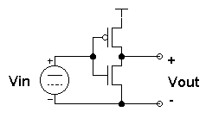
CMOS Inverter VTC
V_{DD}
G
S
pullup
D
I_{pu}
D
Steady state reached when V_{out} reaches value where I_{pu} = I_{pd}.
G
pulldown
I_{pd}
S
When V_{IN} is low, the nfet is off and the pfet is on, so current flows into the output node and V_{OUT} eventually reaches V_{DD} (> V_{OH}) at which point no more current will flow.
V_{out}
When V_{IN} is high, the pfet is off and the nfet is on, so current flows out of the output node and V_{OUT} eventually reaches GND (< V_{OL}) at which point no more current will flow.
V_{OH}
Pfet “on” nfet “off”
V_{OL}
Pfet “off” nfet “on”
V_{in}
V_{IL}
V_{IH}
When V_{IN} is in the middle, both the pfet and nfet are “on” and the shape of the VTC depends on the details of the devices’ characteristics. CMOS gates have very high gain in this region (small changes in V_{IN} produce large changes in V_{OUT}) and the VTC is almost a step function.

Slide 9
Beyond Inverters: Complementary pullups and pulldowns
Now you know what the “C”
in CMOS stands for!
We want complementary pullup and pulldown logic, i.e., the pulldown should be “on” when the pullup is “off” and vice versa.
Power supply
pullup
pulldown
F(inputs)
Pullup switches
on
off
driven “1”
off
on
driven “0”
inputs
output
Pulldown switches
on
on
driven “X”
off
off
no connection
Ground
Since there’s plenty of capacitance on the output node, when the output becomes disconnected it “remembers” its previous voltage -- at least for a while. The “memory” is the load capacitor’s charge. Leakage currents will cause eventual decay of the charge (that’s why DRAMs need to be refreshed!).

Slide 10
CMOS Complements
What a nice V_{OH} you have...
Thanks. It runs in the family...
A
A
conducts when A is high
conducts when A is low: A
A
A
B
B
conducts when A is high and B is high: A.B
conducts when A is low or B is low: A+B = A.B
A
A
B
B
conducts when A is high or B is high: A+B
conducts when A is low and B is low: A.B = A+B

Slide 11
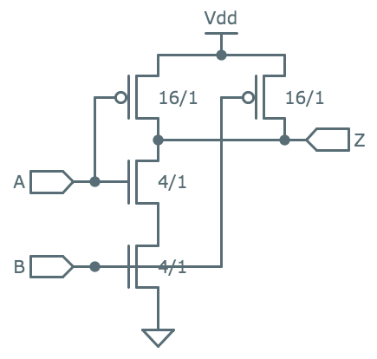
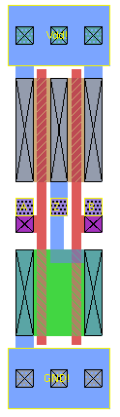
A Pop Quiz!
What function does
this gate compute?
A B Z
0 0
0 1
1 0
1 1
1
1
NAND
82λ
1
0
COST for an older 45nm process:
$3500 per 300mm wafer
300mm round wafer = π(150e⁻³)² = .07m²
NAND gate = (82)(16)(45e⁻⁹)²=2.66e⁻¹²m²
2.6e¹⁰ NAND gates/wafer (= 100 billion FETS!)
marginal cost of NAND gate: 132n$
16λ
Current technology:λ= 14nm

Slide 12
General CMOS Gate Recipe
Step 1. Figure out the pullup network that does what you want, e.g.,
(Determine what combination of inputs generates a high output)
B
A
C
Step 2. Walk the hierarchy replacing nfets with pfets, series subnets with parallel subnets, and parallel subnets with series subnets
A
B
C
Does this recipe work for all logic functions?
A
B
Step 3. Combine pfet pullup network from Step 1 with nfet pulldown network from Step 2 to form a fully-complementary CMOS gate.
C
A
B
C

Slide 13
CMOS Gates Are Naturally Inverting
In a CMOS gate, rising inputs (0→1) lead to falling outputs
NFETs go from “off” to “on” → pulldown paths connected → output may be connected to ground
For CMOS gate:
All inputs 0 → nfets off, pfets on → output must be 1
All inputs 1 → nfets on, pfets off → output must be 0
PFETs go from “on” to “off” → pullup paths disconnected → output may be disconnected from V_{DD}
A B A∙B
Corollary: you can’t build positive logic, e.g., AND, with one CMOS gate
0 0
0 1
1 0
1 1
0
0
0
1
Oops, output is
also rising!
A=1, B rising…

Slide 14
CMOS Timing Specifications
Circuit:
C_{P}
V_{out}
R
Electrical model:
V_{IN}
C_{W}
C_{N}
V_{IN}
Waveforms:
time constant
τ = R_{PD}∙C_{L}
V_{OUT}
time constant
τ = R_{PU}∙C_{L}

Slide 15
Propagation Delay
Propagation delay (t_{PD}): An UPPER BOUND on the delay from valid inputs to valid outputs.
V_{IN}
GOAL:
minimize
propagation
delay!
ISSUE:
keep capacitances
low and transistors fast
V_{IH}
V_{IL}
V_{OUT}
≤ t_{PD}
≤ t_{PD}
V_{OH}
V_{OL}

Slide 16
Contamination Delay
Contamination delay (t_{CD}): A LOWER BOUND on the delay from any invalid input to an invalid output
V_{IN}
Do we really need t_{CD}?
Usually not… it’ll be important when we design circuits with registers (coming soon!)
If t_{CD} is not specified, safe to assume it’s 0.
V_{IH}
V_{IL}
V_{OUT}
≥ t_{CD}
≥ t_{CD}
V_{OH}
V_{OL}

Slide 17
The Combinational Contract
A B
t_{PD} propagation delay
t_{CD} contamination delay
A
B
0 1
1 0
A
B
≥ t_{CD}
Must be ___________
≤ t_{PD}
Notes:
1. No Promises during
2. Default (conservative) spec: t_{CD} = 0
Must be ___________

Slide 18
Acyclic Combinational Circuits
If NAND gates have a t_{PD} = 4nS and t_{CD} = 1nS
12
t_{PD} = _______ nS
t_{CD} = _______ nS
t_{CD} is the minimum cumulative contamination delay over all paths from inputs to outputs
2
B
C
Y
A
t_{PD} is the maximum cumulative propagation delay over all paths from inputs to outputs

Slide 19
One Last Timing Issue…
NOR:
A
A
B
Z
A
A
0
0
1
1
0
1
0
1
1
0
0
0
B
Z
B
B
t_{PD}
t_{PD}
t_{CD}
Z
t_{CD}
Z
Recall the rules for combinational devices:
Output guaranteed to be valid when all inputs have been valid for at least t_{PD}, and, outputs may become invalid no earlier than t_{CD} after an input changes!
Many gate implementations—e.g., CMOS— adhere to even tighter restrictions.

Slide 20
What Happens In This Case?
Input A=1 is sufficient to determine the output
CMOS NOR:
B
X
A
X
Z
B
A
X
t_{PD}
Z
t_{CD}
LENIENT Combinational Device: Output guaranteed to be valid when any combination of inputs sufficient to determine the output value has been valid for at least t_{PD}. Tolerates transitions -- and invalid levels -- on irrelevant inputs!
NOR:
A
B
Z
Lenient
NOR:
A
B
Z
A
0
0
1
1
0
1
0
1
1
0
0
0
0
X
1
0
1
X
1
0
0
B
Z

Slide 21
Summary
CMOS
Only use NFETs in pulldowns, PFETs in pullups → mosfets behave as voltage-controlled switches
Series/parallel Pullup and pulldown switch circuits are complementary
CMOS gates are naturally inverting (rising input transition can only cause falling output transition, and vice versa).
“Perfect” VTC (high gain, V_{OH} = V_{DD}, V_{OL} = GND) means large noise margins and no static power dissipation.
Timing specs
t_{PD}: upper bound on time from valid inputs to valid outputs
t_{CD}: lower bound on time from invalid inputs to invalid outputs
If not specified, assume t_{CD} = 0
Lenient gates: output unaffected by some input transitions
Next time: logic simplification, other canonical forms

