Slide 1
2. The Digital Abstraction
6.004.1x Computation Structures
Part 1 – Digital Circuits
Copyright © 2015 MIT EECS

Slide 2
The Trouble with Analog Signaling

Slide 3
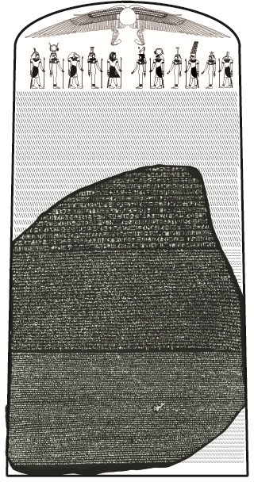
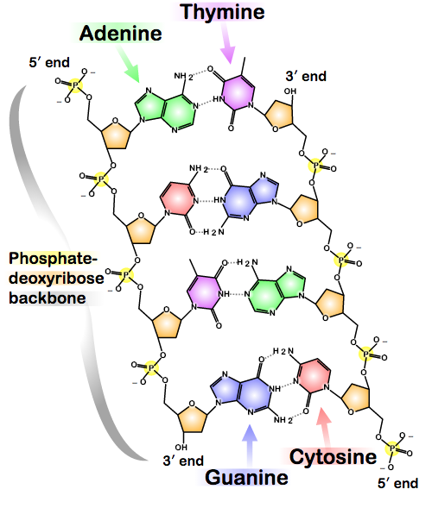
Concrete Encoding of Information
To this point we’ve discussed encoding information using bits. But where do bits come from?
If we’re going to design a machine that manipulates information, how should that information be physically encoded?
Rosetta Stone
DNA
Captmondo (CC BY-SA 3.0)
What makes a good bit?
- small, inexpensive (we want a lot of them)
- stable (reliable, repeatable)
- ease and speed of manipulation (access, transform, combine, transmit, store)
Madeleine Price Ball (CC BY-SA 3.0)
Notes:
https://en.wikipedia.org/wiki/DNA#mediaviewer/File:DNA_chemical_structure.svg
https://en.wikipedia.org/wiki/Rosetta_Stone#mediaviewer/File:RosettaStoneAsPartOfOriginalStele.jpg

Slide 4
Let’s Use Electrical Phenomenon…
Consider using phenomenon associated with charged particles:
voltages phase
currents frequency
In this course we’ll use voltages to encode information. But the best choice depends on the intended application…
Voltage pros:
easy generation, detection
lots of engineering knowledge
potentially low power in steady state
zero
Voltage cons:
easily affected by environment
DC connectivity required?
R & C effects slow things down

Slide 5
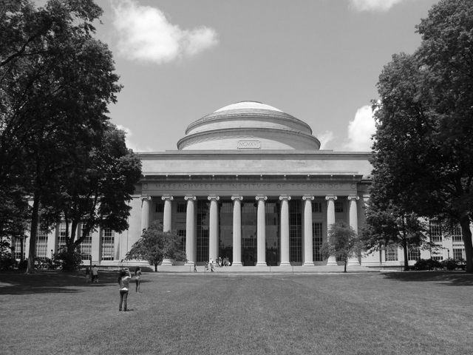
Representing Information with Voltage
Representation of each (x,y) point on a B&W image:
0 volts: BLACK
1 volt: WHITE
0.37 volts: 37% Gray
John Phelan (CC BY 3.0)
How much information at each point?
Suppose we can reliably distinguish voltages that differ by 1/2^{N} volts. Then we can represent N bits of information by voltages in the range 0V to 1V. What are realistic values for N?
Notes:
https://en.wikipedia.org/wiki/Massachusetts_Institute_of_Technology#mediaviewer/File:MIT_Building_10_and_the_Great_Dome,_Cambridge_MA.jpg

Slide 6
Using Voltages to Encode a Picture
Representation of a picture:
Scan points in some prescribed raster order… Generate voltage waveform:
John Phelan (CC BY 3.0)
NTSC TV signal
white
black
sync
Notes:
https://en.wikipedia.org/wiki/Massachusetts_Institute_of_Technology#mediaviewer/File:MIT_Building_10_and_the_Great_Dome,_Cambridge_MA.jpg

Slide 7
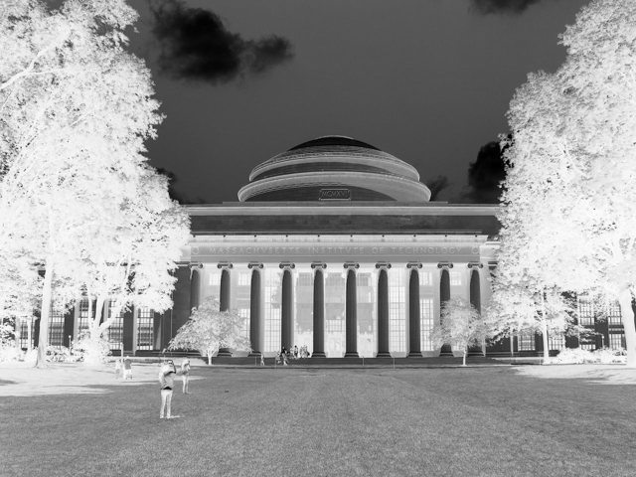
Information Processing = Computation
v
Copy
v
v
Inv
1-v
Why have processing blocks?
Pre-packaged functionality: rely on behavior without having to be an analog engineer
Predictable composition of functions → Tinker-toy assembly
Guaranteed behavior: if components work, system will work!
Wow, rules simple enough for a programmer to follow!

Slide 8

Let’s Build a System!
Copy
Inv
input
Copy
Inv
(Reality)
(In Theory)
Copy
Inv
?
Copy
Inv
output

Slide 9
Why Did Our System Fail?
Why doesn’t theory match reality?
1. COPY block doesn’t work right
2. INV block doesn’t work right
3. Theory is imperfect
4. Reality is imperfect
5. Our system architecture stinks
ANSWER: all of the above!
Noise and inaccuracy are inevitable; we can’t reliably reproduce infinite information − we must design our system to tolerate some amount of error if it is to process information reliably.

Slide 10
The Digital Abstraction

Slide 11
The Digital Abstraction
“Ideal” Abstract World
Real World
Manufacturing Variations
0/1
Bits
Noise
Volts or
Electrons or
Ergs or Gallons
Keep in mind that the world is not digital, we would simply like to engineer it to behave that way. Furthermore, we must use real physical phenomena to implement digital designs!

Slide 12
Using Voltages “Digitally”
Key idea: encode only one bit of information: 2 values “0”, “1”
Use the same uniform representation convention for every component and wire in our digital system
Hard to distinguish V_{TH}-ε from V_{TH}+ε
Attempt #1:
✗
V < V_{TH}
interpreted as “0”
V ≥ V_{TH}
interpreted as “1”
volts
V_{TH}
Attempt #2:
V ≤ V_{L}
interpreted as “0”
V_{L}< V < V_{H}
“Forbidden to ask”
V ≥ V_{H}
interpreted as “1”
✓?
volts
V_{L}
V_{H}

Slide 13
A Digital Processing Element
A combinational device is a circuit element that has
one or more digital inputs
one or more digital outputs
a functional specification that details the value of each output for every possible combination of valid input values
Static
discipline
a timing specification consisting (at minimum) of an upper bound t_{PD} on the required time for the device to compute the specified output values from an arbitrary set of stable, valid input values
Output a “1” if at
least 2 out of 3 of
my inputs are a “1”.
Otherwise, output “0”.
input A
input B
output Y
input C
I will generate a valid
output in no more than
2 minutes after
seeing valid inputs

Slide 14
A Combinational Digital System
A set of interconnected elements is a combinational device if
each circuit element is combinational
every input is connected to exactly one output or to some vast supply of constant 0’s and 1’s
the circuit contains no directed cycles
Why is this true?

Slide 15
Is This a Combinational Device?
A, B and C are combinational devices. Is the following circuit a combinational device?
P
A
C
Q
S
B
R
Does it have digital inputs?
Does it have digital outputs?
Can you derive a functional description?
Can you derive a t_{PD}?

Slide 16
Dealing With Noise

Slide 17
Will This System Work?
Valid “0”: V_{L}-ε
V_{L}+ε: not a valid signal
Combinational
device
Noise
Combinational
device
Upstream device transmits a signal at V_{L}-ε, a valid “0”. Noise on the connecting wire causes the downstream device to receive V_{L}+ε, a signal in the forbidden zone.
Hmm. Looks like the output voltage needs to be adjusted so that a signal will still be valid when it reaches an input even if there’s noise.

Slide 18
Where Does Noise Come From?
Parasitic resistance, inductance, capacitance
IR drop, L(dI/dt) drop, LC ringing from current steps
Imprecision of component values
Manufacturing variations, allowable tolerances
Environmental effects
External EM fields, temperature variations, etc.
…
Power supply
Integrated circuit
+
-
L’s from chip leads
R’s and C’s from Aluminum wiring layers
Current loads from on-chip devices

Slide 19
Needed: Noise Margins!
Proposed fix: separate specifications for inputs and outputs
digital output: “0” ≤ V_{OL}, “1” ≥ V_{OH}
digital input: “0” ≤ V_{IL}, “1” ≥ V_{IH}
V_{OL} < V_{IL} < V_{IH} < V_{OH}
VALID INPUT REPRESENTATIONS
Valid
“0”
Forbidden Zone
Valid
“1”
volts
V_{OL}
V_{IL}
V_{IH}
V_{OH}
NOISE MARGINS
VALID OUTPUT REPRESENTATIONS
A combinational device accepts marginal inputs and provides unquestionable outputs (to leave room for noise).

Slide 20
A Buffer
A simple combinational device:
0
0
1
1
V_{out}
Voltage Transfer Characteristic (VTC):
Plot of V_{out} vs. V_{in} where each measurement is taken after any transients have died out.
V_{OH}
Note: VTC does not tell you anything about how fast a device is — it measures static behavior not dynamic behavior
V_{OL}
V_{in}
V_{IL}
V_{IH}
Static Discipline requires that the VTC avoid the shaded regions (aka “forbidden zones”), which correspond to valid inputs but invalid outputs.

Slide 21
Voltage Transfer Characteristic
V_{out}
V_{OH}
V_{OL}
V_{in}
V_{IL}
V_{IH}
1) Note the VTC can do anything when V_{IL} < V_{IN} < V_{IH}.
2) Note that the center white region is taller than it is wide (V_{OH}-V_{OL} > V_{IH}-V_{IL}). Net result: combinational devices must have GAIN > 1 and be NONLINEAR.

Slide 22
Can This Be a Combinational Inverter?
Suppose that you measured the voltage transfer curve of the device shown below. Can we find a signaling specification that would allow this device to be a combinational inverter?
V_{OUT}
(0,5)
The device must be able to actually produce the desired output level. Thus, V_{OL} can be no lower than 0.5 V.
5
4
(1,4)
V_{OH}
Try V_{OL} = 0.5 V
3
V_{IH} must be high enough to produce V_{OL}
Try V_{IH} = 3 V
2
(2.5,1)
Now, find noise margin N and compute
V_{OH} = V_{IH} + N
V_{IL} = V_{OL} + N
1
V_{OL}
0
(3,0.5)
V_{IN}
0
1
2
3
4
5
Then verify that V_{OUT} ≥ V_{OH} when V_{IN} ≤ V_{IL}.
V_{IL}
V_{IH}
Try N = 0.5 V
Device is a combinational inverter when V_{OL}=0.5, V_{IL}=1, V_{IH}=3, V_{OH}=3.5

Slide 23
Summary: The Digital Abstraction
Use voltages to encode information
“Digital” encoding
valid voltage levels for representing “0” and “1”
forbidden zone avoids mistaking “0” for “1” and vice versa
gives rise to notion of signal VALIDITY.
Noise
Want to tolerate real-world conditions: NOISE.
Key: tougher standards for output than for input
devices must have gain and have a non-linear VTC
Combinational devices
Each logic family has Tinkertoy-set simplicity, modularity
predictable composition: “parts work → system works”
static discipline
digital inputs, outputs; restore marginal input voltages
complete functional spec
valid inputs lead to valid outputs in bounded time

Slide 24
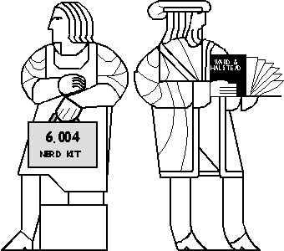
Next Time: Building Logic with Transistors
It’s about
time!
I’d have preferred the DNA…

