Slide 1
21. Parallel Processing
6.004x Computation Structures
Part 3 – Computer Organization
Copyright © 2016 MIT EECS

Slide 2
Processor Performance
CPI
t_{CLK}
Pipelining lowers t_{CLK}. What about CPI?
CPI = CPI_{ideal} + CPI_{stall}
CPI_{ideal}: cycles per instruction if no stall
CPI_{stall} contributors
Data hazards
Control hazards: branches, exceptions
Memory latency: cache misses

Slide 3
5-Stage Pipelined Processors
Advantages
CPI_{ideal} is 1 (pipelining)
Simple, elegant
Still used in ARM & MIPS processors
Room for improvement
Upper performance bound is CPI=1
High-latency instructions not handled well
1 stage for accesses to large caches or multiplier
Long clock cycle time
Unnecessary stalls due to rigid pipeline
If one instruction stalls, anything behind it stalls
IF
RF
ALU
MEM
WB

Slide 4
Improving 5-stage Pipeline Performance
Lower t_{CLK}: deeper pipelines
Overlap more instructions

Slide 5
Limits to Pipeline Depth
Each pipeline stage introduces some overhead (O)
Propagation delay of pipeline registers
Setup and hold times
Clock skew
Inequalities in work per stage
Cannot break up work into stages at arbitrary points
If original t_{CLK} was T, with N stages t_{CLK} is T/N+O
If N→∞, speedup = T / (T/N+O) → T/O
Assuming that CPI stays constant
Eventually overhead dominates and deeper pipelines have diminishing returns
T
T/N
O
T/N
O

Slide 6
Improving 5-stage Pipeline Performance
Lower t_{CLK}: deeper pipelines
Overlap more instructions
Higher CPI_{ideal}: wider pipelines
Each pipeline stage processes multiple instructions
Lower CPI_{stall}: out-of-order execution
Execute each instruction as soon as its source operands are available
Balance conflicting goals
Deeper & wider pipelines ⇒ more control hazards
Branch prediction
It all works because of instruction-level parallelism (ILP)

Slide 7
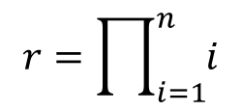
Instruction Level Parallelism (ILP)
Sequential Code
“Safe” Parallel Code
loop:
LD(n, r1)
CMPLT(r31, r1, r2)
BF(r2, done)
LD(r, r2)
LD(n,r1)
MUL(r1, r2, r3)
ST(r3, r)
LD(n,r4)
SUBC(r4, 1, r4)
ST(r4, n)
BR(loop)
done:
loop:
LD(n, r1)
CMPLT(r31, r1, r2)
BF(r2, done)
LD(r, r2) LD(n,r1) LD(n,r4)
MUL(r1, r2, r3) SUBC(r4, 1, r4)
ST(r3, r) ST(r4, n) BR(loop)
done:
These last two can be solved with renaming, i.e., giving each result a unique register name.
Read-after-write
$$r=\prod_{i=1}^{n}{i}$$
Write-after-write
Write-after-read

Slide 8
Wider or Superscalar Pipelines
Each stage operates on up to N instructions each clock cycle
Known as wide or superscalar pipelines
CPI_{ideal} = 1/N
Options (from simpler to harder)
One integer and one floating-point instruction
Any N=2 instructions
Any N=4 instructions
Any N=? Instructions
What are the limits?
See http://people.ee.duke.edu/~sorin/ece252/lectures/3-superscalar.pdf

Slide 9
A Modern Out-of-Order Superscalar Processor
Needed to avoid high CPI_{STALL} on deep pipelines
For OoO: determine when operands are ready for inst.
Make sure side-effects happen in correct order!

Slide 10
Limits To Single-Processor Performance
Pipeline depth: getting close to pipelining limits
Clocking overheads, CPI degradation
Branch prediction & memory latency limit the practical benefits of out-of-order execution
Power grows superlinearly with higher frequency & more OoO logic
Extreme design complexity
Limited ILP → Must exploit DLP and TLP
Data-Level Parallelism: Vector extensions, GPUs
Thread-Level Parallelism: Multiple threads and cores

Slide 11
Data-Level Parallelism
Same operation applied to multiple data elements
Exploit with vector processors or vector ISA extensions
Each datapath has its own local storage (register file)
All datapaths execute the same instruction
Memory access with vector loads and stores + wide memory port
for (int i = 0; i < 16; i++) x[i] = a[i] + b[i];
+1 or Branch
PC
data
Data
Memory
addr
Reg File
Reg File
Reg File
Reg File
Instruction Memory
ALU
ALU
ALU
ALU
addr
Addressing Unit
data
Control

Slide 12
Vector Code Example
for (i = 0; i < 16; i++) x[i] = a[i] + b[i];
Beta assembly
Equivalent vector assembly
CMOVE(16, R0)
loop: LD(R1, 0, R4)
LD(R2, 0, R5)
ADDC(R1, 4, R1)
ADDC(R2, 4, R2)
ADD(R4, R5, R6)
ST(R6, 0, R3)
ADDC(R3, 4, R3)
SUBC(R0, 1, R0)
BNE(R0, loop)
LD.V(R1, 0, V1)
LD.V(R2, 0, V2)
ADD.V(V1, V2, V3)
ST.V(V3, 0, R3)
# of cycles = 1 + 10*15 + 9 = 160
# of cycles = 4

Slide 13
Data-dependent Vector Operations
for (i = 0; i < 16; i++) if (a[i] < b[i]) c[i] = c[i] + 3;
Equivalent vector assembly
LD.V(R1, 0, V1) // load a[i]
LD.V(R2, 0, V2) // load b[i]
LD.V(R3, 0, V3) // load c[i]
CMPLT.V(V1, V2) // set local predicate flags
// predicated instructions perform the
// indicated operation if the local predicate
// flag istrue or isfalse.
ADDC.V.iftrue(V3, 3, V3)

Slide 14
Vector Processing Implementations
Advantages of vector ISAs:
Compact: 1 instruction defines N operations
Parallel: N operations are (data) parallel and independent
Expressive: Memory operations describe regular patterns
Modern CPUs: Vector extensions & wider registers
SSE: 128-bit operands (4x32-bit or 2x64-bit)
AVX (2011): 256-bit operands (8x32-bit or 4x64-bit)
AVX-512 (upcoming): 512-bit operands
Explicit parallelism, extracted at compile time (vectorization)
GPUs: Designed for data parallelism from the ground up
32 to 64 32-bit floating-point elements
Implicit parallelism, scalar binary with multiple instances executed in lockstep (and regrouped dynamically)

Slide 15
Multicore Processors
If applications have a lot of parallelism, using a larger number of simpler cores is more efficient!
High-perf, expensive core
Cost/perf curve of possible core designs
Cost (area, energy…)
4 cores
Moderate perf, efficient core
2 cores
Performance
What is the optimal tradeoff between core cost and number of cores?

Slide 16
Amdahl’s Law
Speedup= time_{without enhancement} / time_{with enhancement}
Suppose an enhancement speeds up a fraction f of a task by a factor of S
time_{new} = time_{old}·( (1-f) + f/S )
S_{overall} = time_{old} / time_{new} = 1 / ( (1-f) + f/S )
time_{old}
(1 - f)
f
time_{new}
(1 - f)
f/S
Corollary: Make the common case fast

Slide 17
Amdahl’s Law and Parallelism
What is the maximum speedup you can get by running on a multicore machine?
S_{overall} = 1 / ( (1-f) + f/S )
S_{overall} 1 / (1-f)
lim
S→∞
Say you write a program that can do 90% of the work in parallel, but the other 10% is sequential
f = 0.9, S=∞ → S_{overall} = 10
What f do you need to use a 1000-core machine well?
S_{overall} = 500 → f = 0.998

Slide 18
Thread-Level Parallelism
Divide computation among multiple threads of execution
Each thread executes a different instruction stream
More flexible than vector processing, but more expensive
Communication models:
Shared memory:
Single address space
Implicit communication by memory loads & stores
Message passing:
Separate address spaces
Explicit communication by sending and receiving messages
Mem
Mem
Mem
Mem
Network

Slide 19
Multicore Caches
Multicores have multiple private caches for performance
We want the semantics of a single shared memory
Main Memory (x=1, y=2)
Memory
bus
Cache
(x=1, y=2)
Cache
(x=1, y=2)
Cache
Cache
Core 0
Core 1
Core 2
Core 3
Consider the following trivial threads running on C₀ and C₁:
Thread A (C₀)
x = 3; print(y);
Thread B (C₁)
y = 4; print(x);

Slide 20
What Are the Possible Outcomes?
Thread A
x = 3; print(y);
Thread B
y = 4; print(x);
$₁: x = 1
y = 2
$₂: x = 1
y = 2
X 3
X 4
Plausible execution sequences:
Hey, we get the same answer every time… Let’s go build it!
SEQUENCE A prints B prints
x=3; print(y); y=4; print(x); 2 1
x=3; y=4; print(y); print(x); 2 1
x=3; y=4; print(x); print(y); 2 1
y=4; x=3; print(x); print(y); 2 1
y=4; x=3; print(y); print(x); 2 1
y=4; print(x); x=3; print(y); 2 1

Slide 21
Uniprocessor Outcome
But, what are the possible outcomes if we ran Thread A and Thread B on a single timed-shared processor?
Thread A
x = 3; print(y);
Thread B
y = 4; print(x);
Notice that the outcome 2, 1 does not appear in this list!
Plausible Uniprocessor execution sequences:
SEQUENCE A prints B prints
x=3; print(y); y=4; print(x); 2 3
x=3; y=4; print(y); print(x); 4 3
x=3; y=4; print(x); print(y); 4 3
y=4; x=3; print(x); print(y); 4 3
y=4; x=3; print(y); print(x); 4 3
y=4; print(x); x=3; print(y); 4 1

Slide 22
Sequential Consistency
Semantic constraint:
Result of executing N parallel threads should correspond to some interleaved execution on a single processor.
Shared Memory
int x=1, y=2;
Thread A
x = 3; print(y);
Thread B
y = 4; print(x);
Weren’t caches supposed to be invisible to programs?
Possible printed values: 2, 3; 4, 3; 4, 1.
(each corresponds to at least one interleaved execution)
IMPOSSIBLE printed values: 2, 1
(corresponds to NO valid interleaved execution).

Slide 23
Alternatives to Sequential Consistency?
ALTERNATIVE MEMORY SEMANTICS:
“WEAK” consistency
EASIER GOAL: Memory operations from each thread appear to be performed in order issued by that thread ;
Memory operations from different threads may overlap in arbitrary ways (not necessarily consistent with any interleaving).
ALTERNATIVE APPROACH:
• Weak consistency, by default;
• MEMORY BARRIER instruction: stalls thread until all previous memory operations have completed.
See http://www.rdrop.com/users/paulmck/scalability/paper/whymb.2010.07.23a.pdf for a very readable discussion of memory semantics in multicore systems.

Slide 24
Fix: “Snoopy” Cache Coherence Protocol
Idea: Have caches communicate over shared bus, letting other caches know when a shared cached value changes
Main Memory (x=1, y=2)
“Snoopy”
bus
Cache
(x=1, y=2)
Cache
(x=1, y=2)
Cache
Cache
Core 0
Core 1
Core 2
Core 3
Goal: minimize contention for snoopy bus by communicating only when necessary, i.e., when there’s a shared value.

Slide 25
Example: MESI Cache Coherence Protocol
Cache line:
State
Tag
Data
Modified The cache line is present only in the current cache, and is dirty; it has been modified from the value in main memory. The cache is required to write the data back to main memory at some time in the future, before permitting any other read of the (no longer valid) main memory state.
Exclusive The cache line is present only in the current cache, but is clean; it matches main memory. It may be changed to the Shared state at any time, in response to a bus read request. Alternatively, it may be changed to the Modified state when writing to it.
Shared Indicates that this cache line may be stored in other caches of the machine and is clean; it matches the main memory. The line may be discarded (changed to the Invalid state) at any time. Writes to SHARED cache lines get special handling…
Invalid Indicates that this cache line is invalid (unused).
https://en.wikipedia.org/wiki/MESI_protocol

Slide 26
The Cache Has Two Customers!
Queue up write misses,
STORE_BARRIER inst waits until store queue is empty
Read
Write
CPU
Store queue
Cache line:
State
Tag
Data
Queue up invalidates,
READ_BARRIER inst waits until invalidate queue is empty
Read
Read w/ intent to modify
Write
Invalidate
Flags:
shared
Snoopy bus
Invalidate queue

Slide 27
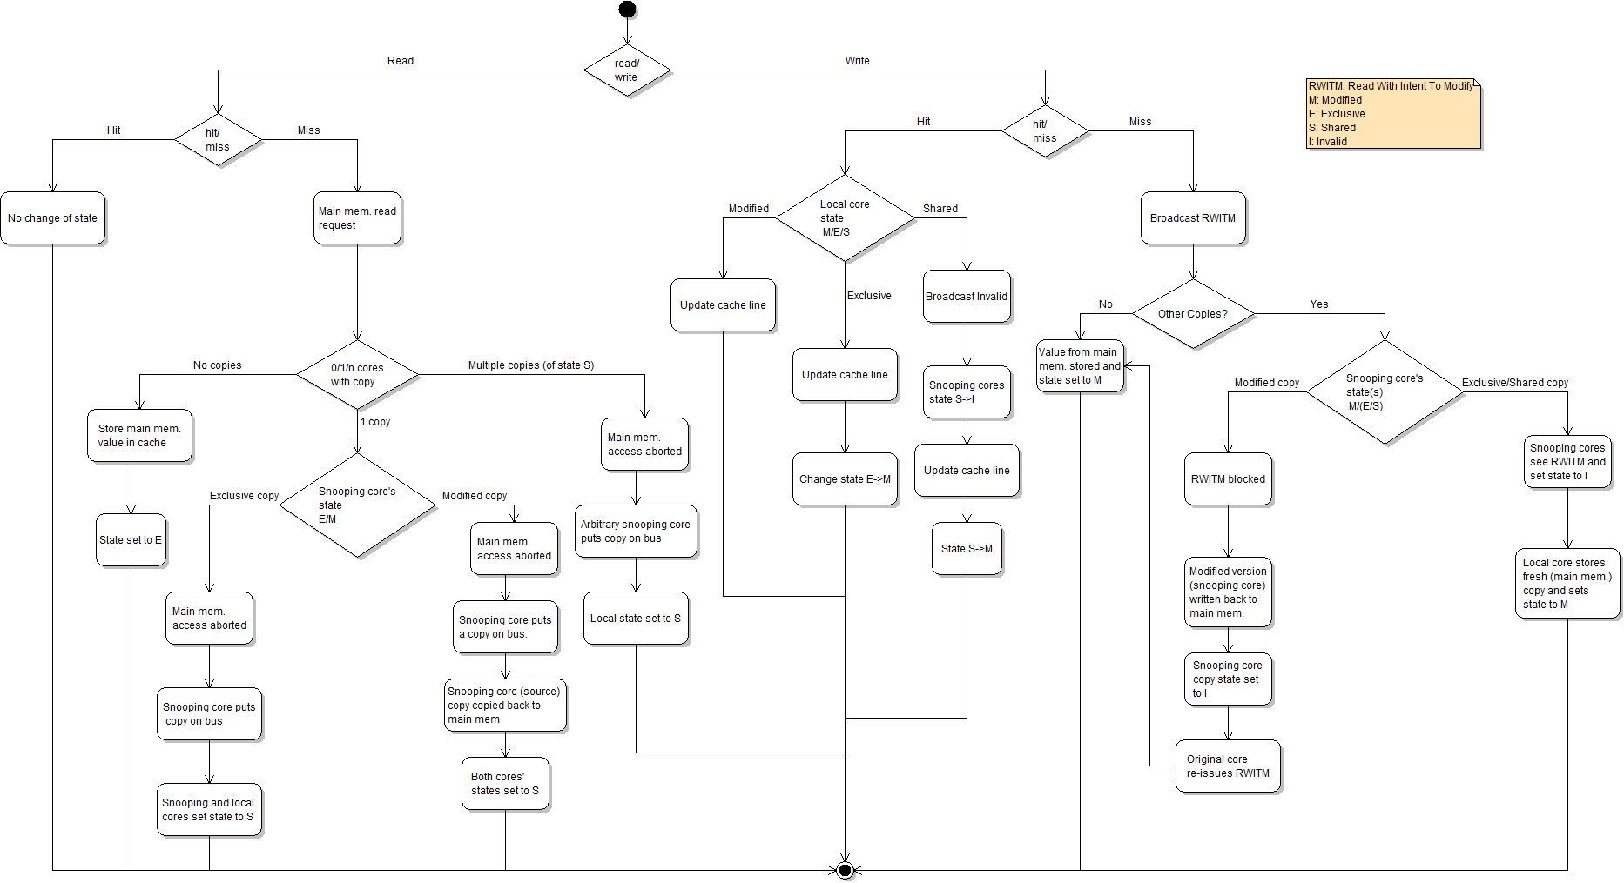
MESI Activity Diagram
Intel adds “F” state to choose which cache responds
CC0: https://en.wikipedia.org/wiki/MESI_protocol#/media/File:MESI_protocol_activity_diagram.png

Slide 28
Cache Coherence in Action
Thread A
x = 3; print(y);
Thread B
y = 4; print(x);
1
2
4
3
$₀: [S] x =1, [S] y = 2
$₁: [S] x =1, [S] y = 2
1. x = 3 → $₀ sends invalidate x, update cache
$₀: [M] x =3, [S] y = 2
$₁: [S] y = 2
2. y = 4 → $₁ sends invalidate y, update cache
$₀: [M] x =3
$₁: [M] y = 4
3. print(x) → $₁ read x, $₀ responds with Shared flag, update mem
$₀: [S] x =3
$₁: [S] x = 3, [M] y = 4
4. print(y) → $₀ read y, $₁ responds with Shared flag, update mem
$₀: [S] x =3, [S] y = 4
$₁: [S] x = 3, [S] y = 4

Slide 29

Parallel Processing Summary
Prospects for future CPU architectures:
Pipelining - Well understood, but mined-out Superscalar - At its practical limits Vector/GPU - Useful for special applications
Prospects for future Computer System architectures: Single-thread limits: forcing multicores, parallelism
Brains work well, with dismal clock rates … parallelism?
Needed: NEW models, NEW ideas, NEW approaches
FINAL ANSWER: It’s up to YOUR generation!
Notes:
https://openclipart.org/detail/140701/brain

