Slide 1
5. Sequential Logic
6.004x Computation Structures
Part 1 – Digital Circuits
Copyright © 2015 MIT EECS

Slide 2
Something We Can’t Build (Yet)
What if you were given the following design specification:
#1
When the button is pushed: 1) Turn the light on if it is off
2) Turn the light off if it is on
button
light
#2
The light should change state within a second of the button press
What makes this device different from those we’ve discussed before?
“State” – i.e., the device has memory
The output was changed by a input “event” (pushing a button) rather than an input “level”

Slide 3
Digital State: What We’d Like to Build
Sequence of values
Next
State
Trigger periodically
Memory
Device
Current
State
Combinational
Logic
LOAD
Input
Output
Plan: Build a Sequential Circuit with stored digital STATE –
Memory stores CURRENT state, produced at output
Combinational Logic computes
NEXT state (from input, current state)
OUTPUT bits (from input, current state)
State changes on LOAD control input
Needed:
Loadable
Memory

Slide 4
Memory: Using Capacitors
We’ve chosen to encode information using voltages and we know from physics that we can “store” a voltage as charge on a capacitor:
Pros:
compact – low cost/bit (on BIG memories)
Cons:
complex interface
stable? (noise, …)
it leaks! ⇒ refresh
word line
bit line
C
NFET serves as access switch
V_{REF}
To write:
Drive bit line, turn on access fet, force storage cap to new voltage
Suppose we use feedback to refresh continuously?
To read: precharge bit line, turn on access fet,
detect (small) change in bit line voltage

Slide 5
Memory: Using Feedback
IDEA: use positive feedback to maintain storage indefinitely. Our logic gates are built to restore marginal signal levels, so noise shouldn’t be a problem!
Result: a bistable storage element
1 0 1
0 1 0
V_{IN}
V_{OUT}
Not affected
by noise
VTC for
inverter pair
Feedback constraint:
V_{IN} = V_{OUT}
V_{OUT}
Three solutions:
two end-points are stable
middle point is metastable
V_{IN}
We’ll get back to this!

Slide 6
Settable Memory Element
It’s easy to build a settable storage element (called a latch) using a lenient MUX:
Here’s a feedback path, so it’s no longer a combinational circuit.
“state” signal
appears as both
input and output
A
G
0
0
1
1
D
--
--
0
1
Q’
0
1
--
--
Q
0
1
0
1
D0
Q’
Q
Y
D
Q stable
B
D1
S
Q follows D
S
G
D: data input
G: gate input
Q: state output

Slide 7
New Device: D Latch
G=1:
Q follows D
G=0:
Q holds
Q’
0
Circuit:
Q
D
D
1
V1
V2
G
G
Q
V1
V2
Schematic Symbol:
D
Q
T_{PD}
T_{PD}
G
BUT… A change in D or G contaminates Q, hence Q’ … how can this possibly work?
G=1: Q Follows D, independently of Q’
G=0: Q Holds stable Q’, independently of D

Slide 8
A Plea for Lenience
1.
2.
3.
D
V1
V2
Q’
0
Q
G
D
1
Q
V1
V2
G
T_{PD}
T_{PD}
T_{PD}
Assume LENIENT Mux, propagation delay of T_{PD}
Then output valid when
Does lenience guarantee a working latch?
G=1, D stable for T_{PD}, independently of Q’; or
What if D and G change at about the same time…
Q=D stable for T_{PD} , independently of G; or
G=0, Q stable for T_{PD} , independently of D

Slide 9
…With a Little Discipline
D Stable
Q’
0
A
D
V2
Q
D
1
G
G
Q
V2
To reliably latch V2:
T_{PD}
T_{PD}
T_{PD}
Apply V2 to D, holding G=1
T_{SETUP}
T_{HOLD}
After T_{PD}, V2 appears at Q=Q’
After another T_{PD}, Q’ & D both valid for T_{PD}; will hold Q=V2 independently of G
Dynamic Discipline for our latch:
T_{SETUP} = 2T_{PD}: interval prior to G transition for which D must be stable & valid
Set G=0, while Q’ & D hold Q=D
After another T_{PD}, G=0 and Q’ are sufficient to hold Q=V2 independently of D
T_{HOLD} = T_{PD}: interval following G transition for which D must be stable & valid

Slide 10
Let’s Try It Out!
New
State
D
Q
Current
State
G
Combinational
Logic
Input
Output
When G=1, latch is Transparent…
… provides a combinational path from D to Q.
Can’t work without tricky timing constraints on G=1 pulse:
Must fit within contamination delay of logic
Must accommodate latch setup, hold times
Want to signal an INSTANT, not an INTERVAL…
Looks like a stupid
approach to me…

Slide 11

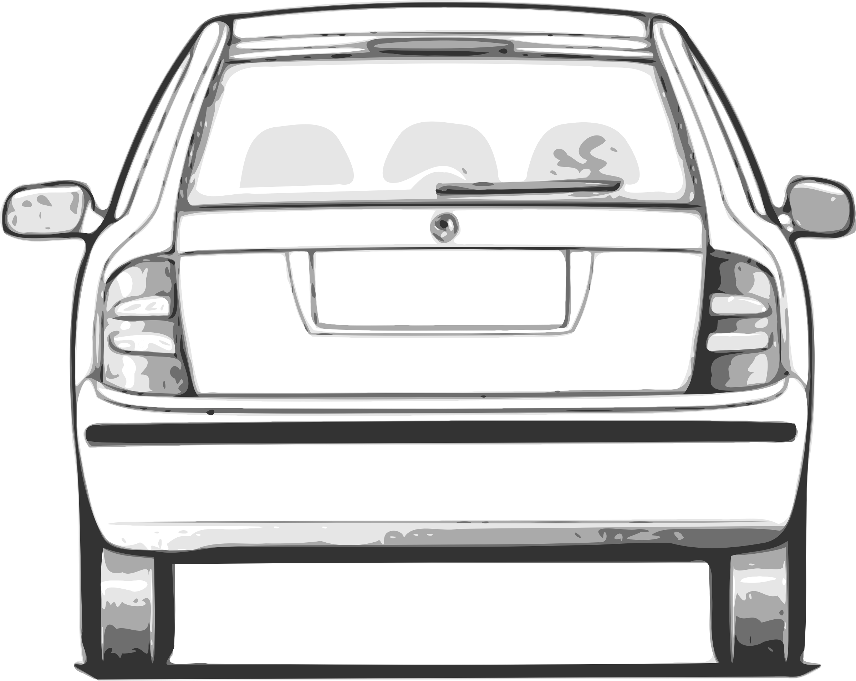
Flakey Control Systems
How do we ensure only one car gets through?
Sequence of values
Gate closed
Gate open
Notes:
https://openclipart.org/detail/1656/fabia---back-view-by-ryanlerch

Slide 12
Solution: Escapement Strategy (2 gates)
Gate 2
Gate 2
Gate 1
Gate 1
Sequence of values
Key: at no time is there a path through both gates
Gate 1: open
Gate 2: closed
Gate 1: closed
Gate 2: open
Notes:
https://openclipart.org/detail/1656/fabia---back-view-by-ryanlerch

Slide 13
(Edge-Triggered) D Register
The gate of this latch is open when the clock is low
What does that one do?
D
D
Q
D
Q
Q
D
input
output
0
1
Q
0
1_{S}
G
G
G
CLK
The gate of this latch is open when the clock is high
Observations:
only one latch “transparent” at any time:
input latch closed when output is open
output latch closed when input is open
⇒ no combinational path through register
(the feedback path in one of the input or output latches is always active)

Slide 14
D-Register Waveforms
D
D
Q
D
Q
Q
D
D
Q
Q
input
output
G
G
CLK
CLK
D
CLK
Q
input latch closed
input latch open
output latch open
output latch closed

Slide 15
Um, about that hold time…
D
D
Q
D
Q
Q
input
output
G
G
CLK
D
CLK
The input’s contamination delay must meet the hold time of the output: t_{CD,M} ≥ t_{H,S}
Output latch is closing ⇒ ☆ must meet setup/hold times but input latch is opening so ☆ may change

Slide 16
D-Register Timing 1
≤t_{PD}
≥t_{CD}
Q
D
D
Q
Q
CLK
CLK
D
t_{PD}: maximum propagation delay, CLK→Q
≥t_{SETUP}
≥t_{HOLD}
t_{CD}: minimum contamination delay, CLK→Q
t_{SETUP}: setup time
guarantee that D has propagated through feedback path before input latch closes
t_{HOLD}: hold time
guarantee input latch is closed and data is stable before allowing D to change

Slide 17
Single-clock Synchronous Circuits
We’ll use registers in a highly constrained way to build digital systems:
Does that symbol register?
Single-clock Synchronous Discipline
• No combinational cycles
• Single periodic clock signal shared among all clocked devices
• Only care about value of register data inputs just before rising edge of clock
• Period greater than every combinational delay + setup time
• Change saved state after noise-inducing logic transitions have stopped!

Slide 18
Timing in a Single-clock System
Q_{R1}
Questions for register-based designs:
how much time for useful work (i.e. for combinational logic delay)?
D
Q
L
D
Q
reg1
reg2
CLK
t₁
t₂
what happens if there’s no combinational logic between two registers?
CLK
t_{PD,reg1}
t_{CD,reg1}
Q_{R1}
t_{CD, L}
t_{PD, L}
œ
what happens if CLK signal doesn’t arrive at the two registers at exactly the same time (a phenomenon known as “clock skew”)?
t_{SETUP,reg2}
t₁ = t_{CD,reg1} + t_{CD,L} ≥ t_{HOLD,reg2}
t₂ = t_{PD,reg1} + t_{PD,L} + t_{SETUP,reg2} ≤ t_{CLK}

Slide 19
Model: Discrete Time
State updated every rising clock edge
Next
State
DREG
Memory
Current
State
Combinational
Logic
Clock
Input
Output
Active Clock Edges punctuate time ---
Discrete Clock periods
Sequences of states
Simple rules – eg truth tables – relating outputs to inputs and the current state)
ABSTRACTION: Finite State Machines (next lecture!)

Slide 20
Sequential Circuit Timing
t_{CD,R} = 1ns t_{PD,R} = 3ns t_{S,R} = 2ns
t_{H,R} = 2ns
Next
State
Current
State
Combinational
Logic
Clock
t_{CD,L} = ? t_{PD,L} = 5ns
Input
Output
Questions:
Constraints on t_{CD} for the logic?
Minimum clock period?
Setup, Hold times for Inputs?
t_{CD,R} (1 ns) + t_{CD,L}(?) ≥ t_{H,R}(2 ns)
t_{CD,L} ≥ 1 ns
t_{CLK} ≥ t_{PD,R}+t_{PD,L}+ t_{S,R} = 10nS
Input
t_{PD,L}
t_{S,INPUT} = t_{PD,L} + t_{S,R} = 7 nS
t_{H,INPUT} = t_{H,R} - t_{CD,L}= 1 nS
Next State
t_{CD,L}
clk
t_{S,R}
t_{H,R}

Slide 21
Summary
Basic memory elements:
Feedback, detailed analysis => basic level-sensitive devices (eg, latch)
2 Latches => Register
Dynamic Discipline: constraints on input timing
Synchronous 1-clock logic:
Simple rules for sequential circuits
Yields clocked circuit with T_{S}, T_{H} constraints on input timing
Finite State Machines
Next Lecture Topic!
>t_{S}
>t_{H}
D
Clk
Q
>t_{CD}
<t_{PD}
In
D Q
D Q
Out
Combinational
logic
Clk

