Slide 1
19. Concurrency & Synchronization
6.004x Computation Structures
Part 3 – Computer Organization
Copyright © 2016 MIT EECS

Slide 2
Interprocess Communication
Why have multiple processes?
Concurrency
Asynchrony
Processes as a programming primitive
Data-/Event-driven
Classic Example: “Producer-Consumer” Problem
PRODUCER
P
CONSUMER
C
How to communicate?
Shared Memory (overlapping contexts)...
Synchronization instructions (hardware support)
Supervisor calls
loop: <xxx>;
send(c); goto loop
loop: c = rcv();
<yyy>; goto loop
Real-World Examples: Compiler/Assembler,
Application Frontend/Backend,
UNIX pipeline
P₁
P₂
Code
Stack
Data
Shared
Data
Code
Stack
Data

Slide 3
Synchronous Communication
loop: <xxx>;
send(c); goto loop
loop: c = rcv();
<yyy>; goto loop
Precedence Constraints:
a ≺ b
PRODUCER
CONSUMER
<xxx>
1
send
“a precedes b”
1
<xxx>
rcv
1
2
send
<yyy>
1
• Can’t consume data before it’s produced
2
<xxx>
rcv
2
3
send_{i} ≺ rcv_{i}
send
<yyy>
2
3
rcv
3
• Producer can’t “overwrite” data before it’s consumed
<yyy>
3
rcv_{i} ≺ send_{i+1}

Slide 4
FIFO Buffering
RELAXES interprocess synchronization constraints. Buffering relaxes the following OVERWRITE constraint to:
N-character FIFO buffer
P
C
rcv_{i} ≺ send_{i+N}
“Circular Buffer:”
Read index
(out)
c₀
c₀
c₀
c₀
c₁
c₀
c₀
c₀
c₁
c₂
c₀
c₁
c₂
c₀
c₁
c₂
c₀
c₃
c₁
c₂
c₃
c₁
c₂
Write index
(in)
<xxx>;
send(c₀);
<xxx>;
send(c₁);
<xxx>;
send(c₂);
<xxx>;
send(c₃);
rcv(); //c₀
<yyy>;
rcv(); //c₁
<yyy>;
rcv(); //c₂
<yyy>;
time

Slide 5
Example: Bounded Buffer Problem
SHARED MEMORY:
char buf[N]; /* The buffer */
int in=0, out=0;
PRODUCER:
CONSUMER:
send(char c){
buf[in] = c;
in = (in+1)% N;
}
char rcv(){
char c;
c = buf[out];
out = (out+1)% N;
return c;
}
Problem: Doesn’t enforce precedence constraints
(e.g. rcv( ) could be invoked prior to any send() )

Slide 6
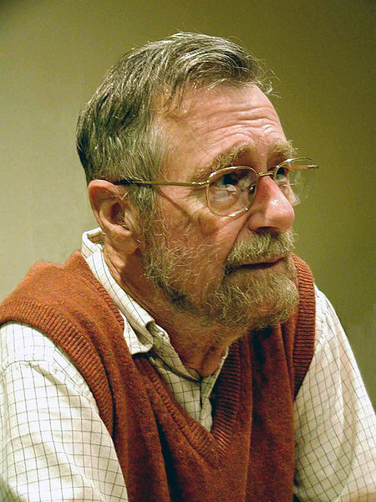

Semaphores (Dijkstra)
Programming construct for synchronization:
NEW DATA TYPE: semaphore, an integer ≥ 0
semaphore s = K; // initialize s to K
NEW OPERATIONS (defined on semaphores):
wait(semaphore s)
wait until s > 0, then s = s – 1
signal(semaphore s)
s = s + 1 (one WAITing process may now be able to proceed)
SEMANTIC GUARANTEE: A semaphore s initialized to K enforces the constraint:
Often you will see P(s) used for wait(s) and V(s) used for signal(s)!
P = “proberen”(test) or “pakken”(grab)
V= “verhogen”(increase)
This is a precedence relationship: the i^{th} call to signal must complete before the the (i+K)^{th} call to wait will succeed.
signal(s)_{i} ≺ wait(s)_{i+K}
Notes:
https://openclipart.org/detail/27848/y-semaphore
https://en.wikipedia.org/wiki/Edsger_W._Dijkstra#/media/File:EdsgerDijkstra.jpg

Slide 7
Semaphores for Precedence
semaphore s = 0;
Goal: want statement A2 in process A to complete before statement B4 in Process B begins.
Process A
A1;
A2;
A3;
A4;
A5;
Process B
B1;
B2;
B3;
B4;
B5;
A2 ≺ B4
signal(s);
wait(s);
Recipe:
Declare semaphore = 0
signal(s) at start of arrow
wait(s) at end of arrow

Slide 8
Semaphores for Resource Allocation
Abstract problem:
• POOL of K resources
• Many processes, each needs resource for occasional uninterrupted period
• MUST guarantee that at most K resources are in use at any time.
Semaphore Solution:
In shared memory:
semaphore s = K; // K resources
Using resources:
wait(s); // Allocate a resource
… // use it for a while
signal(s); // return it to pool
Invariant: Semaphore value = number of resources left in pool

Slide 9
Bounded Buffer Problem w/ Semaphores
SHARED MEMORY:
char buf[N]; /* The buffer */
int in=0, out=0;
semaphore chars=0;
PRODUCER:
CONSUMER:
send(char c)
{
buf[in] = c;
in = (in+1)%N;
signal(chars);
}
char rcv()
{ char c;
wait(chars);
c = buf[out];
out = (out+1)%N;
return c;
}
Does this work?
PRECEDENCE managed by semaphore: send_{i} ≺ rcv_{i}
RESOURCE managed by semaphore chars: # of chars in buf

Slide 10
Flow Control Problems
N-character FIFO buffer
P
C
Q: What keeps PRODUCER from putting N+1 characters into the N-character buffer?
A: Nothing.
Result: OVERFLOW.
WHAT we’ve got thus far:
WHAT we still need:
send_{i} ≺ rcv_{i}
rcv_{i} ≺ send_{i+N}

Slide 11
Bounded Buffer Problem w/ more Semaphores
SHARED MEMORY:
char buf[N]; /* The buffer */
int in=0, out=0;
semaphore chars=0, space=N;
PRODUCER:
CONSUMER:
send(char c)
{
wait(space);
buf[in] = c;
in = (in+1)%N;
signal(chars);
}
char rcv()
{
char c;
wait(chars);
c = buf[out];
out = (out+1)%N;
signal(space);
return c;
}
Resources managed by semaphore: characters in FIFO, spaces in FIFO. Works with single producer, consumer. But what about multiple producers and consumers?

Slide 12
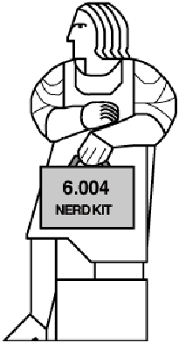

Simultaneous Transactions
Suppose you and your friend visit the ATM at exactly the same time, and remove $50 from your account. What happens?
Debit(int account, int amount) {
t = balance[account]; balance[account] = t – amount;
}
What is supposed to happen?
Process # 1 Process #2
LD(R10, balance, R0) SUB(R0, R1, R0)
ST(R0, balance, R10)
… …
LD(R10, balance, R0) SUB(R0, R1, R0)
ST(R0, balance, R10)
ATM
ATM
Withdraw(6004, 50)
Withdraw(6004, 50)
NET: You have $100, and your bank balance is $100 less.

Slide 13

But, What If…
We need to be careful when writing concurrent programs. In particular, when modifying shared data.
For certain code segments, called CRITICAL SECTIONS, we would like to ensure that no two executions overlap.
This constraint is called MUTUAL EXCLUSION.
Solution: embed critical sections in wrappers (e.g., “transactions”) that guarantee their atomicity, i.e., make them appear to be single, instantaneous operations.
Process # 1 Process #2
LD(R10, balance, R0)
…
LD(R10, balance, R0) SUB(R0, R1, R0)
ST(R0, balance, R10)
…
SUB(R0, R1, R0)
ST(R0, balance, R10)
…
NET: You have $100 and your bank balance is $50 less!
Notes:
https://openclipart.org/detail/227246/cash

Slide 14
Semaphores for Mutual Exclusion
Debit(int account, int amount) { t = balance[account]; balance[account] = t – amount;
}
semaphore lock = 1;
a ≺≻ b
wait(lock); // Wait for exclusive access
“a precedes b
or
b precedes a”
(i.e., they don’t overlap)
signal(lock); // Finished with lock
RESOURCE managed by “lock” semaphore:
Access to critical section
Look up “database” on Wikipedia to learn about systems that support efficient transactions on shared data.
ISSUES:
Granularity of lock 1 lock for whole balance database? 1 lock per account? 1 lock for all accounts ending in 004

Slide 15
Producer/Consumer Atomicity Problems
Consider multiple PRODUCER processes:
P₁
N-character FIFO buffer
C
P₂
P
P
1
2
...
...
buf[in] = c;
buf[in] = c;
in = (in+1) % N;
in = (in+1) % N;
...
...
BUG: Producers interfere with each other.

Slide 16
Bounded Buffer Problem w/ even more Semaphores
SHARED MEMORY:
char buf[N]; /* The buffer */
int in=0, out=0;
semaphore chars=0, space=N;
semaphore lock=1;
PRODUCER:
CONSUMER:
send(char c)
{
wait(space);
wait(lock);
buf[in] = c;
in = (in+1)%N;
signal(lock);
signal(chars);
}
char rcv()
{ char c;
wait(chars);
wait(lock);
c = buf[out];
out = (out+1)%N;
signal(lock);
signal(space);
return c;
}

Slide 17
The Power of Semaphores
SHARED MEMORY:
A single synchronization primitive that enforces both:
char buf[N]; /* The buffer */
int in=0, out=0;
semaphore chars=0, space=N;
semaphore lock=1;
PRODUCER:
CONSUMER:
Precedence relationships:
send_{i} ≺ rcv_{i}
rcv_{i} ≺ send_{i+N}
send(char c)
{
wait(space);
wait(lock)
buf[in] = c;
in = (in+1)%N;
signal(lock);
signal(chars);
}
char rcv()
{ char c;
wait(chars);
wait(lock);
c = buf[out];
out = (out+1)%N;
signal(lock);
signal(space);
return c;
}
Mutual-exclusion relationships:
protect variables in and out

Slide 18
Semaphore Implementation
Semaphores are themselves shared data and implementing WAIT and SIGNAL operations will require read/modify/write sequences that must executed as critical sections. So how do we guarantee mutual exclusion in these particular critical sections without using semaphores?
Approaches:
SVC implementation, using atomicity of kernel handlers. Works in timeshared processor sharing a single uninterruptable kernel.
Implementation of a simple lock using a special instruction (e.g. “test and set”), depends on atomicity of single instruction execution. Works with shared-bus multiprocessors supporting atomic read-modify-write bus transactions. Using a simple lock to implement critical sections, we can use software to implement other semaphore functionality.
Implementation using atomicity of individual read or write operations. For example, see “Dekker’s Algorithm” on Wikipedia.

Slide 19
Semaphores as a Supervisor Call
wait_h( ) {
int *addr; addr = VtoP(User.Regs[R0]); // get arg if (*addr <= 0) { User.Regs[XP] = User.Regs[XP] – 4; sleep(addr);
} else
*addr = *addr - 1;
}
signal_h( ) {
int *addr; addr = VtoP(User.Regs[R0]); // get arg *addr = *addr + 1;
wakeup(addr);
}
Calling sequence:
…
// put address of lock
// into R0
CMOVE(lock, R0)
SVC(WAIT) or SVC(SIGNAL)
SVC call is not interruptible since it is executed in kernel mode.

Slide 20
Hardware Support for Semaphores
TCLR(RA, literal, RC) test and clear location
PC ← PC + 4 EA ← Reg[Ra] + literal Reg[Rc] ← MEM[EA] MEM[EA] ← 0
Executed ATOMICALLY (cannot be interrupted)
Can easily implement mutual exclusion using binary semaphore
wait: TCLR(R31, lock, R0) BEQ(R0,wait) … critical section …
CMOVE(1,R0)
ST(R0, lock, R31)
Atomicity guaranteed by memory
wait(lock)
signal(lock)

Slide 21

Synchronization: The Dark Side
The naïve use of synchronization constraints can introduce its own set of problems, particularly when a process requires access to more than one protected resource.
Transfer(int account1, int account2, int amount) {
wait(lock[account1]); wait(lock[account2]); balance[account1] = balance[account1] - amount; balance[account2] = balance[account2] + amount; signal(lock[account2]);
signal(lock[account1]);
}
ATM
Transfer(6005, 6004, 50)
ATM
Transfer(6004, 6005, 50)
DEADLOCK (aka “deadly embrace”)!
Notes:
https://openclipart.org/detail/161629/go-go-sumo-sumo-1859

Slide 22
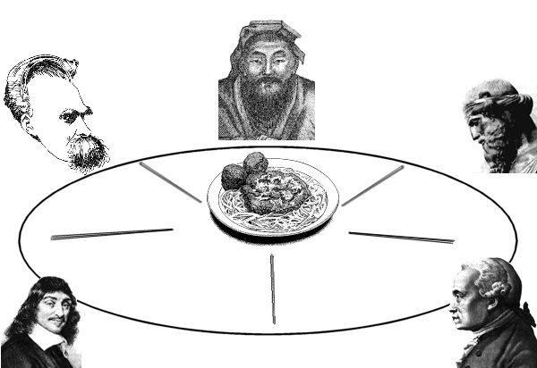



Dining Philosophers
Philosophers think deep thoughts, but have simple secular needs. When hungry, a group of N philosophers will sit around a table with N chopsticks interspersed between them. Food is served, and each philosopher enjoys a leisurely meal using the chopsticks on either side to eat.
They are exceedingly polite and patient, and each follows the following dining protocol:
PHILOSOPHER'S ALGORITHM:
Wait, I think I see a problem here...
• Take (wait for) LEFT stick
Shut up!!
• Take (wait for) RIGHT stick
• EAT until sated
• Replace both sticks
Notes:
https://openclipart.org/detail/403/turkey
https://openclipart.org/detail/1252/turkey
https://openclipart.org/detail/1025/turkey-platter

Slide 23
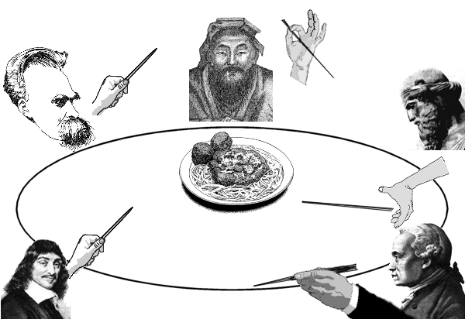
Deadlock!
No one can make progress because they are all waiting for an unavailable resource
CONDITIONS:
1) Mutual exclusion - only one process can hold a resource at a given time
2) Hold-and-wait - a process holds allocated resources while waiting for others
3) No preemption - a resource can not be removed from a process holding it
4) Circular Wait
Cousin Tom is spared!
He still doesn’t look too happy…
SOLUTIONS:
Avoidance
-or-
Detection and Recovery

Slide 24
One Solution
KEY: Assign a unique number to each chopstick, request resources in globally consistent order:
New Algorithm:
• Take LOW stick
3
2
• Take HIGH stick
• EAT
1
• Replace both sticks.
5
4
SIMPLE PROOF:
Deadlock means that each philosopher is waiting for a resource held by some other philosopher …
But, the philosopher holding the highest numbered chopstick can’t be waiting for any other philosopher (no hold-and-wait cycle) …
Thus, there can be no deadlock.

Slide 25
Dealing With Deadlocks
Cooperating processes:
Establish a fixed ordering to shared resources and require all requests to be made in the prescribed order
Transfer(int account1, int account2, int amount) { int a = min(account1, account2);
int b = max(account1, account2);
wait(lock[a]); wait(lock[b]); balance[account1] = balance[account1] - amount; balance[account2] = balance[account2] + amount; signal(lock[b]);
signal(lock[a]);
}
ATM
Transfer(6005, 6004, 50)
ATM
Transfer(6004, 6005, 50)
Unconstrained processes:
- O/S discovers circular wait & kills waiting process
- Transaction model
- Hard problem

Slide 26
Summary
Communication among asynchronous processes requires synchronization….
Precedence constraints: a partial ordering among operations
Semaphores as a mechanism for enforcing precedence constraints
Mutual exclusion (critical sections, atomic transactions) as a common compound precedence constraint
Solving Mutual Exclusion via binary semaphores
Synchronization serializes operations, limits parallel execution.
Many alternative synchronization mechanisms exist!
Deadlocks:
Consequence of undisciplined use of synchronization mechanism
Can be avoided in special cases, detected and corrected in others.

