Slide 1
8. Design Tradeoffs
6.004x Computation Structures
Part 1 – Digital Circuits
Copyright © 2015 MIT EECS

Slide 2
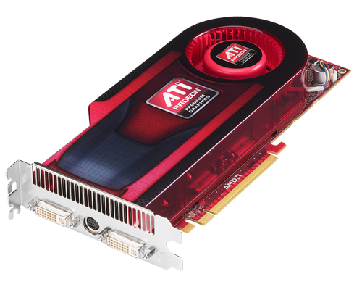

Optimizing Your Design
There are a large number of implementations of the same functionality -- each represents a different point in the area-time-power space
Optimization metrics:
power
Area of the design
Throughput
Latency
Power consumption
Energy of executing a task
…
area
time
vs.
©Advanced Micro Devices (with permission)
Justin14 (CC BY-SA 4.0)
Notes:
http://commons.wikimedia.org/wiki/File:White_AppleWatch_with_Screen.png
http://commons.wikimedia.org/wiki/File:ATI_Radeon_HD_4890_Graphics_Card.jpg

Slide 3
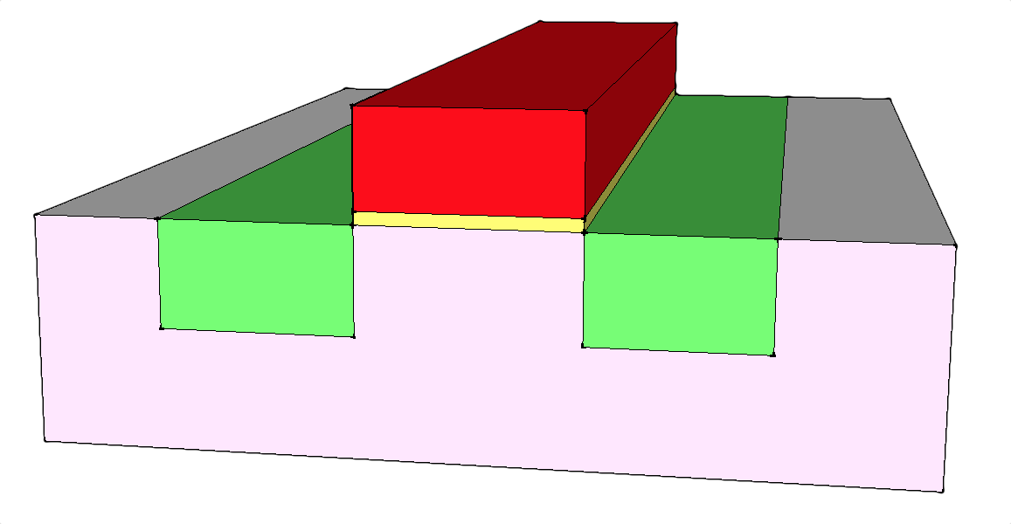
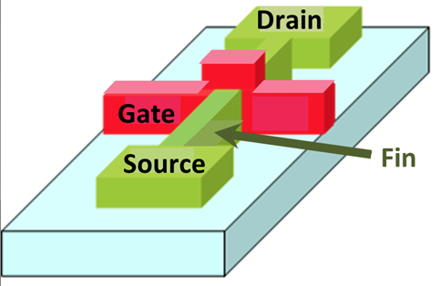
CMOS Static Power Dissipation
MOSFET
1
Tunneling current through gate oxide: SiO₂ is a very good insulator, but when very thin (< 20Å) electrons can tunnel across.
1
2
2
Current leakage from drain to source even though MOSFET is “off” (aka sub-threshold conduction)
Leakage gets larger as difference between V_{TH} and “off” gate voltage (eg, V_{OL} in an nfet) gets smaller. Significant as V_{TH} has become smaller.
Fix: 3D FINFET wraps gate around inversion region
FINFET
Irene Ringworm (CC BY-SA 3.0)
Notes:
http://commons.wikimedia.org/wiki/File:Doublegate_FinFET.PNG

Slide 4
CMOS Dynamic Power Dissipation
V_{IN} moves from L to H to L
V_{OUT} moves from H to L to H
V_{IN}
V_{OUT}
C
t_{CLK}=1/f_{CLK}
C discharges and then recharges:
Power dissipated to discharge C:
Power dissipated to recharge C:

Slide 5

CMOS Dynamic Power Dissipation
V_{IN} moves from L to H to L
V_{OUT} moves from H to L to H
V_{IN}
V_{OUT}
C
t_{CLK}=1/f_{CLK}
C discharges and then recharges:
Power dissipated
= f C V_{DD}² per node = f N C V_{DD}² per chip
where f = frequency of charge/discharge N = number of changing nodes/chip
“Back of the envelope”:
f ~ 1GHz = 1e9 cycles/sec
N ~ 1e8 changing nodes/cycle
C ~ 1fF = 1e-15 farads/node
V ~ 1V
⇒ 100 Watts
trends
Notes:
https://openclipart.org/detail/83869/closed-envelope

Slide 6
How Can We Reduce Power?
A[31:0]
Z
B[31:0]
add
V
ALUFN[0]
N
What if we could eliminate unnecessary transitions? When the output of a CMOS gate doesn’t change, the gate doesn’t dissipate much power!
boole
ALUFN[3:0]
ALU[31:0]
shift
ALUFN[1:0]
Z
V
cmp
N
ALUFN[2:1]
ALUFN[5:4]

Slide 7
Fewer Transitions → Lower Power
A[31:0]
Z
B[31:0]
D Q
G
add
V
N
Signals in this region make transitions only when ALU is doing a shift operation
ALUFN[5] == 0
ALUFN[0]
D Q
G
boole
ALUFN[3:0]
ALUFN[5:4] == 10
ALU[31:0]
D Q
G
shift
ALUFN[1:0]
Must computation consume energy? See §6.5 of Notes
ALUFN[5:4] == 11
Variations: Dynamically adjust t_{CLK} or V_{DD} (either overall or in specific regions) to accommodate workload.
Z
V
cmp
N
ALUFN[2:1]
ALUFN[5:4]

Slide 8
Improving Speed: Adder Example
A_{n-1} B_{n-1} A_{n-2} B_{n-2} A₂ B₂ A₁ B₁ A₀ B₀
C
A B
CO CI
S
A B
CO CI
S
A B
CO CI
S
A B
CO CI
S
A B
CO CI
S
FA
FA
…
FA
FA
FA
0
S_{n-1} S_{n-2} S₂ S₁ S₀
Worse-case path: carry propagation from LSB to MSB, e.g., when adding 11…111 to 00…001.
t_{PD} = (N-1)*(t_{PD,NAND3} + t_{PD,NAND2}) + t_{PD,XOR}
≈ Θ(N)
CI to CO
CI_{N-1} to S_{N-1}
Θ(N) is read “order N” and tells us that the latency of our adder grows in proportion to the number of bits in the operands.

Slide 9
Performance/Cost Analysis
“Order Of” notation:
"g(n) is of order f(n)"
g(n) = Θ(f(n))
g(n)=Θ(f(n)) if there exist C₂ ≥ C₁ > 0 such that for all but finitely many integral n ≥ 0
Θ(...) implies both inequalities; O(...) implies only the second.
g(n) = O(f(n))
Example: n²+2n+3 = Θ(n²)
since n² < n²+2n+3 < 2n²
“almost always”
Notes:
We’ll see that this is a little
pessimistic...

Slide 10
Carry Select Adders
Hmm. Can we get the high half of the adder working in parallel with the low half?
A[31:16]
B[31:16]
A[15:0]
B[15:0]
Two copies of the high half of the adder: one assumes a carry-in of “0”, the other carry-in of “1”.
16-bit Adder
0
16-bit Adder
0
16-bit Adder
1
1 0
S[31:16]
S[15:0]
Once the low half computes the actual value of the carry-in to the high half, use it select the correct version of the high-half addition.
t_{PD} = 16*t_{PD,CI→CO} + t_{PD,MUX2} ≃ half of 32*t_{PD,CI→CO}
Aha! Apply the same strategy to build 16-bit adders from 8-bit adders. And 8-bit adders from 4-bit adders, and so on. Resulting t_{PD} for N-bit adder is Θ(log N).

Slide 11
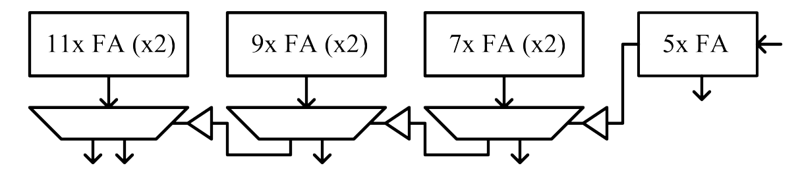
32-bit Carry Select Adder
Practical Carry-select addition: choose block sizes so that trial sums and carry-in from previous stage arrive simultaneously at MUX.
A[31:21]
B[31:21]
A[20:12]
B[20:12]
A[11:5]
B[11:5]
A[4:0]
B[4:0]
S[4:0]
C_{OUT} SUM
C_{OUT} SUM
C_{OUT} SUM
C_{OUT},S[31:21]
S[20:12]
S[11:5]
Select input is heavily loaded, so buffer for speed.
Design goal: have these two sets of signals arrive simultaneously at each carry-select mux

Slide 12
Wanted: Faster Carry Logic!
Let’s see if we can improve the speed by rewriting the equations for C_{OUT}:
C_{OUT} = AB + AC_{IN} + BC_{IN}
= AB + (A + B)C_{IN}
= G + P C_{IN}
where G = AB and P = A + B
generate
propagate
CO logic using only 3 NAND2 gates! Think I’ll borrow that for my FA circuit!
Actually, P is usually defined as P = A⊕B which won’t change C_{OUT} but will allow us to express S as a simple function of P and C_{IN}: S = P ⊕ C_{IN}
A B
CI
CO
S
G P

Slide 13
Carry Look-ahead Adders (CLA)
We can build a hierarchical carry chain by generalizing our definition of the Carry Generate/Propagate (GP) Logic. We start by dividing our addend into two parts, a higher part, H, and a lower part, L. The GP function can be expressed as follows:
Generate a carry out if the high part generates one, or if the low part generates one and the high part propagates it. Propagate a carry if both the high and low parts propagate theirs.
G_{HL} = G_{H} + P_{H} G_{L}
P_{HL} = P_{H} P_{L}
H
L
A B
CO CI
G P S
A B
CO CI
G P S
FA
FA
G_{H} P_{H}
P/G generation
G_{L}
P_{L}
GP
G_{HL} P_{HL}
G_{H} P_{H}
G_{L}
P_{L}
1st level of
lookahead
GP
G_{HL} P_{HL}
Hierarchical building block

Slide 14
8-bit CLA (generate G & P)
A7 B7 A6 B6 A5 B5 A4 B4 A3 B3 A2 B2 A1 B1 A0 B0
A B CO CI
G P S
A B CO CI
G P S
A B CO CI
G P S
A B CO CI
G P S
A B CO CI
G P S
A B CO CI
G P S
A B CO CI
G P S
A B CO CI
G P S
FA
FA
FA
FA
FA
FA
FA
FA
G_{H} P_{H} G_{L}
G_{H} P_{H} G_{L}
G_{H} P_{H} G_{L}
G_{H} P_{H} G_{L}
GP
GP
GP
GP
G_{HL} P_{HL} P_{L}
G_{HL} P_{HL} P_{L}
G_{HL} P_{HL} P_{L}
G_{HL} P_{HL} P_{L}
G₇₋₆ P₇₋₆
G₅₋₄ P₅₋₄
G₃₋₂ P₃₋₂
G₁₋₀ P₁₋₀
Θ(log N)
G_{H} P_{H} G_{L}
G_{H} P_{H} G_{L}
GP
GP
G_{HL} P_{HL} P_{L}
G_{HL} P_{HL} P_{L}
G₇₋₄ P₇₋₄
G₃₋₀ P₃₋₀
G_{H} P_{H} G_{L}
GP
G_{HL} P_{HL} P_{L}
G₇₋₀ P₇₋₀
We can build a tree of GP units to compute the generate and propagate logic for any sized adder. Assuming N is a power of 2, we’ll need N-1 GP units.
This will let us to quickly compute the carry-ins for each FA!

Slide 15
8-bit CLA (carry generation)
Now, given a the value of the carry-in of the least-significant bit,we can generate the carries for every adder.
c_{H} = G_{L} + P_{L}c_{in} c_{L} = c_{in}
C7 C6 C5 C4 C3 C2 C1 C0
G₆
P₆
G_{L}
c_{H}
G₄
P₄
G_{L}
c_{H}
G₂
P₂
G_{L}
c_{H}
G₀
P₀
G_{L}
c_{H}
C
c_{L}
C
c_{L}
C
c_{L}
C
c_{L}
P_{L}
c_{in}
P_{L}
c_{in}
P_{L}
c_{in}
P_{L}
c_{in}
C6 C4 C2 C0
G₅₋₄
P₅₋₄
G_{L}
c_{H}
G₁₋₀
P₁₋₀
G_{L}
c_{H}
Θ(log N)
C
c_{L}
C
c_{L}
P_{L}
c_{in}
P_{L}
c_{in}
Notice that the inputs on the left of each C blocks are the same as the inputs on the right of each corresponding GP block.
C4 C0
C6 = G₅₋₄+P₅₋₄ C4
G₃₋₀
P₃₋₀
c_{H}
G_{L}
C
c_{L}
P_{L}
c_{in}
C4 = G₃₋₀+P₃₋₀ C0
C0

Slide 16
8-bit CLA (complete)
A7 B7 A6 B6 A5 B5 A4 B4 A3 B3 A2 B2 A1 B1 A0 B0
A B CO CI
G P S
A B CO CI
G P S
A B CO CI
G P S
A B CO CI
G P S
A B CO CI
G P S
A B CO CI
G P S
A B CO CI
G P S
A B CO CI
G P S
FA
FA
FA
FA
FA
FA
FA
FA
G_{H} P_{H} C_{j}
G_{H} P_{H} C_{j}
G_{H} P_{H} C_{j}
G_{H} P_{H} C_{j}
G_{L}
P_{L}
C_{i}
G_{L}
P_{L}
C_{i}
G_{L}
P_{L}
C_{i}
G_{L}
P_{L}
C_{i}
GP/C
GP/C
GP/C
GP/C
G_{HL} P_{HL} C_{i}
G_{HL} P_{HL} C_{i}
G_{HL} P_{HL} C_{i}
G_{HL} P_{HL} C_{i}
G_{H} P_{H} C_{j}
G_{H} P_{H} C_{j}
G_{L}
P_{L}
C_{i}
G_{L}
P_{L}
C_{i}
GP/C
GP/C
G_{HL} P_{HL} C_{i}
G_{HL} P_{HL} C_{i}
G_{H} P_{H} C_{j}
t_{PD} = Θ(log N)
G_{L}
P_{L}
C_{i}
GP/C
G_{HL} P_{HL} C_{i}
C0
Notice that we don’t need the carry-out output of the adder any more.
A B
G_{H} P_{H}
c_{H}
G_{H} P_{H} C_{H}
G_{L}
P_{L}
+
G_{L}
C
=
GP/C
G_{L}
P_{L}
C_{L}
GP
c_{L}
P_{L}
c_{i}
CI
G_{HL} P_{HL}
G_{HL} P_{HL} C_{in}
CO
S
G P
To learn more, look up Kogge-Stone adders on Wikipedia.

Slide 17
Binary Multiplication*
The “Binary” Multiplication Table
* Actually unsigned binary multiplication
∗
0
1
Hey, that looks like an AND gate
0
0
0
A₃
A₂
A₁
A₀
1
0
1
x
B₃
B₂
B₁
B₀
AB_{i} called a “partial product”
A₃B₀
A₂B₀
A₁B₀
A₀B₀
A₃B₁
A₂B₁
A₁B₁
A₀B₁
A₃B₂
A₂B₂
A₁B₂
A₀B₂
+
A₃B₃
A₂B₃
A₁B₃
A₀B₃
Multiplying N-digit number by M-digit number gives (N+M)-digit result
Easy part: forming partial products (just an AND gate since B_{I} is either 0 or 1)
Hard part: adding M N-bit partial products

Slide 18
Combinational Multiplier
A B
FA
CI
a₃
a₂
a₁
a₀
b₀
CO
a₃
a₂
a₁
a₀
b₁
S
A B
HA
HA
FA
FA
HA
a₃
a₂
a₁
a₀
b₂
CO
S
FA
FA
FA
HA
a₃
a₂
a₁
a₀
b₃
FA
FA
FA
HA
z₇
z₆
z₅
z₄
z₃
z₂
z₁
z₀
Latency = Θ(N)
Throughput = Θ(1/N)
Hardware = Θ(N²)

Slide 19
2’s Complement Multiplication
Step 1: two’s complement operands so high order bit is –2^{N-1}. Must sign extend partial products and subtract the last one
Step 3: add the ones to the partial products and propagate the carries. All the sign extension bits go away!
X3 X2 X1 X0
* Y3 Y2 Y1 Y0
--------------------
X3Y0 X3Y0 X3Y0 X3Y0 X3Y0 X2Y0 X1Y0 X0Y0
+ X3Y1 X3Y1 X3Y1 X3Y1 X2Y1 X1Y1 X0Y1
+ X3Y2 X3Y2 X3Y2 X2Y2 X1Y2 X0Y2
- X3Y3 X3Y3 X2Y3 X1Y3 X0Y3
-----------------------------------------
Z7 Z6 Z5 Z4 Z3 Z2 Z1 Z0
X3Y0 X2Y0 X1Y0 X0Y0
+ X3Y1 X2Y1 X1Y1 X0Y1
+ X3Y2 X2Y2 X1Y2 X0Y2
+ X3Y3 X2Y3 X1Y3 X0Y3
+ 1
- 1 1 1 1
Step 2: don’t want all those extra additions, so add a carefully chosen constant, remembering to subtract it at the end. Convert subtraction into add of (complement + 1).
Step 4: finish computing the constants…
X3Y0 X2Y0 X1Y0 X0Y0
+ X3Y1 X2Y1 X1Y1 X0Y1
+ X3Y2 X2Y2 X1Y2 X0Y2
+ X3Y3 X2Y3 X1Y3 X0Y3
+ 1 1
X3Y0 X3Y0 X3Y0 X3Y0 X3Y0 X2Y0 X1Y0 X0Y0
+ 1
+ X3Y1 X3Y1 X3Y1 X3Y1 X2Y1 X1Y1 X0Y1
+ 1
+ X3Y2 X3Y2 X3Y2 X2Y2 X1Y2 X0Y2
+ 1
+ X3Y3 X3Y3 X2Y3 X1Y3 X0Y3
+ 1
+ 1
- 1 1 1 1
–B = ~B + 1
Result: multiplying 2’s complement operands takes just about same amount of hardware as multiplying unsigned operands!

Slide 20
2’s Complement Multiplier
a₃
a₂
a₁
a₀
b₀
1
a₃
a₂
a₁
a₀
b₁
FA
FA
FA
HA
a₃
a₂
a₁
a₀
b₂
FA
FA
FA
HA
1
a₃
a₂
a₁
a₀
b₃
HA
FA
FA
FA
HA
z₇
z₆
z₅
z₄
z₃
z₂
z₁
z₀

Slide 21
Increase Throughput With Pipelining
gotta break
that long
carry chain!
a₃
a₂
a₁
a₀
b₀
a₃
a₂
a₁
a₀
b₁
HA
FA
FA
HA
a₃
a₂
a₁
a₀
b₂
FA
FA
FA
HA
a₃
a₂
a₁
a₀
b₃
FA
FA
FA
HA
z₇
z₆
z₅
z₄
z₃
z₂
z₁
z₀
Before pipelining: Throughput = ~1/(2N) = Θ(1/N)
After pipelining: Throughput = ~1/N = Θ(1/N)

Slide 22
“Carry-save” Pipelined Multiplier
Observation: Rather than propagating the carries to the next column, they can instead be forwarded onto the next column of the following row
a₃
a₂
a₁
a₀
b₀
a₃
a₂
a₁
a₀
b₁
HA
HA
HA
a₃
a₂
a₁
a₀
b₂
FA
FA
FA
a₃
a₂
a₁
a₀
b₃
FA
FA
FA
HA
HA
HA
FA
HA
Latency = Θ(N)
Throughput = Θ(1)
Hardware = Θ(N²)
HA
z₇
z₆
z₅
z₄
z₃
z₂
z₁
z₀

Slide 23
Reduce Area With Sequential Logic
Assume the multiplicand (A) has N bits and the multiplier (B) has M bits. If we only want to invest in a single N-bit adder, we can build a sequential circuit that processes a single partial product at a time and then cycle the circuit M times:
S_{N}
S_{N-1}…S₀
Init: P←0, load A&B
Repeat M times {
P ← P + (B_{LSB}==1 ? A : 0)
shift S_{N},P,B right one bit
}
Done: (N+M)-bit result in P,B
LSB
P
B
NC
A
M bits
N
Carry-save
1
N
+
xN
N+1
N+1 Sum bits and N saved carries
Latency = Θ(N)
Throughput = Θ(1/N)
Hardware = Θ(N)
T_{PD} = Θ(1) for carry-save (see previous slide), but adds Θ(N) cycles & Θ(N) hardware

Slide 24
Summary
Power dissipation can be controlled by dynamically varying T_{CLK}, V_{DD} or by selectively eliminating unnecessary transitions.
Functions with N inputs have minimum latency of O(log N) if output depends on all the inputs. But it can take some doing to find an implementation that achieves this bound.
Performing operations in “slices” is a good way to reduce hardware costs (but latency increases)
Pipelining can increase throughput (but latency increases)
Asymptotic analysis only gets you so far – factors of 10 matter in real life and typically N isn’t a parameter that’s changing within a given design.

