Slide 1
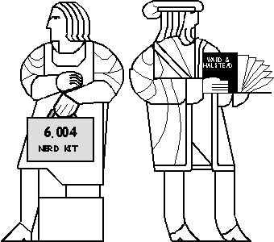
Caches & The Memory Hierarchy
Why the book?
Lecture notes
are faster!
Cache miss
Memory Technologies
The Memory Hierarchy
The Locality Principle
Cache architectures

Slide 2
Our “Computing Machine”
Memory
ILL
XAdr
OP
JT
PCSEL
4
3
2
1
0
We need to fetch one instruction each cycle
Reset
RESET
1
0
PC
00
A
Instruction
Memory
+4
ID[31:0]
D
Ra: ID[20:16]
Rb: ID[15:11]
Rc: ID[25:21]
Ultimately data is loaded from and results stored to memory
+
WASEL
0
1
RA2SEL
XP
1
RA1
Register
RA2
Rc: ID[25:21]
0
WA
WA
File
WD
Z
RD1
RD2
WE
W
E
R
F
(PC+4)+4*SXT(C)
C: SXT(ID[15:0])
JT
IRQ
Z
ID[31:26]
ASEL
1
0
1
0
BSEL
Control Logic
ALUFN
ASEL
A
B
BSEL
ALU
MWR
MOE
ALUFN
WD
WE
MWR
Data
Memory
OE
MOE
PCSEL
Adr
RA2SEL
RD
WASEL
WDSEL
WERF
PC+4
0
1
2
W
D
S
E
L

Slide 3
Memory Technologies
Technologies have vastly different tradeoffs between capacity, access latency, bandwidth, energy, and cost
… and logically, different applications
 | Capacity | Latency | Cost/GB
Register | 1000s of bits | 20 ps | $$$$
SRAM | ~10 KB-10 MB | 1-10 ns | ~$1000
DRAM | ~10 GB | 80 ns | ~$10
Flash* | ~100 GB | 100 us | ~$1
Hard disk* | ~1 TB | 10 ms | ~$0.10
Processor Datapath
Memory Hierarchy
I/O subsystem
* non-volatile (retains contents when powered off)

Slide 4
Static RAM (SRAM)
Data in
Drivers
6
SRAM cell
Wordlines
(horizontal)
Address
3
Bitlines
(vertical, two per cell)
Address decoder
8x6 SRAM array
Sense amplifiers
6
Data out

Slide 5
SRAM Cell
6-MOSFET (6T) cell:
Two CMOS inverters (4 MOSFETs) forming a bistable element
Two access transistors
Bistable element
(two stable states) stores a single bit
bitline
bitline
6T SRAM Cell
Vdd
GND
“1”
GND
Vdd
“0”
Wordline N
access FETs

Slide 6
SRAM Read
1
Drivers precharge all bitlines to Vdd (1), and leave them floating
Address decoder activates one wordline
Each cell in the activated word slowly pulls down one of the bitlines to GND (0)
Sense amplifiers sense change in bitline voltages, producing output data
2
3
4
bitline
bitline
Vdd
6T SRAM Cell
Vdd
1
1
0
wordline
access FETs
GND→Vdd
V(t)
V(t)
3
OFF→ON
2
2
t
t

Slide 7
SRAM Write
1
Drivers set and hold bitlines to desired values (Vdd and GND for 1, GND and Vdd for 0)
Address decoder activates one wordline
Each cell in word is overpowered by the drivers, stores value
2
3
bitline
bitline
1
GND
Vdd
1
3
Vdd
→GND
GND
→Vdd
All transistors are carefully sized so that bitline GND overpowers cell Vdd, but bitline Vdd does not overpower cell GND (why?)
wordline
access FETs
GND→Vdd
OFF→ON
2
2

Slide 8
Multiported SRAMs
SRAM so far can do either one read or one write/cycle
We can do multiple reads and writes with multiple ports by adding one set of wordlines and bitlines per port
Cost/bit? For N ports…
Wordlines: _____
Bitlines: _____
Access FETs: _____
Wires often dominate area → O(N²) area!
N
2*N
2*N

Slide 9
Summary: SRAMs
Array of k*b cells (k words, b cells per word)
Cell is a bistable element + access transistors
Analog circuit with carefully sized transistors to allow reads and writes
Read: Precharge bitlines, activate wordline, sense
Write: Drive bitlines, activate wordline, overpower cells
6 MOSFETs/cell… can we do better?
What’s the minimum number of MOSFETs needed to store a single bit?

Slide 10
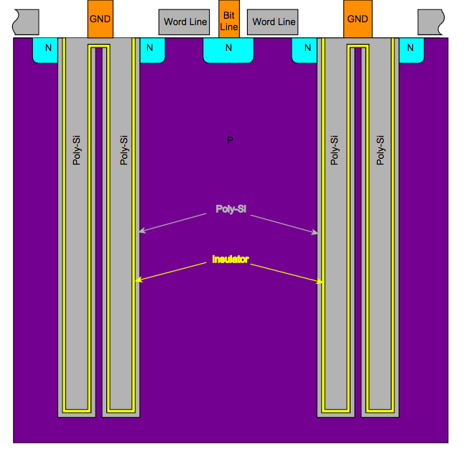
1T Dynamic RAM (DRAM) Cell
Cyferz (CC BY 2.5)
Storage capacitor
1T DRAM Cell
word line
access FET
V_{REF}
bitline
C in storage capacitor determined by:
better dielectric
more area
e A
d
Trench capacitors take little area
C =
thinner film
~20x smaller area than SRAM cell → Denser and cheaper!
Problem: Capacitor leaks charge, must be refreshed periodically (~milliseconds)
Notes:
http://upload.wikimedia.org/wikipedia/en/b/be/DRAM_trench_structure_configuration1_1.svg

Slide 11
DRAM Writes and Reads
Writes: Drive bitline to Vdd or GND, activate wordline, charge or discharge capacitor
Reads:
Precharge bitline to Vdd/2
Activate wordline
Capacitor and bitline share charge
If capacitor was discharged, bitline voltage decreases slightly
If capacitor was charged, bitline voltage increases slightly
Sense bitline to determine if 0 or 1
Issue: Reads are destructive! (charge is gone!)
So, data must be rewritten to cell at end of read
1T DRAM Cell
word line
Storage capacitor
access FET
V_{REF}
bitline

Slide 12
Summary: DRAM
1T DRAM cell: transistor + capacitor
Smaller than SRAM cell, but destructive reads and capacitors leak charge
DRAM arrays include circuitry to:
Write word again after every read (to avoid losing data)
Refresh (read+write) every word periodically
DRAM vs SRAM:
~20x denser than SRAM
~2-10x slower than SRAM

Slide 13
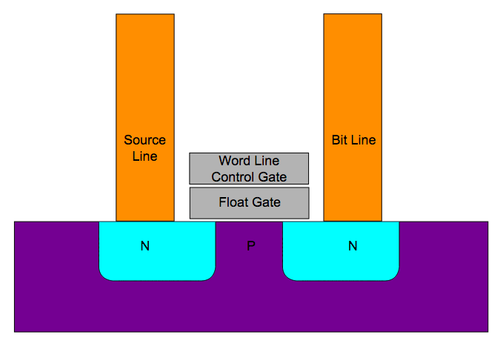
Non-Volatile Storage: Flash
Electrons here diminish strength of field from control gate ⇒ no inversion ⇒ NFET stays off even when word line is high.
Cyferz (CC BY 2.5)
Flash Memory: Use “floating gate” transistors to store charge
Very dense: Multiple bits/transistor, read and written in blocks
Slow (especially on writes), 10-100 us
Limited number of writes: charging/discharging the floating gate (writes) requires large voltages that damage transistor
Notes:
http://en.wikipedia.org/wiki/File:Flash_cell_structure.svg

Slide 14
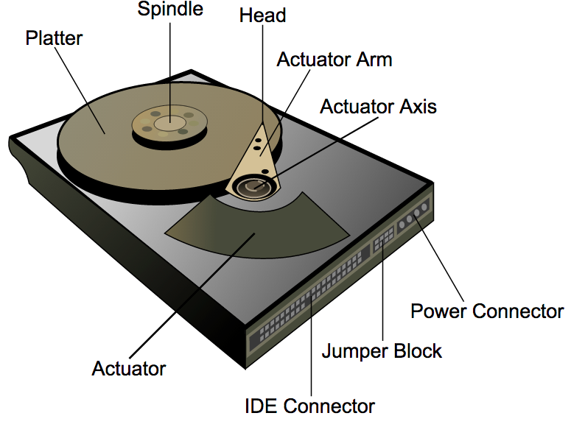
Non-Volatile Storage: Hard Disk
Disk head
Surachit (CC BY 2.5)
Circular track divided into sectors
Hard Disk: Rotating magnetic platters + read/write head
Extremely slow (~10ms): Mechanically move head to position, wait for data to pass underneath head
~100MB/s for sequential read/writes
~100KB/s for random read/writes
Cheap
Notes:
http://commons.wikimedia.org/wiki/File:Hard_drive-en.svg

Slide 15
Summary: Memory Technologies
 | Capacity | Latency | Cost/GB
Register | 1000s of bits | 20 ps | $$$$
SRAM | ~10 KB-10 MB | 1-10 ns | ~$1000
DRAM | ~10 GB | 80 ns | ~$10
Flash | ~100 GB | 100 us | ~$1
Hard disk | ~1 TB | 10 ms | ~$0.10
Different technologies have vastly different tradeoffs
Size is a fundamental limit, even setting cost aside:
Small + low latency, high bandwidth, low energy, or
Large + high-latency, low bandwidth, high energy
Can we get the best of both worlds? (large, fast, cheap)

Slide 16
The Memory Hierarchy
Want large, fast, and cheap memory, but…
Large memories are slow (even if built with fast components)
Fast memories are expensive
Idea: Can we use a hierarchal system of memories with different tradeoffs to emulate a large, fast, cheap memory?
CPU
FLASH
?
Mem
DRAM
≈
SRAM
Speed:
Capacity:
Cost:
Fastest
Smallest
Highest
Slowest
Largest
Lowest
Fast
Large
Cheap

Slide 17
Memory Hierarchy Interface
Approach 1: Expose Hierarchy
Registers, SRAM, DRAM, Flash, Hard Disk each available as storage alternatives
Tell programmers: “Use them cleverly”
Approach 2: Hide Hierarchy
Programming model: Single memory, single address space
Machine transparently stores data in fast or slow memory, depending on usage patterns
CPU
10 KB SRAM
10 MB SRAM
10 GB DRAM
1 TB Flash/HDD
CPU
1 TB HDD/SSD
100 KB SRAM
10 GB DRAM
X?
L1Cache
Main memory
Swap space

Slide 18
The Locality Principle
Keep the most often-used data in a small, fast SRAM (often local to CPU chip)
Refer to Main Memory only rarely, for remaining data.
The reason this strategy works: LOCALITY
Locality of Reference:
Access to address X at time t implies that access to address X+ΔX at time t+Δt becomes more probable as ΔX and Δt approach zero.

Slide 19
Memory Reference Patterns
S is the set of locations accessed during Δt.
Working set: a set S which changes slowly wrt access time.
Working set size, |S|
address
data
stack
|S|
code
Δ
t
Δt
time

Slide 20
Caches
Cache: A small, interim storage component that transparently retains (caches) data from recently accessed locations
Very fast access if data is cached, otherwise accesses slower, larger cache or memory
Exploits the locality principle
Computer systems often use multiple levels of caches
Caching widely applied beyond hardware (e.g., web caches)

Slide 21
A Typical Memory Hierarchy
Everything is a cache for something else…
Access time | Capacity | Managed By
1 cycle | 1 KB | Software/Compiler
2-4 cycles | 32 KB | Hardware
10 cycles | 256 KB | Hardware
40 cycles | 10 MB | Hardware
200 cycles | 10 GB | Software/OS
10-100us | 100 GB | Software/OS
10ms | 1 TB | Software/OS
On the datapath
Registers
Level 1 Cache
Level 2 Cache
Level 3 Cache
On chip
Other chips
Main Memory
Flash Drive
Mechanical devices
Hard Disk

Slide 22
Cache Access
0x6004
Processor
DATA
Cache
Main Memory
0x6034
0x6034
DATA
DATA
LD 0x6004
LD 0x6034
Processor sends address to cache
Two options:
Cache hit: Data for this address in cache, returned quickly
Cache miss: Data not in cache
Fetch data from memory, send it back to processor
Retain this data in the cache (replacing some other data)
Processor must deal with variable memory access time

Slide 23
Cache Metrics
Hit Ratio:
Miss Ratio:
Average Memory Access Time (AMAT):
Goal of caching is to improve AMAT
Formula can be applied recursively in multi-level hierarchies:
AMAT = HitTime + MissRatio × MissPenalty

Slide 24
Example: How High of a Hit Ratio?
Processor
Main Memory
Cache
4 cycles
100 cycles
What hit ratio do we need to break even? (Main memory only: AMAT = 100)
100 = 4 + (1 − HR) × 100 ⇒ HR = 4%
What hit ratio do we need to achieve AMAT = 5 cycles?
5 = 4 + (1 − HR) × 100 ⇒ HR = 99%

Slide 25
Basic Cache Algorithm
ON REFERENCE TO Mem[X]:
Look for X among cache tags...
CPU
HIT: X = TAG(i) , for some cache line i
READ: return DATA(i)
WRITE: change DATA(i); Start Write to Mem(X)
Tag
Data
A
Mem[A]
MISS: X not found in TAG of any cache line
REPLACEMENT SELECTION:
Select some line k to hold Mem[X] (Allocation)
READ: Read Mem[X]
Set TAG(k)=X, DATA(k)=Mem[X]
WRITE: Start Write to Mem(X)
Set TAG(k)=X, DATA(k)= new Mem[X]
B
Mem[B]
(1-HR)
MAIN
MEMORY
Q: How do we “search” the cache?

Slide 26
Direct-Mapped Caches
Each word in memory maps into a single cache line
Access (for cache with 2^{W} lines):
Index into cache with W address bits (the index bits)
Read out valid bit, tag, and data
If valid bit == 1 and tag matches upper address bits, HIT
Valid bit
Tag (27 bits)
Data (32 bits)
Example: 8-location DM cache (W=3)
0
1
2
3
4
5
6
7
32-bit BYTE address
00000000000000000000000011101000
Tag
bits
Index
bits
Offset bits
=?
HIT

Slide 27
Example: Direct-Mapped Caches
64-line direct-mapped cache → 64 indexes → 6 index bits
Read Mem[0x400C]
Valid bit
Tag (24 bits)
Data (32 bits)
0100 0000 0000 1100
0
1
2
3
4
63
1
1
0
1
1
1
0x000058
0x000058
0x000058
0x000040
0x000007
0x000058
0xDEADBEEF
0x00000000
0x00000007
0x42424242
0x6FBA2381
0xF7324A32
TAG: 0x40
INDEX: 0x3
OFFSET: 0x0
HIT, DATA 0x42424242
…
…
…
Would 0x4008 hit?
INDEX: 0x2 → tag mismatch → miss
What are the addresses of data in indexes 0, 1, and 2?
TAG: 0x58 → 0101 1000 iiii ii00 (substitute line # for iiiiii) → 0x5800, 0x5804, 0x5808
Part of the address (index bits) is encoded in the location!
Tag + Index bits unambiguously identify the data’s address

Slide 28
Block Size
Take advantage of locality: increase block size
Another advantage: Reduces size of tag memory!
Potential disadvantage: Fewer blocks in the cache
Valid bit
Tag (26 bits)
Data (4 words, 16 bytes)
Example: 4-block, 16-word DM cache
32-bit BYTE address
0 1 2 3
Block offset bits: 4 (16 bytes/block)
Tag bits: 26 (=32-4-2)
Index bits: 2 (4 indexes)

Slide 29
Block Size Tradeoffs
Larger block sizes…
Take advantage of spatial locality
Incur larger miss penalty since it takes longer to transfer the block into the cache
Can increase the average hit time and miss rate
Average Access Time (AMAT) = HitTime + MissPenalty*MR
Miss Penalty
Miss Ratio
AMAT
Exploits spatial locality
Increased miss penalty and miss rate
~64 bytes
Fewer blocks, compromises locality
Block Size
Block Size
Block Size

Slide 30
Direct-Mapped Cache Problem: Conflict Misses
Word
Address
1024
37
1025
38
1026
39
1024
37
…
Cache
Line index
0
37
1
38
2
39
0
37
Hit/
Miss
HIT
HIT
HIT
HIT
HIT
HIT
HIT
HIT
Loop A:
Pgm at 1024, data at 37:
Assume:
1024-line DM cache
Block size = 1 word
Consider looping code, in steady state
Assume WORD, not BYTE, addressing
Loop B:
Pgm at 1024, data at 2048:
1024
2048
1025
2049
1026
2050
1024
2048
...
0
0
1
1
2
2
0
0
MISS
MISS
MISS
MISS
MISS
MISS
MISS
MISS
Inflexible mapping (each address can only be in one cache location) → Conflict misses!

Slide 31
Fully-Associative Cache
Opposite extreme: Any address can be in any location
No cache index!
Flexible (no conflict misses)
Expensive: Must compare tags of all entries in parallel to find matching one (can do this in hardware, this is called a CAM)
Valid bit
Tag
Data
=?
=?
=?
=?
…
…
…
…
…
…
32-bit BYTE address
0 1 2 3
Tag bits
Offset bits

Slide 32
N-way Set-Associative Cache
Compromise between direct-mapped and fully associative
Nomenclature:
# Rows = # Sets
# Columns = # Ways
Set size = #ways = “set associativity” (e.g., 4-way → 4 entries/set)
compare all tags from all ways in parallel
An N-way cache can be seen as:
N direct-mapped caches in parallel
Direct-mapped and fully-associative are just special cases of N-way set-associative
Tag
Data
Tag
Data
Tag
Data
Tag
Data
8 sets
=?
=?
=?
=?
4 ways

Slide 33
N-way Set-Associative Cache
Example: 3-way 8-set cache
INCOMING ADDRESS
WAY
Tag
Data
Tag
Data
Tag
Data
k
i
SET
=?
=?
=?
MEM DATA
DATA TO CPU
HIT
0

Slide 34
“Let me count the ways.”
Elizabeth Barrett Browning
address
data
Potential cache line conflicts during interval Δt
stack
code
Δt
time

Slide 35
Associativity Tradeoffs
More ways…
Reduce conflict misses
Increase hit time
Miss ratio (%)
Associativity
Hit Time
AMAT
Lower conflict misses
Higher hit time
[H&P: Fig 5.9]
Cache size (bytes)
Ways
Ways
Little additional benefits beyond 4 to 8 ways

Slide 36
Associativity Implies Choices
Issue: Replacement Policy
Direct-mapped
N-way set-associative
Fully associative
address
address
address
N
Compare addr with only one tag
Location A can be stored in exactly one cache line
Compare addr with N tags simultaneously
Location A can be stored in exactly one set, but in any of the N cache lines belonging to that set
Compare addr with each tag simultaneously
Location A can be stored in any cache line

Slide 37
Replacement Policies
Optimal policy (Belady’s MIN): Replace the block that is accessed furthest in the future
Requires knowing the future…
Idea: Predict the future from looking at the past
If a block has not been used recently, it’s often less likely to be accessed in the near future (a locality argument)
Least Recently Used (LRU): Replace the block that was accessed furthest in the past
Works well in practice
Need to keep ordered list of N items → N! orderings → O(log₂N!) = O(N log₂N) “LRU bits” + complex logic
Caches often implement cheaper approximations of LRU
Other policies:
First-In, First-Out (least recently replaced)
Random: Choose a candidate at random
Not very good, but does not have adversarial access patterns

Slide 38
Write Policy
Write-through: CPU writes are cached, but also written to main memory immediately (stalling the CPU until write is completed). Memory always holds current contents
Simple, slow, wastes bandwidth
Write-behind: CPU writes are cached; writes to main memory may be buffered. CPU keeps executing while writes are completed in the background
Faster, still uses lots of bandwidth
Write-back: CPU writes are cached, but not written to main memory until we replace the block. Memory contents can be “stale”
Fastest, low bandwidth, more complex
Commonly implemented in current systems
Notes:
dsm: Slide used to say 90% of cache ops are reads. Nope. On systems with wback caches, ~10% of the LLC or mem traffic is typically writes. But that doesn’t mean stores are rare!

Slide 39
Write-Back
ON REFERENCE TO Mem[X]: Look for X among tags...
HIT: TAG(X) == Tag[i] , for some cache block i
READ: return Data[i]
WRITE: change Data[i]; Start Write to Mem[X]
MISS: TAG(X) not found in tag of any cache block that X can map to
REPLACEMENT SELECTION:
Select some line k to hold Mem[X]
Write Back: Write Data[k] to Mem[Address from Tag[k]]
READ: Read Mem[X]
Set Tag[k] = TAG(X), Data[k] = Mem[X]
WRITE: Start Write to Mem[X]
Set Tag[k] = TAG(X), Data[k] = new Mem[X]

Slide 40
Write-Back with “Dirty” Bits
D
V
TAG
DATA
Add 1 bit per block to record whether block has been written to. Only write back dirty blocks.
0
0
CPU
1
1
TAG(A)
Mem[A]
MAIN
0
MEMORY
0
0
1
TAG(B)
Mem[B]
0
ON REFERENCE TO Mem[X]: Look for TAG(X) among tags...
HIT: TAG(X) == Tag[i] , for some cache block i
READ: return Data[i]
WRITE: change Data[i] Start Write to Mem[X] D[i]=1
MISS: TAG(X) not found in tag of any cache block that X can map to
REPLACEMENT SELECTION:
Select some block k to hold Mem[X]
If D[k] == 1 (Writeback) Write Data[k] to Mem[Address of Tag[k]]
READ: Read Mem[X]; Set Tag[k] = TAG(X), Data[k] = Mem[X], D[k]=0
WRITE: Start Write to Mem[X] D[k]=1
Set Tag[k] = TAG(X), Data[k] = new Mem[X]

Slide 41
Summary: Cache Tradeoffs
AMAT = HitTime + MissRatio × MissPenalty
Larger cache size: Lower miss rate, higher hit time
Larger block size: Trade off spatial for temporal locality, higher miss penalty
More associativity (ways): Lower miss rate, higher hit time
More intelligent replacement: Lower miss rate, higher cost
Write policy: Lower bandwidth, more complexity
How to navigate all these dimensions? Simulate different cache organizations on real programs

