Slide 1

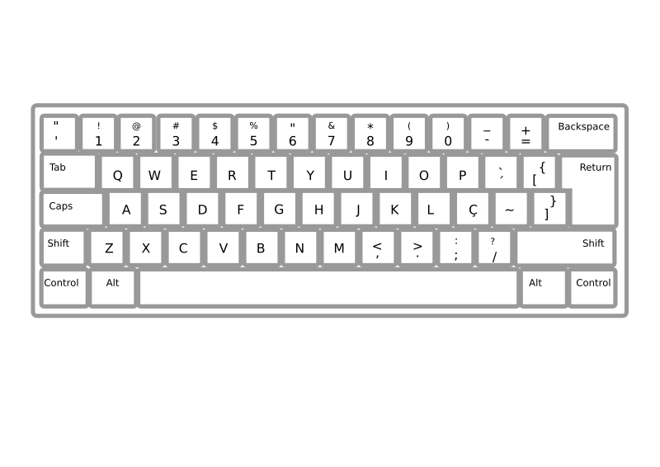
SVCs, Devices, and Interrupts
Loop:
LD(R3,0,R0)
ADDC(R3,4,R3)
SUBC(R2,1,R2)
BNE(R2,Loop)
…
(Cough) Excuse me, sir…
Interrupts for Async I/O
ReadKey SVC example
“Real Time”
Latencies & Deadlines
Weak priorities
Strong priorities

Slide 2


OS Organization: I/O Devices
loop:SVC(0)
...
SVC(1)
...
BR(loop)
loop:SVC(2)
...
SVC(3)
...
BR(loop)
loop:SVC(3)
...
SVC(1)
...
BR(loop)
…
User
Mode
PC[31]=0
USER PROCESSES
P1
P2
PN
P1:
MState
DPYNUM=0
P2:
MState
DPYNUM=1
…
PN:
MState
DPYNUM=27
Kernel
Mode
PC[31]=1
KERNEL
Saved
Regs
(MState)
Scheduler
Key
Buffer
Click
Buffer
Yield
WrCh
GetKey
…
Timer Handler
Keyboard Handler
Mouse Handler
Illegal Op Handler

Slide 3
Asynchronous I/O Handling
Application:
…
ReadKey() // read key into R0
…
TRAP to OS
Device Buffer
(in OS Kernel)
ReadKey_h() { (remove next char from buffer, return in R0)
…}
SVC call from application
IN
“A”
OUT
IN
OUT
. . .
INTERRUPT to OS
KeyHit_h() { (read ASCII code, put in buffer)
}
INTERRUPT from Keyboard n

Slide 4
Interrupt-based Asynch I/O
OPERATION: NO attention to Keyboard during normal operation
• on key strike: hardware asserts IRQ to request interrupt
• USER program interrupted, PC+4 of interrupted inst. saved in XP
• state of USER program saved on KERNEL stack;
• Keyboard handler invoked, runs to completion;
• state of USER program restored; program resumes.
TRANSPARENT to USER program.
Keyboard Interrupt Handler (in O.S. KERNEL):
Assume each keyboard has an associated buffer
struct Device {
char Flag, Data;
} Keyboard;
KeyHit_h() {
Buffer[inptr] = Keyboard.Data;
inptr = (inptr + 1) % BUFSIZE;
}

Slide 5

ReadKey SVC: Attempt #1
SVC recap: SVC, encoded as illegal instruction, causes an exception. OS notices special SVC opcode, dispatches to appropriate sub-handler based on index in low-bits of SVC inst.
First draft of a ReadKey SVC handler (supporting a virtual keyboard): returns next keystroke on a user’s keyboard in response to the SVC request:
ReadKey_h()
{
int kbdnum = ProcTbl[Cur].DPYNum;
while (BufferEmpty(kbdnum)) {
/* busy wait loop */
}
UserMState.Regs[0] = ReadInputBuffer(kbdnum);
}
ReadKey_h()
{
int kbdnum = ProcTbl[Cur].DPYNum;
while (BufferEmpty(kbdnum)) {
/* busy wait loop */
}
UserMState.Regs[0] = ReadInputBuffer(kbdnum);
}
Problem: Can’t interrupt code running in the supervisor mode… so the buffer never gets filled.
Notes:
https://openclipart.org/detail/192993/silhouette-of-female-typing-on-a-computer

Slide 6
ReadKey SVC: Attempt #2
A BETTER keyboard SVC handler:
That’s a funny way to write a loop
ReadKey_h()
{
int kbdnum = ProcTbl[Cur].DPYNum;
if (BufferEmpty(kbdnum)) {
/* busy wait loop */
UserMState.Regs[XP] = UserMState.Regs[XP]-4;
} else
UserMState.Regs[0] = ReadInputBuffer(kbdnum);
}
This one actually works!
Problem: The process just wastes its time-slice waiting for someone to hit a key...

Slide 7
ReadKey SVC: Attempt #3
EVEN BETTER: On I/O wait, YIELD remainder of quantum:
ReadKey_h()
{
int kbdnum = ProcTbl[Cur].DPYNum;
if (BufferEmpty(kbdnum)) {
UserMState.Regs[XP] = UserMState.Regs[XP]-4;
Scheduler( );
} else
UserMState.Regs[0] = ReadInputBuffer(kbdnum);
}
RESULT: Better CPU utilization!!
Does timesharing cause CPU use to be less efficient?
COST: Scheduling, context-switching overhead; but
GAIN: Productive use of idle time of one process by running another.

Slide 8
Sophisticated Scheduling
To improve efficiency further, we can avoid scheduling processes in prolonged I/O wait:
Processes can be in ACTIVE or WAITING (“sleeping”) states;
Scheduler cycles among ACTIVE PROCESSES only;
Active process moves to WAITING status when it tries to read a character and buffer is empty;
Waiting processes each contain a code (eg, in PCB) designating what they are waiting for (eg, keyboard N);
Device interrupts (eg, on keyboard N) move any processes waiting on that device to ACTIVE state.
UNIX kernel utilities:
sleep(reason) - Puts CurProc to sleep. “Reason” is an arbitrary binary value giving a condition for reactivation.
wakeup(reason) - Makes active any process in sleep(reason).

Slide 9
ReadKey SVC: Attempt #4
ReadKey_h() { … if (BufferEmpty(kbdnum)) { User.Regs[XP] = User.Regs[XP] - 4; sleep(kbdnum); } else { … } }
sleep(status s) { ProcTbl[Cur].status = s; Scheduler(); }
Scheduler() {
…
while (ProcTbl[i].status != 0) { i = (i+1)%N; }
…
}
SVC call from application
wakeup(status s) {
for (i = 0; i < N; i += 1) {
if (ProcTbl[i].status == s)
ProcTbl[i].status = 0;
}
}
KeyHit_h() { … WriteBuffer(kbdnum, key); wakeup(kbdnum); … }
INTERRUPT from Keyboard n

Slide 10
Example: Match Handler to OS
Always reads from the same buffer
ReadCh_h() { // Version R1
if (BufferEmpty(0))
UserMState.Regs[XP] = UserMState.Regs[XP] – 4;
else
UserMState.Regs[0] = ReadInputBuffer(0);
}
ReadCh_h() { // Version R2
int kbdnum = ProcTbl[Cur].DPYNum;
while (BufferEmpty(kbdnum));
UserMState.Regs[0] = ReadInputBuffer(kbdnum);
}
ReadCh_h() { // Version R3
int kbdnum = ProcTbl[Cur].DPYNum;
if (BufferEmpty(kbdnum)) {
UserMState.Regs[XP] = UserMState.Regs[XP] – 4;
Scheduler();
} else
UserMState.Regs[0] = ReadInputBuffer(kbdnum);
}
C
R1
Oops!
Infinite loop?
B
R2
A
R3
Model A: A timeshared Beta system whose OS kernel is uninterruptable
Model B: A timeshared Beta system which enables device interrupts during handing of SVC traps
Model C: A single-process (not timeshared) system which runs dedicated application code
Notes:
Model A: R3
Model B: R2
Model C: R1

Slide 11
ReadCh_h() { // Version R1
if (BufferEmpty(0))
UserMState.Regs[XP] = UserMState.Regs[XP] – 4;
else
UserMState.Regs[0] = ReadInputBuffer(0);
}
ReadCh_h() { // Version R2
int kbdnum = ProcTbl[Cur].DPYNum;
while (BufferEmpty(kbdnum));
UserMState.Regs[0] = ReadInputBuffer(kbdnum);
}
ReadCh_h() { // Version R3
int kbdnum = ProcTbl[Cur].DPYNum;
if (BufferEmpty(kbdnum)) {
UserMState.Regs[XP] = UserMState.Regs[XP] – 4;
Scheduler();
} else
UserMState.Regs[0] = ReadInputBuffer(kbdnum);
}
R1
 | A | B | C
R1 |  |  | X
R2 |  | X
R3 | X
X
X
R2
X
X
X
R3
Model A: A timeshared Beta system whose OS kernel is uninterruptable
Model B: A timeshared Beta system which enables device interrupts during handing of SVC traps
Model C: A single-process (not timeshared) system which runs dedicated application code
Which handler & OS?
“I get compile-time errors; Scheduler and ProcTbl are undefined!”
Notes:
User has handler R3 on system C. R3 is the only handler that calls Scheduler() and C is not timeshared it’s the only OS that would have a scheduler.

Slide 12
ReadCh_h() { // Version R1
if (BufferEmpty(0))
UserMState.Regs[XP] = UserMState.Regs[XP] – 4;
else
UserMState.Regs[0] = ReadInputBuffer(0);
}
ReadCh_h() { // Version R2
int kbdnum = ProcTbl[Cur].DPYNum;
while (BufferEmpty(kbdnum));
UserMState.Regs[0] = ReadInputBuffer(kbdnum);
}
ReadCh_h() { // Version R3
int kbdnum = ProcTbl[Cur].DPYNum;
if (BufferEmpty(kbdnum)) {
UserMState.Regs[XP] = UserMState.Regs[XP] – 4;
Scheduler();
} else
UserMState.Regs[0] = ReadInputBuffer(kbdnum);
}
R1
 | A | B | C
R1 |  |  | X
R2 |  | X
R3 | X
X
R2
X
X
X
X
R3
Model A: A timeshared Beta system whose OS kernel is uninterruptable
Model B: A timeshared Beta system which enables device interrupts during handing of SVC traps
Model C: A single-process (not timeshared) system which runs dedicated application code
Which handler & OS?
“Hey, now the system always reads everybody’s input from keyboard 0.
In addition, it seems to waste a lot more CPU cycles than it used to.”
Notes:
User has handler R1 on system A. R1 is the only handler that assumes keyboard 0. The model A user was using a handler (R3) which called scheduler when the buffer R1 A was empty which in theory wastes fewer CPU cycles than busy looping. So when the user substitutes R1, the program busy loops when the buffer is empty. The model B user wouldn't have the same complaint since the handler she was using (R2) already loops.

Slide 13
ReadCh_h() { // Version R1
if (BufferEmpty(0))
UserMState.Regs[XP] = UserMState.Regs[XP] – 4;
else
UserMState.Regs[0] = ReadInputBuffer(0);
}
ReadCh_h() { // Version R2
int kbdnum = ProcTbl[Cur].DPYNum;
while (BufferEmpty(kbdnum));
UserMState.Regs[0] = ReadInputBuffer(kbdnum);
}
ReadCh_h() { // Version R3
int kbdnum = ProcTbl[Cur].DPYNum;
if (BufferEmpty(kbdnum)) {
UserMState.Regs[XP] = UserMState.Regs[XP] – 4;
Scheduler();
} else
UserMState.Regs[0] = ReadInputBuffer(kbdnum);
}
R1
 | A | B | C
R1 |  |  | X
R2 |  | X
R3 | X
X
X
R2
X
X
X
R3
Model A: A timeshared Beta system whose OS kernel is uninterruptable
Model B: A timeshared Beta system which enables device interrupts during handing of SVC traps
Model C: A single-process (not timeshared) system which runs dedicated application code
Which handler & OS?
“Neat, the new system seems to work fine.
It even wastes less CPU time than it used to!”
Notes:
User has handler R3 on system B. The model B, who used to use R2, is happy because we’ve replaced the kernel busy loop in the old handler with a call to scheduler.

Slide 14

The Need for “Real Time”
Side-effects of CPU virtualization + abstraction of machine resources (memory, I/O, registers, etc. ) + multiple “processes” executing concurrently + better CPU utilization - Processing throughput is more variable
Our approach to dealing with the asynchronous world - I/O - separate “event handling” from “event processing”
Difficult to meet “hard deadlines” - control applications, e.g., ESC on cars - playing videos/MP3s
Real-time as an alternative to time-sliced or fixed-priority preemptive scheduling
Notes:
https://openclipart.org/detail/234997/push-back-time

Slide 15

Interrupt Latency
One way to measure the real-time performance of a system is INTERRUPT LATENCY:
HOW MUCH TIME can elapse between an interrupt request and the START of its handler?
time
What is largest L such that L_{MAX} + S = D?
Latency (L)
Service
Time (S)
Request
Deadline (D)
Sometimes bad things happen when service is delayed beyond its “dead”-line:
Missed characters
Automobile crashes
Nuclear meltdowns
“HARD”
Real time
constraints
Notes:
https://openclipart.org/detail/190427/death-and-the-hour-glass

Slide 16
Sources of Interrupt Latency
time
Latency
Service
Time
Request
Deadline?
We can consider this when we write our O/S
What causes interrupt latency:
State save, context switch.
Periods of un-interruptability:
Long, uninterruptable instructions – e.g. block moves
Explicitly disabled periods (e.g. .during service of other interrupts).
We can address this in our ISA
But, this is application dependent!
GOAL: BOUND (and minimize) interrupt latency!
Optimize interrupt sequence context switch
Make unbounded-time instructions interruptable (state in registers, etc).
Avoid/minimize disable time
Allow handlers to be interrupted, in certain cases.

Slide 17
Scheduling of Multiple Devices
"TOY" System scenario:
Actual w/c
Latency
________
________
________
DEVICE
Keyboard
Disk
Printer
Service
Time
800
500
400
500 + 400 = 900
Can we do better?
800 + 400 = 1200
800+ 500 = 1300
What is the WORST CASE latency seen by each device?
D
P
K
K
P
D
K
D
P
Req: D,P,K
Req: K,P,D
Req: K,D,P
Assumptions:
Infrequent interrupt requests (each happens only once/scenario)
Simultaneous requests might be served in ANY order…. Whence
Service of EACH device might be delayed by ALL others!

Slide 18
Weak (Non-preemptive) Priorities
ISSUE: Processor becomes interruptable on returning to user mode, several interrupt requests are pending. Which is served first?
P
D
K
K
D
P
Req:
Req:
P,K,D
K,P,D
WEAK PRIORITY ORDERING: Check in prescribed sequence, e.g.:
DISK > PRINTER > KEYBOARD.
Actual w/c
Latency
________
________
________
DEVICE
Keyboard
Disk
Printer
Service
Time
800
500
400
Latencies with WEAK PRIORITIES:
Service of each device might be delayed by:
Service of 1 other (arbitrary) device, whose interrupt request was just honored; +
Service of ALL higher-priority devices.
900
800
1300
vs 1200 –
Now delayed by only 1 service!

Slide 19
Setting Priorities
How should priorities be assigned given hard real-time constraints? We’ll assume each device has a service deadline D.
If not otherwise specified, assume D is the time until the next request for the same device, e.g., the keyboard handler should be finished processing one character before the next arrives.
“Earliest Deadline” is a strategy for assigning priorities that is guaranteed to meet the deadlines if any priority assignment can meet the deadlines:
Sort the requests by their deadlines
Assign the highest priority to the earliest deadline, second priority to the next deadline, and so on.
Weak priority scheduling: choose the pending request with the highest priority, i.e., that has the earliest deadline.

Slide 20
The Need for Preemption
Without preemption, ANY interrupt service can delay ANY other service request… the slowest service time constrains response to fastest devices. Often, tight deadlines can’t be met using this scheme alone.
EXAMPLE: 800 uSec deadline (hence 300 uSec maximum interrupt latency) on disk service, to avoid missing next sector...
Latency w/ preemption
Latency using weak priority | Device | Service Time (S) | Deadline (D) | L_{MAX}
900us | Keyboard | 800us
800us | Disk | 500us | 800us | 300us
1300us | Printer | 400us
Priority
1
[D,P] 900
3
~0
2
[D] 500
CAN'T SATISFY the disk requirement in this system using weak priorities!
need PREEMPTION: Allow handlers for LOWER PRIORITY interrupts to be interrupted by HIGHER priority requests!

Slide 21
Strong Priority Implementation
STRONG PRIORITY ORDERING: Allow handlers for LOWER PRIORITY interrupts to be preempted (interrupted) by HIGHER PRIORITY requests.
SCHEME:
Expand supervisor bit in PC to be a PRIORITY integer PRI (eg, 3 bits for 8 levels)
ASSIGN a priority to each device.
Prior to each instruction execution:
Find priority P_{DEV} of highest requesting device, say D_{i}
Take interrupt if and only if P_{DEV} > PRI, set PRI = P_{DEV}.
PC:
PRI
Program Counter
Strong priorities:
KEY: Priority in Processor state
Allows interruption of (certain) handlers
Allows preemption, but not reentrance
BENEFIT: Latency seen at high priorities UNAFFECTED by service times at low priorities.

Slide 22
Recurring Interrupts
Consider interrupts which recur at bounded rates:
Priority | Latency using strong priority | Device | Service Time (S) | Deadline (D) | L_{MAX} | Max Freq.
1 | 900us | Keyboard | 800us |  |  | 100/s
3 | 0 | Disk | 500us | 800us | 300us | 500/s
2 | 500us | Printer | 400us |  |  | 1000/s
D
P
P
K
D
P
P
D
D
P
P
P
P
P
D
D
K
Note that interrupt LATENCIES don't tell the whole story—consider COMPLETION TIMES, e.g., for Keyboard in the example above.
Keyboard service not complete until 3 ms after request!

Slide 23
Interrupt Load
How much CPU time is consumed by interrupt service?
10 ms. cycle
D
P
P
P
P
P
P
P
P
P
D
P
D
D
D
D
P
K
K
P | Latency | Device | Service Time (S) | Deadline (D) | L_{MAX} | Max Freq. | % Load
1 | 900us | Keyboard | 800us |  |  | 100/s
3 | 0 | Disk | 500us | 800us | 300us | 500/s
2 | 500us | Printer | 400us |  |  | 1000/s
800us*100/s = 8%
500us*500/s = 25%
400us*1000/s = 40%
User-mode share of CPU = 1 – ∑(S_{DEV}*max_freq_{DEV}) = 0.27
Also check to see if enough CPU time to meet all deadlines

Slide 24
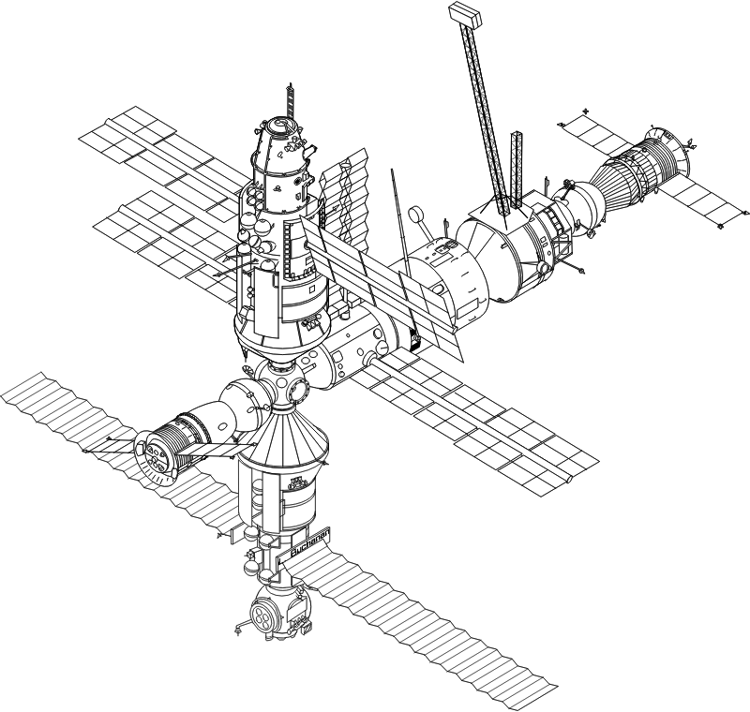
Example: Mr. Blue Visits the ISS
International Space Station’s on-board computer performs 3 tasks:
guiding incoming supply ships to a safe docking
monitoring gyros to keep solar panels properly oriented
controlling air pressure in the crew cabin
Task Period Service time Deadline
Supply ship guidance 30ms 5ms 25ms
Gyroscopes 40 10 20
Cabin pressure 100 ? 100
16.67%
25%
10%
C,G = 10 + 10 + (5) = 25
C = 10 + (10) = 20
S,G = 5 + 10 + (10) = 25
10
Assuming a weak priority system:
What is the maximum service time for “cabin pressure” that still allows all constraints to be met?
Give a weak priority ordering that meets the constraints
What fraction of the time will the processor spend idle?
What is the worst-case completion time for each task?
≤ 10 mS
G > SSG > CP
48.33%
Notes:
https://openclipart.org/detail/176068/international-space-station
https://openclipart.org/detail/38137/kid-shaking
Since G can be delayed by a max of 10ms, no other device can take more than 10ms for service in a weak priority system – hence C must take <= 10ms.
If C service takes 10, then G must be highest since it can be delayed by at most 10. S must be next, with a max latency of 20; then C.
16.6% S + 25% G + 10% C = 51.66%, leaving 48.33% for app.
Since we’re asked for delay to COMPLETION of service, we must include service times of each device in its own delay:
S delayed by C, G = 10 + 10 (+ 5 svc time) = 25
G delayed by C = 10 (+ 10 svc time) = 20
C delayed by S, G = 5 + 10 (+ 10 svc time) = 25

Slide 25
Example: Mr. Blue Visits ISS (cont’d.)
Our Russian collaborators don’t like the sound of a “weak” priority interrupt system and lobby heavily to use a “strong” priority interrupt system instead.
Task Period Service time Deadline
Supply ship guidance 30ms 5ms 25ms
Gyroscopes 40 10 20
Cabin pressure 100 ? 100
16.67%
25%
50%
[G] 10 + 5
10
50
100
Assuming a strong priority system, G > SSG > CP:
What is the maximum service time for “cabin pressure” that still allows all constraints to be met?
What fraction of the time will the processor spend idle?
What is the worst-case completion time for each task?
100 – (3*10) – (4*5) = 50
8.33%
Notes:
Assume C is assigned the lowest (strong) priority.
If we maximize the svc time of C, its service might be interrupted by several requests from higher priority devices (G and S)…
In its 100ms window, 4 S requests and 3 G requests can happen (and will be given priority over C service. Thus, in this window, there is then
100 – 3*20 – 4*5 = 50ms
left for C service.

Slide 26
Summary
Device interface – two parts:
Device side: handle interrupts from device (transparent to apps)
Application side: handle interrupts (SVCs) from application
Scheduler interaction:
“Sleeping” (*inactive) processes waiting for device I/O
Handler coding issues, looping thru User mode
Real Time constraints, scheduling, guarantees
Complex, hard scheduling problems – a black art!
Weak (non-preemptive) vs Strong (preemptive) priorities help…
Common real-world interrupt systems:
Fixed number (eg, 8 or 16) of strong priority levels
Each strong priority level can support many devices, arranged in a weak priority chain

