Slide 1
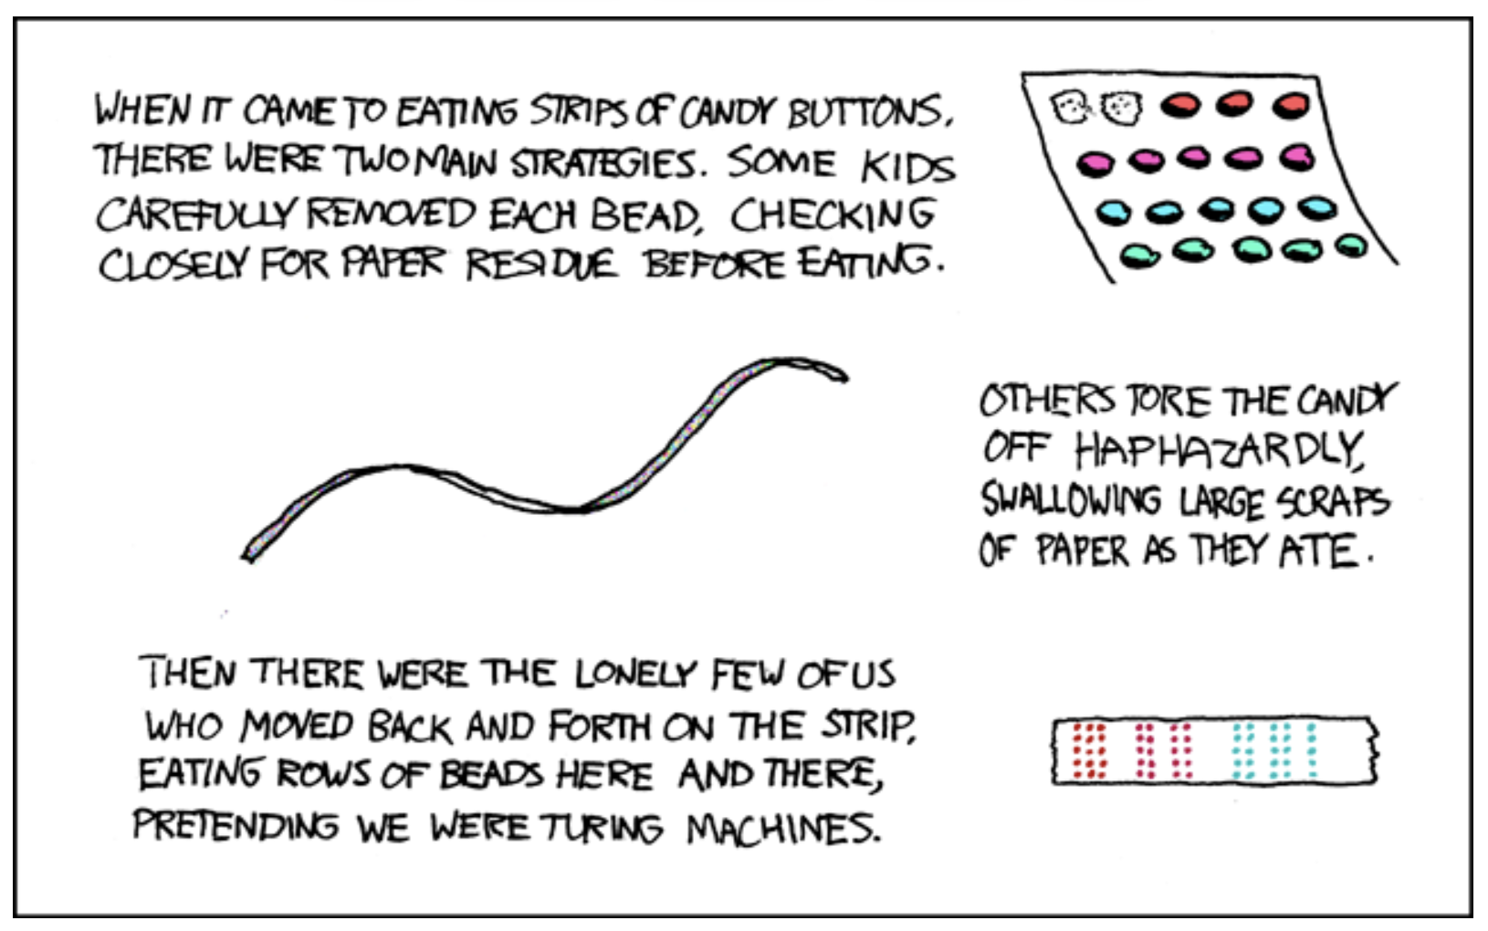
Models of Computation
https://xkcd.com/205/

Slide 2
Universality?
Recall: We say a set of Boolean gates is universal if we can implement any Boolean function using only gates from that set.
What problems can we solve with a von Neumann computer? (e.g., the Beta)
Everything that FSMs can solve?
Every problem?
Does it depend on the ISA?
Needed: a mathematical model of computation
Prove what can be computed, what can’t

Slide 3
Models of Computation
The roots of computer science stem from the evaluation of many alternative mathematical “models” of computation to determine the classes of computations each could represent.
An elusive goal was to find a universal model, capable of representing all practical computations...
switches
gates
combinational logic
memories
FSMs
We’ve got FSMs… what else do we need?
Are FSMs the ultimate digital computing device?

Slide 4
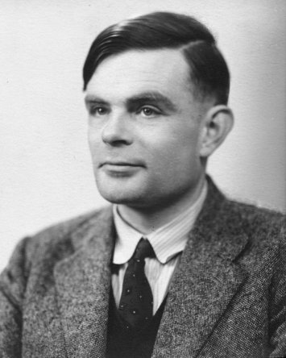
FSM Limitations
Despite their usefulness and flexibility, there are common problems that cannot be solved by any FSM. For instance:
Well-formed Parentheses Checker:
Given any string of coded left & right parens, outputs 1 if it is balanced, else 0.
Simple, easy to describe.
“(()())”
Paren
Checker
OK
“(())())”
Paren
Checker
Nix
NO!
Can this problem be solved using an FSM???
I know how
to fix that!
PROBLEM: Requires arbitrarily many states, depending on input. Must "COUNT" unmatched left parens. An FSM can only keep track of a finite number of unmatched parens: for every FSM, we can find a string it can’t check.
Alan Turing

Slide 5
Turing Machines
Alan Turing was one of a group of researchers studying alternative models of computation.
He proposed a conceptual model consisting of an FSM combined with an infinite digital tape that could be read and written at each step.
encode input as symbols on tape
FSM reads tape/writes symbols/ changes state until it halts
Answer encoded on tape
Turing’s model (like others of the time) solves the "FINITE" problem of FSMs.
Bounded tape configuration can be expressed as a (large!) integer
0
0
0
0
0
0
0
1
1
1
1
0
0
0
0
0
0,(1,R)
S₁
1,(1,L)
S₂
0,(1,L)
1,Halt
FSMs can be enumerated and given a (very large) integer index.
We can talk about TM 347 running on input 51, producing an answer of 42.
TMs as integer functions:
y = TM_{I}[x]

Slide 6
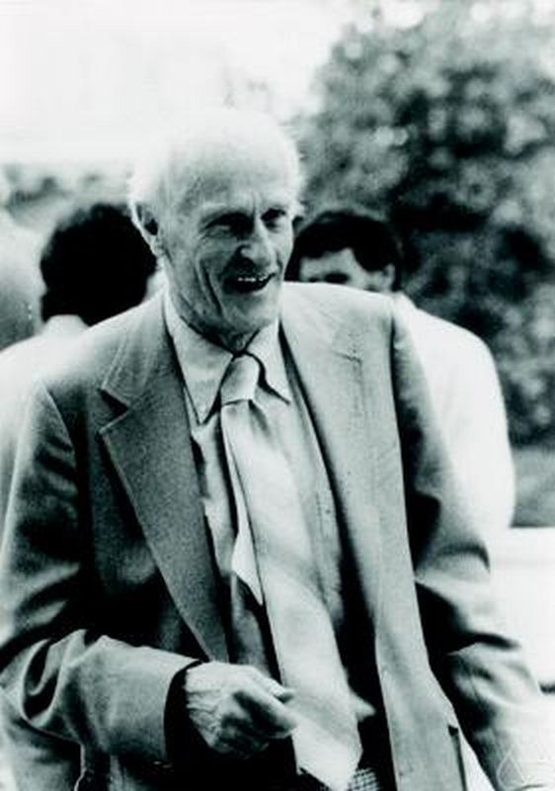
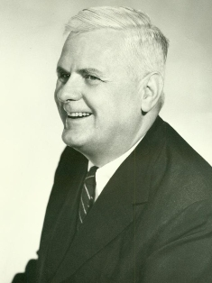
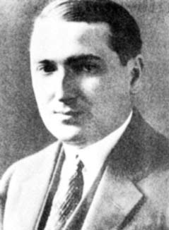
Other Models of Computation…
Turing Machines [Turing]
Recursive Functions [Kleene]
0
0
1
0
0
1
1
0
0
FSM
i
(define (fact n)
(... (fact (- n 1)) ...)
Stephen
Kleene
Alan Turing
Lambda calculus [Church, Curry, Rosser...]
Production Systems [Post, Markov]
λ
x.
λ
y.xxy
α
→
β
(lambda(x)(lambda(y)(x (x y))))
IF pulse=0 THEN
patient=dead
Alonzo
Church
Emile Post

Slide 7
Computability
FACT: Each model studied is capable of computing exactly the same set of integer functions!
Proof Technique:
Constructions that translate between models
BIG IDEA:
Computability, independent of computation scheme chosen
Church's Thesis:
Every discrete function computable by ANY realizable machine is computable by some Turing machine.
f(x) computable ⇔ for some k, all x
f(x) = T_{k}[x]
unproved, but
universally
accepted...

Slide 8
meanwhile... Turing machines Galore!
“special-purpose”
Turing Machines....
0
0
1
0
0
1
1
0
0
FSM
0
0
1
0
0
1
1
0
0
Factorization
FSM
0
0
1
0
0
1
1
0
0
Primality Test
FSM
Multiplication
Is there an alternative to infinitely many ad-hoc Turing Machines?
0
0
1
0
0
1
1
0
0
FSM
Sorting

Slide 9
The Universal Function
Here’s an interesting function to explore: the Universal function, U, defined by
it sure would be neat to have a single, general-purpose machine...
U(k, j) = T_{k}[j]
Could this be computable???
SURPRISE! U is computable by a Turing Machine:
k
T_{U}
T_{k}[j]
j
In fact, there are infinitely many such machines. Each is capable of performing any computation that can be performed by any TM!

Slide 10
Universality
What’s going on here?
k encodes a “program” – a description of some arbitrary machine.
j encodes the input data to be used.
T_{U} interprets the program, emulating its processing of the data!
k
T_{U}
T_{k}[j]
j
KEY IDEA: Interpretation. Manipulate coded representations of computing machines, rather than the machines themselves.

Slide 11
Turing Universality
The Universal Turing Machine is the paradigm for modern general-purpose computers!
Basic threshold test: Is your computer Turing Universal ?
If so, it can emulate every other Turing machine!
Thus, your computer can compute any computable function
To show your computer is Universal: demonstrate that it can emulate some known UTM.
Actually given finite memory, can only emulate UTMs + inputs up to a certain size
This is not a high bar: conditional branches (BEQ) and some simple arithmetic (SUB) are enough.

Slide 12

Coded Algorithms: Key to CS data vs hardware
Pgm
P_{x}
Algorithms as data: enables
COMPILERS: analyze, optimize, transform behavior
T_{COMPILER-X-to-Y}[P_{X}] = P_{Y}, such that T_{X}[P_{X}, z] = T_{Y}[P_{Y}, z]
Pgm
P_{y}
P_{Jade}
P_{LINUX}
Pgm
Pgm
Pgm
LANGUAGE DESIGN: Separate specification from implementation
C, Java, JSIM, Linux, ... all run on X86, Sun, ARM, JVM, CLR, ...
Parallel development paths:
Language/Software design
Interpreter/Hardware design
SOFTWARE ENGINEERING:
Composition, iteration, abstraction of coded behavior
F(x) = g(h(x), p((q(x)))
Notes:
https://openclipart.org/detail/183525/eco-green-recyling-work

Slide 13
Uncomputability (!)
Uncomputable functions: There are well-defined discrete functions that a Turing machine cannot compute
No algorithm can compute f(x) for arbitrary x in finite number of steps
Not that we don’t know algorithm - can prove no algorithm exists
Corollary: Finite memory is not the only limiting factor on whether we can solve a problem
The most famous uncomputable function is the so-called Halting function, f_{H}(k, j), defined by:
f_{H}(k, j) = 1 if T_{k}[j] halts;
0 otherwise.
f_{H}(k, j) determines whether the k^{th} TM halts when given a tape containing j.

Slide 14
Why f_{H} is Uncomputable
If f_{H} is computable, it is equivalent to some TM (say, T_{H}):
k
T_{H}
1 iff T_{k}[j] halts,
else 0
j
Then T_{N} (N for “Nasty”), which must be computable if T_{H} is:
T_{N}
1
LOOP
T_{N}[x]: LOOPS if T_{x}[x] halts;
HALTS if T_{x}[x] loops
x
T_{H}
?
0
HALT
Finally, consider giving N as an argument to T_{N}:
T_{N} can’t be computable, hence T_{H} can’t either!
T_{N}[N]: LOOPS if T_{N}[N] halts;
HALTS if T_{N}[N] loops
Contradiction!

