Slide 1
From Atoms to Amazon
Cloud
Parallelism & communication
Virtual Machines
Virtual Memory
Operating System
Programming languages
Interpretation & Compilation
6.004
Data and Control structures
Instruction set + memory
Programmable architectures
FSMs + Datapaths
Bits, Logic gates
Digital Circuits
Lumped component model
Devices
Insulator, conductor,
semiconductor
Materials
Atoms

Slide 2
The Power of Engineering Abstractions
Good abstractions allow us to reason about behavior while shielding us from the details of the implementation.
Cloud
Virtual Machines
Programming languages
Corollary: implementation technologies can evolve while preserving the engineering investment at higher levels.
Instruction set + memory
Leads to hierarchical design:
Limited complexity at each level ⇒ shorten design time, easier to verify
Reusable building blocks
Bits, Logic gates
Lumped component model
Insulator, conductor,
semiconductor

Slide 3
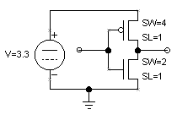

6.004: The Big Lesson
You’ve built, debugged, understood a complex computer from FETs to OS… what have you learned?
Engineering Abstractions:
Understanding of their technical underpinnings
Respect for their value
Techniques for using them
ILL
XAdr
OP
JT
PCSEL
4
3
2
PC
1
0
00
Instruction
+4
A
Memory
But, most importantly: The self assurance to discard them, in favor of new abstractions!
+
D
Ra <20:16>
Rb: <15:11>
0
1
Rc <25:21>
RA2SEL
C: <15:0> << 2
XP
WASEL
RA1
Register
RA2
sign-extended
Rc <25:21>
1
WA
WA
File
WD
<PC>+4+C*4
C: <15:0>
Z
0
RD1
JT
C: <15:0>
RD2
WE
W
E
R
F
IRQ
Z
ASEL
1
0
sign-extended
1
0
BSEL
Control Logic
PCSEL
RA2SEL
A
B
ASEL
ALUFN
ALU
WD
R/W
Wr
BSEL
Data Memory
WDSEL
ALUFN
Adr
RD
Wr
WERF
WASEL
<PC>+4
0
1
2
W
D
S
E
L
Good engineers use abstractions;
GREAT engineers create them!
Graphics I/O
MEM
MEM
“AGP” bus
CPU
L2 $
DISK
I/O
I/O

Slide 4
Things to look forward to… 6.004 is only an appetizer!
Languages & Models
Python/Java/Ruby/…
Objects/Streams/Aspects
Networking
Processors
Superscalars
Deep pipelines
Multicores
Tools
Design Languages
FPGA prototyping
Timing Analyzers
Algorithms
Arithmetic
Signal Processing
Language implementation
Systems Software
Storage
Virtual Machines
Networking

Slide 5
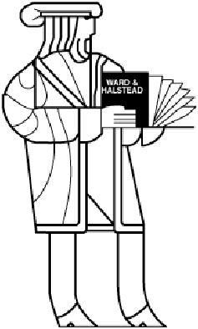
Thinking Outside the Box
Will computers always look and operate the way computers do today?
Some things to question:
Well-defined system “state”
Silicon-based logic
Logic at all
Programming
?
Von Neumann
Architectures
Synchronous Clocked Systems
Boolean Logic
Si
MOSFET
transistors

Slide 6
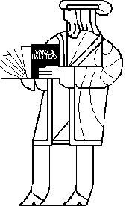
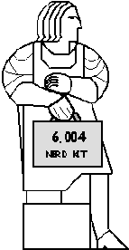
THE END!
Computing is slow…
The future is in your hands.
Start innovating!
-- 6.004 Staff
The only problem
with Haiku is that you just get started and then
-- Roger McGough

