Slide 1
Combinational Logic
A
B
6.004
Gates
F = A xor B
Sum of products
Inverting logic
Logic minimization
Karnaugh Maps
Muxes/Table Lookup
Read-only Memories

Slide 2
Functional Specifications
There are many ways of specifying the function of a combinational device, for example:
Argh… I’m tired of word games
A
If C is 1 then copy B to Y, otherwise copy A to Y
Y
B
C
Truth Table
Concise alternatives:
truth tables are a concise description of the combinational system’s function.
Boolean expressions form an algebra whose operations are AND (multiplication), OR (addition), and inversion (overbar).
Any combinational (Boolean) function can be specified as a truth table or an equivalent sum-of-products Boolean expression!

Slide 3
Here’s a Design Approach
Truth Table
Write out our functional spec as a truth table
Write down a Boolean expression with terms covering each ‘1’ in the output:
We’ll show how to build a circuit using this equation in the next two slides.
This approach will always give us Boolean expressions in a particular form: SUM-OF-PRODUCTS

Slide 4
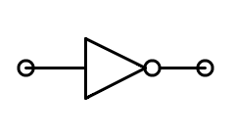
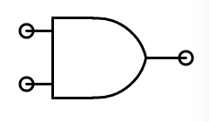
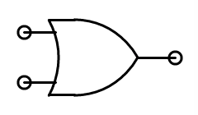
Sum-of-products Building Blocks
A | Z
0 | 1
1 | 0
INVERTER:
A | B | Z
0 | 0 | 0
0 | 1 | 0
1 | 0 | 0
1 | 1 | 1
AND:
A | B | Z
0 | 0 | 0
0 | 1 | 1
1 | 0 | 1
1 | 1 | 1
OR:

Slide 5
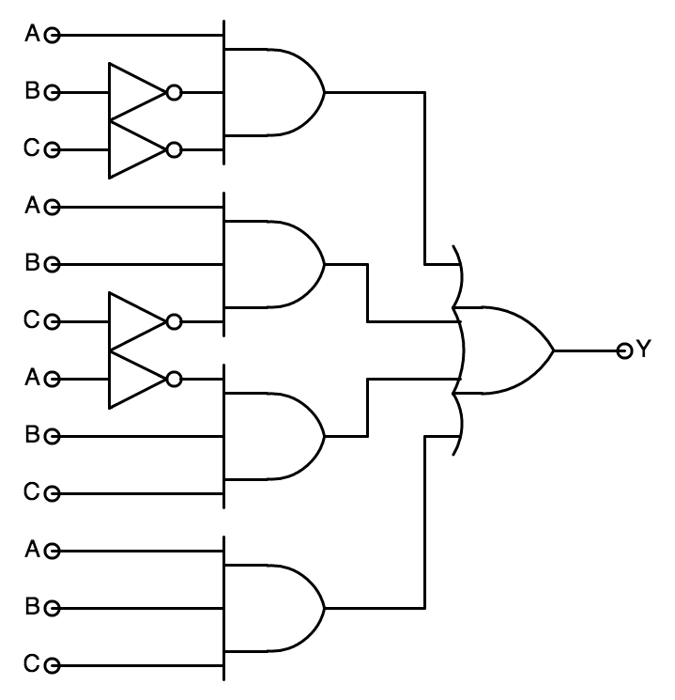
Straightforward Synthesis
We can implement
SUM-OF-PRODUCTS
with just three levels of
logic:
Inverters
ANDs
OR
-it’s systematic!
-it works!
-it’s easy! -are we done yet???
Propagation delay --
No more than 3 gate delays?
*
*assuming gates with an arbitrary number of inputs, which, as we’ll see, isn’t a good assumption!

Slide 6
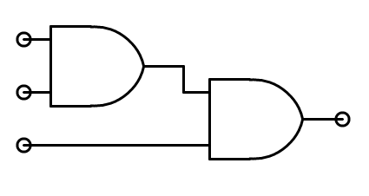
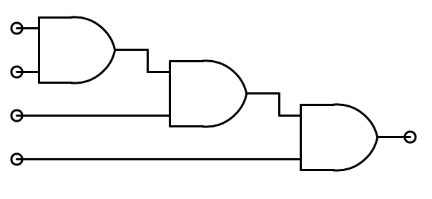
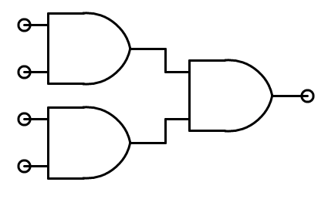
ANDs and ORs with > 2 Inputs
Replace 2-input AND gates with 2-input OR gates to create large fan-in OR gates.
Chain: Propagation delay increases linearly with number of inputs
Which one should I use?
Tree: Propagation delay increases logarithmically with number of inputs

Slide 7
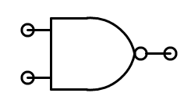
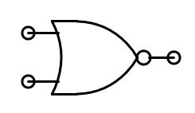
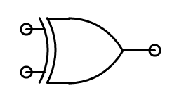
More Building Blocks
NAND (not AND)
A | B | Z
0 | 0 | 1
0 | 1 | 1
1 | 0 | 1
1 | 1 | 0
NOR (not OR)
A | B | Z
0 | 0 | 1
0 | 1 | 0
1 | 0 | 0
1 | 1 | 0
In a CMOS gate, rising inputs lead to falling outputs and vice-versa, so CMOS gates are naturally inverting. Want to use NANDs and NORs in CMOS designs… But NAND and NOR operations are not associative, so wide NAND and NOR gate can’t use a chain or tree strategy. Stay tuned for more on this!
XOR is very useful when implementing parity and arithmetic logic. Also used as a “programmable inverter”: if A=0, Z=B; if A=1, Z=~B
Wide fan-in XORs can be created with chains or trees of 2-input XORs.
XOR (exclusive OR)
A | B | Z
0 | 0 | 0
0 | 1 | 1
1 | 0 | 1
1 | 1 | 0

Slide 8
Universal Building Blocks
NANDs and NORs are universal:
Any logic function can be implemented using only NANDs (or, equivalently, NORs). Good news for CMOS technologies!
=
=
=
=
=
=

Slide 9
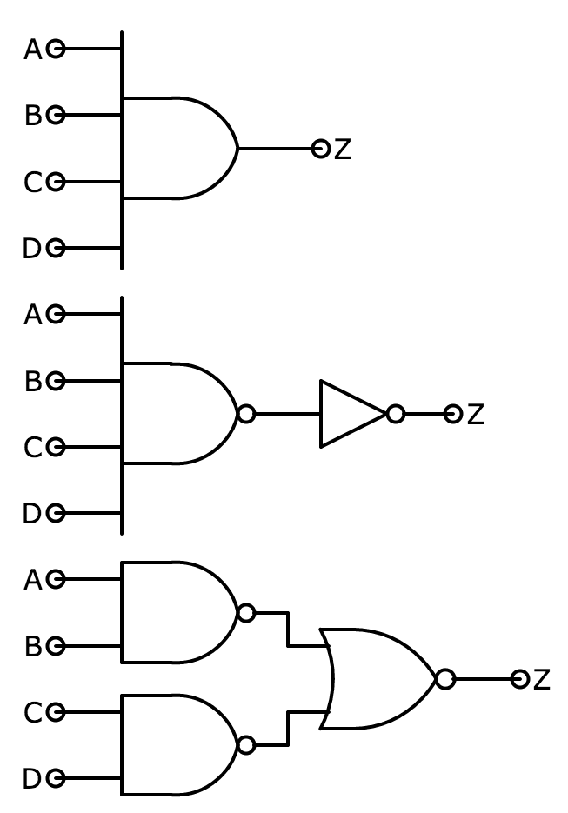
CMOS ♥ Inverting Logic
See “The Standard Cell Library” handout in Updates & Handouts
AND4:
t_{PD} = 160 ps, size = 20μ²
NAND4 + INV:
t_{PD} = 90 ps, size = 27μ²
Demorgan’s Laws:
2*NAND2 + NOR2:
t_{PD} = 80 ps, size = 30μ²

Slide 10
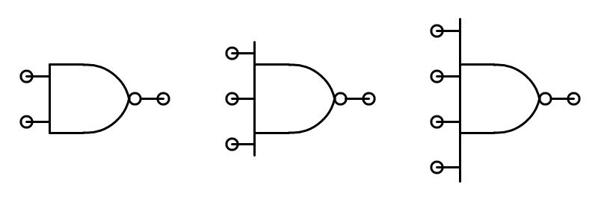
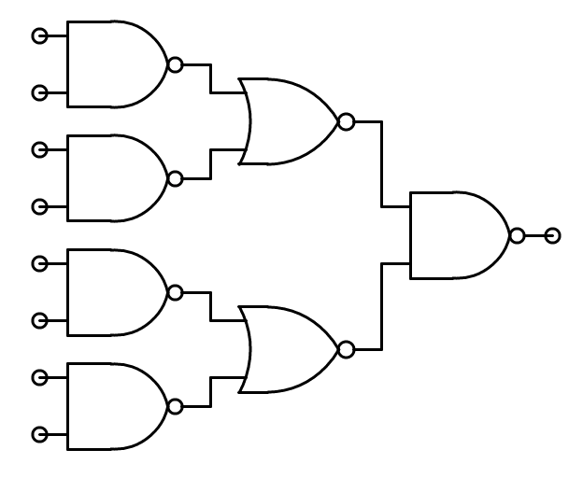
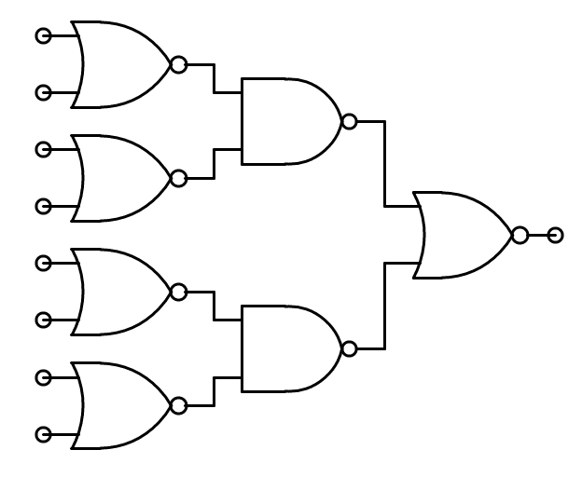
Wide NANDs and NORs
Most logic libraries include 2-, 3- and 4-input devices:
But for a large number of inputs, the series connections of too many MOSFETs can lead to very large effective R. Design note: use trees of smaller devices…
8-input NAND
8-input
NOR

Slide 11
CMOS Sum-of-products Implementation
AB=A+B
“Pushing Bubbles”
NAND-NAND
NOR-NOR
C
C
C
≡
A
A
A
Y
Y
Y
B
B
B
AB=A+B
C
C
C
A
A
≡
A
Y
Y
Y
B
B
B
You might think all these extra inverters would make this structure less attractive. However, quite the opposite is true.

Slide 12
Logic Simplification
Can we implement the same function with fewer gates? Before trying we’ll add a few more tricks in our bag.
BOOLEAN ALGEBRA:
OR rules: a + 1 = 1, a + 0 = a, a + a = a AND rules: a1 = a, a0 = 0, aa = a Commutative: a + b = b + a, ab = ba Associative: (a + b) + c = a + (b + c), (ab)c = a(bc) Distributive: a(b+c) = ab + ac, a + bc = (a+b)(a+c) Complements: Absorption:
Reduction: DeMorgan’s Law:

Slide 13
Boolean Minimization
Can’t he come up
with a new example???
Let’s (again!) simplify
Using the identity
For any expression α and variable A:
Hey… I could write a program to do that

Slide 14
Truth Tables with “Don’t Cares”
One way to reveal the opportunities for a more compact implementation is to rewrite the truth table using “don’t cares” (-- or X) to indicate when the value of a particular input is irrelevant in determining the value of the output.
C | B | A | Y
0 | 0 | 0 | 0
0 | 0 | 1 | 1
0 | 1 | 0 | 0
0 | 1 | 1 | 1
1 | 0 | 0 | 0
1 | 0 | 1 | 0
1 | 1 | 0 | 1
1 | 1 | 1 | 1
C | B | A | Y
0 | X | 0 | 0
0 | X | 1 | 1
1 | 0 | X | 0
1 | 1 | X | 1
X | 0 | 0 | 0
X | 1 | 1 | 1
Note: Some input combinations (e.g., 000) are matched by more than one row in the “don’t care” table. It would be a bug if all the matching rows didn’t specify the same output value!

Slide 15
The Case for a Non-minimal SOP
A(1)
C(1)
0
0
A
C | B | A | Y
0 | 0 | 0 | 0
0 | 0 | 1 | 1
0 | 1 | 0 | 0
0 | 1 | 1 | 1
1 | 0 | 0 | 0
1 | 0 | 1 | 0
1 | 1 | 0 | 1
1 | 1 | 1 | 1
Y(1)
B
1
C
B(1)
Y
That’s what we call a “glitch” or “hazard”
NOTE: The steady state behavior of these circuits is identical. They differ in their transient behavior.
A
C
A
Y
B
C
Y
B
Now it’s LENIENT!

Slide 16
Karnaugh Maps: A Geometric Approach
K-Map: a truth table arranged so that terms which differ by exactly one variable are adjacent to one another so we can see potential reductions easily.
Truth Table
Here’s the layout of a 3-variable K-map filled in with the values from our truth table:
Why did he
shade that
row Gray?
010
011
000
001
It’s cyclic. The left edge is adjacent to the right edge. (It’s really just a flattened out cube).
110
111
100
101

Slide 17
Extending K-maps to 4-variable Tables
4-variable K-map F(A,B,C,D):
Again it’s cyclic. The left edge is adjacent to the right edge, and the top is adjacent to the bottom.
For functions of 5 or 6 variables, we’d need to use the 3rd dimension to build a 4x4x4 K-map. But then we’re out of dimensions…
Notes:
http://commons.wikimedia.org/wiki/File:Toroidal_coord.png

Slide 18
Finding Implicants
An implicant
is a rectangular region of the K-map where the function has the value 1 (i.e., a region that will need to be described by one or more product terms in the sum-of-products)
has a width and length that must be a power of 2: 1, 2, 4
can overlap other implicants
is a prime implicant if it is not completely contained in any other implicant.
can be uniquely identified by a single product term. The larger the implicant, the smaller the product term.

Slide 19
Finding Prime Implicants
We want to find all the prime implicants. The right strategy is a greedy one.
Find the uncircled prime implicant with the greatest area
Order: 4x4 ⇒ 2x4 or 4x2 ⇒ 4x1 or 1x4 or 2x2 ⇒ 2x1 or 1x2 ⇒ 1x1
Overlap is okay
Circle it
Repeat until all prime implicants are circled

Slide 20
Write Down Equations
Picking just enough prime implicants to cover all the 1’s in the KMap, combine equations to form minimal sum-of-products.
We’re done!
Minimal SOP is not necessarily unique!

Slide 21
Prime Implicants, Glitches & Leniency
This circuit produces a glitch on Y when A=1, B=1, C: 1→0
A
C
B
A
B
C
Y
To make the circuit lenient, include product terms for ALL prime implicants.
A
C
B

Slide 22
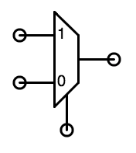
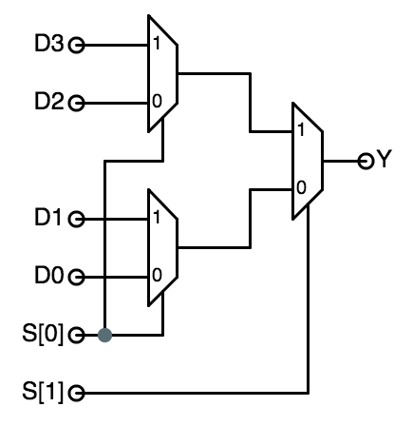
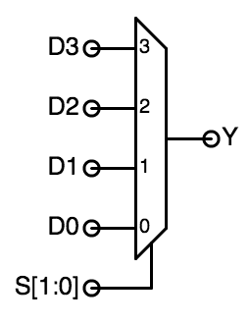
We’ve Been Designing a Mux
Truth Table
D₁
Y
D₀
S
2-input Multiplexer
MUXes can be generalized to 2^{k} data inputs and k select inputs …
… and implemented as a tree of smaller MUXes:

Slide 23
Systematic Implementation Strategies
Consider implementing some arbitrary Boolean function, F(A,B,C) ... using a MULTIPLEXER as the only circuit element:
Full-Adder Carry Out Logic
0
0
0
1
0
1
1
1
0
1
2
3
4
5
6
7
C_{out}
A,B,C_{in}
Notes:
SIMPLE approach for ANY 2-input function:
HARD-WIRE Truth Table to a MUX!
Variants:
DIP Switches
Blowable FUSES
MEMORY CELLS
“Select” inputs “ADDRESS” TT Entry.

Slide 24
Synthesis By Table Lookup
Muxes are universal!
In future technologies muxes might be the “natural gate”.
A
B
1
0
0
1
A Y
0
1_{S}
Y
=
A
MUX
Logic
A
B
Y
0
B
0
1
Fn(A,B)
0
1_{S}
Y
=
A
B
1
0
1
A
B
Y
0
1_{S}
=
Generalizing:
In theory, we can build any 1-output combinational logic block with multiplexers.
For an N-input function we need a _____ input mux.
Y
A
2^{N}
Is this practical for BIG truth tables? How about 10-input function? 20-input?
B
B
0
1
What does that one do?
0
1_{S}
Y
A
Notes:
For N-input function, need
N select inputs to MUX
2**N data inputs to MUX (LOTSA pins!)
Practical TABLE LOOKUP needs more efficient
use of space...
2^{n}
1024-input MUX???

Slide 25
A New Combinational Device
D₀
DECODER:
k SELECT inputs,
N = 2^{k} DATA OUTPUTs.
Select inputs choose one of the D_{j} to assert HIGH, all others will be LOW.
D₁
Have I mentioned that HIGH is a synonym for ‘1’ and LOW means the same as ‘0’
D_{N-1}
k
NOW, we are well on our way to building a general purpose table-lookup device.
We can build a 2-dimensional ARRAY of decoders and selectors as follows ...
Notes:
DECODER -- sorta inverse MUX.
BINARY number as input
UNARY (decoded) output.

Slide 26
Read-only Memory (ROM)
Full Adder
Each column is large fan-in “NOR.” Note location of pulldowns correspond to a “1” output in the truth table!
A
B
C_{o}
FA
C_{i}
000
S
For K inputs, decoder produces 2^{K} signals, only 1 of which is asserted at a time -- think of it as one signal for each possible product term.
Shared
decoder
001
A | B | C_{i} | S | C_{o}
0 | 0 | 0 | 0 | 0
0 | 0 | 1 | 1 | 0
0 | 1 | 0 | 1 | 0
0 | 1 | 1 | 0 | 1
1 | 0 | 0 | 1 | 0
1 | 0 | 1 | 0 | 1
1 | 1 | 0 | 0 | 1
1 | 1 | 1 | 1 | 1
010
011
100
101
110
111
A
B
C_{IN}
One column for each output
S
C_{OUT}

Slide 27
Read-only Memory (ROM)
Full Adder
Each column is large fan-in “NOR.” Note location of pulldowns correspond to a “1” output in the truth table!
A
B
C_{o}
FA
C_{i}
000
S
1
For K inputs, decoder produces 2^{K} signals, only 1 of which is asserted at a time -- think of it as one signal for each possible product term.
Shared
decoder
001
A | B | C_{i} | S | C_{o}
0 | 0 | 0 | 0 | 0
0 | 0 | 1 | 1 | 0
0 | 1 | 0 | 1 | 0
0 | 1 | 1 | 0 | 1
1 | 0 | 0 | 1 | 0
1 | 0 | 1 | 0 | 1
1 | 1 | 0 | 0 | 1
1 | 1 | 1 | 1 | 1
010
011
100
101
110
0
0
1
111
A
0
1
B
C_{IN}
1
0
One column for each output
S
C_{OUT}

Slide 28
Read-only Memory (ROM)
Full Adder
LONG LINES slow down propagation times…
A
B
The best way to improve this is to build square arrays, using some inputs to drive output selectors (MUXes):
C_{o}
FA
C_{i}
S
A | B | C_{i} | S | C_{o}
0 | 0 | 0 | 0 | 0
0 | 0 | 1 | 1 | 0
0 | 1 | 0 | 1 | 0
0 | 1 | 1 | 0 | 1
1 | 0 | 0 | 1 | 0
1 | 0 | 1 | 0 | 1
1 | 1 | 0 | 0 | 1
1 | 1 | 1 | 1 | 1
00
01
10
11
A
B
0
1
0
1
C_{IN}
S
C_{OUT}
2D Addressing: Standard for ROMs, RAMs, logic arrays…

Slide 29
Logic According to ROMs
ROMs ignore the structure of combinational functions ...
• Size, layout, and design are independent of function
• Any Truth table can be “programmed” by
minor reconfiguration:
- Metal layer (masked ROMs)
- Fuses (Field-programmable PROMs)
- Charge on floating gates (EPROMs)
... etc.
Model: LOOK UP value of function in truth table...
Inputs: “ADDRESS” of a T.T. entry
ROM SIZE = # TT entries...
... for an N-input boolean function, size ≅ __________
ROMs tend to generate “glitchy” outputs. WHY?
2^{N} x #outputs
Notes:
2-D: 2x/dimension
NOT OPTIMAL -- Optimized for WORST case
(NO structure in TT entries!)
ADVANTAGE: Flexibility.
CHANGE function with little change in HW.

Slide 30
Summary
Sum of products
Any function that can be specified by a truth table or, equivalently, in terms of AND/OR/NOT (Boolean expression)
“3-level” implementation of any logic function
Limitations on number of inputs (fan-in) increases depth
SOP implementation methods
NAND-NAND, NOR-NOR
Muxes used to build table-lookup implementations
Easy to change implemented function -- just change constants
ROMs
Decoder logic generates all possible product terms
Selector logic determines which terms are ORed together

