Slide 1

DBT-BIC-NNP-TREE Genome Informatics — Genome HackWeek 2026
Annotate, Innovate, Collaborate | CSIR-IICB, Kolkata
GENOME HACKWEEK 2026 · 90 MINUTES
R Basics for Biologists
A practical introduction to R programming for genomics
Aditya Upadhyay
|
CSIR-IICB, Kolkata
|
31 August 2026
Aditya Upadhyay
R Basics for Biologists
Notes:
Welcome. Ninety minutes, five parts, and we finish by plotting real RNA-seq data from a published mouse mammary gland study. Ask everyone to open RStudio now and confirm they can see four panes.

Slide 2
DBT-BIC-NNP-TREE Genome Informatics — Genome HackWeek 2026
Annotate, Innovate, Collaborate | CSIR-IICB, Kolkata
Today's Session
Five parts, ninety minutes, one real dataset
01
What Is R?
Where the language came from, and why biologists pick it
11 min
02
R and RStudio
Panes, scripts, working directory, help, and error messages
18 min
03
R Fundamentals
Objects, data types, vectors, and data frames
20 min
04
Packages & the Tidyverse
CRAN, Bioconductor, and the tidyverse stack
12 min
05
Hands-On: RNA-seq
Read, tidy, join and plot GSE60450 with ggplot2
22 min
Follow along: RStudio open, a folder named Intro_R_course, and the data/ folder unzipped inside it.
Aditya Upadhyay
Session outline
Notes:
Set expectations: this is not an R mastery course. Learning R is like learning a spoken language — nobody is fluent after ninety minutes. The goal is enough confidence to keep going.

Slide 3
DBT-BIC-NNP-TREE Genome Informatics — Genome HackWeek 2026
Annotate, Innovate, Collaborate | CSIR-IICB, Kolkata
01
What Is R?
History, architecture, and why it matters for biology
Aditya Upadhyay
Part 01 · What Is R?
Notes:
Part one is context — eleven minutes. Keep it moving; the payoff comes in part five.

Slide 4
DBT-BIC-NNP-TREE Genome Informatics — Genome HackWeek 2026
Annotate, Innovate, Collaborate | CSIR-IICB, Kolkata
How R Fits Into Your Computer
The communication stack, from your question down to the hardware
You, the biologist
Questions, hypotheses, analyses
WHY THIS MATTERS
▼
R asks the operating system to do the low-level work, so the same script runs unchanged on your laptop, a colleague's Mac, and the institute's Linux cluster.
R, or Python
A language that turns intent into instructions
▼
Operating system
Windows, macOS, or Linux
R is also an interpreted language: you type a line, R runs it and answers immediately. No compile step — which is exactly what you want when exploring data.
▼
Hardware
CPU, RAM, storage
Aditya Upadhyay
Part 01 · What Is R?
Notes:
R never touches the hardware directly, it asks the operating system. That is why the same script runs on a Windows laptop, a colleague's Mac and the institute's Linux cluster with no changes.

Slide 5
DBT-BIC-NNP-TREE Genome Informatics — Genome HackWeek 2026
Annotate, Innovate, Collaborate | CSIR-IICB, Kolkata
History & Introduction
From a Bell Labs research language to the standard for statistical computing
1976
1991
1997
Today
The S language
R is born
CRAN opens
20,000+ packages
John Chambers and colleagues build S at Bell Labs as a language for interactive data analysis.
Ross Ihaka and Robert Gentleman in Auckland write a free, open-source dialect of S.
One archive, one install command. Community packages become checked, versioned and findable.
R runs genomics, ecology, clinical trials, epidemiology and data journalism worldwide.
Aditya Upadhyay
Part 01 · What Is R?
Notes:
Two names worth remembering: John Chambers at Bell Labs for S, and Ihaka and Gentleman in Auckland for R. CRAN is why the ecosystem compounded.

Slide 6
DBT-BIC-NNP-TREE Genome Informatics — Genome HackWeek 2026
Annotate, Innovate, Collaborate | CSIR-IICB, Kolkata
Why Learn R?
Six reasons biologists move from spreadsheets to scripts
01
02
03
Free and open source
Built for statistics
Ready for genomics
No licence, no seat limit. It runs on every machine in the lab and on the cluster.
t-tests, ANOVA, mixed models and regression ship in the base install, not an add-on.
Bioconductor adds 2,300+ reviewed packages for sequencing, arrays and annotation.
04
05
06
Publication figures
Reproducibility
Automation
ggplot2 gives journal-quality graphics you can regenerate on demand, not redraw.
A script is a record. Anyone — including you in six months — can re-run it exactly.
Loop over 10,000 genes or 200 samples instead of clicking through them one by one.
Aditya Upadhyay
Part 01 · What Is R?
Notes:
Ask who currently analyses data in Excel — most hands go up. Excel is fine for forty rows. The arguments that land are reproducibility, Bioconductor, and figures you can regenerate.

Slide 7
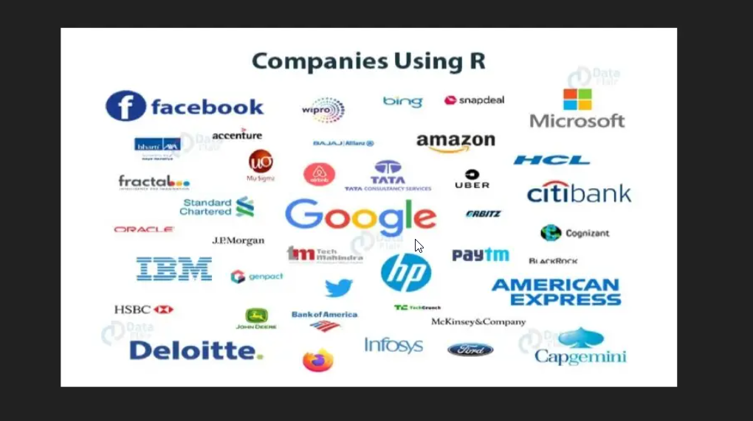
DBT-BIC-NNP-TREE Genome Informatics — Genome HackWeek 2026
Annotate, Innovate, Collaborate | CSIR-IICB, Kolkata
Who Uses R?
Across academia, industry, government and journalism
Google
Advertising effectiveness and economic forecasting
Microsoft
Acquired Revolution R; ships R in Azure ML and SQL Server
The New York Times
Data journalism graphics, built and rebuilt on deadline
Pharma and public health
Clinical trial reporting to regulators, and outbreak modelling
Aditya Upadhyay
Part 01 · What Is R?
Notes:
This slide answers the sceptic: R is not an academic curiosity. Most of these organisations publish their R work openly.

Slide 8
DBT-BIC-NNP-TREE Genome Informatics — Genome HackWeek 2026
Annotate, Innovate, Collaborate | CSIR-IICB, Kolkata
02
R and RStudio
The four panes, scripts, working directories, help and errors
Aditya Upadhyay
Part 02 · R and RStudio
Notes:
Part two, eighteen minutes. This decides whether people come back to R next week — orientation matters more than syntax at this stage.

Slide 9
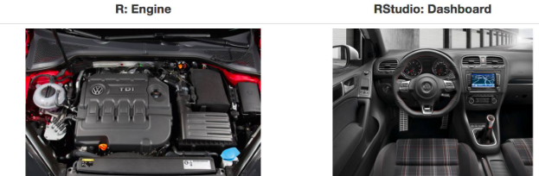
DBT-BIC-NNP-TREE Genome Informatics — Genome HackWeek 2026
Annotate, Innovate, Collaborate | CSIR-IICB, Kolkata
R and RStudio: An Analogy
You install two things, and only one of them does the work
A SECOND ANALOGY
install.packages() is buying the saucepan.
library() is taking it out of the cupboard.
You buy it once. You take it out every time you cook.
Doyle, Chung & Perreau — Introduction to R for Biologists , University of Melbourne
The engine moves the car; the dashboard is how you drive it. Install R first, then RStudio — RStudio without R has nothing to run.
Aditya Upadhyay
Part 02 · R and RStudio
Notes:
People install RStudio and think they have installed R. Say it plainly — you need both, R first. The cooking analogy is worth repeating all session.

Slide 10
DBT-BIC-NNP-TREE Genome Informatics — Genome HackWeek 2026
Annotate, Innovate, Collaborate | CSIR-IICB, Kolkata
R vs RStudio
What each one actually gives you
R
RStudio
the dashboard
the engine
Interprets and runs R code
Script editor with highlighting and autocomplete
Holds the statistical and graphical functions
Environment pane — every object you have created
Manages objects and memory in the session
Plots, files, packages and help in one window
Runs headless — servers, clusters, scheduled jobs
R Markdown and Quarto rendering built in
Projects that manage the working directory for you
Download from CRAN. This is the part you cannot skip.
Optional in principle. In practice, use it.
Aditya Upadhyay
Part 02 · R and RStudio
Notes:
Stress the last line on the left: R can run headless. Everything shown in RStudio today can be submitted as a batch job on the cluster without rewriting anything.

Slide 11
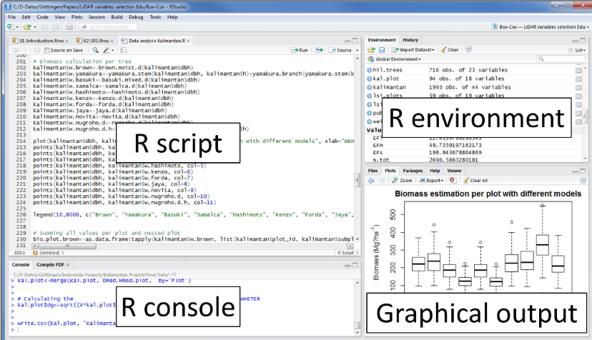
DBT-BIC-NNP-TREE Genome Informatics — Genome HackWeek 2026
Annotate, Innovate, Collaborate | CSIR-IICB, Kolkata
The RStudio Interface
Four panes, each with a distinct job
Your layout may differ — pane positions are configurable under Tools > Global Options > Pane Layout.
Aditya Upadhyay
Part 02 · R and RStudio
Notes:
Switch to the live RStudio window here if the projector allows it. Otherwise walk the screenshot: script top left, console bottom left, environment top right, output bottom right.

Slide 12
DBT-BIC-NNP-TREE Genome Informatics — Genome HackWeek 2026
Annotate, Innovate, Collaborate | CSIR-IICB, Kolkata
The Four Panes
What lives where, and the shortcut for each
1
Source — the script editor
2
Console — the live session
Write and save .R files. Send the current line to the console with Ctrl + Enter (Cmd + Enter on Mac). Highlight several lines to run them in order.
Where code actually runs, and where output, warnings and errors appear. Clear it with Ctrl + L; cancel a stuck command with Esc.
3
Environment and History
4
Files, Plots, Packages, Help
Every object you create appears here with its dimensions. Click one to view it. History lists every command you have run this session.
File browser, plot viewer with Export, package installer, and the help pages — all as tabs in one pane.
Aditya Upadhyay
Part 02 · R and RStudio
Notes:
Two shortcuts to make people write down: Ctrl/Cmd + Enter to send a line from script to console, and Ctrl-L to clear the console.

Slide 13
DBT-BIC-NNP-TREE Genome Informatics — Genome HackWeek 2026
Annotate, Innovate, Collaborate | CSIR-IICB, Kolkata
Console or Script?
Two ways to run the same line, with very different consequences
The console
An R script
Type a command, press Enter, get an answer. Fast for a one-off check.
File > New File > R Script, then Ctrl/Cmd + Enter to send the current line to the console.
History keeps everything you tried, including the mistakes. Nothing is saved for a reader.
Saved, commented, re-runnable. This is the version of your analysis that survives.
# testing R — comments start with a hash
COMMENT AS YOU GO
1 + 1
Anything after # is ignored by R. Write comments for your future self — six months from now you will not remember why you filtered that sample out.
## [1] 2
2 + 2
## [1] 4
Aditya Upadhyay
Part 02 · R and RStudio
Notes:
Live-code this: type 1 + 1 in the console, then make a script with File > New File > R Script and run 2 + 2 with the shortcut. Record versus scratchpad is the whole point.

Slide 14
DBT-BIC-NNP-TREE Genome Informatics — Genome HackWeek 2026
Annotate, Innovate, Collaborate | CSIR-IICB, Kolkata
The Working Directory
Where R looks when you ask it to read or write a file
# where am I?
1
Make a folder you can find again — for example Intro_R_course.
getwd()
## [1] "/Users/you/Intro_R_course"
# move there from the console
2
In the Files tab, click the three dots, select the folder, click Open.
setwd("~/Intro_R_course")
# now relative paths just work
counts <- read_csv("data/counts.csv")
3
Choose More > Set As Working Directory.
4
Save your script there as intro.R, and unzip data/ inside it.
BETTER STILL
Use an RStudio Project (File > New Project). Opening the project sets the working directory for you, every time, on any machine.
5
Keep data and scripts together. Paths stay short and portable.
Aditya Upadhyay
Part 02 · R and RStudio
Notes:
The single most common source of beginner frustration: R cannot find the file. Do the five steps live, then mention RStudio Projects as the way to stop thinking about it.

Slide 15
DBT-BIC-NNP-TREE Genome Informatics — Genome HackWeek 2026
Annotate, Innovate, Collaborate | CSIR-IICB, Kolkata
Getting Help in R
Three places to look before you ask anyone
# the help page for one function
The Help pane
?install.packages
A ? before any name opens its page bottom-right. Read Arguments first, then jump to Examples.
# search every installed package
??"linear model"
# run the documented examples
example(mean)
Tab completion
# long-form package tutorial
Start typing and press Tab . RStudio finishes function names, arguments, column names and file paths.
vignette("dplyr")
# what arguments does it take?
args(read.csv)
The community
Stack Overflow for the language, Biostars and the Bioconductor support site for biology. Paste the error text verbatim.
Aditya Upadhyay
Part 02 · R and RStudio
Notes:
Demonstrate tab completion live — type ggp and press Tab. Then show a help page and point out the Examples section at the bottom is usually the fastest way in.

Slide 16
DBT-BIC-NNP-TREE Genome Informatics — Genome HackWeek 2026
Annotate, Innovate, Collaborate | CSIR-IICB, Kolkata
Common R Errors
You will hit every one of these today — here is what each means
WHAT YOU TYPED
WHAT R SAYS
THE PROBLEM
Library(tidyverse)
could not find function "Library"
R is case-sensitive
libary(tidyverse)
could not find function "libary"
Typo — check the spelling
library(tidyverse
+
Unclosed bracket. R is waiting — press Esc
read_csv(data/meta.csv)
object 'data' not found
File paths must be quoted
read_csv("meta.csv")
does not exist in current wd
Wrong path, or wrong working directory
read_tsv("meta.csv")
1 column, all values glued
Right file, wrong separator
An error is not a failure — it is R telling you precisely where it stopped. Read the last line first.
Aditya Upadhyay
Part 02 · R and RStudio
Notes:
Break the fear early. Type each of these wrong on purpose, read the error out loud, then fix it. A lone plus sign means R is still waiting — Escape gets you out.

Slide 17
DBT-BIC-NNP-TREE Genome Informatics — Genome HackWeek 2026
Annotate, Innovate, Collaborate | CSIR-IICB, Kolkata
03
R Fundamentals
Objects, data types, vectors and data frames
Aditya Upadhyay
Part 03 · R Fundamentals
Notes:
Part three, twenty minutes, the densest stretch. It is fine if details blur — the vocabulary is what matters, so they recognise these words in a tutorial next week.

Slide 18
DBT-BIC-NNP-TREE Genome Informatics — Genome HackWeek 2026
Annotate, Innovate, Collaborate | CSIR-IICB, Kolkata
R Data Types
Everything in R is an object, and every object has a type
numeric
integer
character
Decimals. The default for any calculation.
Whole numbers. Note the trailing L.
Text. Gene IDs and sequences live here.
x <- 42.5
n <- 100L
gene <- "BRCA1"
class(x) ## "numeric"
is.integer(n) ## TRUE
nchar(gene) ## 5
logical
factor
Watch out
TRUE or FALSE. What every filter returns.
Categories with a fixed set of levels.
Mix types in one vector and R silently converts them all to the most permissive type — usually character.
pval <- 0.03
grp <- factor(c("WT","KO"))
pval < 0.05 ## TRUE
levels(grp) ## KO WT
c(1, "a", TRUE)
## "1" "a" "TRUE"
Aditya Upadhyay
Part 03 · R Fundamentals
Notes:
Two of these cause almost all beginner confusion: character versus factor, and integer versus numeric. Factors matter because every model in R treats them as categories.

Slide 19
DBT-BIC-NNP-TREE Genome Informatics — Genome HackWeek 2026
Annotate, Innovate, Collaborate | CSIR-IICB, Kolkata
Objects and Assignment
The arrow that does most of the work in R
# assign the right-hand value to a name
Type it with one keystroke
gene_id <- "ENSMUSG00000000381"
Alt + - on Windows and Linux, Option + - on macOS, writes <- with the spaces already correct.
# nothing prints — that is normal
counts <- read_csv("data/counts.csv")
# type the name to see the object
gene_id
Naming conventions
## [1] "ENSMUSG00000000381"
Lower case, words joined by underscores: mygenes_counts . Descriptive beats short.
# these names are not allowed
# gene id <- 1 spaces
# 2genes <- 1 starts with a digit
# c <- 1 masks a base function
Why not =?
It mostly works, but = also means "set this argument" inside a function call. Keeping <- for assignment keeps the two ideas apart.
Aditya Upadhyay
Part 03 · R Fundamentals
Notes:
Show Alt-minus on screen; people use it hundreds of times a day. Also: assignment produces no output — beginners think nothing happened and run the line again.

Slide 20
DBT-BIC-NNP-TREE Genome Informatics — Genome HackWeek 2026
Annotate, Innovate, Collaborate | CSIR-IICB, Kolkata
Vectors: R's Core Data Structure
A sequence of values of one type — the building block for everything else
c() concatenates
# build some vectors
Combines individual values into one vector
age <- c(15, 17, 14, 15, 16)
marks <- c(90, 86, 70, 88, 45)
names <- c("John", "Bob", "Kevin")
One type per vector
# check what they are
Mixing types triggers silent coercion, usually to character
class(marks) ## "numeric"
class(names) ## "character"
length(age) ## 5
Indexing starts at 1
# vectorised arithmetic
v[1] is the first element — not v[0] as in Python
marks / 100 ## proportions
marks > 80 ## TRUE TRUE FALSE TRUE FALSE
mean(marks) ## 75.8
Operations are vectorised
v * 2 doubles every element at once. No loop.
Aditya Upadhyay
Part 03 · R Fundamentals
Notes:
Vectorisation is the idea to sell: marks divided by 100 divides every element, no loop needed. People coming from Excel find this liberating once it clicks.

Slide 21
DBT-BIC-NNP-TREE Genome Informatics — Genome HackWeek 2026
Annotate, Innovate, Collaborate | CSIR-IICB, Kolkata
Accessing & Subsetting Vectors
Square brackets select; a logical test filters
age[1]
One element — the first
# RNA-seq read counts for one sample
counts <- c(120, 0, 4500, 890, 230, 55)
age[2:4]
A slice, second to fourth
# drop the genes with no reads
counts[counts > 0]
age[c(1,3,5)]
Several positions at once
## [1] 120 4500 890 230 55
# log-transform, the usual first step
age[-2]
Everything except the second
log2(counts + 1)
# scale to the largest value
marks[marks > 80]
A logical filter — keep what is TRUE
counts / max(counts)
# how many genes passed?
g %in% mygenes
Is each value in this set?
length(counts[counts > 0]) ## 5
Aditya Upadhyay
Part 03 · R Fundamentals
Notes:
The logical filter on the right transfers directly to real work — removing zero-count genes before a differential expression analysis is exactly this operation.

Slide 22
DBT-BIC-NNP-TREE Genome Informatics — Genome HackWeek 2026
Annotate, Innovate, Collaborate | CSIR-IICB, Kolkata
Data Frames: R's Spreadsheet
A table whose columns can each hold a different type — Excel, but scriptable and millions of rows deep
# build one by hand
OPERATIONS YOU WILL USE DAILY
samples <- data.frame(
nrow() ncol()
colnames()
sample_id = c("S1", "S2", "S3", "S4"),
Count rows, columns
Get or set column names
condition = c("WT", "WT", "KO", "KO"),
rbind()
cbind()
expression = c(120.5, 134.2, 45.1, 52.8),
Stack two frames
Join side by side
significant = c(FALSE, FALSE, TRUE, TRUE)
)
merge()
subset()
# one column, as a vector
SQL-style join on a key
Filter rows, pick columns
samples$expression
read.csv()
write.csv()
# rows that meet a condition
Import from a file
Export to a file
samples[samples$significant == TRUE, ]
A tibble is the tidyverse's data frame: same idea, prints more usefully, never mangles your column names.
# tidyverse equivalent
filter(samples, significant)
Aditya Upadhyay
Part 03 · R Fundamentals
Notes:
Frame the data frame as the object they will spend all their time with: a spreadsheet where each column has a type. Everything after this operates on data frames.

Slide 23
DBT-BIC-NNP-TREE Genome Informatics — Genome HackWeek 2026
Annotate, Innovate, Collaborate | CSIR-IICB, Kolkata
Inspecting Your Data
Commands to run before you plot anything
dim(sampleinfo) ## [1] 12 4
str()
head(sampleinfo) ## first 6 rows
Structure: every column, its type, and its first few values. The fastest sanity check there is.
tail(sampleinfo) ## last 6 rows
View(sampleinfo) ## opens a spreadsheet tab
colnames(sampleinfo)
## [1] "...1" "characteristics"
summary()
## [3] "immunophenotype" "developmental stage"
Min, quartiles, median, mean and max for numeric columns; length for text columns.
# one column, first three values
sampleinfo$characteristics[1:3]
# rename that unnamed first column
colnames(sampleinfo)[1] <- "sample_id"
$
Pulls one column out as a vector, so everything you learned about vectors applies.
Aditya Upadhyay
Part 03 · R Fundamentals
Notes:
Insist on the habit: never plot data you have not looked at. Run str and summary on the counts object live and read out what the column types tell you.

Slide 24
DBT-BIC-NNP-TREE Genome Informatics — Genome HackWeek 2026
Annotate, Innovate, Collaborate | CSIR-IICB, Kolkata
04
Packages & the Tidyverse
CRAN, Bioconductor, and the packages worth knowing by name
Aditya Upadhyay
Part 04 · Packages & the Tidyverse
Notes:
Part four, twelve minutes. Keep it brisk — this is the map of the ecosystem, not a tour of every package.

Slide 25
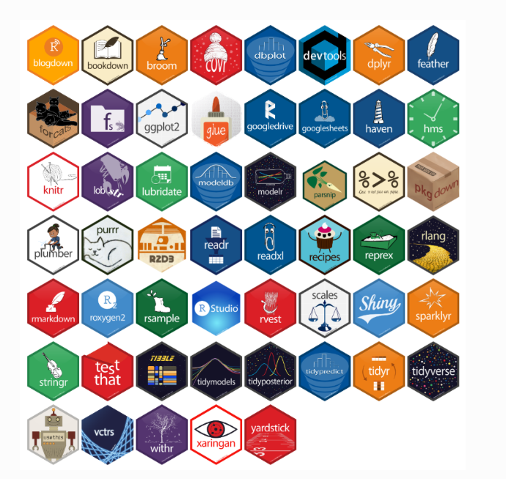
DBT-BIC-NNP-TREE Genome Informatics — Genome HackWeek 2026
Annotate, Innovate, Collaborate | CSIR-IICB, Kolkata
Why Use Packages?
Base R has around 1,200 functions; the community has added tens of thousands
"Why hard-code it when there is a package for it?"
A package bundles functions, documentation, tests and example data. Someone has already solved your problem, written the tests, and published the paper.
CRAN
20,000+ general packages. Checked on every platform, versioned, the default source.
Bioconductor
2,300+ genomics tools with a shared release cycle and shared data structures.
GitHub
Development versions and niche tools. No review — read the code before you trust it.
Aditya Upadhyay
Part 04 · Packages & the Tidyverse
Notes:
The hex stickers are a real cultural artefact. One point: almost anything you need has already been written, tested and documented by someone whose research problem was yours.

Slide 26
DBT-BIC-NNP-TREE Genome Informatics — Genome HackWeek 2026
Annotate, Innovate, Collaborate | CSIR-IICB, Kolkata
Installing and Loading Packages
Install once per machine; load once per session
# once per machine — buying the saucepan
Quotes on the way in
install.packages("tidyverse")
install.packages("dplyr") takes a string; library(dplyr) does not need one.
# every session — out of the cupboard
library(tidyverse)
# Bioconductor uses its own installer
install.packages("BiocManager")
Functions take arguments
BiocManager::install("DESeq2")
A function is a canned script. Here "tidyverse" is the argument. Parentheses are always required.
# development version from GitHub
remotes::install_github("tidyverse/dplyr")
# what am I actually running?
packageVersion("dplyr")
Double colon
sessionInfo()
dplyr::filter() calls a function without loading the whole package — and makes the source explicit.
Aditya Upadhyay
Part 04 · Packages & the Tidyverse
Notes:
Do this live: install one small package and load it. Then repeat the saucepan analogy — install once, library every session.

Slide 27
DBT-BIC-NNP-TREE Genome Informatics — Genome HackWeek 2026
Annotate, Innovate, Collaborate | CSIR-IICB, Kolkata
The Tidyverse for Data Science
One library(tidyverse) loads them all — they are designed to work together
Tidy data : each variable is a column, each observation is a row, each value is a cell. Get there once and every tool below speaks the same language.
readr
tidyr
dplyr
read_csv(), read_tsv() — faster than base R and honest about column types
pivot_longer(), pivot_wider(), separate() — reshaping
filter(), mutate(), group_by(), summarise(), joins
ggplot2
stringr
purrr
Layered graphics. aes() maps columns to visual properties
str_detect(), str_replace() — pattern matching on text
map() applies a function across a list — a for-loop without the bookkeeping
Aditya Upadhyay
Part 04 · Packages & the Tidyverse
Notes:
The tidy data rule is the important sentence. Once data is in that shape, every tidyverse verb works on it without special cases — that is the whole payoff.

Slide 28
DBT-BIC-NNP-TREE Genome Informatics — Genome HackWeek 2026
Annotate, Innovate, Collaborate | CSIR-IICB, Kolkata
R for Bioinformatics
Eight packages worth knowing by name before you need them
WRANGLING
FIGURES
RNA-SEQ
RNA-SEQ
dplyr
ggplot2
DESeq2
edgeR
Filter, mutate, group and summarise tables of any size
Scatter, box, violin, volcano and heatmap plots by layering
Differential expression on a negative binomial model
An alternative pipeline, strong with few replicates
SEQUENCES
SEQUENCES
RANGES
FIGURES
Biostrings
seqinr
GenomicRanges
pheatmap
Fast DNA, RNA and protein string handling and matching
GenBank and UniProt access, GC content, codon usage
Interval arithmetic on coordinates — overlaps, gaps, coverage
Clustered heatmaps, publication-ready in three lines
Aditya Upadhyay
Part 04 · Packages & the Tidyverse
Notes:
These are the names to leave the room with. For RNA-seq this week, DESeq2 and edgeR are the two to look at tomorrow; for sequence work it is Biostrings.

Slide 29
DBT-BIC-NNP-TREE Genome Informatics — Genome HackWeek 2026
Annotate, Innovate, Collaborate | CSIR-IICB, Kolkata
05
Hands-On: Visualising RNA-seq Data
One published dataset, from CSV file to publication figure
Aditya Upadhyay
Part 05 · Hands-On RNA-seq
Notes:
Part five, twenty-two minutes, the part people remember. Everything from here is one continuous worked example — read, tidy, join, plot.

Slide 30
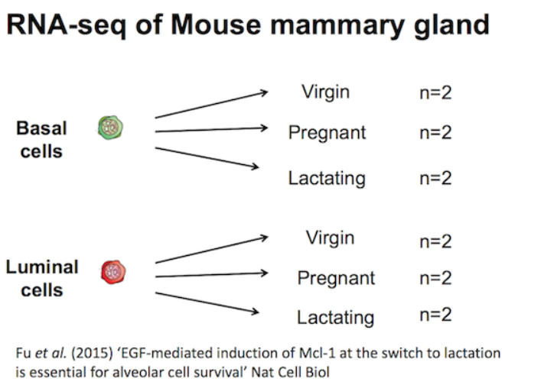
DBT-BIC-NNP-TREE Genome Informatics — Genome HackWeek 2026
Annotate, Innovate, Collaborate | CSIR-IICB, Kolkata
The Dataset: Mouse Mammary Gland
Fu et al. 2015 — EGF-mediated induction of Mcl-1 at the switch to lactation
Accession
GSE60450
Design
2 cell types × 3 stages × 2 mice = 12 samples
Counts
23,735 genes × 14 columns, normalised for depth and composition
TWO FILES IN data/
GSE60450_GeneLevel_Normalized (CPM.and.TMM)_data.csv GSE60450_filtered_metadata.csv
Aditya Upadhyay
Part 05 · Hands-On RNA-seq
Notes:
Explain the design out loud: two cell populations, three developmental stages, two mice each. Wap and the caseins should be off in virgin mice and enormous during lactation.

Slide 31
DBT-BIC-NNP-TREE Genome Informatics — Genome HackWeek 2026
Annotate, Innovate, Collaborate | CSIR-IICB, Kolkata
Reading Data Into R
Two CSV files in, two tibbles out
library(tidyverse)
That output is not an error
counts <- read_csv("data/GSE60450_...TMM)_data.csv")
It is the column specification: how many rows, and what type read_csv guessed for each column.
## Rows: 23735 Columns: 14
## chr (2): ...1, gene_symbol
## dbl (12): GSM1480291, GSM1480292, ...
## • `` -> `...1`
read_csv, not read.csv
sampleinfo <- read_csv("data/GSE60450_filtered_metadata.csv")
The tidyverse version returns a tibble and leaves your column names alone. Base R turns developmental stage into developmental.stage.
## Rows: 12 Columns: 4
# give the first column a real name
colnames(counts)[1] <- "gene_id"
colnames(sampleinfo)[1] <- "sample_id"
Names with spaces
Wrap them in backticks: `developmental stage` — backticks, not quotes.
Aditya Upadhyay
Part 05 · Hands-On RNA-seq
Notes:
Run this live and read the column specification out loud — it is not an error. Point out the ...1 column name: read_csv found a blank header and filled it in.

Slide 32
DBT-BIC-NNP-TREE Genome Informatics — Genome HackWeek 2026
Annotate, Innovate, Collaborate | CSIR-IICB, Kolkata
Tidy Data: Wide to Long
Twelve count columns become two — one row per gene per sample
seqdata <- pivot_longer(counts,
BEFORE — WIDE
cols = starts_with("GSM"),
gene_id
GSM1480291
GSM1480292
names_to = "Sample",
values_to = "Count")
Wap
90.2
95.6
# same result, a column range
Csn2
2451.0
2380.4
pivot_longer(counts,
cols = GSM1480291:GSM1480302, ...)
AFTER — LONG
# same result, name what to keep
gene_id
Sample
Count
pivot_longer(counts,
Wap
GSM1480291
90.2
cols = -c("gene_id", "gene_symbol"), ...)
Wap
GSM1480292
95.6
dim(seqdata)
## [1] 284820 4
Csn2
GSM1480291
2451.0
Csn2
GSM1480292
2380.4
Aditya Upadhyay
Part 05 · Hands-On RNA-seq
Notes:
This is the conceptual hinge of the session. Twelve count columns become two: Sample and Count. ggplot cannot plot the wide version; it can plot the long one.

Slide 33
DBT-BIC-NNP-TREE Genome Informatics — Genome HackWeek 2026
Annotate, Innovate, Collaborate | CSIR-IICB, Kolkata
Joining Two Tables
The counts know the sample ID; the metadata knows what the sample is
allinfo <- full_join(seqdata, sampleinfo,
full_join()
by = join_by(Sample == sample_id))
Keeps every row from both tables. Missing values arrive as NA — a useful warning that a key did not match.
# six long descriptions → six short labels
allinfo <- mutate(allinfo, Group = case_when(
str_detect(characteristics, "basal.*virgin") ~ "bvirg",
str_detect(characteristics, "basal.*preg") ~ "bpreg",
str_detect(characteristics, "basal.*lact") ~ "blact",
left_join()
str_detect(characteristics, "luminal.*virgin") ~ "lvirg",
Keeps every row of the first table only. The usual choice when one table is the reference.
str_detect(characteristics, "luminal.*preg") ~ "lpreg",
str_detect(characteristics, "luminal.*lact") ~ "llact"))
head(allinfo) ## Group is the last column
inner_join()
Keeps only rows present in both. Quietly drops unmatched samples, so check the row count.
Aditya Upadhyay
Part 05 · Hands-On RNA-seq
Notes:
Two operations: the join attaches metadata to every count row, then case_when shortens six unwieldy descriptions into six short group labels we can put on an axis.

Slide 34
DBT-BIC-NNP-TREE Genome Informatics — Genome HackWeek 2026
Annotate, Innovate, Collaborate | CSIR-IICB, Kolkata
The Grammar of Graphics
Every ggplot needs exactly three things — and then you add layers
ggplot(data = <THE DATA>,
GEOMS YOU WILL USE
mapping = aes(<COLUMNS → x, y, colour>)) +
geom_point()
Scatter, volcano
<GEOM_FUNCTION>()
geom_jitter()
Scatter, nudged apart
geom_boxplot()
Group comparison
geom_violin()
Distribution shape
geom_line()
Time course
1 · DATA
2 · MAPPING
3 · GEOM
geom_tile()
Heatmap
One tidy data frame, in long format
Which column becomes which visual property
The kind of mark drawn for each row
geom_histogram()
One distribution
facet_wrap()
One panel per group
Type geom in RStudio and press Tab to see the rest.
The + must go at the end of a line, never the beginning. R reads a line ending in + as unfinished — which is exactly what you want.
Aditya Upadhyay
Part 05 · Hands-On RNA-seq
Notes:
Data, mapping, geom — three things, and swapping the geom changes the whole plot type without touching anything else. Warn about the plus sign going at the end of the line.

Slide 35
DBT-BIC-NNP-TREE Genome Informatics — Genome HackWeek 2026
Annotate, Innovate, Collaborate | CSIR-IICB, Kolkata
Your First Plot: Distribution of Counts
Four lines, run one after the other, each fixing the last
# 1 — as it comes. A few genes dominate.
ggplot(allinfo, aes(x = Sample, y = Count)) +
geom_boxplot()
# 2 — log the y axis to see the spread
ggplot(allinfo, aes(x = Sample, y = log2(Count))) +
geom_boxplot()
## Warning: Removed 84054 rows containing
## non-finite values — log2(0) is undefined
# 3 — add 1 first, keep the zeros
ggplot(allinfo, aes(x = Sample, y = log2(Count + 1))) +
geom_boxplot()
# 4 — colour = outlines, fill = areas
ggplot(allinfo, aes(x = Sample, fill = Sample,
WHAT TO LOOK FOR
y = log2(Count + 1))) + geom_boxplot()
The twelve distributions should look similar. They are not identical — and a box plot hides shape, so try geom_violin() next.
Aditya Upadhyay
Part 05 · Hands-On RNA-seq
Notes:
Run all four versions in sequence. The warning about 84,054 non-finite values is the teaching moment: log2 of zero is undefined, so add one.

Slide 36
DBT-BIC-NNP-TREE Genome Informatics — Genome HackWeek 2026
Annotate, Innovate, Collaborate | CSIR-IICB, Kolkata
Subplots with Faceting
One panel per gene, for the eight most highly expressed genes
# the eight genes with the highest counts
mygenes <- c("Csn1s2a", "Csn1s1", "Csn2", "Glycam1",
"COX1", "Trf", "Wap", "Eef1a1")
# %in% tests membership of a set
mygenes_counts <- filter(allinfo,
gene_symbol %in% mygenes)
# one panel per gene, one point per sample
ggplot(mygenes_counts,
aes(x = Group, y = log2(Count + 1),
colour = Group)) +
geom_jitter() +
facet_wrap(~ gene_symbol)
WHY JITTER, NOT BOXPLOT
Two replicates per group is not enough for a box. geom_jitter() shows every point, nudged sideways so they do not overlap.
Aditya Upadhyay
Part 05 · Hands-On RNA-seq
Notes:
This is the plot with the biology in it. Wap and the caseins are near zero in virgin mice and enormous in lactating ones.

Slide 37
DBT-BIC-NNP-TREE Genome Informatics — Genome HackWeek 2026
Annotate, Innovate, Collaborate | CSIR-IICB, Kolkata
Customising Your Plot
Colours, labels and themes — added as layers, never by editing the data
# your own colours — colours() lists them all
mycolours <- c("turquoise", "plum", "tomato",
"violet", "steelblue", "chocolate")
ggplot(mygenes_counts, aes(x = Group,
y = log2(Count + 1), colour = Group)) +
geom_jitter() +
facet_wrap(~ gene_symbol) +
scale_colour_brewer(palette = "Dark2") +
labs(x = "Cell type and stage",
y = "log2 normalised count",
title = "Mammary gland RNA-seq data") +
theme_bw() +
theme(axis.text.x = element_text(angle = 90))
Swap theme_bw() for theme_minimal() or theme_classic() . Brewer palettes such as "Dark2" are built to survive printing and colour blindness.
Aditya Upadhyay
Part 05 · Hands-On RNA-seq
Notes:
Add one layer at a time and let people see each change land. Dark2 and the other Brewer palettes are chosen for print and for colourblind readers.

Slide 38
DBT-BIC-NNP-TREE Genome Informatics — Genome HackWeek 2026
Annotate, Innovate, Collaborate | CSIR-IICB, Kolkata
Ordering Categories with Factors
Alphabetical order is rarely the biological order
# the order the biology suggests
<chr> vs <fct>
group_order <- c("bvirg", "bpreg", "blact",
A character column sorts alphabetically. A factor sorts by the levels you declared. str() shows which is which.
"lvirg", "lpreg", "llact")
# make a factor with those levels
mygenes_counts <- mutate(mygenes_counts,
Group_f = factor(Group, levels = group_order))
levels(mygenes_counts$Group_f)
It follows everywhere
## [1] "bvirg" "bpreg" "blact" "lvirg" ...
Axis order, legend order and facet order all read the levels. Set them once.
# then plot Group_f instead of Group
ggplot(mygenes_counts, aes(x = Group_f,
y = log2(Count + 1), colour = Group_f)) +
geom_jitter() +
Statistics care too
facet_wrap(~ gene_symbol)
The first level is the reference group in a model, so it decides which direction a fold change points.
Aditya Upadhyay
Part 05 · Hands-On RNA-seq
Notes:
Alphabetical order puts lactating before virgin, which reverses the biology. Make it a factor with the levels you want and every plot and legend follows.

Slide 39
DBT-BIC-NNP-TREE Genome Informatics — Genome HackWeek 2026
Annotate, Innovate, Collaborate | CSIR-IICB, Kolkata
Exercise: Make It Your Own
Four variations on the plot you just built. Everything you need is already in your session.
1
Swap the geom
2
Colour by something else
Replace geom_boxplot() with geom_violin() on the counts plot. What does the violin show that the box hid?
Fill by immunophenotype, then by `developmental stage` . Note what happens without the backticks.
3
Hide the outliers
4
Sign it and export it
Read ?geom_boxplot and find the argument that shrinks outlier points — then the one that removes them.
Add labs(subtitle = "your initials") , pick a colourblind-safe palette, then export the plot as a PDF.
Aditya Upadhyay
Part 05 · Hands-On RNA-seq
Notes:
Leave this up during questions. The data folder and this script are all they need. If there is time, do task one together.

Slide 40
DBT-BIC-NNP-TREE Genome Informatics — Genome HackWeek 2026
Annotate, Innovate, Collaborate | CSIR-IICB, Kolkata
Reproducible Research with R Markdown
One file holding code, results and narrative — rendered to HTML, PDF or Word
## Load the data
HTML
Self-contained report you can email or host
```{r setup}
library(tidyverse)
PDF
Typeset via LaTeX — supplementary material
counts <- read_csv("data/counts.csv")
```
## Distribution of counts per sample
Word
Editable .docx for track-changes feedback
```{r boxplot, fig.height=4}
ggplot(allinfo, aes(Sample, log2(Count + 1))) +
geom_boxplot()
Slides
Quarto or xaringan, for the lab meeting
```
sessionInfo() ## versions, at the end
THE TEST OF A GOOD ANALYSIS
Someone else opens your folder, presses Knit, and gets your numbers and your figures. Nothing to copy, nothing to paste.
Aditya Upadhyay
Wrap-up
Notes:
Close the loop on reproducibility. An R Markdown file is the analysis and the write-up in one place; sessionInfo at the end records the versions that produced it.

Slide 41
DBT-BIC-NNP-TREE Genome Informatics — Genome HackWeek 2026
Annotate, Innovate, Collaborate | CSIR-IICB, Kolkata
Key Points
What to remember from the last ninety minutes
1
Work in a script, not the console, and comment as you go.
2
Set the working directory first; most beginner errors are path errors.
3
read_csv() in, then dim(), str() and summary() before anything else.
4
pivot_longer(), mutate(), filter() and the joins reshape almost any table.
5
A ggplot is data, mapping and geom. facet_wrap() gives one panel per group.
6
Factors control the order of categories — in plots, legends and models alike.
R takes time to learn, like a spoken language. Nobody is fluent after ninety minutes — and nobody needs to be.
Aditya Upadhyay
Wrap-up
Notes:
Six sentences. Read them out; this is the recap people will photograph.

Slide 42
DBT-BIC-NNP-TREE Genome Informatics — Genome HackWeek 2026
Annotate, Innovate, Collaborate | CSIR-IICB, Kolkata
Your Next Steps in R
A three-month plan that ends with an analysis you can publish
1
Get comfortable with base R
Weeks 1–2
Vectors, data frames, functions. Work through swirl().
2
Learn the tidyverse properly
Weeks 3–4
dplyr and tidyr for wrangling, ggplot2 for figures.
3
Apply it to your own biology
Weeks 5–8
One dataset — yours or from GEO — end to end.
4
Write it up in R Markdown
Month 3
Share the .Rmd, not just the figures.
5
Ask, and then answer
Ongoing
Bioconductor support, Biostars, Stack Overflow.
R for Data Science
Intro to R for Biologists
Bioconductor workflows
Wickham & Grolemund — free at r4ds.hadley.nz
Doyle, Chung & Perreau — today's worked example
RNA-seq, single cell and annotation, start to finish
Aditya Upadhyay
Wrap-up
Notes:
Give them a schedule, not a reading list. The most useful commitment is step three: one real dataset of their own, end to end.

Slide 43
DBT-BIC-NNP-TREE Genome Informatics — Genome HackWeek 2026
Annotate, Innovate, Collaborate | CSIR-IICB, Kolkata
Thank You
Questions — and let's plot some data
Aditya Upadhyay
|
Genome HackWeek 2026
|
CSIR-IICB, Kolkata
Slides, script and the data/ folder are on the workshop drive.
Aditya Upadhyay
Wrap-up
Notes:
Take questions here. If nobody speaks, offer the first exercise task as a prompt: who wants to see what the violin plot shows?

