Slide 1
The Language of Proteins
Protein Embeddings, Visualisation & Clustering
Aribam Geeta, PhD
Project Associate I
Computational Genomics Lab,
CSIR-Indian Institute of Chemical Biology

Slide 2
Talk outline
What and why protein language models? — What makes a protein sequence behave like a language
How do they work? — Tokens, embeddings, transformers, and what pre-training actually learns
What does an embedding look like? — Compressing high-dimensional vectors into a picture and biological interpretation

Slide 3
1
Understanding the language of proteins

Slide 4
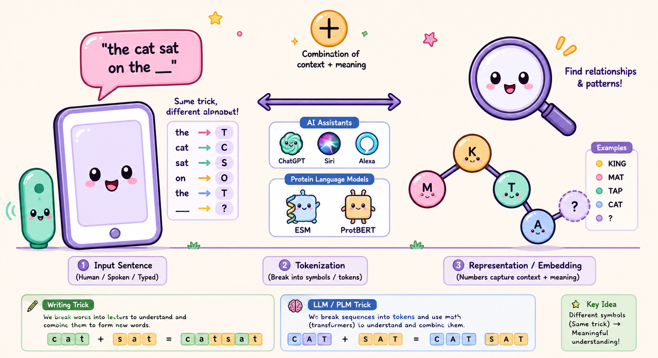
Protein Language Models???
You talk to AI every day. Today, AI talks Protein.

Slide 5
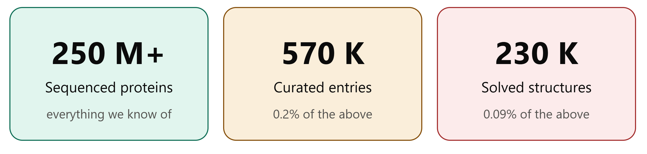
Why PLM?
Millions of protein sequences are available, but many lack structural or functional annotation.
Learn the distribution over sequences, then read information out of it

Slide 6
Why treat proteins like Language?
 | Languages 26 alphabet | Protein 20 amino acids
String | The cat sat on the mat. | MADRLYMTKIHHQFDGD…
Word | cat, mat | motif, domain
Sentence | a clause with meaning | a folded protein
Grammar | syntax, word order | folding & stability constraints
Meaning | semantics | 3D structure → function
A protein sequence carries biological information, similar to how a sentence carries meaning.
The order of amino acids matters because it influences protein structure and function.

Slide 7
Where the analogy breaks
Protein sequences have patterns, just like human language, so language models can learn from them.
But proteins have no spaces or clear word boundaries; important patterns can overlap.
There is no dictionary that tells us what a sequence or motif means.
3D structure matters: amino acids far apart in sequence can interact when the protein folds.
Unlike human language, a model's predictions can ultimately be tested through biological experiments.

Slide 8
Same pipeline, different corpus
Data Model Task
Data Model Task
Books
English
language
model
Text generation
NCBI
Protein
model
Structure prediction
Wikipedia
Summarization
GISAID
Function annotation
Reddit
Sentiment analysis
PDB
Variant effect
Code generation
Sequence design
Github
SAbDab
The core architecture remains the same.
What changes is the training data, tokenizer, and definition of the task..

Slide 9
2
Inside a Protein Language Model

Slide 10
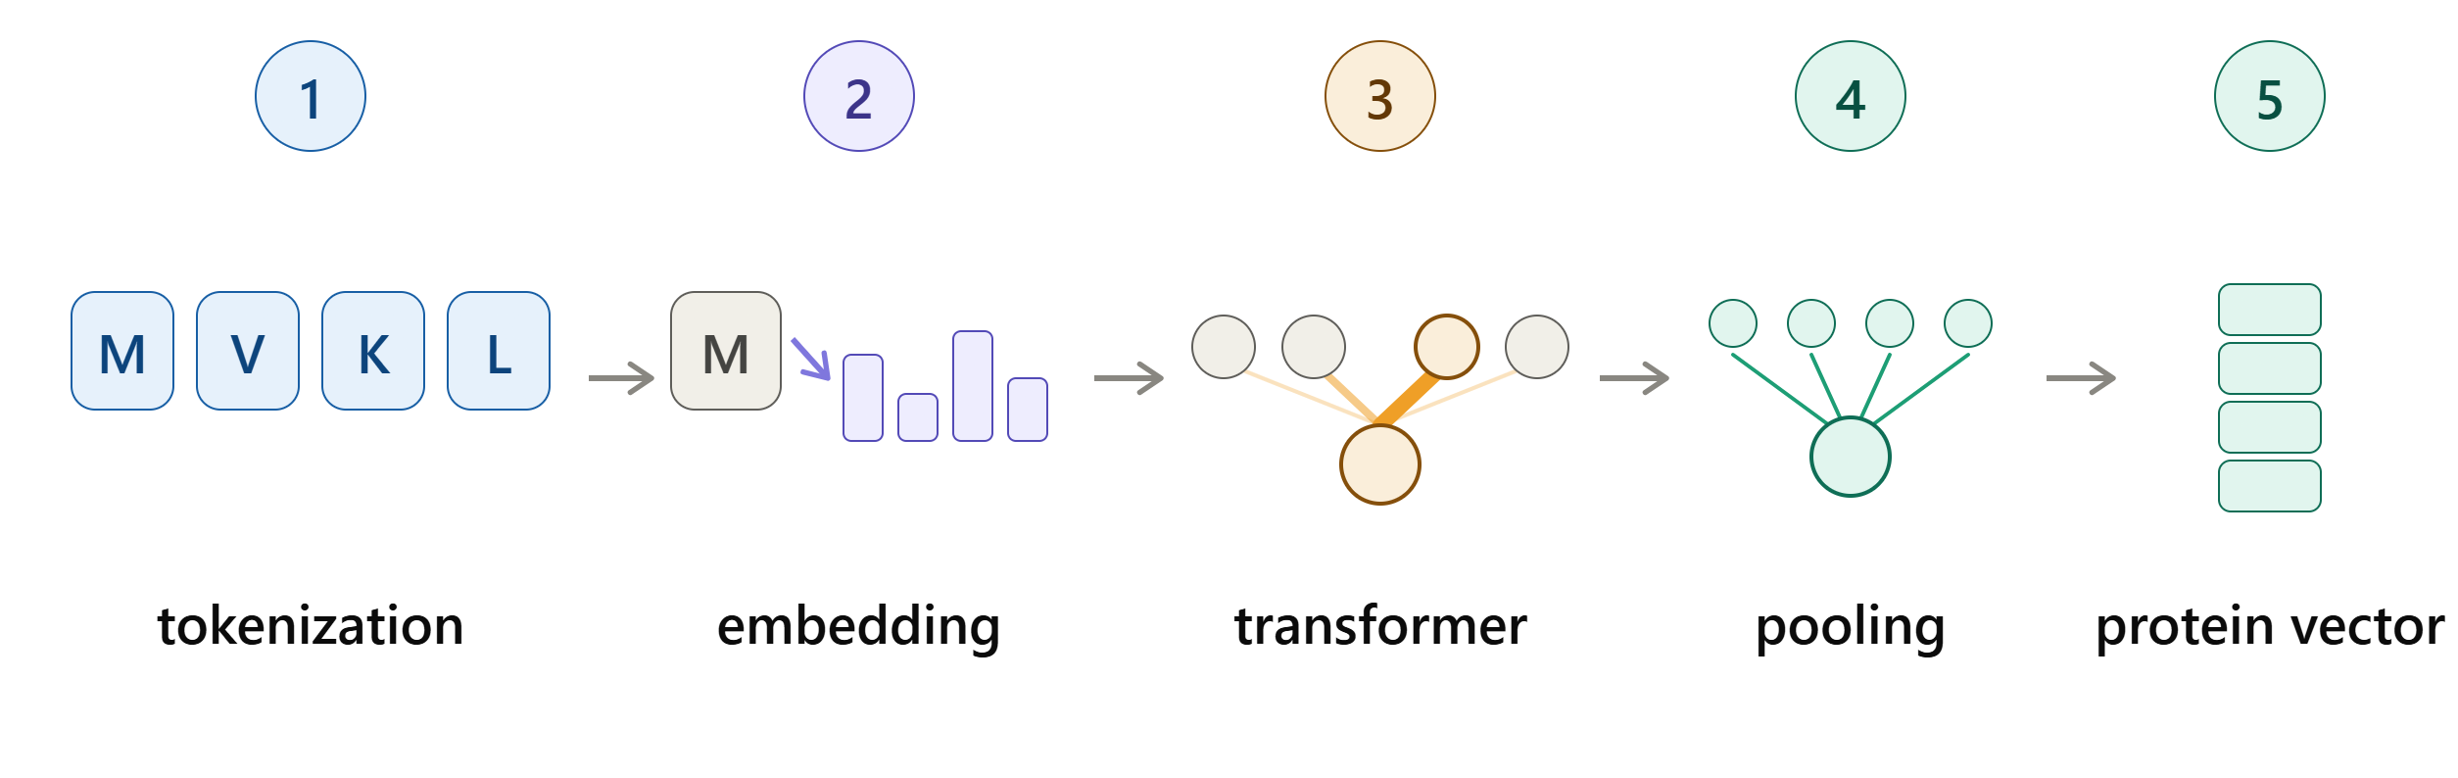
How a Protein Language Model works?
Features learned by training on large datasets of unlabeled protein sequences

Slide 11
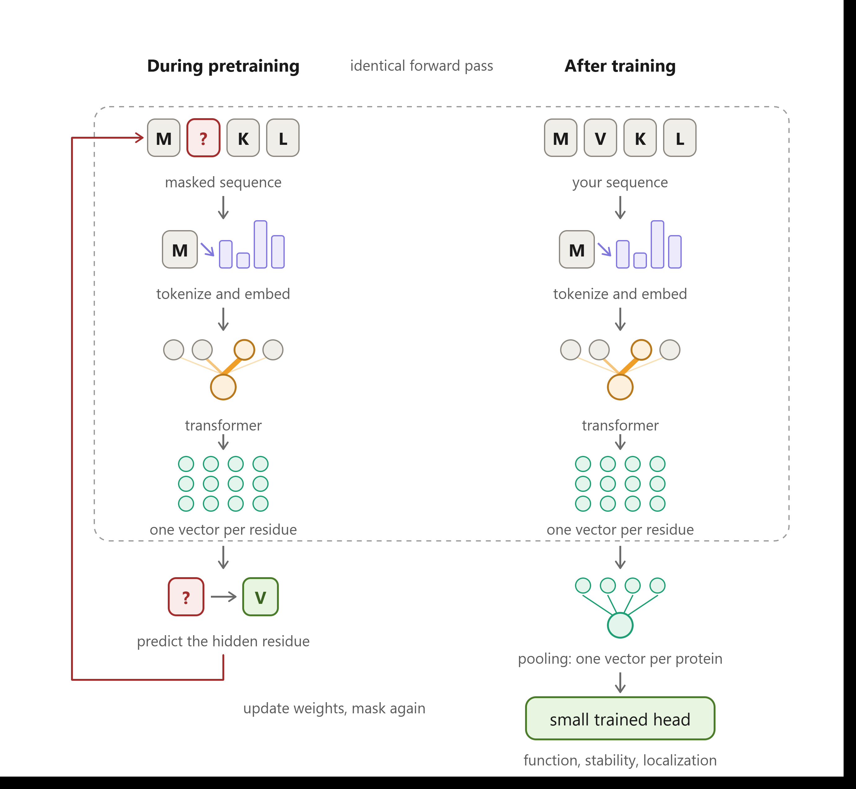
How does a Protein Language Model learn?

Slide 12
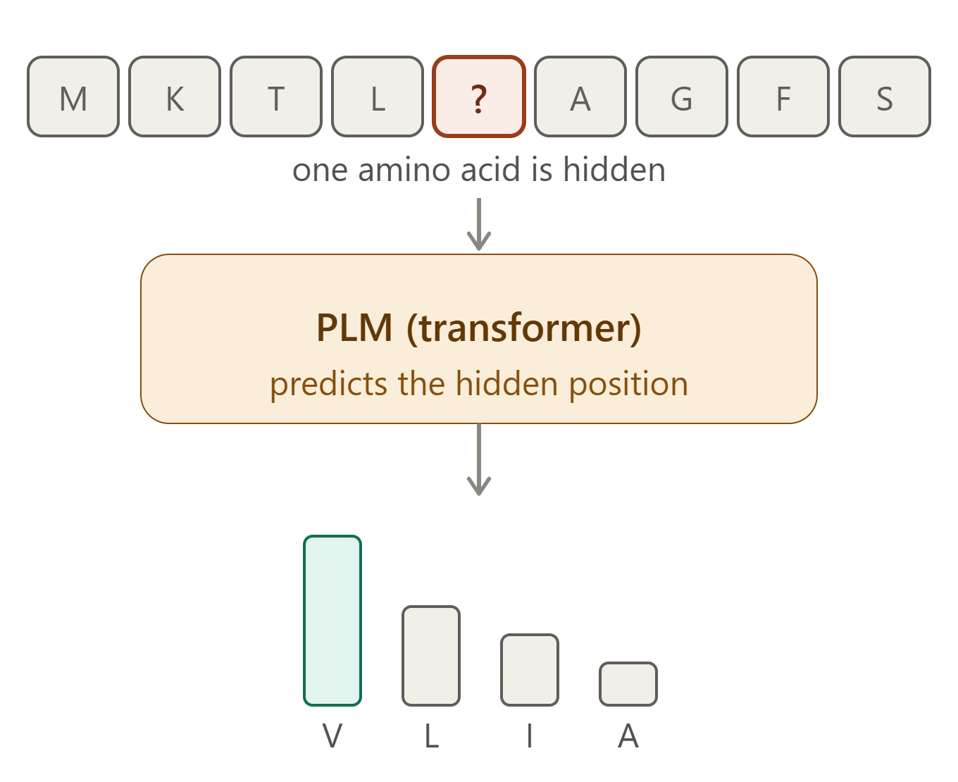
Pre-training on protein sequences
Masked Language Modeling – A common training strategy is to hide some amino acids and ask the model to predict them.
Loop: see context → self-attention relates residues → predict masked residue → compare to actual → adjust and repeat, millions of times.

Slide 13
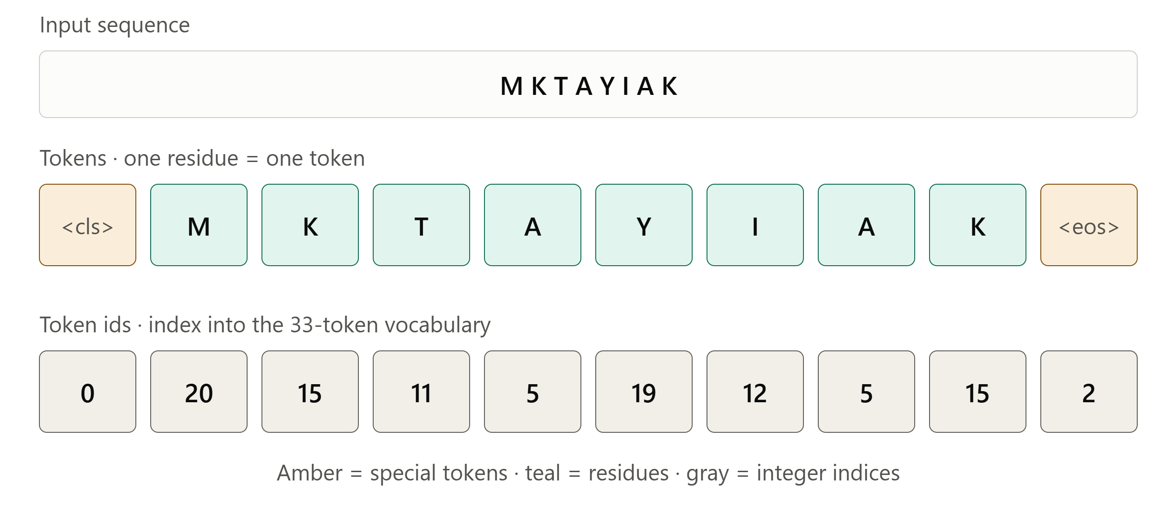
1. Tokenization: Protein sequence to tokens
Tokenization breaks a protein sequence into smaller units called tokens: one amino acid = one token
Special tokens are added such as: a start/CLS token and an end token, giving the model fixed reference points in every sequence.
Output of this step: a sequence of integers (token IDs), not yet carrying any biological meaning — just an index into a vocabulary of ~33 symbols.

Slide 14
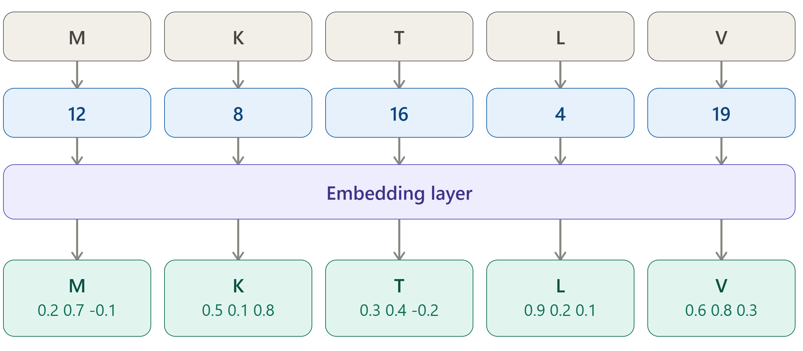
2. Token embeddings
Embeddings convert each token into a numerical vector that the model can learn from.
Each token ID is mapped to a vector of numbers.
These vectors are the model’s initial numerical representation of the amino acids.
The vector is called an embedding.

Slide 15
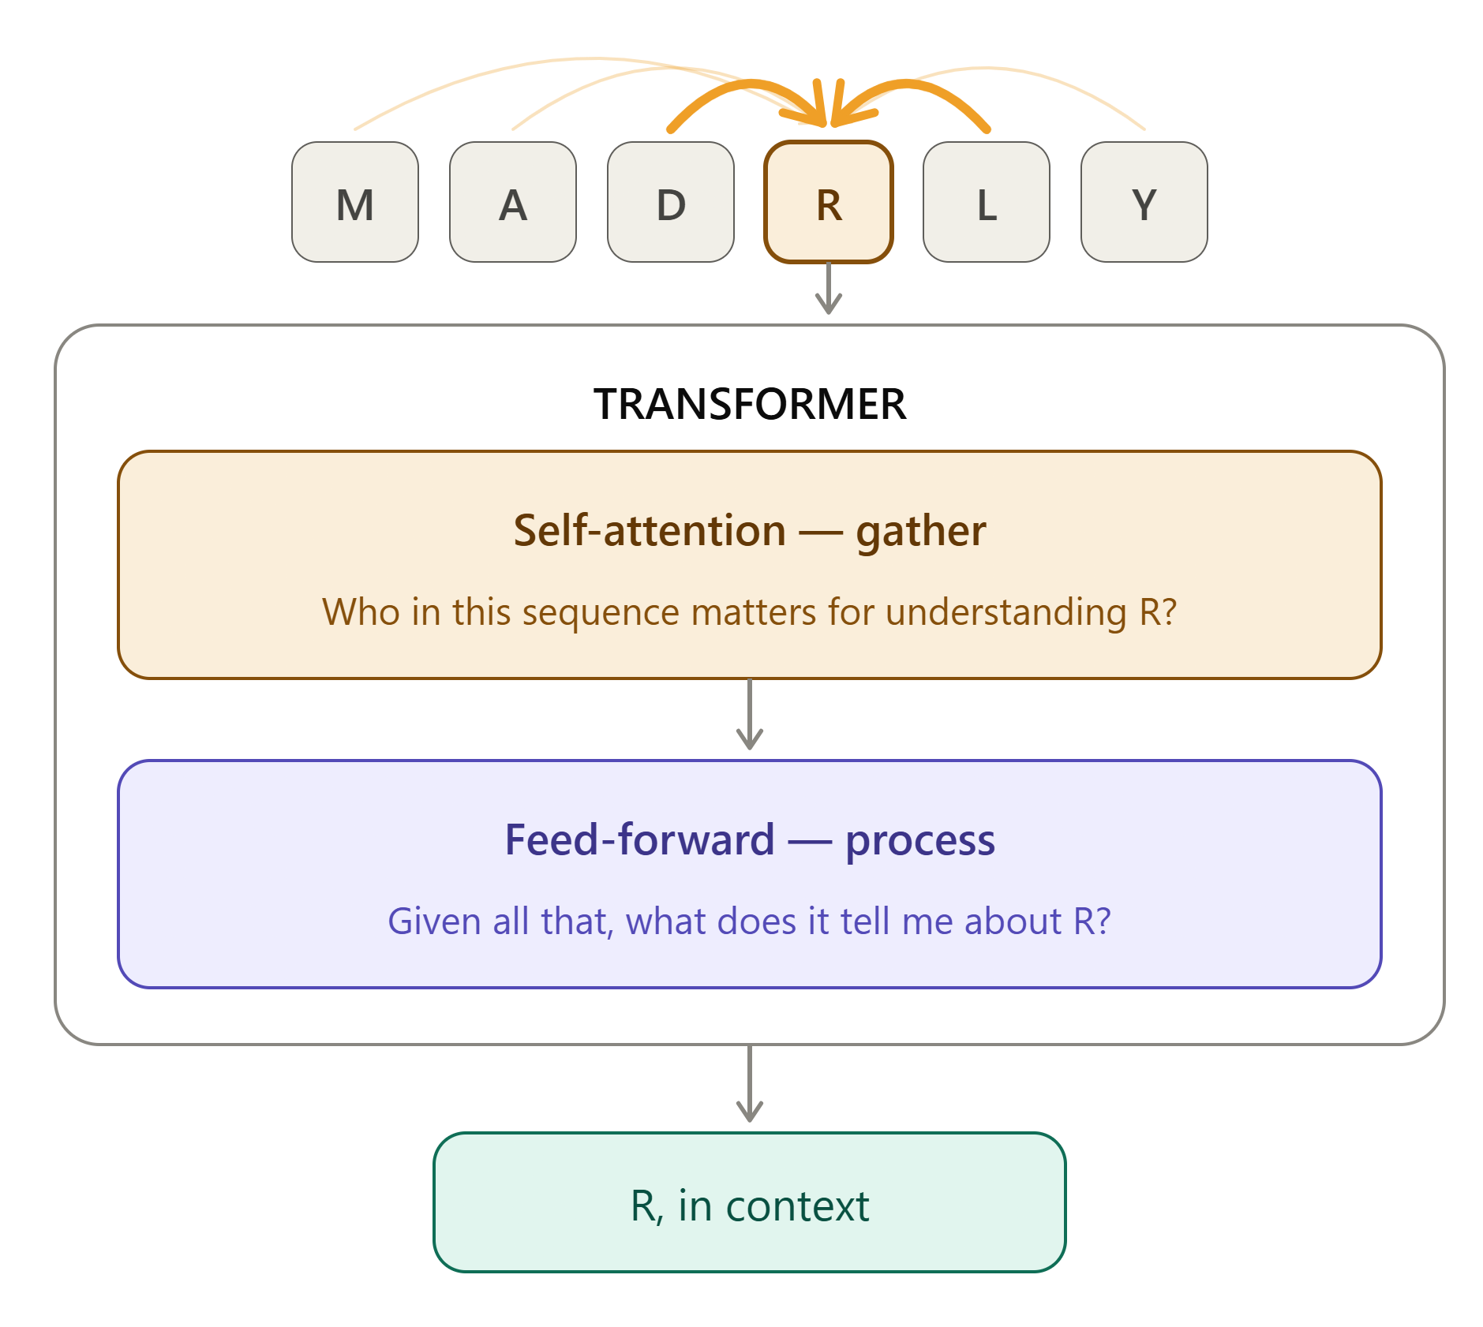
3. The Transformer: Learning context
The Transformer processes the entire sequence and considers relationships between residues.
Self-attention allows each residue to weigh information from other residues in the sequence.
A residue can therefore be represented based on its sequence context, not just its own identity.
This helps the model learn patterns such as motifs, residue relationships, and long-range dependencies.

Slide 16
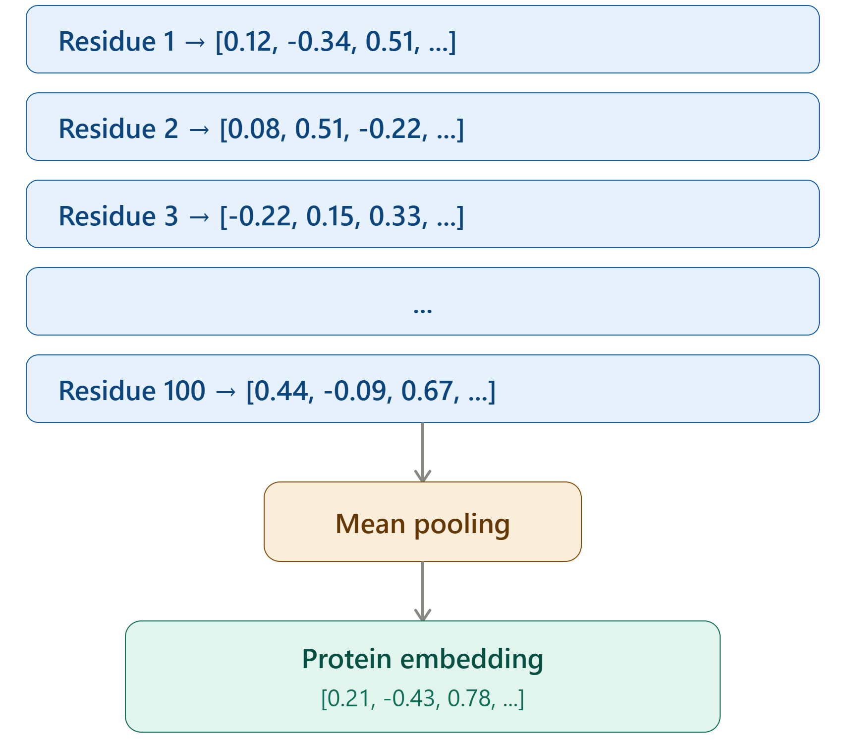
4. From residue embeddings to protein embedding
To represent the whole protein with one vector, these residue embeddings can be combined or pooled.
A common approach is mean pooling — calculating the average across all residue embeddings.
The resulting protein embedding is a fixed-length vector that summarizes information learned from the entire sequence.

Slide 17
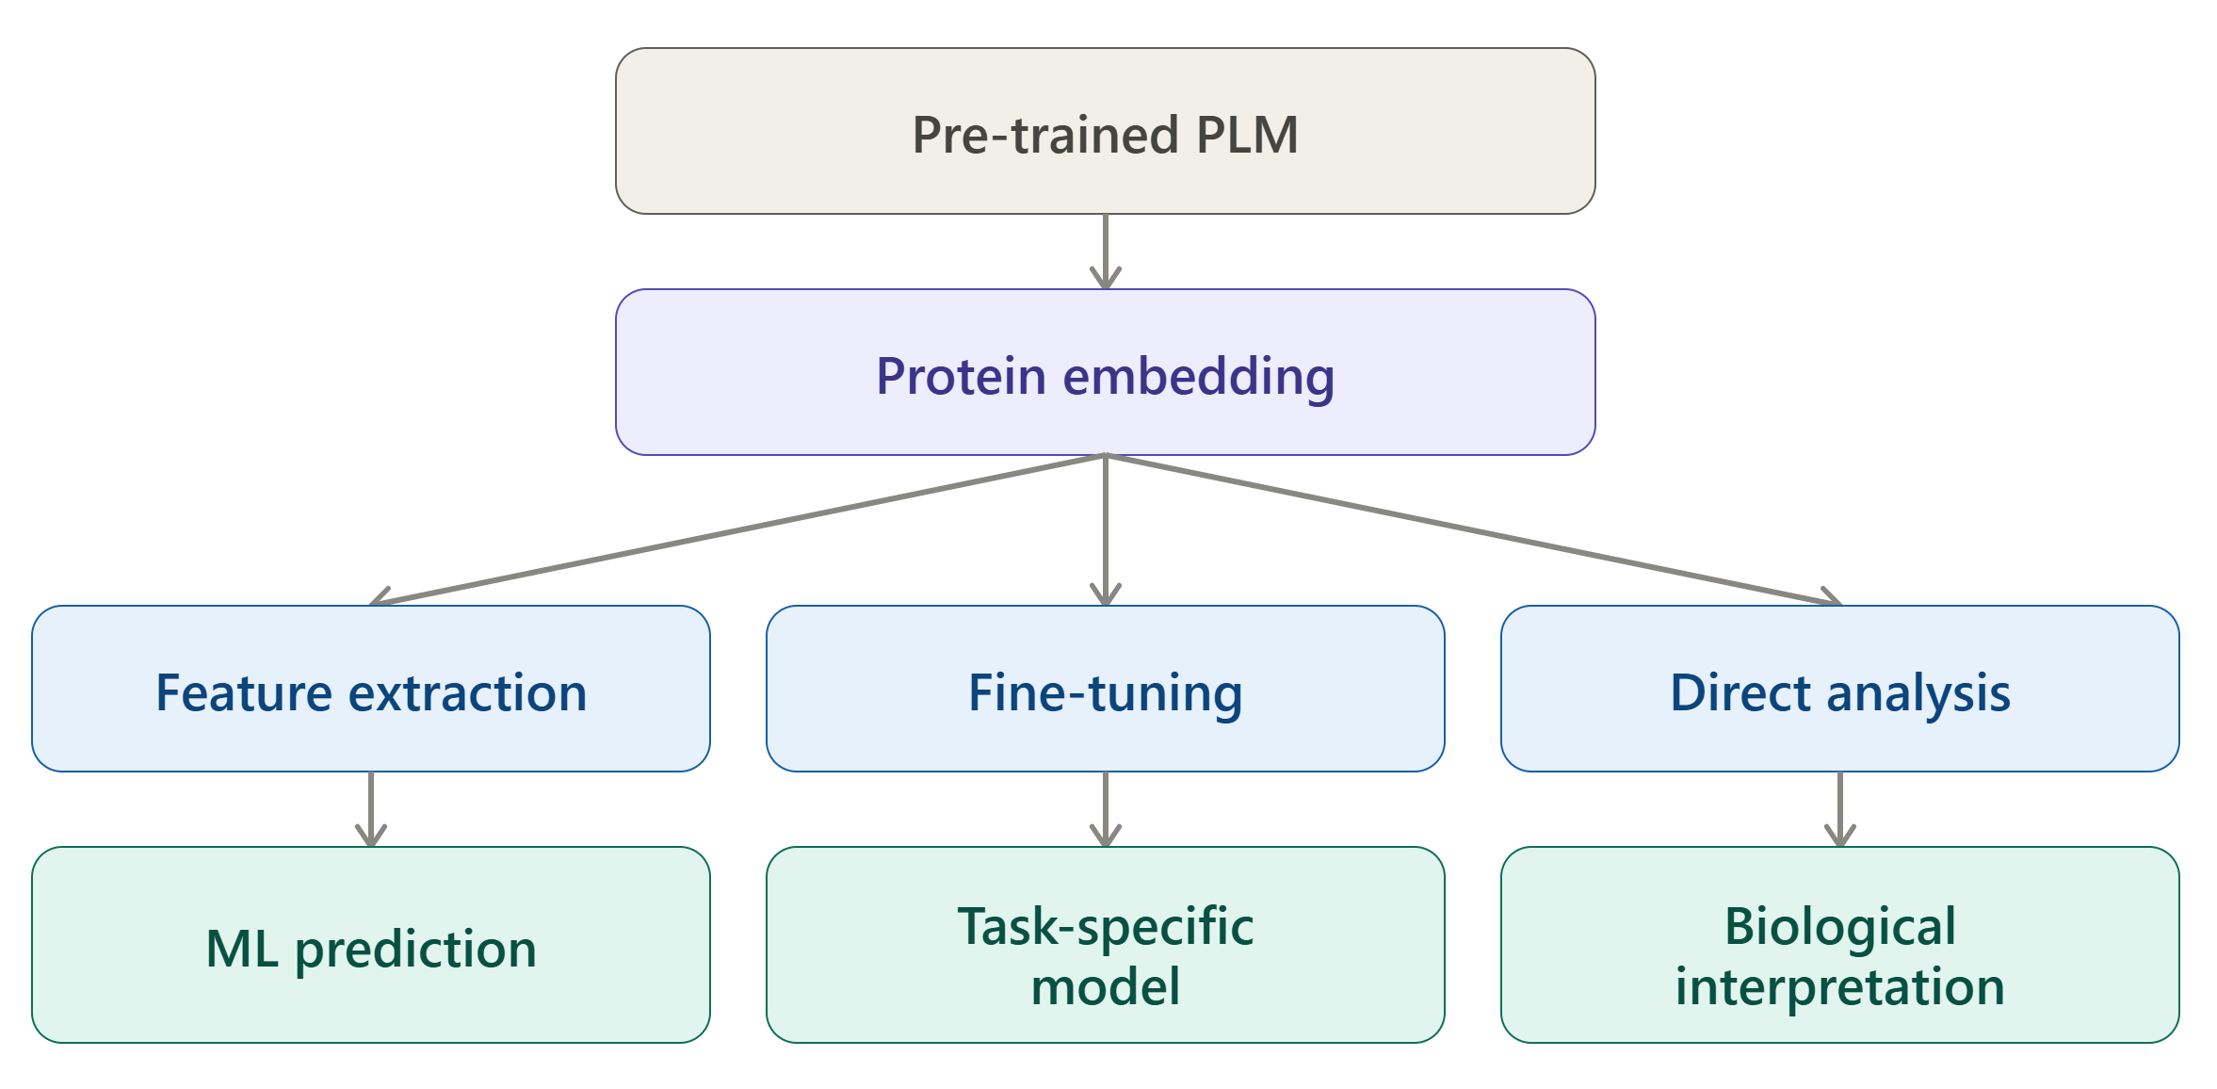
From Protein Embeddings to Biological Applications

Slide 18
Protein Language Models in practice
Model | Architecture | Dim. | Training data | From | Use
ESM-2 | Transformer | 320 – 5120 | UniRef50 | Meta | Embeddings
ProtBERT | BERT | 1024 | UniRef100 | Rostlab | Embeddings
ProtT5 | T5 | 1024 | BFD + UniRef50 | Rostlab | Embeddings

Slide 19
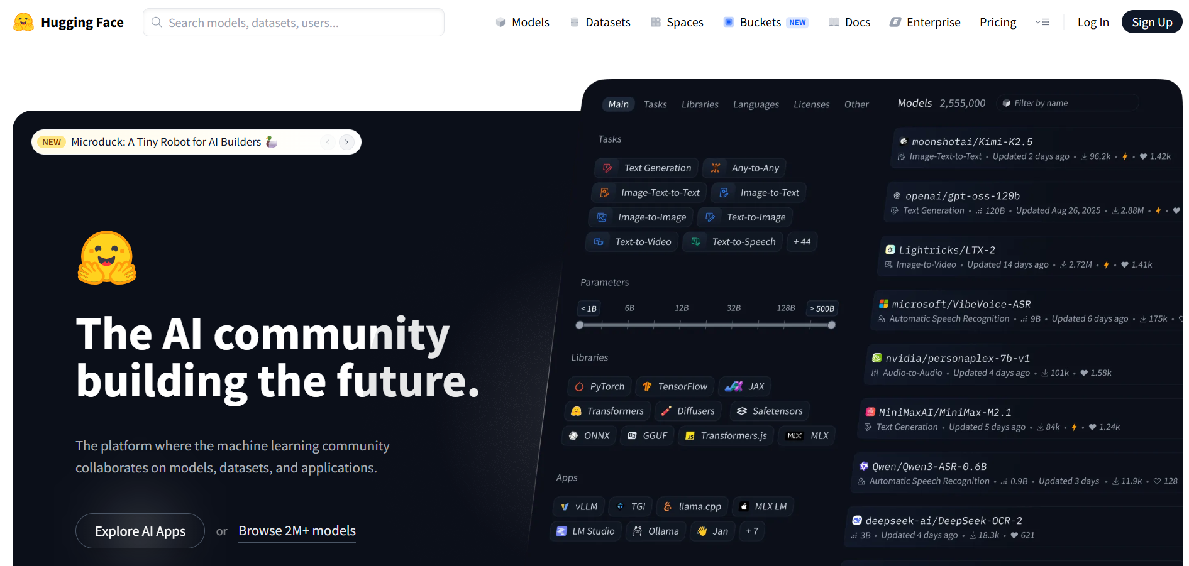
Where can we find pre-trained PLMs? — Hugging Face
Hugging Face is a platform/ecosystem for accessing pre-trained AI models and datasets
Provides many pre-trained protein language models
Models can be loaded and used without training from scratch
Requires an API token for authenticated access to certain models and services

Slide 20
3
Exploring the protein embedding space

Slide 21
Protein Embeddings as Data
Each protein is represented by a high-dimensional vector containing hundreds or thousands of numbers.
These embeddings allow us to compare proteins and explore potential biological relationships.
However, high-dimensional embeddings are difficult to visualize and interpret directly.
Unsupervised learning helps us discover patterns without predefined labels through
Clustering
Dimensionality reduction

Slide 22
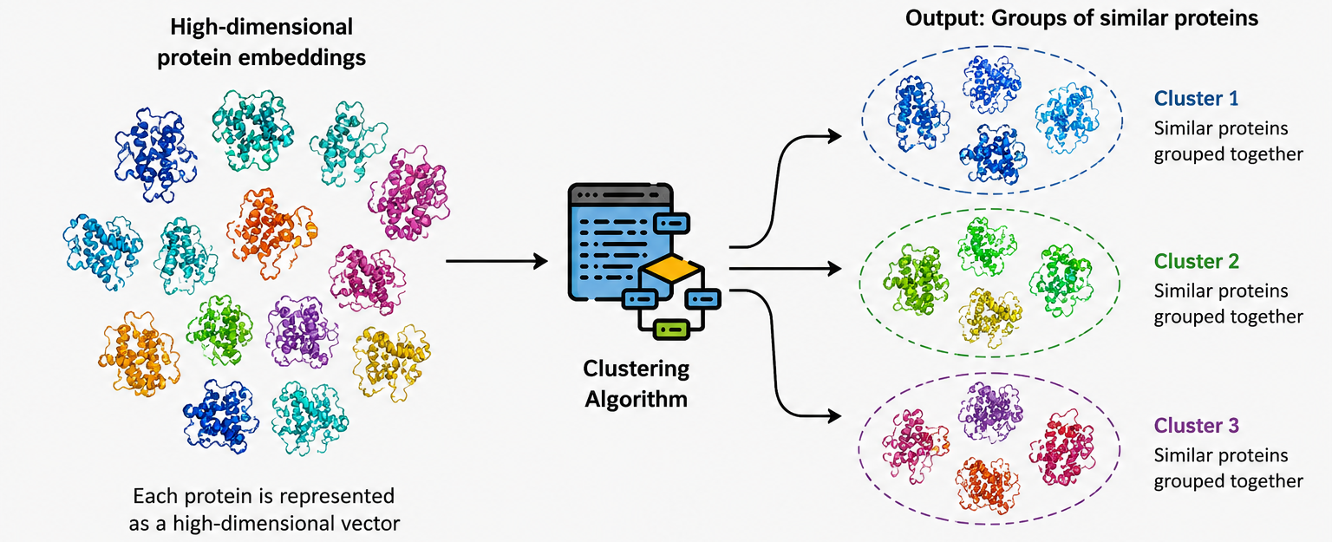
Clustering
Clustering is a method that groups proteins/ samples based on their similarity.
Proteins that are more similar in the embedding space are assigned to the same cluster.

Slide 23
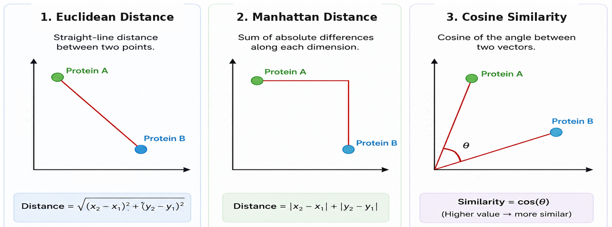
How do we measure similarity?
To cluster samples, we need a distance or similarity metric.
Common distance measure – Manhattan distance, Euclidean distance and Cosine Similarity
Small distance → more similar and Large distance → more different

Slide 24
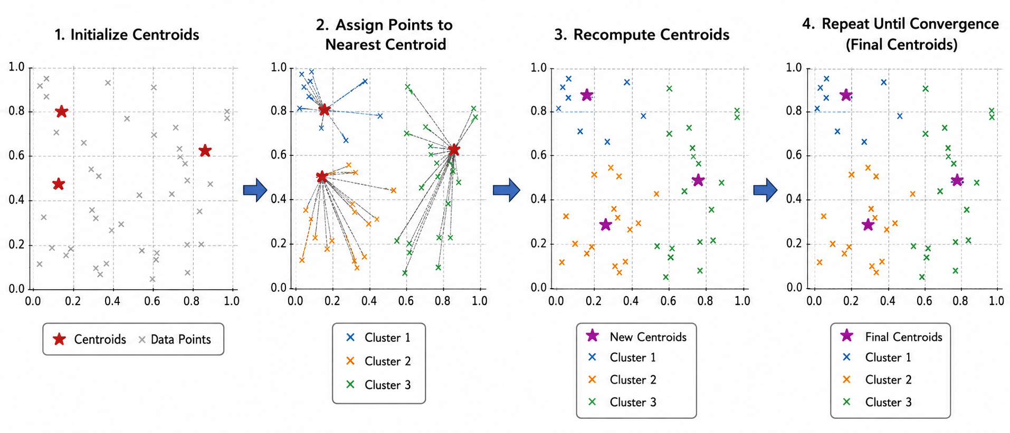
K-Means Clustering
K-means divides proteins into a predefined number (K) of clusters based on their embedding similarity.
‘K’ represents the number of groups or clusters we want to classify items into
‘Means’ refers to the mean or average position used to calculate the centre of each cluster.

Slide 25
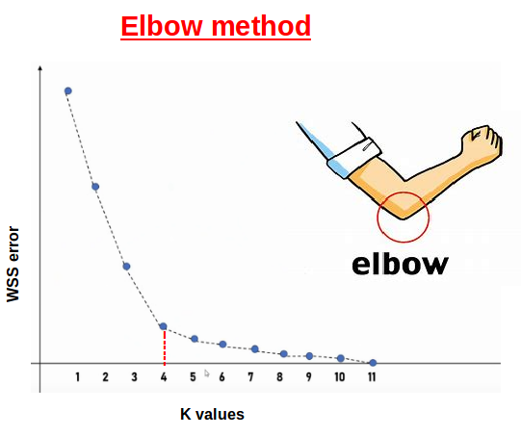
Choosing the number of clusters — How do we know K?
Why is K important?
K determines the number of clusters
Too few clusters → different groups may be combined
Too many clusters → meaningful groups may be unnecessarily split
Elbow curve method
Run K-means with different values of K
Calculate within-cluster sum of squares (WCSS)
The elbow represents a point where increasing K gives diminishing improvement

Slide 26
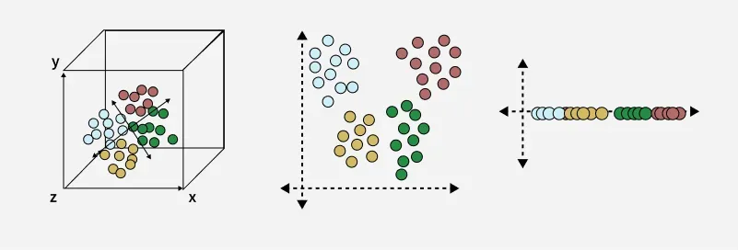
Dimensionality Reduction: Making high-dimensional data visible
Protein embeddings may contain hundreds or thousands of dimensions, which cannot be visualized directly.
Dimensionality reduction transforms high-dimensional data into a smaller number of dimensions while retaining important patterns.
Approaches: PCA and UMAP
3D — Original data → 2D — Reduced representation → 1D — Further reduction

Slide 27
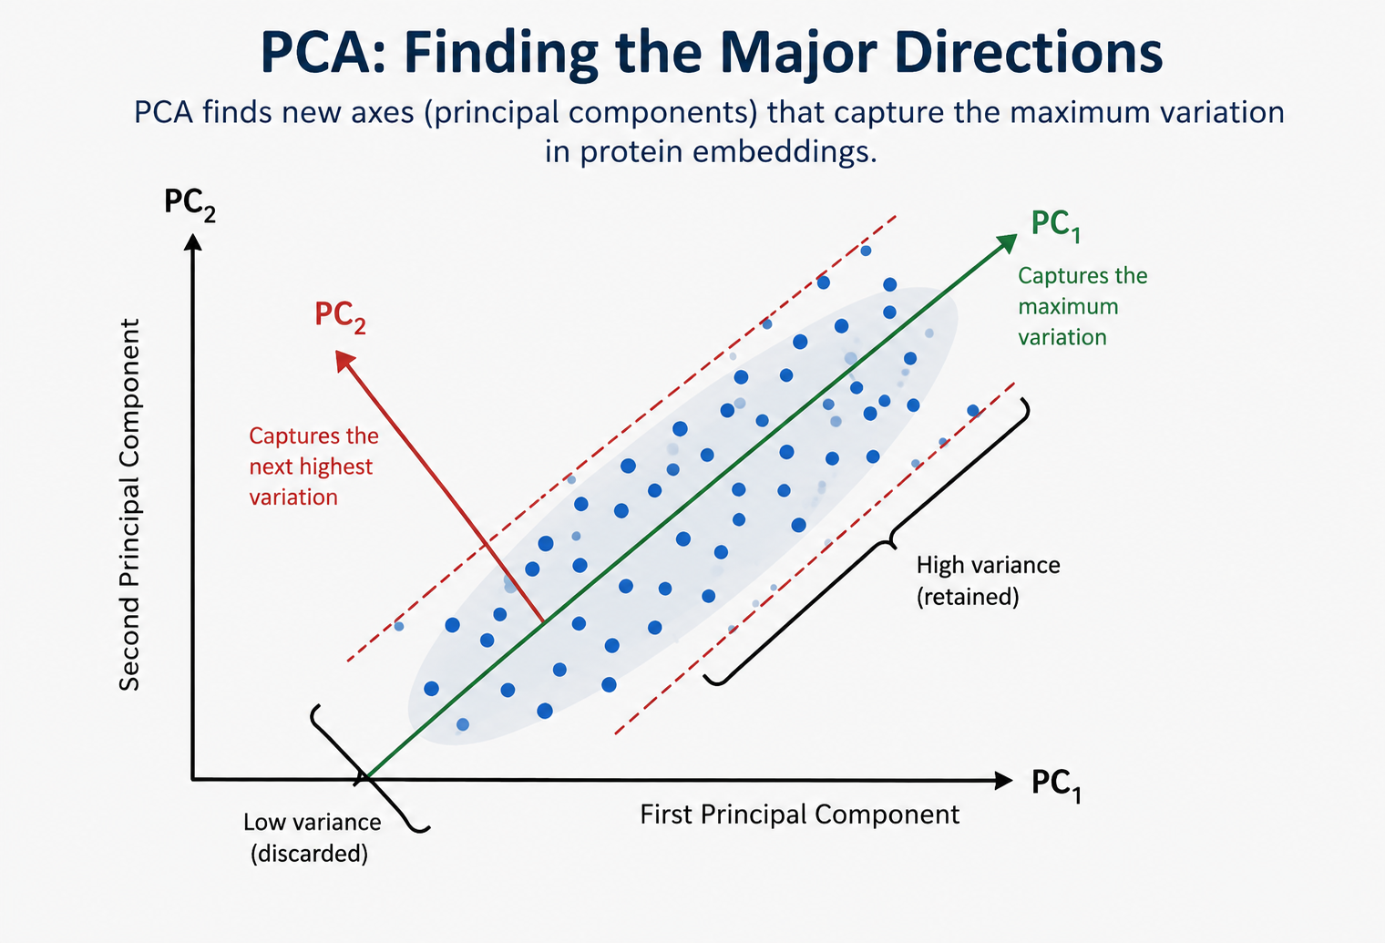
Principal Component Analysis (PCA)
PCA (Principal Component Analysis) transforms high-dimensional data into a new set of variables called Principal Components (PCs).
PC1 captures the largest amount of variation in the data; PC2 captures the next largest variation.
PCA is a linear method that helps reveal major patterns and relationships in high-dimensional data.

Slide 28
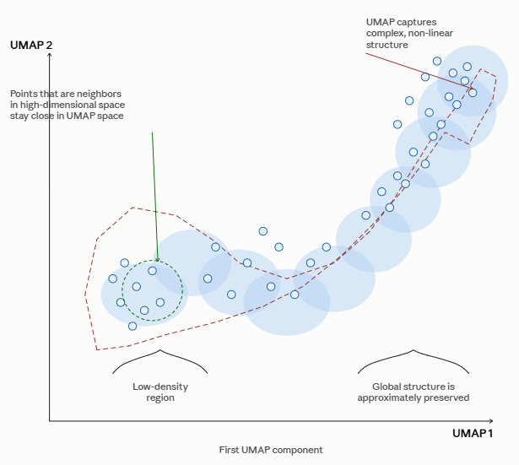
Uniform Manifold Approximation and Projection (UMAP)
UMAP is a non-linear dimensionality reduction method.
It is designed to preserve the local neighborhood structure of high-dimensional data.
Proteins that are close in the original embedding space tend to remain close in the UMAP representation.
UMAP can reveal complex patterns and groups that may not be obvious with a linear method such as PCA.

Slide 29
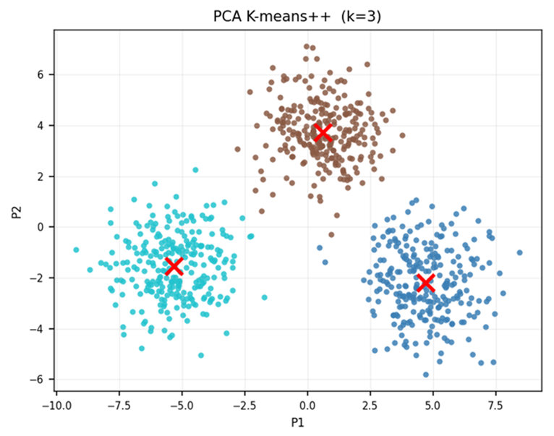
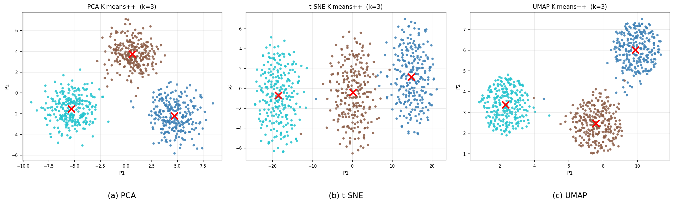
From protein clusters to biological meaning
Biological interpretation
Protein domains
Conserved motifs
Each point = one protein
Nearby points → similar embedding representations
Colour → K-means cluster

Slide 30
Key Takeaways
PLMs learn meaningful representations from protein sequences
Embeddings convert proteins into high-dimensional numerical vectors
K-means groups proteins based on similarity in their embeddings
PCA & UMAP reduce dimensions and visualize protein relationships

Slide 31
HANDS-ON CHALLENGE
YOUR TASK: Can PLM embeddings capture biological differences between proteins from different kingdoms?
① Explore Embeddings: Protein sequences → PLM → embeddings
② Cluster by K-means: Find groups of similar proteins
③ Visualize by PCA and UMAP: Explore the embedding space
④ Interpret the kingdom

