Slide 1
Python Image Processing Libraries
Libraries
Image Basics
Scientific Viz
Hands-On : Cnsplot
Vaishnavi R Project Associate – 1 CG Lab CSIR IICB

Slide 2
PART A · INTRODUCTION
Where We're Going
Today we will first understand the major Python libraries used for image processing. We will then use Python to perform common image-processing operations such as resizing, cropping and flipping. Finally, we will move from image processing to scientific visualization and use cnsplots to create publication-ready figures from a biological dataset.
A
B
C
D
Foundations
Hands-On Basics
Scientific Viz
cnsplots Hands-On
What image processing means, and what the 10 major libraries are each for.
Load, resize, crop, flip, rotate and convert a real image with Pillow + NumPy.
Why raw plots aren't enough for publication, and where cnsplots fits in.
A real differential-expression dataset, ending in a publication-ready volcano plot.

Slide 3
PART A · INTRODUCTION
The Image Processing Pipeline
Every image starts as a grid of pixel values. Once loaded as an array, the same math tools apply — whether you're transforming, analyzing, or visualizing the result.
Image
→
Pixel grid
→
NumPy array
→
Algorithm
→
Result
What you see
Rows × columns
Numbers, not magic
Math on the array
Insight or output
Transform
Analyze
Visualize
Resize, crop, rotate, adjust color — reshaping the array without changing what it represents.
Segment regions, detect edges, count objects — extracting structure from the numbers.
Plot, annotate, and present results — turning array output back into something readable.

Slide 4
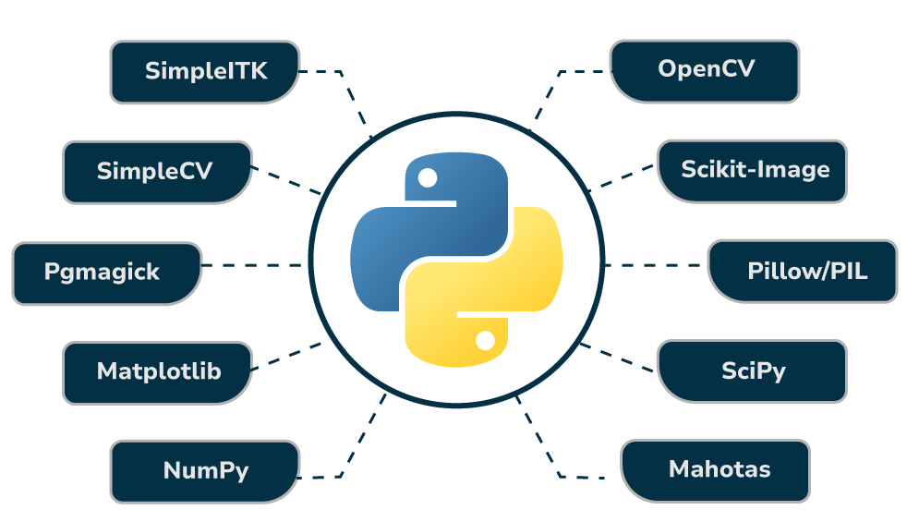
PART B · Library Overview
Python Libraries for Image processing

Slide 5
PART B · LIBRARY OVERVIEW
WHAT IT DOES
01 / 10
OpenCV
• Reads, writes, and displays images and video
• Real-time processing — built in optimized C++
• Detects edges, faces, contours, and objects
• Powers tracking, filtering, and transformations
Built for speed and computer vision — the library to reach for when Pillow isn't enough.
WHY IT'S USEFUL
• Much faster than pure Python or Pillow at scale
• Industry standard for computer vision and CV research
• Handles video streams and webcams natively
• Huge ecosystem — face detection, tracking, ML integration
OpenCV loads images as BGR (not RGB) by default — convert with cv2.cvtColor(img, cv2.COLOR_BGR2RGB) before displaying with Matplotlib.
HOW TO IMPORT
# pip install opencv-python
“
OpenCV still returns a NumPy array — same rules apply, just faster, and built for vision tasks.
import cv2
img = cv2.imread("cells.jpg")
print(img.shape)

Slide 6
PART B · LIBRARY OVERVIEW
02 / 10
scikit-image
A comprehensive, NumPy-native toolkit for image analysis and processing.
WHAT IT DOES
WHY IT'S IMPORTANT
HOW TO IMPORT
Filtering: edge detection, denoising, sharpening
Segmentation: separating objects from background
Feature extraction: corners, blobs, texture
Morphological operations: erosion, dilation, skeletonization
Built on SciPy, NumPy, and Cython — fast and array-native
Clean, well-documented, beginner-friendly API
Purpose-built for scientific image analysis (vs. general CV)
Strong fit for biology, microscopy, and research imaging
# pip install scikit-image from skimage import io, filters img = io.imread("cells.jpg") edges = filters.sobel(img)
Imported as skimage, not scikit-image — a common first-time import error.
This is the library the deep hands-on segment builds on — today's real dataset work happens here.

Slide 7
PART B · LIBRARY OVERVIEW
WHAT IT DOES
03 / 10
scipy.ndimage handles multi-dimensional array operations
Provides filtering: Gaussian, median, uniform blur
Supports geometric transforms: rotate, shift, zoom
Offers interpolation and morphological operations
SciPy
Scientific computing library with a dedicated image-processing submodule: scipy.ndimage.
WHY IT'S USEFUL
Built directly on NumPy — seamless array integration
Strong for scientific, medical, and engineering imaging
Lightweight alternative to OpenCV for simple filtering
Good for batch numerical processing of image stacks
SciPy is general scientific computing — image tools live specifically inside the scipy.ndimage submodule, not the top-level package
>_
HOW TO IMPORT
# pip install scipy
“
from scipy import ndimage blurred = ndimage.gaussian_filter(arr, sigma=3) rotated = ndimage.rotate(arr, 45)
Think of SciPy as NumPy's mathematical toolbox — it processes the array, it doesn't manage image files.

Slide 8
PART B · LIBRARY OVERVIEW
04 / 10
Mahotas
A fast, C++-backed computer vision library focused on speed and texture analysis.
WHAT IT DOES
WHY IT'S IMPORTANT
HOW TO IMPORT
Feature detection: Haralick, Zernike, SURF features
Image segmentation: watershed, thresholding
Texture analysis: local binary patterns, GLCM
Morphological processing and filtering
Optimized for speed — core algorithms written in C++
Well-suited to large-scale image datasets
Strong texture and feature-analysis toolkit
Integrates smoothly with NumPy arrays
# pip install mahotas import mahotas as mh img = mh.imread("cells.jpg") mean = img.mean()
Mahotas shines at texture and feature analysis — less commonly used for basic editing tasks like resize/crop.
Reach for Mahotas when the question is "what texture or feature is in this image," not "how do I edit it."

Slide 9
WHAT IT DOES
PART B · LIBRARY OVERVIEW
Reads medical imaging formats (DICOM, NIfTI, MetaImage)
Image registration — aligning scans across time or modality
Advanced segmentation for anatomical structures
N-dimensional image support (2D, 3D, 4D volumes)
05 / 10
SimpleITK
The go-to toolkit for medical image analysis, registration, and segmentation.
WHY IT'S USEFUL
Built on ITK — decades of medical imaging research
Industry standard for radiology and biomedical research
Handles 3D/4D volumetric data other libraries don't
Simplifies ITK's complex C++ API into clean Python
Built for medical/volumetric data — overkill for everyday 2D photo editing tasks.
>_
HOW TO IMPORT
# pip install SimpleITK
“
If your dataset is scans, not photos, SimpleITK is usually the right starting point.
import SimpleITK as sitk
img = sitk.ReadImage("scan.nii")
arr = sitk.GetArrayFromImage(img)

Slide 10
PART B · LIBRARY OVERVIEW
06 / 10
SimpleCV
A beginner-friendly computer vision framework built to lower the entry barrier.
WHAT IT DOES
WHY IT'S IMPORTANT
HOW TO IMPORT
Simplified interface over complex CV algorithms
Image acquisition from cameras and files
Basic feature extraction and object detection
Designed for fast prototyping, not production pipelines
Much gentler learning curve than raw OpenCV
Good for teaching CV concepts to newcomers
Readable, high-level method names
Useful for quick prototypes and demos
# pip install SimpleCV from SimpleCV import Image img = Image("cells.jpg") img.show()
SimpleCV is largely unmaintained and Python 2-era — mention historically, don't recommend for new projects.
Useful to know it exists — but for a new project today, OpenCV or scikit-image is the better choice.

Slide 11
PART B · LIBRARY OVERVIEW
07/ 10
WHAT IT DOES
PmagicK
• Resize, scale, crop, rotate, and flip images • Apply blur, sharpen, and artistic effects (charcoal, emboss) • Adjust contrast, brightness, gamma, and color • Draw text and annotations directly on images
A Python binding for GraphicsMagick/ImageMagick — lightweight editing and effects.
WHY IT'S IMPORTANT
• Wraps the powerful GraphicsMagick/ImageMagick engine • Supports a very wide range of file formats • Lightweight and easy to pick up quickly • Good for batch conversions and simple effect pipelines
Requires the GraphicsMagick system library installed separately — not a pure pip install.
i
>_
HOW TO IMPORT
“
Functionally similar to Pillow, but leans on ImageMagick's mature effects engine underneath.
# pip install pgmagick
from pgmagick import Image
img = Image("cells.jpg")
img.scale("256x256")

Slide 12
PART B · LIBRARY OVERVIEW
08 / 10
Matplotlib
Not an image-processing library — but essential for displaying and annotating results.
WHAT IT DOES
WHY IT'S IMPORTANT
HOW TO IMPORT
Displays images as arrays with imshow()
Plots histograms of pixel intensity distributions
Overlays annotations, contours, and bounding boxes
Visualizes multi-channel and grayscale data with colormaps
The standard way to actually *see* array-based results
Works directly with NumPy arrays — zero conversion needed
Essential for comparing before/after processing results
Used throughout the deep hands-on segment with cnsplots
# pip install matplotlib import matplotlib.pyplot as plt plt.imshow(arr) plt.show()
Matplotlib expects RGB order — remember to convert OpenCV's BGR arrays before calling imshow().
Every processing step in this session ends the same way: back through Matplotlib, so you can actually see the result.

Slide 13
PART B · LIBRARY OVERVIEW
09/ 10
Pillow (PIL)
The friendly image library for Python — image I/O and everyday image manipulation.
Pillow is the modern, actively maintained fork of the Python Imaging Library (PIL).
HOW TO IMPORT
# pip install pillow from PIL import Image img = Image.open("sample.jpg") print(img.size)
WHAT IT DOES
WHY IT'S USEFUL
• Open, read, save and display images • Resize, crop, rotate and flip • Convert modes such as RGB ↔ grayscale • Apply enhancement and predefined filters
• Simple and beginner friendly • Good for everyday image processing • Works with many common formats • Easy bridge to NumPy arrays
Pillow can manipulate the Image object without NumPy.
Note: Pillow manages image files and common image operations. NumPy is optional unless you want direct array/pixel access.

Slide 14
PART B · HANDS-ON BASICS
Hands-on : Load & Inspect an Image
RUN:
WHAT TO OBSERVE
from PIL import Image img = Image.open("sample.jpg") print("Format:", img.format) print("Mode:", img.mode) print("Size:", img.size) img.show()
Format → JPEG / PNG / etc. Mode → RGB / RGBA / L Size → (width, height)

Slide 15
PART B · HANDS-ON BASICS
Hands-on : Resize & Save
RUN :
from PIL import Image img = Image.open("sample.jpg") resized = img.resize((400, 300)) resized.save("resized.jpg") print("Original:", img.size) print("Resized:", resized.size) resized.show()
TRY THIS
1. Change (400, 300) 2. Run again 3. Compare the new size 4. Open resized.jpg

Slide 16
PART B · HANDS-ON BASICS
Hands-on : Crop, Rotate & Flip
RUN :
from PIL import Image img = Image.open("sample.jpg") cropped = img.crop((100, 60, 700, 400)) cropped.save("cropped.jpg") rotated = img.rotate(90, expand=True) rotated.save("rotated.jpg") flipped = img.transpose(Image.Transpose.FLIP_LEFT_RIGHT) flipped.save("flipped.jpg") cropped.show() rotated.show() flipped.show()
EXPERIMENT
Crop box: (100, 60, 700, 400) Rotation: 90 → 45 → 180 Try FLIP_TOP_BOTTOM too.

Slide 17
PART B · HANDS-ON BASICS
Hands-on : Grayscale & Enhancement
RUN :
from PIL import Image, ImageEnhance img = Image.open("sample.jpg") gray = img.convert("L") gray.save("gray.jpg") bright = ImageEnhance.Brightness(img).enhance(1.5) bright.save("bright.jpg") contrast = ImageEnhance.Contrast(img).enhance(1.5) contrast.save("contrast.jpg") gray.show() bright.show() contrast.show()
CHANGE THE VALUES
Brightness: 1.5 → 0.5 → 2.0 Contrast: 1.5 → 0.8 → 2.0 Observe the output.

Slide 18
PART B · HANDS-ON BASICS
Hands-on 5: Blur & Sharpen
RUN :
from PIL import Image, ImageFilter img = Image.open("sample.jpg") blurred = img.filter( ImageFilter.GaussianBlur(radius=3) ) blurred.save("blurred.jpg") sharpened = img.filter(ImageFilter.SHARPEN) sharpened.save("sharpened.jpg") blurred.show() sharpened.show()
EXPERIMENT
Change the radius: 1 → 3 → 8 What happens as the radius increases? Then compare BLUR with SHARPEN.

Slide 19
PART B · HANDS-ON BASICS
Hands-on 6: Edge Detection
RUN :
WHAT TO LOOK FOR
from PIL import Image, ImageFilter img = Image.open("sample.jpg") edges = img.filter(ImageFilter.FIND_EDGES) edges.save("edges.jpg") edges.show()
Edges appear where image intensity changes rapidly. Try the same image after converting to grayscale. Next: OpenCV will give us more advanced computer-vision tools.

Slide 20
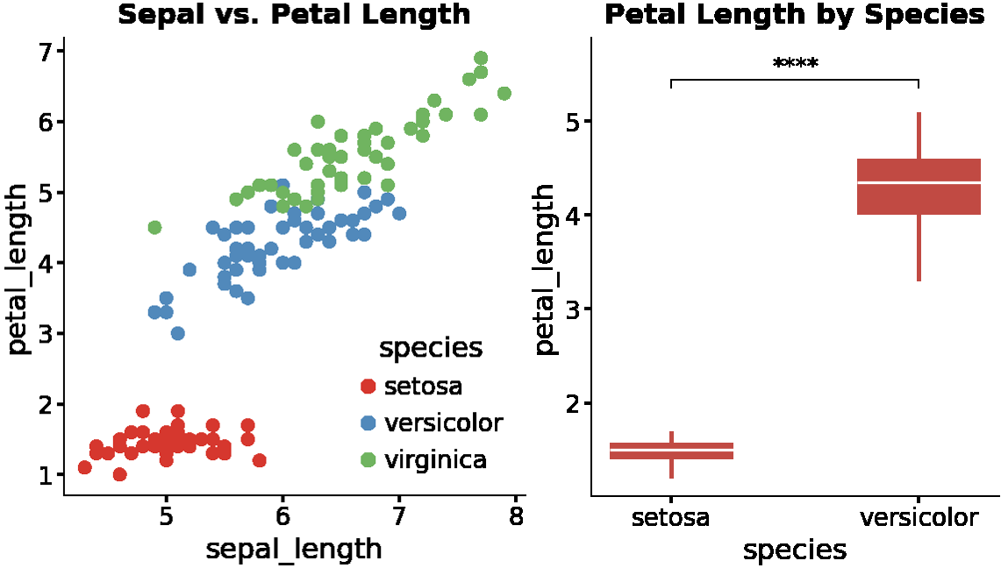
PART B · HANDS-ON BASICS
Hands-on : Merging Two Images
RUN
REAL RENDER
from PIL import Image img1 = Image.open("scatter.png") img2 = Image.open("box.png") h = min(img1.height, img2.height) merged = Image.new("RGB", (img1.width+img2.width, h)) merged.paste(img1, (0,0)); merged.paste(img2, (img1.width,0))
OUTPUT
img1: 602 x 649 img2: 540 x 648 merged: 1141 x 648
scatter.png + box.png · two real plots from this deck, joined

Slide 21
PART B · LIBRARY OVERVIEW
NumPy
The array engine underneath every image — not image-specific, but foundational.
WHAT IT DOES
WHY IT'S IMPORTANT
HOW TO IMPORT
Represents images as multi-dimensional arrays
Enables fast, vectorized math on pixel data
Supports slicing, indexing, and reshaping
Forms the data structure every other library builds on
Every image library ultimately returns a NumPy array
Pixel-level operations run in optimized C, not Python loops
Foundation for OpenCV, scikit-image, Matplotlib, and more
One consistent interface across the whole ecosystem
# pip install numpy import numpy as np arr = np.array(img) print(arr.shape, arr.dtype)
Note: NumPy itself doesn't open image files — it works on the array once Pillow or OpenCV has loaded it.
Every library on this list either produces or consumes a NumPy array — that's the thread tying the whole session together.

Slide 22
PART B · LIBRARY OVERVIEW
From Pillow Image → NumPy Array
Connect the Image object to the numerical representation used by many other libraries.
RUN :
from PIL import Image import numpy as np img = Image.open("sample.jpg") arr = np.array(img) print("Image size:", img.size) print("Array shape:", arr.shape) print("Data type:", arr.dtype)
WHAT THIS SHOWS
Pillow → opens the image file NumPy → represents pixel data as numbers shape → height × width × channels dtype → how values are stored
Important: NumPy is NOT required for every image operation. Pillow can resize, crop, rotate, filter and save without importing NumPy.

Slide 23
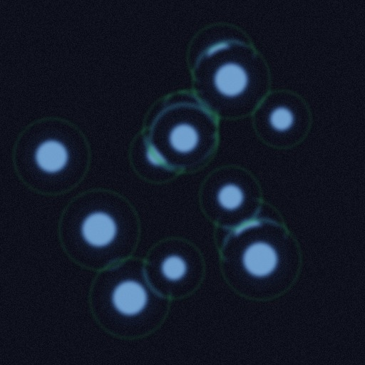
PART B · HANDS ON
An Image Is Just a NumPy Array
Three lines turn any image file into numbers you can inspect, slice, and compute on directly.
SAMPLE IMAGE
IMAGE → ARRAY
from PIL import Image import numpy as np img = Image.open("cells.jpg") arr = np.array(img) print(arr.shape) print(arr.dtype)
REAL OUTPUT — VERIFIED
(512, 512, 3) uint8
(height, width, channels) — 512 rows, 512 columns, 3 color channels (R, G, B). uint8 means each value is an integer from 0 to 255.
shape (512, 512, 3) · dtype uint8

Slide 24
PART C · SCIENTIFIC VISUALIZATION
Why Raw Plots Aren't Enough
Wrong font for a journal — DejaVu Sans, not Helvetica/Arial
All four spines boxed — visual clutter reviewers flag
100 DPI by default — not print resolution
No significance encoding — every point is the same color
No automatic labeling of the genes/points that matter
Every fix means hand-writing rcParams — and redoing it every figure

Slide 25
PART C · SCIENTIFIC VISUALIZATION
It's Not Just Matplotlib
 | Matplotlib | Seaborn | Plotly | cnsplots
Journal font (Helvetica/Arial) by default | ✗ DejaVu Sans | ✗ DejaVu Sans | ✗ unset | ✓ verified fallback
Clean 2-spine axes by default | ✗ 4 spines boxed | ✗ still boxed* | ● different chrome | ✓ top/right removed
300 DPI+ static export, no setup | ● manual rcParams | ● manual rcParams | ✗ needs Chrome install* | ✓ 288 DPI default
Volcano / survival / ROC built in | ✗ none | ✗ none | ✗ none | ✓ all three
Clustered heatmap + dendrogram | ✗ none | ✓ clustermap() | ✗ density only | ✓ heatmapplot()
One import fixes all of the above | ✗ no | ✗ no* | ✗ no | ✓ yes

Slide 26
PART D · CNSPLOTS
What Is cnsplots
A matplotlib/seaborn wrapper with defaults styled for Cell, Nature, and Science.
WHAT IT DOES
WHY IT'S IMPORTANT
HOW TO IMPORT
Wraps matplotlib + seaborn with journal-ready defaults
30+ scientific plot types — volcano, GSEA, forest, survival, ROC, heatmap, phylo, upset
Exact pixel-based figure sizing
Exports PDF/SVG with editable, embedded fonts for Illustrator
One call replaces a page of rcParams tuning
Purpose-built for biology — direct scanpy integration
Output is submission-ready, not “close enough”
Still 100% matplotlib/seaborn — every ax. method still works
# pip install cnsplots
import cnsplots as cns
Note: Pulls in scanpy, lifelines, gseapy, biopython — a heavier install than Pillow, budget a minute. If a build fails on autograd-gamma, run pip install "setuptools<81" wheel first.

Slide 27
PART D · CNSPLOTS
Installation
A standard PyPI package. Installing it pulls in every backend it wraps — lazily, so nothing loads until you use it.
Installed automatically:
STANDARD INSTALL
pip install cnsplots
matplotlib
seaborn
pandas / NumPy / SciPy
VERIFY
scanpy
lifelines
gseapy
python -c "import cnsplots as cns; \
print(cns.__version__)"
# 0.6.0
Biopython
PyComplexHeatmap
set-plotting libs
DEVELOPMENT INSTALL (uv-based)
git clone https://github.com/faridrashidi/cnsplots
cd cnsplots
make install # editable install, dev + docs extras

Slide 28
PART D · CNSPLOTS
The Gallery — 30+ Plot Types
Same one-line pattern, three demoed today. Everything below is the same API.
DISTRIBUTIONS
Box · Violin · Histogram · KDE · Ridge · Q-Q
RELATIONSHIPS
Scatter · Regression · Line · Slope
CATEGORICAL
Bar · Lollipop · Strip · Dot
COMPOSITIONS
Pie · Donut · Stacked bar · Sankey
SPECIALIZED — BIOLOGY
Volcano · GSEA · Forest · Survival · ROC · Heatmap · Phylo · Venn · UpSet

Slide 29
PART D · CNSPLOTS
Volcano Plot
Every gene's fold-change vs. significance — one plot instead of a spreadsheet.
WHEN TO USE
DATA
HOW TO RUN
Comparing two conditions across hundreds or thousands of genes at once
Treated vs. control, tumor vs. normal — one differential-expression result
Spotting the strongest hits by eye before digging into the results table
The standard first figure in almost every RNA-seq paper
A real DE results table — DESeq2 / edgeR / limma output, not raw counts
One row per gene: fold-change + adjusted p-value + gene symbol
Needs hundreds of genes to be meaningful, not a handful
cnsplots' own volcano_df (500 rows) is placeholder data, shaped like a real result
cns.figure(200, 200)
cns.volcanoplot(df, x="log2FoldChange", y="-log10(adjp)", symbol="gene", n_show=8)
Verified in source: cnsplots hardcodes padj < 0.05 and |log2FC| > 0.5 for Up/Down — not a parameter you can change; pre-filter first if your table uses different cutoffs.

Slide 30
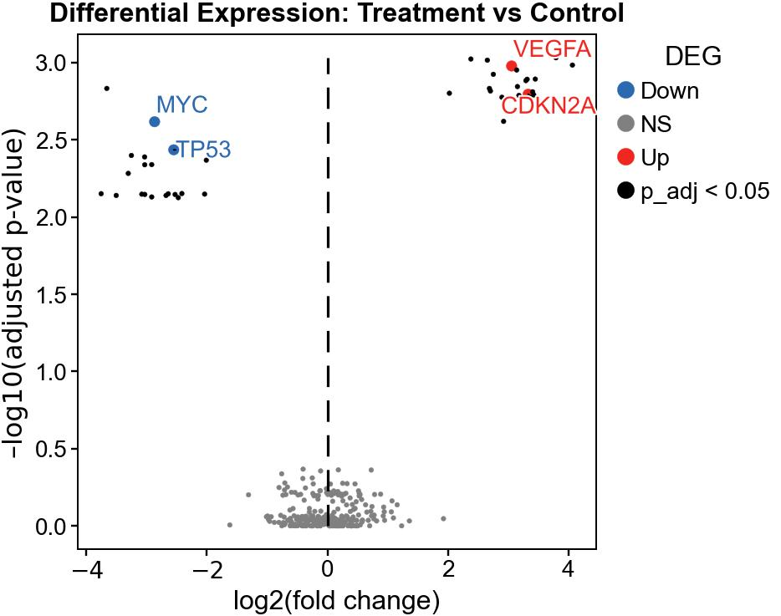
PART D · CNSPLOTS
Hands-on : Volcano Plot
Run this on cnsplots' own bundled differential-expression table.
RUN
cns.figure(200, 200) ax = cns.volcanoplot( volcano_df, x="log2FoldChange", y="-log10(adjp)", symbol="symbol", n_show=8, ) cns.savefig("volcano.png")
OUTPUT
500 genes -> 122 Up / 144 Down 8 labeled each side
volcano_df · 500 rows, placeholder gene names
30

Slide 31
PART D · CNSPLOTS
Scatter Plot
Do two measurements move together?
WHEN TO USE
DATA
HOW TO RUN
Testing a relationship between two continuous measurements
Dose vs. response, two genes' expression, two clinical readings
Before/after values for the same sample
The first check before you claim two things are correlated
Real, paired numeric values — one row per sample
Both axis columns must be numeric, not categorical-coded-as-text
Needs dozens of points minimum for a trend to mean anything
An optional grouping column colors the points by category
cns.figure(180, 180)
cns.scatterplot(df, x="colA", y="colB", hue="group")
cnsplots colors points by hue automatically, with a legend added. No group column? Just drop the hue argument entirely.

Slide 32
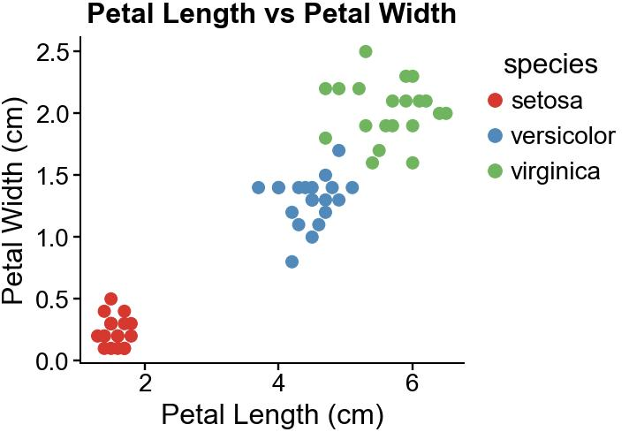
PART D · CNSPLOTS
Hands-on : Scatter Plot
Sepal length vs. petal length, colored by species — real Fisher's iris data.
RUN
cns.figure(170, 170) ax = cns.scatterplot( iris_df, x="sepal_length", y="petal_length", hue="species", s=12, ) cns.savefig("scatter.png")
OUTPUT
n = 150 flowers Pearson r = 0.87, p = 1.0e-47
iris_df · 150 real flowers, 3 species
32

Slide 33
PART D · CNSPLOTS
Box Plot
Median, quartiles, and outliers — the classic group comparison.
WHEN TO USE
DATA
HOW TO RUN
Comparing the median and spread of a measurement across groups
A quick, familiar summary — reviewers know how to read it instantly
Spotting outliers explicitly, shown as individual points
A good default when you don't need the full distribution shape
Long-format data: one numeric column, one group column
Works with smaller n than a violin plot — quartiles are more stable than a KDE shape
Same table shape as the violin and bar plots
Outliers are hidden by default in cnsplots — turn them on deliberately
cns.figure(150, 170)
cns.boxplot(df, x="group", y="value", pairs=[(...)], showoutliers=True)
Verified in source: pairs= runs a Mann-Whitney U test — the same non-parametric test the violin plot uses; showoutliers defaults to False.
33

Slide 34
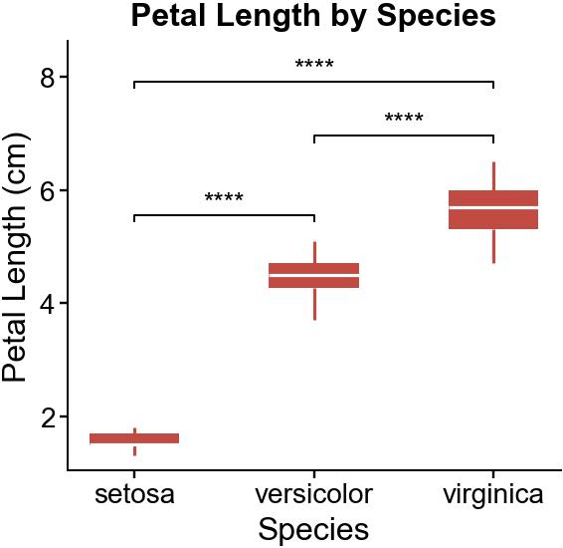
PART D · CNSPLOTS
Hands-on : Box Plot
Petal length, setosa vs. versicolor — same iris data as the violin plot.
RUN
cns.figure(150, 170) ax = cns.boxplot( two_sp, x="species", y="petal_length", pairs=[("setosa", "versicolor")], ) cns.savefig("box.png")
OUTPUT
n = 50 / 50 Mann-Whitney p = 5.65e-18 (****)
iris_df · setosa vs. versicolor, petal_length

Slide 35
PART D · CNSPLOTS
Violin Plot
The whole distribution, not just its quartiles.
WHEN TO USE
DATA
HOW TO RUN
You need the SHAPE of the distribution, not just its median
Catches bimodality, skew, and clusters a box plot would flatten
Comparing groups where the spread might differ, not just the center
Presenting to an audience that will actually look at the shape
Long-format: one numeric column, one group column — same as box plot
Aim for 10+ replicates per group — small n makes the KDE shape misleading
Works best when you suspect the distribution isn't simply normal
The same table can feed box, violin, or bar — try more than one
cns.figure(160, 180)
cns.violinplot(df, x="group", y="value", pairs=[(...)], add_box=True)
pairs= runs a Mann-Whitney U test (non-parametric) — same test as the box plot; add_box=True overlays the quartile box inside.

Slide 36
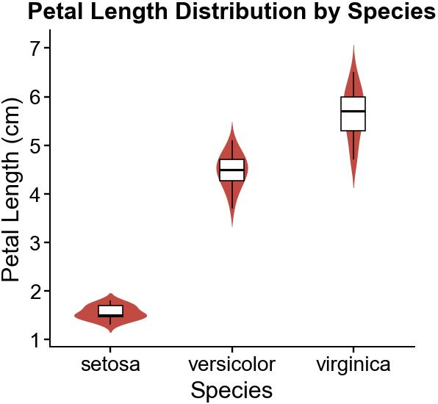
PART D · CNSPLOTS
Hands-on : Violin Plot
Same setosa vs. versicolor comparison as the box plot — now with shape.
RUN
cns.figure(185, 170) ax = cns.violinplot( two_sp, x="species", y="petal_length", pairs=[("setosa", "versicolor")], add_box=True, ) cns.savefig("violin.png")
OUTPUT
n = 50 / 50 Mann-Whitney p = 5.65e-18 (****)
iris_df · setosa vs. versicolor, petal_length

Slide 37
PART D · CNSPLOTS
Clustered Heatmap
Patterns across many features and many samples at once.
WHEN TO USE
GOOD DATA
HOW TO RUN
Finding structure you didn't specify in advance
Which samples group together, which features co-vary
Screening hundreds to thousands of features in a single view
A first-pass exploratory plot before you decide what to test formally
A numeric matrix: samples x features
Enough of both (tens+) for clustering to be meaningful
Z-score each feature first — raw-scale values wash out the pattern entirely
Wrap the matrix as an AnnData object for cnsplots
cns.figure(260, 210)
cns.heatmapplot(adata, row_cluster=True, col_cluster=True, row_split="group")
Verified necessary every time: z-scoring each feature — raw-scale values wash out the pattern. row_split groups rows by a metadata column, no extra legend needed.
37

Slide 38
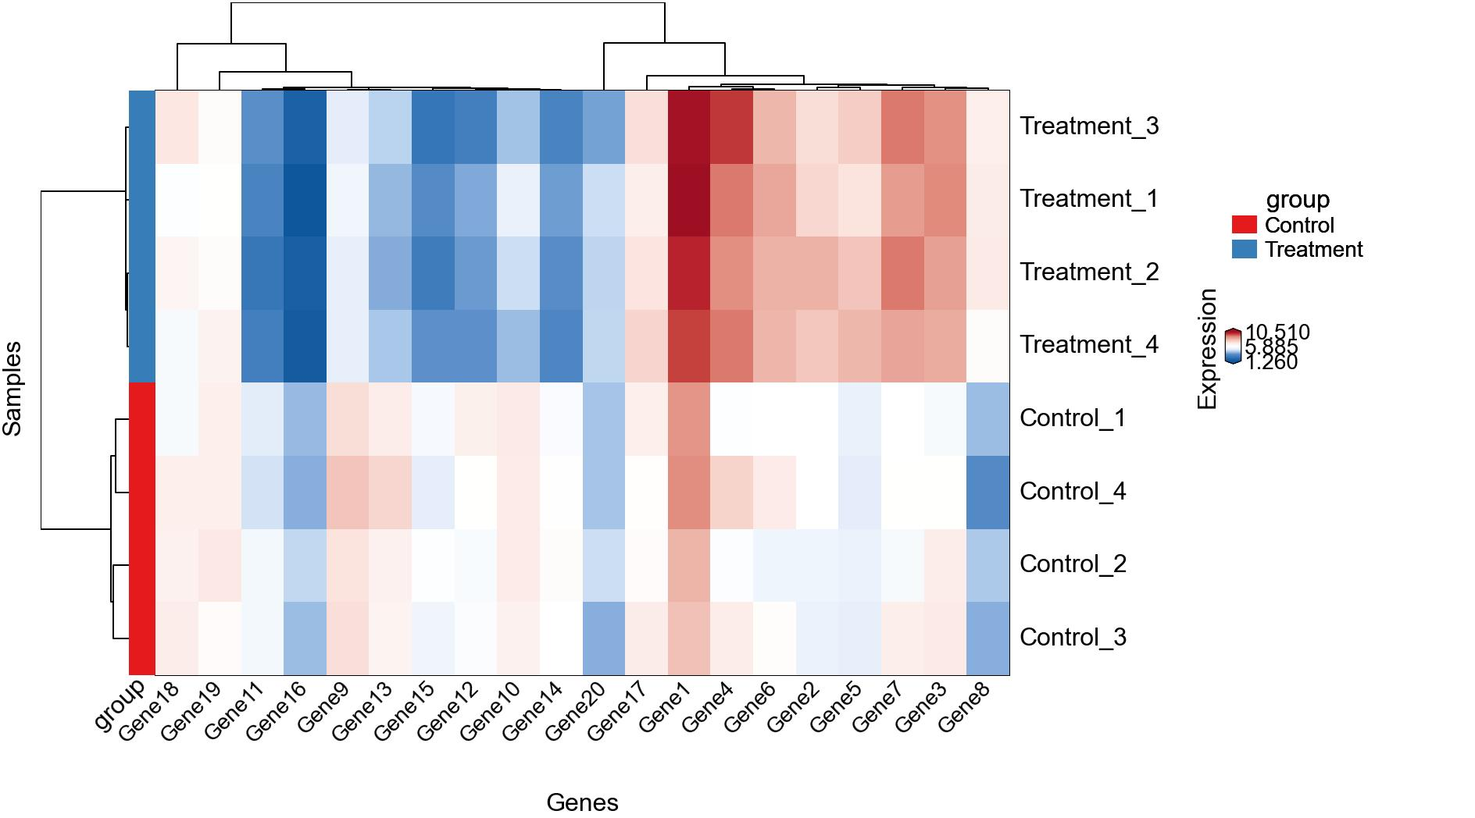
PART D · CNSPLOTS
Hands-on : Clustered Heatmap
cnsplots' own synthetic cluster demo data — 11 samples, 640 features.
RUN
cns.figure(230, 210) cmp = cns.heatmapplot( blobs, row_cluster=True, col_cluster=True, row_split="Ensemble", cmap="BuRd_custom", ) cns.savefig("heatmap.png")
OUTPUT
11 samples x 640 features split into 3 groups (Ensemble)
blobs (synthetic) · 11 x 640, not real expression values

