Slide 1
Unix/Linux Command
Vaishnavi R Project Associate – 1 CG Lab CSIR IICB

Slide 2
Introduction to Unix
Linux is a community of open-source Unix like operating systems based on Linux kernel. Released by Linus Torvalds on 17 september1991.
Initially- Personal computers, gradually – servers, mainframe computers, supercomputers, etc.,
Unix operating system provides powerful command-line tools and scripting capabilities essential for bioinformatics data processing and analysis
Emphasizes modularity, flexibility, and interoperability allowing researchers to create custom workflows for complex genomic data manipulation
Unix vs other operating systems
Offers superior text processing capabilities compared to Windows, crucial for handling large genomic datasets.
Provides a more standardized command-line interface across different Unix-like systems (Linux, macOS).
Supports robust scripting languages (Bash, Perl, Python) commonly used in bioinformatics workflows
Offers better performance and resource management for computationally intensive bioinformatics tasks.

Slide 3
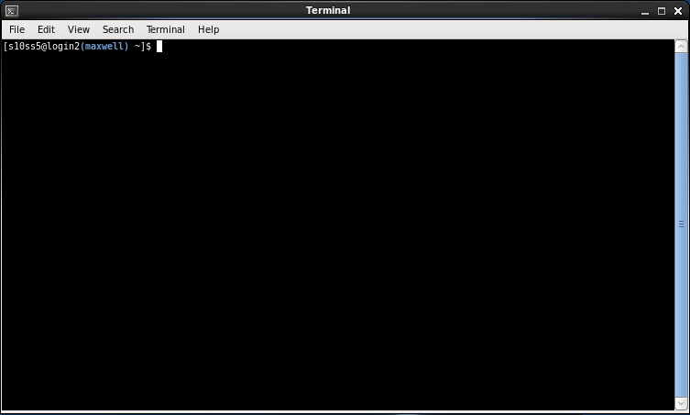
The Terminal
The Command Line, The Shell, The Prompt
Where you see this “$” followed by text, I want you to type the text on your command line

Slide 4
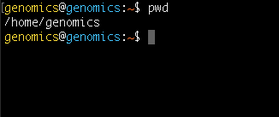
Location is Important
First Task – Where am I?
$ pwd
This is your “present working directory”.

Slide 5
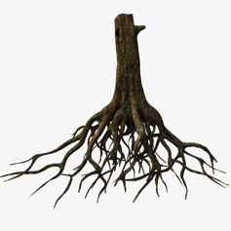

/
= ROOT
…
home
bin
lib
genomics
master
ubuntu

Slide 6
/
…
home
bin
lib
genomics
master
ubuntu

Slide 7

/
…
home
lib
bin
~
genomics
master
ubuntu
This location is also known as your Home Directory
Tilde is shorthand for Home ~

Slide 8
Now let’s create some directories and files
Make a directory
$ mkdir Data
Change into this directory
$ cd Data
Now what is your present working directory?
NOTE! Directory names (and file names for the matter) can not contain spaces.
Underscores are often used instead if you want to separate words.

Slide 9

/
…
home
bin
lib
~
genomics
master
ubuntu
Data

Slide 10
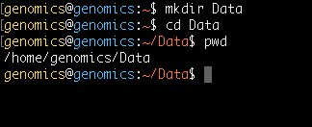
/
…
home
bin
lib
genomics
master
ubuntu
~
Data

Slide 11
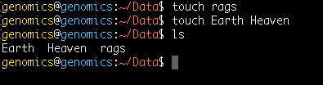
Now let’s create some directories and files
Make an empty file
$ touch rags
And another two
$ touch Earth Heaven
Now let’s list the contents of the current directory (Data)
$ ls

Slide 12


home
genomics
master
ubuntu
~
Data
rags
Earth
Heaven

Slide 13

home
genomics
master
ubuntu
~
Now list ALL of the files
$ ls -a
Data
rags
Earth
Heaven

Slide 14
home
ubuntu
genomics
master
~
Now list ALL of the files
$ ls -a
Data
rags
Earth
Heaven
..
.

Slide 15
..
home
..
..
..
genomics
master
ubuntu
~
..
Data
These special files are in every directory
.. Points to one directory above
. Points to the current directory
rags
Earth
Heaven

Slide 16
.
home
.
.
.
genomics
master
ubuntu
~
.
Data
These special files are in every directory
.. Points to one directory above
. Points to the current directory
rags
Earth
Heaven

Slide 17

. and .. are used for specifying location
Whenever you do anything on Unix
(move around, move a file, rename a file etc…)
You have to tell the system where that thing is using a path
. and .. are part of RELATIVE paths

Slide 18
home
Moving from Data to New
RELATIVE PATH
genomics
master
ubuntu
~
Data
New
$ cd ../New

Slide 19
home
genomics
master
ubuntu
Moving from Data to New
RELATIVE PATH
~
Data
New
$ cd ../New

Slide 20
home
genomics
master
ubuntu
Moving from Data to home
RELATIVE PATH
~
Data
New
$ cd ../../

Slide 21
home
genomics
master
ubuntu
Moving from Data to home
RELATIVE PATH
~
Data
New
$ cd ../../

Slide 22
Relative paths will always change
depending on your location.
The alternative is ABSOLUTE paths.
These always start from root and will never change.

Slide 23
/
…
home
bin
lib
genomics
master
ubuntu
Moving from Data to New
ABSOLUTE PATH
~
$ cd /home/genomics/New
Data
New

Slide 24
/
…
home
bin
lib
genomics
master
ubuntu
Moving from Data to New
ABSOLUTE PATH
~
$ cd /home/genomics/New
Data
New

Slide 25
/
…
home
bin
lib
genomics
master
ubuntu
Moving from Data to home
ABSOLUTE PATH
~
$ cd /home/
Data
New

Slide 26
/
…
home
bin
lib
genomics
master
ubuntu
Moving from Data to home
ABSOLUTE PATH
~
$ cd /home/
Data
New

Slide 27
A Note About Dot!
. means “In your pwd …”
This command means “List everything that’s in the pwd”
$ ls ./
This command means “List everything that’s in the pwd within a sub-directory called Data”
$ ls ./Data/
In most cases, people don’t use ./ at the beginning of a path. As long as the file/directory is within your pwd, the command will work.
=
$ ls ./Data/
$ ls Data
Dot is most helpful when you want to “copy a file to your pwd”
…But we’ll talk about this more later!

Slide 28
Let’s put this to practice
Where am I right now? (Should be the Data directory)
$ pwd
Change to the directory above
$ cd ../
Let’s list the contents of the Data directory
$ ls ./Data/

Slide 29
Challenge 1!
Move into the Data directory and list the contents of your home directory
$ cd Data
$ ls ..
OR
OR
$ ls /home/genomics/
$ ls ~
In Data, make a new directory and move into this location
$ mkdir new
$ cd new
From this new directory, move into your home directory IN ONE COMMAND and check your location
$ cd ../..
OR
$ cd /home/genomics/
OR
$ cd ~
OR
$ cd
$ pwd

Slide 30
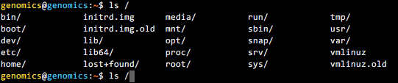
If You’re Typing, You’re Doing Something Wrong!
Tab complete is a nice trick to save you typing paths
For this example we are going to list everything in the directory
/home/genomics/workshop_materials/
Start by typing:
Followed by tab twice quickly
$ ls /
This shows the contents of the root directory

Slide 31
If You’re Typing, You’re Doing Something Wrong!
Now type:
$ ls /h
Followed by tab once. The path to the /home/ directory has filled in.
$ ls /home/
Now type:
$ ls /home/g
Followed by tab once. The path to the /home/genomics/ directory has filled in.
$ ls /home/genomics
Tab complete will fill in paths, save you time in typing and prevent typos!
Finally type:
$ ls /home/genomics/w
Followed by tab once to finish the path, and then enter.
You’ve now listed that directory contents.

Slide 32
If You’re Typing, You’re Doing Something Wrong!
Two more tricks for less typing!
* Represents a special character
For example:
Will list everything in my home directory ending .txt
The up arrow can be used to re-run commands
Press your up arrow and see
If you want all of these commands listed, simply type
$ ls /home/genomics/*.txt
$ history

Slide 33
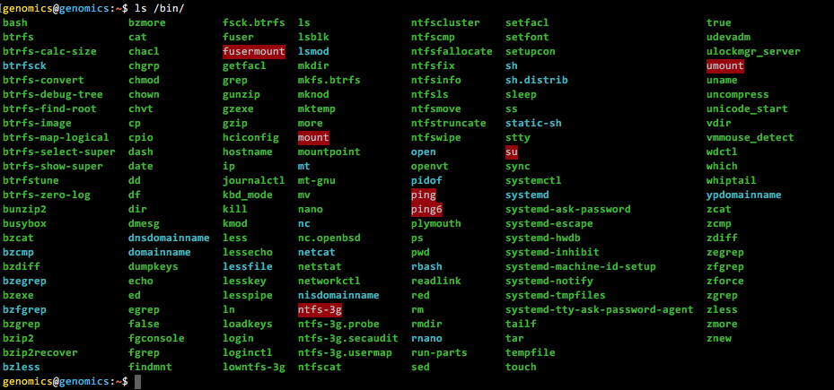
Binary programs
These are all programs installed on the Unix machine.
They can be found in /bin
$ ls /bin
These include pwd, mkdir, ls …

Slide 34
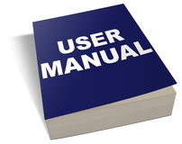
Every binary program has a manual
To view the manual page, type man followed by the name of the program
Open the manual page for ls
Scroll through (enter) and find the options for:
long listing format (-l), human-readable sizes (-h) and sort by modification time (-t)
Exit the manual page (type q) and give these ls options a go in your Data directory
$ man <PROGRAMME>
$ man ls
$ ls –l ./Data
OR
$ ls –t ./Data
$ ls –l -h ./Data
OR
$ ls –lh ./Data
$ ls –l -h -t./Data
OR
$ ls –lht ./Data
$ ls –l –h –t -a ./Data
OR
$ ls –lhta ./Data

Slide 35
/
…
home
lib
bin
Examples!
genomics
master
ubuntu
~
First I need you to make a new directory
called “Working” within your home directory.
Afterwards your file structure should look like
this!
Data
Working
rags
Earth
Heaven

Slide 36
/
…
home
lib
bin
Moving Files
genomics
master
ubuntu
~
Lets move Heaven and Earth from Data to Working
Now move Heaven too
REMEMBER TAB COMPLETE!
$ cd ~/Data
$ mv ./Earth ../Working/
Data
Working
File Path
Location Path
rags
Earth
Heaven

Slide 37
/
…
home
bin
lib
genomics
master
ubuntu
Moving Files
~
mv can also be used to rename files
Let’s change rags to riches
Data
Working
$ mv ./rags ./riches
File Path
Location Path
rags
Earth
Heaven

Slide 38
/
…
home
lib
bin
genomics
master
ubuntu
~
Data
Working
riches
Earth
Heaven

Slide 39
/
…
home
bin
lib
Deleting Files
genomics
master
ubuntu
~
Now let’s delete Heaven
(Check your present working directory is Data)
When prompted type y for yes and press enter
Data
Working
$ rm –i ../Working/Heaven
riches
Earth
Heaven

Slide 40
/
…
home
bin
lib
genomics
master
ubuntu
~
Deleting Files
Now let’s delete the entire Working directory
Including Earth
Data
Working
$ rm -r –i ../Working/
riches
Earth

Slide 41

/
…
home
bin
lib
rm -rf / is basically Unix's version of a horror story.
Deleting Files
genomics
master
ubuntu
~
Deleting files is very dangerous! There is no recycle bin
in Unix! Once gone, files are gone forever!
Therefore try to ALWAYS use rm –i
Data
riches

Slide 42
/
…
home
bin
lib
Copying Files
genomics
master
ubuntu
~
Let’s make a copy of riches within the home directory
(Make sure your present working directory is Data)
Data
$ cp ./riches ../
riches
File Path
Location Path

Slide 43
/
…
home
bin
lib
genomics
master
ubuntu
~
riches
Data
riches

Slide 44
/
…
home
bin
lib
Copying Files
~
genomics
master
ubuntu
You can also copy entire directories and use this function
to rename files/directories
Move to home
Make a copy of the Data directory here and call it Backup
riches
$ cd ~
Data
$ cp –r ./Data ./Backup
riches

Slide 45
/
home
…
bin
lib
~
master
ubuntu
genomics
riches
Data
Backup
riches
riches

Slide 46
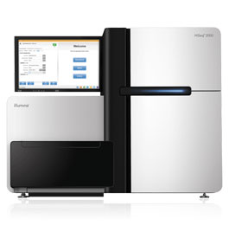
Typical File Sizes
One Sequencing Sample on the Illumina NextSeq
3,000,000 reads = 1 Gb
But typically you will sequence more than one sample
You may have different patients, different locations, replicates etc…
The size of the sequencing data file can easily become 100s of Gb
(or even bigger depending on the sequencer used)

Slide 47
Archived/Compressed Files
Commonly, people will archive directories and compress large files so that they are
easier to store or share. Here’s an example:
sequences.tar.gz
.tar – means that it is a tape archived directory
.gz – means that it is gzipped file
These can be used alone or in combination
To uncompress
A Tar Archive
(x = extract, v = verbose, f = all files)
A Gzipped file
A Gzipped Tar archive

Slide 48

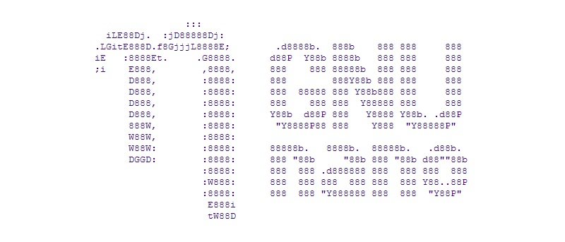

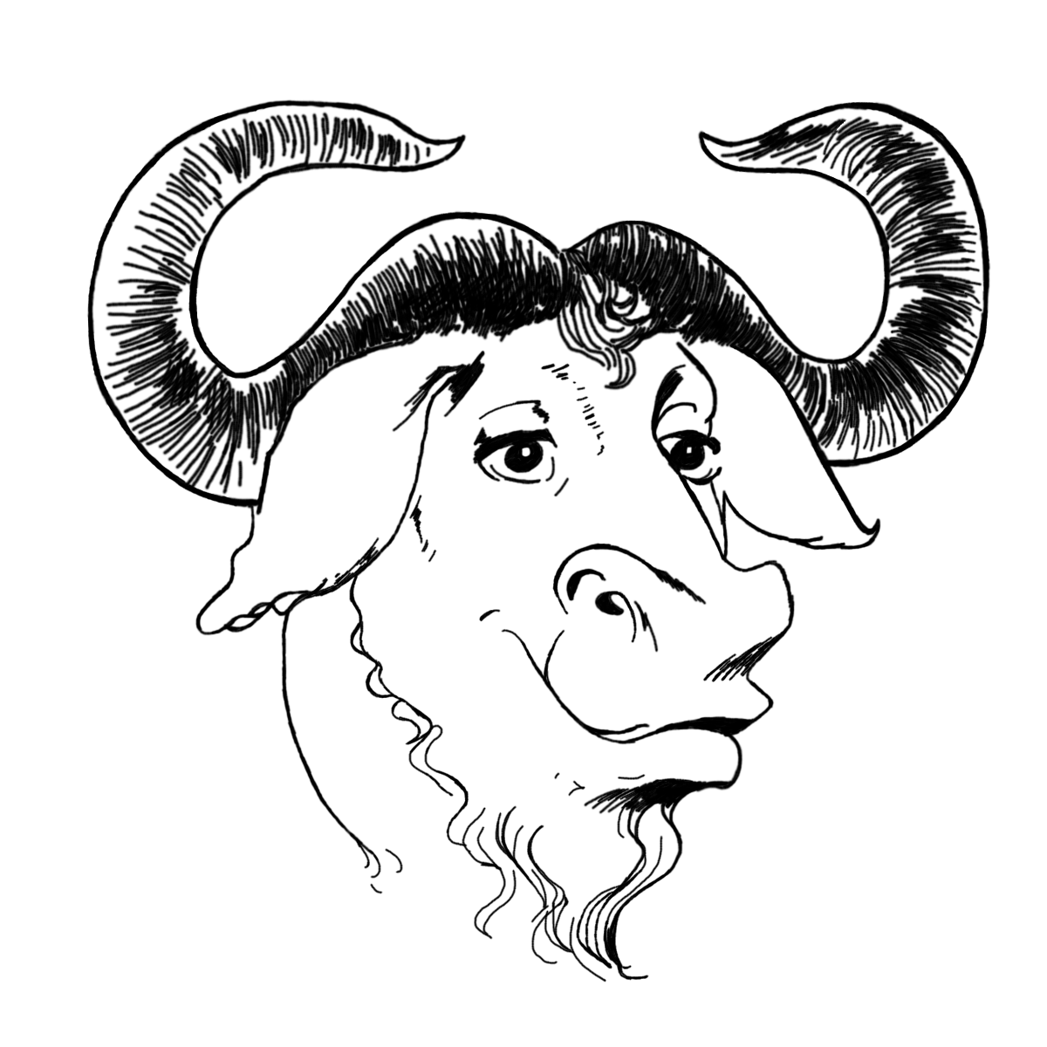
Text Editors
These are pieces of software which can be used to edit files.
Think of them as Unix versions of Notepad.
Some have an interactive user interface – E.G. gedit
Some work from within the command line – E.G. nano, vim, emacs
Use nano to open the scientists.txt file and add yourself to the list!
nano ~/workshop_materials/unix/scientists.txt

Slide 49

Software Installation
The “get and compile” method!
Get the software from somewhere and then install it manually.
GitHub is a fantastic repository containing a lot of bioinformatics software! It works using git so it’s easy to download.
There are others… sourceforge, personal webpages etc...
Commonly wget is used with these!

Slide 50
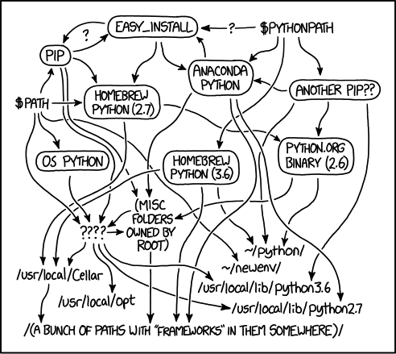
IT IS NOT AS EASY AS IT SOUNDS

Slide 51
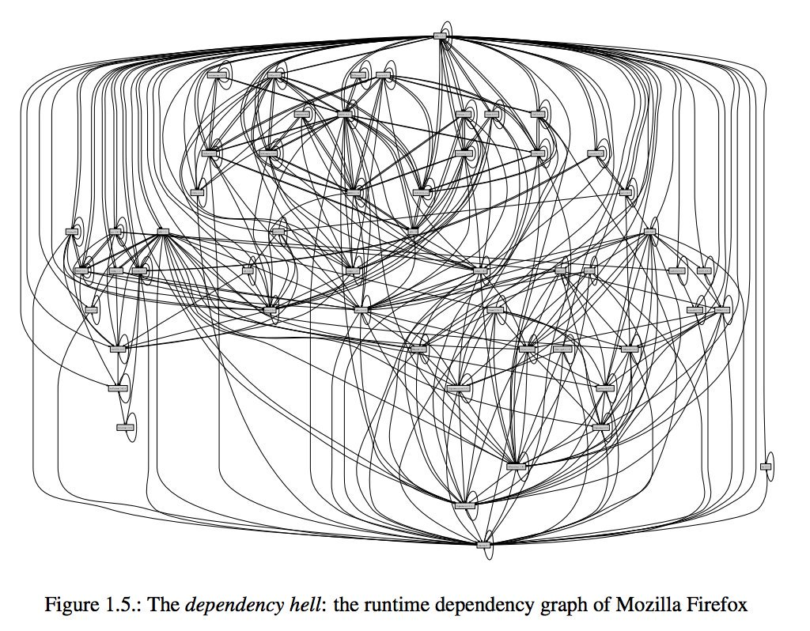
Dependencies
A lot of software needs other software to work…
Which in turn needs other software..
Which also needs other software...

Slide 52

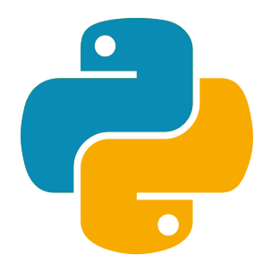



Software Managers
apt-get install
OR
yum
pip install
Don’t forget cpanm for perl
and install.packages() for R
These are all trying to
make your life easier...

Slide 53

Confused!?
Don’t worry, you aren’t the only one!
This section is just to make you aware of software installation techniques so you aren’t surprised when you get home and can’t find SAMtools on your system!

Slide 54
For after the workshop…
A Quick Guide to Organizing Computational Biology Projects. Noble (2009) PLoS Computational Biology
http://journals.plos.org/ploscompbiol/article?id=10.1371/journal.pcbi.1000424
Best Practices for Scientific Computing. Wilson et al. (2014) PLoS Biology
http://journals.plos.org/plosbiology/article?id=10.1371/journal.pbio.1001745
SandBox.bio
https://sandbox.bio/tutorials?id=terminal-basics
Hackerrank
https://www.hackerrank.com/domains/shell
Google!!
CYGWIN- For Linux practice.

Slide 55
CHALLENGE 1!
Move into the Data directory and list the contents of your home directory
In Data, make a new directory and move into this location
From this new directory, move into your own home directory (genomics) IN ONE COMMAND and check your location
Change to the workshop_materials directory at the following path:
Make a copy of this file in the Backup directory you created earlier
Unzip the read files
Rename the unarchived files – sequence_1.fq and sequence_2.fq
Delete the original .tar file
/usr/local/DATA

Slide 56
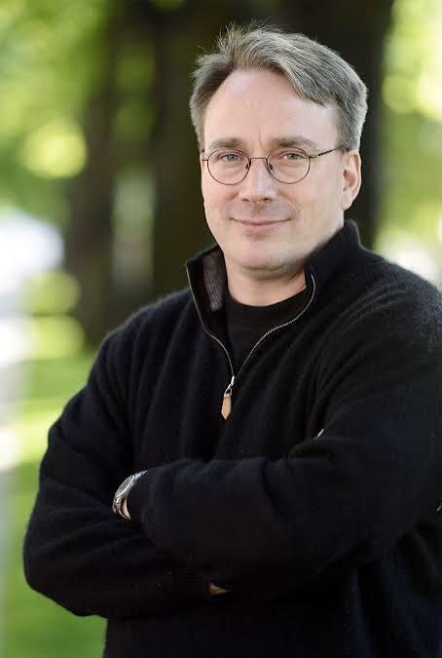
FACTS
Linux was almost called "Freax" - a colleague uploaded it as "Linux" instead, and the name stuck.
Torvalds called it "just a hobby" on Usenet in 1991 - Linux now runs most of the world's servers.
Torvalds also created Git in 2005 - now the world's top version control tool.

