Slide 1
Introduction to RNA-seq
Aribam Geeta, PhD
Project Associate I
Computational Genomics Lab,
CSIR-Indian Institute of Chemical Biology

Slide 2
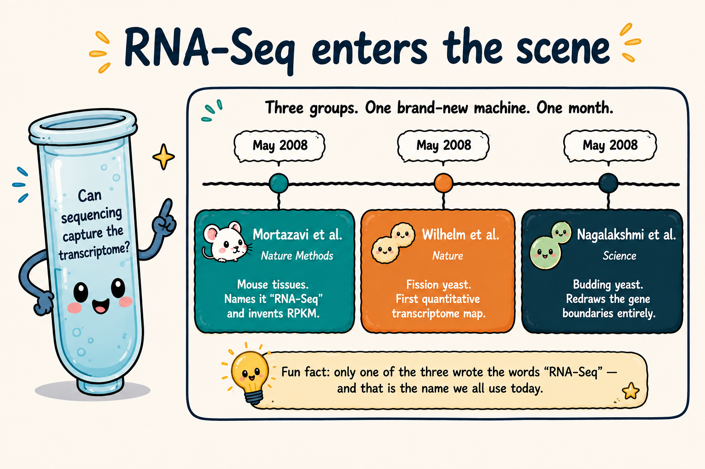
The race to RNA-Seq
RNA-Seq — a new way to study the transcriptome

Slide 3
Today’ RNA-Seq journey
RNA-Seq Foundations
What are we measuring? What is RNA-Seq? How does the workflow look?
PART 1 — Before We Sequence Experimental design • Sample preparation • Sequencing choices
PART 2 — From Reads to Numbers QC • Mapping and its pitfalls • Counting
PART 3 — From Numbers to Biology Normalisation • DGE• Visualisation

Slide 4
RNA-Seq Foundations
What are we measuring? What is RNA-Seq? How does the workflow look?

Slide 5
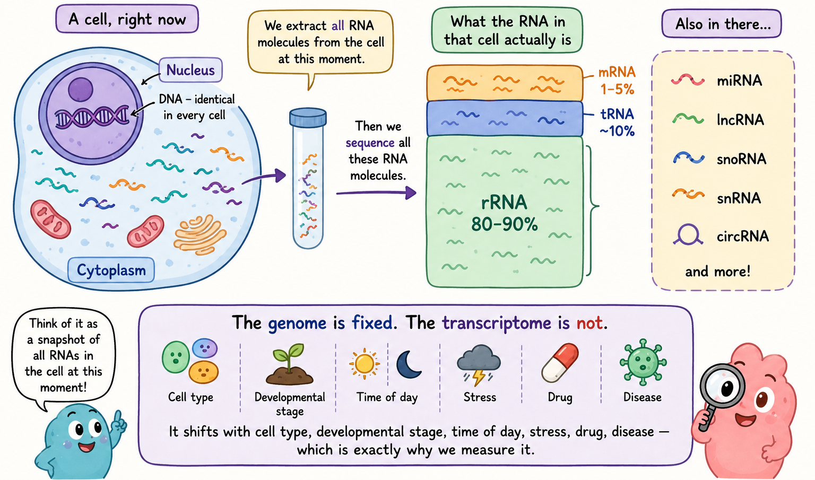
What is Transcriptome?
The complete set of RNA transcripts produced by a cell or organism at a particular time or under a particular condition.

Slide 6
What Is RNA-Seq — and Why?
An NGS-based approach used to identify and quantify RNA molecules in a biological sample.
Detects lowly expressed transcripts with far fewer false positives than arrays
Same data can address isoforms, non-coding RNA, novel transcripts, etc.

Slide 7
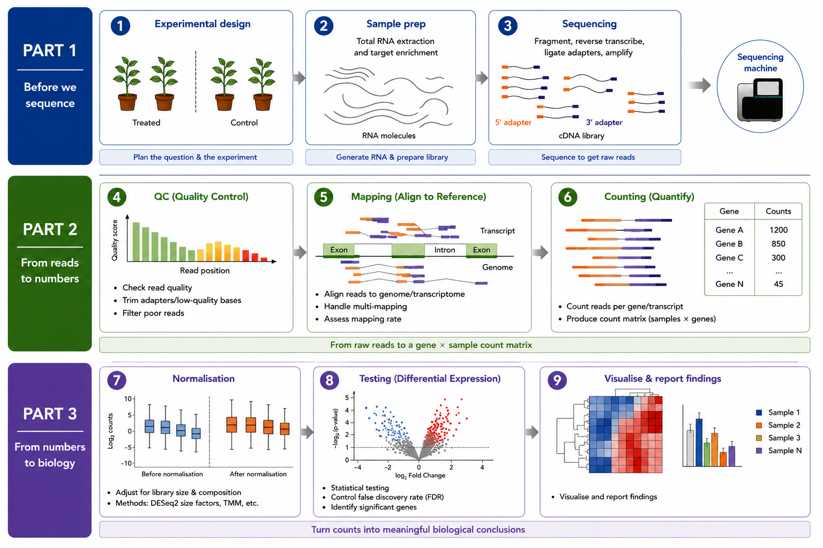
The complete workflow
Image adapted from Van den Berge et al. (2019)

Slide 8
01
Before we sequence
Designing → Preparing → Sequencing?

Slide 9
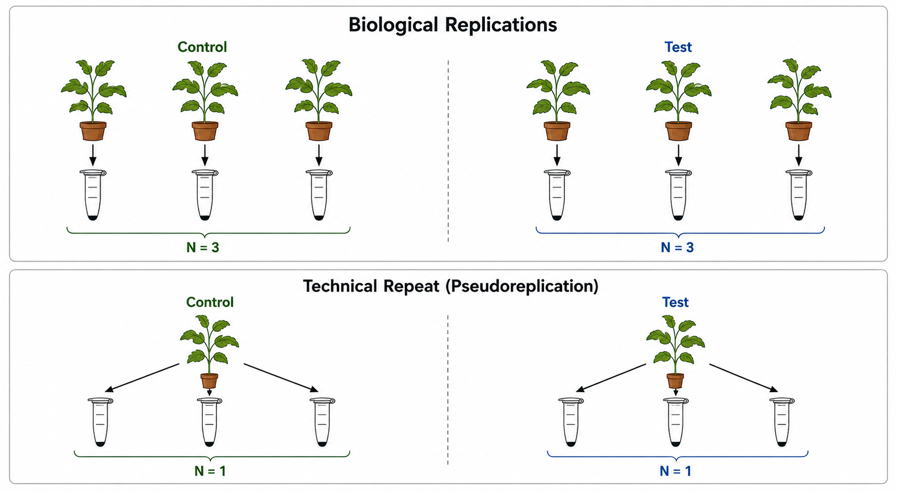
Step 1 — Design: Replicates
Gene expression varies because of
Biological differences between samples
Sample handling and technical variation
Solution: Replicates
Replicates help distinguish true biological effects from noise
How many biological replicates?
3
What most published RNA-Seq studies used
The common practice
6
Recommended for reliable transcriptome description
The recommendation
Biological Replicates
Technical Replicates

Slide 10
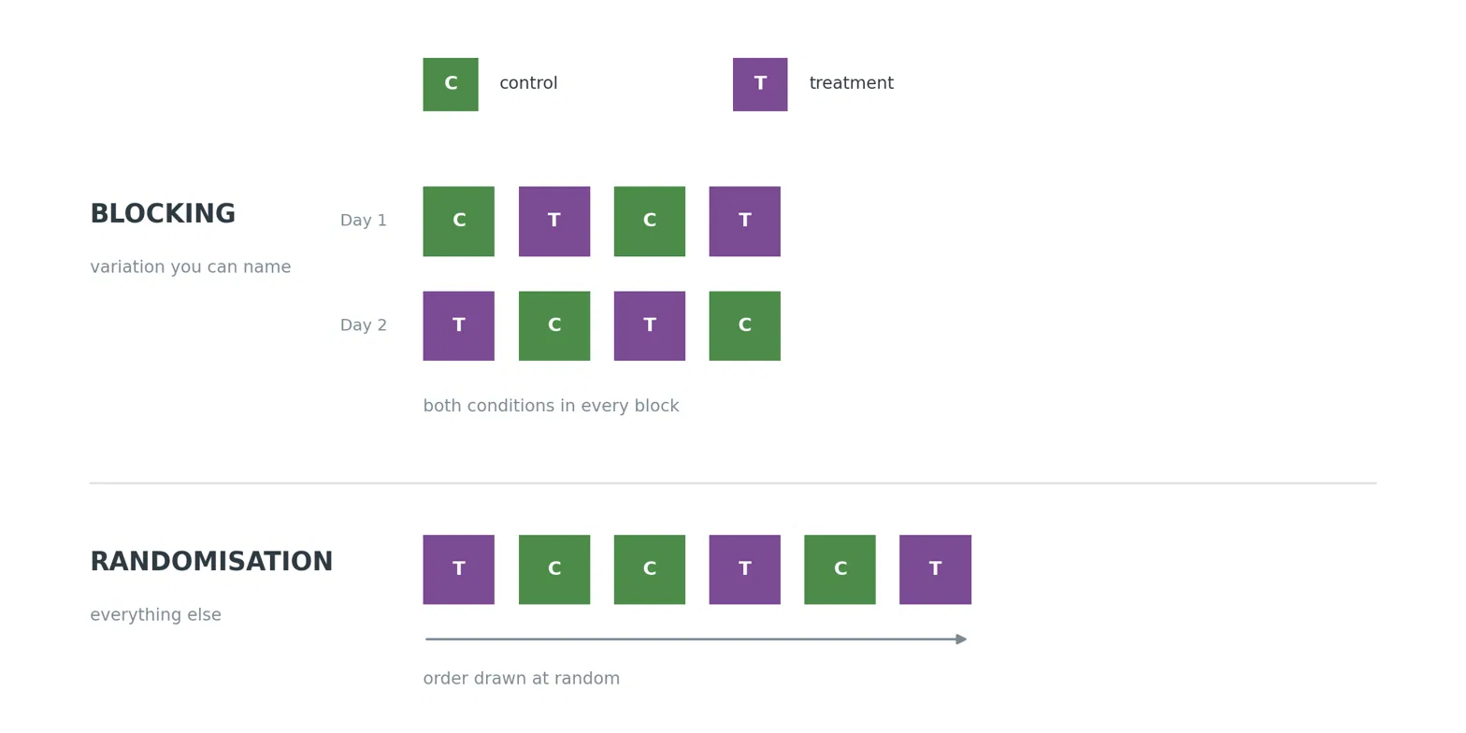
Step 1 — Design: Avoiding bias
Two key strategies
Randomization
Blocking

Slide 11
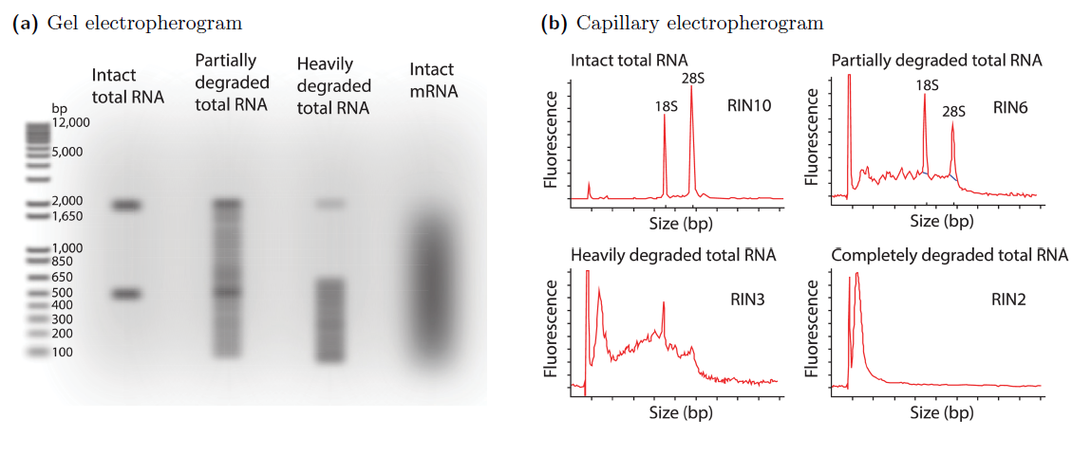
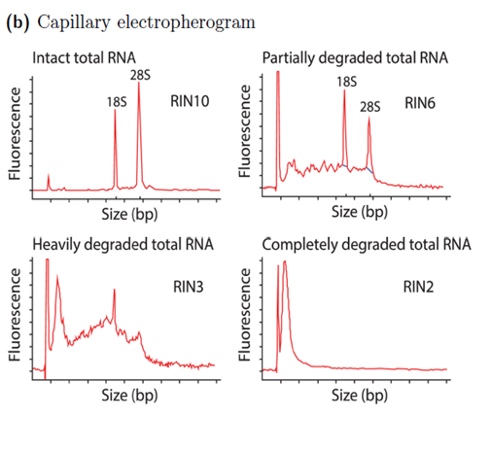
Step 2 — RNA quality: RIN
RNA extraction
Remove contaminants and preserve RNA integrity
RNA Integrity Number (RIN)
RIN = 1–10 → measure of RNA integrity
Higher RIN = better RNA quality
RIN ≥ 7–8 → generally preferred for standard RNA-Seq
Degraded RNA → biased transcript representation
Image adapted from Dundar et al. (2015)

Slide 12
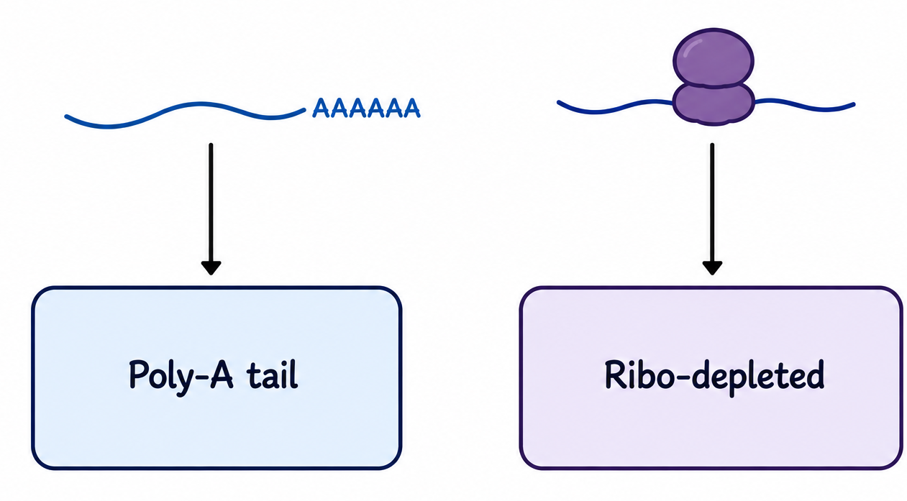
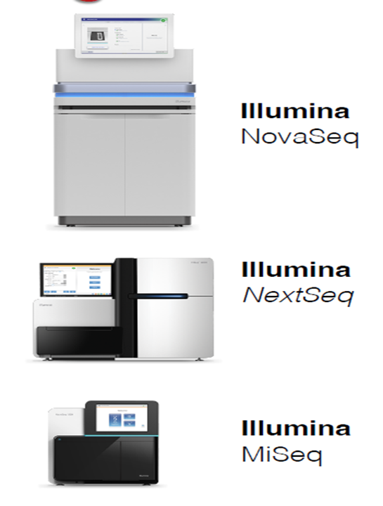
Step 3 —Library preparation and Sequencing
Library Preparation / RNA Selection: mRNA enrichment or rRNA depletion
SEQUENCING
Platform selection depends on sample number, required sequencing depth and cost
Image adapted from Dundar et al. (2015) and Hunt AG. (2014)

Slide 13
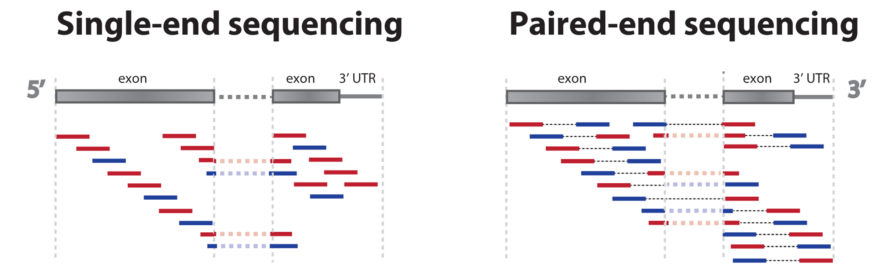
Step 3 — Sequencing reads
Read Type
Single-end (SE): sequencing from one end of the fragment
Paired-end (PE): sequencing from both ends of the fragment
Read Length
Short-read sequencing: approximately 50–300 bp
Common RNA-seq formats: SE75, PE100, PE150
Figure adapted from https://statomics.github.io/SGA/sequencing_intro.html

Slide 14
02
From reads to numbers
QC → Mapping → Counting

Slide 15
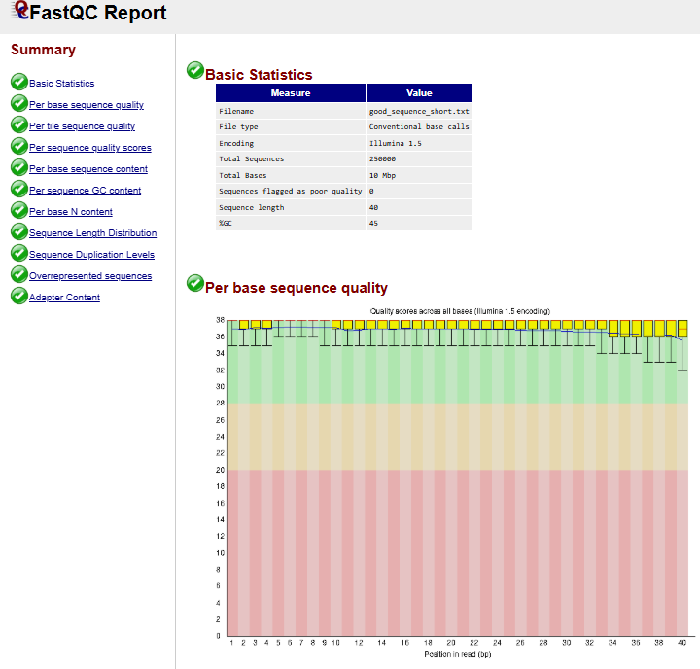
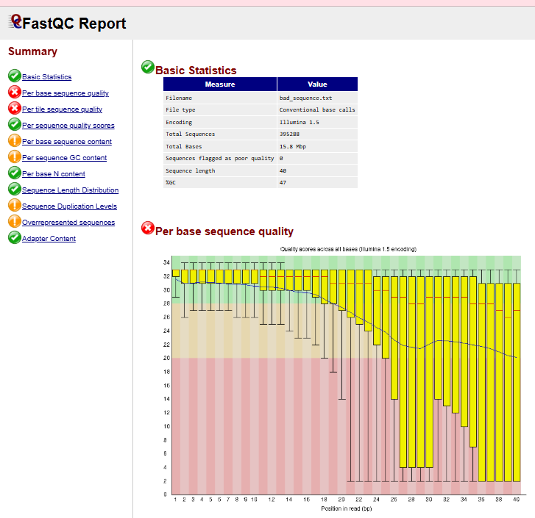
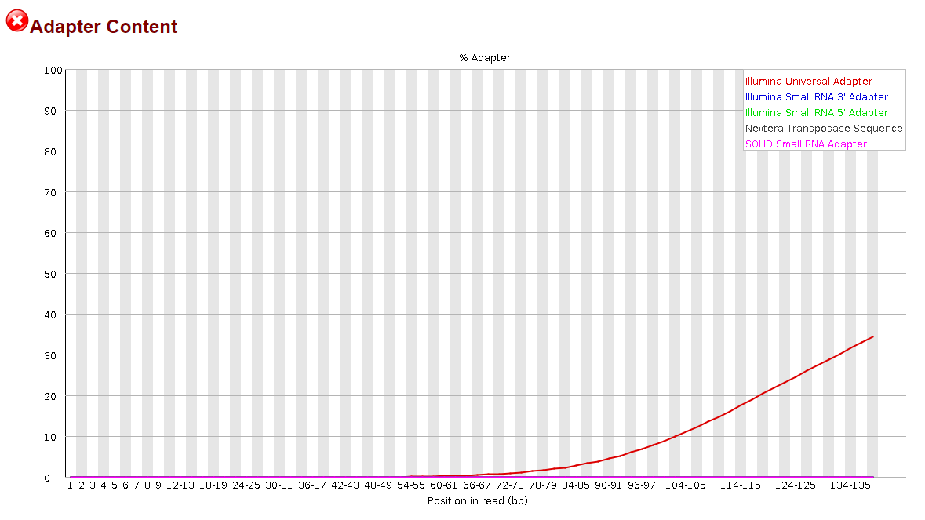
Step 4 — Read Quality Check
Inspect the reads
Check the quality of bases across the reads
Look for adapter contamination
Clean the reads
Remove adapter sequences.
Trim low-quality bases from the reads
Remove reads that are too short after trimming
QC tools: FastQC, MultiQC
Trimming tools: BBDuk, Cutadapt, Trimmomatic
GOOD
BAD
Figure adapted from https://www.bioinformatics.babraham.ac.uk/projects/fastqc/

Slide 16
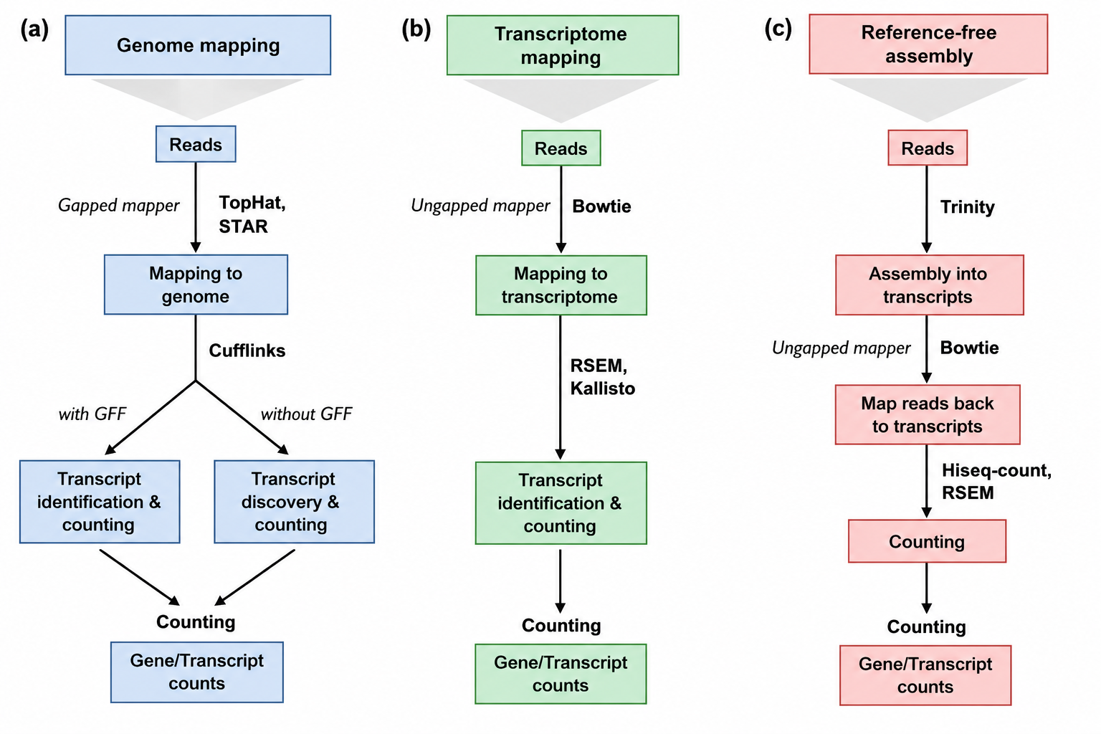
Step 5 — Read Mapping: Where do reads come from?
What is mapping?
Mapping assigns sequencing reads to their most likely location in a reference sequence.
What do we map against?
• Reference Genome • Reference Transcriptome • De novo Transcriptome
Figure adapted from Conesa et al. (2016).

Slide 17
Step 5 — Read Mapping: How do we map the reads?
Mapping approach | How it works | Key tools | Best suited for
1. Splice-aware genome alignment | Maps reads to the genome while allowing for introns and splice junctions. | STAR, HISAT2 | Eukaryotic RNA-Seq
2. Splice-unaware alignment | Performs base-by-base alignment without modeling introns. | Bowtie2, BWA | Prokaryotic RNA-Seq and unspliced sequences
3. Pseudoalignment | Uses k-mer/sequence compatibility rather than full base-by-base alignment. | Salmon, kallisto | Fast transcript-level quantification

Slide 18
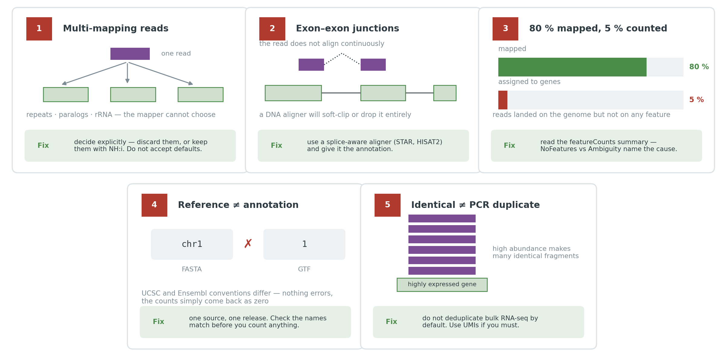
Step 5 — Read Mapping: Mapping Pitfalls

Slide 19
Step 6 — Gene Counting
After mapping, how many reads/fragments are assigned to each gene are determined
A GTF/GFF annotation provides the genomic coordinates and feature information needed for counting
Counting software, such as featureCounts, uses the mapped reads + annotation to assign reads to genes.

Slide 20
02
From numbers to biology
Normalisation → DGE → Visualisation

Slide 21
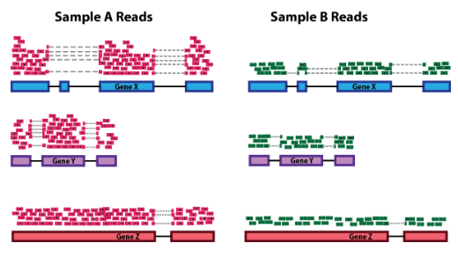
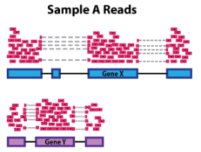
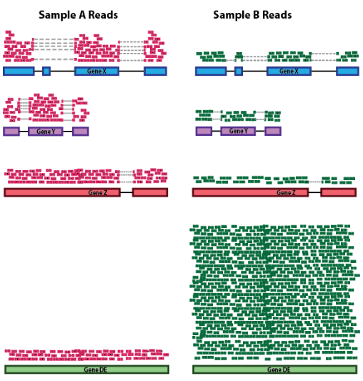
Step 7 — Normalisation
Sequencing depth
Gene length
Normalization adjusts raw counts for unwanted technical differences between samples.
It makes expression values more comparable across samples.
Why do we normalisation?
Raw counts are influenced by factors other than true expression:
Sequencing depth → more reads can produce higher counts.
Gene length → longer genes generate more reads.
RNA composition → highly abundant genes can skew the count distribution
RNA composition

Slide 22
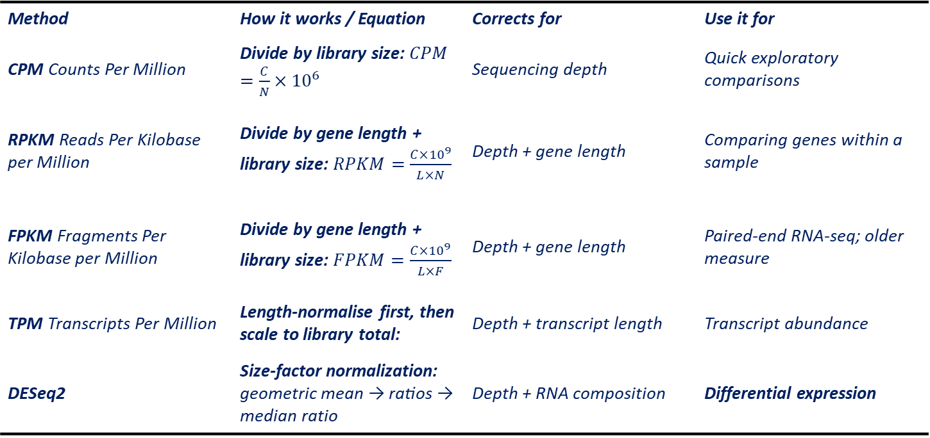
Step 7 — Normalisation: Common methods
Method | How it works / Equation | Corrects for | Use it for
CPM Counts Per Million | Divide by library size: $CPM=\frac{C}{N}×{10}^{6}$ | Sequencing depth | Quick exploratory comparisons
RPKM Reads Per Kilobase per Million | Divide by gene length + library size: $RPKM=\frac{C×{10}^{9}}{L×N}$ | Depth + gene length | Comparing genes within a sample
FPKM Fragments Per Kilobase per Million | Divide by gene length + library size: $FPKM=\frac{C×{10}^{9}}{L×F}$ | Depth + gene length | Paired-end RNA-seq; older measure
TPM Transcripts Per Million | Length-normalise first, then scale to library total: | Depth + transcript length | Transcript abundance
DESeq2 | Size-factor normalization: geometric mean → ratios → median ratio | Depth + RNA composition | Differential expression
C = gene count N = library size (total mapped reads) F = total mapped fragments L = gene/transcript length (kb) s = DESeq2 size factor

Slide 23
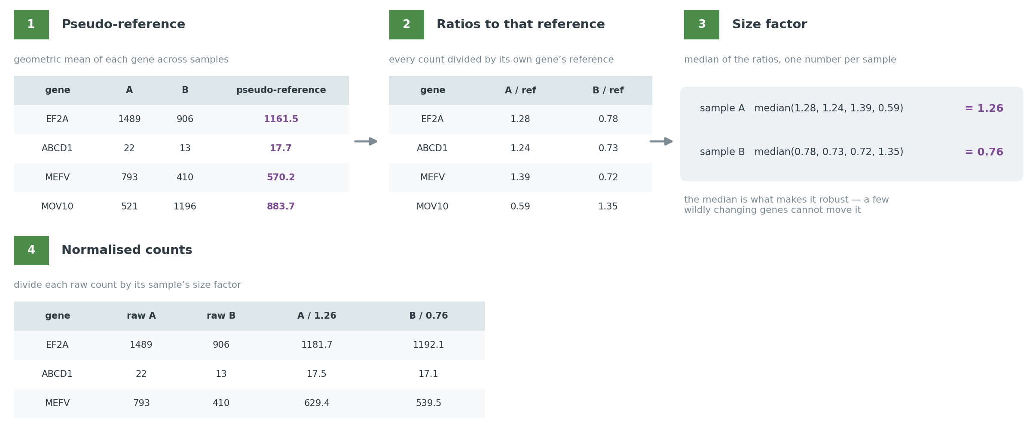
Step 7 — Normalisation: DESeq2
DESeq2 uses the median of ratios method to normalize for sequencing depth and RNA composition

Slide 24
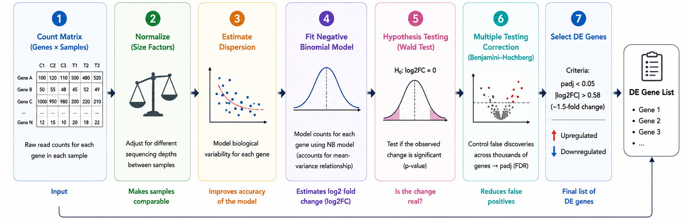
Step 8 — Differential expression
Goal: Identify genes with different expression between conditions

Slide 25
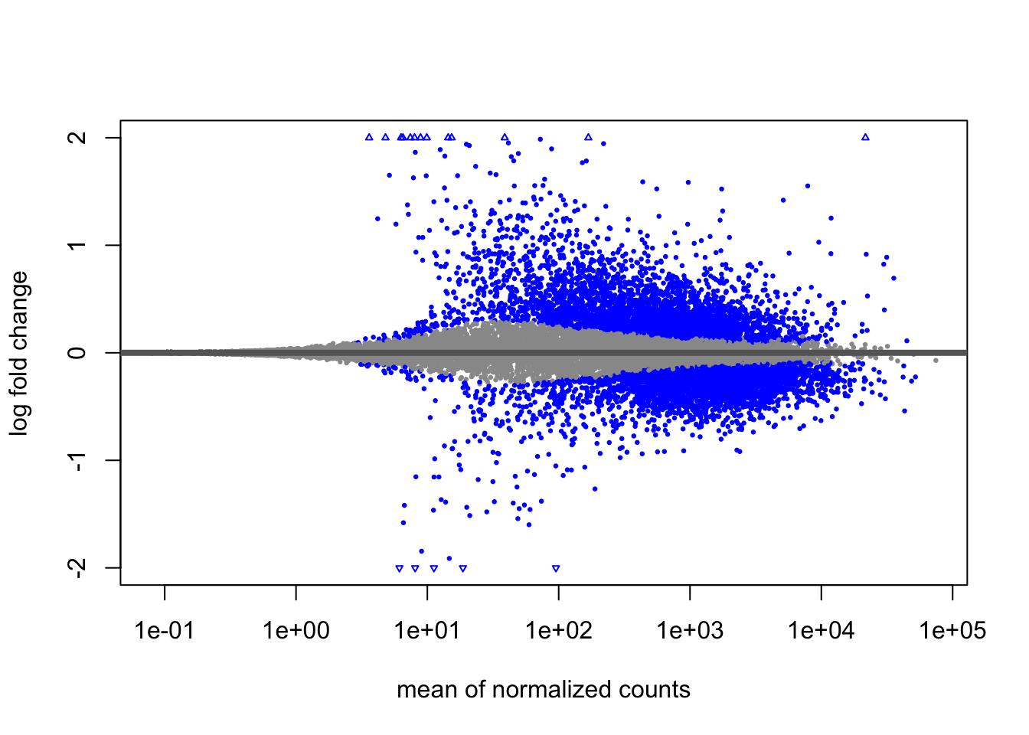
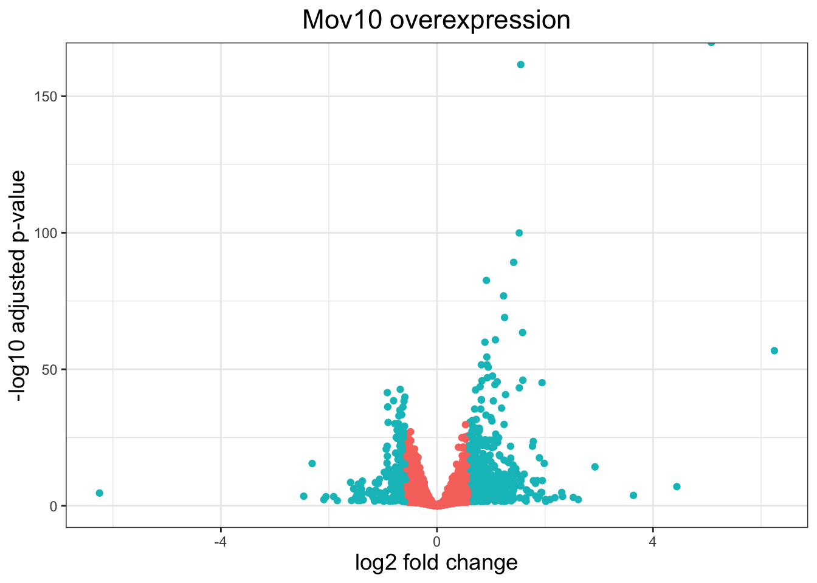
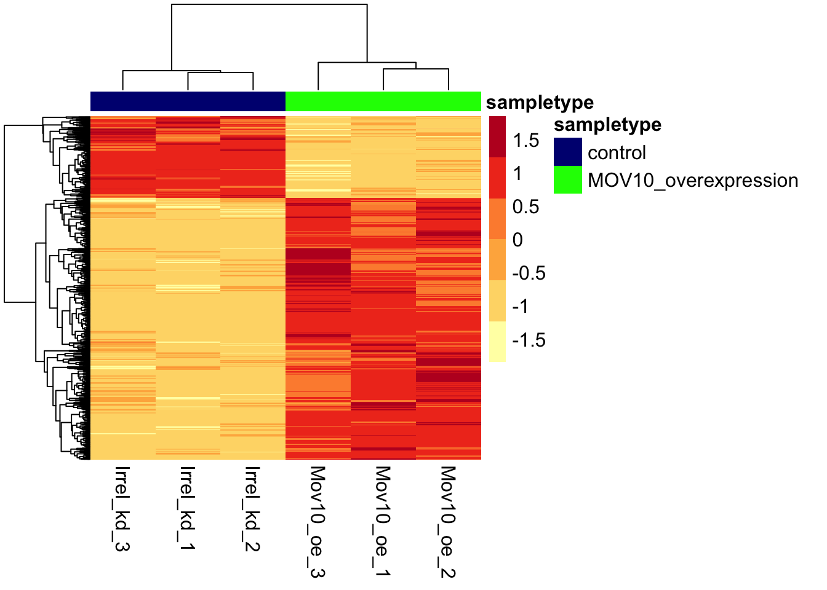
Step 9 — Visualising DGE
1. MA plot
2. Volcano plot
3. Heatmap
Shows expression level vs. fold changeI
dentifies genes with large expression changes
Shows log₂ fold change vs. statistical significance
Highlights strongly and significantly changed genes
Shows expression patterns of selected genes across samples
Reveals gene clusters and sample similarities

Slide 26
Key takeaways
Start with a well-designed experiment — define the biological question, use appropriate replicates, and control sources of variation
Make sure the sequencing data are trustworthy — perform quality control and trimming before downstream analysis.
Convert reads into reliable counts — choose the appropriate reference, map the reads, use the correct annotation, and apply appropriate counting rules.
Make samples comparable — normalize the count data to account for sequencing depth and other technical differences.
Explore, test, and interpret the data —differential expression to identify changes, and visualization to reveal biological meaning.

Slide 27
RNA-SEQ CHALLENGE
Your Task: From Cleaned Reads to Biological Insight
① Map the reads — SERVER
Cleaned reads → Bowtie2 → SAM/BAM → sorted BAM
② Count the genes — SERVER
Sorted BAM + GFF annotation → featureCounts → count matrix
③ Analyze the expression — RStudio
Count matrix → DESeq2 normalization → differential expression
④ Explore the results — RStudio
PCA → Sample clustering → MA plot → Volcano plot → Heatmap
⑤ Interpret the biology: Do the expression patterns reveal meaningful differences between the experimental conditions?

