Slide 1
From sequence to structure: Decoding the tree genome annotation
DBT-BIC-NNP-TREE Genome Informatics: Annotate, Innovate, Collaborate
31 August – 4 September 2026 | Room 120, Guest Block, IICB TRUE Campus, Salt Lake

Slide 2
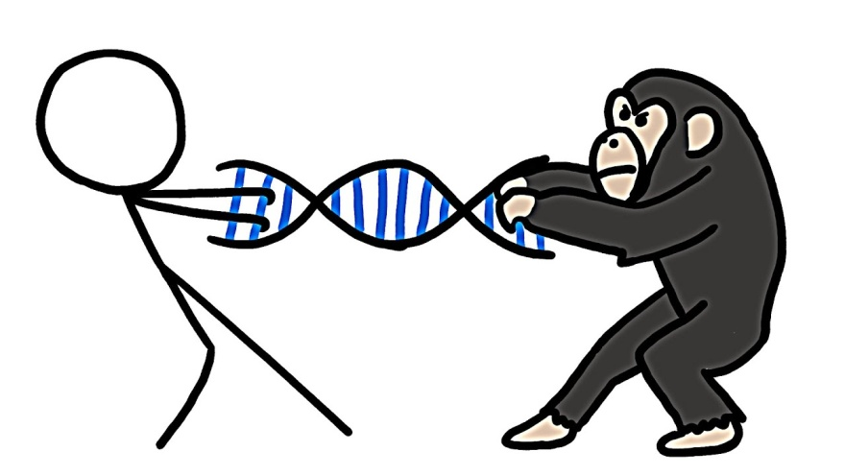
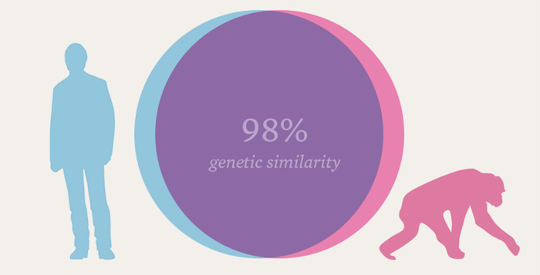
Genetic not genomic!!

Slide 3
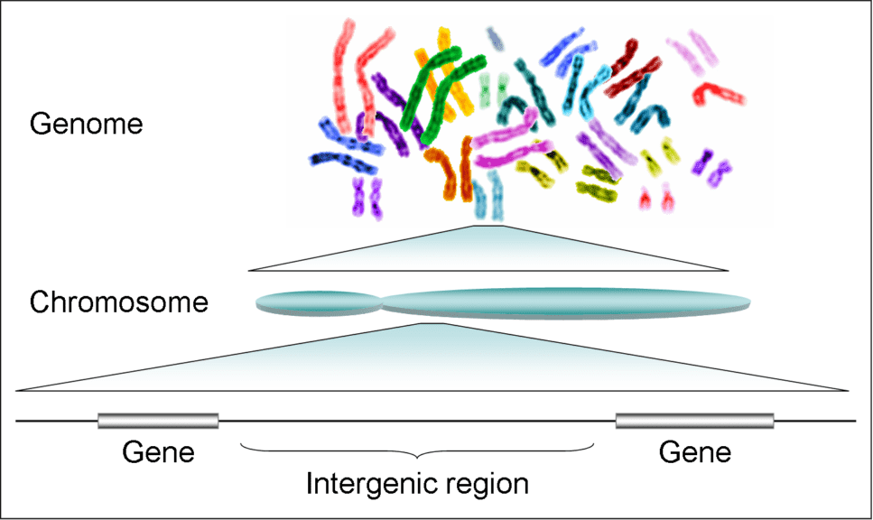

Slide 4
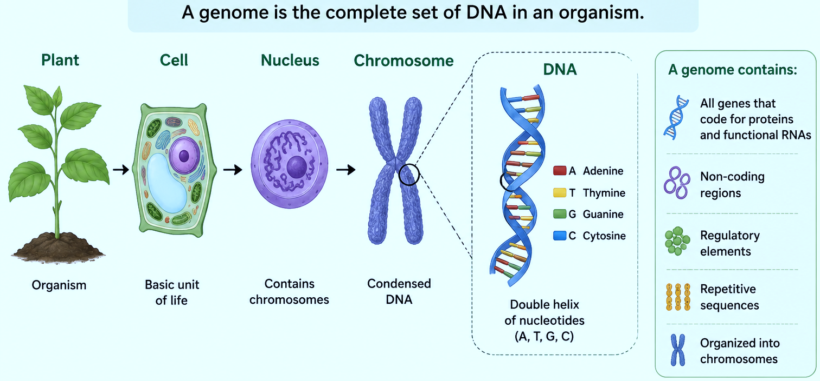
What is genome?

Slide 5
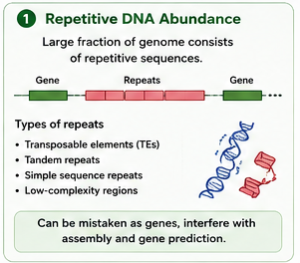
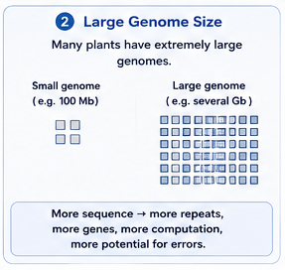
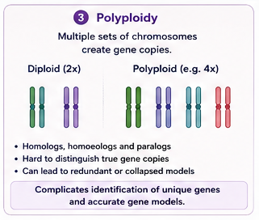
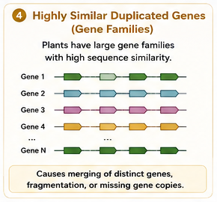
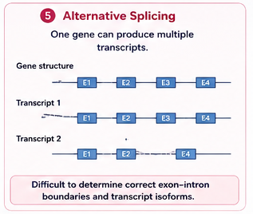
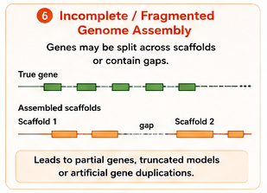
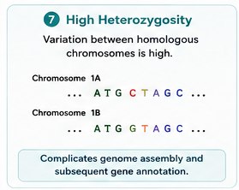
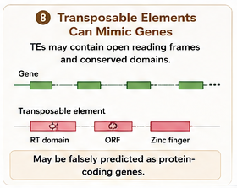

Slide 6
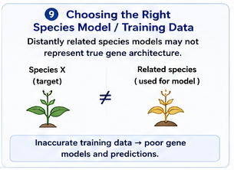
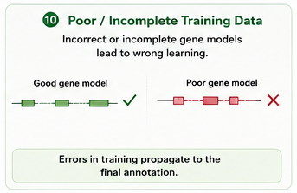
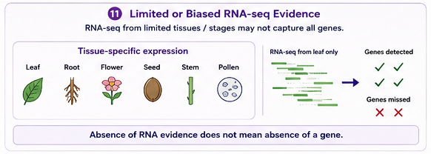
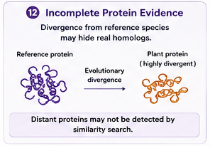
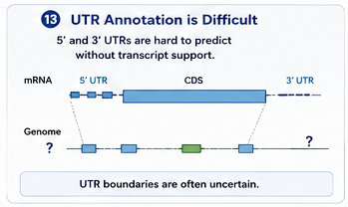
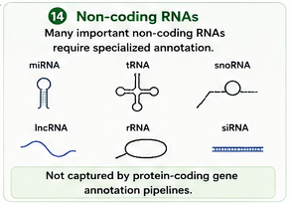
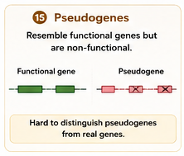

Slide 7
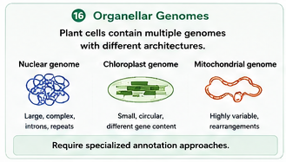
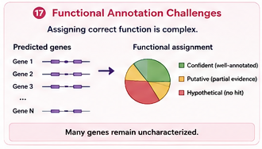
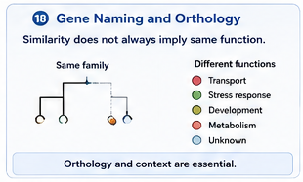
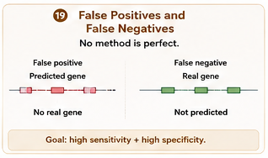
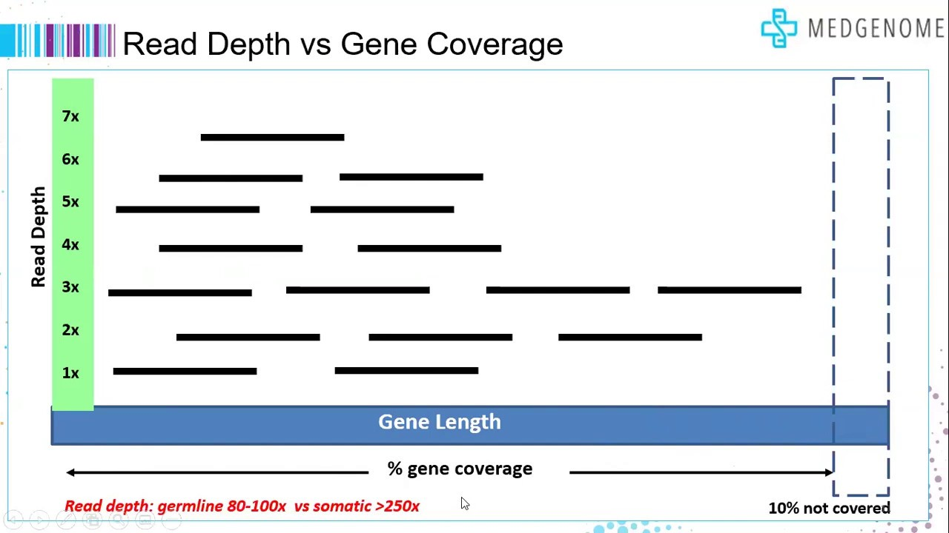

Slide 8
SLIDE 31
GENOME ANNOTATION
STRUCTURAL ANNOTATION
FUNCTIONAL ANNOTATION
“Where is the gene?”
“What does it do?”
Genes
Exons
CDS
Function
Domains
GO terms
Prediction finds the gene and its parts — this is what your gene-prediction tool outputs as a GFF3.
Structural annotation answers WHERE; functional annotation answers WHAT. Both are needed before a gene set is actually usable.
Annotation explains that gene — this needs a separate step your prediction tool does not run for you.

Slide 9
DNA EXTRACTION
Sequencing
(ILLUMINA , NANOPORE)
Output (DATA)
QC of raw data
Cleaning of raw data
QC over cleaned data
Assembly of reads
Annotation
Downstream analysis

Slide 10
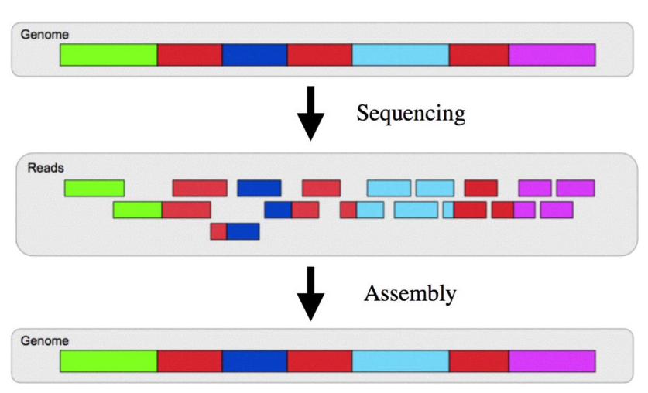
Annotation
AATTGTGCAG
AGGGTAAACCCGGTTAACCG
TACTAATT
ATTTGG
GENE1
NONCODING
GENE2
REPEAT

Slide 11
Stage | Representative Tools
Quality Control | FastQC, fastp, NanoPlot
Genome Assembly | hifiasm, Flye, Canu, NextDenovo
Assembly Evaluation | QUAST, BUSCO, Merqury
Repeat Masking | EDTA, RepeatModeler2, RepeatMasker
Gene Prediction | AUGUSTUS, GeneMark-ES/ET, SNAP
Evidence Integration | BRAKER, MAKER2, PASA, EVM
Functional Annotation | InterProScan, eggNOG-mapper, BLAST/DIAMOND

Slide 12

Which Tools Check Read Quality?
FastQC
Scans raw short reads for base quality, adapter content, and GC bias — the first sanity check before anything else runs.
WHY IT MATTERS
Poor-quality reads propagate downstream: they fragment assemblies and generate unreliable gene models. QC is the first bioinformatics step for a reason.
fastp
Fast trimming of adapters and low-quality bases; produces the QC report in the same pass.
NanoPlot
Same job for long-read (ONT) data — read length and quality drive assembly contiguity directly.

Slide 13

Which Tools Build the Genome?
hifiasm
Current default for PacBio HiFi reads; resolves haplotypes directly — critical for heterozygous plant genomes.
WHY IT MATTERS
No single assembler wins on every genome. Plant genomics labs commonly run two assemblers and compare results before committing.
Flye
Handles ONT long reads and hybrid data with higher per-read error rates.
Canu / NextDenovo
Alternative long-read assemblers, often run alongside the above for comparison on repetitive genomes.

Slide 14

How Do We Know the Assembly Is Good?
QUAST
Reports N50, contig counts, and total length — basic contiguity statistics.
WHY IT MATTERS
A high N50 alone does not prove a good assembly. Completeness and accuracy are separate questions and need separate tools to answer.
BUSCO
Searches for conserved single-copy orthologs to score completeness.
Merqury
Reference-free, k-mer based check for base accuracy and haplotype phasing.

Slide 15

Which Tools Find Repeats Before Gene Prediction?
EDTA
Purpose-built for plant transposable elements — today’s standard for building plant repeat libraries.
WHY IT MATTERS
Skipping this step is the single biggest cause of false “genes” in plant annotation — many are just unmasked transposons.
RepeatModeler2
De novo discovery of repeat families not already known or classified.
RepeatMasker
Applies the repeat library to soft-mask the genome before gene prediction runs.

Slide 16

Which Tools Predict Gene Structure?
AUGUSTUS
Ab initio, HMM-based structural predictor; needs species-specific training parameters.
WHY IT MATTERS
Ab initio prediction alone has a real accuracy ceiling. Training-parameter mismatch — e.g. Arabidopsis parameters on a distantly related species — measurably lowers accuracy.
GeneMark-ES/ET
Self-trains without a reference gene set; often paired with AUGUSTUS.
SNAP
Lightweight ab initio predictor, commonly combined with others for a consensus call.

Slide 17

Which Tools Say What a Gene Does?
InterProScan
Assigns protein domains, motifs, and GO terms — the functional baseline layer.
WHY IT MATTERS
Structural prediction alone — e.g. raw AUGUSTUS output — is not annotation. Functional labels require this separate step.
eggNOG-mapper
Fast orthology-based functional and pathway category assignment.
BLAST / DIAMOND
Homology search against UniProt/Swiss-Prot for descriptive gene names.

Slide 18
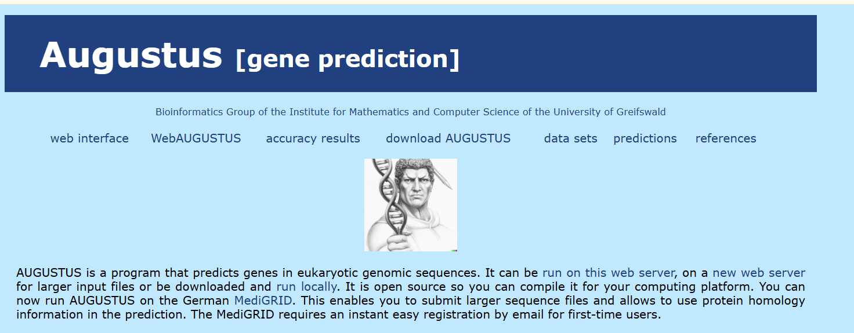

Slide 19
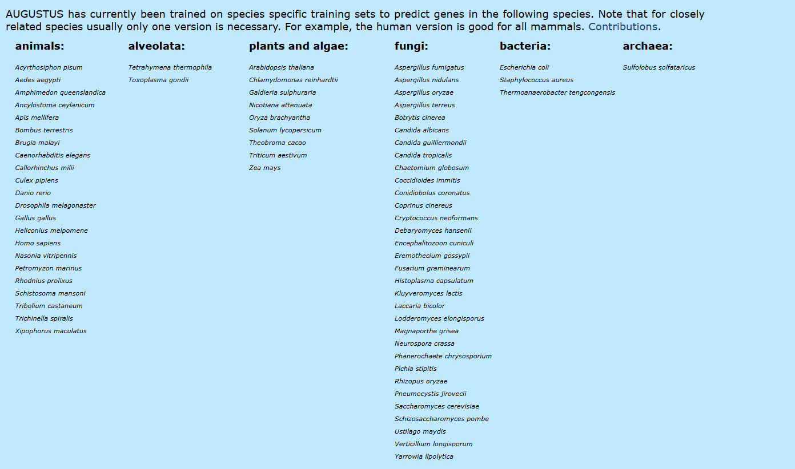

Slide 20
AUGUSTUS: From Training & Input to a Consensus Gene Model
INPUT · GENOME PREPARATION
TRAINING · PARAMETER ESTIMATION
Genome FASTA
Known training genes
(downloaded / new assembly)
(reference or close relative)
raw assembly
curate gene models
Repeat masking
Training gene set
(EDTA / RepeatMasker)
soft-mask TEs
supply to AUGUSTUS
Masked genome
AUGUSTUS training
(etraining)
fit HMM parameters
Species-specific parameters
(intron / exon / splice-site model)
AUGUSTUS MODEL
parameter-optimized gene predictor
Ab initio — statistical model
Evidence based model
RNA-seq evidence (Splish site, Exon hints )
Protein evidence (Homology hints)
Sequence patterns
EVIDENCE INTEGRATION
reconciles ab initio + extrinsic hints
consensus model
Final gene models

Slide 21



AUGUSTUS’s Core Engine: The GHMM
Generalized Hidden Markov Model — the statistical engine behind every AUGUSTUS prediction
Explicit duration modeling
Content & signal sensors
Hidden states
Every base is assigned to a biological state — intergenic, UTR, exon, intron — and AUGUSTUS finds the single most probable path through them.
The “generalized” part: exon and intron lengths follow their own trained distributions.
Each state carries its own trained sequence model — codon usage in exons, donor/acceptor consensus at boundaries.
THE STATE PATH AUGUSTUS DECODES
intergenic
5' UTR
exon
donor site
intron
acceptor site
exon
donor site
intron
acceptor site
exon
3' UTR
intergenic
AUGUSTUS scores every possible path through this chain using trained length and content models, then reports the single highest-scoring path as the predicted gene structure.

Slide 22
Running AUGUSTUS: the simplest workflow
1
Provide the genome
Input the assembled genome as a single FASTA file (one entry per chromosome/contig/scaffold).
2
Pick a trained species model
AUGUSTUS ships with pre-trained parameter sets (e.g. human, fly, arabidopsis) that encode the GHMM's transition/emission probabilities. Train your own only if none fit.
3
Add hints (optional but recommended)
Extrinsic evidence — RNA-seq alignments or protein alignments — can be fed in to bias the GHMM toward biologically supported exon boundaries.
4
Run augustus
augustus --species=<model> genome.fasta > output.gff
The GHMM decodes the most probable gene-structure path (Viterbi algorithm) for each sequence.
5
Get gene models
Output is a GFF3/GTF file: coordinates for genes, transcripts, exons, CDS and UTRs — the structural blueprint, with no biological function attached yet.
5

Slide 23
Genome
FASTA
AUGUSTUS
(GHMM)
Gene Models
(GFF3/GTF)
EggNOG-mapper
Raw assembled
DNA sequence
Structural gene
prediction
Exons, introns,
CDS coordinates
Functional
annotation
STAGE 1 — Where are the genes?
STAGE 2 — What do genes do?
AUGUSTUS finds the location and structure of genes using a probabilistic model (GHMM). It does not know what those genes do. EggNOG-mapper takes the predicted protein sequences and matches them to known, well-studied genes to transfer functional labels (GO, KEGG, COG, Pfam).

Slide 24
How EggNOG-mapper assigns gene function
1
2
3
4
5
Input
Homology search
Orthologous group assignment
Function transfer
Output
Predicted protein sequences (FASTA) from AUGUSTUS's gene models.
Fast sequence search (DIAMOND / HMMER / MMseqs2) against the precomputed eggNOG orthology database.
Each query protein is placed into its best-matching orthologous group (OG) from eggNOG.
Functional labels already known for that OG — GO terms, KEGG pathways, COG category, Pfam domains, gene description — are transferred to the query.
An annotation table: one row per gene, columns for description, GO/KEGG/COG/Pfam and more.
command line: emapper.py -i proteins.fasta --itype proteins -o output_prefix
Result: predicted genes now carry putative functions, pathways, and protein domains — turning a structural gene model into a biologically meaningful annotation.

Slide 25
Intergenic
5' UTR
Start
Codon
Exon
Intron
Stop
Codon
3' UTR
Intergenic
repeats for every additional
exon / intron pair
Splice-site signals
Reading frame consistency
Exon → Intron transitions require a donor site (usually GT); Intron → Exon transitions require an acceptor site (usually AG). AUGUSTUS scores these motifs to decide where introns most likely begin and end.
The GHMM tracks reading-frame phase across exon boundaries, so joined exons still translate into one continuous, in-frame protein sequence.

Slide 26





T R E E
T
Tolerance
Genes that buffer trees against drought, heat, and cold
R
Resilience
Pathways that let a tree recover after disturbance
E
Evolution
Signatures of selection carried across generations
E
Ecological Adaptation
Local adaptation to soil, climate, and biotic pressure
Genome
Gene
Function
Adaptation

