Slide 1

Introduction 2026
DBT-BIC-NNP-TREE Genome Informatics: Annotate, Innovate, Collaborate
31 August – 4 September 2026 | Room 120, Guest Block, IICB TRUE Campus, Salt Lake

Slide 2
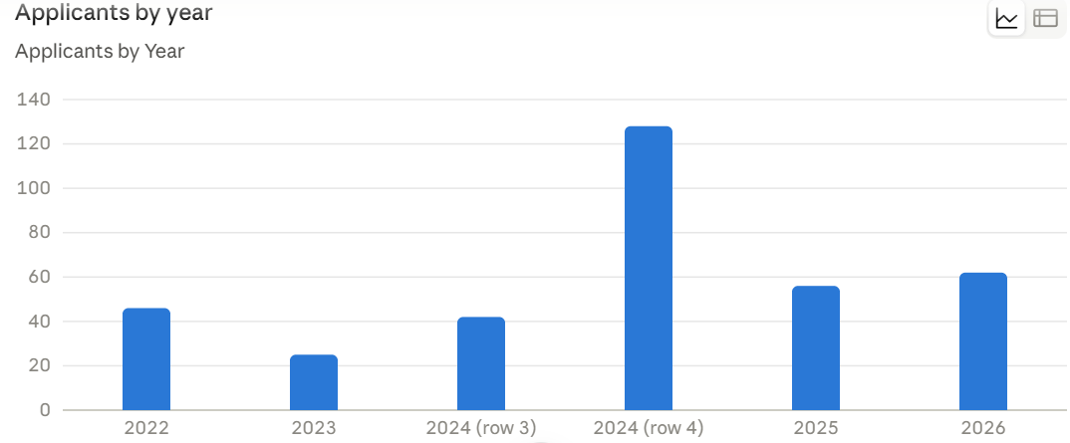

Slide 3
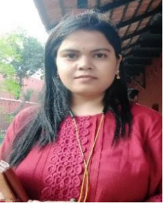

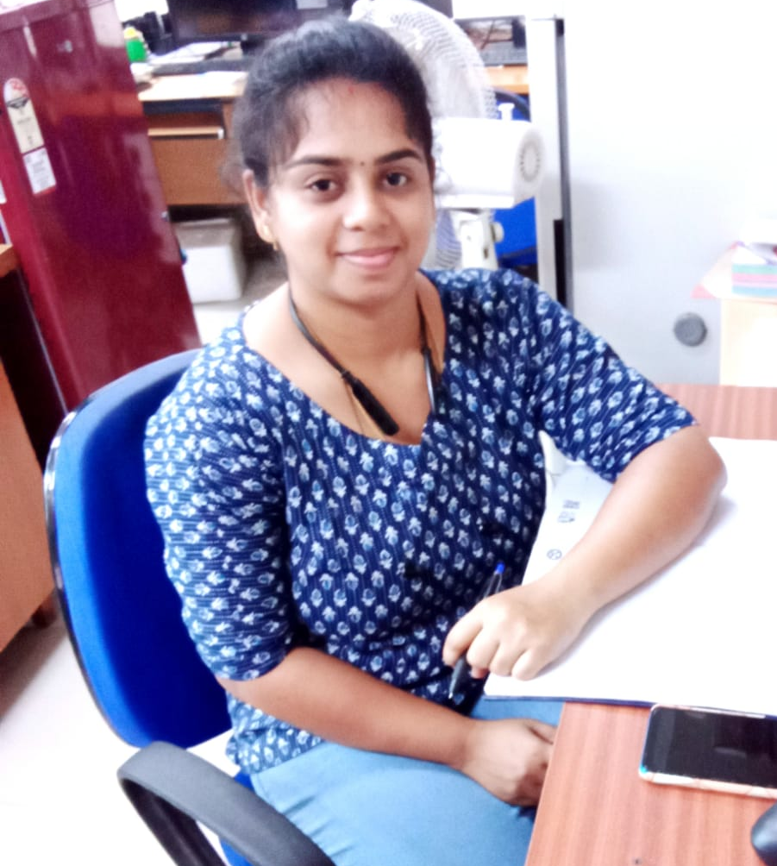
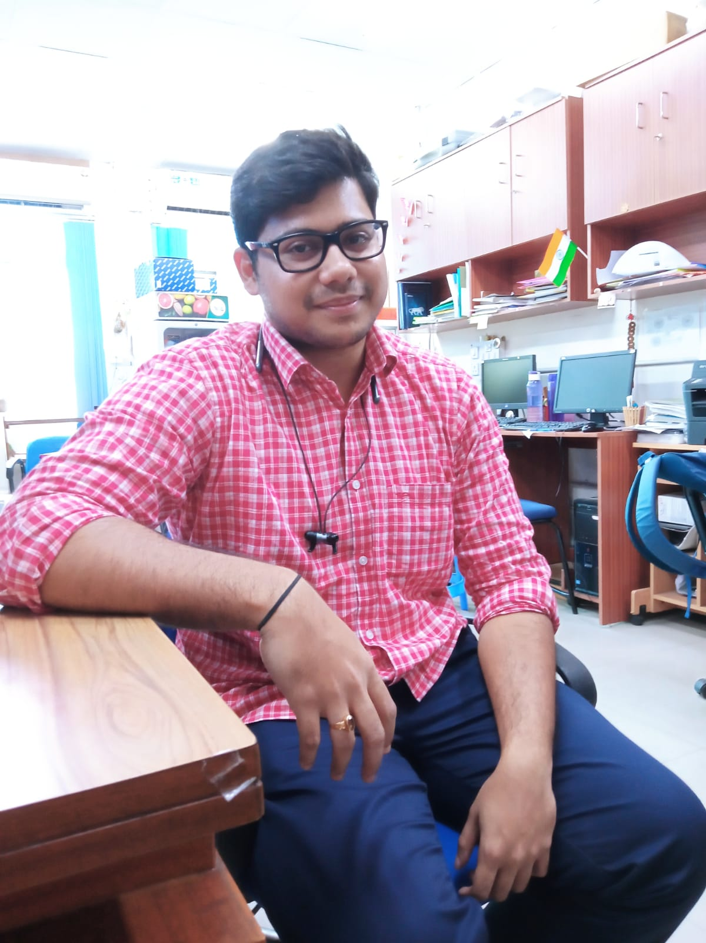
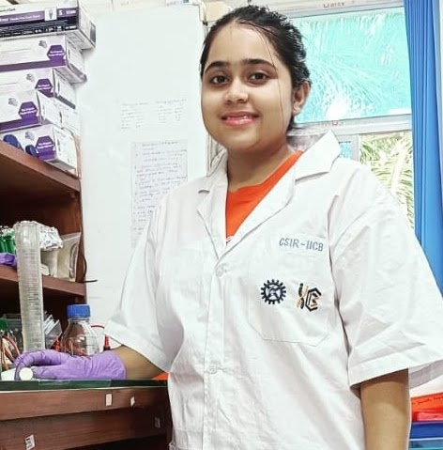
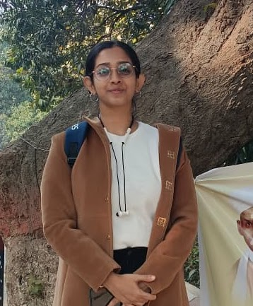
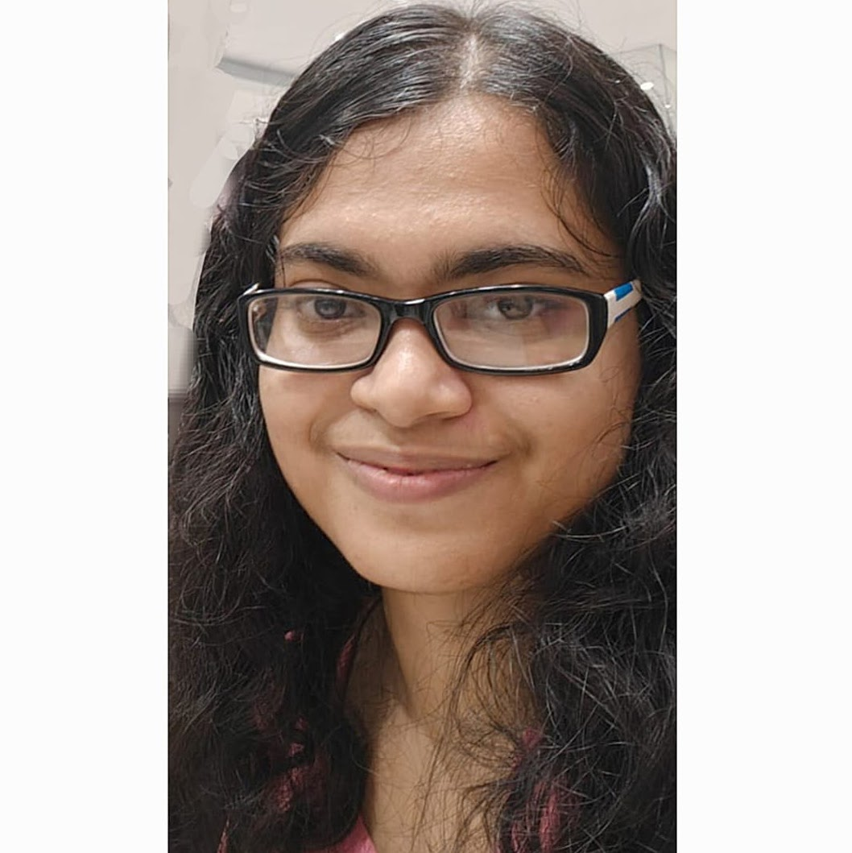
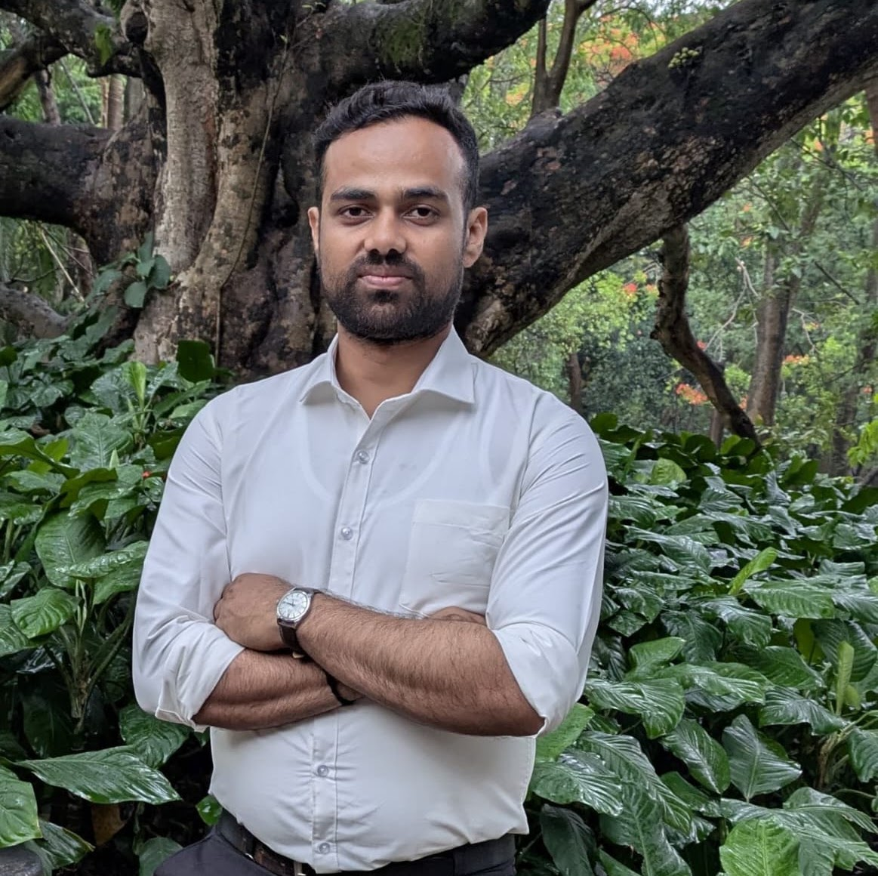
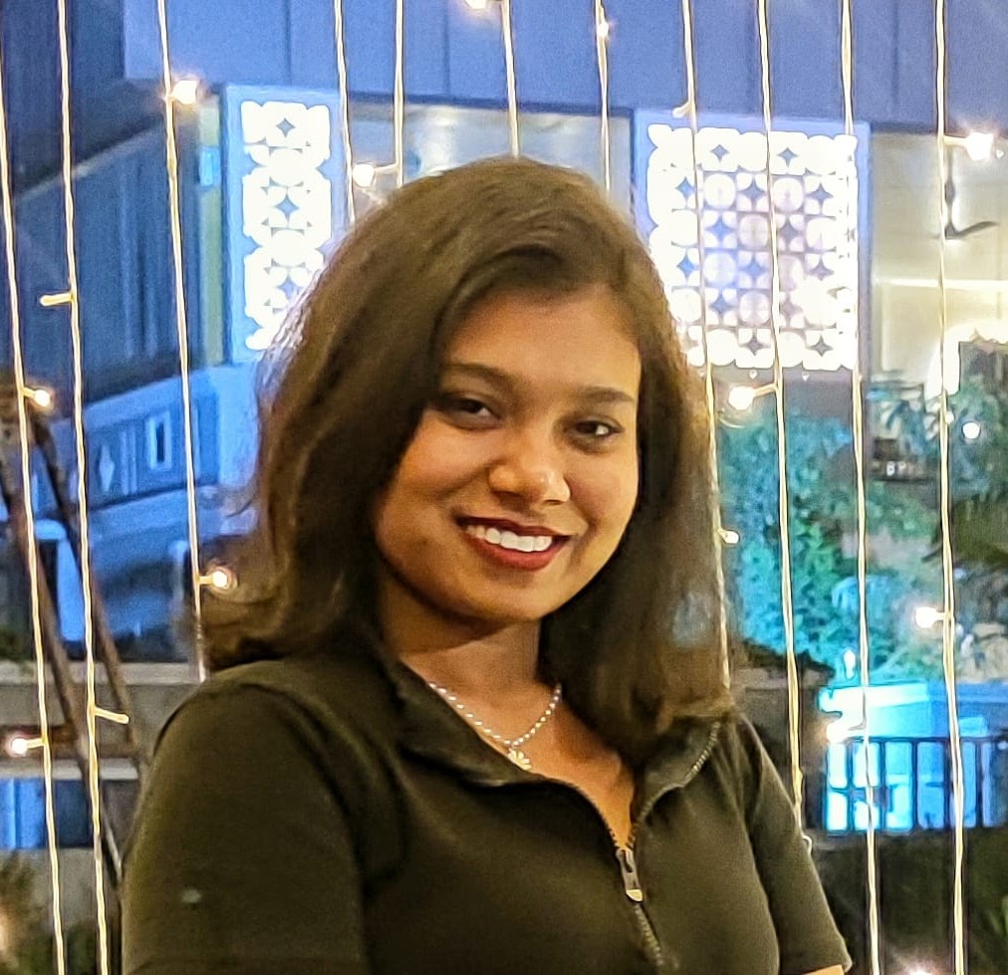
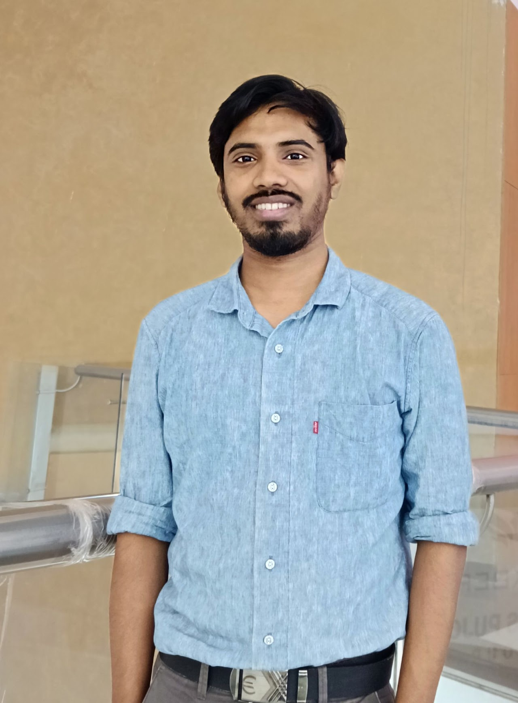

Slide 4
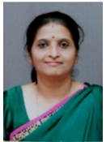
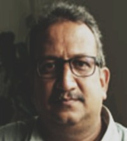
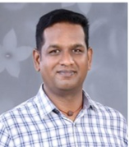
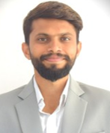
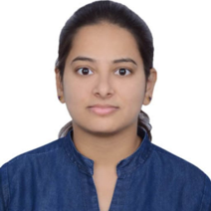
S.No | Photo | Name | Affiliation | Contacts
1 |  | Prof. Modhumita Dasgupta | Scientist G, Division of Plant Biotechnology and Cytogenetics Institute of Forest Genetics and Tree Breeding Forest Campus. | gmodhumita@gmail.com +91-422-2484123
2 |  | Dr. Santan Barthwal | Scientist-G, ICFRE-Forest Research Institute, Dehradun | barthwal.santan@gmail.com 01352224403
3 |  | Dr. A. Balasubramanian | Scientist B, ICFRE-Institute of Forest Genetics and Tree Breeding, Coimbatore | balabio@gmail.com 91-422 2484124
4 |  | Dr. Shivaprasad KM | Scientist B, ICFRE-Institute of Forest Biodiversity, Hyderabad | shivakm@icfre.org 040-66309503
5 |  | Dr. Archana R | Scientist C, ICFRE-Institute of Wood Science and Technology, Bengaluru | archanar@icfre.org

Slide 5
S.No | Name | Institute | Contacts
1 | Subhamoy Dutta | ICAR-Central Inland Fisheries Research Institute | subhamoydutta2026@gmail.com 8609485303
2 | Priyanshi saini | Guru Gobind Singh Indraprastha University | priyanshisaini472@gmail.com 8882083627
3 | Anirban Nandy | University Of Kalyani | anirbanbcbp24@klyuniv.ac.in 8420518814
4 | Yashasvini Rai | Institute Of Advanced Research, Gandhinagar Gujarat | ryashi148@gmail.com 6394385304
5 | Snehasish Ray | Brainware University | snehasishray286@gmail.com 9123758939
6 | Samiha Shabnam Banu | University Of Calcutta/Rajabazar Science College | samihashabnambanu@gmail.com 9330608319
7 | Madhurima Maiti | University Of Calcutta | madhurimamaiti2001@gmail.com 9051114123
8 | Purabi Rani Das | Brainware University | dpurabi875@gmail.com 8798345836
9 | Soumen Das | West Bengal State University | dassoumen1994.vc.sd@gmail.com 7686964542
10 | Anup Ghosal | JIS Institute of Advanced Studies and Research | aghosla20221@gmail.com 9038882695
11 | Tanushree Paul | CSIR-IICB | paultanushree17201@gmail.com 6291399043
12 | Abishek Swarnakar | CSIR-IICB | abhishekswarnakar@csiriicb.res.in 9007643203
13 | Sohini Saha | CSIR-IICB | sohinisaha196@gmail.com 9971462905
14 | Sarbani Saha | CSIR-IICB | sarbani@csiriicb.res.in 9804408027
15 | Md Arsadullah Ansari | CSIR-IICB | mdarsadullah@gmail.com 7001484963
16 | Pamelika Das | CSIR-IICB | pamelikadas@gmail.com 8697129788
17 | Dipamoy Datta | CSIR-IICB | ddbmbg@gmail.com 8420427958
18 | Avimanyu Das | CSIR-IICB | avimanyudas08@gmail.com 7596819917
19 | Vishal Agarwal | CSIR-IICB | vishal1298agarwal@gmail.com 9804214151
20 | Shreeparna Mondal | CSIR-IICB | shreeparnamondal771@gmail.com 9875313332

Slide 6
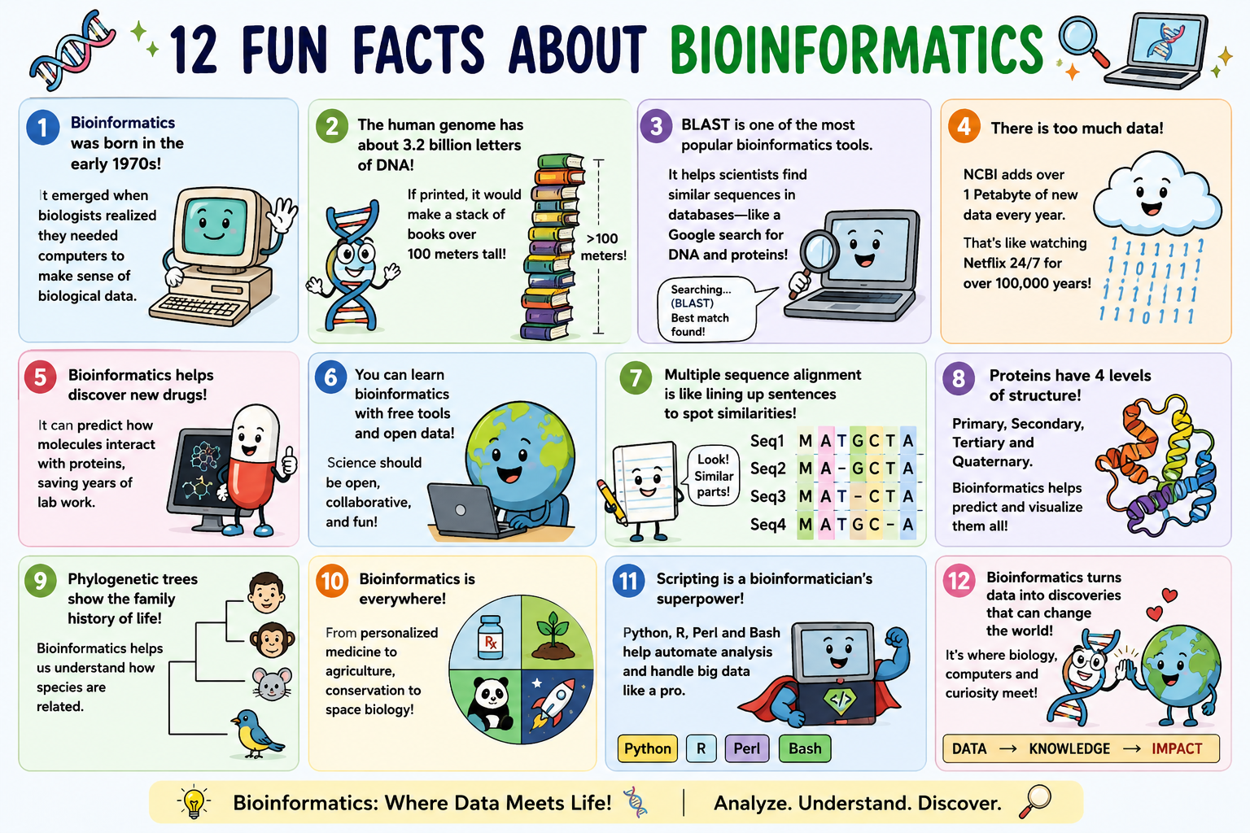

Slide 7
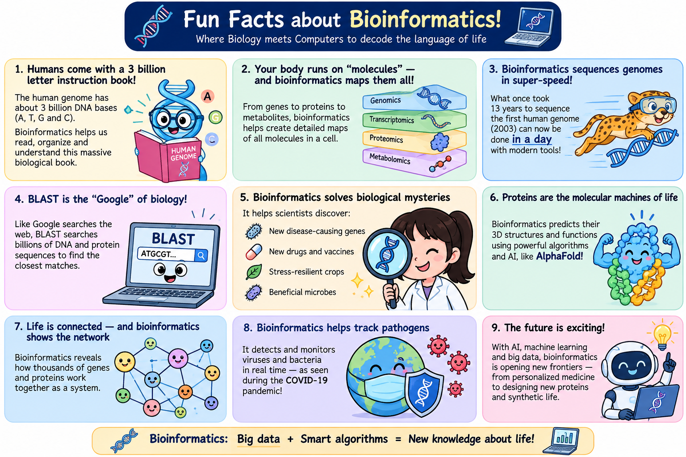

Slide 8
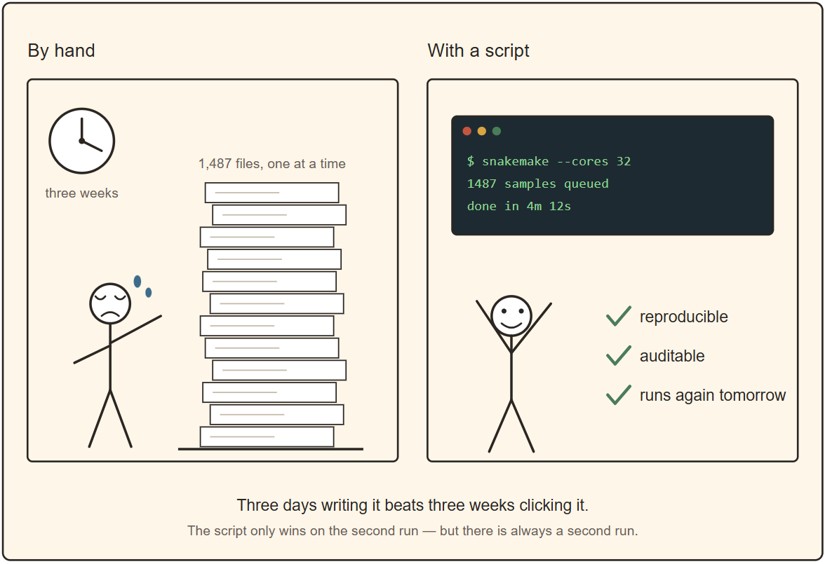

Slide 9
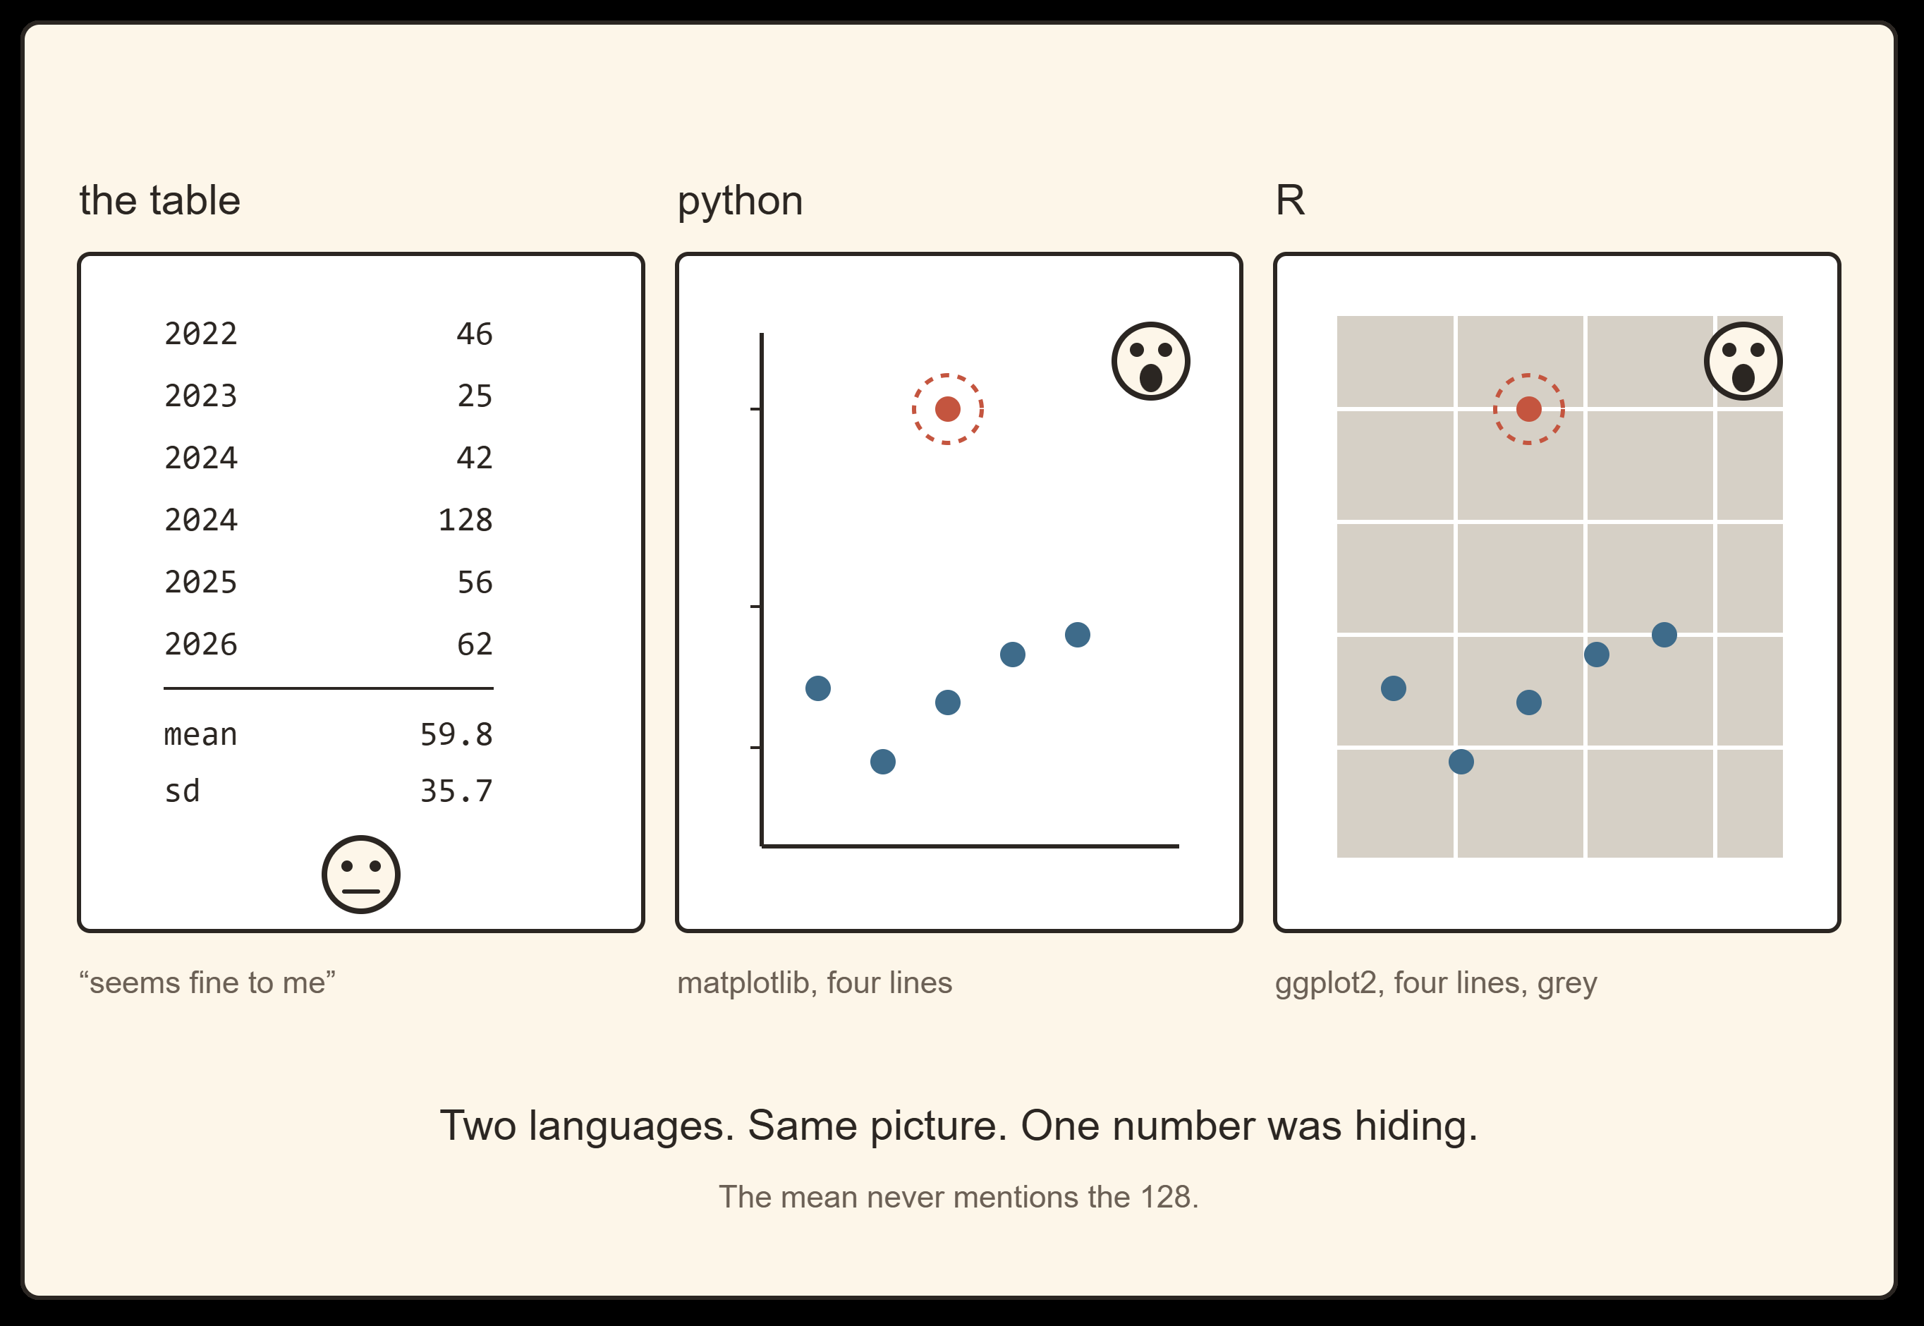

Slide 10
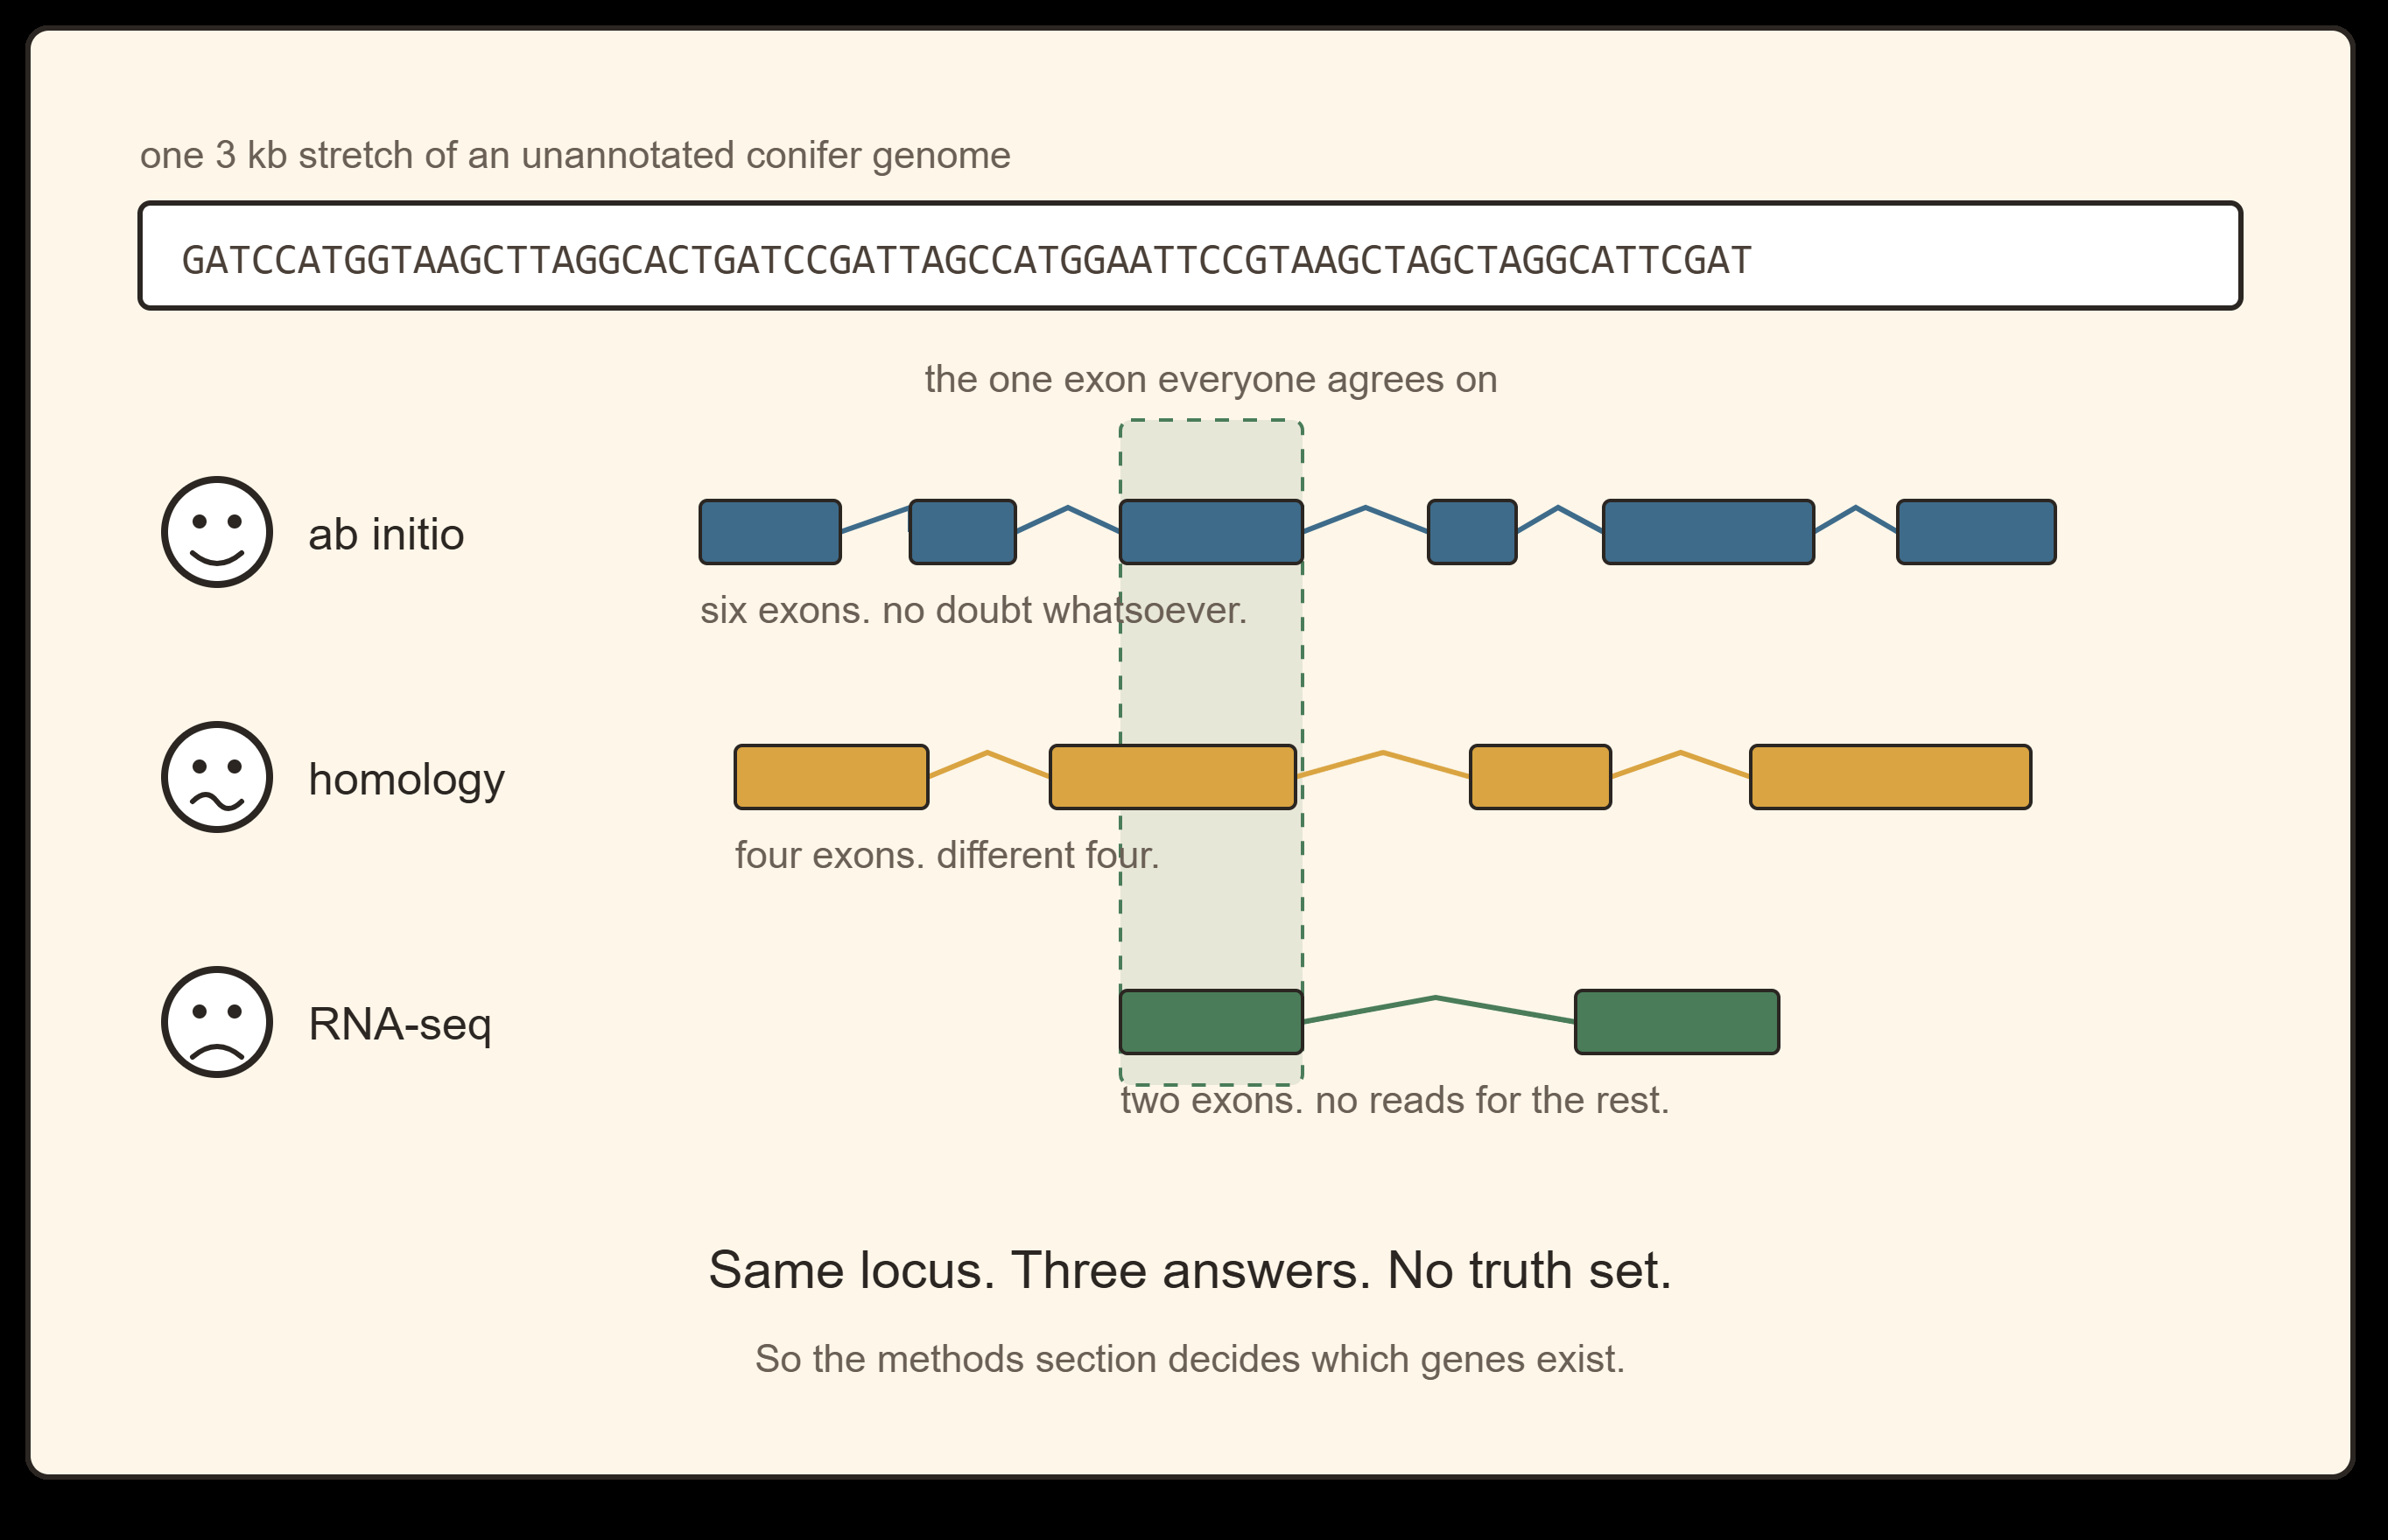
RNA-seq gets the fewest exons, not the most. Evidence-based annotation under-calls anything not expressed in the tissue and condition you sampled, which for a tree means most of the genome most of the year.

Slide 12
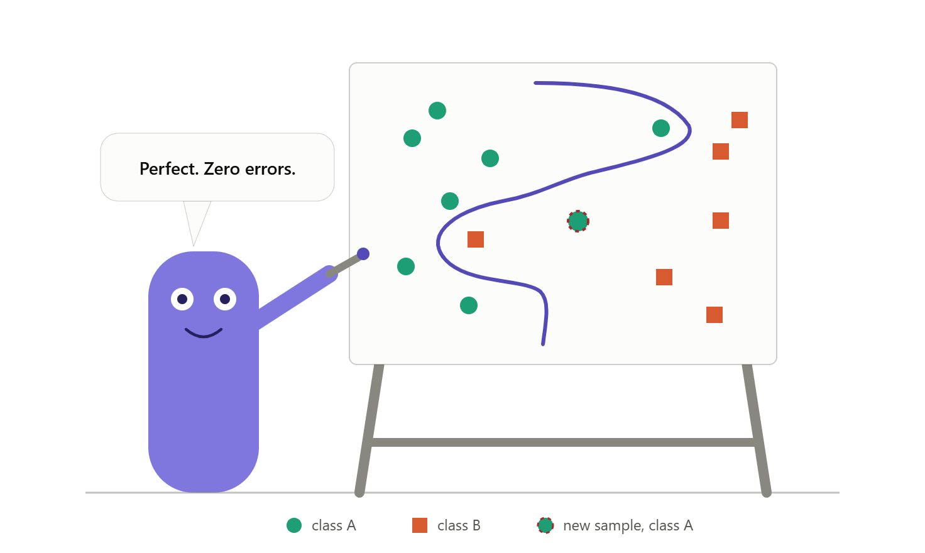

Slide 13
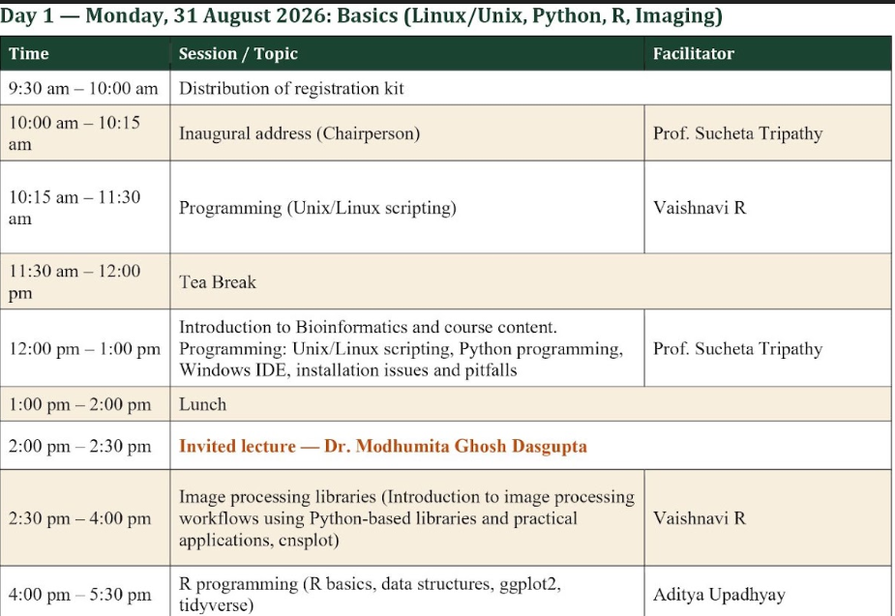

Slide 14
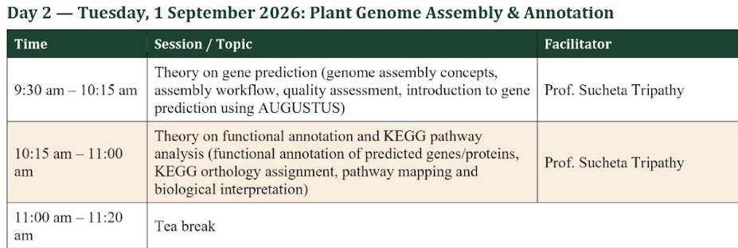
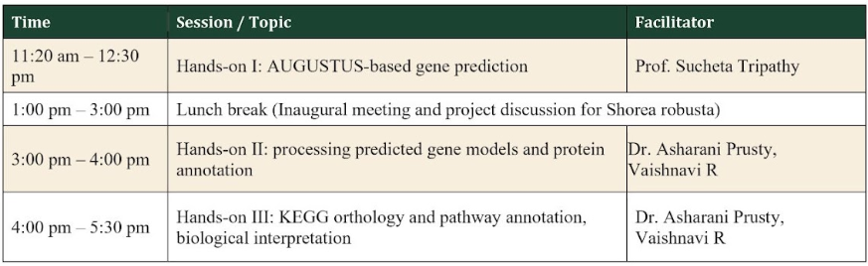

Slide 15
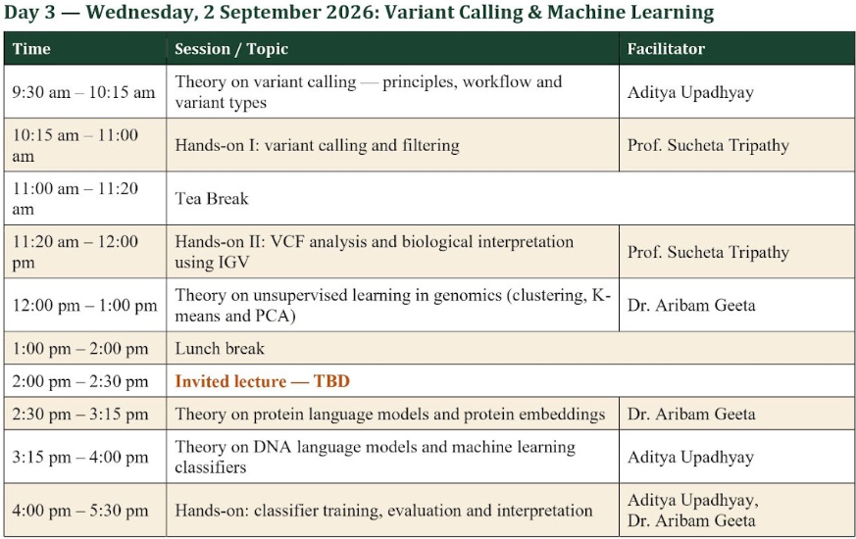

Slide 16
