Slide 1
Variant Calling
DBT-BIC-NNP-TREE Genome Informatics: Annotate, Innovate, Collaborate
31 August – 4 September 2026 | Room 120, Guest Block, IICB TRUE Campus, Salt Lake

Slide 2
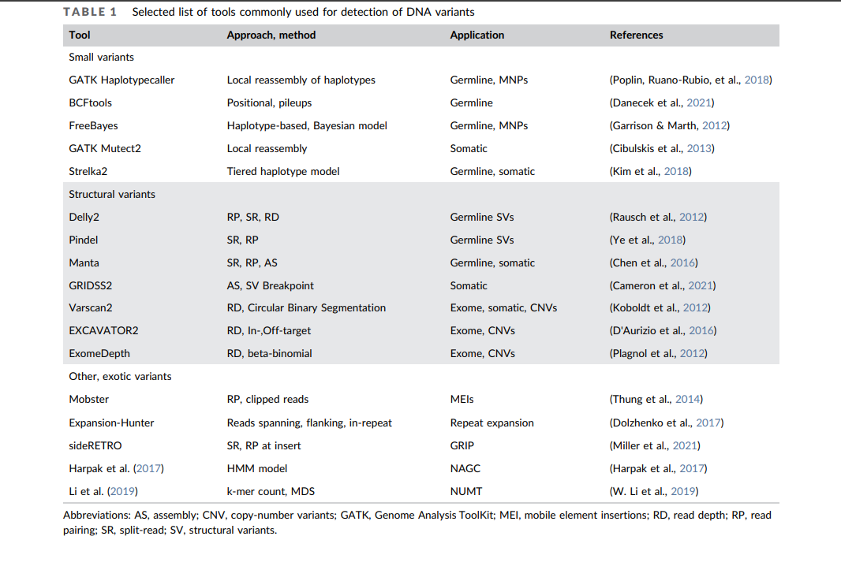

Slide 3
Reference FASTA
↓
FASTQ reads
↓
Quality control
↓
Read mapping
↓
SAM → BAM
↓
Sort + index
↓
Variant calling
↓
VCF
↓
Filtering
#CHROM POS ID REF ALT QUAL FILTER INFO
NC_000913 1523 . A G 99 PASS DP=45
NC_000913 2876 . C T 87 PASS DP=32
NC_000913 4312 . G GA 65 PASS DP=28

