Slide 1




DBT-BIC-NNP-TREE GENOME INFORMATICS · GENOME HACKWEEK 2026
Teaching a computer to read DNA
Machine learning and classifiers on biological sequence — built from scratch, for people who have never trained a model.
SEQUENCE
→
NUMBERS
→
CLASSIFIER
→
HONEST SCORE
Aditya Upadhyay
CSIR-IICB, Kolkata · 2 September 2026
Notes:
Welcome. This session assumes no machine learning background at all. Everything is built up from the sequence.

Slide 2
GENOME HACKWEEK 2026 · CSIR-IICB KOLKATA
SIX PARTS
Contents
01
Why classify DNA?
02
Machine learning in plain terms
What a promoter is, and why searching for a keyword will not find one
Features, labels, training and testing — the whole vocabulary, once
03
DNA as a language
04
Pretrained DNA models
Letters, k-mer words, counting features, and what attention does
Learning from unlabelled sequence, and what differs between the models
05
Building the classifier
06
Judging the result
Embeddings, logistic regression, and the notebook we will run
Confusion matrix, ROC and AUC, and what was really held out
None. If you can read a DNA sequence and a percentage, you can read every slide here. A glossary of every term used sits at the back.
PREREQUISITES
Aditya Upadhyay · CSIR-IICB Kolkata
DNA language models & classifiers
02
Notes:
Six parts. Part 02 is the plain-language machine learning primer; skip it only if you have trained a model before.

Slide 3
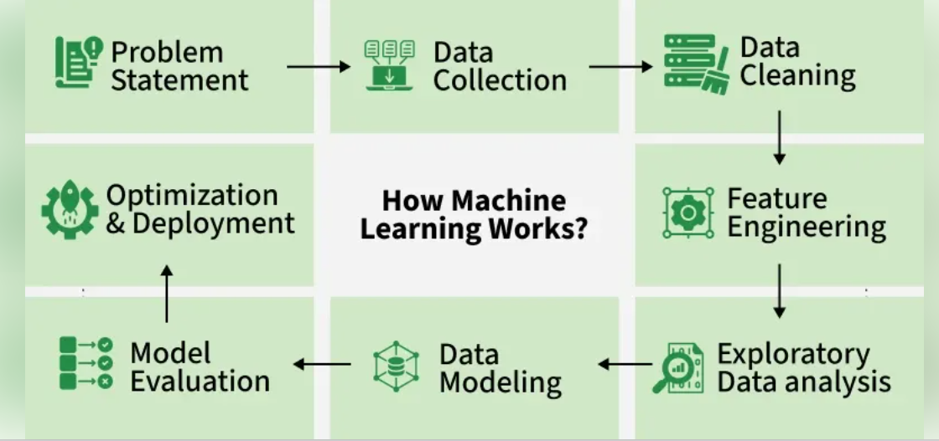
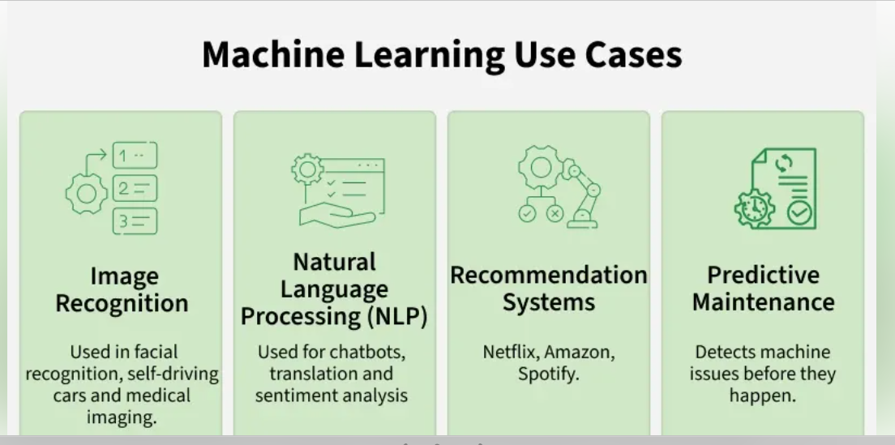
GENOME HACKWEEK 2026 · CSIR-IICB KOLKATA
How Machine Learning Works
Aditya Upadhyay · CSIR-IICB Kolkata
DNA language models & classifiers
03
Notes:
These slides are meant to be re-read alone at home, so every recurring marker means the same thing everywhere.

Slide 4
GENOME HACKWEEK 2026 · CSIR-IICB KOLKATA
01
IN THIS PART
05
The genome we have to interpret
Why classify DNA?
06
What a promoter actually is
One question runs through the whole session: given a short stretch of DNA, is it a promoter — a place where transcription starts — or not?
07
The task, stated precisely
08
Why searching for TATAAA fails
PART 01 OF 06
Notes:
One question carries the whole session: is this window a promoter or not?

Slide 5
GENOME HACKWEEK 2026 · CSIR-IICB KOLKATA
PART 01 · WHY CLASSIFY DNA?
The genome we have to interpret
The human reference genome is about 3.2 billion bases long. Under 2% of it codes for protein. Nearly everything else — switches, insulators, repeats, structure — is sequence whose job we cannot look up in a table.
▮ <2% protein-coding
▮ ~8% other annotated elements
▮ ~90% introns, regulatory sequence, repeats, unannotated DNA
Only the dark sliver has an entry in a database somewhere. For the pale 90% there is nothing to look up, so the only way to say what a stretch of DNA does is to predict it from the sequence itself.
IN PLAIN WORDS
3.2 billion
~20,000
< 2%
bases in the human reference genome — printed 3,000 letters to a page, about a million pages
protein-coding genes, each needing at least one promoter before it can be switched on
of bases code for protein, so almost every question starts from unannotated sequence
Aditya Upadhyay · CSIR-IICB Kolkata
DNA language models & classifiers
05
Notes:
Under two per cent of the genome codes for protein. The rest is what we have to interpret computationally.

Slide 6
GENOME HACKWEEK 2026 · CSIR-IICB KOLKATA
PART 01 · WHY CLASSIFY DNA?
What a promoter actually is
The stretch of DNA just upstream of a gene where RNA polymerase and its partner proteins assemble. Get it right and the gene is transcribed; miss it and nothing happens.
upstream sequence
CORE PROMOTER
exon 1
exon 2
exon 3
−1000 bp
−100 to +50 bp
TSS: transcription start site → the gene body
SIGNAL ONE
SIGNAL TWO
SIGNAL THREE
TATA box
CpG island
Factor binding sites
TATAAA
GCGCGGCGGC
CCAAT · GGGCGG
Sits about 30 bases before the start site — but only a minority of human promoters have one.
A GC-rich stretch. Most human promoters look like this rather than like a TATA box.
Short words that specific proteins recognise, in loose combinations rather than a fixed order.
No single signal appears in every promoter, so there is no checklist to apply. That is exactly what makes this a machine-learning problem rather than a lookup.
IN PLAIN WORDS
Aditya Upadhyay · CSIR-IICB Kolkata
DNA language models & classifiers
06
Notes:
Three signals, none of them present in every promoter. That absence is the reason we need a model.

Slide 7
GENOME HACKWEEK 2026 · CSIR-IICB KOLKATA
PART 01 · WHY CLASSIFY DNA?
The task, stated precisely
WHAT GOES IN
WHAT COMES OUT
One 300-base window
One number between 0 and 1
GGCTATAAAGGCACGTGCCAATCAGGCGCGGCGGCTATTAGCCGGAATTCCGGCGCGGTAT…
0.87
0 = not a promoter
1 = promoter
Always the same length, taken either around a known transcription start site (we label it 1) or from somewhere else in the genome (we label it 0).
We turn that score into a yes-or-no answer with a threshold — 0.5 unless we choose otherwise. Moving the threshold trades false alarms against missed promoters.
THE DATASET WE WILL USE
Positives
Negatives
Split
Size
windows centred on annotated start sites
windows from elsewhere, matched for length
train / validation / test, held out by chromosome
a few thousand windows — small enough to run on a laptop
Aditya Upadhyay · CSIR-IICB Kolkata
DNA language models & classifiers
07
Notes:
One 300-base window in, one number between 0 and 1 out. Everything else is detail.

Slide 8
GENOME HACKWEEK 2026 · CSIR-IICB KOLKATA
PART 01 · WHY CLASSIFY DNA?
Why searching for TATAAA fails
Suppose the rule is: if the window contains TATAAA, call it a promoter. Run it on 1,000 windows, 100 of which are real promoters.
WINDOWS
CONTAIN TATAAA
RULE SAYS
A PROMOTER WITHOUT THE WORD
…GGCGCGCGGCGGCAGGCCAAT…
100 real promoters
about 25
25 found, 75 missed
GC-rich, a real promoter, no TATAAA anywhere. The rule misses it.
900 other windows
about 90
90 false alarms
THE WORD WITHOUT A PROMOTER
25%
22%
…ATTTATAAACTCAAATTTA…
of real promoters found
of its alarms were right
An AT-rich intron. Same six letters, no promoter. The rule fires anyway.
What separates the two cases is context — what else is nearby, how GC-rich the neighbourhood is, how the words combine. A model can weigh all of that at once; a keyword search cannot.
IN PLAIN WORDS
Aditya Upadhyay · CSIR-IICB Kolkata
DNA language models & classifiers
08
Notes:
Illustrative numbers, but the shape is real: TATA boxes are neither necessary nor sufficient.

Slide 9
GENOME HACKWEEK 2026 · CSIR-IICB KOLKATA
02
IN THIS PART
10
What machine learning means
Machine learning in plain terms
11
The five words you need
12
How a model learns
13
Train, validate, test
Every term used in the rest of the deck is defined here, with no mathematics and no code. Nothing later depends on anything not on these four slides.
PART 02 OF 06
Notes:
This part assumes nothing. If you have trained a model before, it is a five-minute refresher.

Slide 10
GENOME HACKWEEK 2026 · CSIR-IICB KOLKATA
PART 02 · MACHINE LEARNING IN PLAIN TERMS
What machine learning means
Only one thing changes between the two columns below: who writes the rule. In the left column a person does. In the right column the computer works it out from examples where the answer is already known.
THE ORDINARY WAY
THE MACHINE-LEARNING WAY
A rule you write
A rule fitted to examples
if "TATAAA" in window: return "promoter"
show 4,000 windows whose answers we already know → the computer fits the rule
You decide what matters, in advance. Easy to read, easy to explain — and it fails whenever biology is messier than your rule, which here it always is.
You supply examples instead of logic. The computer searches for a rule that gets most of them right, including combinations you would never have written down.
IN PLAIN WORDS
WATCH OUT
Machine learning is curve-fitting with a lot of dials. Show it enough labelled examples and it finds the dial settings that reproduce the answers best. It has no idea what DNA is.
A fitted rule is only as good as the examples it was fitted to. Every failure later in this deck traces back to that.
Aditya Upadhyay · CSIR-IICB Kolkata
DNA language models & classifiers
10
Notes:
The difference is where the rule comes from: a person writes it, or the data produces it.

Slide 11
GENOME HACKWEEK 2026 · CSIR-IICB KOLKATA
PART 02 · MACHINE LEARNING IN PLAIN TERMS
The five words you need
TERM
WHAT IT MEANS
IN OUR PROMOTER TASK
Feature
Any number you can compute from one example
How many times CGG appears in the window; how GC-rich it is
Label
The answer you already know for that example
1 if the window sits on an annotated start site, 0 if it does not
Model
A rule with adjustable numbers in it, turning features into a prediction
A weighted sum of the features, squashed into a score between 0 and 1
Training
Adjusting those numbers until the predictions match the known labels
A few seconds of computation on a few thousand windows
Test set
Examples kept aside and never shown during training
Windows from chromosomes the model has never seen
Features are what you measure, labels are the answers, the model is the rule connecting them, training is fitting it, and the test set is the exam it has not seen.
IN PLAIN WORDS
Aditya Upadhyay · CSIR-IICB Kolkata
DNA language models & classifiers
11
Notes:
These five words carry the rest of the deck. Everything else is a variation on them.

Slide 12
GENOME HACKWEEK 2026 · CSIR-IICB KOLKATA
PART 02 · MACHINE LEARNING IN PLAIN TERMS
How a model learns
Training is one short loop, repeated thousands of times a second. No insight, no understanding — just a measured error and a small correction.
01
02
03
04
Guess
Measure the error
Nudge the dials
Repeat
Take one window's features, push them through the current rule, get a score. At the start the dials are random, so the score is meaningless.
Compare the score with the label we already know. Said 0.2, answer was 1 — that gap is the loss.
Move every weight a little in the direction that would have made the gap smaller. This is what "gradient descent" names.
Next window, next nudge. One pass over the whole training set is an epoch. Stop when the error stops falling.
IN PLAIN WORDS
WATCH OUT
It is trial and error with bookkeeping. Nobody tells the model that GC-rich means promoter; it discovers that raising the weight on GC content lowers its error, and keeps doing so.
Keep nudging long enough and the model starts memorising the individual training windows instead of the pattern. That is overfitting — and it is why the next slide exists.
Aditya Upadhyay · CSIR-IICB Kolkata
DNA language models & classifiers
12
Notes:
Guess, measure the error, nudge the dials, repeat. That loop is all of training.

Slide 13
GENOME HACKWEEK 2026 · CSIR-IICB KOLKATA
PART 02 · MACHINE LEARNING IN PLAIN TERMS
Train, validate, test
A student who has seen the exam paper will score well on it. To find out what a model actually knows, split the data into three piles and let it see them at different moments.
TRAIN · 70%
VALIDATE · 15%
TEST · 15%
Training set
Validation set
Test set
The examples the model fits its dials to. It sees these thousands of times.
Used while you are still making choices — which features, how long to train. Consult it as often as you like.
Opened once, at the very end, to report a number. Look at it repeatedly and you have quietly turned it into a validation set.
IN PLAIN WORDS
WATCH OUT
Homework, mock exam, final exam. The score that counts is the one from material the model has never met.
In genomics the piles must be separated by chromosome, not by shuffling — neighbouring windows are near-copies of each other. Slide 32 shows what that does to the score.
Aditya Upadhyay · CSIR-IICB Kolkata
DNA language models & classifiers
13
Notes:
Three piles of data, three different jobs. Touch the test set once.

Slide 14
GENOME HACKWEEK 2026 · CSIR-IICB KOLKATA
03
IN THIS PART
15
Letters, words, sentences
DNA as a language
16
Turning letters into numbers
17
Three ways to cut a sequence
A language model cuts a sentence into words and learns how those words relate. We do exactly the same thing to a DNA sequence — starting with a plain count.
18
Attention, in three steps
19
What attention looks at
PART 03 OF 06
Notes:
We borrow the machinery of language models, so first we have to decide what a DNA word is.

Slide 15
GENOME HACKWEEK 2026 · CSIR-IICB KOLKATA
PART 03 · DNA AS A LANGUAGE
Letters, words, sentences
IN DNA
IN LANGUAGE
EXAMPLE
WHY IT MATTERS TO US
A base
a letter
A · C · G · T
Only four symbols — a far smaller alphabet than any human language
A k-mer or motif
a word
TATAAA, CCAAT
Short patterns that proteins recognise — our smallest useful unit
A promoter or enhancer
a phrase
a switch for one gene
Several words together do the job — this is the level we classify
A genome
a book
3.2 billion letters
Vast, unlabelled text — perfect material for a model to learn from
WHERE THE ANALOGY BREAKS
No spaces
No dictionary
Both strands read
Nothing in the sequence tells you where one word ends and the next begins.
Nobody can hand the model a list of valid DNA words to look up.
The same region can be read in either direction, unlike a sentence.
Aditya Upadhyay · CSIR-IICB Kolkata
DNA language models & classifiers
15
Notes:
The analogy is useful but it breaks in three specific places — say where.

Slide 16
GENOME HACKWEEK 2026 · CSIR-IICB KOLKATA
PART 03 · DNA AS A LANGUAGE · WORKED EXAMPLE
Turning letters into numbers
A classifier only accepts numbers, never letters. The simplest honest way to get them: count every three-letter word in the window.
STEP 1 — SLIDE A WINDOW OF THREE ALONG THE SEQUENCE
STEP 2 — COUNT THEM INTO A FIXED-LENGTH LIST
ACGTTACGGTAC
AAA
ACG
CGG
CGT
GGT
TAC
…
ACG
CGT
GTT
TTA
TAC
ACG
CGG
GGT
GTA
TAC
0
2
1
1
1
2
…
12 bases give 10 overlapping 3-mers. Two of them repeat: ACG twice, TAC twice.
There are 4³ = 64 possible 3-mers, so every window — whatever it contains — becomes the same 64 numbers in the same order. That fixed shape is what lets us compare two windows at all.
k = 3 → 64 features · k = 4 → 256 · k = 6 → 4,096
WHY THIS ALREADY WORKS A BIT
WHAT IT THROWS AWAY
GC-rich promoters have high counts for GCG, CGG and GGC. The classifier can pick that up without anyone mentioning CpG islands.
All order. Counts cannot tell whether TATAAA sat 30 bases before the start site or 300 away. Everything after this slide is about keeping that information.
Aditya Upadhyay · CSIR-IICB Kolkata
DNA language models & classifiers
16
Notes:
Work this example on paper with them. Twelve bases, ten 3-mers, sixty-four counts.

Slide 17
GENOME HACKWEEK 2026 · CSIR-IICB KOLKATA
PART 03 · DNA AS A LANGUAGE
Three ways to cut a sequence
Cutting the sequence into units is called tokenization, and each unit is a token. The same twelve bases, cut three different ways:
INPUT · ACGTTACGGTAC
OVERLAPPING 3-MERS
10 tokens
NON-OVERLAPPING 6-MERS
2 tokens
LEARNED SUBWORDS
3 tokens
ACG
CGT
GTT
TTA
TAC
ACG
CGG
ACGTTA
CGGTAC
ACGT
TACGG
TAC
GGT
GTA
TAC
Each token covers more sequence, so a fixed budget of tokens reaches much further — at the cost of blurring single-base detail.
Boundaries are learned from the data: frequent stretches become one token, rare ones stay short. Common patterns cost fewer tokens.
Finest detail, every position covered — but the list is long and neighbouring tokens repeat most of their letters.
Used by DNABERT (2021) and k-mer baselines
Used by the Nucleotide Transformer
Used by DNABERT-2
IN PLAIN WORDS
RULE OF THUMB
Whatever the tokenizer calls one unit is the smallest thing the model can reason about. Change the tokenizer and you change what the model is able to notice — before any learning happens.
Smaller tokens: more detail, shorter reach. Larger tokens: longer reach, less detail.
Aditya Upadhyay · CSIR-IICB Kolkata
DNA language models & classifiers
17
Notes:
Tokenizer choice fixes what the model can notice, before any learning happens.

Slide 18
GENOME HACKWEEK 2026 · CSIR-IICB KOLKATA
PART 03 · DNA AS A LANGUAGE
Attention, in three steps
Counting threw away order. Attention is the mechanism that puts it back: every position in the window looks at all the others and decides which of them matter to it.
STEP 1 · COMPARE
STEP 2 · WEIGH
STEP 3 · MIX
Who is relevant to me?
Turn scores into shares
Rewrite each position
Each position is compared with every other position in the window, producing one raw score per pair.
The scores are squashed into weights between 0 and 1 that add up to 1 — a fixed budget of attention to spend.
Every position is replaced by a blend of the positions it weighted highly. It now carries its context with it.
score(TATAAA, GCGCGG) = 3.1
GCGCGG
0.62
TATAAA + 0.62·GCGCGG + 0.26·CCAAT …
CCAAT
0.26
AAATTT
0.12
WHY IT MATTERS FOR OUR TASK
THE COST
TATAAA in a GC-rich neighbourhood with a CCAAT box nearby is a promoter signal. The same six letters in an AT-rich intron are not. Attention is how one model can tell those two apart.
Every position against every other: 300 positions is 90,000 comparisons, 3,000 is 9 million. Doubling the window quadruples the work — the fact that shapes Part 04.
Aditya Upadhyay · CSIR-IICB Kolkata
DNA language models & classifiers
18
Notes:
Compare, weigh, mix. Three steps, no equations needed.

Slide 19
GENOME HACKWEEK 2026 · CSIR-IICB KOLKATA
PART 03 · DNA AS A LANGUAGE
What attention looks at
HOW TO READ IT
Each row is one position asking a question; each column is a position being looked at. A dark cell means that row paid a lot of attention to that column.
GGC
CGC
TAT
AAA
GCG
TTA
CCA
AAT
GTA
ACG
GGC
CGC
WHAT TO NOTICE
TAT
Weight piles up in narrow vertical bands rather than spreading evenly: almost every position is watching GCG and CCA. In real models those bands land on known functional motifs — although nobody ever told the model those motifs exist. Different attention heads specialise: some watch short local patterns, others long distances.
AAA
GCG
TTA
CCA
AAT
GTA
ACG
WATCH OUT
High attention tells you where the model looked. It is not evidence that the motif causes the biology — for that you still need an experiment.
One row highlighted: what TAT attends to
less attention
more
Schematic of one attention head, drawn in the style of the published DNABERT maps (Ji et al., Bioinformatics, 2021).
Aditya Upadhyay · CSIR-IICB Kolkata
DNA language models & classifiers
19
Notes:
Published figure from the DNABERT paper. Read the axes out loud before interpreting.

Slide 20
GENOME HACKWEEK 2026 · CSIR-IICB KOLKATA
04
IN THIS PART
21
Learning with no labels
Pretrained DNA models
22
The models on the shelf
First a model reads enormous amounts of DNA with no labels at all. Then we reuse what it learned for our own small, labelled task.
23
How far a model can see
PART 04 OF 06
Notes:
Someone else pays for the expensive training. We download the result.

Slide 21
GENOME HACKWEEK 2026 · CSIR-IICB KOLKATA
PART 04 · PRETRAINED DNA MODELS
Learning with no labels
Annotated promoters are scarce; raw sequence is not. So the training task is invented out of the sequence itself — hide part of it, and predict what was hidden.
RECIPE ONE
RECIPE TWO
Fill in the blank
Guess what comes next
GGC
TAT
?????
GGC
ACG
GGCTATAAAGGC
→
?
The model sees both sides and must recover the hidden piece. To do that well it has to learn which patterns go together — which is precisely the knowledge we want to borrow.
Only the sequence so far is visible. The same idea in one direction — and it lets the model generate new sequence as well as score existing sequence.
Used by DNABERT-2 and the Nucleotide Transformer
Used by HyenaDNA and Evo
THE TERM FOR IT
WHAT IT COSTS
WHAT WE PAY
Self-supervised learning: the answer key is the piece of sequence that was hidden, so no human labelling is involved at all.
Weeks on many GPUs — done once, by the group that publishes the model.
A download. We never repeat the pretraining; we reuse the result.
Aditya Upadhyay · CSIR-IICB Kolkata
DNA language models & classifiers
21
Notes:
Self-supervised means the answer key is the sequence that was hidden.

Slide 22
GENOME HACKWEEK 2026 · CSIR-IICB KOLKATA
PART 04 · PRETRAINED DNA MODELS
The models on the shelf
MODEL
TOKENS
REACH
SIZE
WHAT IT IS GOOD FOR
DNABERT-2
learned subwords
512 tokens
117 M
Short windows, cheap to run — a sensible default for our task
Zhou et al., 2023
Nucleotide Transformer
6-mers
1,000 tokens ≈ 6 kb
50 M – 2.5 B
Broad benchmark coverage; pretrained across many species
Dalla-Torre et al., 2025
HyenaDNA
single bases
up to 1 M bases
2 M – 7 M
Long-range questions at single-base resolution, without attention's cost
Nguyen et al., 2023
Evo
single bases
131 k tokens
7 B
Generation and variant scoring, mostly on microbial genomes
Nguyen et al., Science, 2024
Tokenizer
Reach
Size
Sets the smallest thing the model can notice, and how many tokens a window costs.
How much sequence fits in at once — short motifs only, or distant regulation too.
More parameters can store more patterns, but need more data, memory and time.
Aditya Upadhyay · CSIR-IICB Kolkata
DNA language models & classifiers
22
Notes:
For this workshop the choice barely matters — the workflow is identical for every row.

Slide 23
GENOME HACKWEEK 2026 · CSIR-IICB KOLKATA
PART 04 · PRETRAINED DNA MODELS
How far a model can see
How much sequence a model can hold at once is its context window. Bars below are on a logarithmic scale — each step is ten times the one before.
DNABERT-2
512 tokens
Nucleotide Transformer
1,000 tokens ≈ 6 kb
Evo
131,000 tokens
HyenaDNA
1,000,000 bases
Context windows as reported by each model's own paper. HyenaDNA works at single-base resolution, so one token is one base; the Nucleotide Transformer's 1,000 six-mer tokens cover about 6 kb.
Attention cost grows with the square of the length, so reach is expensive to buy.
Enhancers can sit tens of thousands of bases from the gene they control, so short windows genuinely miss biology.
Even a million bases is a slice of one chromosome (50–250 million), so nobody reads a whole genome at once.
For our promoter task, 300 to 1,000 bases is plenty. A longer reach is a design choice, not a measure of how much the model understands.
IN PLAIN WORDS
Aditya Upadhyay · CSIR-IICB Kolkata
DNA language models & classifiers
23
Notes:
Reach is a design choice, not a measure of understanding.

Slide 24
GENOME HACKWEEK 2026 · CSIR-IICB KOLKATA
05
IN THIS PART
25
What an embedding is
Building the classifier
26
Embedding space, before and after
27
Logistic regression, in full
Take the numbers a pretrained model hands us, fit a small classifier on top of them, and read what it says.
28
Three ways to use a big model
29
The notebook, step by step
PART 05 OF 06
Notes:
Now we actually build the thing: embeddings in, logistic regression on top.

Slide 25
GENOME HACKWEEK 2026 · CSIR-IICB KOLKATA
PART 05 · BUILDING THE CLASSIFIER
What an embedding is
→
→
→
1 · INPUT
2 · PRETRAINED ENCODER
3 · EMBEDDING
4 · A POINT IN SPACE
GGCTATAAAGGCACGTGCCAAT…
[ 0.42, −1.03, 0.87, 0.11, … ]
One dot
The model
Windows the model finds similar end up close together.
One 300-base window, still as letters.
Already trained on billions of bases. We change none of its weights — we only read what it produces.
A list of 768 numbers — the same length for every window, whatever it contains.
IN PLAIN WORDS
COMPARED WITH K-MER COUNTS
THE DIVISION OF LABOUR
An embedding is a summary of the window written as numbers, produced by a model that has read a great deal of DNA. It is the same idea as the 64 k-mer counts — just richer.
Counts are 64 numbers you could work out by hand. An embedding is hundreds of numbers that also carry order and context — but no single one of them has a name you can explain.
The encoder turns sequence into numbers. The classifier only has to draw a boundary between two clouds of numbers — a much smaller job, trainable in seconds.
Aditya Upadhyay · CSIR-IICB Kolkata
DNA language models & classifiers
25
Notes:
An embedding is just a list of numbers that stands for one window.

Slide 26
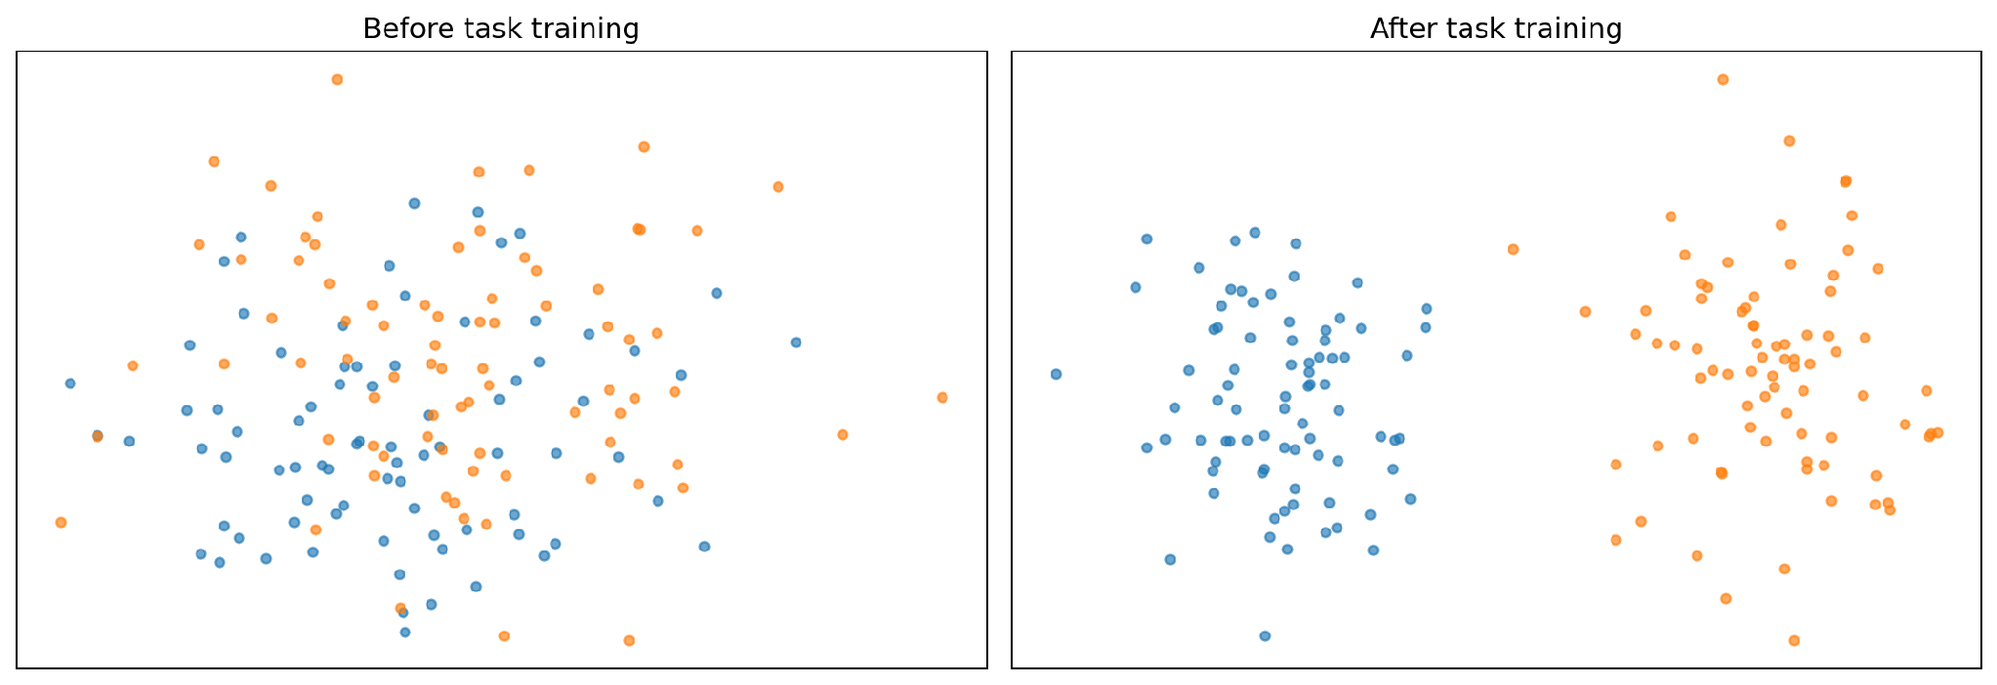
GENOME HACKWEEK 2026 · CSIR-IICB KOLKATA
PART 05 · BUILDING THE CLASSIFIER
Embedding space, before and after
● promoter windows
● non-promoter windows
Each dot is one window, projected from hundreds of dimensions down to two.
LEFT · STRAIGHT FROM PRETRAINING
RIGHT · AFTER TASK TRAINING
WATCH OUT
The classes are mixed. The model was never told this task existed.
Two groups. One straight boundary now separates most points — all a simple classifier needs.
Distances in a 2-D projection are not real distances. Take the idea, not the coordinates.
Aditya Upadhyay · CSIR-IICB Kolkata
DNA language models & classifiers
26
Notes:
Same windows, same model, before and after task training. Distances in 2-D are not real distances.

Slide 27
GENOME HACKWEEK 2026 · CSIR-IICB KOLKATA
PART 05 · BUILDING THE CLASSIFIER · WORKED EXAMPLE
Logistic regression, in full
Each feature gets a weight; the contributions are added up and squashed into a probability.
STEP 1 — WEIGH THE FEATURES AND ADD THEM UP
STEP 2 — SQUASH THE TOTAL INTO 0…1
Feature
Value
Weight
Contribution
+1.53
→
0.82
GC content
0.68
+3.0
+2.04
count of CGG
0.31
+1.2
+0.37
A large positive total becomes a probability near 1, a large negative total near 0, and a total of zero becomes exactly 0.5.
count of AAATT
0.55
−1.6
−0.88
total
+1.53
Positive weights push towards "promoter", negative ones push away. Training just searches for the weights that fit the examples best.
STEP 3 — DECIDE
0.82 is above our 0.5 threshold, so we call this window a promoter — and we remember that the model was only 82% confident.
from sklearn.linear_model import LogisticRegression clf = LogisticRegression(max_iter=1000) clf.fit(X_train, y_train) p = clf.predict_proba(X_test)[:, 1]
Aditya Upadhyay · CSIR-IICB Kolkata
DNA language models & classifiers
27
Notes:
Weigh, add, squash, decide. Walk the arithmetic line by line.

Slide 28
GENOME HACKWEEK 2026 · CSIR-IICB KOLKATA
PART 05 · BUILDING THE CLASSIFIER
Three ways to use a big model
Ordered by cost. Today's hands-on session uses the middle row, and most projects should start there too.
APPROACH
WHAT YOU TRAIN
LABELS NEEDED
HARDWARE
WHEN TO REACH FOR IT
Zero-shot
nothing at all
none
a laptop
Ranking or scoring when you have no labelled data at all
Linear probing
one small classifier on frozen embeddings
a few hundred
a laptop
Testing what the representation already contains — fast, and hard to get wrong
TODAY'S HANDS-ON
Fine-tuning
the encoder as well
thousands
a GPU
When probing has clearly hit a ceiling and you have data to spare
WHY WE PROBE RATHER THAN FINE-TUNE
A USEFUL HABIT
"Frozen" means we do not change the encoder's weights, so only a handful of numbers are learned. There is very little to overfit, and the result is easy to interpret: whatever the classifier achieves was already present in the embedding.
Always run the cheap baseline first — k-mer counts plus logistic regression. If the pretrained embedding cannot beat it, the extra machinery is not earning its keep.
Aditya Upadhyay · CSIR-IICB Kolkata
DNA language models & classifiers
28
Notes:
We probe rather than fine-tune: little to overfit, easy to interpret.

Slide 29
GENOME HACKWEEK 2026 · CSIR-IICB KOLKATA
PART 05 · BUILDING THE CLASSIFIER · HANDS-ON
The notebook, step by step
01
02
03
04
Load the windows
Build the k-mer baseline
Swap in embeddings
Judge it honestly
A few thousand labelled 300-base windows, already split by chromosome. Check the class balance before anything else.
Same classifier, same split, same metrics — only the features change. That is what makes the comparison fair.
Confusion matrix, precision, recall, F1 and the precision–recall curve — then repeat on the held-out chromosome.
Count 4-mers, fit logistic regression, write the score on the board. Everything later has to beat this.
CountVectorizer(analyzer='char', ngram_range=(4,4))
emb = model(**tok(seqs)).last_hidden_state.mean(1)
df.label.value_counts()
classification_report(y_test, y_pred)
EXPECT ROUGHLY
AND
WHAT SUCCESS MEANS TODAY
k-mer baseline: F1 around 0.75–0.85 on an easy split.
Embeddings: a few points better, and a bigger gain on the hard split.
A pipeline you can rerun on your own data next week — not a record score.
Aditya Upadhyay · CSIR-IICB Kolkata
DNA language models & classifiers
29
Notes:
Four cells. Everything later has to beat the baseline in step 2.

Slide 30
GENOME HACKWEEK 2026 · CSIR-IICB KOLKATA
06
IN THIS PART
31
Reading a confusion matrix
Judging the result
32
Where you put the cut-off
33
The ROC curve
A classifier can score well for entirely the wrong reasons. Two things decide whether its number means anything: the metric you chose, and what you held out.
34
AUC, in one number
35
What was really held out
36
Four questions to keep asking
37
Takeaways
PART 06 OF 06
Notes:
Two things decide whether a number means anything: the metric, and what was held out.

Slide 31
GENOME HACKWEEK 2026 · CSIR-IICB KOLKATA
PART 06 · JUDGING THE RESULT
Reading a confusion matrix
A table of the four things that can happen. Here: 1,000 test windows, 100 of them real promoters.
MODEL SAYS PROMOTER
MODEL SAYS NOT
WHY ACCURACY ALONE IS USELESS HERE
REALLY A PROMOTER
90%
accuracy from a model that answers "not a promoter" every single time — because 900 of the 1,000 windows really are not promoters.
72
28
true positives
missed promoters
Its recall is 0. It found none of the promoters, which were the only thing we cared about.
NOT A PROMOTER
40
860
false alarms
correctly rejected
WHICH ERROR HURTS MORE?
Screening candidates for the lab? Missed promoters are expensive, so favour recall. Sending a shortlist to a collaborator? False alarms waste their time, so favour precision. The threshold is where you make that choice.
0.64
0.72
0.68
precision — 72 of the 112 alarms were right
recall — 72 of the 100 promoters found. The same thing a clinician calls sensitivity
F1 — the balance of the two
REPORT THIS, NOT ONE NUMBER
Class balance · precision · recall · F1 · AUC · the precision–recall curve · and what the baseline scored on the same split.
Aditya Upadhyay · CSIR-IICB Kolkata
DNA language models & classifiers
31
Notes:
Accuracy is useless when the classes are unbalanced. Precision and recall are not.

Slide 32
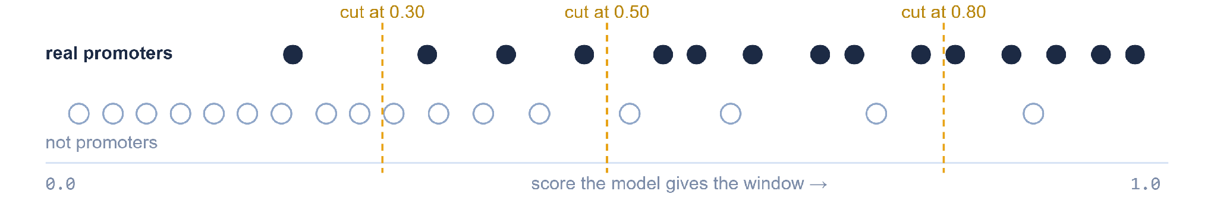
GENOME HACKWEEK 2026 · CSIR-IICB KOLKATA
PART 06 · JUDGING THE RESULT
Where you put the cut-off
The model never says yes or no. It gives every window a score between 0 and 1. You decide where to cut — and that one decision, not the model, sets how many promoters you catch.
STRICT · CUT AT 0.80
MIDDLE · CUT AT 0.50
LENIENT · CUT AT 0.30
45 of 100 promoters caught · 9 false alarms
72 of 100 promoters caught · 40 false alarms
90 of 100 promoters caught · 135 false alarms
Almost every hit is real, but you have thrown away more than half the biology.
The default, and the table on the previous slide. Nothing about it is special.
You miss almost nothing, and pay for it with a much longer shortlist.
Aditya Upadhyay · CSIR-IICB Kolkata
DNA language models & classifiers
32
Notes:
The model never says yes or no. It gives a score. Everything on the last slide came from one arbitrary cut at 0.5.

Slide 33
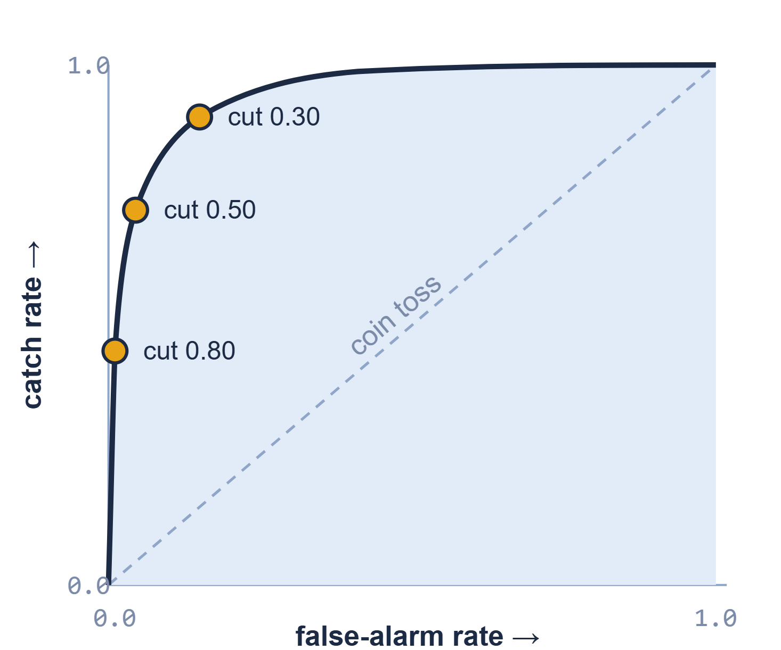
GENOME HACKWEEK 2026 · CSIR-IICB KOLKATA
PART 06 · JUDGING THE RESULT
The ROC curve
Rather than argue about one cut-off, try every cut-off and plot what happens. Each point on this curve is one possible cut. That is the whole idea.
THE TWO AXES, IN WORDS YOU ALREADY USE
Up is the catch rate: of the 100 real promoters, the fraction found. Clinicians call it sensitivity; we called it recall. Right is the false-alarm rate: of the 900 non-promoters, the fraction wrongly flagged. It is 1 − specificity.
HOW THE CURVE IS DRAWN
Slide the cut-off from 1.0 down to 0.0. At the strict end you catch nothing and flag nothing — bottom left. At the lenient end you catch everything and flag everything — top right. Every cut-off in between is a dot; join them up.
READING IT IN ONE LOOK
A curve that hugs the top-left corner catches most promoters while raising few false alarms. The dashed diagonal is a model that guesses at random. Below the diagonal means worse than guessing.
Aditya Upadhyay · CSIR-IICB Kolkata
DNA language models & classifiers
33
Notes:
The ROC curve is just the previous slide's three cut-offs, plotted — and then every other cut-off too.

Slide 34
GENOME HACKWEEK 2026 · CSIR-IICB KOLKATA
PART 06 · JUDGING THE RESULT
AUC, in one number
AUC is the area under that curve. It summarises every cut-off at once, so you can compare two models without first agreeing on a threshold.
0.93
The definition worth memorising: pick one real promoter and one non-promoter at random. AUC is the chance the model gave the promoter the higher score. Here, 93 times out of 100.
WHAT THE NUMBER IS WORTH
0.50 · a coin toss
0.70 · weak
0.85 · useful
0.95+ · suspicious
An AUC near 1.0 on a genomics task is far more often a leaky split than a great model. Check what was held out before you celebrate.
WHY PEOPLE LIKE IT
WHERE IT MISLEADS YOU
It needs no threshold, so nobody can tune one to flatter the result, and it only depends on how the windows are ranked — not on the scores themselves.
With 100 promoters against 900 non-promoters, 40 false alarms barely dent the false-alarm/positive rate but wreck your precision. AUC 0.93 here, yet only 64 in 100 flagged windows are real. Report the precision–recall curve alongside it.
Aditya Upadhyay · CSIR-IICB Kolkata
DNA language models & classifiers
34
Notes:
AUC is one number for the whole curve. Say the ranking definition out loud — it is the only one worth memorising.

Slide 35
GENOME HACKWEEK 2026 · CSIR-IICB KOLKATA
PART 06 · JUDGING THE RESULT
What was really held out
The same model and the same data can produce two very different scores, depending only on how the test set was chosen.
THE EASY SPLIT
THE HONEST SPLIT
Shuffle and cut 80 / 20
Hold out whole groups
chr 1–17
chr 18–22
mouse
▮ train ▮ test — drawn from the same neighbourhoods
▮ train ▮ held out ▮ unseen species
Windows overlap, and neighbouring regions look alike, so a near-copy of almost every test window sits in the training set. The model can recognise rather than generalise, and the score comes out flattering.
Every test window comes from a chromosome — or a species — the model has never met. Nothing in the training set is a near-copy, so the score reflects transfer rather than recall.
Typical outcome: F1 0.90 — and no idea whether it would survive a new genome.
Typical outcome: F1 0.78 — lower, and far more informative.
What exactly was held out, and how similar was it to the training data? A model that only works on the genome it trained on has memorised one genome, not learned biology.
ASK THIS EVERY TIME
Aditya Upadhyay · CSIR-IICB Kolkata
DNA language models & classifiers
35
Notes:
Ask this of any published score, including your own.

Slide 36
GENOME HACKWEEK 2026 · CSIR-IICB KOLKATA
PART 06 · JUDGING THE RESULT
Four questions to keep asking
Not everything a model learns is biology. Put every result — yours and everyone else's — through these four.
01
Interpretability
02
Data bias
Which parts of the sequence actually drove the prediction? For k-mer counts you can read the weights straight off. For embeddings you need attribution methods — or a careful experiment.
Whose genomes went into pretraining? Human and a handful of model organisms dominate. Performance on a plant or a non-model pathogen is a genuinely open question.
03
Shortcuts
04
More is not better
If all your negatives came from repeat-rich regions, the model can win by detecting repeats. Build negatives that differ from positives only in the thing you are actually asking about.
A longer window, a bigger model, more parameters — each sounds like progress, and each has to earn its place against the cheap baseline on the honest split.
A good result you cannot explain is a hypothesis, not a finding.
Aditya Upadhyay · CSIR-IICB Kolkata
DNA language models & classifiers
36
Notes:
Not everything a model learns is biology.

Slide 37
GENOME HACKWEEK 2026 · CSIR-IICB KOLKATA
CLOSING
Takeaways
SEQUENCE
→
NUMBERS
→
CLASSIFIER
→
PREDICTION
→
HONEST CHECK
01
02
03
A pretrained model is useful because it hands you a ready-made numerical description of sequence. You never have to design features by hand.
A small classifier on top is enough to find out what that description contains — and it always has to beat the k-mer baseline to be worth keeping.
A believable score needs a metric that matches the question and a test set the model has genuinely never seen.
IF YOU REMEMBER ONE SENTENCE
The model turns sequence into numbers; the science is in choosing the labels, the split and the metric.
Aditya Upadhyay · CSIR-IICB Kolkata
DNA language models & classifiers
37
Notes:
Three points, one sentence to keep.

Slide 38
GENOME HACKWEEK 2026 · CSIR-IICB KOLKATA
APPENDIX · REFERENCE
Glossary
AUC
Attention
Baseline
Classifier
The chance the model scores a random promoter above a random non-promoter.
The step where each position looks at the others and mixes in the ones that matter.
The cheapest sensible method, run first so anything fancier has to beat it.
A model whose output is a class — here, promoter or not promoter.
Context window
Embedding
F1
Feature
How much sequence a model can take in at once.
The list of numbers a pretrained model produces to stand for one input window.
One number balancing precision and recall; high only when both are high.
Any number computed from one example and fed to the model.
Fine-tuning
Frozen
k-mer
Label
Training the big model itself on your task, not just a classifier on top.
Left unchanged during training — we train only the classifier on top.
Any stretch of k consecutive bases; ACG is a 3-mer.
The known answer for a training example — here 1 or 0.
Loss
Overfitting
Precision
Pretraining
A number measuring how wrong the predictions are; training makes it small.
Fitting the training examples so closely that new data does worse.
Of everything the model flagged, the fraction that was right.
The long, unlabelled training run done once by whoever published the model.
Promoter
ROC curve
Recall
Self-supervised
The stretch of DNA just upstream of a gene where transcription is started.
Catch rate against false-alarm rate, as the cut-off sweeps strict to lenient.
Of everything that really was a promoter, the fraction the model found.
Training where the answer key comes from the data itself — no human labelling.
Sensitivity / specificity
Threshold
Token
TSS
Clinical names for catch rate and correct-rejection rate; sensitivity = recall.
The cut-off that turns a score between 0 and 1 into a yes-or-no answer.
One unit of input after cutting up the sequence; the smallest thing seen.
Transcription start site: the first base that gets copied into RNA.
Aditya Upadhyay · CSIR-IICB Kolkata
DNA language models & classifiers
38
Notes:
Reference slide for studying afterwards.

Slide 39
GENOME HACKWEEK 2026 · CSIR-IICB KOLKATA
APPENDIX · STUDY PATH
Where to go next
In this order. Each step assumes only the one before it, and all four are doable on a laptop.
01
02
03
04
Rerun the notebook
Swap in your own data
Read the model papers
Learn the tooling properly
Change one thing at a time: k from 4 to 6, then the threshold, then the split. Watch which change moves the score and which does not.
Any two-class sequence question works: enhancer or not, coding or non-coding, one species against another. The pipeline does not change.
DNABERT-2 (Zhou 2023), Nucleotide Transformer (Dalla-Torre 2025), HyenaDNA (Nguyen 2023). Read each paper's evaluation section first.
scikit-learn's user guide for the classifier side, Hugging Face's course for the model side. Both are free and worked-example driven.
A HABIT WORTH FORMING
QUESTIONS AFTERWARDS
Write down the baseline score, the split and the metric before you start tuning anything. Almost every irreproducible result in this field comes from skipping that one note.
Bring them to the HackWeek desk, or to any later session this week — the same pipeline underlies all of them.
Aditya Upadhyay · CSIR-IICB Kolkata
DNA language models & classifiers
39
Notes:
A study path in order, for people continuing on their own.

Slide 40
DBT-BIC-NNP-TREE GENOME INFORMATICS · GENOME HACKWEEK 2026
Thank you
Questions before we open the notebook?
Aditya Upadhyay · CSIR-IICB, Kolkata
DNA language models & sequence classifiers
Genome HackWeek 2026 · 2 September 2026 · Annotate, Innovate, Collaborate
Notes:
Questions before we open the notebook.

