Slide 1
Encoder-Decoder Models, Attention, and Contextual Embeddings
Jurafsky and Martin Chapter 10

Slide 2
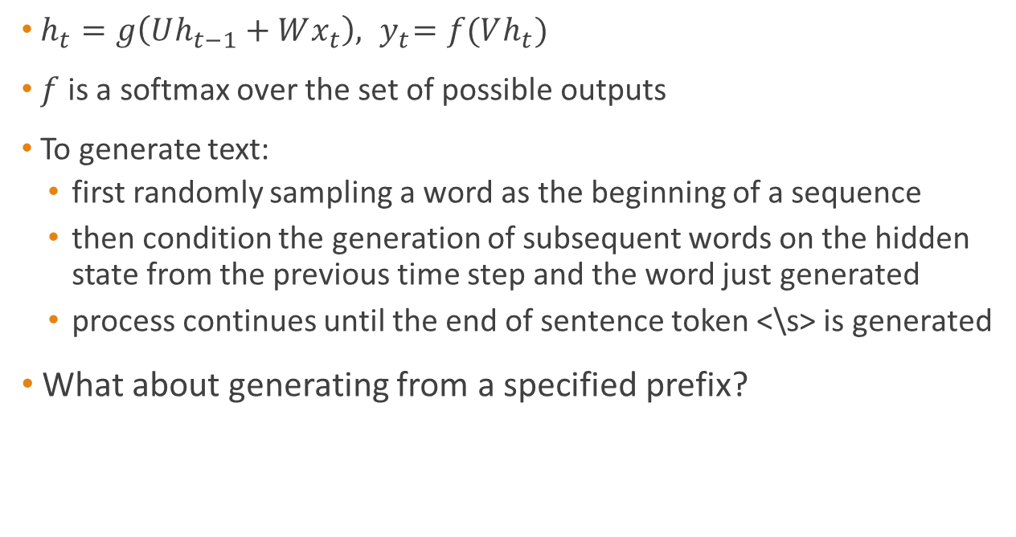
Recall: autoregressive generation
$h_{t}=g\left(Uh_{t−1}+Wx_{t}\right), { y}_{t}=f(Vh_{t})$
$f$ is a softmax over the set of possible outputs
To generate text:
first randomly sampling a word as the beginning of a sequence
then condition the generation of subsequent words on the hidden state from the previous time step and the word just generated
process continues until the end of sentence token <\s> is generated
What about generating from a specified prefix?

Slide 3
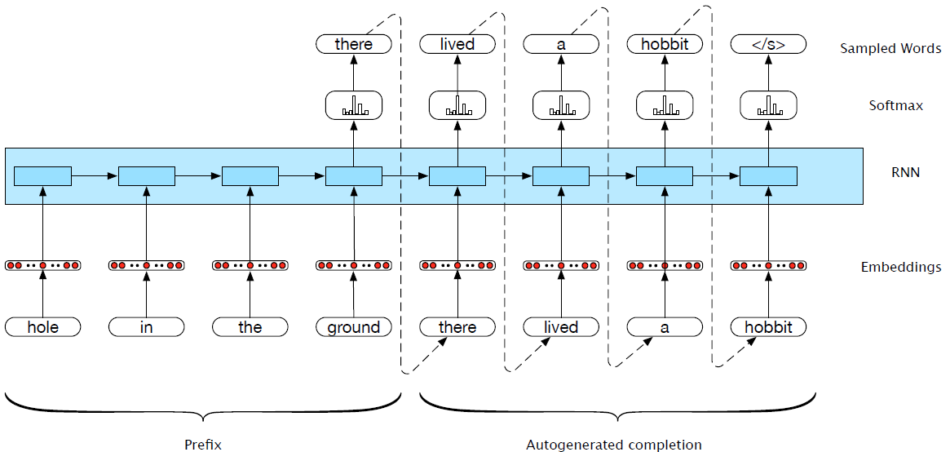
Generation with prefix

Slide 4
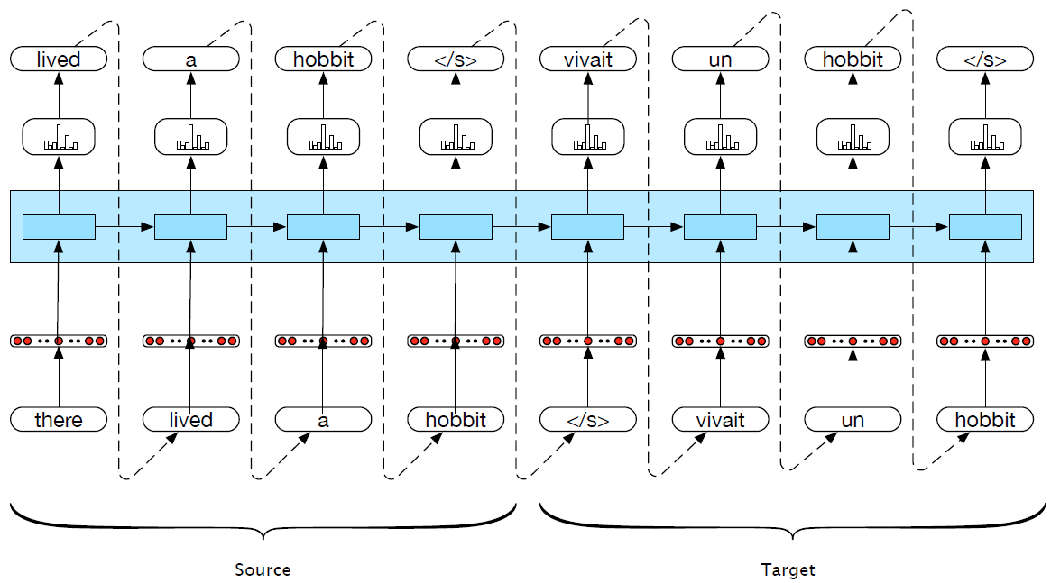
Machine translation

Slide 5
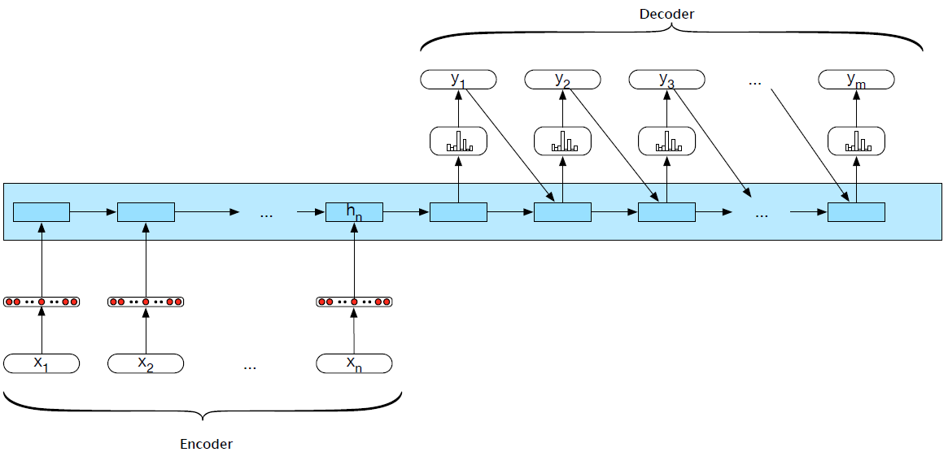
Encoder-decoder networks

Slide 6
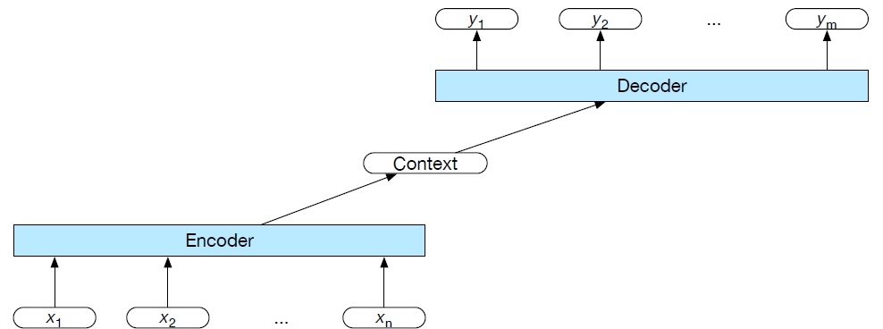
Encoder-decoder networks
An encoder that accepts an input sequence and generates a corresponding sequence of contextualized representations
A context vector that conveys the essence of the input to the decoder
A decoder, which accepts context vector as input and generates an arbitrary length sequence of hidden states, from which a corresponding sequence of output states can be obtained

Slide 7
Encoder-decoder: specifics
Encoder and decoder choices: simple RNNs, LSTMs, GRUs, convolutional networks, transformers, stacked Bi-LSTMs, etc.
Beam search:
In decoding, can we explore several possible outputs?
Beam search: combining a breadth-first-search strategy with a heuristic filter that scores each option and prunes the search space to stay within a fixed-size memory footprint, called the beam width

Slide 8
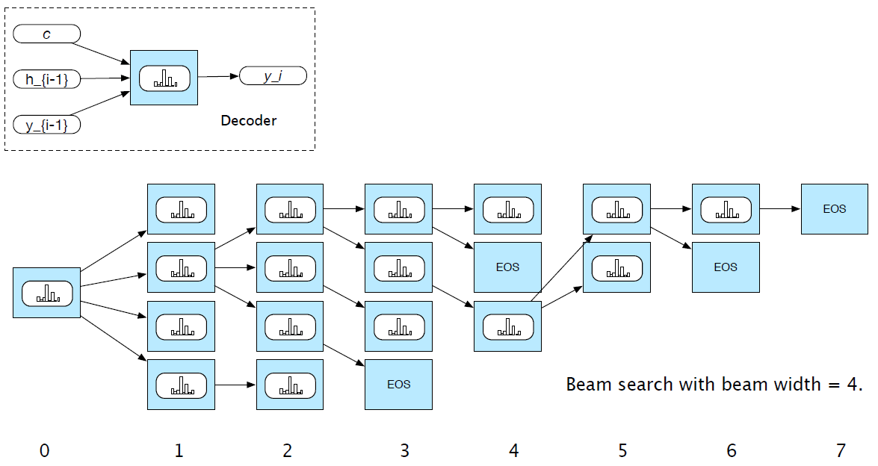
Beam search

Slide 9
Attention
Weaknesses of the context vector:
Only directly available at the beginning of the process and its influence will wane as the output sequence is generated
Context vector is a function (e.g. last, average, max, concatenation) of the hidden states of the encoder. This approach loses useful information about each of the individual encoder states
Potential solution: attention mechanism

Slide 10
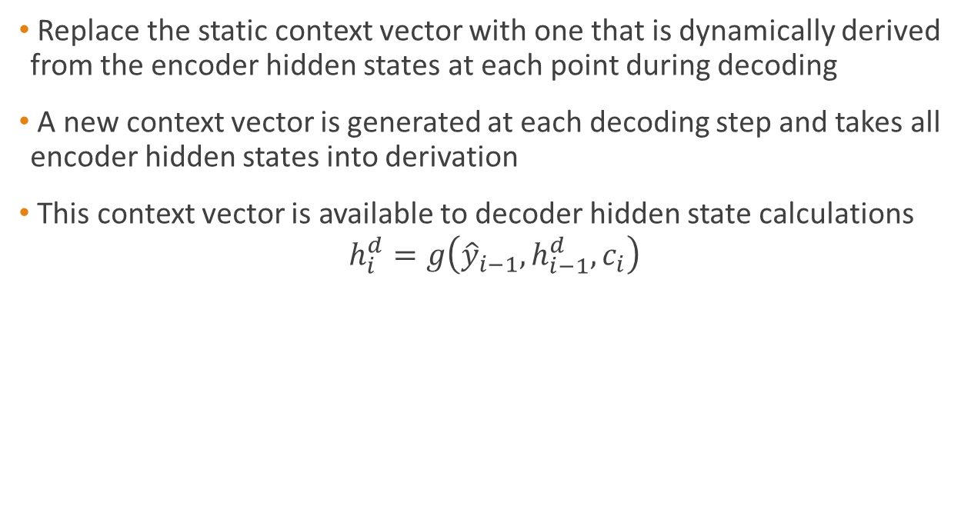
Attention mechanism
Replace the static context vector with one that is dynamically derived from the encoder hidden states at each point during decoding
A new context vector is generated at each decoding step and takes all encoder hidden states into derivation
This context vector is available to decoder hidden state calculations
$$h_{i}^{d}=g\left({\hat{y}}_{i−1},h_{i−1}^{d},c_{i}\right)$$

Slide 11
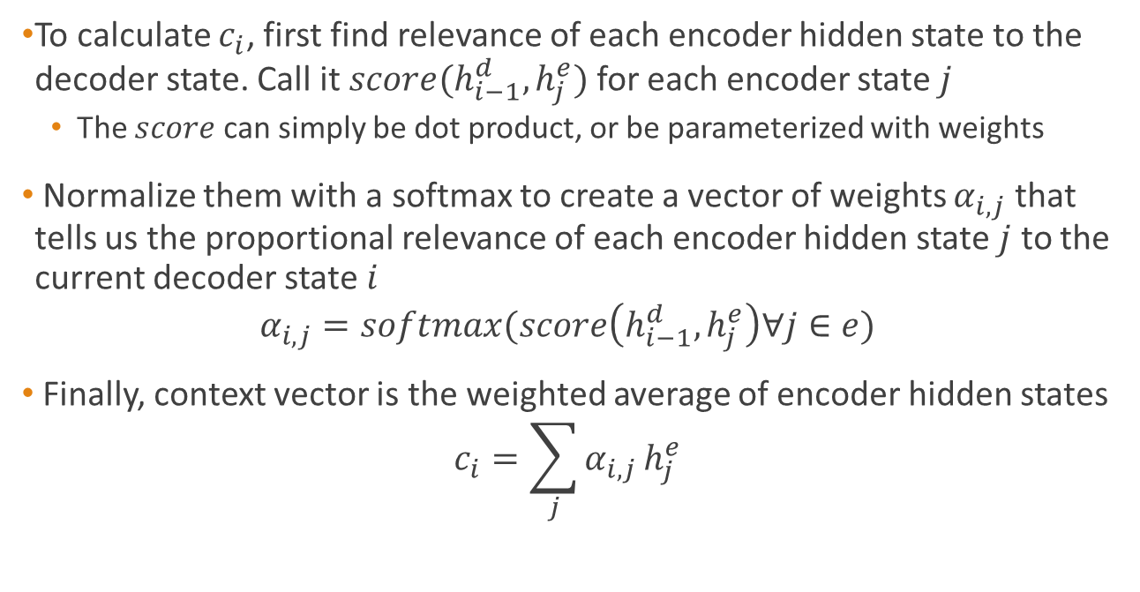
Attention mechanism
To calculate $c_{i}$, first find relevance of each encoder hidden state to the decoder state. Call it $score(h_{i−1}^{d},h_{j}^{e})$ for each encoder state $j$
The $score$ can simply be dot product, or be parameterized with weights
Normalize them with a softmax to create a vector of weights $α_{i,j}$ that tells us the proportional relevance of each encoder hidden state $j$ to the current decoder state $i$
$$α_{i,j}=softmax(score\left(h_{i−1}^{d},h_{j}^{e}\right)∀j∈e)$$
Finally, context vector is the weighted average of encoder hidden states
$$c_{i}=\sum_{j}{α_{i,j}}h_{j}^{e}$$

Slide 12
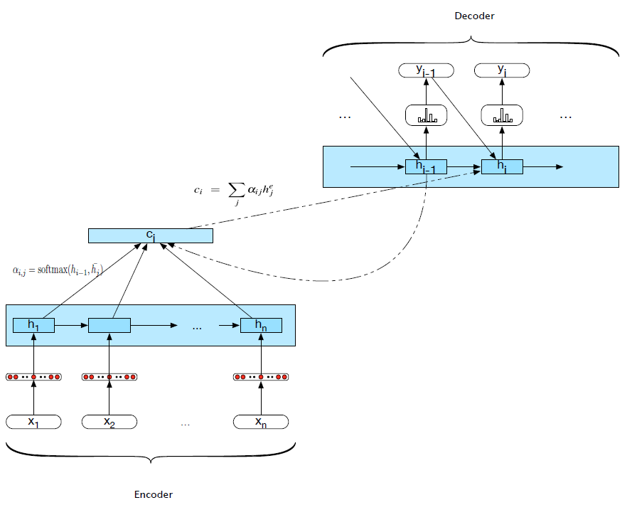
Attention mechanism

Slide 13
Applications of Encoder-Decoder Networks
Text summarization
Text simplification
Question answering
Image captioning
And more. What do those tasks have in common?

