Slide 1
Syntactic Parsing and the Penn Treebank
Jurafsky and Martin Chapters 11 and 12
Based on slides from Sameer Singh, Dan Jurafsky, Noah Smith, Slav Petrov, and everyone else they copied from.

Slide 2
Source of Grammar?
Manual
Write symbolic grammar (CFG or often richer) and lexicon
S → NP VP NN → interest
NP → (DT) NN NNS → rates
NP → NN NNS NNS → raises
NP → NNP VBP → interest
VP → V NP VBZ → rates
Used grammar/proof systems to prove parses from words
Fed raises interest rates 0.5% in effort to control inflation
Minimal grammar: 36 parses
Simple 10 rule grammar: 592 parses
Real-size broad-coverage grammar: millions of parses
Noam Chomsky

Slide 3
Source of Grammar?
From data!
The Penn Treebank
Building a treebank seems a lot slower and less useful than building a grammar
But a treebank gives us many things
Reusability of the labor
Many parsers, POS taggers, etc.
Valuable resource for linguistics
Broad coverage
Frequencies and distributional information
A way to evaluate systems
[Marcus et al. 1993, Computational Linguistics]

Slide 4
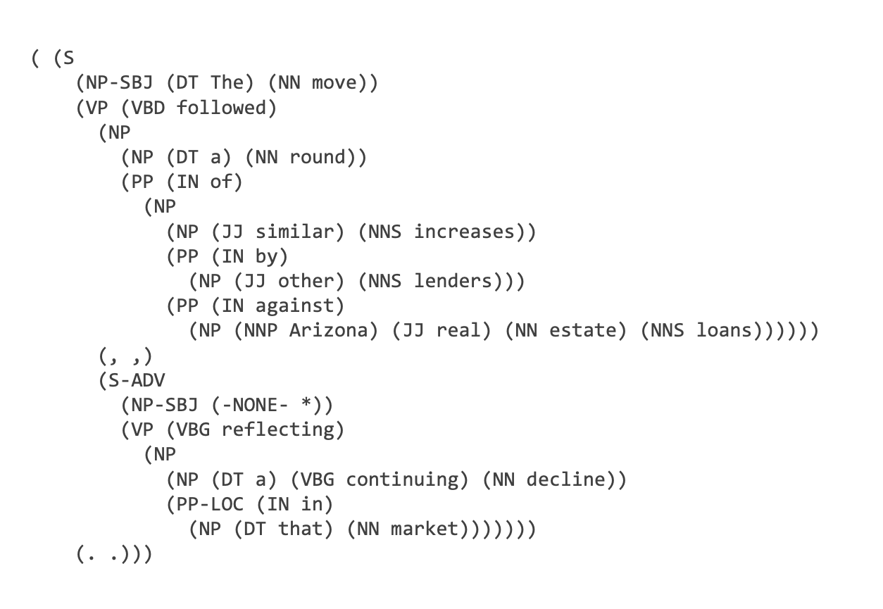
Notes:
40,000 training sentences (sections 0-21)
2,300 test sentences (22 and 23)
Mostly WSJ newspaper texts, some spoken conversations.

Slide 5
( (S
(NP-SBJ (DT The) (NN move))
(VP (VBD followed)
(NP
(NP (DT a) (NN round))
(PP (IN of)
(NP
(NP (JJ similar) (NNS increases))
(PP (IN by)
(NP (JJ other) (NNS lenders)))
(PP (IN against)
(NP (NNP Arizona) (JJ real) (NN estate) (NNS loans))))))
(, ,)
(S-ADV
(NP-SBJ (-NONE- *))
(VP (VBG reflecting)
(NP
(NP (DT a) (VBG continuing) (NN decline))
(PP-LOC (IN in)
(NP (DT that) (NN market)))))))
(. .)))

Slide 6
Some of the rules, with counts
40717 PP → IN NP
33803 S → NP-SBJ VP
22513 NP-SBJ → -NONE-
21877 NP → NP PP
20740 NP → DT NN
14153 S → NP-SBJ VP .
12922 VP → TO VP
11881 PP-LOC → IN NP
11467 NP-SBJ → PRP
11378 NP → -NONE-
11291 NP → NN
...
989 VP → VBG S
985 NP-SBJ → NN
983 PP-MNR → IN NP
983 NP-SBJ → DT
969 VP → VBN VP
100 VP → VBD PP-PRD
100 PRN → : NP :
100 NP → DT JJS
100 NP-CLR → NN
99 NP-SBJ-1 → DT NNP
98 VP → VBN NP PP-DIR
98 VP → VBD PP-TMP
98 PP-TMP → VBG NP
97 VP → VBD ADVP-TMP VP
...
10 WHNP-1 → WRB JJ
10 VP → VP CC VP PP-TMP
10 VP → VP CC VP ADVP-MNR
10 VP → VBZ S , SBAR-ADV
10 VP → VBZ S ADVP-TMP
4500 rules
for VP!
Notes:
Any guesses on how many unique VP rules there are?

Slide 7
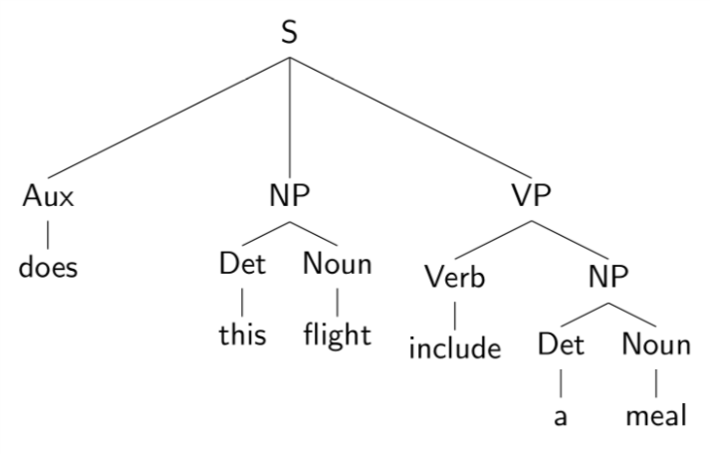
Evaluating Parses
Each parse tree is represented by a list of tuples:
Use this to estimate precision/recall!

Slide 8
Evaluating Parses
Each parse tree is represented by a list of tuples:
Use this to estimate precision/recall!

Slide 9
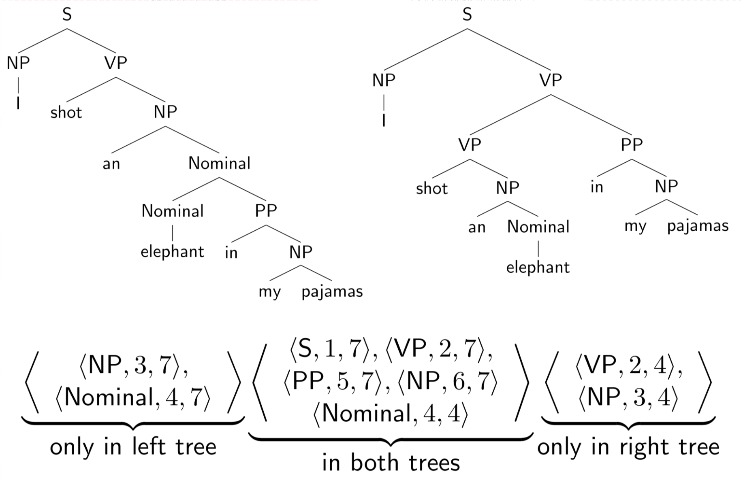
Evaluating Parses: Example

Slide 10
Evaluating Parses: Example

Slide 11
Outline
Context Free Grammars
Parsing: CKY Algorithm
Extensions: Probabilistic and Lexicalized
Dependency Parsing

Slide 12
The Parsing Problem
Given sentence x and grammar G,
Recognition
Is sentence x in the grammar? If so, prove it.
“Proof” is a deduction, valid parse tree.
Parsing
Show one or more derivations for x in G.
Even with small grammars, brute force grows exponentially!
“Book that flight”

Slide 13
Left to Right?
The old man the boat.
The complex houses married and single soldiers and their families.
Garden Path Sentences

Slide 14
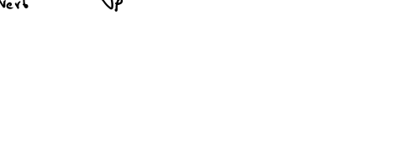
Left to Right?
The old man the boat.
The complex houses married and single soldiers and their families.
Garden Path Sentences

Slide 15
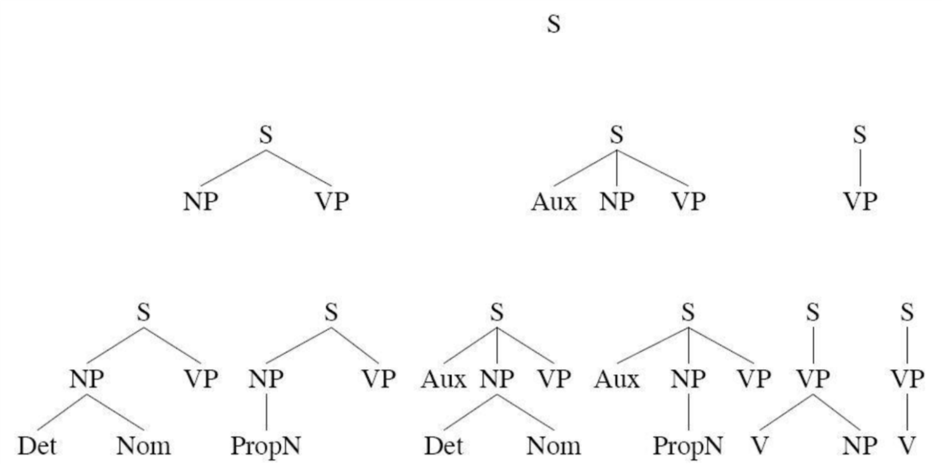
Top Down Parsing
“Book that flight”
Considers only valid trees
But are inconsistent with the words!

Slide 16
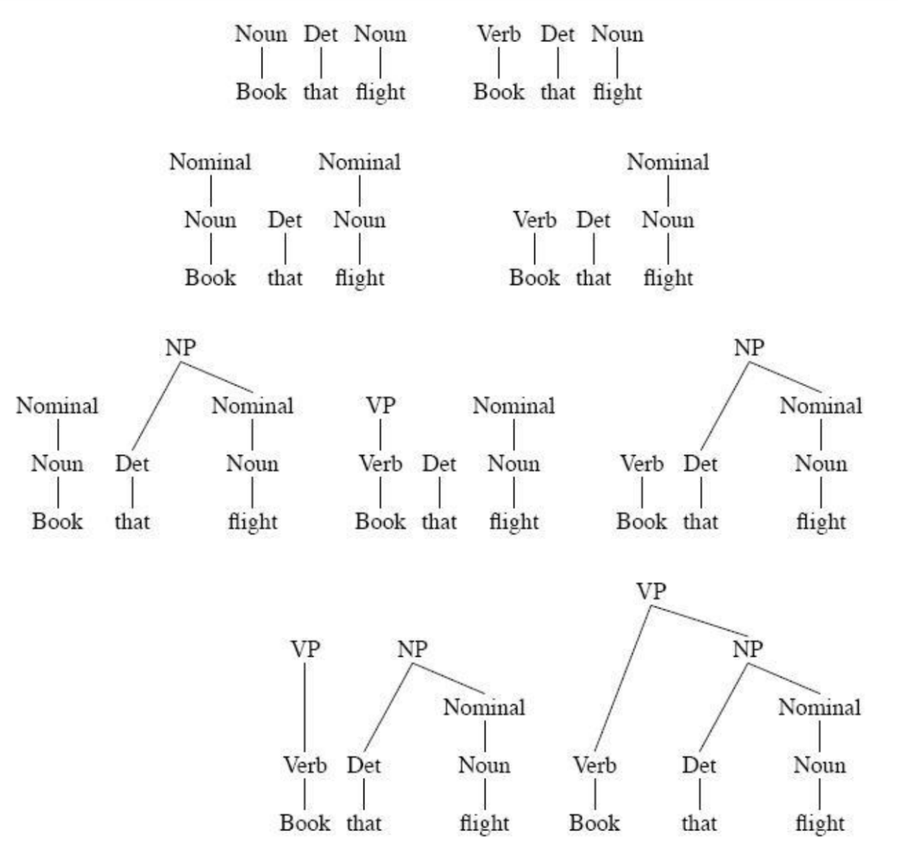
Bottom-up Parsing
“Book that flight”
Builds only consistent trees
But most of them are invalid (don’t go anywhere)!

Slide 17
Bottom-up Parsing
“Book that flight”
Builds only consistent trees
But most of them are invalid (don’t go anywhere)!

Slide 18
Chomsky Normal Form
Context free grammar where all non-terminals to go:
2 non-terminals, or
A single terminal
A → B C
D → w
Converting to CNF
Case 1
Case 2
A → B
B → C D
B → w
A → C D
A → w
A → X E
X → Y D
Y → B C
A → B C D E

Slide 19
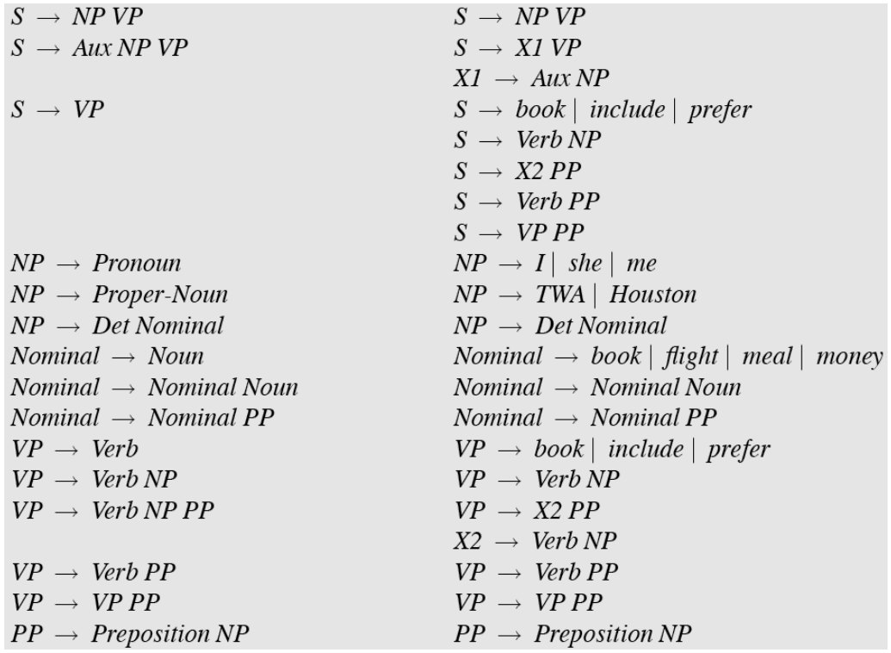
Original Grammar
Chomsky Normal Form

Slide 20
Dynamic Programming
table[i,j] = Set of all valid non-terminals for the constituent span (i,j)
A
(j-1,j)
Rule: A → word[j]
Base case
A should be in table[j-1,j]
word[j]
Recursion
Rule: A → B C
(i,j)
A
If you find a k such that
B is in table[i,k], and
C is in table[k,j], then A should be in table[i,j]
C
B
(i,k)
(k,j)

Slide 21
Dynamic Programming
table[i,j] = Set of all valid non-terminals for the constituent span (i,j)
A
(j-1,j)
Rule: A → word[j]
Base case
A should be in table[j-1,j]
word[j]
Recursion
Rule: A → B C
(i,j)
A
If you find a k such that
B is in table[i,k], and
C is in table[k,j], then A should be in table[i,j]
C
B
(i,k)
(k,j)

Slide 22
CKY Algorithm
Book
the
flight
through
TWA
Notes:
Online demo: http://lxmls.it.pt/2015/cky.html
S -> NP VP
S -> X1 VP
X1 -> Aux NP
S -> book S -> includeS -> prefer
S -> Verb NP
S -> X2 PP
S -> Verb PP
S -> VP PP
NP -> I NP -> sheNP -> me
NP -> TWANP -> Houston
NP -> Det Nominal
Nominal -> bookNominal -> flight
Nominal -> Nominal Noun
Nominal -> Nominal PP
Verb -> book Verb -> includeVerb -> prefer
VP -> Verb NP
VP -> X2 PP
X2 -> Verb NP
VP -> Verb PP
VP -> VP PP
PP -> Preposition NPPreposition -> throughPreposition -> withPreposition -> onDet -> theDet -> a

Slide 23
CKY Algorithm
Book
the
flight
through
TWA
Notes:
01, S VP Verb Nom Noun; 12, Det; 23 Nom N; 3,4 Prep; 4,5 NP, Proper
13 NP; 35 PP;
03, S, VP, X2; 25, Nom
15 NP
05 X2, VP, VP, S(01,15), S(03,35,X2 PP), S(03,35,VP PP)

Slide 24
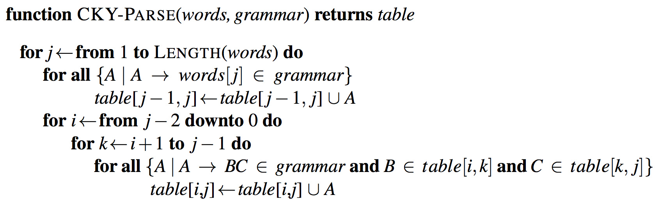
CKY Algorithm

Slide 25
CKY Algorithm

Slide 26
CKY Algorithm: Complexity
|N|: Number of non-terminals
|R|: Number of rules
n: Number of tokens in the sentence
Memory
Time
Notes:
Nn^2 and Rn^3

Slide 27
CKY Algorithm: Complexity
|N|: Number of non-terminals
|R|: Number of rules
n: Number of tokens in the sentence
Memory
Time
Notes:
Nn^2 and Rn^3

Slide 28
Outline
Parsing: CKY Algorithm
Extensions: Probabilistic and Lexicalized
Dependency Parsing

Slide 29
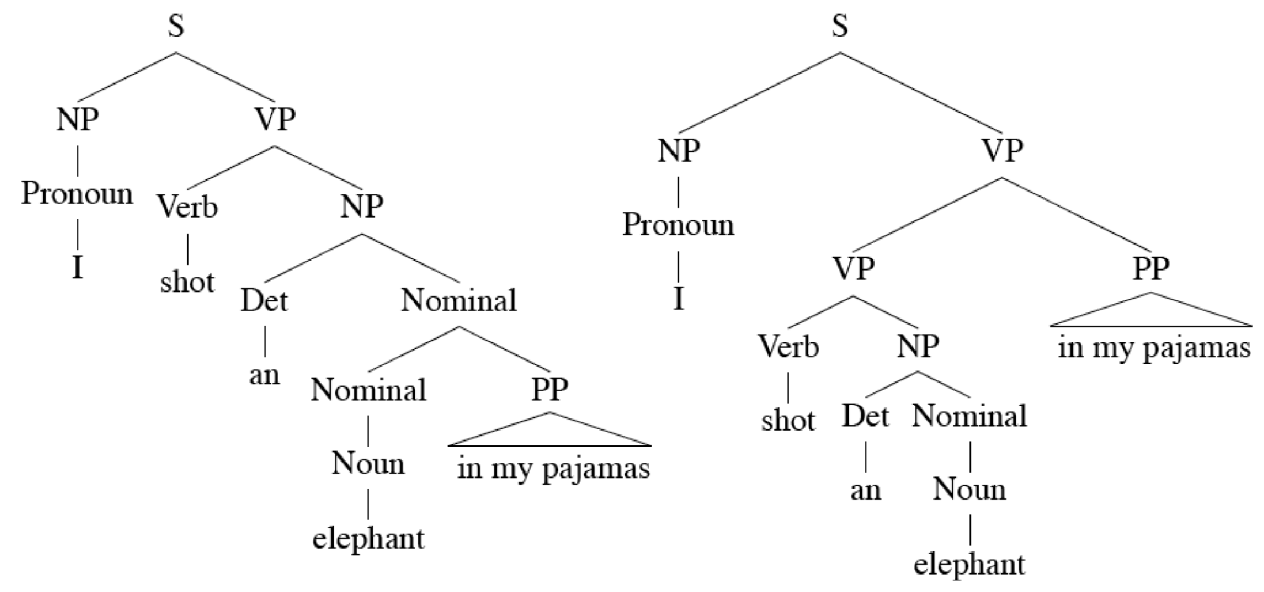
Ambiguity: Which parse?
I shot an elephant in my pajamas.

Slide 30
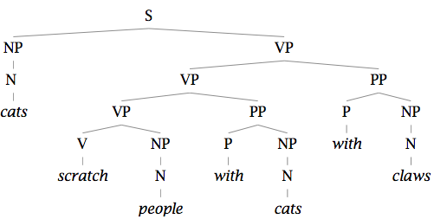
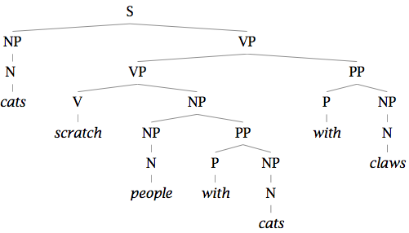
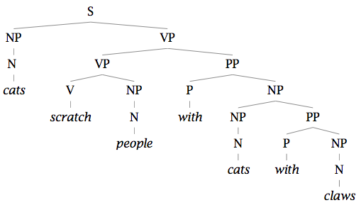
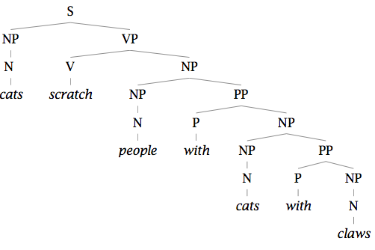
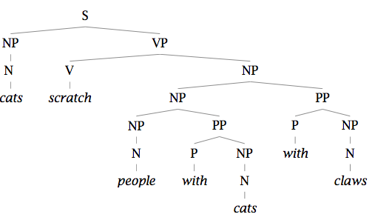
Finding the Best Parse Tree
Cats scratch people with cats with claws.

Slide 31
Finding the Best Parse Tree
Cats scratch people with cats with claws.

Slide 32
Probabilistic CFGs
Same as a regular context-free grammar:
Terminal, non-terminals, and rules
Additionally, attach a probability to each rule!
Rule: A → B C
Probability: P(A → B C | A)
Compute the probability of a parse tree:

Slide 33
Probabilistic CFGs
Same as a regular context-free grammar:
Terminal, non-terminals, and rules
Additionally, attach a probability to each rule!
Rule: A → B C
Probability: P(A → B C | A)
Compute the probability of a parse tree:

