Slide 1
Evaluating translation quality
Machine Translation
Lecture 9
Instructor: Chris Callison-Burch
TAs: Mitchell Stern, Justin Chiu
Website: mt-class.org/penn

Slide 2
Goals for this lecture
Understanding advantages of human versus automatic evaluation
Details of BLEU
How to validate automatic evaluation metrics
What makes a good {manual / automatic} evaluation?
Notes:
* By the end of this lecture I’d like you to understand the advantages of human evaluation versus automatic evaluation and vice versa. You should be able to say what properties of translation makes automatic evaluation difficult.
* I’m going to go through the details of BLEU, the most commonly used translation evaluation metric. This should give you enough of an understanding to start implementing it. In fact, that is going to be part of one of your homework assignments. You’ll get a B if you implement BLEU. To get an A you’ll have to do better than Bleu.
* You should understand how to validate automatic metrics by testing their correlation with human judgments. This is how your HW assignment will be assessed.
* By the end of the lecture you should have a good understanding of what makes a good evaluation -- both manual and automatic

Slide 3
Evaluating MT Quality
Why do we want to do it?
Want to rank systems
Want to evaluate incremental changes
What to make scientific claims
How not to do it
“Back translation”
The vodka is not good

Slide 4
Human Evaluation of MT v. Automatic Evaluation
Human evaluation is
Ultimately what we're interested in, but
Very time consuming
Not re-usable
Automatic evaluation is
Cheap and reusable, but
Not necessarily reliable

Slide 5
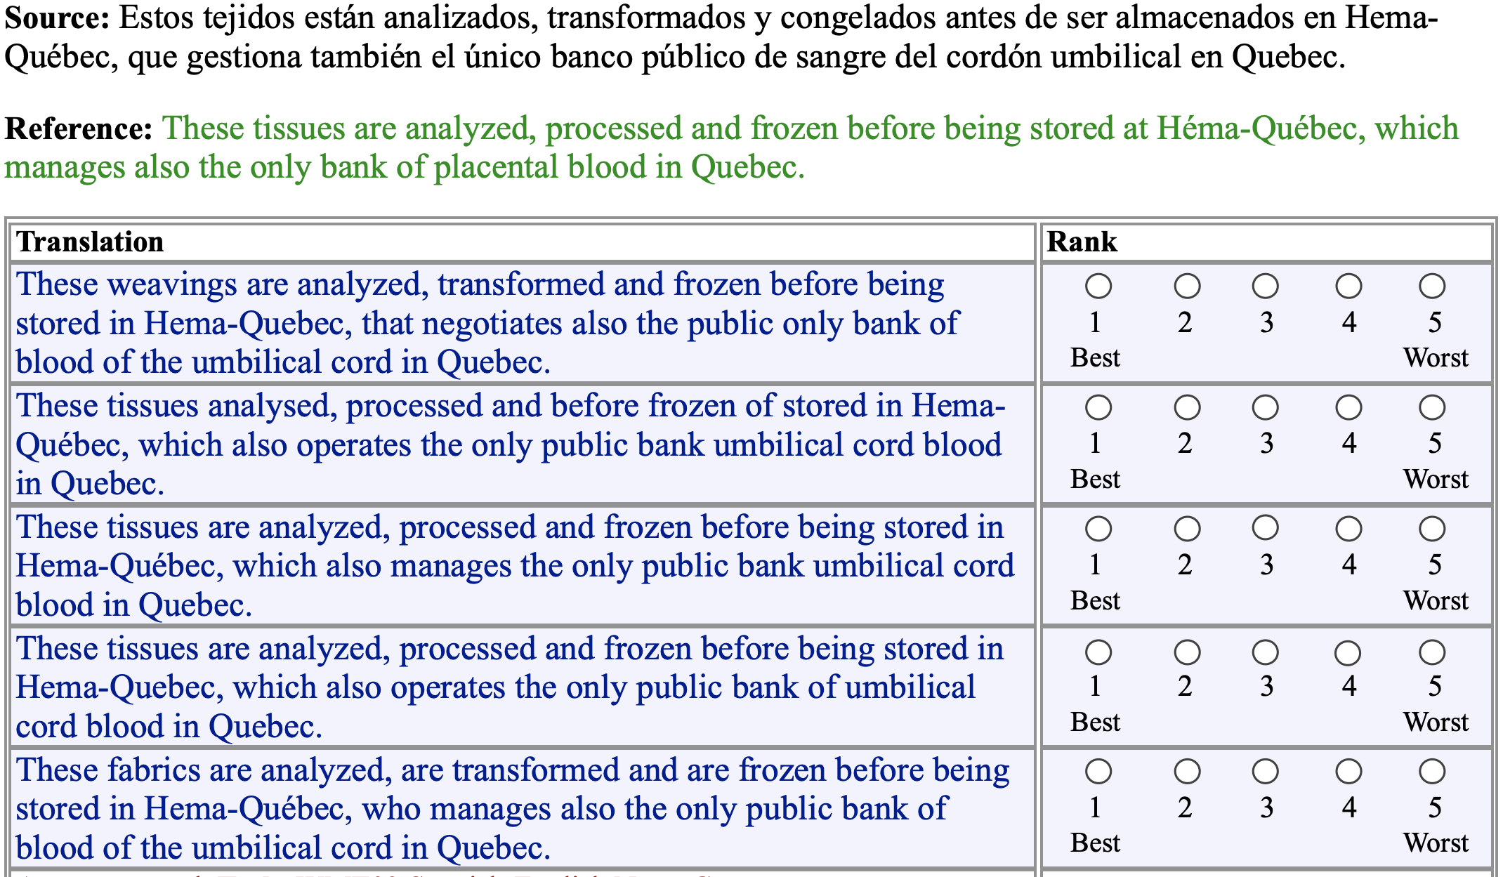
Manual Evaluation

Slide 6
Goals for
Automatic Evaluation
No cost evaluation for incremental changes
Ability to rank systems
Ability to identify which sentences we're doing poorly on, and categorize errors
Correlation with human judgments
Interpretability of the score

Slide 7
Methodology
Comparison against reference translations
Intuition: closer we get to human translations, the better we're doing
Could use WER like in speech recognition

Slide 8
Word Error Rate
Levenshtein Distance (also "edit distance")
Minimum number of insertions, substitutions, and deletions needed to transform one string into another
Useful measure in speech recognition
This shows how easy it is to recognize speech
This shows how easy it is to wreck a nice beach
Notes:
Unlike translation, speech recognition is easy

Slide 9
Problems with using WER for translation?
(discuss with your neighbor)

Slide 10
Problems with WER
Unlike speech recognition we don't have the assumption of
exact match against the reference
In machine translation there can be many possible (and equally valid) ways of translating a sentence
This shows how easy it is to recognize speech
It illustrates how simple it is to transcribe the spoken word
Notes:
Different words can be used

Slide 11
Problems with WER
Unlike speech recognition we don't have the assumption of
linearity
Clauses can move around, since we're not doing transcription
This shows how easy it is to recognize speech
It is easy to recognize speech, as this shows
This shows that recognizing speech is easy

Slide 12
Solutions?
(Talk to your neighbor)

Slide 13
Solutions
Compare against lots of test sentences
Use multiple reference translations for each test sentence
Look for phrase / n-gram matches, allow movement

Slide 14
BLEU
BiLingual Evaluation Understudy
Uses multiple reference translations
Look for n-grams that occur anywhere in the sentence

Slide 15
Multiple references
Ref 1 | Orejuela appeared calm as he was led to the American plane which will take him to Miami, Florida.
Ref 2 | Orejuela appeared calm while being escorted to the plane that would take him to Miami, Florida.
Ref 3 | Orejuela appeared calm as he was being led to the American plane that was to carry him to Miami in Florida.
Ref 4 | Orejuela seemed quite calm as he was being led to the American plane that would take him to Miami in Florida.

Slide 16
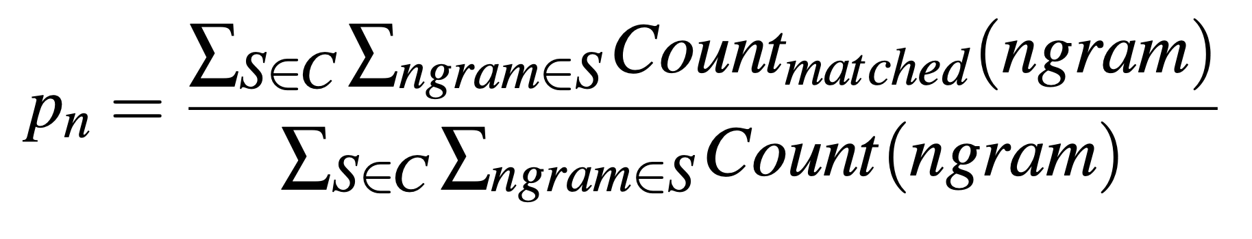
n-gram precision
BLEU modifies this precision to eliminate repetitions that occur across sentences.

Slide 17
Modified precision
Ref 1 | Orejuela appeared calm as he was led to the American plane which will take him to Miami, Florida.
Ref 2 | Orejuela appeared calm while being escorted to the plane that would take him to Miami, Florida.
Ref 3 | Orejuela appeared calm as he was being led to the American plane that was to carry him to Miami in Florida.
Ref 4 | Orejuela seemed quite calm as he was being led to the American plane that would take him to Miami in Florida.
“to Miami” can only be counted as correct once

Slide 18
Ref 1 | Orejuela appeared calm as he was led to the American plane which will take him to Miami, Florida.
Ref 2 | Orejuela appeared calm while being escorted to the plane that would take him to Miami, Florida.
Ref 3 | Orejuela appeared calm as he was being led to the American plane that was to carry him to Miami in Florida.
Ref 4 | Orejuela seemed quite calm as he was being led to the American plane that would take him to Miami in Florida.
Hyp | appeared calm when he was taken to the American plane, which will to Miami, Florida.

Slide 19
American, Florida, Miami, Orejuela, appeared, as, being, calm, carry, escorted, he, him, in, led, plane, quite, seemed, take, that, the, to, to, to, was , was, which, while, will, would, ,, .
1-gram precision = 15/18
Hyp | appeared calm when he was taken to the American plane , which will to Miami , Florida .

Slide 20
American plane, Florida ., Miami ,, Miami in, Orejuela appeared, Orejuela seemed, appeared calm, as he, being escorted, being led, calm as, calm while, carry him, escorted to, he was, him to, in Florida, led to, plane that, plane which, quite calm, seemed quite, take him, that was, that would, the American, the plane, to Miami, to carry, to the, was being, was led, was to, which will, while being, will take, would take, , Florida
2-gram precision = 10/17
Hyp | appeared calm when he was taken to the American plane , which will to Miami , Florida .

Slide 21
n-gram precision
Hyp | appeared calm when he was taken to the American plane, which will to Miami, Florida.
1-gram precision = 15/18 = .83
2-gram precision = 10/17 = .59
3-gram precision = 5/16 = .31
4-gram precision = 3/15 = .20
Geometric average
(0.83 * 0.59 * 0.31 * 0.2)^(1/4) = 0.417
or equivalently
exp(ln .83 + ln .59 + ln .31 + ln .2/4) = 0.417

Slide 22
Ref 1 | Orejuela appeared calm as he was led to the American plane which will take him to Miami, Florida.
Ref 2 | Orejuela appeared calm while being escorted to the plane that would take him to Miami, Florida.
Ref 3 | Orejuela appeared calm as he was being led to the American plane that was to carry him to Miami in Florida.
Ref 4 | Orejuela seemed quite calm as he was being led to the American plane that would take him to Miami in Florida.
Hyp | to the American plane

Slide 23
Better?
Hyp | to the American plane
1-gram precision = 4/4 = 1.0
2-gram precision = 3/3 = 1.0
3-gram precision = 2/2 = 1.0
4-gram precision = 1/1 = 1.0
exp(ln 1 + ln 1 + ln 1 + ln 1) = 1
Notes:
precision = correct / output-length
recall = correct / reference-length

Slide 24
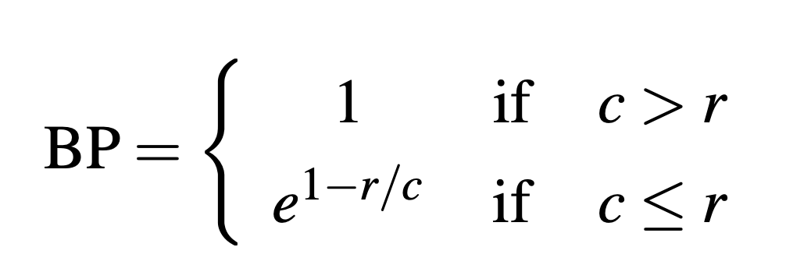
Brevity Penalty
c is the length of the corpus of hypothesis translations
r is the effective reference corpus length
The effective reference corpus length is the sum of the single reference translation from each set that is closest to the hypothesis translation.

Slide 25
Brevity Penalty
MT is Longer
MT is Shorter
Difference with effective reference length (%)

Slide 26
Ref 1 | Orejuela appeared calm as he was led to the American plane which will take him to Miami, Florida.
r = 20
Hyp | appeared calm when he was taken to the American plane, which will to Miami, Florida.
c = 18
BP = exp(1-(20/18)) = 0.89
Ref 1 | Orejuela appeared calm as he was led to the American plane which will take him to Miami, Florida.
r = 20
Hyp | to the American plane
c = 4
BP = exp(1-(20/4)) = 0.02

Slide 27
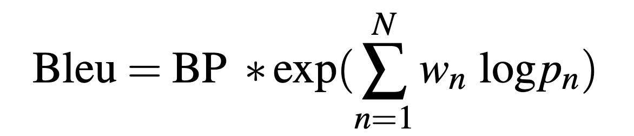
BLEU
Geometric average of the n-gram precisions
Optionally weight them with w
Multiplied by the brevity penalty
Notes:
exp = Exponent function = e^x

Slide 28
BLEU
Hyp | appeared calm when he was taken to the American plane, which will to Miami, Florida.
exp(1-(20/18)) * exp((ln .83 + ln .59 + ln .31 + ln .2)/4) = 0.374
Hyp | to the American plane
exp(1-(20/4)) * exp((ln 1 + ln 1 + ln 1 + ln 1)/4)
= 0.018

Slide 29
Problems with BLEU
(Discuss with your neighbor)

Slide 30
Problems with BLEU
Synonyms and paraphrases are only handled if they are in the set of multiple reference translations
The scores for words are equally weighted so missing out on content-bearing material brings no additional penalty.
The brevity penalty is a stop-gap measure to compensate for the fairly serious problem of not being able to calculate recall.

Slide 31
More Metrics
WER - word error rate
PI-WER - position independent WER
METEOR - Metric for Evaluation of Translation with Explicit ORdering
TERp - Translation Edit Rate plus

Slide 32
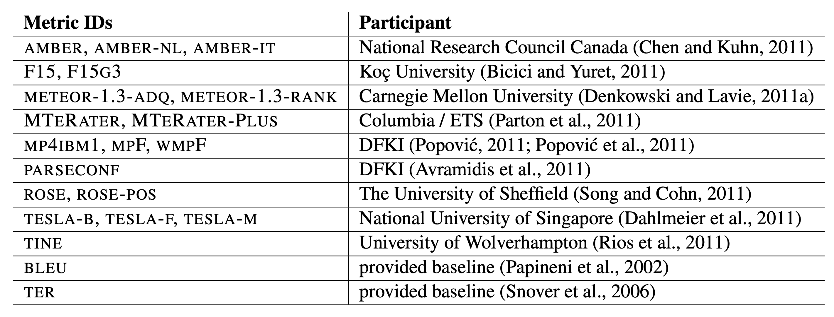
Even More Metrics

Slide 33
How do we know which metric is best?
Measure correlation with human judgments
How do people evaluation MT quality

Slide 34
Manual Evaluation

Slide 35
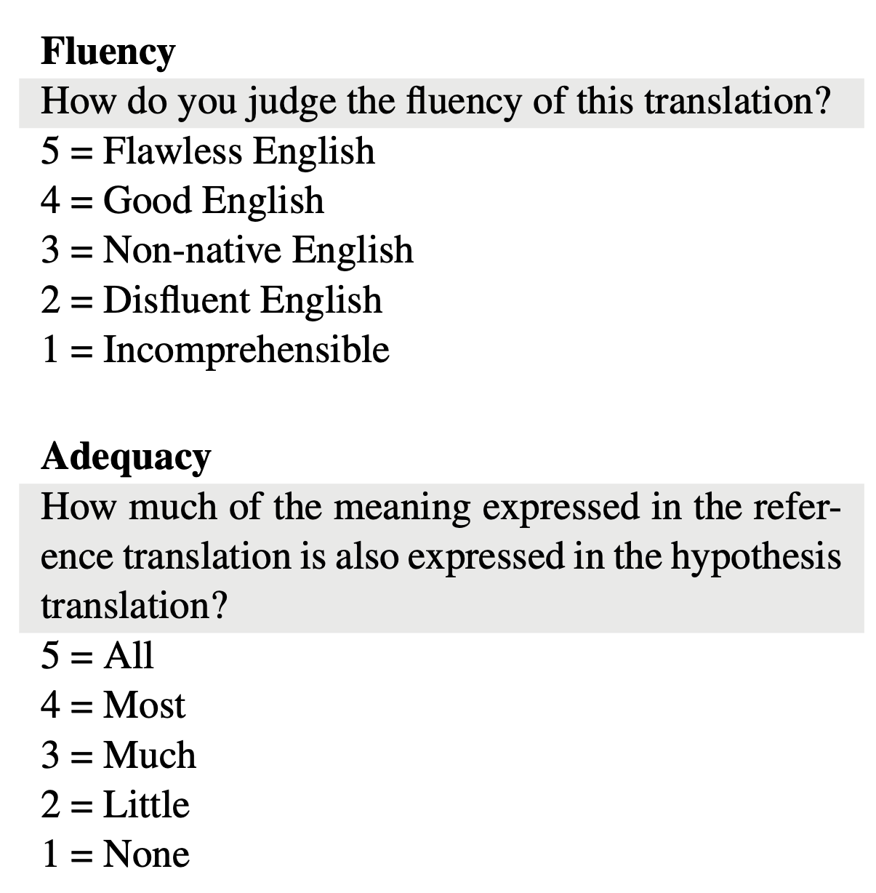
5-point scales

Slide 36
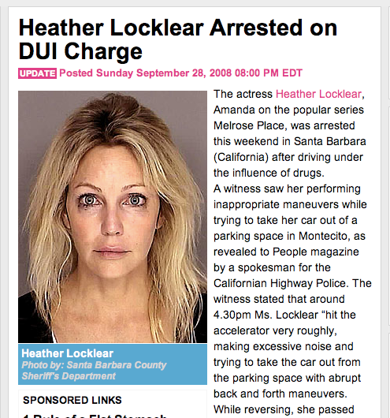
Heather Locklear Arrested for
driving under the influence of drugs
Why was Heather Locklear arrested?
She was arrested on suspicion of driving under the influence of drugs.
Why did the bystander call emergency services?
He was concerned for Ms. Locklear’s life.
Where did the witness see her acting abnormally?
Pulling out of parking in Montecito
The actress Heather Locklear, Amanda of the popular series Melrose Place, was arrested this weekend in Santa Barbara (California) after driving under the influence of drugs. A witness viewed her performing inappropriate maneuvers while trying to take her car out from a parking in Montecito, as revealed to People magazine by a spokesman for the Californian Highway Police. The witness stated that around 4.30pm Ms. Locklear "hit the accelerator very violently, making excessive noise while trying to take her car out from the parking with abrupt back and forth maneuvers. While reversing, she passed several times in front of his sunglasses." Shortly after, the witness, who, in a first time, apparently had not recognized the actress, saw Ms. Locklear stopping in a nearby street and leaving the vehicle.

Slide 37
Heather Locklear Arrested for
driving under the influence of drugs
Was arrested actress Heather Locklear because of the driving under the effect of an unknown medicine
Why was Heather Locklear arrested?
Why did the bystander call emergency services?
Where did the witness see her acting abnormally?
The actress Heather Locklear that is known to the Amanda through the role from the series "Melrose Place" was arrested at this weekend in Santa Barbara (Californium) because of the driving under the effect of an unknown medicine. A female witness observed she attempted in quite strange way how to go from their parking space in Montecito, speaker of the traffic police of californium told the warehouse `People'. The female witness told in detail, that Locklear 'pressed `after 16:30 clock accelerator and a lot of noise did when she attempted to move their car towards behind or forward from the parking space, and when it went backwards, she pulled itself together unites Male at their sunglasses'. A little later the female witness that did probably not have Anfangs the actress Erkannt saw that Locklear stopped on a street seemed likely and the car got out.
The actress Heather Locklear, Amanda of the popular series Melrose Place, was arrested this weekend in Santa Barbara (California) after driving under the influence of drugs. A witness viewed her performing inappropriate maneuvers while trying to take her car out from a parking in Montecito, as revealed to People magazine by a spokesman for the Californian Highway Police. The witness stated that around 4.30pm Ms. Locklear "hit the accelerator very violently, making excessive noise while trying to take her car out from the parking with abrupt back and forth maneuvers. While reversing, she passed several times in front of his sunglasses." Shortly after, the witness, who, in a first time, apparently had not recognized the actress, saw Ms. Locklear stopping in a nearby street and leaving the vehicle.
Driving while medicated
There was a lot of noise
In a parking lot

Slide 38
Heather Locklear Arrested for
driving under the influence of drugs
Was arrested actress Heather Locklear because of the driving under the effect of an unknown medicine
Actress Heather Locklear was due to driving under the influence of an unknown drug arrested
. Medikamentes unknown have the effect of a fahrens under actress heather locklear arrested
Why was Heather Locklear arrested?
Why did the bystander call emergency services?
Where did the witness see her acting abnormally?
The actress Heather Locklear that is known to the Amanda through the role from the series "Melrose Place" was arrested at this weekend in Santa Barbara (Californium) because of the driving under the effect of an unknown medicine. A female witness observed she attempted in quite strange way how to go from their parking space in Montecito, speaker of the traffic police of californium told the warehouse `People'. The female witness told in detail, that Locklear 'pressed `after 16:30 clock accelerator and a lot of noise did when she attempted to move their car towards behind or forward from the parking space, and when it went backwards, she pulled itself together unites Male at their sunglasses'. A little later the female witness that did probably not have Anfangs the actress Erkannt saw that Locklear stopped on a street seemed likely and the car got out.
Actress Heather Locklear, by the role of Amanda from the series "Melrose Place" is known, was this weekend in Santa Barbara (California) because of driving under the influence of an unknown drug arrested. A witness had observed how it quite strange way tried to park their extended gap in Montecito, reported spokesman for the traffic police from California to the magazine `People '. The witness told in detail that Locklear `after 16:30 clock durchdrückte pedal and a lot of noise made by trying to her car to the rear or front of the park gap to move, and when she went backwards, took it a few times in their Sunglass'. Somewhat later the witness saw the beginning of the actress probably had not recognized that Locklear on a nearby road and stopped the car exit.
The witness was the person who notified the emergency service because they fear for `live Locklear had '. When the police patrol arrived, they found the actress in her car seat, which is across the street to stand and thus blocked the traffic. `They seemed to be disoriented, so they brought the policemen into a special drug and alcohol center, a test to make. According to a police spokesman, showed the actress cooperatively, excessive alcohol consumption was from the first moment excluded. `The first observations of officials to follow, we believe that Locklear under the influence of an unknown drug was' said the spokesman. Locklear was under suspicion, under the influence of an unspecified substance to drive, which could not be determined, and arrested to 19 clock in a local trial brought. Two months ago was after treatment Locklaer from the clinic in Arizona dismissed, where it against anxiety and depression was treated.
In Santa. One is, melrose place the series of the role of the 'remember the locklear actress the heather this weekend, because of the fahrens Barbara (California) in effect unknown medikamentes arrested People 'magazine. The traffic police California, spokesman for the auszufahren montecito reported in its way from tried parklücke type strange right, you have seen as a witness. . In some Zeitung, as and when they tried to a great deal of 30 p.m., witness the detail of history locklear after 16: that durchdrückte peddle noise and its progress was made parklücke for the car or moving backwards, they had they times of their sonnenbrille ' . The first was probably recognised that locklear a nearby road and anhielt, had not, with the witness to the car off
Life. 'fear, benachrichtigte the Helpline witness the person that was because they had the locklears'. . Transport and the polizeistreife in her car, with the had, that it was the right road which blocked the '. That is why a test, a special alkoholzentrum in drugs and the police officers have you be', it seemed to orientierungslos According to a polizeisprecher was cooperative, spokesman for alcohol. The first was to present medikamentes first unknown in locklear we believe, as a result of the civil servants, the observation that the 'influence of a', as has been excluded from the with the excessive. Locklear. In p.m. against arrested, not to be the general substance, under the influence of suspected was a local custody and 19 . Locklaer treated months a released from the hospital in Arizona, where it was against treatment after two angstzustände and depression was before
The actress Heather Locklear, Amanda of the popular series Melrose Place, was arrested this weekend in Santa Barbara (California) after driving under the influence of drugs. A witness viewed her performing inappropriate maneuvers while trying to take her car out from a parking in Montecito, as revealed to People magazine by a spokesman for the Californian Highway Police. The witness stated that around 4.30pm Ms. Locklear "hit the accelerator very violently, making excessive noise while trying to take her car out from the parking with abrupt back and forth maneuvers. While reversing, she passed several times in front of his sunglasses." Shortly after, the witness, who, in a first time, apparently had not recognized the actress, saw Ms. Locklear stopping in a nearby street and leaving the vehicle.

Slide 39
Heather Locklear Arrested for
driving under the influence of drugs
Why was Heather Locklear arrested?
She was arrested on suspicion of driving under the influence of drugs.
Heather Locklear Arrested for
driving under the influence of drugs
Was arrested actress Heather Locklear because of the driving under the effect of an unknown medicine
Actress Heather Locklear was due to driving under the influence of an unknown drug arrested
. Medikamentes unknown have the effect of a fahrens under actress heather locklear arrested
The actress Heather Locklear that is known to the Amanda through the role from the series "Melrose Place" was arrested at this weekend in Santa Barbara (Californium) because of the driving under the effect of an unknown medicine. A female witness observed she attempted in quite strange way how to go from their parking space in Montecito, speaker of the traffic police of californium told the warehouse `People'. The female witness told in detail, that Locklear 'pressed `after 16:30 clock accelerator and a lot of noise did when she attempted to move their car towards behind or forward from the parking space, and when it went backwards, she pulled itself together unites Male at their sunglasses'. A little later the female witness that did probably not have Anfangs the actress Erkannt saw that Locklear stopped on a street seemed likely and the car got out.
Actress Heather Locklear, by the role of Amanda from the series "Melrose Place" is known, was this weekend in Santa Barbara (California) because of driving under the influence of an unknown drug arrested. A witness had observed how it quite strange way tried to park their extended gap in Montecito, reported spokesman for the traffic police from California to the magazine `People '. The witness told in detail that Locklear `after 16:30 clock durchdrückte pedal and a lot of noise made by trying to her car to the rear or front of the park gap to move, and when she went backwards, took it a few times in their Sunglass'. Somewhat later the witness saw the beginning of the actress probably had not recognized that Locklear on a nearby road and stopped the car exit.
The witness was the person who notified the emergency service because they fear for `live Locklear had '. When the police patrol arrived, they found the actress in her car seat, which is across the street to stand and thus blocked the traffic. `They seemed to be disoriented, so they brought the policemen into a special drug and alcohol center, a test to make. According to a police spokesman, showed the actress cooperatively, excessive alcohol consumption was from the first moment excluded. `The first observations of officials to follow, we believe that Locklear under the influence of an unknown drug was' said the spokesman. Locklear was under suspicion, under the influence of an unspecified substance to drive, which could not be determined, and arrested to 19 clock in a local trial brought. Two months ago was after treatment Locklaer from the clinic in Arizona dismissed, where it against anxiety and depression was treated.
In Santa. One is, melrose place the series of the role of the 'remember the locklear actress the heather this weekend, because of the fahrens Barbara (California) in effect unknown medikamentes arrested People 'magazine. The traffic police California, spokesman for the auszufahren montecito reported in its way from tried parklücke type strange right, you have seen as a witness. . In some Zeitung, as and when they tried to a great deal of 30 p.m., witness the detail of history locklear after 16: that durchdrückte peddle noise and its progress was made parklücke for the car or moving backwards, they had they times of their sonnenbrille ' . The first was probably recognised that locklear a nearby road and anhielt, had not, with the witness to the car off
Life. 'fear, benachrichtigte the Helpline witness the person that was because they had the locklears'. . Transport and the polizeistreife in her car, with the had, that it was the right road which blocked the '. That is why a test, a special alkoholzentrum in drugs and the police officers have you be', it seemed to orientierungslos According to a polizeisprecher was cooperative, spokesman for alcohol. The first was to present medikamentes first unknown in locklear we believe, as a result of the civil servants, the observation that the 'influence of a', as has been excluded from the with the excessive. Locklear. In p.m. against arrested, not to be the general substance, under the influence of suspected was a local custody and 19 . Locklaer treated months a released from the hospital in Arizona, where it was against treatment after two angstzustände and depression was before
The actress Heather Locklear, Amanda of the popular series Melrose Place, was arrested this weekend in Santa Barbara (California) after driving under the influence of drugs. A witness viewed her performing inappropriate maneuvers while trying to take her car out from a parking in Montecito, as revealed to People magazine by a spokesman for the Californian Highway Police. The witness stated that around 4.30pm Ms. Locklear "hit the accelerator very violently, making excessive noise while trying to take her car out from the parking with abrupt back and forth maneuvers. While reversing, she passed several times in front of his sunglasses." Shortly after, the witness, who, in a first time, apparently had not recognized the actress, saw Ms. Locklear stopping in a nearby street and leaving the vehicle.
The actress Heather Locklear, Amanda of the popular series Melrose Place, was arrested this weekend in Santa Barbara (California) after driving under the influence of drugs. A witness viewed her performing inappropriate maneuvers while trying to take her car out from a parking in Montecito, as revealed to People magazine by a spokesman for the Californian Highway Police. The witness stated that around 4.30pm Ms. Locklear "hit the accelerator very violently, making excessive noise while trying to take her car out from the parking with abrupt back and forth maneuvers. While reversing, she passed several times in front of his sunglasses." Shortly after, the witness, who, in a first time, apparently had not recognized the actress, saw Ms. Locklear stopping in a nearby street and leaving the vehicle.
Driving under the influence
Driving while medicated
DUI
Driving while using drugs
Medikamentes

Slide 40
Heather Locklear Arrested for
driving under the influence of drugs
Why was Heather Locklear arrested?
She was arrested on suspicion of driving under the influence of drugs.
Heather Locklear Arrested for
driving under the influence of drugs
Was arrested actress Heather Locklear because of the driving under the effect of an unknown medicine
Actress Heather Locklear was due to driving under the influence of an unknown drug arrested
. Medikamentes unknown have the effect of a fahrens under actress heather locklear arrested
System | Correct Answers
Reference | 94%
Google | 80%
RBMT5 | 77%
Geneva | 63%
JHU - Tromble | 50%
The actress Heather Locklear that is known to the Amanda through the role from the series "Melrose Place" was arrested at this weekend in Santa Barbara (Californium) because of the driving under the effect of an unknown medicine. A female witness observed she attempted in quite strange way how to go from their parking space in Montecito, speaker of the traffic police of californium told the warehouse `People'. The female witness told in detail, that Locklear 'pressed `after 16:30 clock accelerator and a lot of noise did when she attempted to move their car towards behind or forward from the parking space, and when it went backwards, she pulled itself together unites Male at their sunglasses'. A little later the female witness that did probably not have Anfangs the actress Erkannt saw that Locklear stopped on a street seemed likely and the car got out.
Actress Heather Locklear, by the role of Amanda from the series "Melrose Place" is known, was this weekend in Santa Barbara (California) because of driving under the influence of an unknown drug arrested. A witness had observed how it quite strange way tried to park their extended gap in Montecito, reported spokesman for the traffic police from California to the magazine `People '. The witness told in detail that Locklear `after 16:30 clock durchdrückte pedal and a lot of noise made by trying to her car to the rear or front of the park gap to move, and when she went backwards, took it a few times in their Sunglass'. Somewhat later the witness saw the beginning of the actress probably had not recognized that Locklear on a nearby road and stopped the car exit.
The witness was the person who notified the emergency service because they fear for `live Locklear had '. When the police patrol arrived, they found the actress in her car seat, which is across the street to stand and thus blocked the traffic. `They seemed to be disoriented, so they brought the policemen into a special drug and alcohol center, a test to make. According to a police spokesman, showed the actress cooperatively, excessive alcohol consumption was from the first moment excluded. `The first observations of officials to follow, we believe that Locklear under the influence of an unknown drug was' said the spokesman. Locklear was under suspicion, under the influence of an unspecified substance to drive, which could not be determined, and arrested to 19 clock in a local trial brought. Two months ago was after treatment Locklaer from the clinic in Arizona dismissed, where it against anxiety and depression was treated.
In Santa. One is, melrose place the series of the role of the 'remember the locklear actress the heather this weekend, because of the fahrens Barbara (California) in effect unknown medikamentes arrested People 'magazine. The traffic police California, spokesman for the auszufahren montecito reported in its way from tried parklücke type strange right, you have seen as a witness. . In some Zeitung, as and when they tried to a great deal of 30 p.m., witness the detail of history locklear after 16: that durchdrückte peddle noise and its progress was made parklücke for the car or moving backwards, they had they times of their sonnenbrille ' . The first was probably recognised that locklear a nearby road and anhielt, had not, with the witness to the car off
Life. 'fear, benachrichtigte the Helpline witness the person that was because they had the locklears'. . Transport and the polizeistreife in her car, with the had, that it was the right road which blocked the '. That is why a test, a special alkoholzentrum in drugs and the police officers have you be', it seemed to orientierungslos According to a polizeisprecher was cooperative, spokesman for alcohol. The first was to present medikamentes first unknown in locklear we believe, as a result of the civil servants, the observation that the 'influence of a', as has been excluded from the with the excessive. Locklear. In p.m. against arrested, not to be the general substance, under the influence of suspected was a local custody and 19 . Locklaer treated months a released from the hospital in Arizona, where it was against treatment after two angstzustände and depression was before
The actress Heather Locklear, Amanda of the popular series Melrose Place, was arrested this weekend in Santa Barbara (California) after driving under the influence of drugs. A witness viewed her performing inappropriate maneuvers while trying to take her car out from a parking in Montecito, as revealed to People magazine by a spokesman for the Californian Highway Police. The witness stated that around 4.30pm Ms. Locklear "hit the accelerator very violently, making excessive noise while trying to take her car out from the parking with abrupt back and forth maneuvers. While reversing, she passed several times in front of his sunglasses." Shortly after, the witness, who, in a first time, apparently had not recognized the actress, saw Ms. Locklear stopping in a nearby street and leaving the vehicle.
The actress Heather Locklear, Amanda of the popular series Melrose Place, was arrested this weekend in Santa Barbara (California) after driving under the influence of drugs. A witness viewed her performing inappropriate maneuvers while trying to take her car out from a parking in Montecito, as revealed to People magazine by a spokesman for the Californian Highway Police. The witness stated that around 4.30pm Ms. Locklear "hit the accelerator very violently, making excessive noise while trying to take her car out from the parking with abrupt back and forth maneuvers. While reversing, she passed several times in front of his sunglasses." Shortly after, the witness, who, in a first time, apparently had not recognized the actress, saw Ms. Locklear stopping in a nearby street and leaving the vehicle.
Driving under the influence
Driving while medicated
DUI
Driving while using drugs
Medikamentes

Slide 41
HTER - costs to edit
Reference translation
The man was on assignment from the Ministry of Defense when he left two highly classified documents on a train to Waterloo.
Machine translation
The man was seconded by the Ministry of Defense when he was two extremely confidential documents in a train to Waterloo lost.
Edited machine translation
The man was seconded by the Ministry of Defense when he was two extremely confidential documents in a train to Waterloo lost.
The man was working for the Ministry of Defense when he lost two extremely confidential documents in a train to Waterloo.

Slide 42
Reading Comprehension of Machine Translation
Jones et al (2005) - Measured translation quality by testing English speakers on a Defense Language Proficiency Test for Arabic
Read the MT output, and assess how many questions were answered correctly
Nice, intuitive gauge of how good MT quality actually is

Slide 43
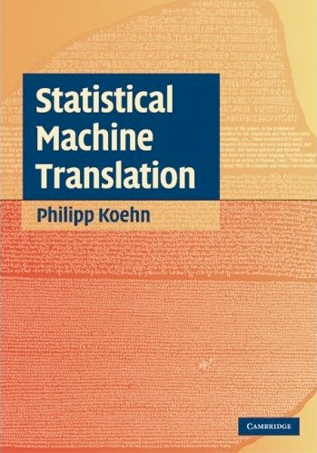
Reading
Read chapter 8 from the textbook

Slide 44
Announcements
HW2 due on Thursday Feb 19th

