Slide 1
Temporality Working Group Task Force 1: Temporal Expressions and Relations
Dan Roth
Hans Chalupsky, Kira Griffitt, Teruko Mitamura, Benjamin Rozonoyer
Ralph Weischedel, Oleg Aulov, Hoa Dang, Zaid Sheikh, Joseph Olive, George Chin
Patrick Mackey (lead)
June 2020

Slide 2
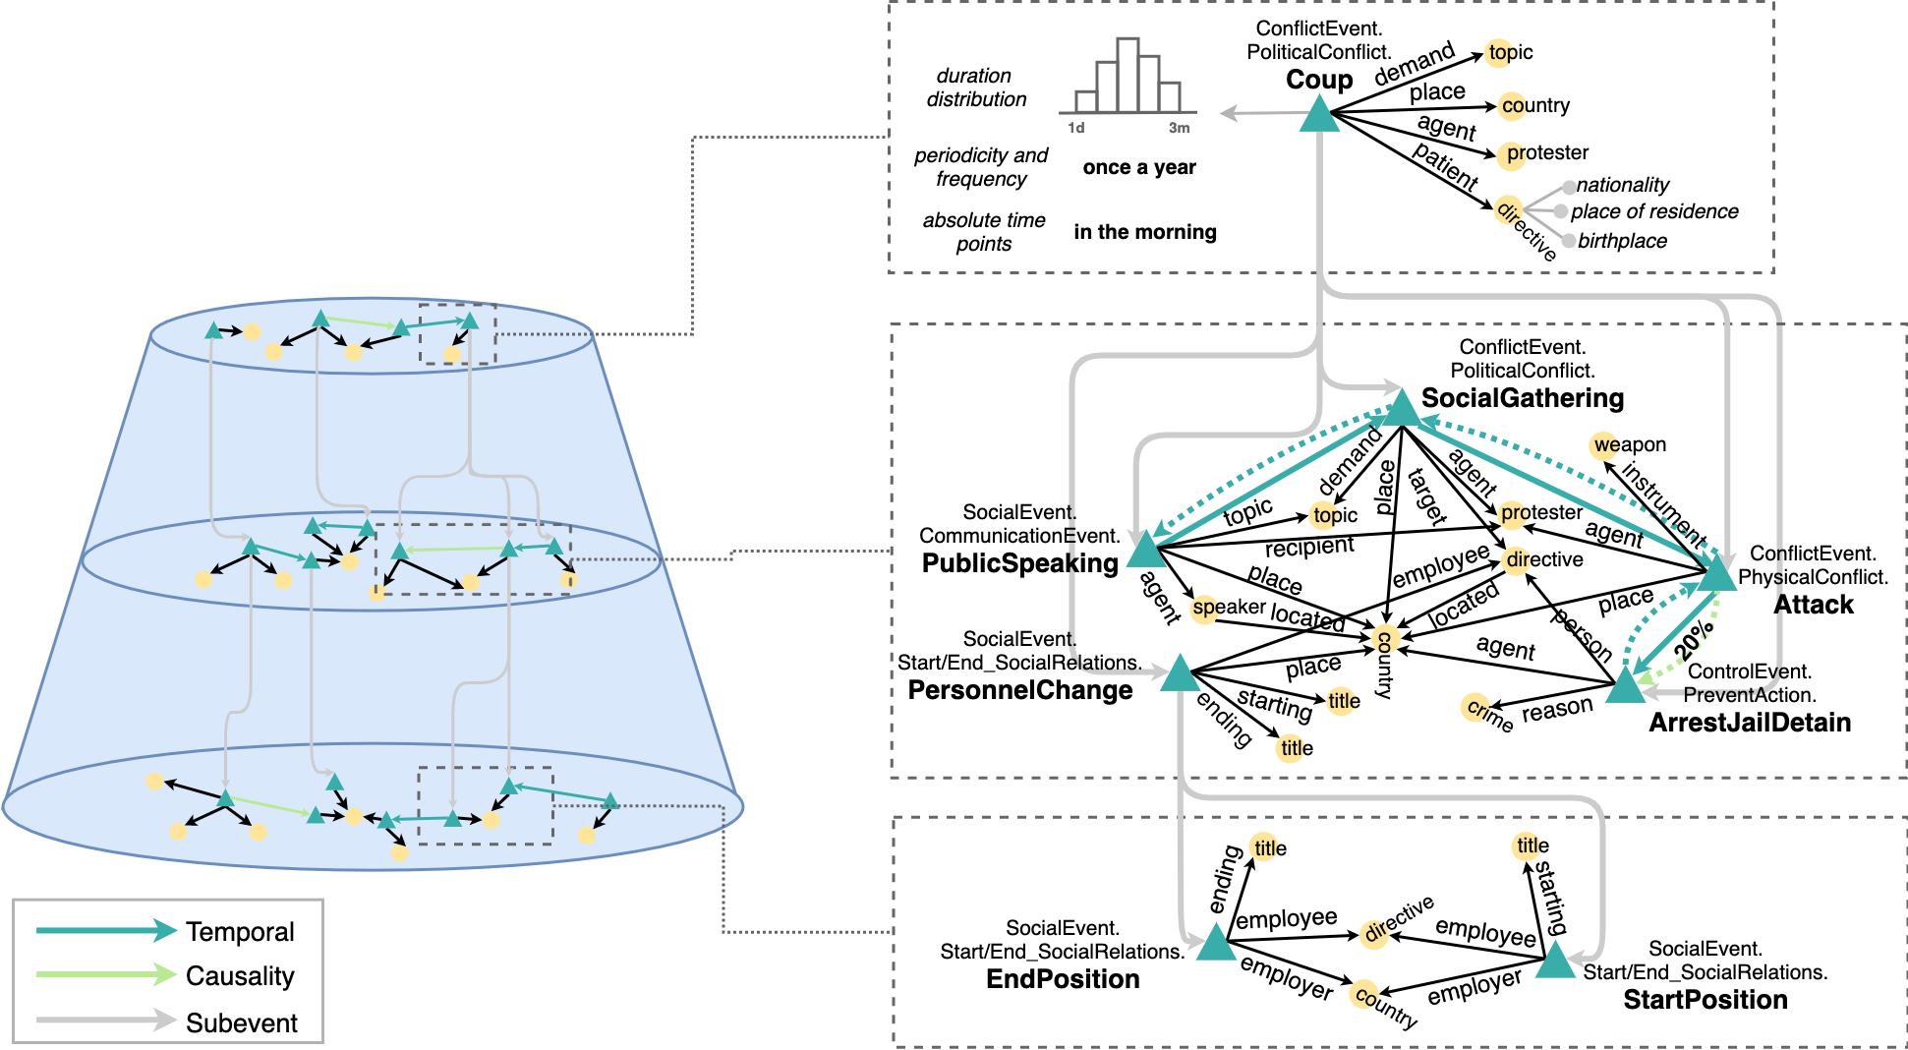
Kairos: Hierarchical Narrative Graph Schema
Kairos is about
Identifying, understanding, organizing, abstracting and predicting events, over time.
Slide by Heng Ji
Notes:
The world view from Kairos:
An event centerd view of the world, where time is of crucial impotance – from temporal aspects of entities and social events at the bottom to temporal order of events all the way at the top to asscoating duration, frequency and abslute time with events.

Slide 3
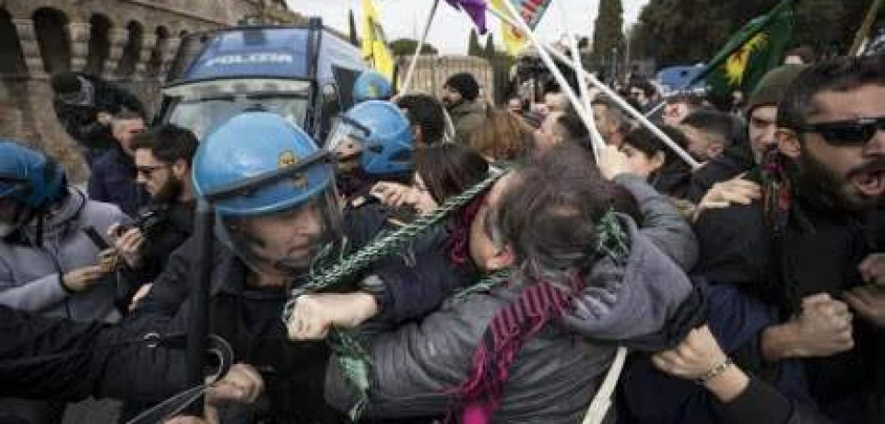
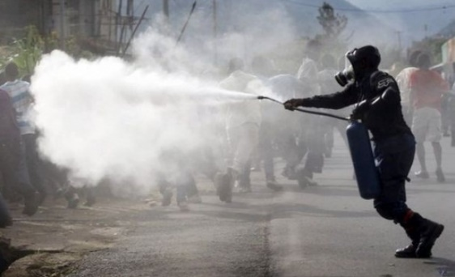
Understanding Time is Important
People were angry
Police used tear gas
Time
People were angry at something (which ended in violent conflicts with the police)…The police finally used tear gas (to restore order).
Notes:
Given two events, the order in which they occur on the timeline could give rise to two completely different interpretation of the what has happened

Slide 4
Understanding Time is Important
Police used tear gas
People were angry
Time
Police used tear gas…People were angry at the police.
Notes:
If we simply reverse the order of these events, we get a new story, which says that police used tear gas and then people were angry at the police. We can see that time is crucial if we want to understand what’s going on in a situation.

Slide 5
Understanding Time is Important
Police used tear gas
People were angry
Time
In natural language, we rarely see explicit timestamps, so we have to figure out the temporal order from cues in the text.
Notes:
But in natural language, we never have timestamps like here telling us which one is earlier and which one is later. That leads to “temporal relations”

Slide 6
Representing time-varying information
Temporal information is often not complete nor certain
Temporal information is often implicit (commonsense)
Events are associated with time
Start, End, Duration, Frequency
Many (most) attributes and relations change over time
Ex: employment, location, nationality, headquarters, president, event participant, etc.
Knowledge Bases (knowledge Graphs) need to be qualified temporally
Time & temporal order of events
When relations start & end
Otherwise, it would result in potentially contradictory statements
Ex: Senator Obama vs. President Obama
And impact event coreference and & consistency checking
Multiple presidents; Multiple spouses
Goal: Represent temporal qualifications over conditions that change over time (fluents)

Slide 7
Things to Think About
Natural Language communicates explicit temporal information infrequently
This vagueness is inherent to natural language
It’s not (just) a shortcoming of the state of the art in NLP
But some of it can be handled using inference and (commonsense) knowledge
The mapping from natural language to KR is lossy
We need to agree on the phenomena we want to represent, and how
Realizing that more is expressed in the natural language than in our KR
The challenge is in mapping from text to a well-defined KR capturing its temporal aspects.
The rest is easy (?)
Police used tear gas starting at 7pm on Saturday and stopped at 7:30;….
People were angry at the police between 7:01 and 9pm.
Notes:
The space is defined by these two statements:
How time is communicates in NL
2. The mmaping to KR

Slide 8
Representational desiderata
Simplicity
Represent common cases with minimal overhead
Semantic clarity
What does it mean for a relation to be temporally qualified by some time argument T?
All time points? At least one? None outside?
How informative are temporal relations?
Expressiveness
Multiple perspectives; Nesting; Axes of events
Negation
Dealing with Uncertainty
In extraction; Inherent uncertainty in the text
The lion had a large meal and slept for 24 hours.
When did it eat? Exactly 24 hours?
The lion didn’t sleep after having a large meal.
[Negated]
The lion may have had a large meal before sleeping.
[Uncertain]
If the lion has a large meal, it will sleep for 24 hours.
[Hypothetical]
The lion typically sleeps for 24 hours after having large meals.
[Repetitive]
After having a large meal, lions may sleep longer.
[Generic]
In 1944 US and Germany were at war;
John got married in 1944;
Jim was born in 1944.
The great depression started before FDR took office.
WWI started before FDR took office.
Mary graduated from college in 1969 (or 1971)
John believed in 1995 that Mary attended college in the 1960s
Mary did not attend college in the 1970s (but at some other time)

Slide 9
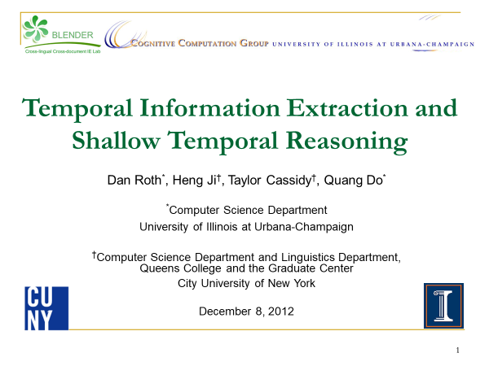
What has Happened?
A lot has happened in NLP research about Time in the last few years
Progress on existing tasks
Beginning to think about new tasks
Check out our COLING-2012 Tutorial:
Still, a very good resource
But, in some areas, shows progress we’ve made.
(but not so much about what can be represented and how)

Slide 10
Plan: Temporal Expressions and Relations
Absolute and Relative time
Extracting time from text
Relations between events
Event Timelines
Knowledge Graphs: Slot Filling
Temporal disambiguation
Temporal Commonsense
Applications to Temporal Reasoning and KBs
Representations
Absolute
Intervals
Temporal Relations
Temporal Commonsense
Datasets available
Ambiguity in Representations
Temporal uncertainties
Time-varying attributes

Slide 11
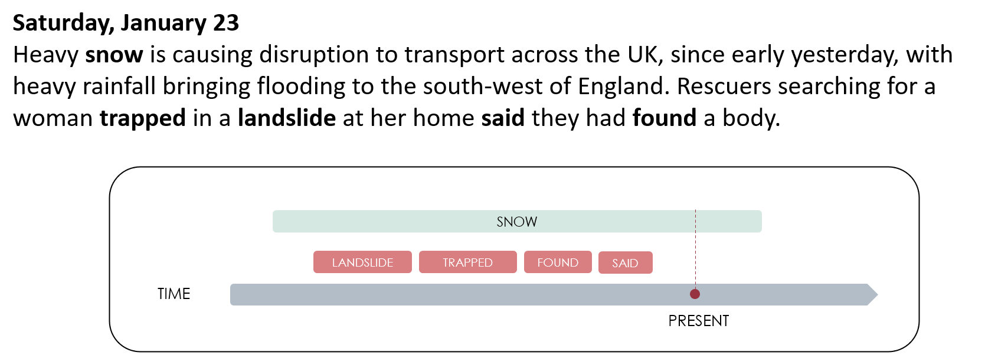
Tasks
Understanding time requires that we:
Identify Events and States
Answer questions about:
when,
how long,
how often,
and various extensions and compositions of these.

Slide 12
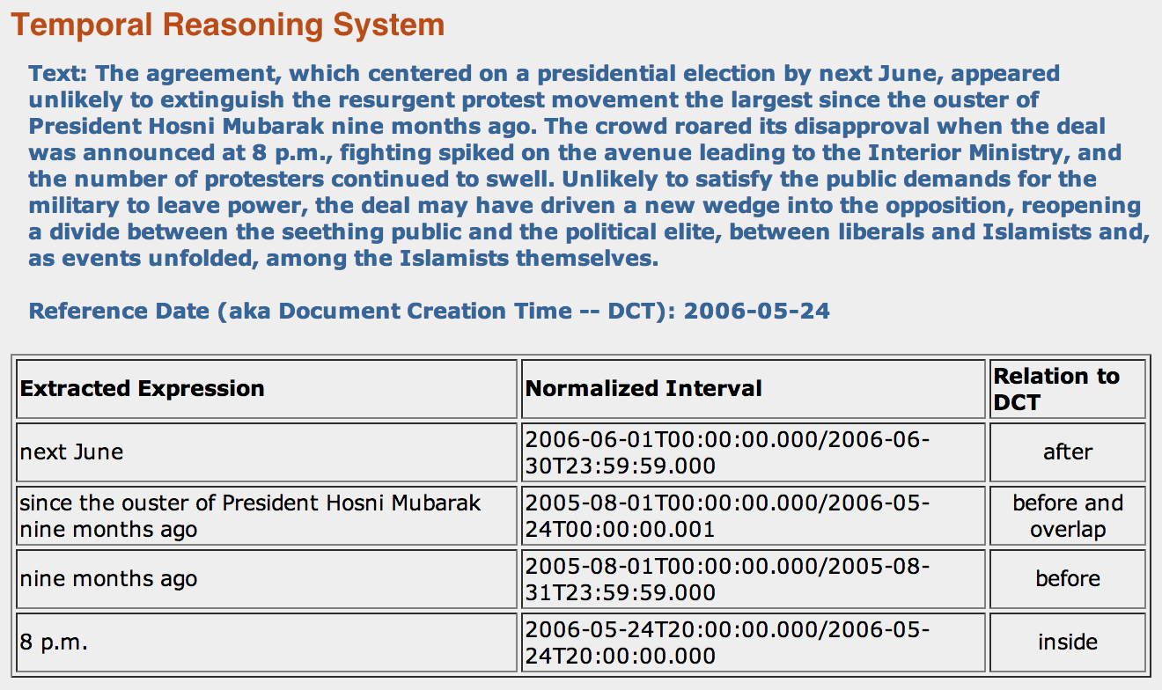
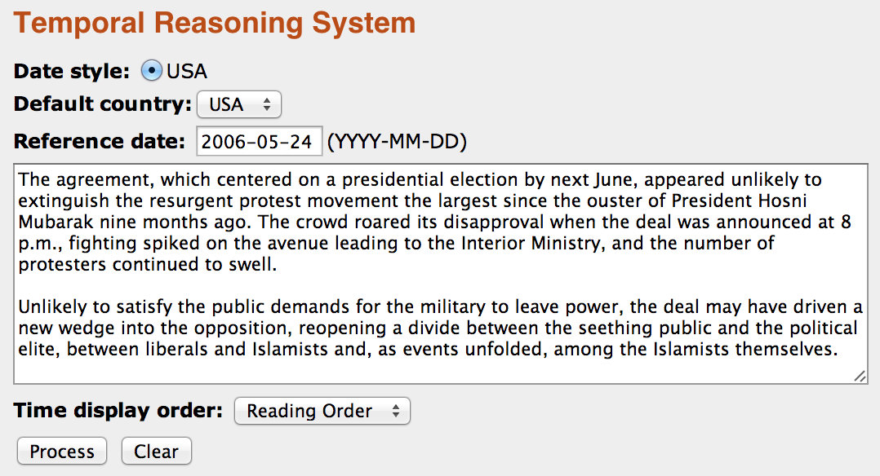
1. Absolute Time
Even when time is mentioned in text (not often: 20%-30% of the events)
It is not mentioned explicitly
There is a need to extract temporal expressions from text
Normalize
Associate time with
Events, Entities, States, Attributes
One’s employer
President in office
Ownership of a car
Relatively solved problem
Integration within and across
documents hasn’t been addressed
An interval representation
Temporal Relations
Qiang Ning and Ben Zhou and Zhili Feng and Haoruo Peng and Dan Roth, CogCompTime: A Tool for Understanding Time in Natural Language EMNLP’18

Slide 13
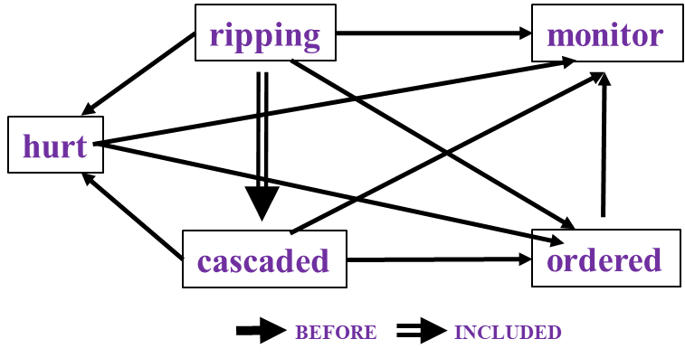
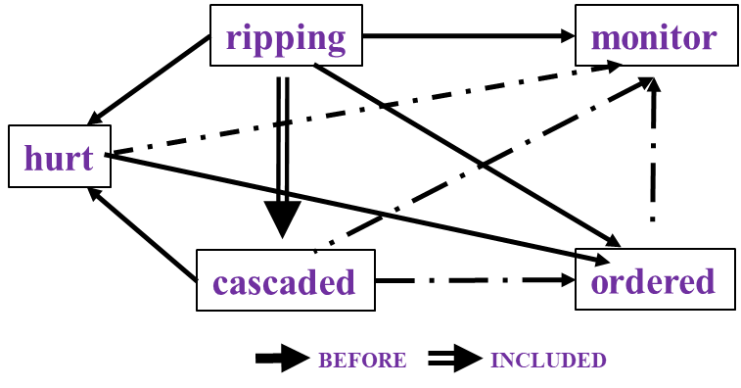

2. Temporal Relations
In many cases, absolute time isn’t mentioned, but we still want to understand the temporal relations between events.
In Los Angeles that lesson was brought home today when tons of earth cascaded down a hillside, ripping two houses from their foundations. No one was hurt, but firefighters ordered the evacuation of nearby homes and said they'll monitor the shifting ground until March 23rd.
A lot of work in the last few years.
Difficult task— even for human annotators (O(N²) edges)
Approaches exploit strong expectations from the output
Transitivity
Some events tend to precede others, or follow others
cascaded
ordered
Time
ripping
Must be before
Temporal rules and constraints are discussed in the ontology working group. But, they are necessary for extraction & representation.

Slide 14
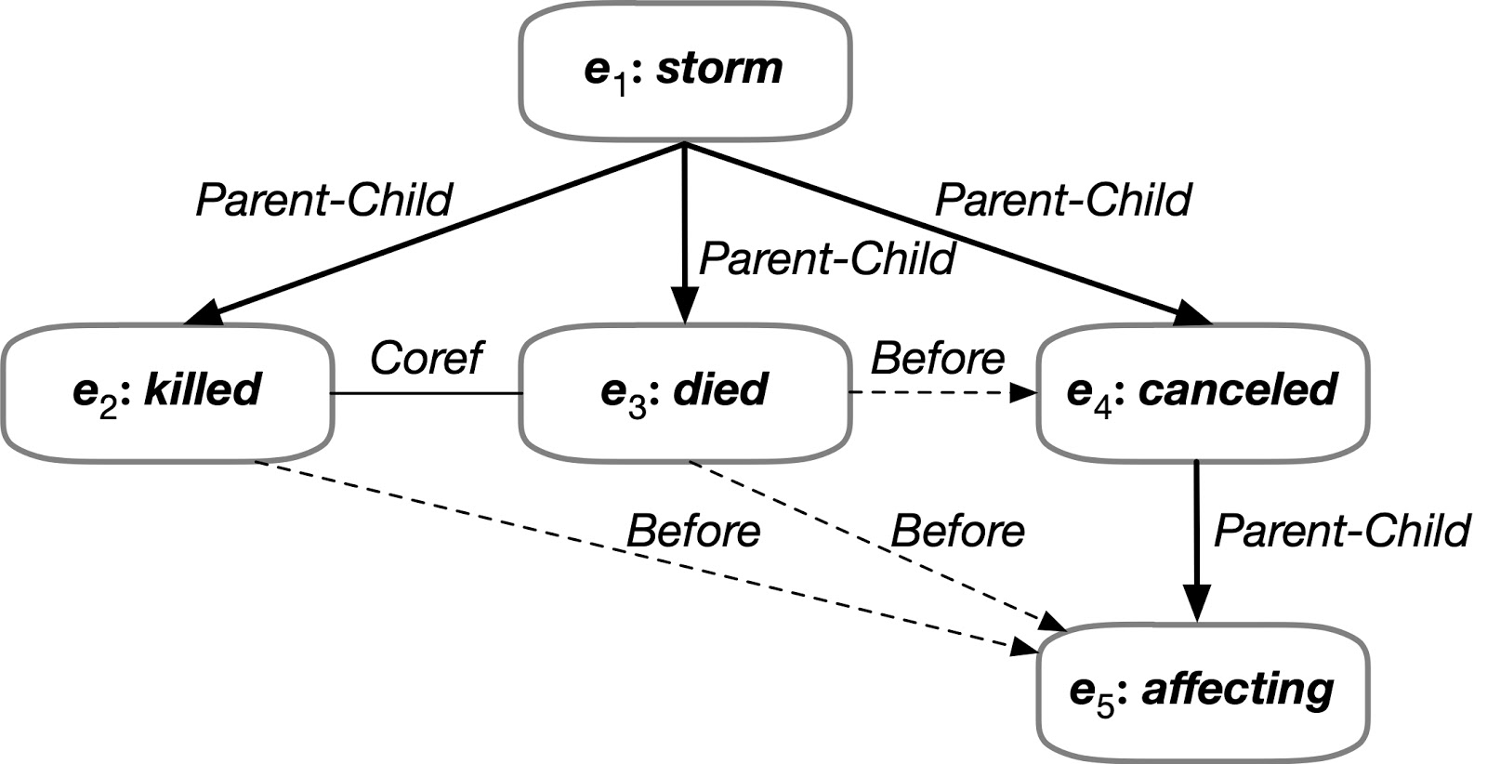
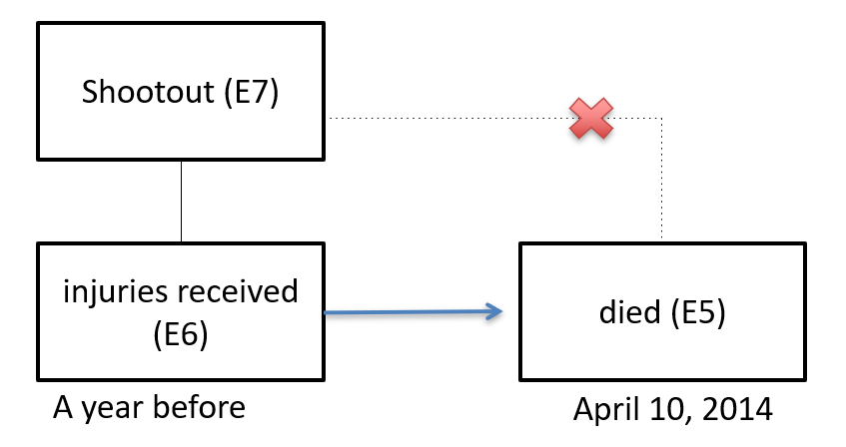
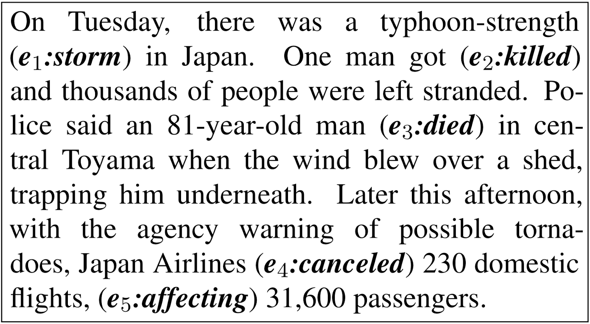
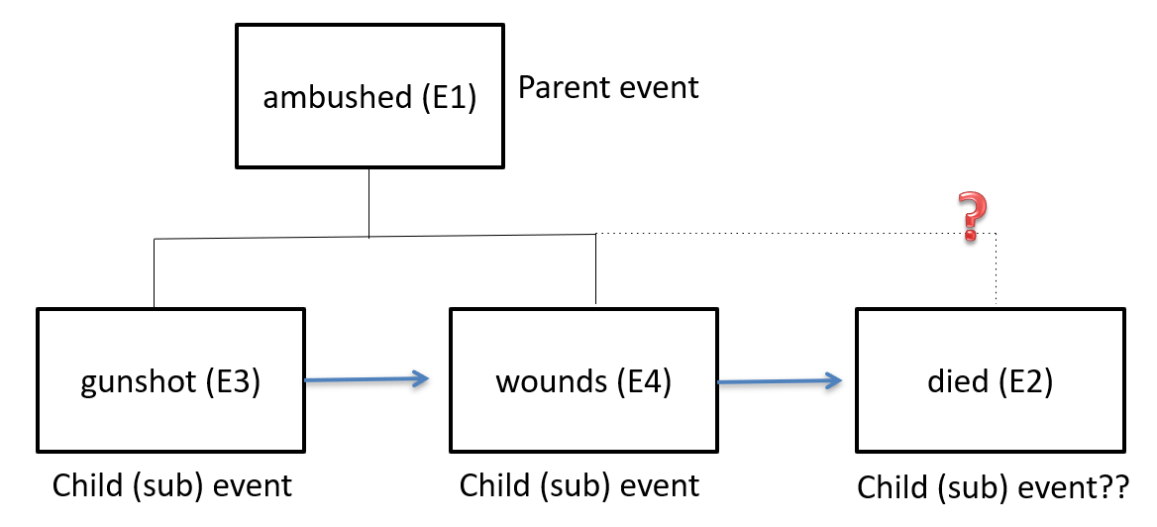
Global Issues: Event-Event Relations & Time
Temporal relations interact with other event-event relations and sub-event structures
Often, the text is the only clue
Temporal information helps to decide which event(s) are in the subevent family; it eliminates E5 from the subevent family
Ontological (commonsense) helps sequencing events (e.g., gunshot causes wounds, died from wounds); even without temporal marker appear in the text
Temporal representations cannot not be extracted only based on local information

Slide 15
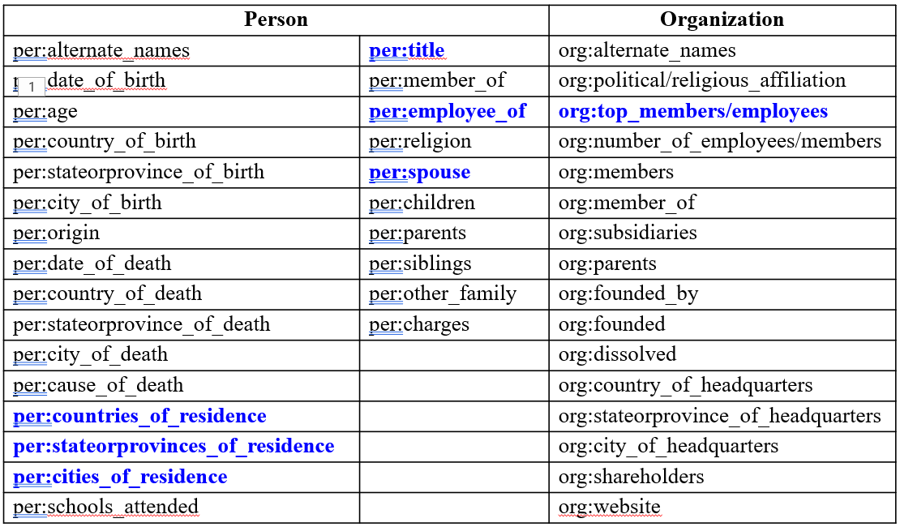
3. Temporal Slot Filling
Given a query entity, a knowledge base (KB) and a source corpus,
Fill slots with temporal information that is gathered from the entire corpus
Very difficulty talk; very little work. Even “cleaning” a temporal KB is difficult.
Query Example
<query id="SFT201">
<name>Angela Merkel</name>
<docid>NYT_ENG_20071015.0123.LDC2009T13</docid>
<enttype>PER</enttype>
<nodeid>E0288830</nodeid>
</query>
Output Example
SFT201 per:countries_of_residence T2 20051231 AFP_ENG_20081022.0383 Germany
SFT201 per:countries_of_residence T3 20081022 AFP_ENG_20081022.0383 Germany
SFT201 per:spouse T1 19980101 APW_ENG_20051122.0372.LDC2007T07 Joachim Sauer
SFT201 per:spouse T2 19981231 APW_ENG_20051122.0372.LDC2007T07 Joachim Sauer
SFT201 per:spouse T3 20051122 APW_ENG_20051122.0372.LDC2007T07 Joachim Sauer
Temporal Disambiguation and conflict resolution may require global information (e.g., information about the spouse)

Slide 16
Representation & Annotation: TimeML Annotation
Annotation
<EVENT>: a cover term for annotating situations that happen or occur, denoted by verbs (“attacked”), nominalizations (“airstrike”) etc.
<TIMEX3>: abstract temporal entity based on temporal expression
<SIGNAL>: a textual element that makes explicit the relation holding between two entities, e.g. “when”, “at”, “-” in “June 5-7”
<MAKEINSTANCE>: creates an abstract event as motivated by text annotations, with grammatical attributes such as tense, aspect, polarity, modality
LINKS
<TLINK> = temporal link: temporal relations between events and times, very similar to Allen’s interval algebra relations
<SLINK> = subordination link: link between modal, factive, counter-factive, evidential or conditional hedges and the events that they hedge – a means of relating irrealis events to events situated in time
<ALINK> = aspectual link: relationship between aspectual verbs and the events they refer to

Slide 17
Data Sets and Annotation Schemes
Time expressions and Normalization:
Timex:
WikiWars 2010
TimeBank 2003 2006
The TempEval 1-3 datasets (2007, 2010, 2013) these datasets included the TimeBank corpus
Timex normalization SemEval workshop 2018

Slide 18
Data Sets and Annotation Schemes
Temporal Relations:
TimeBank and the TempEval 1-3 datasets (2007, 2010, 2013)
VerbClause by Bethard 2007
THYME for clinical temporal relations paper 2014 project website
Also: Clinical TempEval for temporal relations in the medical domain (2015 2016 2017)
TimeBank-dense by Cassidy 2014
SemEval 2015 Task 4 Timeline construction
(not successful; timeline is still difficult even now, and it was mature to launch a task in 2014) 2014
Temporal anchoring by Reimers 2016
RED by O’Gorman et al. 2016
MATRES for temporal relations, Ning et al. 2018
UDST by Vashishtha et al. 2019
LDC's catalog contains several additional corpora with temporal annotation:
LDC2006T06 ACE 2005 Multilingual Training Corpus
contains TIMEX2/normalization and is used by a lot of AIDA/KAIROS sites as training data.
LDC2020T08 TAC KBP English Temporal Slot Filling
Comprehensive Training and Evaluation Data 2011 and 2013
There are also several ACE Time Normalization (TERN) data sets in the catalog.

Slide 19
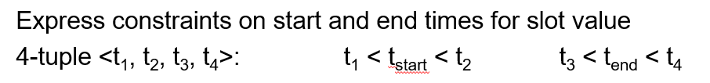
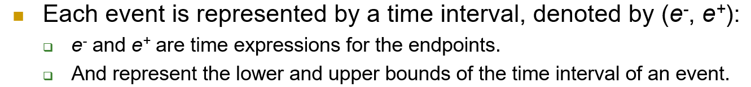
Representations: Absolute
Most effort was devoted to associate events with time intervals
Temporal Representation Formalisms
Allen Relation (Allen, 1983)
TimeML (Pustejovsky et al., 2003)
Temporal Closure (Verhagen, 2005)
Fuzzy Intervals (Schockaert et al., 2008)
4-Tuple Temporal Representation (Ji et al., 2011)
Supports (some level of) uncertainty
Timeline Representation (Do et al., 2012)
Simpler
Easier to enforce constraints
These came with a calculus to deal with relations between time intervals.
What is the meaning of the interval representation?
In 1944 US and Germany were at war: (all the year?)
John got married in 1944: (from September 4th, until…)
Jim was born in 1944: (June 24th 1944)
The best we can do is: [1.1.44, 12.31.44]
Without additional knowledge
Possible extension (other options exist):
[throughout, one point, starts at; starts and ends, unknown]

Slide 20
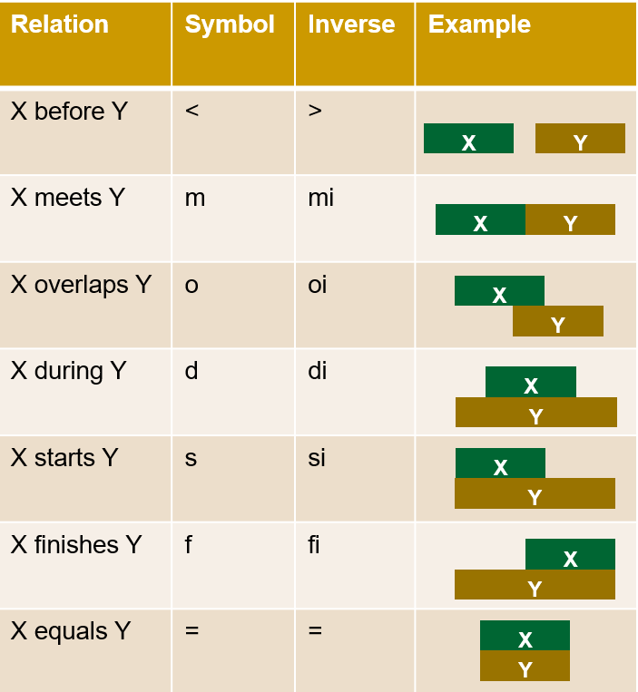
Representation: Relational
Determining relations between events is formalized as a multiclass classification.
Up to 13 different labels (interval relations) have been used (Allen’s interval relations)
In recent years people have used a smaller set of labels.
E1
E1
E1 is before E2
E2
E1 is before E2
E2

Slide 21
Representation: Relational
Multiple problems have been identified with these datasets and annotation schemes
The difficulty to balance between coverage and IAA.
It is possible to achieve good IAA by focusing on a small portion of phenomena
Multiple Axes
Focus on Start Time
Cost: loss of granularity
MATRES (Ning et al.) bases the relations on Start_Time and uses only:
Before_start; After_Start, Equal, and Vague.
Vague relation: when an annotator considers the following to be possible, given that text:
E1 starts before E2, and E2 starts before E1
Other efforts:
Use natural language to annotate natural language.
TORQUE: temporal ordering question-answering – a new QA dataset to be released soon
Intention axis
restore order
to eliminate army
police tried
51 people killed
Main axis

Slide 22
Sufficient Representations
employ17
Temporally unqualified
employer(Hans, ISI)
Time argument
employer(Hans, ISI, t42)
TimeInterval(t42), start(t42, …), end(t42,…)…
employer
Hans
ISI
per
org
Hans
ISI
employer
Hans
ISI
employ17
time
per
org
t42
Hans
ISI
time
start
end
t42
start
end
The interval-based representation are sufficient to express various choices considered from the KG perspective

Slide 23
Sufficient representations /2
holdsIn19
Modal operators
holdsIn(employer(Hans, ISI), t42))
Variants: holdsAt, holdsWithin,…
Initiation, termination
initiates(hireEvent17, employer(Hans, ISI))
terminates(quitEvent33, employer(Hans, ISI))
time(hireEvent17, t42),….
prop
time
employ17
t42
per
org
Hans
ISI
hireEvent17
quitEvent33
initiates
terminates
employ17
time
time
per
org
t42
Hans
ISI
The interval-based representation are sufficient to express various choices considered from the KG perspective

Slide 24
Current Temporal Annotation in AIDA and KAIROS
AIDA
Event/Relation Start and End Date
Start and end date, with label (e.g. starton, endbefore, etc.)
Expressed as YYYY-MM-DD (e.g. "Jan 9, 2018" → 2018-01-09)
Under-specification possible (e.g. "January 2018" → 2018-01-XX)
KAIROS
Event/Relation Start and End Date + Time
Start and end date + time, with label (e.g. starton, endbefore, etc.)
Expressed as YYYY-MM-DD, HH:MM:SS (e.g. "Jan 9, 2018, at noon" → 2018-01-09, 12:00:00)
Event/Relation Duration
Duration w/ label (e.g. approximately, lessthan)
Units: year, month, week, day, hour, minute, second + Counts (e.g. 2 weeks)
Temporal Relations Between Events
To be defined by Ontology Working Group
Expected interactions with other event relations (e.g. causal)
AIDA and KAIROS
Annotation decisions are based on full document context including “dateline” if available
Most date references in AIDA & KAIROS data are coarse-grained (e.g. date, not millisecond)
Document metadata that is not present in processed text is not currently used to inform annotation
Richer temporal annotation schemes can be applied if required
Prior projects have used TIMEX2, TimeML among others
Notes:
This slide shows LDC’s current/planned approaches to Temporal annotation in the AIDA and KAIROS programs
For AIDA
We annotate start and and end dates (if known)
With a label to indicate the type of start or end information (e.g. “starton”, ”endbfore”, etc.)
These are normalized to YYYY-MM-DD format
Underspecified dates can be annotated
expressed with “X”s in the underspecified components
For KAIROS
We plan to annotate start and end dates (if known) with a start or end type label (as in AIDA)
Normalized to YYYY-MM-DD format
We plan to also provide start and end times (if known)
Normalized in HH:MM:SS format
In addition, for KAIROS we plan to annotate durations (if known) for event/relation mentions
Units will be year, month, week, day, hour, minute, and second + Count of the unit (e.g. 2 weeks)
We also plan to annotate temporal relations between events
Note these are to-be-defined by the OWG
Also note we expect temporal relations to some overlap with other event-event relations (e.g. causal)
Some cross-program notes
Temporal annotations in both programs are based on full document context (including ”dateline” if available)
Most date references are coarse-grained
Document metadata that is not present in processed text is NOT currently used to inform annotation
Richer temporal annotation schemes can be applied (e.g. TIMEX2, TimeML, etc.)

Slide 25
Temporal Common Sense
A lot of the temporal information in text is implicit; extracting it requires commonsense.
My friend Bill went to Duke University in North Carolina. With a degree in CS, he joined Google MTV as a software engineer. As a huge basketball fan, he has attended all 3 NBA finals since then. He also plans to visit Duke regularly as an alumnus to attend their home games.

Slide 26
Temporal Common Sense
My friend Bill went to Duke University in North Carolina. With a degree in CS, he joined Google MTV as a software engineer. As a huge basketball fan, he has attended all 3 NBA finals since then. He also plans to visit Duke regularly as an alumnus to attend their home games.
College: about 4 years, start at the age of 18
Duration
Typical Time
Bill in North Carolina: about 4 years
Duration
Stationarity
Duke in North Carolina: always
Stationarity

Slide 27
Temporal Common Sense
My friend Bill went to Duke University in North Carolina. With a degree in CS, he joined Google MTV as a software engineer. As a huge basketball fan, he has attended all 3 NBA finals since then. He also plans to visit Duke regularly as an alumnus to attend their home games.
College: about 4 years, start at the age of 18
Duration
Typical Time
Bill in North Carolina: about 4 years
Duration
Stationarity
Duke in North Carolina: always (expected)
Stationarity
Join Google: after college graduation
Ordering
NBA Finals: every year
Frequency
Visit Alma Mater: 0-2 times per year, 0-2 days each time
Frequency
Duration
Attend basketball games: a few hours
Duration

Slide 28
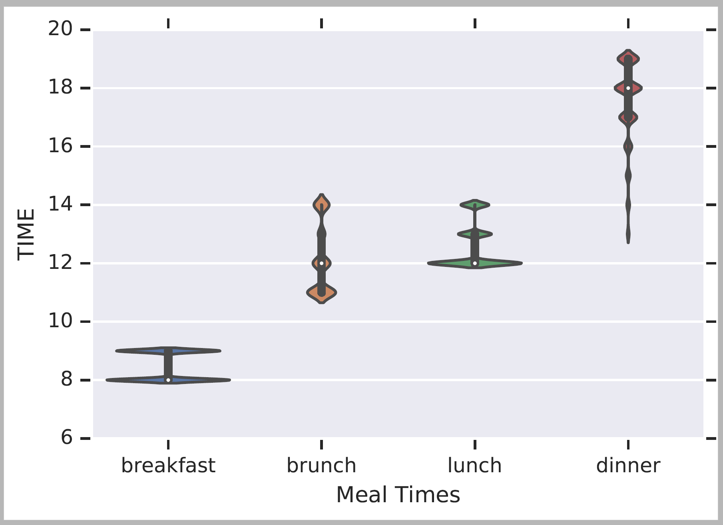
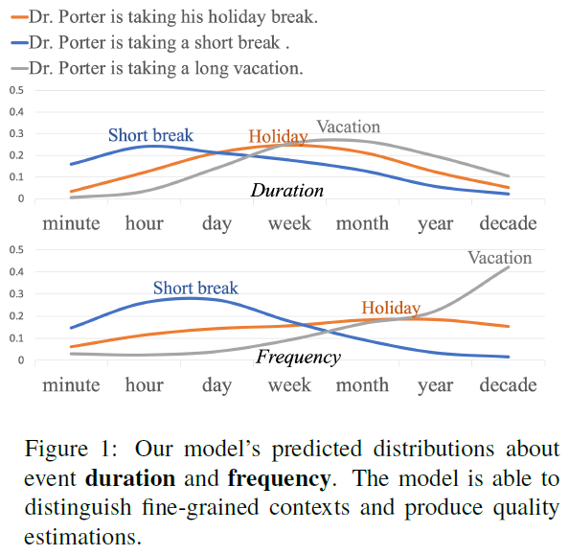
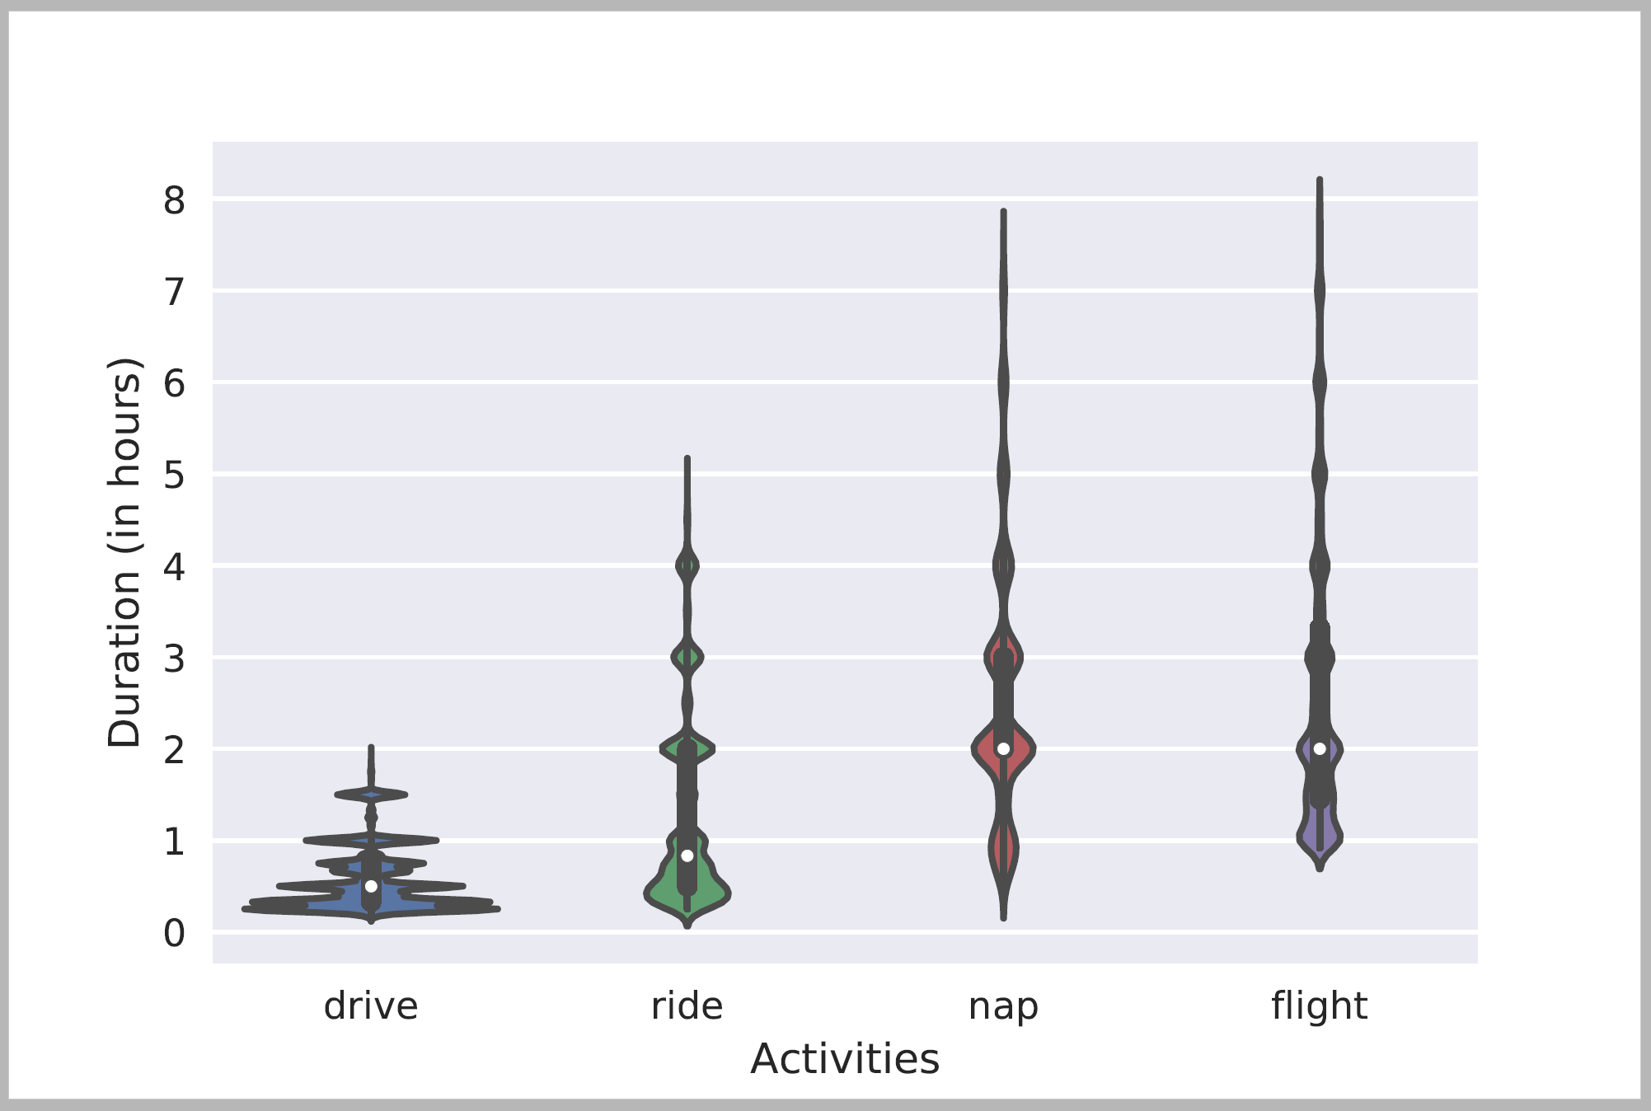
Temporal Common Sense
Most of the effort is in Knowledge Acquisition: Duration, typical time, frequency.
How to represent?
Typical Time
Typical Temporal Relations
[Zhou et al. ACL’20, Elazar et al. ACL’19, Ning et al. EMNLP’19, NAAC’18]
Duration

Slide 29
Distributional Representations of Time
In the context of commonsense it became clear that the representation needs to be distributional (Zhou et al. 2020)
Distribution over units
Should this be adopted/combined with interval based representations?

Slide 30
Incomplete information and uncertainty
Main challenges with temporal qualification
Imprecise and incomplete temporal information: inherent vagueness of language
Large swaths of extracted facts will not have any temporal information attached
Granularity: “She worked at Microsoft in 2006” (the whole year, three months,…?)
Only relative information: “After Microsoft she went to Google”
Partial information: “She started at Microsoft in 2006” (but is she still working there)
Extraction and linking uncertainty: lossy mapping to KR
The semantic of “X happens on Saturday” often depends on X
Source uncertainty: John is pretty certain that she started working there in 2006
Commonsense
Representational approaches
(1) can be handled with partial, fuzzy interval representations (e.g., start/end interval pairs)
(2) can be addressed by attaching confidence scores (or probabilities) to relations similar to what is done now in AIDA; modal operators might be preferable for this purpose
(3) can be addressed using distributional representation over time units.

Slide 31
(Some of the) Challenges
Can we have one single system that unifies all these facets of time?
The benefit would be that these aspects are all related and can help each other.
Understanding/Extracting/Abstracting events is difficult
Current annotation isn’t expressive enough to support some temporal needs
Often vs. Sometimes;
I played basketball v. I play basketball
Move to a QA format of annotation
More expressive; more realistic form of supervision
Grounding activities in time
I gave a book to Mary. Who has the book now? Who had the book at the beginning?
Set the alarm to an hour before the Final.
We cannot Reason
[MC-TACO, Zhou et al. ‘19]

Slide 32
Discussion: Time argument vs. modal operator
employ17
employ24
Time argument
Simple representation, just add arg to rel or evt
Keeps the logic first-order
Variant of this is currently used in AIDA
Requires copies of the relation to represent alternative times
Qualifier becomes part of relation signature
No alternative semantics
Modal operators
Same relation is the argument of arbitrary temporal or other modal assertions
All qualifying information linked to a single point
Can have different operators with different semantics
Requires relation reification so propositions can serve as arguments
per
org
per
org
Hans
ISI
Hans
ISI
time
time
t42
t73
start
end
start
end
holdsIn19
holdsIn26
prop
prop
time
employ17
time
t42
t73
per
org
Hans
ISI

Slide 33
Intervals and vagueness (needs update)
Precise intervals
“John worked at Google from Jan. 1, 2013 to Dec. 31, 2013”
Employer(John, Google)
t = [2013-01-01, 2013-12-31] 2-tuple
t = [[2013-01-01, 2013-01-01], [2013-12-31, 2013-12-31]] 4-tuple
Assuming finest granularity “days”
Vague intervals
“John worked at Google in 2013”
Employer(John, Google)
t = [2013-XX-XX, 2013-XX-XX] 2-tuple
t = [[--, 2013-12-31], [2013-01-01, --]] 4-tuple
While it is possible to capture what must minimally be true in this case, the level of precision in the representation (paraphrased below) seems at odds with the vagueness of the statement:
“John started to work at Google sometime before the end of 2013, and ended to work there sometime after the beginning of 2013”

Slide 34
Representing time-varying information
Temporal information is often not complete nor certain
Temporal information is often implicit (commonsense)
Events are associated with time
Start, End, Duration, Frequency
Many (most) attributes and relations change over time
Ex: employment, location, nationality, headquarters, president, event participant, etc.
Without temporal qualification KBs are “unordered story salads” (K. Erk)
We don’t know time & temporal order of events
We don’t know when relations start & end
Gives rise to many apparently contradictory statements
Ex: Senator Obama vs. President Obama
Impacts ability to do event coreference and & consistency checking
Multiple presidents; Multiple spouses)
Goal: Represent temporal qualifications over conditions that change over time (fluents)

