Slide 1
Reminders
Homework 7 due Date is Due by Midnight on 3/25
Wash your hands
Take care of yourself. Mental health is important too.

Slide 2
New course policies
I’m granting everyone 10 extra late days. You can now use up to 3 late days per HW or quiz.
I’m offering a HW option for the term project component of the grade. You can do 4 extra HW assignments instead of a project.
I’m allowing everyone to drop their lowest scoring qui .
Everyone can drop their lowest scoring homework.
You can opt to do the course pass/fail. 50% and above is passing.

Slide 3
Homework Option
We are creating a set of 4 additional weekly homework assignments. They will have the same deadlines as the project milestones. You may do the homework assignments individually or in pairs.
HW9: Classifying Depression – requires special data access
HW10: Neural Machine Translation
HW11: BERT
HW12: Perspectives Detection
You can do the homework individually or in pairs.
HW will be graded based on leaderboard and reports (autograders may not be available).
Notes:
Because the homework assignments are new, some of them might not have autograders. They will instead be graded based on the leaderboard and on your report.

Slide 4
Project Option
http://computational-linguistics-class.org/term-project.html

Slide 5
Dependency Parsing
Jurafsky and Martin Chapter 15

Slide 6
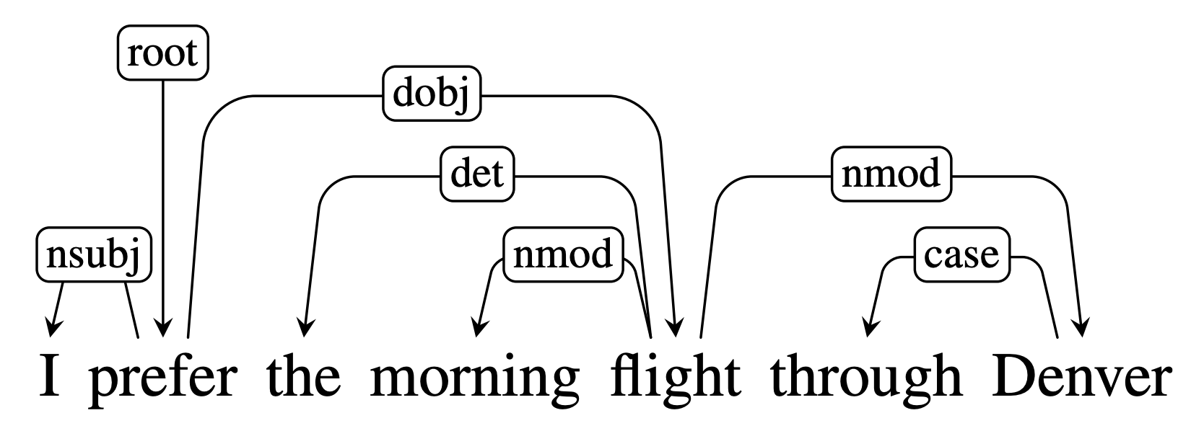
Dependency Grammars
In previous chapters, we saw how context-free grammars produce constituent-based representations.
In contrast, dependency grammars depict the syntactic structure of sentences solely in terms of the words (or lemmas) in a sentence and an associated set of directed head-dependent grammatical relations that hold among these words.

Slide 7
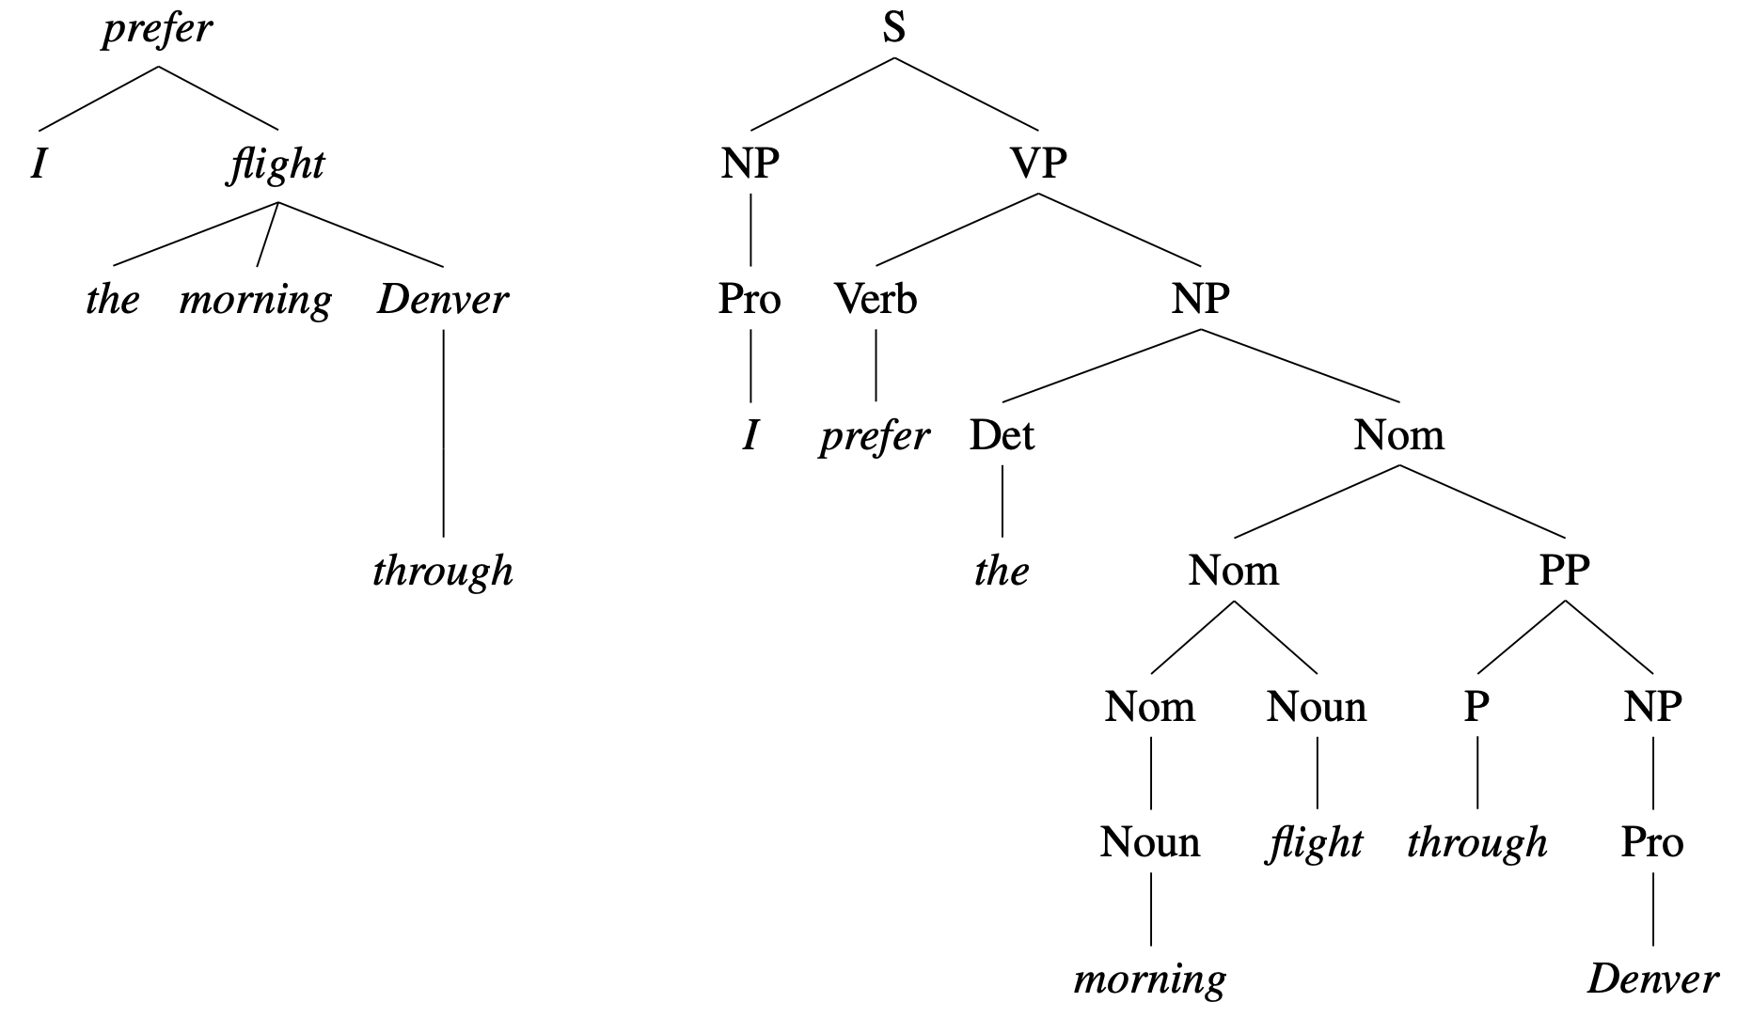
Dependency – based
Constituent– based

Slide 8
Advantages
One major advantage of dependency grammars is their ability to deal with languages that have a relatively free word order.
Dependency grammars abstract away from word-order information, representing only the information necessary for the parse. In contrast, phrase-structure grammars need separate rules for each possible place in the tree where a phrase can occur.
Dependency relations also provide an approximation to the semantic relationship between the words and their arguments, which is directly useful for many applications, such as: coreference resolution, question answering and information extraction.

Slide 9
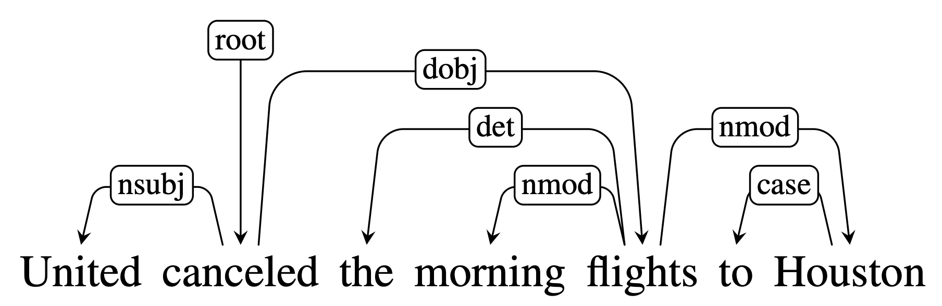
Dependency Relations
Each relation is represented by an arc from the head to the dependent
In addition to specifying head/dependent pairs, dependency grammars further classify the type of grammatical function involved.
Head
Dependent
nsubj and dobj identify the subject and direct object of the verb cancelled
nmod, det and case relations denote modifiers of the nouns flights and Houston.

Slide 10
The Universal Dependencies project provides an inventory of dependency relations that are linguistically motivated and computationally useful.
Relation | Examples with head and dependent
NSUBJ | United canceled the flight.
DOBJ | United diverted the flight to Reno.
IOBJ | We booked her the flight to Miami.
NMOD | We took the morning flight.
AMOD | Book the cheapest flight.
NUMMOD | JetBlue canceled 1000 flights.
APPOS | United, a unit of UAL, matched the fares.
DET | The flight was canceled.
CONJ | We flew to Denver and drove to Steamboat.
CC | We flew to Denver and drove to Steamboat.
CASE | Book the flight through Houston.

Slide 11
Dependency Trees
A dependency structure can be represented in the forms of a directed graph G = (V, A) where V refers to the set of words in each sentence, and A refers to the set of arcs capturing grammatical relationships. A dependency tree also satisfies the following constraints:
There is a single designated root node that has no incoming arcs
Each vertex has exactly one incoming arc (except the root node)
There is a unique path from the root node to each vertex in V
Together, these constrains ensure that the dependency structure is connected and that there is a single root node connected to the remaining vertices by unique paths.

Slide 12
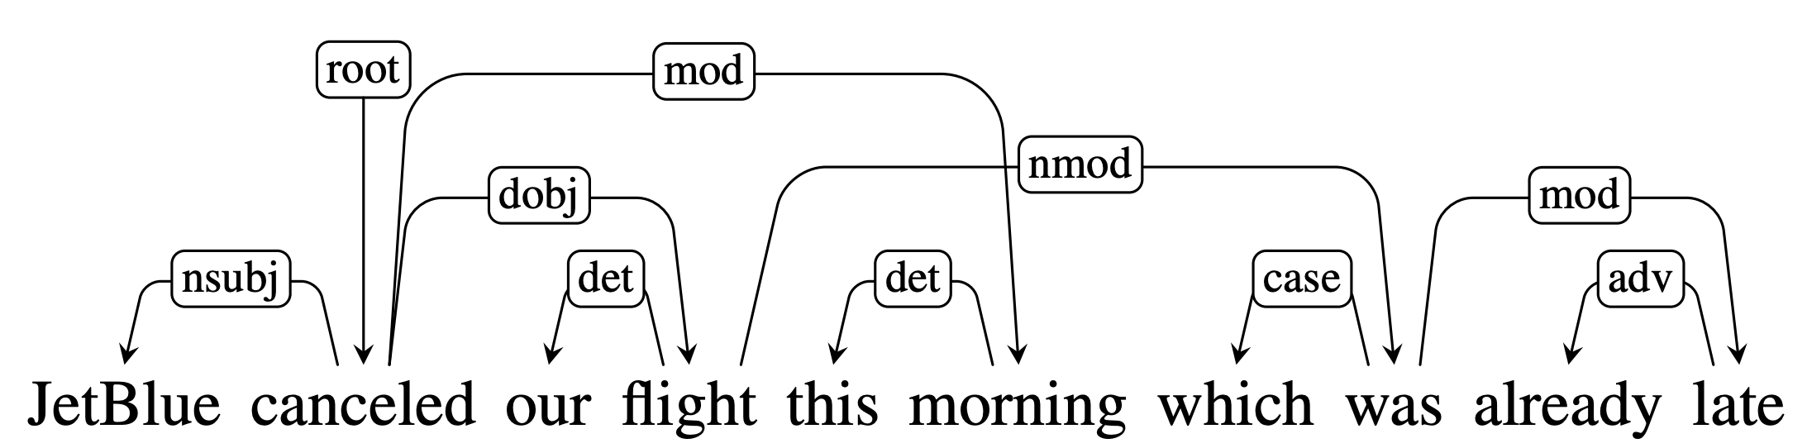
Projectivity
An arc from a head to a dependent is said to be projective if there is a path from the head to every word that lies between the head and the dependent in the sentence.
A dependency tree is said to be projective if it can be drawn with no crossing edges.
An example of a non-projective dependency tree.

Slide 13
Dependency Treebanks
Dependency Treebanks are typically created by the following methods:
Having human annotators build dependency structures directly
Using an automatic parser and then employing human annotators to correct the output
Automatically transforming phrase-structure treebanks into dependency structure treebanks
Directly annotated dependency treebanks have been often created for morphologically rich languages such as Czech (Prague Dependency Treebank), Hindi and Finnish.

Slide 14
Parsing Methods
There are two main approaches used in dependency parsers:
Transition - Based Dependency Parsing
Graph - Based Dependency Parsing
A limitation of transition-based approaches is that they only use projective trees, hence any sentences with non-projective structures will contain errors. In contrast, graph-based parsing approaches are more flexible to handle projectivity.

Slide 15
Transition-based Parsing
Transition-based parsing systems employ a greedy stack-based algorithm to create dependency structures.
A key element in transition-based parsing is the notion of a configuration which consists of a stack, an input buffer of words and a set of relations representing the dependency tree.
In this framework, the parsing process consists of a sequence of transitions through the space of possible configurations. The goal of this process is to find a final configuration where all the words have been accounted for and an appropriate dependency tree was found.

Slide 16
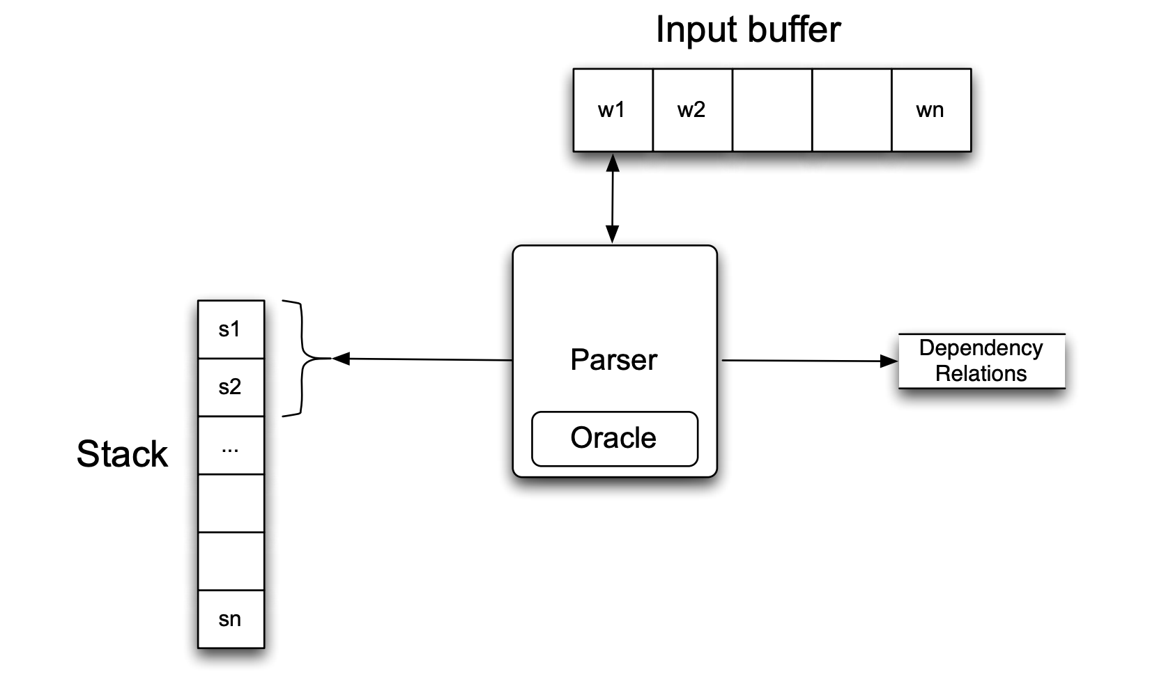
Basic Transition-based Parser
The parser examines the top two elements of the stack and selects an action based on consulting an oracle that examines the current configuration.

Slide 17
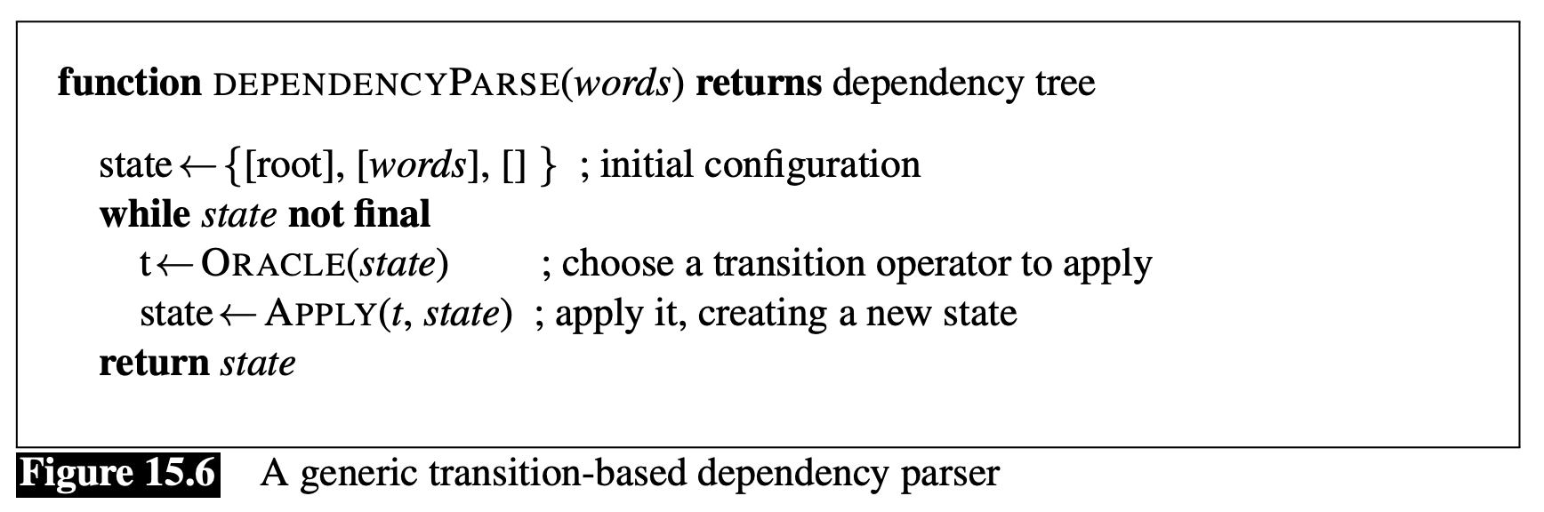
Basic Transition-based Parser
Complexity is linear in the length of the sentence O(V) since it is based on a single left to right pass through the words in the sentence ➞ each word must be first shifted onto the stack and then reduced

Slide 18
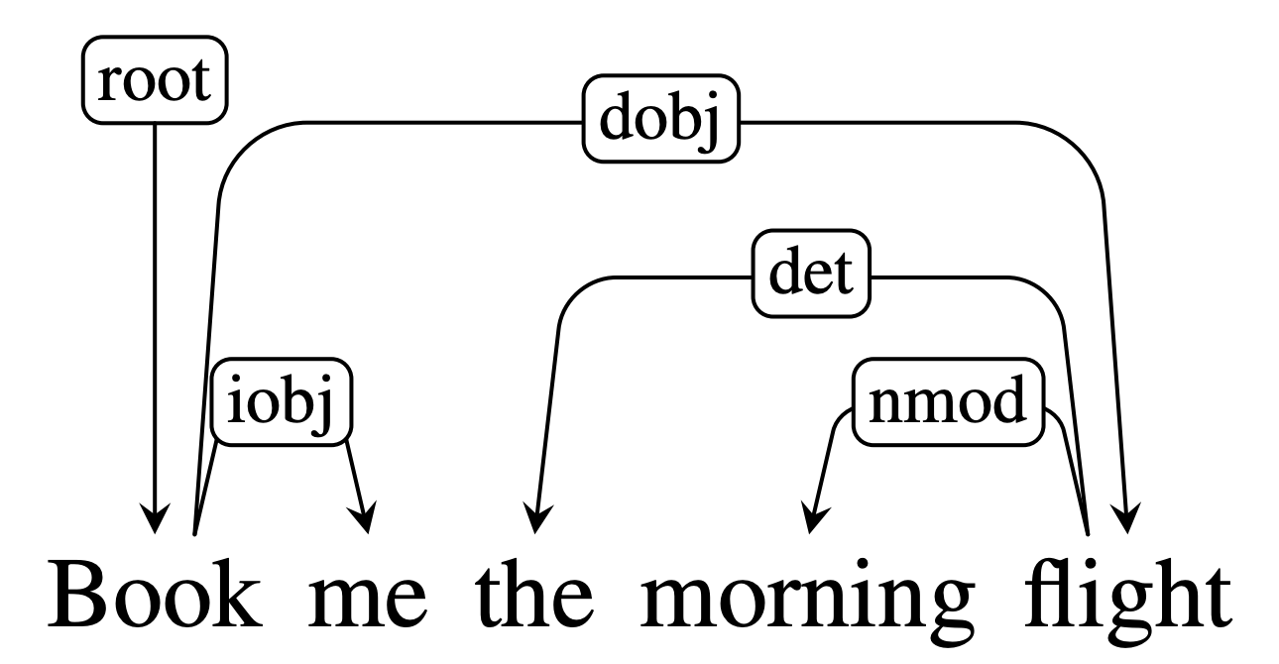
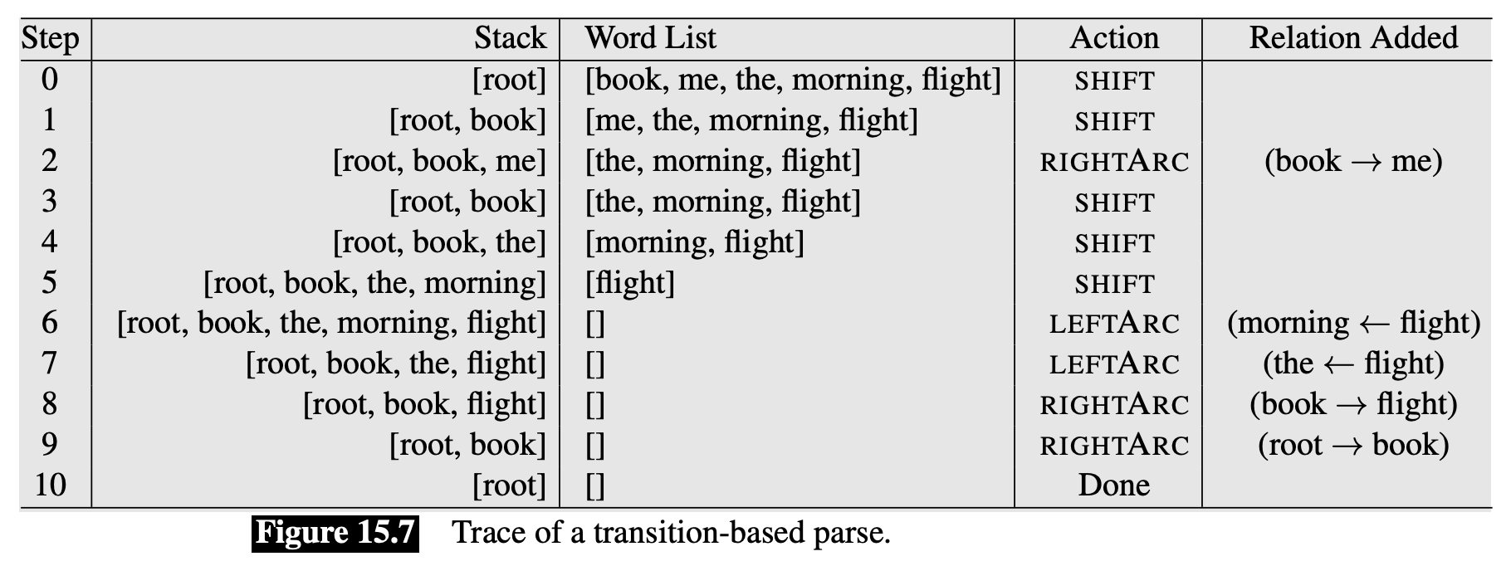
Worked example:

Slide 19
Creating the Oracle
SOTA transition-based systems use supervised machine learning methods to train classifiers that play the role of the oracle, which takes in as input a configuration and returns as output a transition operator.
Problem: What about the training data? To train the oracle, we need configurations paired with transition operators, which aren’t provided by the Treebanks…
Solution: simulate the operation of the parser by running the algorithm and relying on a new training oracle to give correct transition operators for each successive operation.

Slide 20
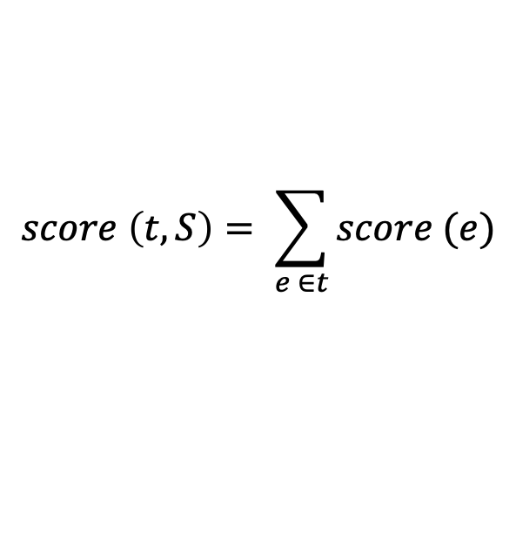

Graph-based Parsing
Graph-based methods for creating dependency structures search through the space of possible dependency trees for a tree that maximizes some score function:
where, the score for a tree is based on the scores of the edges that comprise the tree:
A common approach involves the use of maximum spanning trees (MST)
$$\hat{T} \left(S\right)={argmax}_{t ∈{ G}_{s}} score (t, S)$$
$$score \left(t, S\right)= \sum_{e ∈t}{score (e)}$$

Slide 21
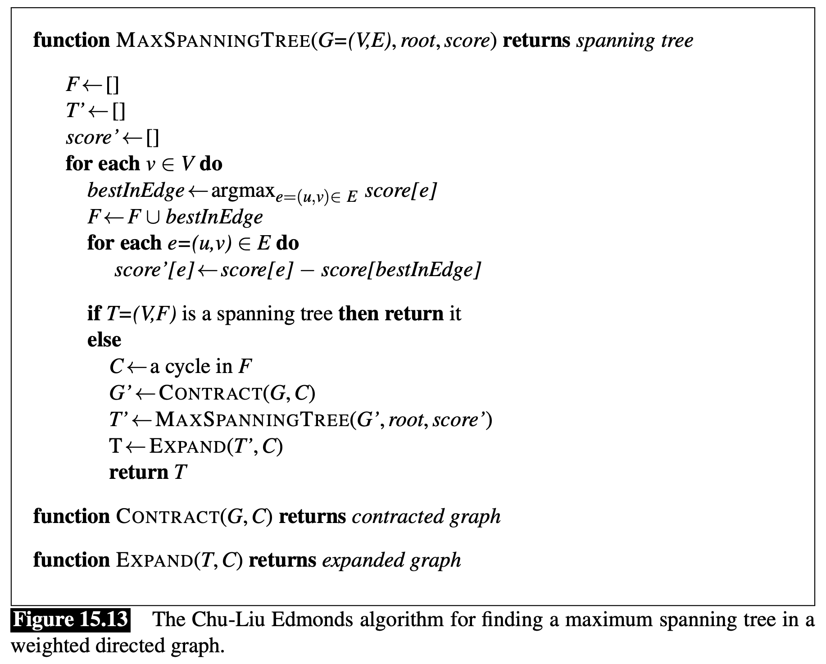

Slide 22
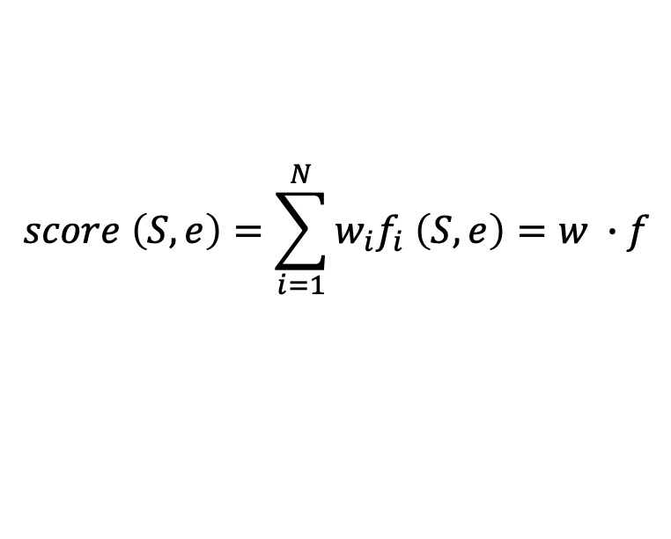
Training
While we can reduce the score of tree to a sum of the scores of the edges that comprise it, each edge score can also be reduced to a weighted sum of features extracted from it.
Commonly used features include:
$$score \left(S, e\right)=\sum_{i=1}^{N}{w_{i}f_{i} \left(S, e\right)}=w ∙f$$
Wordforms, lemmas and POS of the headword and dependent
Corresponding features of contexts before, after and between words
Word embeddings
Dependency relation type
Direction of the relation (to the right or to the left)
Distance from the head to the dependent

Slide 23
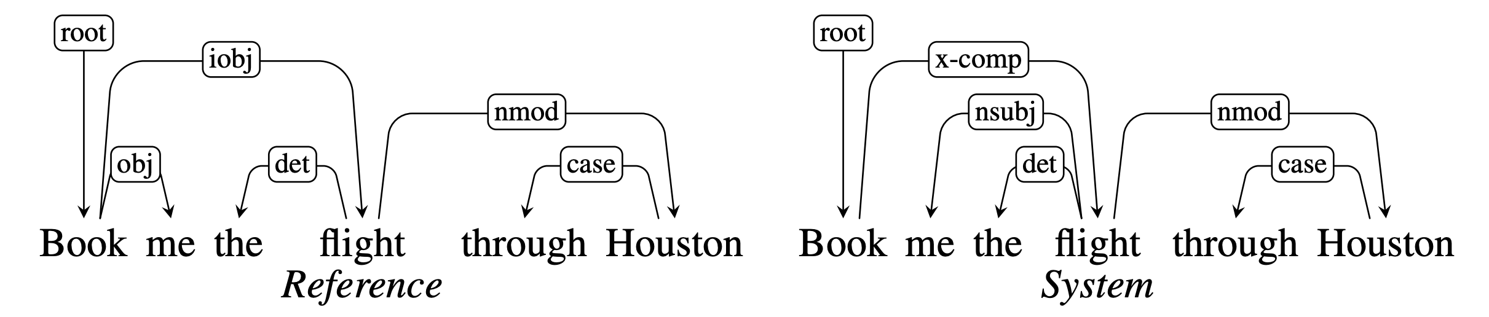
Evaluation
The common method for evaluating dependency parsers are labeled attachment accuracy (LAS) and unlabeled attachment accuracy
Labeled attachment refers to the proper assignment of a word to its head with the correct dependency relation.
Unlabeled attachment refers to the proper assignment of a word to its head ONLY (ignores dependency relation)
LAS = 2/3, UAS = 5/6

